Slide 1
Promoting Healthier Beverage Consumption
Cathy Lynn Joyce, MD, PhD
Director, Section of Adolescent Medicine
Department of Pediatrics
Rush University Medical Center

Slide 2
This presentation is made possible by the Illinois Chapter, American Academy of Pediatrics Health Care Provider Campaign on SSBs

Slide 3
Learning Objectives
List a minimum of three adverse effects of regular consumption of sugar-sweetened beverages.
List a minimum of three reasons why SSBs are a suitable target for obesity prevention.
Provide short and accurate responses to common questions raised by health care professionals and others about moving toward healthier beverage consumption.
Describe a simple approach to assessing individual beverage consumption and identifying unhealthy beverage consumption.
Describe the likely impact of taxation upon consumption of SSBs.
Summarize the Healthy Eating and Active Living (HEAL Act), bill status, HEAL Act messages

Slide 4
Definitions
Sugar-sweetened beverages (SSBs) are drinks sweetened with sugar, high-fructose corn syrup, or other caloric sweeteners. (Yale Rudd Center)

Slide 5
The Link to Obesity and Related Diseases is Well Established
Frank Hu (Harvard):
Resolved: there is sufficient scientific evidence that decreasing sugar-sweetened beverage consumption will reduce the prevalence of obesity and obesity-related diseases.

Slide 6
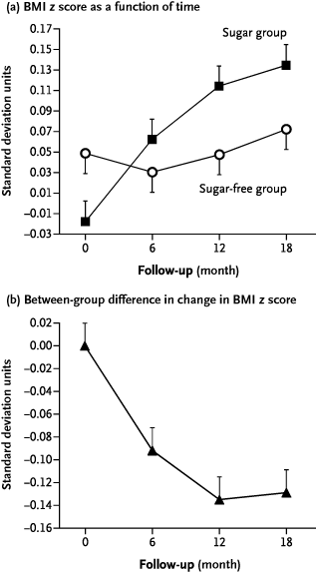
Resolved: there is sufficient scientific evidence that decreasing sugar‐sweetened beverage consumption will reduce the prevalence of obesity and obesity‐related diseases
Obesity Reviews Volume 14, Issue 8, pages 606-619, 13 JUN 2013 DOI: 10.1111/obr.12040 http://onlinelibrary.wiley.com/doi/10.1111/obr.12040/full#obr12040-fig-0003
Notes:
Body mass index (BMI) z score in the 477 children who drank the study beverages for the full 18 months. The z score for BMI is the BMI expressed as the number of standard deviations by which a child differed from the mean in the Netherlands for his or her age and sex. Panel A shows mean z scores for the two study groups over the 18‐month study period. Panel B shows the between‐group difference in the mean change from baseline (the mean change in the BMI z score in the sugar‐free group minus the mean change in the sugar group), as a function of time. T bars in both panels indicate standard errors. From reference .
IF THIS IMAGE HAS BEEN PROVIDED BY OR IS OWNED BY A THIRD PARTY, AS INDICATED IN THE CAPTION LINE, THEN FURTHER PERMISSION MAY BE NEEDED BEFORE ANY FURTHER USE. PLEASE CONTACT WILEY'S PERMISSIONS DEPARTMENT ON PERMISSIONS@WILEY.COM OR USE THE RIGHTSLINK SERVICE BY CLICKING ON THE 'REQUEST PERMISSIONS' LINK ACCOMPANYING THIS ARTICLE. WILEY OR AUTHOR OWNED IMAGES MAY BE USED FOR NON-COMMERCIAL PURPOSES, SUBJECT TO PROPER CITATION OF THE ARTICLE, AUTHOR, AND PUBLISHER.

Slide 7
Bradford Hill Criteria
Strength | Prospective cohort studies have consistently shown a positive association between SSB intake and long-term weight gain and obesity in children and adults. RCTs have shown clinically significant benefits of reduction in SSB or added sugar consumption on body weight.
Consistency | The evidence from prospective cohort studies and RCTs is highly consistent in both children and adults.
Temporality | The temporal relationship between SSB intake and obesity risk is well established, given that the evidence reviewed here is derived from prospective cohort studies and RCTs.
Dose–response relationship | As SSB intake increases, the amount of weight gain increases in a dose–response manner.
Biological plausibility | SSBs contain large amounts of energy from rapidly absorbable sugars. Consumption of these calories in liquid form is associated with less satiety and an incomplete compensatory reduction in energy intake at subsequent meals.
Alternate explanations | The positive association between SSBs and obesity found in observational studies may be due to confounding by other correlated dietary and lifestyle factors; however, these factors were carefully adjusted for in multivariate analyses.
Experimental evidence | Rigorously conducted RCTs have shown that reducing consumption of SSBs significantly decreases weight gain and adiposity in children.

Slide 8
Dental Caries
Szpunar et al (1995): For every 5gm increase in dietary sugar, risk of dental caries increases by 1%.

Slide 9
Tooth decay is associated with SSB intake
Beverages are a vehicle for delivering caries causing sugars to oral bacteria.
Oral bacteria ferments caries causing sugars such as sucrose, glucose and lactose to produce acid.
The caries risk is affected by the frequency, timing and length of consumption of SSBs.
Each acid attack lasts about 20 minutes and starts all over with each sip.
These ongoing acid attacks weaken tooth enamel.
References: 1) Marshall Teresa, Preventing dental caries associated with sugar-sweetened beverages,
Journal of the American Dental Association, Volume 144, Number 10, pages 1148-1152
2) http://www.wda.org/your-oral-health/sip-all-day

Slide 10
Recommendations for reducing caries risk associated with SSBs and 100% fruit juice
Consume SSBs and 100 percent fruit juice at meals only.
Consume SSBs and 100 percent fruit juice with a 15-minute time frame.
Use a straw when consuming SSBs and 100% fruit juice.
Brush teeth with fluoridated toothpaste 20 minutes after intake of SSBs or 100% fruit juice.
Chew sugar free gum immediately after intake of SSBs and 100% fruit juice.
Rinse mouth with water immediately after intake of SSBs or 100% fruit juice.
Source: US Dept of Agriculture

Slide 11
Recommendations
To prevent Dental Caries--- Do Not consume SSBs or Fruit Juice
Preferred Drink---Water

Slide 12
Behavioral problems
16oz caffeinated soda contains 50-75 mg of caffeine
Energy drinks 150mg – 300mg per serving

Slide 13
Behavioral Problems
Multiple effects including poor sleep.

Slide 14
Bone Density
High SSB Intake
Low calcium Intake
Lower bone mass accrual (girls)
Greater risk of fractures and overall poor bone health

Slide 15
Why are you picking on SSBs?
Reason 1: There is strong evidence linking their consumption to obesity and other problems, and strong evidence that reducing SSB consumption helps children and families achieve or maintain a healthy weight.
Reason 2: SSB consumption can be described as a single behavior, for which goals can be easily set, and counseling can be easily carried out.
Reason 3: Changes in public policy including taxation work.

Slide 16
Industry Tactics in Response to Proposed Taxation
Distraction: “What we really should be talking about is getting people moving - promoting physical activity.”
Americans certainly need to be more physically active, but we’re not talking about that. We’re talking about SSBs.
Personal freedom: “People should have the freedom to drink what they choose without government interference.”
People remain free to drink what they choose. The price they pay should more closely reflect the health impact, including costs, of their choices.
Legacy of pouring rights contracts.

Slide 17
Industry Tactics (cont’d)
Unrealistic expectations of evidence: “You can’t prove 100% that SSBs promote obesity and obesity-related disease.”
True. Tactic used by tobacco companies. Preponderance of evidence supports role of SSBs in obesity and related diseases. You can’t prove 100% that cigarette smoking is related to lung cancer, but how many people doubt the link these days?
A calorie is a calorie, no matter in the form of soda or vegetables.
True. But satiety is the key concept. If you’re hungry and eat a solid meal, you won’t be that hungry anymore. If you drank the same number of calories in the form of SSBs, you would likely still be hungry, and eat something, leading to increased intake.

Slide 18
Assessment
Do you drink anything besides water?
What did you have to drink besides water yesterday?
Notes:
Rao

Slide 19
Quick Assessment Tool
BEVERAGE CATEGORY | APP. NUMBER OF SERVINGS
Regular full-calorie soft drinks
Fruit drinks/punches
Energy drinks
Sports drinks
Sweetened, flavored milk (e.g. chocolate milk, hot chocolate, milk shakes)
Sweetened coffee drinks
Fruit juices
Sweetened iced tea
Notes:
Rao

Slide 20
Case Scenario
Tanya just started as a Job Corps student. Her BMI is 37.7. She drinks Gatorade, Vitamin Water, 100% fruit juices and pop with meals and several times through out the day. She acknowledges that she consumes a large amounts of sugar-sweetened beverages. Her entire family is obese.
Notes:
Rao

Slide 21
Counseling
“I am concerned about how much pop you drink. Do you know about some of the dangers of drinking pop?”
Overweight/obesity
Risk for diabetes, high blood pressure, and heart disease
Risk for tooth decay
Notes:
Rao

Slide 22
FAQs
“What should I be drinking?”
Present healthier beverage alternatives:
Water; low-fat milk
“Do you mean bottled water?”
Regular tap water is fine.
“I don’t like the taste of water.”
Water is tasteless. Create a healthy beverage environment.

Slide 23
FAQs (cont’d)
“Will I lose weight if I switch to water?”
If you drink a lot of SSBs now, yes you will lose weight.
“You can’t get water in some places?”
Water is always available on Job Corps Centers. Water is readily available in most other environments. You can always carry a reusable water bottle with you when traveling off center.
Job Corps-PRH:
Foods of Minimal Nutritional Value (FMNV) as defined in Appendix B of 7 CFR Part 210 may be available to students in the cafeteria on a limited basis. Students may be given the option to purchase FMNV through vending machines or student store.
SSBs =FMNV

Slide 24
FAQs (cont’d)
“What about diet sodas and other drinks?”
There have been recent concerns about the unhealthy impact of such products. They are probably better than SSBs, but certainly no substitute for water or low fat milk.
“What are some other benefits of making smart beverage choices?”
E.g. Cost savings – 1-2 2L bottles for family of four per day -- >$1000 per year

Slide 25
The Healthy Eating and Active Living (HEAL) Act
Notes:
I am going to summarize some of the major goals and provisions of the Healthy Eating and Active living Act or HEAL Act.
As discussed earlier, the link between SSBs, obesity, and its related conditions has been established. Obesity is complex and we know we must take a multi-pronged approach to reducing obesity rates. The Healthy Eating and Active Living Act is one of those approaches.

Slide 26
HEAL Act - Multi-Pronged Approach
HEAL Act - Illinois bill
Provides Illinois communities opportunities for healthy living
Larger multi-year campaign
Notes:
Healthy Eating and Active Living (HEAL) Act is state legislation, which was first introduced in the Illinois state legislature in 2014.
It is part of a larger multi-year campaign on SSBs, called the Rethink Your Drink campaign.

Slide 27
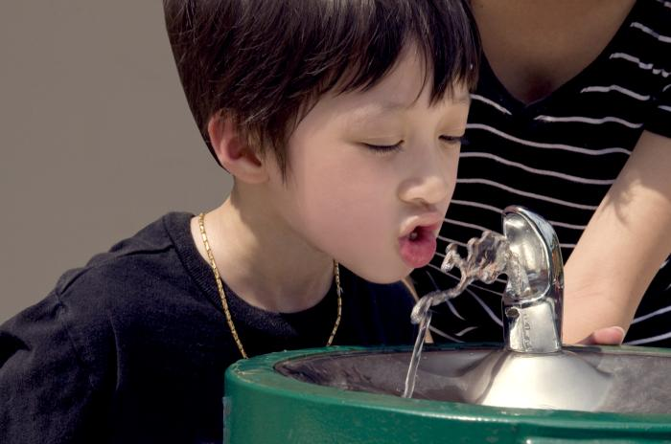
HEAL Act - Multi-Pronged Approach
Engages Illinois communities and health care providers
Promote healthier beverage options
Health Care Provider Campaign on SSBs
Illinois Chapter, American Academy of Pediatrics (ICAAP)
Illinois Alliance to Prevent Obesity (IAPO)
Notes:
Rethink Your Drink campaign engages Illinois communities and health care providers to promote healthier beverage options.
The Illinois Chapter of the American Academy of Pediatrics, Obesity Prevention Initiatives, is leading the health care provider campaign on SSBs in partnership with the Illinois Alliance to Prevent Obesity.
The Alliance is a coalition of more than 140 organizations in Illinois working to develop solutions to the obesity epidemic.

Slide 28
SSBs Health Impacts
Many kids and families in our communities are suffering from largely preventable conditions
Sugary drinks are the biggest source of added sugar in the American diet
Contribute to high rates of obesity, diabetes, some cancers, and heart disease
Cost Illinoisans over $6 billion a year in unnecessary health care costs.
Notes:
Here are some of the reasons behind the HEAL Act:
Kids, families, and communities are suffering from largely preventable conditions
Sugar-sweetened beverages (SSBs) are the biggest source of added sugar in the American diet
Contribute to high rates of obesity and related conditions, cost $6 billion per year in unnecessary heath care costs.

Slide 29
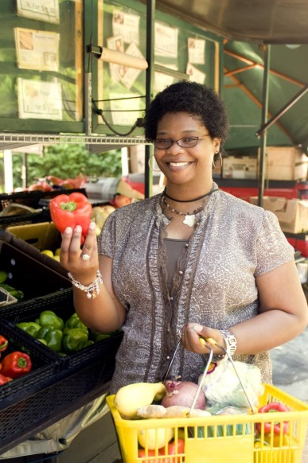
HEAL Act Solutions
The Healthy Eating and Active Living Act would provide kids, families and communities the
tools to live healthier lives
Notes:
If healthy options aren’t available or affordable
Hard for people to make healthy choices, even if they want to.
Especially in underserved communities
There are ways of changing our environment and policies to support healthier choices, by creating, for example, safe places for children and families to exercise, and providing access to healthy and affordable foods
The Healthy Eating and Active Living Act would provide kids, families, and communities the tools to live healthier lives

Slide 30
HEAL Act Essentials
Establishes State Wellness Fund in Illinois
A single penny per ounce excise tax SSBs
Estimated revenues $600 million annually
Photo credit: Rockford_CVB
Notes:
The HEAL Act establishes an Illinois Wellness Fund with revenues through a single penny-per-ounce tax on sugary beverages
The HEAL Act is expected to raise $600 million a year in state revenues to invest in prevention

Slide 31
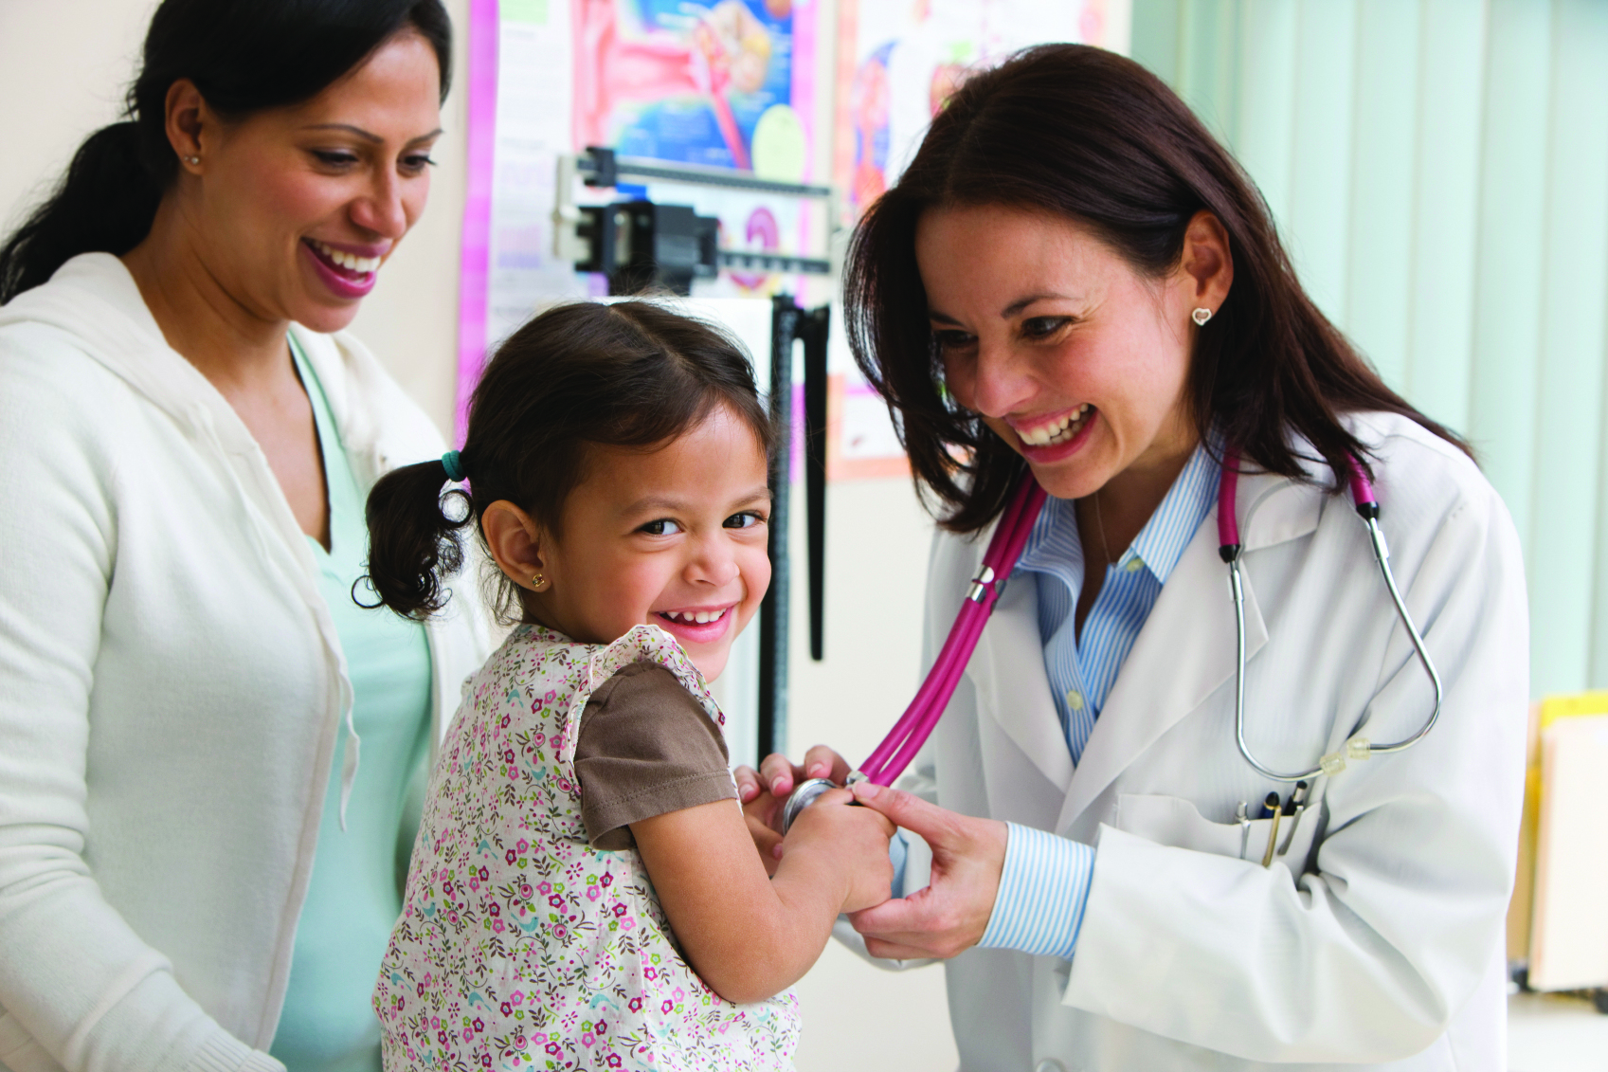
HEAL Act Funds
~50% Illinois
Medicaid Program
~50% Community
Prevention
Notes:
The revenue from the HEAL act would be used to reinforce the goal of making comprehensive changes to address the obesity epidemic
50% of revenues from the HEAL Act would go towards
Clinical services and community intervention programs in the Illinois Medicaid Program
50% towards
Community prevention efforts we know will work to reduce obesity

Slide 32
HEAL Act Funds Illinois Medicaid Program
~$300 million a year
Multi-disciplinary clinical services
Weight management programs
Social workers, dieticians, psychologists
Care coordination
Community evidenced-based physical activity and nutrition programs for children and adults
Notes:
The bill calls for funding of patient access to weight management programs, multi-disciplinary providers, such as social workers, dieticians, and psychologist, and care coordination.
It would help fund evidenced-based community physical activity and nutrition intervention programs, such as MEND (Mind, Exercise, Nutrition, Do It!) and the Diabetes Prevention Program.
The HEAL Act focuses on populations at the greatest risk of overweight/obesity.

Slide 33
HEAL Act Funds Community Prevention
~$300 million a year
School health & wellness
Public health departments and agencies
Physical activity improvements
Community nutrition
Local food systems
Focus - underserved communities
Notes:
The Act designates $300 million to support , for instance,
healthier school lunches; P.E. programs
Public health and chronic disease prevention efforts
Safe routes to school
Nutrition education – cooking classes
Farmers markets and community gardens
The Act prioritizes funds to go to communities with the greatest need for these resources.

Slide 34
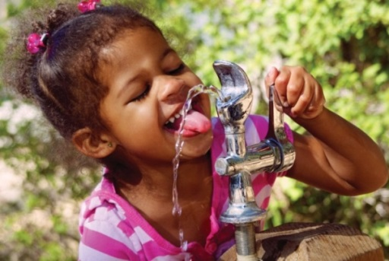
Estimated Impacts
Save at least $150 million a year in Illinois health care costs
5% reduction in adult obesity
9% reduction in childhood obesity
Small (4,500) net increase in Illinois jobs
Chaloupka, F.J., Wang, Y.C., Powell, L. M., et. al (2011). Estimated the potential impact of sugar-sweetened and other beverage excise taxes in Illinois. Powell, L. M., et. al (2011). Estimated the potential impact of sugar-sweetened and other beverage excise taxes in Illinois.
Notes:
Economists from University of Illinois did some estimates and found that a proposal like this one could:
Save $150 million a year in obesity-related health care costs (Chaloupka study)
Reduce adult obesity by about 5% and childhood obesity by about 9%.
Once you add in the effect of investing the money back into community health and prevention, the impact could be even larger.
Plus, the revenue investment into health may even increase jobs in the state by about 4500.
Reference Bullets 2 and 3:
Chaloupka, F.J., Wang, Y.C., Powell, L. M., et. al (2011). Estimated the potential impact of sugar-sweetened and other beverage excise taxes in Illinois. Bullet 3: Powell, L., Wada, R., Persky, J. & Chaloupka, F. (2014).
Employment impact of sugar-sweetened beverage taxes. American Journal of Public Health

Slide 35
HEAL Act Funding Mechanism
Excise tax collected from distributors of SSBs
Excise - consumer sees price difference on shelf
Tax Excludes
Diet drinks
100% fruit juice
Milk products
Notes:
In order to raise the revenue to invest in wellness and prevention, the proposal would place a tax on Illinois distributors of SSBs.
The tax is structured as an excise tax so that consumers would see a price difference on the shelf and the tax would promote reduction in consumption (could result in 23.5% reduction in sugary drink consumption – HEAL Act Fact Sheet)
Listed are some of the drinks excluded from the tax.
The specific definition of SSBs is included in the state bill.

Slide 36
Bill Status
Introduced in 2014
Illinois State legislature
Sponsors
House – Robyn Gabel
Senate – Mattie Hunter
HEAL Act
February 2015 filing
House and Senate
Same bill sponsors
Photo Credit: Illinois State Tourism Bureau
Notes:
As part of the multi-year campaign, The Healthy Eating and Active Living Act was first introduced in 2014 in the Illinois House and Senate and wasn’t expected to pass out of the state legislature – but is now gaining momentum
The most recent version of the 2014 bill is an Amendment to Sponsor Madigan’s House Bill 397, House (Motor Fuel tax law). To view - Go to link below – which is HB 0397, – then click on House Amendment 001
http://www.ilga.gov/legislation/fulltext.asp?DocName=09800HB0397ham001&GA=98&SessionId=85&DocTypeId=HB&LegID=70345&DocNum=397&GAID=12&Session=
House and Senate Sponsors (are listed on the slide)
The 2015 HEAL Act legislation must be filed in February 2015 and has the support of the same lead sponsors
The 2015 bill includes revisions to strengthen the language of the bill to clarify its intent

Slide 37
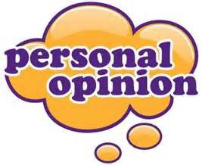
Public Perception
Focus Groups
Provide kids, families and communities the tools to lead healthier lives
“Healthy Eating and Active Living Act” vs HEAL Act
“Sugary Drinks” vs SSBs
SSBs linkage to “diabetes, cancer, heart disease” vs obesity
Notes:
Language matters
Would the general public support the Healthy Eating and Active Living Act?
From focus groups, we have learned that the public would support such a bill if it provides kids, families, and communities with the tools to live healthier lives
We have also learned there is a preference for using specific language when discussing the bill (as seen on the slide, e.g., the term sugary beverages is preferred over sugar-sweetened beverages).

Slide 38
Take Action
Work to ensure practices and policies that promote healthier beverage consumption
Join
the Health Care
Provider Campaign
on SSBs!
Notes:
How can you get involved?
Join the Health Care provider campaign on SSBs!

Slide 39
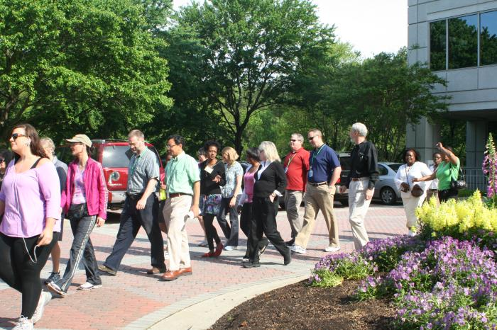
Contact
To join the Campaign on SSBs or for more information, please contact:
Mary Elsner, JD
Director, Obesity Prevention Initiatives
Health Care Provider Campaign on SSBs
Illinois Chapter, American Academy of
Pediatrics
melsner@illinioisaap.com
312/733-1026, ext 220
Download Rethink Your Drink materials from ICAAP:
http://illinoisaap.org/2014/11/ssbmaterials/
Notes:
For more information:
You can contact staff at the Illinois Chapter, American Academy of Pediatrics (ICAAP): Mary Elsner, Director of Obesity Prevention Initiatives
You can also download campaign resource materials from the ICAAP website listed in the slide (which includes the HEAL Act fact sheet, campaign posters, and other materials);
[Grand Rounds: And/or, you can contact (the presenter or leaders) at your work place or medical center about how you can join in those efforts]

