Slide 1
Health and Wellness &
Disability Program Transition Services:
Requirements and Innovative Practices To Assist Students Exiting From Job Corps
Shannon Bentley, RN, Nurse Specialist
Melissa Cusey, RN, nurse specialist
Nancy Dean, RN, HWM, Phoenix Job Corps
Nikki Dyer, RN, Pittsburgh Job Corps
Susan Sosinski, RN, HWM, Cassadaga Job Corps
Kristen Philbrook/laura kuhn
Regional disability coordinators

Slide 2
Career Transition Services
PRH Chapter 6, 3.14, R3 (c) & Chapter 3, 3.21
R3. Reasonable Accommodation Process
  During Career Transition Readiness all students will receive information about workers’ rights and responsibilities including reasonable accommodation in the workplace (see Section 3.21, R2, g)
R5. Transitional Needs Assessment
  Centers shall assist each student in assembling and updating his or her transitional support needs, including:
  d. Health care

Slide 3

Role of Health & Wellness
Begin to plan for exit on first day in program
Be involved in the transition period
Provide ongoing education to student on healthy choices and employability
Provide a copy of immunization record in portfolio
Assist student in making needed referrals for continued services after separation
Notes:
Top 2 reasons students do not achieve and keep gainful employment is they call in sick and get fired or they can not pass a drug test. It is very important to provide ongoing education to students on healthy life style choices, realistic health care and how it ties in to employability

Slide 4
Role of Health & Wellness
Provide at least 2 weeks of medications or a prescription if the student has insurance
Ensure all students are familiar with workplace rights, including reasonable accommodation
For students with disabilities who may need accommodations in the workplace, ensure these students are comfortable with disclosure and help set up accommodations if requested
Discuss any concerns the student may have about health care needs
Notes:
The more information we provide to students on healthy choices, realistic health care and how it affects employability, the better prepared the student will be upon leaving the program and entering the work world

Slide 5

Barriers
Student not prepared to follow up at home with continued treatment
Student’s unrealistic view of health care
Not being able to pass a drug test
Needing accommodations for interviews and employment
Notes:
May affect student’s health and ability to find or maintain employability
Student does not understand how calling in sick on numerous occasions for minor conditions can affect their employability
Students need to understand that most employers have a pre-hire drug screen and some employers may do random drug testing

Slide 6
Center Best Practices: Pittsburgh Job Corps
Nikki Dyer, rn

Slide 7

Where Do I Go From Here?
Preparation begins day one and continues throughout enrollment
Review JC History and Physical Form
Initial Interview with student

Slide 8
Only Weeks Remain Before Leaving JC
What Plans Need Made
  Medications
  Chronic Care Follow Up
  What Medical Insurance Does The Job Offer
  Locating Needed Medical Treatment

Slide 9
Need Assistance Planning
Career Transition Readiness
Career Transition Services

Slide 10
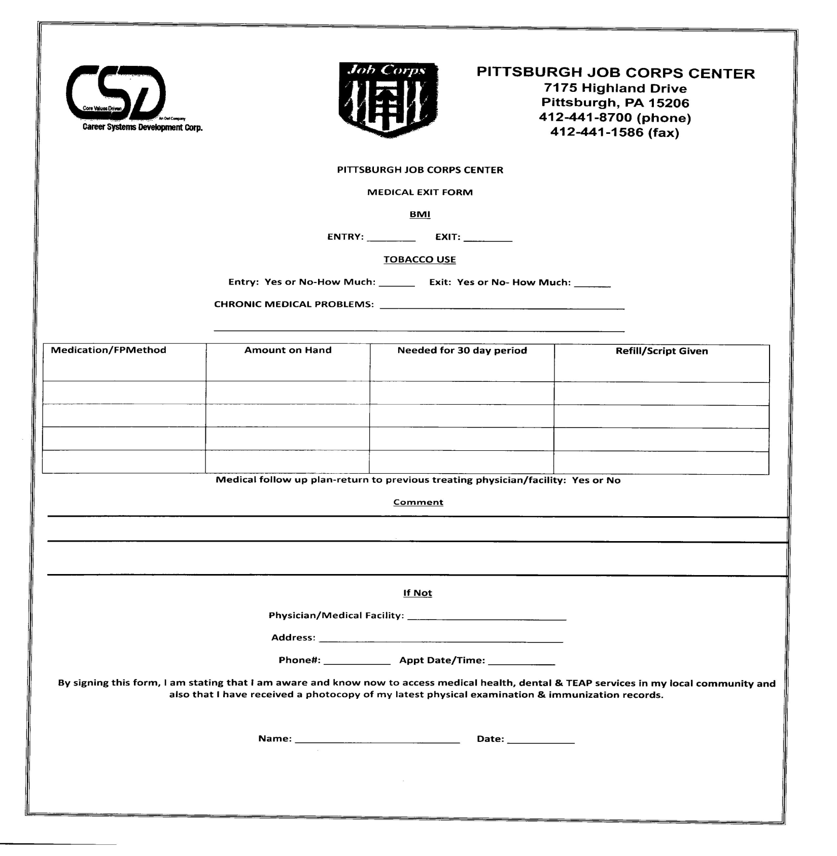

Slide 11
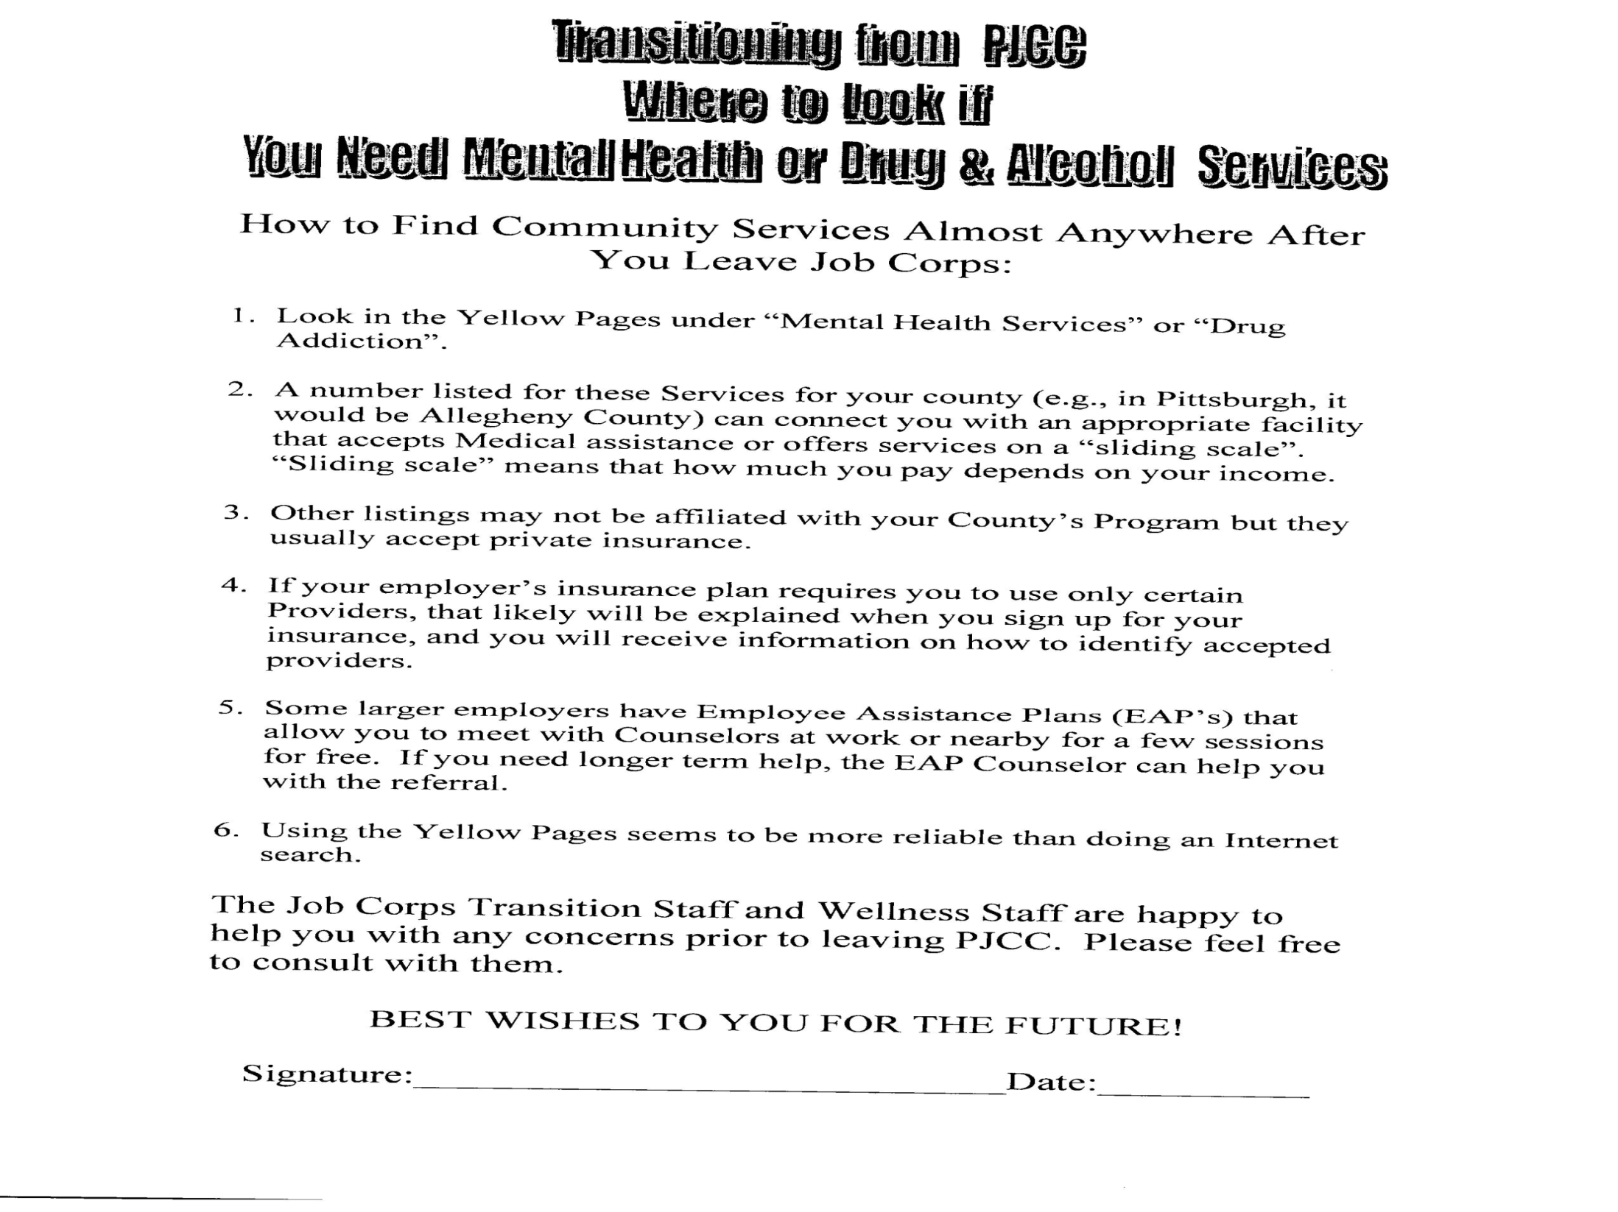

Slide 12
Wellness Last Visit
Review and Finalize Plans
Provide Copies of Critical Documents
Reinforce Healthy Choices

Slide 13
Center Best Practices: Cassadaga Job Corps
Susan Sosinski, HWM, RN

Slide 14
Overview
Health and Wellness Manager meets weekly with the CTR class
Advocating for self
  when working with health care professionals

Slide 15
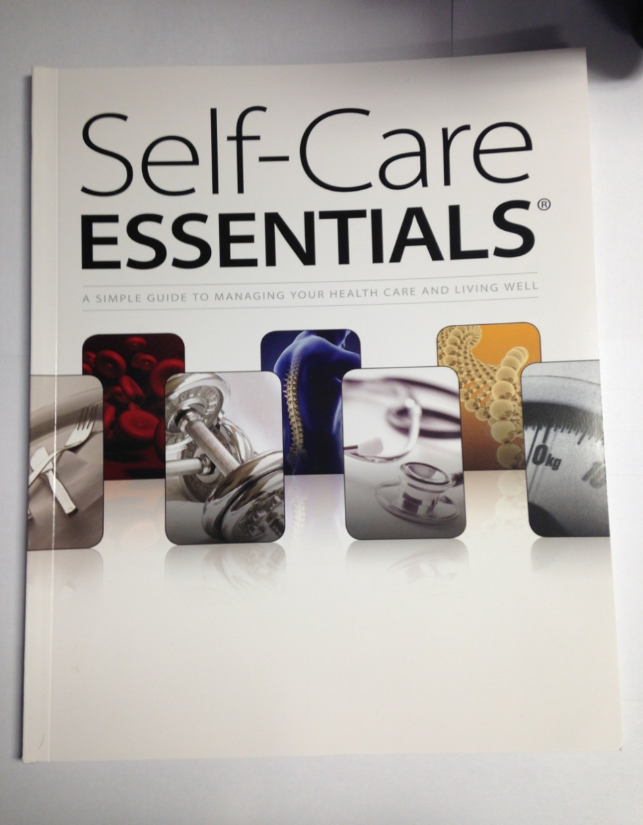
Self-Care Essentials
Sharing the “Miss Sue is no longer available to care for me, so I need to learn to take care of myself!” book

Slide 16
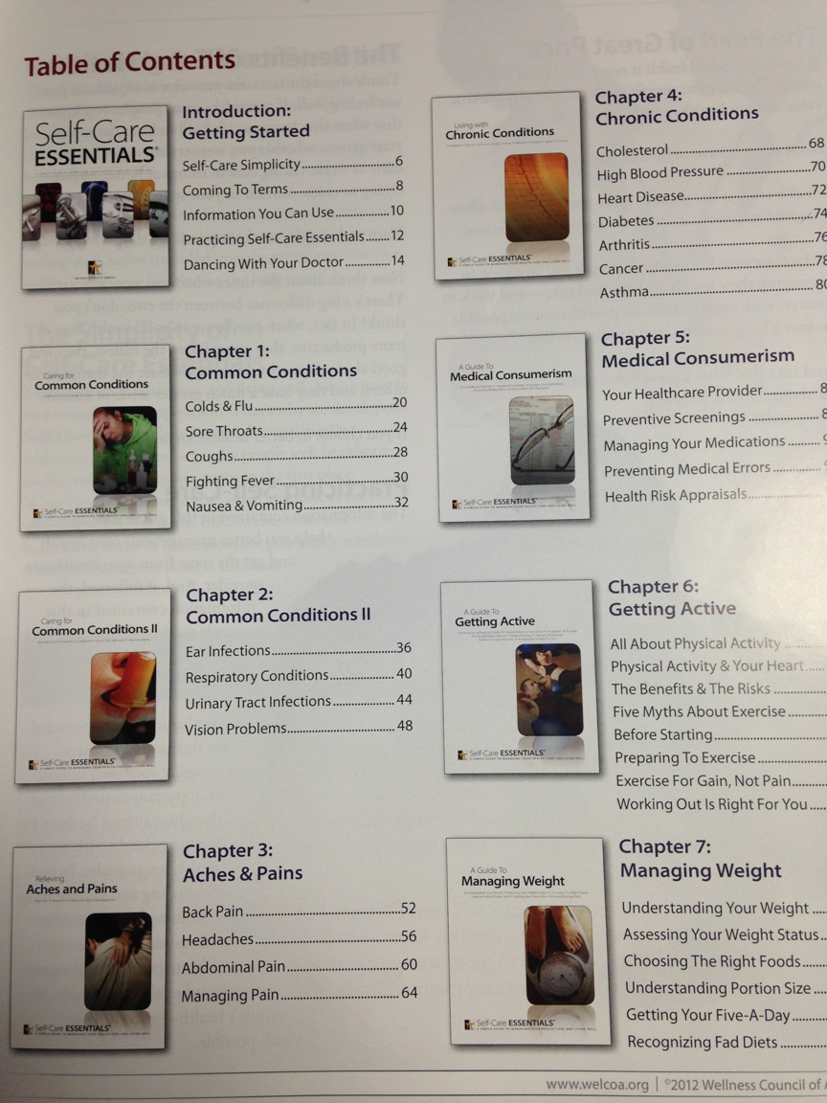
Self-Care Essentials
To order:
Wellness Council of America (WELCOA)
17002 Marcy St, Suite 140
Omaha, NE 68118 Ph: (402) 827-3590
www.welcoa.org

Slide 17
CTR in Cassadaga
Distributes and reviewed care of physical and immunization records
  2 copies
    One for S/E to keep and one for employer/PCP

Slide 18
Center Best Practices:
Phoenix Job Corps
Nancy Dean, RN, FNP

Slide 19
Overview
All students have an exit medical summary meeting 14-30 days prior to exit
  Given copy of immunizations
  Ensure community referrals in place for all those students with chronic medical and mental health issues
  Ensure all have 30 days of medication including birth control, copy of Depo, PAP records, chest x-rays for positive PPD
  Do exit weight and record in CIS for evaluation of HEALS program

Slide 20
Overview
DC attends Transition Panels with disability students 60 days before scheduled exit with counselor, instructor and CTS
  Ensures the following are in place:
    Transportation
    Housing
    Community Referrals
    Does student need accommodation for employment
    Any other needs

Slide 21
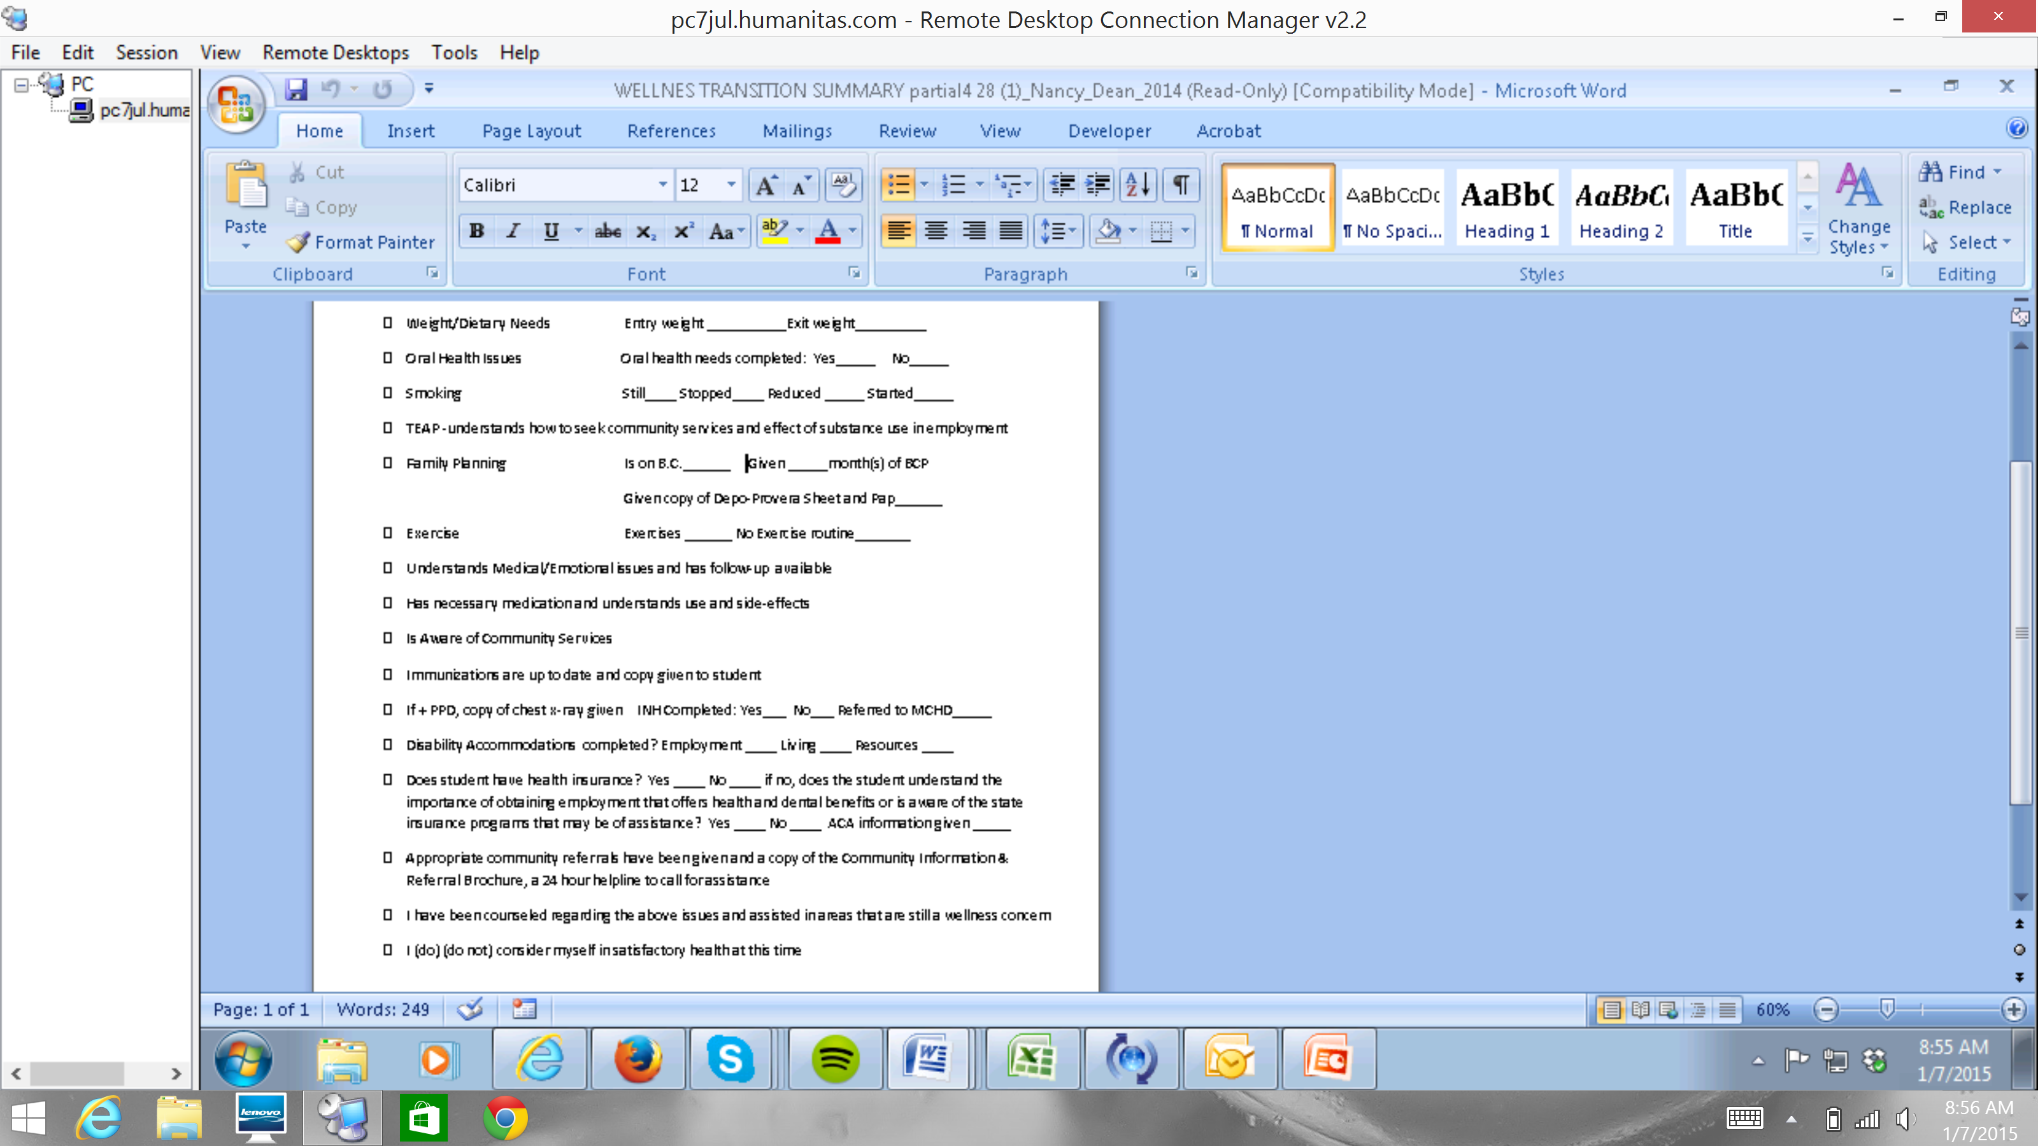
Transition Summary

Slide 22
Transition Summary

Slide 23
Other Best Practices
Shannon Bentley, RN
Melissa cusey, RN, bsn

Slide 24
Center Best Practices
Center Dentist provides the student with a dental plan of care of services already provided and what student still needs
Wellness staff discusses various insurance plans the student may be offered with employment
Wellness staff show students how to fill out insurance forms and medical history forms using mock forms
Wellness staff have guest speakers from local businesses come in and discuss various insurance plans they offer

Slide 25
Center Best Practices: Boston Region
Brooklyn: Provides young ladies a treatment plan with follow up GYN exams and birth control. Provides obese students with their BMI and referrals to outside resources. Provides students with mental health diagnoses with referral appointments and diabetics with supplies.
Exeter: During the exit interview copies of immunizations, health insurance information, referrals, a supply of medications or prescription, and a Teen Health Guide is provided.

Slide 26
Center Best Practices: Philadelphia Region
Carl D. Perkins: During an exit interview HWM provides copies of immunizations, 2 weeks supply of medications, appointments and referrals for follow up care.
Old Dominion: Provides a self care pamphlet, exit weight and BMI, provides medications and or prescriptions, assists with referrals, provides immunization records, and a copy of the student’s last physical.

Slide 27
Center Best Practices: Philadelphia Region
Woodstock: Provides a self care kits to exiting students with OTC (Over The Counter) supplies, toothbrush and toothpaste, provides a copy of the student’s eye prescription, immunization records, and 2 weeks of medications/prescription, does exit BMI and weight.
Red Rock: Meets with exiting student and reviews medications, assists with needed referrals, copy of immunization record and dental record of care is provided.

Slide 28
Center Best Practices: Dallas Region
Carville: Students are taught skills early on to continue to maintain their health once they leave the program. For example, students are taught to call the pharmacy automatic service to reorder medications and later they are taught how to get medication transferred to their local pharmacy.
Gary: Students with chronic illnesses are identified upon entry. A discharge packet is started at that time. It has information on where to continue care in the vicinity of their home of record, their immunization record (which is updated), information on their illness and medications. If a student has a disability s/he is given information on whether or not to disclose to future employers and the benefits of both (all of which is discussed with them during 60 day accommodation plan review, monthly or as needed clinic visits). These packets are given to the students when they near their graduation date.
All students are given presentations on their personal healthcare management, how their health will impact their employability and what is expected of a healthcare consumer.

Slide 29
Center Best Practices: Atlanta Region
Bamberg: Students in CTR class come to wellness every Monday afternoon to meet with the nurses and go over their Exit checklist. Some of the items covered on the checklist include insurance, when to call the doctor and when to go to the ER. The HWC staff give students at least 2 weeks medications and a Rx to get filled. Students also receive a copy of their immunization records, dental plan, self-care kit, and a copy of their IEP or 504 Plan. Students also receive a copy of the agencies and clinics in their county.
Gadsden: Wellness goes to the CTR classroom and meets with students 1-1 to give them handouts for chronic medical conditions, give students their medications, copies of immunization records, and their dental plan. They also go over a checklist with all students in the class. If a student has been on medications, the HWM goes on Needymeds.org and helps the student to sign up. The website also has a list of free or sliding scale clinics (medical, dental and mental health) in students’ home communities.

Slide 30
Center Best Practices: Atlanta Region
Gulfport: Students come to wellness once they are in the CTR class for an exit interview. Students who see the CMHC are scheduled one last time to go over coping mechanisms. Students are also set up with appointments in their area for medication or counseling depending on the recommendations of the center physician or CMHC, they also received 2-3 weeks of medications.

Slide 31
Center Best Practices: Chicago Region
Joliet: The CTP instructor brings students to wellness. Nurses discuss transition process and answer questions. Students are provided with a copy of their immunization records.
Humphrey HWM goes to CTR class to answer questions, goes over worker’s rights and responsibilities, and provides students with immunization records. She does not get an opportunity to meet with students individually.

Slide 32
Center Best Practices: San Francisco Region
Cascades: Counseling sends out a list of students in CTR class and has an open house for all departments to meet with students to answer questions about transition; wellness also meets 1 on 1 with students to give them copy of immunization records, medications.
Hawaii (Oahu): HWC staff meets individually with students and gives them immunization records and information from the state. Disability/TEAP specialist goes to the CTR classroom to give information to students.

Slide 33

Transition
What role can career transition readiness staff play?

Slide 34
Protected Health/Disability Information
HIPAA
HIPAA Authorization allows certain information to be shared with the career transition staff
Notes:
Information that may shared includes the following: mental health information (excluding psychotherapy notes), including information about medications that may alter mental functioning; information about pregnancies, diseases (including HIV), medication management, and illegal drug use or alcohol abuse (including drug test results); information about accommodations or modifications you have requested, whether for a disability or for any other health condition; oral health information, including treatment plan and appointments; and any health information that may be responsible for a leave of absence from Job Corps or your separation from Job Corps. We may share this information for the purpose of helping you identify community health, housing, child care, support groups, affinity job clubs, social organizations, or other community resources that may assist you in staying healthy and obtaining and keeping employment. In addition, this information may be shared for the purpose of following up with you regarding your independent living needs as well as to encourage the student to return to Job Corps, if possible.

Slide 35

Protected Health/Disability Information
Transition staff should be aware of appropriate sharing of health/disability information
Accommodation Needs—The CDD and CTS should work together to conduct an accommodation needs assessment.
Does the student have all accommodations necessary to conduct job searches?
Does the student have the necessary supporting documentation to secure accommodations in the workplace, in institutions of higher learning, or for state certification examinations?
Notes:
Transition staff may not share health/disability information with an employer without the consent of the student. If the nature of a student’s disability might cause an employer to question the candidate's ability to perform the essential requirements of the position and the student has agreed to disclose, then with the student’s consent, paperwork or documentation should be ready and organized.

Slide 36

Students with Disabilities in the Job Corps Program
Approximately 25%
of students disclose a disability

Slide 37
Barriers for Students with Disabilities
Needing accommodations for interviews and employment
Understanding disclosure during the transition process including the decision of whether or not to disclose and if so, where, when and to whom?
The need for individualized job development to carve out positions for the student utilizing their current level of skills and abilities may require collaboration with center partners
Notes:
Students with disabilities are typically not familiar with disability disclosure including when and how to disclose the need for accommodations in the workplace.
Depending upon the students’ disability and functional limitations, their personal decision to disclose needs to be addressed. For some students, it may be in their best interest to wait to disclose, for others it may be helpful for them to disclose prior to starting a job. But where, when and to whom? During the application process, the interview, after an offer of employment, once they are on the job? These are decisions that students with visible and invisible disabilities need help with. All centers are required to build partnerships with agencies that can provide services to our students with disabilities. Agencies that assist with these issues and providing discreet services such as job development are crucial for that students’ success. For example, vocational rehabilitation is a federal program that can provide these and other types of services before and after the student exits from the program. The student should be assisted with applying for these services long before they are ready to leave the center.
Carving out a position might occur when working with large employers. For example, if the student is good at filing and making copies, removing this function might free up several other workers to work on more demanding tasks.

Slide 38
Job Corps Disability Breakdown

Slide 39

Cognitive Disabilities – 62%
ADHD: 26%
Learning: 67%
Intellectual (MR): 5%
Other: 2%
TBI: 0.3%
Notes:
Statistics as of 12.5.2014

Slide 40

Mental Health Disabilities – 20%
Anxiety: 20%
Mood: 48%
Serious Emotional Disturbance: 13%
Psychotic: 3%
Personality: 3%
Other: 13%
Notes:
Statistics as of 12.5.2014

Slide 41

Medical Disabilities – 11%
Chronic Asthma: 42%
Diabetes: 11%
HIV/AIDS: 4%
Hypertension: 9%
Sickle Cell: 1%
Other: 33%
Notes:
Statistics as of 12.5.2014

Slide 42

Educating the Student
PRH 6.14, R3 (c)
During Career Transition Readiness all students will receive information about workers rights and responsibilities including reasonable accommodation in the workplace (see Section 3.21, R2, g).
  Self advocacy
  Workplace rights
  Disclosure
Students with disabilities who may need to disclose to an employer should receive one-on-one assistance

Slide 43
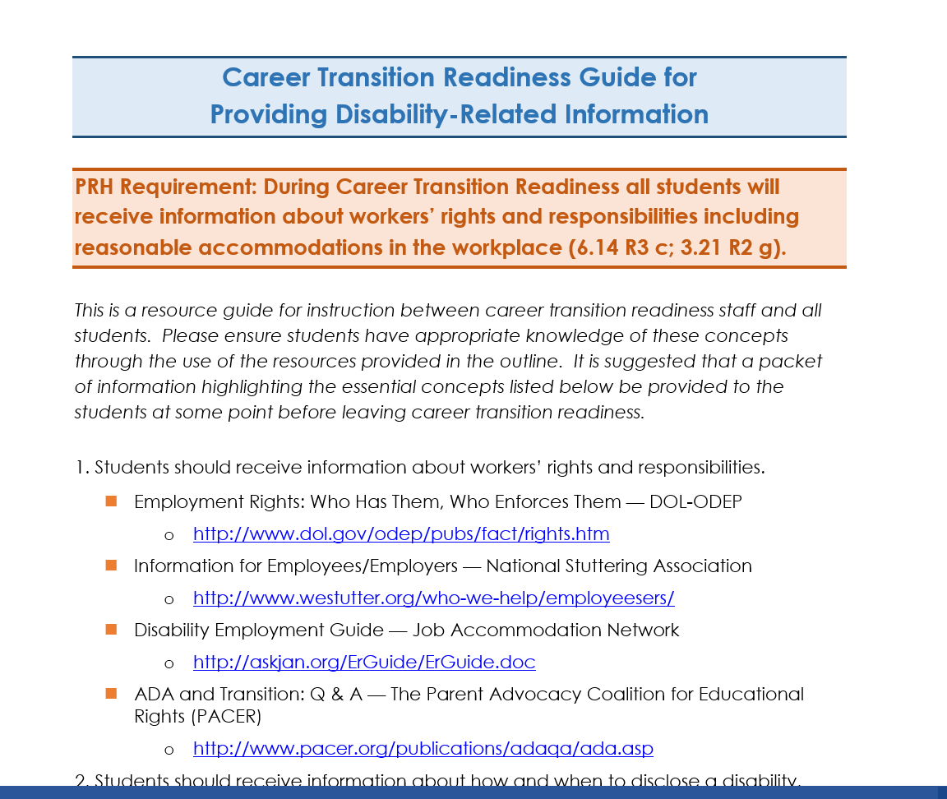
Career Transition Readiness Guide
A resource guide available on the Disability website for use by career transition staff to teach ALL students about workers’ rights and responsibilities including reasonable accommodation.
https://supportservices.jobcorps.gov
Notes:
This career transition readiness guide provides career transition instructors with an outline of many resources needed to teach all students about workers’ rights and responsibilities including reasonable accommodation in the workplace.

Slide 44

411 on Disability Disclosure
This workbook helps students make informed
decisions about whether or not to disclose their disability and understand how that decision may impact their education, employment, and social lives
Notes:
Based on the premise that disclosure is a very personal decision, the workbook helps young people think about and practice disclosing their disability.
The workbook does not tell a young person what to do. Rather, it helps them make informed decisions about disclosing their disability, decisions that will affect their educational, employment, and social lives.
The only reason to disclose a disability is if accommodation required for an interview or to perform the essential functions of a particular job. A student’s resume and cover letter should focus on the abilities he/she brings to the job, not on the disability.

Slide 45

Educating the Employer
Get them involved!
  Center’s programs and activities: Include disability organization representatives on the community relations and business industry councils
  Provide employers with information on hiring individuals with disabilities through discussion and literature
Notes:
Employers may need preparation, orientation, and support to recruit and integrate students with disabilities into the workplace. Employer education material ideas can be found on the Disability website. Here’s an example of a publication encouraging employers to hire individuals with disabilities: https://www.disability.gov/resource/disability-employment-101/
#1 - Involve them in the center's programs and activities to expose them to students in their training environments where diversity is evident and students are already being accommodated.
#2 -This exposure introduces employers to resources that could assist in providing accommodations in the workplace as well as serves to dispel common myths about hiring individuals with disabilities.
Information on disability website about how to educate employers on issues such as disclosure and other disability-related workplace issues is available in tools for career transition counselors section of disability website.

Slide 46
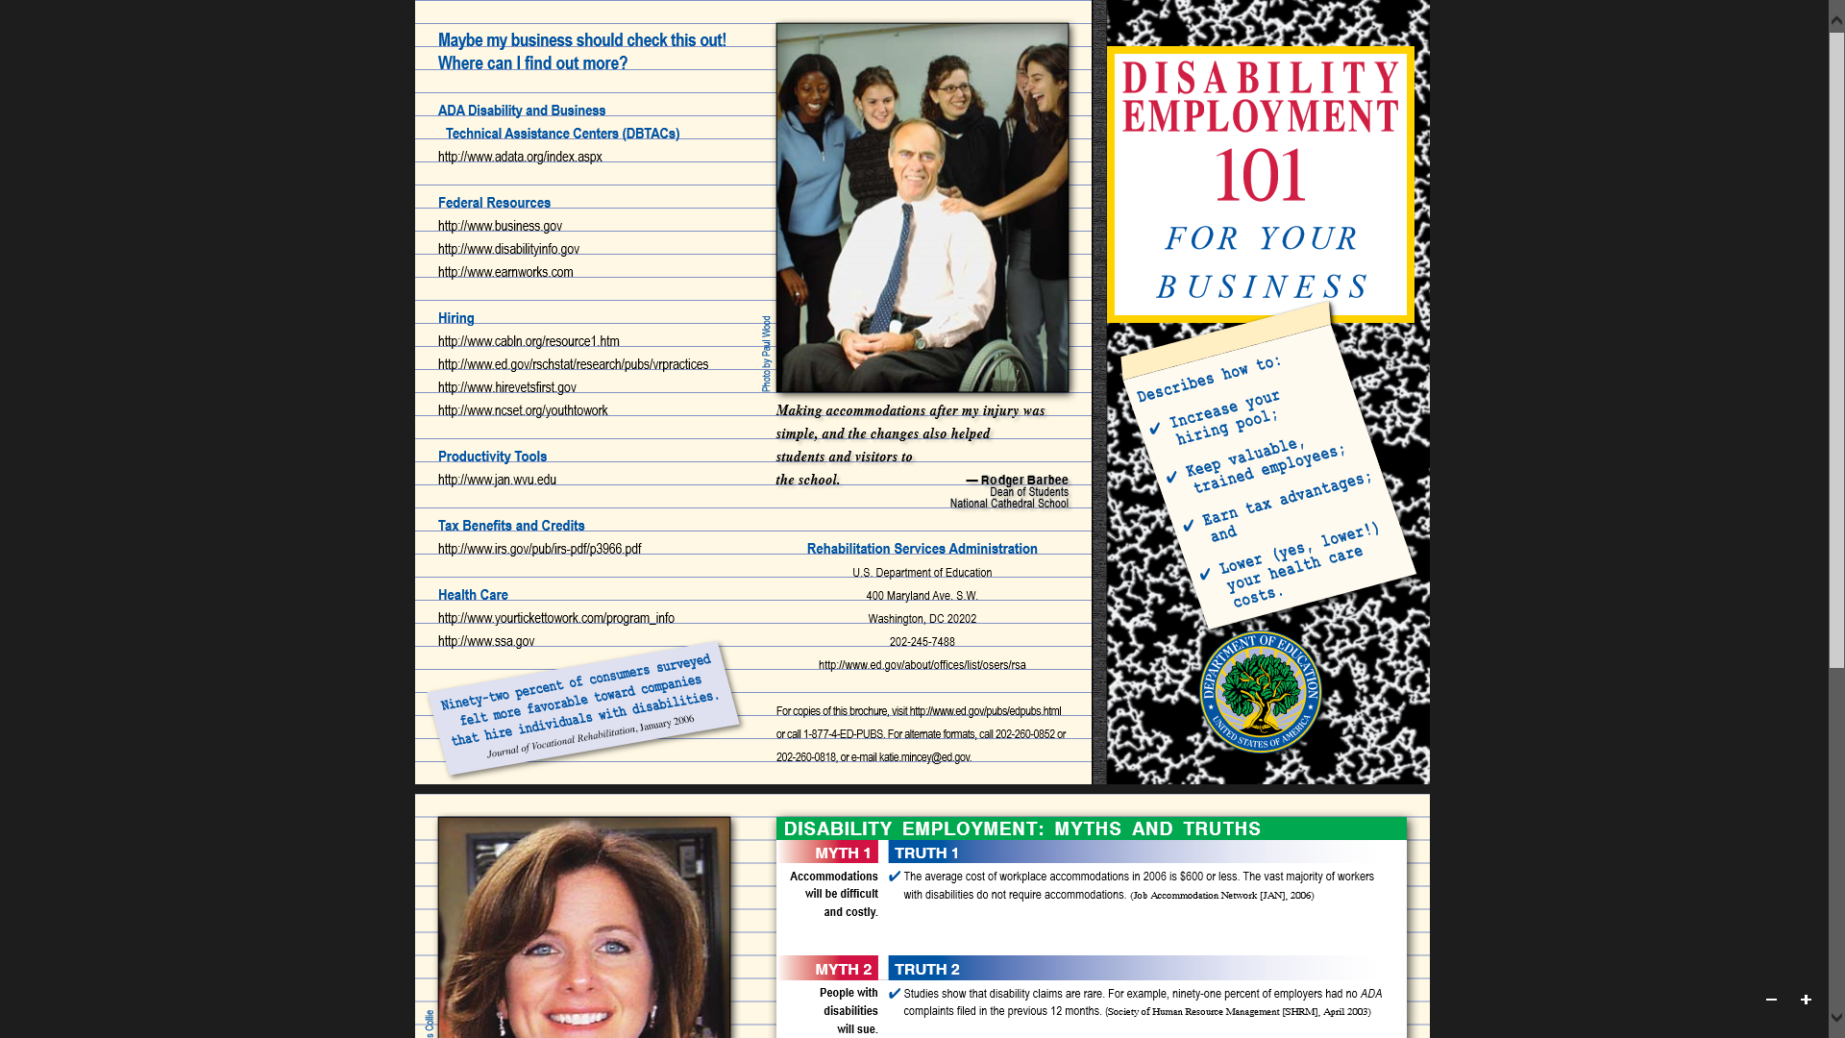
https://www.disability.gov/resource/disability-employment-101/

Slide 47
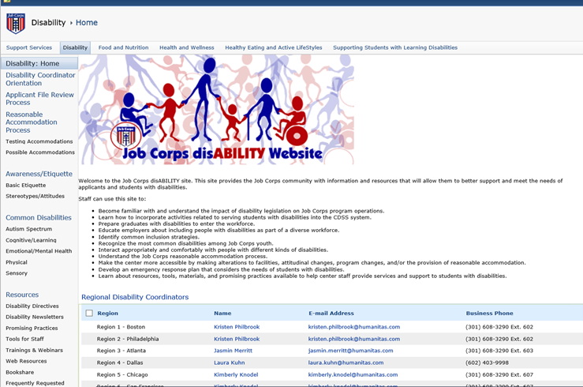
Job Corps Disability Website
Notes:
On the menu on the left, click on “Tools for Staff,” then select “Career Transition Counselors”

Slide 48
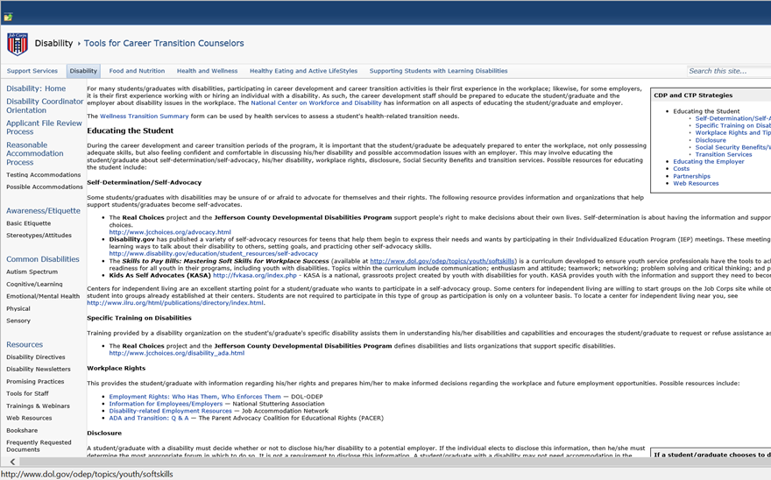
Tools for Career Transition Staff
Notes:
Resources include: Skills to Pay the Bills, 411 on Disability Disclosure…

