Slide 1

ALL YOU EVER WANTED TO KNOW ABOUT
APPLICANT FILE REVIEW and TEAP
June, 2016

Slide 2


Presenters
Diane A. Tennies, PhD, LADC
Debbie M. Jones, B.S.
Lead TEAP Health Specialist,
Humanitas, Inc.
Disability Program Analyst
Humanitas, Inc.

Slide 3
Learning Objectives
01
Participants will be able to articulate the difference between Appendix 609 and 610, as well as when to use each of these forms.
AFR Assessment
02
Participants will be able to list the criteria for determining who is a person with a substance-use related disability.
Disability
03
Participants will be able to successfully complete the interactive interview process with prospective applicants.
Interactive Process
04
Participants will identify 2-3 accommodations related to an applicant’s functional limitations with a focus on independence and employability.
Accommodations

Slide 4

Applicant File Review (AFR) Process
for Applicants with
Substance Use Histories

Slide 5
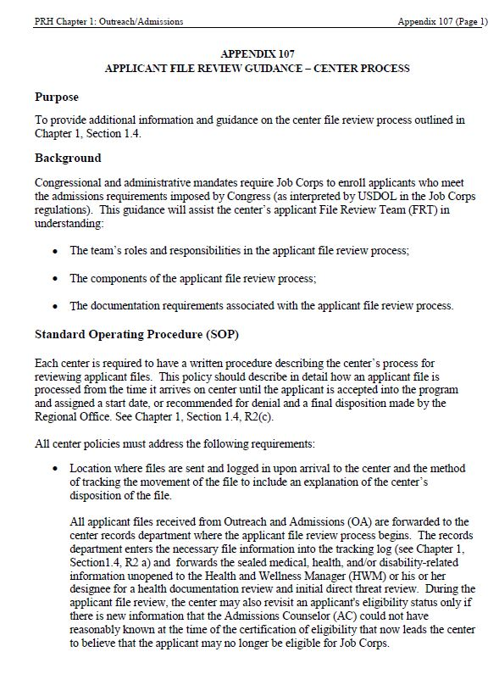
Appendix 107 is your “go to document” for the overall file review process.
  Latest version is December 2015.

Slide 6
Application Outcomes
  Applicant may no longer be eligible due to new information that the AC could not have reasonably known at the time of eligibility certification.
  Applicant poses a direct threat to self or others.
Center enrolls applicant.
  Applicant’s health care needs exceed those of basic health care.
RECOMMENDATION OF DENIAL
ENROLLMENT
RECOMMENDATION OF DENIAL
RECOMMENDATION OF DENIAL

Slide 7
Direct Threat Assessment
A direct threat assessment should be completed whenever center believes that an individual:
  poses a direct threat to the health or safety of himself or others,
  poses a significant risk of substantial harm to the health or safety of the individual or others; and
  cannot be eliminated or reduced by reasonable accommodation or modification.
Assessment conducted and signed by licensed clinician.

Slide 8
When to Use Appendix 609 versus 610
Direct Threat – 609
Health Care Needs - 610
Rarely used when dealing with Substance Abuse/Dependency issues with applicants
Commonly used when dealing with Substance Abuse/Dependency issues with applicant

Slide 9
Appendix 609 – Direct Threat Assessment (DTA)
What is the nature and severity of potential harm?
  What kind of harm is posed by the individual’s medical condition or disability?
  What is the seriousness of the potential harm (e.g., death, serious injury, minor emotional distress?
What is the duration of the risk (e.g., how long will risk last)?
What is the likelihood that the potential harm will occur (e.g. high, moderate, low)?
What is the imminence of the potential harm (e.g., how soon likely to occur)?

Slide 10
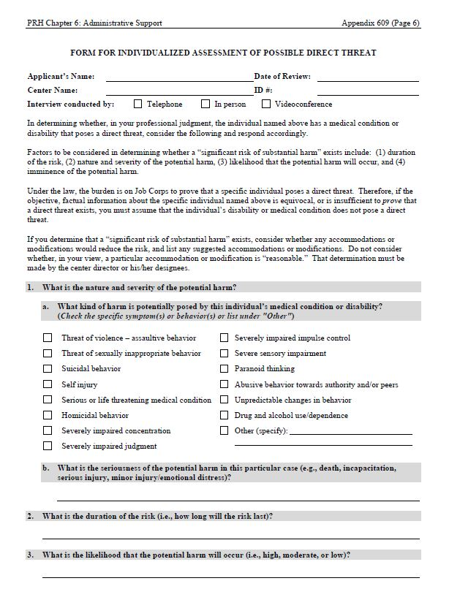
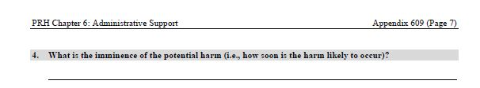
  Items 1 identifies symptoms, behaviors, and functional limitations, essentially. This will be important when we talk about accommodations!

Slide 11
Appendix 610 – Health Care Needs Assessment (HCNA)
The Health Care Needs Assessment should be completed if there is a concern that the center cannot meet the basic health care needs of the applicant.
  The applicant’s health-care needs exceed those of basic care and cannot be met by the center.
  The applicant’s health-care needs are manageable at Job Corps as defined by basic health-care services in Exhibit 6-4, but require community supports and services which are not available near center.
    Assessment conducted and signed by the TEAP when at all possible. If not the TEAP – then explain why.
Notes:
The center must document efforts to arrange for less frequent treatment in home state and/or to secure community support near center and include this information in the health-care needs assessment.

Slide 12
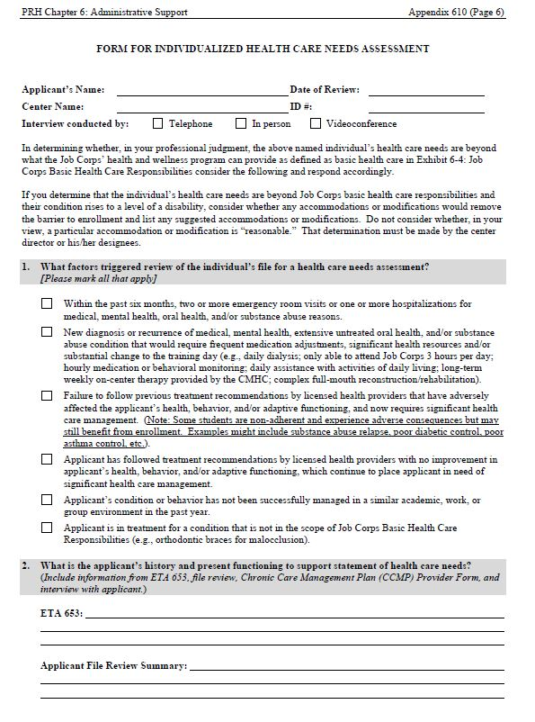
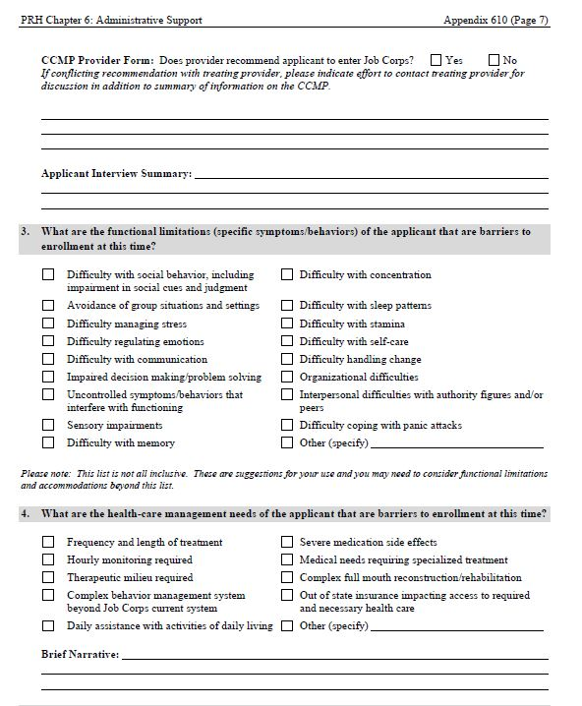
  Item #3 identifies symptoms, behaviors, and functional limitations, essentially. This will be important when we talk about accommodations!

Slide 13

HCN Exceeds Basic Care - Red Flags
Health care needs beyond Job Corps basic health care responsibilities (PRH Exhibit 6-4)
  Frequent recent ER visits
  Newly diagnosed or uncontrolled health issue
  Symptoms/condition not well managed in similar environment as Job Corps
  Require extensive resources/intervention

Slide 14

Deciding if Job Corps is Appropriate for Applicant

Slide 15

How do We Decide if JC is Appropriate for Applicant?
Individualized consideration
  Current stability
  History of stability
  Current behaviors
  History of behaviors
  Medical risks and health care needs
  SAFETY
Failure to comply with an outside provider’s recommendation does not automatically mean a recommendation of denial.

Slide 16
Important Information to Review
ETA 6-52 (Outreach and Admissions Applicant Information Sheet)
ETA 6-53 (Health Questionnaire)
CCMP Provider Forms
Inpatient psychiatric or medical hospitalizations or Emergency Department visits (if relevant), treatment summaries
IEP, 504, and other educational information provided
Psychological Assessment
Background Check
Individual Statement from Applicant

Slide 17

Applicant Interview is KEY!
Interactive in-person or telephone
  Only ask specific questions regarding any behaviors or information of concern that has been disclosed or documented in the applicant file.
  Document specific behavioral or clinical observations from interview.
  If center H & W staff (e.g., TEAP specialist) disagrees with the opinion provided by outside professional on CCMP, try to contact professional to resolve or explain difference of opinion. Document contact or lack of response.

Slide 18

Defining Disability
Notes:
In order for you to identify whether or not to consider reasonable accommodation for an applicant or student, you have to know if they are a person with a disability or not so let’s talk about the definition of disability generally and then as it relates to substance-related disorders.

Slide 19

What is the Definition of Disability?
An individual who has a physical or mental impairment that substantially limits one or more major life activities, a record of such an impairment, or is regarded as having an impairment.
  Remember – being regarded as having an impairment does not entitle one to positive actions (i.e. accommodations) but it does protect the individual from being discriminated against for having a disability.*
So, how does that apply to TEAP and Substance Use Disorders?
  Two categories – Drug Addiction and Alcoholism
*1EEOC Regulations To Implement the Equal Employment Provisions of the Americans With Disabilities Act, as Amended, 29 C.F.R. § 1630 (2011).

Slide 20
Who Qualifies as a Person with a Disability with Reference to Substance Use?
Review Appendix 605 for information regarding students with substance-related disabilities in Job Corps.
  First, not everyone who has a substance use disorder diagnosis qualifies as a person with a disability.
  Federal law explicitly excludes persons who are currently engaging in the illegal use of drugs; however, the individual could be currently using alcohol and still qualify as a person with a disability.

Slide 21
Substance-related Disability Criteria Defined (Appendix 605)
Persons with a drug addiction diagnosis who have successfully completed a supervised drug rehabilitation program (an in-patient, out-patient, or employee assistance program), and who are no longer using drugs illegally.
Persons with a drug addiction diagnosis who have been rehabilitated successfully in some other way (e.g., recognized self-help programs such as Narcotics Anonymous) and who are no longer using drugs illegally.
Persons who have a drug addiction diagnosis, are currently participating in a supervised rehabilitation program, and who are no longer using drugs illegally.

Slide 22

Reasonable Accommodation
in the Assessment Process

Slide 23

Applicant File Review
Process
When completing the DTA or HCNA for an applicant with a disability, the reasonable accommodation committee (RAC) must convene to consider reasonable accommodation (RA).

Slide 24
Reasonable Accommodation Committee (RAC)
The DC and the applicant MUST be involved in the RA review as per the PRH.
  The DC is the coordinator of the reasonable accommodation process; therefore, this individual must lead this portion of the assessment process.
    Other clinicians may participate/make recommendations as they wish and as time permits and are strongly encouraged to do so.

Slide 25
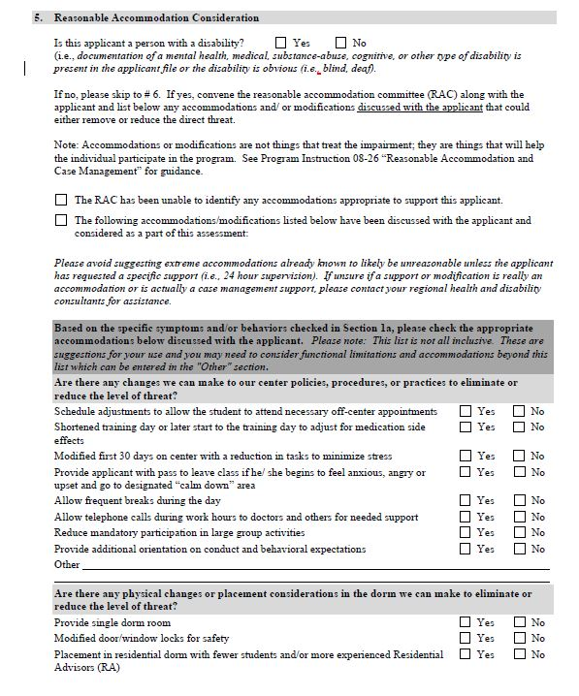

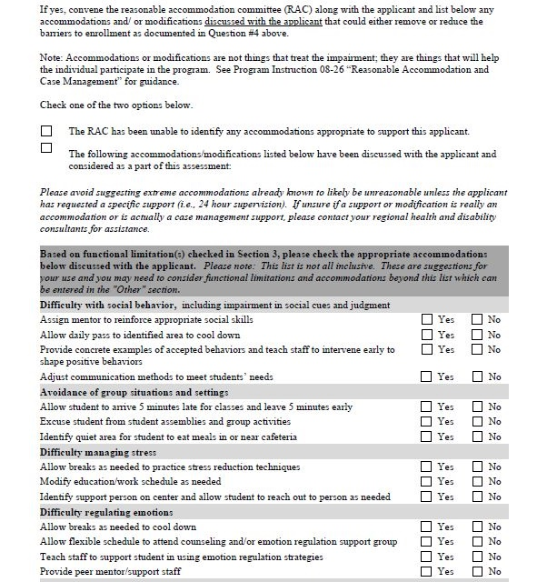
DTA
RA Section
HCNA
RA Section

Slide 26
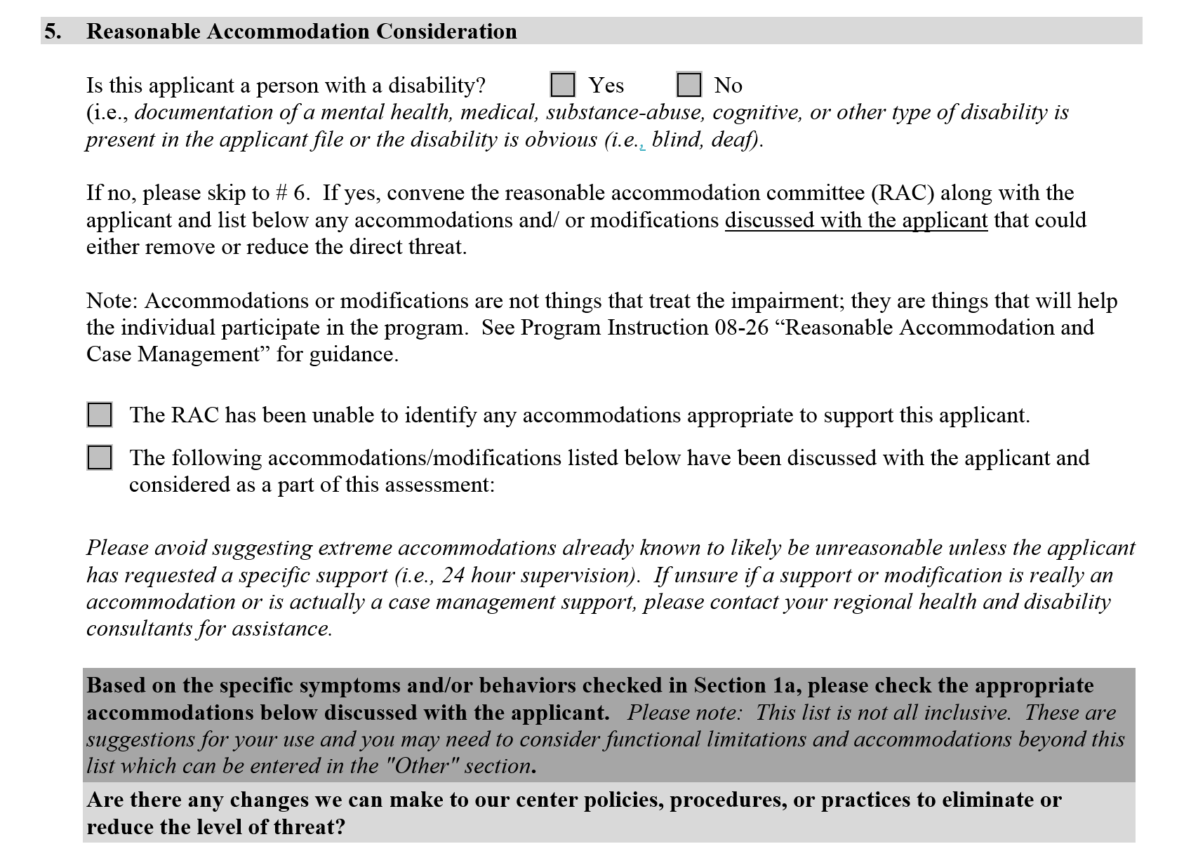

Slide 27


Slide 28
RA in the DTA or HCNA –
What must be Considered?
Review any behaviors/functional limitations checked with an affirmative answer in item #1 of the DTA and #3 of the HCNA.
Go to item #5 and identify related appropriate accommodations that may assist the applicant based upon the behaviors/functional limitations checked in item #1 if DTA and #3 if HCNA!
Review only those appropriate for the functional limitations identified or as requested and applicable by the individual applicant.

Slide 29
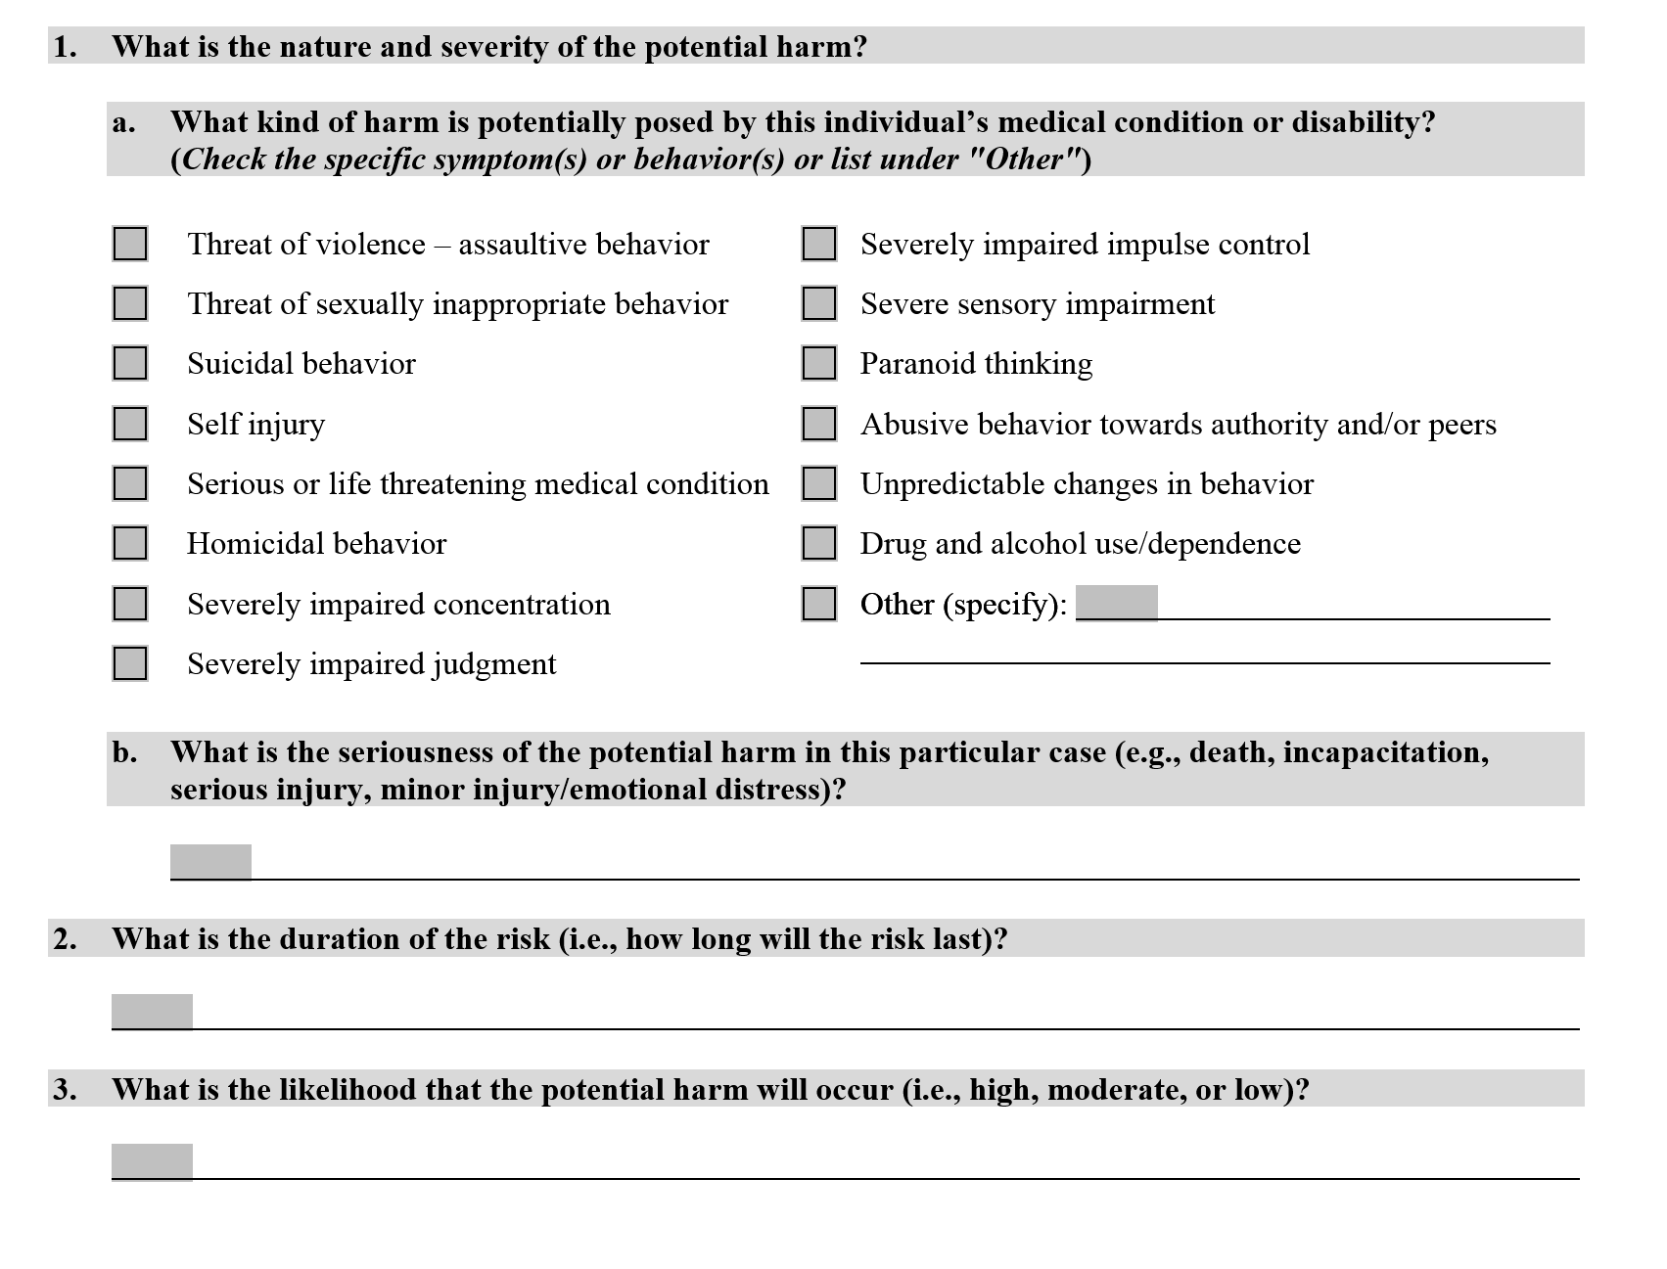
DTA

Slide 30
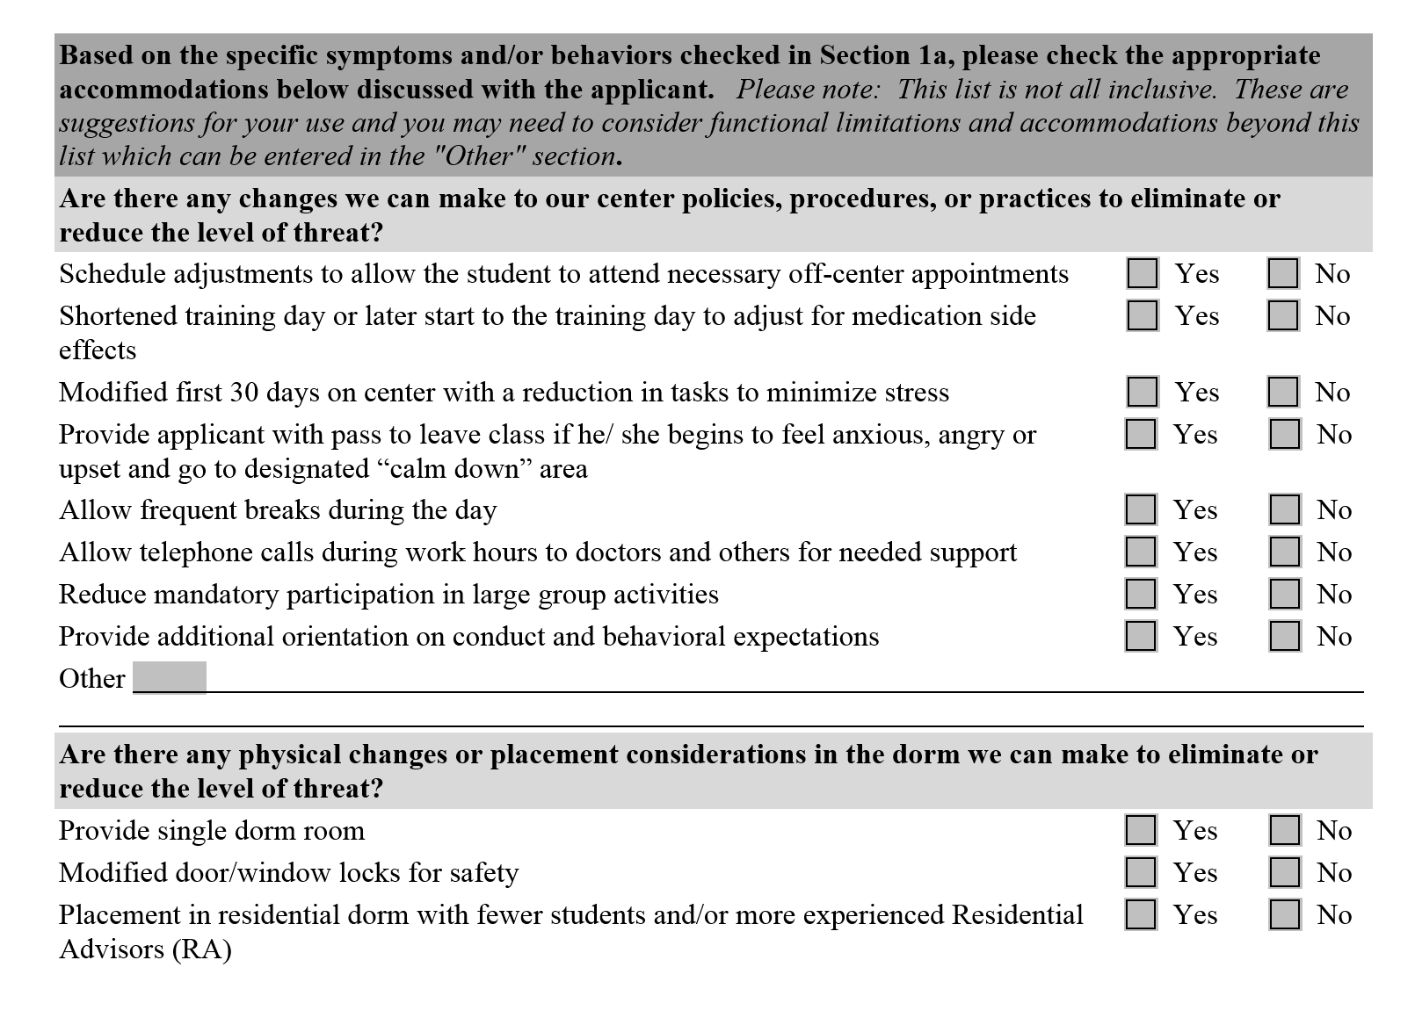

Slide 31
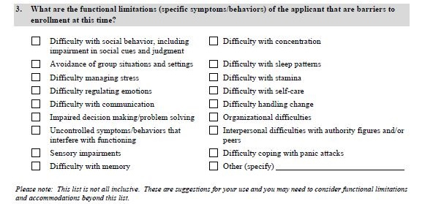
HCNA

Slide 32
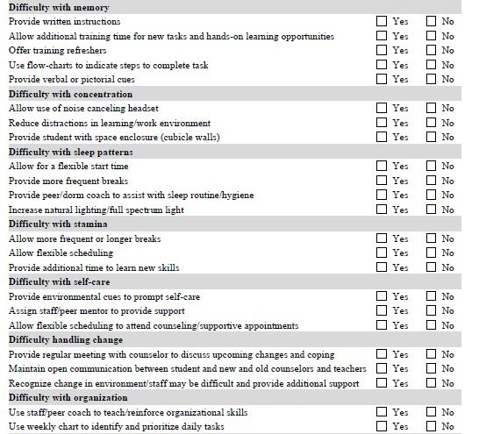

Slide 33

Yes/No Boxes in Item #5 of Assessments
Completing the check boxes:
  Checking “yes” means that the applicant was offered the specific accommodation and accepted it.
  Checking “no” means that the applicant was offered the specific accommodation and rejected it.
  Leaving the box blank means the accommodation was not offered and/or discussed because it was not appropriate or necessary.

Slide 34

Making the Final Decisions
within the Assessment

Slide 35
Then the licensed clinical professional completing the assessment considers whether or not accommodations would sufficiently remove the barriers to enrollment.
Applicant File Review
Process
The licensed clinical professional makes a final decision based upon the findings of the assessment.

Slide 36
Making the Final Decisions within the Assessment
Then as the clinician completing the assessment, you would resume completion of the assessment with item #6. The question you must answer is whether the identified accommodations are sufficient to reduce the barriers to enrollment such that the applicant could be enrolled.
If not, could the applicant be enrolled in a location closer to current services or providers (i.e. item #7).

Slide 37
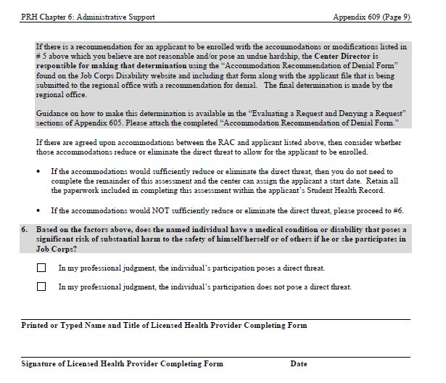
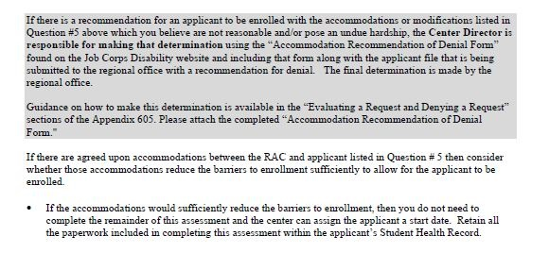
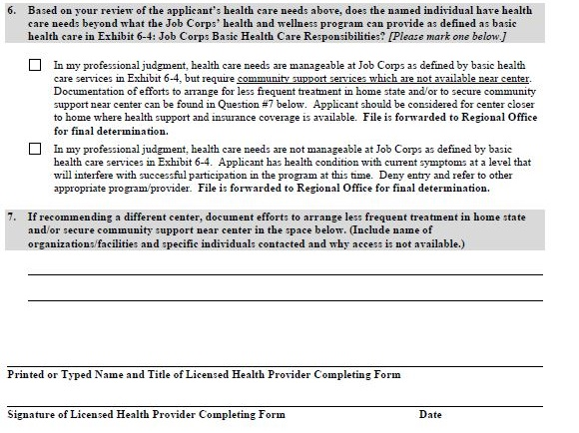
DTA
HCNA

Slide 39
Referral to
Alternate Center
Who?
What to do?
This will come up for individuals receiving opiate replacement therapies as rare that can transfer prescription to another clinic.
Contact the treating provider and discuss applicant’s needs and see if treating provider (not HWC staff) recommends less frequent treatment or monitoring.
If treating provider does not recommend changes to frequency of treatment or monitoring, consider local community services with sliding fee scales for applicants without insurance or insurance in another state.
Document efforts to arrange for less frequent treatment in home state and/or to secure community support near center included in the file. Applicant should be considered for center closer to home where health support and insurance coverage is available.

Slide 40
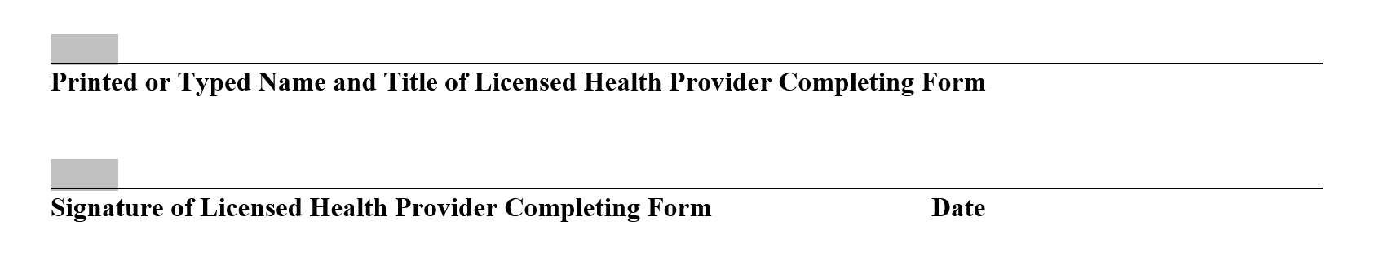
Sign the assessment!!!

Slide 41
Any applicant file recommended for denial is to be forwarded to the Regional Office for review and final determination of the application status.
Applicant File Review
Process

Slide 42
Recap of AFR Process via HCNA or DTA
Items #1-4
Item #5
Item #6
Item #7
Clinical Review
Reasonable Accommodation
Final decision of the completing clinician
Justification for
alternate center

Slide 43

Let’s Practice!

Slide 44
Substance-related Scenarios
Applicant states that he is actively using alcohol but agrees to the center’s zero tolerance policy, has previously successfully completed some form of rehabilitation, and has no legal history or recent hospitalizations.
  What are the clinical implications/considerations?
  Is the individual entitled to accommodations? If so, why and if not, why not?

Slide 45
Substance-related Scenarios
Applicant did not successfully complete most recent outpatient plan of care. Individual states he would test positive for marijuana if tested today.
  What are the clinical implications/considerations?
  Is the individual entitled to accommodations? If so, why and if not, why not?

Slide 46
Substance-related Scenarios
Applicant successfully completed an inpatient treatment program 3 months ago. Applicant has fairly extensive substance-related history. He requested accommodations to attend meetings off center at least 2x a week. He has 2 letters of recommendation in his file from outside case managers/treating clinicians. He admits some difficulties with sleeping but states they are not “too bad.”
  What are the clinical implications/considerations?
  Is the individual entitled to accommodations? If so, why and if not, why not?

Slide 47

Resources

Slide 48
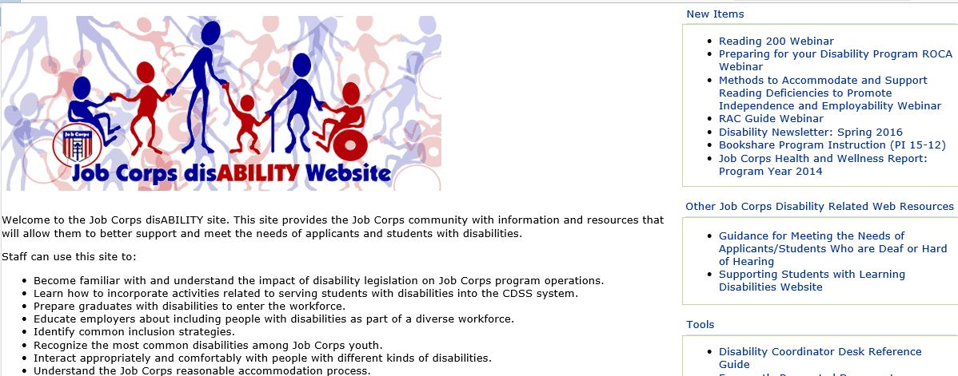
Job Corps Disability Website https://supportservices.jobcorps.gov/disability/Pages/default

Slide 49
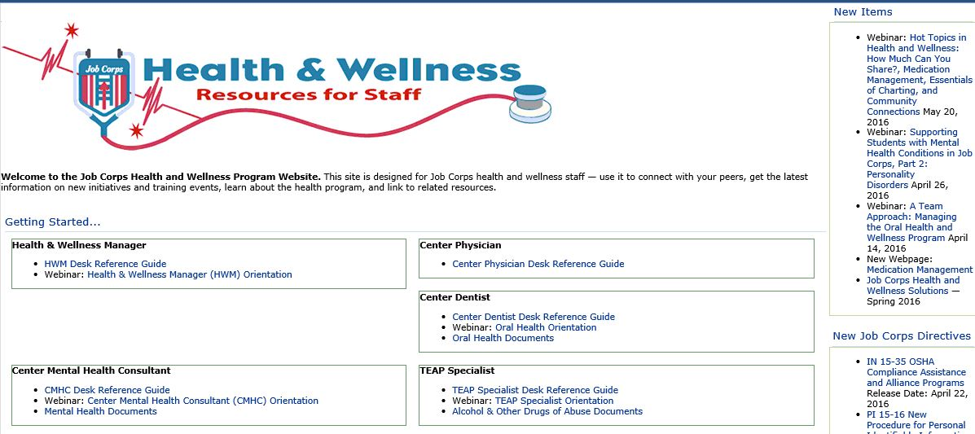
Job Corps Health & Wellness Website https://supportservices.jobcorps.gov/Health/Pages/default.aspx

Slide 50
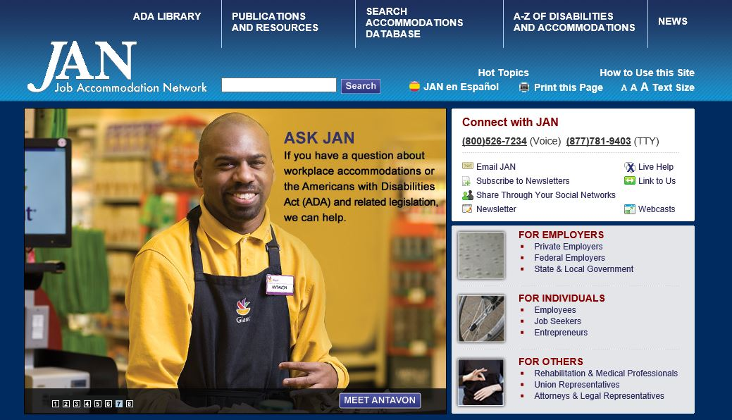
Job Accommodation Network http://askjan.org

