Slide 1
Job Corps TEAP Specialist Orientation
Diane A. Tennies, PhD, LADC
Lead/Regional TEAP Health Specialist

Slide 2
Job Corps’ Mission
As a national, primarily residential training program, Job Corps' mission is to attract eligible young adults, teach them the skills they need to become employable and independent, and place them in meaningful jobs, higher education, or the military.
Notes:
Job Corps is the nation’s largest residential, educational, and career technical training program for economically challenged young adults aged 16 to 24. There is no upper age limit for individuals with disabilities who are otherwise eligible. Students are offered such services as basic education, occupational exploration, career technical training, work-based learning, social and employability skills training, health care, counseling, recreation, and post-program placement support. As a national, primarily residential training program, Job Corps' mission is to attract eligible young adults, teach them the skills they need to become employable and independent, and place them in meaningful jobs, higher education, or the military.

Slide 3
Regional Health Specialists (RHS) Tasks
Provide technical assistance by answering questions via email, text or phone calls
Conduct center assessments
Provide training to regional and center staff
Assist with understanding and implementing policies
Provide up-to-date information to assist in meeting program requirements
Conduct monthly teleconferences

Slide 4
Regional Office Center Assessments (ROCAs)
Every 1 to 2 years, Health Specialists and Assessors visit each center as part of a Regional Office Center Assessment (ROCA) team.
Using the Program Assessment Guide (PAG), in conjunction with the Policy and Requirements Handbook (PRH), this team will conduct an overall assessment of your center’s health and wellness program.

Slide 5
Important Resources
PRH—The Policy and Requirements Handbook
PAG—The Program Assessment Guide
COP/SOP—Center or Standard Operating Procedures
DRG—Desk Reference Guide

Slide 6
Health Directives
PRH Change Notices—Contain new or revised policy with instructions to delete, replace, or add pages to the PRH.
Program Instructions—Provide one-time instructions with a designated expiration date and usually require center response (e.g., survey).
Information Notices—Provide one-time announcements with information that is of interest to centers (e.g., data summaries, meeting or training announcements).

Slide 7
Job Corps Career Development Services System (CDSS)
Includes four CDSS periods within which health and wellness services and activities are conducted:
Outreach and Admissions (OA) Period
Career Preparation Period (CPP)
Career Development Period (CDP)
Career Transition Period (CTP)

Slide 8
Job Corps Health & Wellness Website
Designed for Job Corps health and wellness staff
Use it to connect with your peers, get the latest information on new initiatives and training events, learn about the health and wellness program, and link to related resources.
https://supportservices.jobcorps.gov/Health/Pages/default.aspx

Slide 9
Trainee Employee Assistance Program TEAP

Slide 10
TEAP Responsibility
Overall goal:
Assist students in developing appropriate health and wellness practices that will enhance their ability to obtain/maintain employment AKA “Employability Skills”
So….how do we do this?

Slide 11
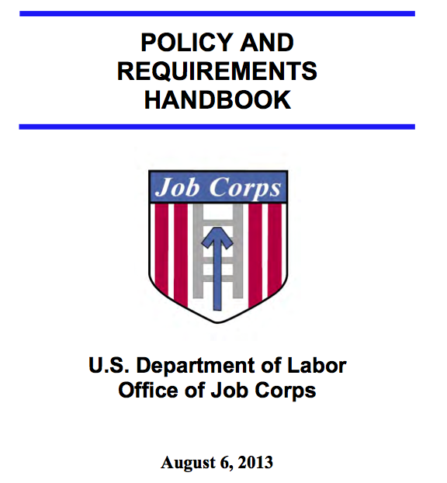

Slide 12
Hours and Qualifications
TEAP Specialist: Six hours/100 students/week is the minimum required level of TEAP coverage by a qualified TEAP specialist (see Exhibit 6.5)
Example: a center with 300 students must have a TEAP specialist working at least 18 hours per week.
Exhibit 5-3 (as of 03/08/2016)- to be qualified means: Active, unrestricted substance abuse license or credential that meets minimum state licensing or credentialing requirements to practice in the state where the center is located.
Waiver process changes.
ALL TEAPs must meet minimum staffing qualifications listed in Exhibit 5-3 within one year of employment (new as of 03/08/2016).

Slide 13
TEAP Responsibilities and Guidance
Located in PRH 6.11 R1
Also:
Exhibit 6-4: JC Basic Health Care Responsibilities
Desk Reference Guide (more about this later)
Exhibit 3-1: Infraction Levels, Definitions and Appropriate Center Actions

Slide 14
6.11, R1 (a)
The general emphasis of TEAP shall be on:
Prevention
Education
Identification of substance abuse problems
Relapse prevention
Helping students overcome barriers to employability
Why Prevention and Education emphasis?

Slide 16
Life would be easier if everyone would…

Slide 17
Prevention and Education Services (6.11, R1 (b))
1-hour presentation on substance use prevention in CPP to include:
Description of the Center’s TEAP.
JC’s and the center’s drug and alcohol policies.
Consequences for testing positive (alcohol and/or drugs).
Career Development and Transition Period presentations.
Annual center-wide activities (3).
Consultation with staff around prevention and education efforts.
Coordination with other departments/programs.

Slide 18
Prevention and Education Services
Templates are available for all three transition phase presentations on the JC Community Website.
https://supportservices.jobcorps.gov/health/Pages/default.aspx
Where are they located on the JC website?

Slide 19
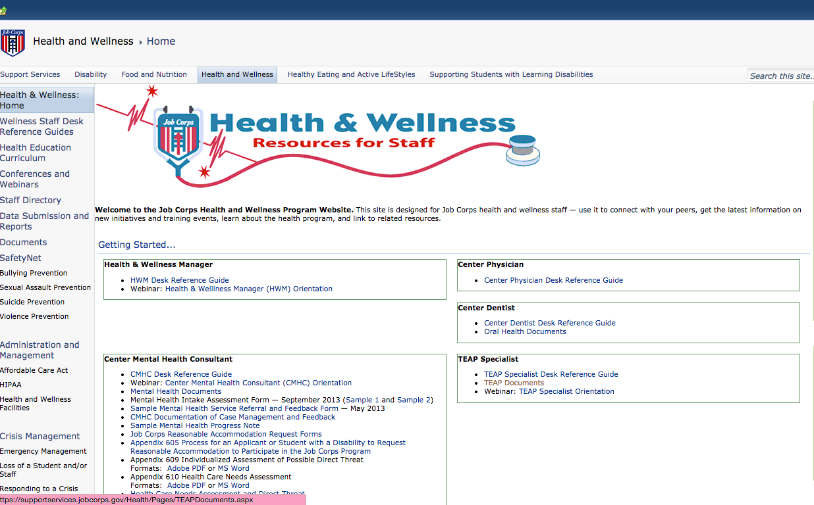
Look on the right hand side – third box down

Slide 21
CPP Presentation
CPP presentation components:
TEAP Specialist Introduction Confidentiality (42 CFR Part 2 and HIPAA)
Zero Tolerance (ZT) Policy
Center-wide Prevention And Education Activities
Drug Screening
TEAP Mandatory Program
Alcohol Use Policies
Alternative Activities
Tobacco Use Prevention Program (TUPP)
Hazards Of Drug Use
Summary And Questions/Answers

Slide 22
Career Development (CDP) and Transition Periods (CTP) – see 6.11 R1 b 2
More flexibility with format and time.
Focus on linking success in JC to a drug-free lifestyle which equals EMPLOYABILITY.
Templates on JC Community Website with many ideas for these meetings.

Slide 23
CDT/CTP Programming
Goal:
Feelings of competence/success reinforced when students successfully complete the phases of JC.
Activities:
Brainstorm what factors helped with success in earlier phases including:
Personal/individual strengths: high motivation, focus on goals and better future, etc.
External structure and routine: waking up at set time, set daily schedule and expectations, etc.
Support/mentoring: helpful and supportive instructors, RAs, counselors, H&W staff.
Access to care services: support with not using drugs/alcohol.

Slide 24
CDT/CTP Programming (cont.)
Then tie to TEAP and employability to identify challenges of transitioning out of JC:
Staying abstinent/managing.
Returning to the old neighborhood/negative influences.
Finding local services (AA/EAP programs).
Develop plan to include:
Services available in local communities (e.g., EAP, AA/NA, other support groups).
Use internet to find resources in their home town/future town.
Draft plan to access these services addressing barriers such as transportation.

Slide 25
Another Prevention & Education Requirement (6.11; R1,b(3))
Three center-wide activities annually (keep track of this information)
National TEAP Observances such as:
Kick Butt Day in March
National Alcohol Awareness Month - April
National Recovery Month – September
Red Ribbon Week in October
Above the Influence Day in October
Substance Abuse Awareness Month – October
Great American Smokeout - November
Outside Speakers/Activities.
Tabling in cafeteria when students leave on break.
Various Contests (e.g. poster, essay, poetry).
Presentations at weekly assembly.
TEAP sponsored recreational activities.

Slide 26
Prevention and Education (6.11;R1,b(4))
Clinical consultation to get input and buy-in from:
Center Director
Management Staff
CMHC
Wellness Staff
Take lead on prevention activities
Develop support and alliances for assistance
Keep it salient/relevant
Delegate

Slide 27
Prevention and Education (6.11;R1(b,5))
Integration of Prevention/Education via coordination with:
HEALs
SGA
Residential
Recreation

Slide 28
Assessment (6.11;R1,c)
Identify high-risk students
Each JC Center to determine:
Specifics of assessment process.
Timeframe for assessment.
Process for documentation in SHR.
The general process is:
Review SIF (Social Intake Form) within one week.
Utilized Formalized assessment measures (e.g., SASSI3 or SASSIA2) as well as clinical judgment to determine students’ level of risk for substance use and necessary next steps.
Other assessment measures acceptable as long empirically-derived.
CRAFFT is NOT considered FAM because it is given to everyone at entrance.

Slide 29
Scoring of the CRAFFT within the SIF
Total of nine questions – both screening and follow-up questions
There are two other questions that are not part of CRAFFT but offer valuable information:
Are you bothered by a close friend/family member/partner’s alcohol or drug use?
In the past three months have you used any type of tobacco product?
Screening Questions:
Drank any alcohol (more than a few sips)?
Smoked any marijuana?
Used anything else to get "high”?
If yes to any, then student answers next six questions

Slide 30
Scoring of CRAFFT (cont.)
Have you ever ridden in a CAR driven by someone (including yourself) who was "high" or had been using alcohol or drugs?
Do you ever use alcohol or drugs to RELAX, feel better about yourself, or fit in?
Do you ever use alcohol/drugs while you are by yourself, ALONE?
Do you ever FORGET things you did while using alcohol or drugs?
Do your family or FRIENDS ever tell you that you should cut down on your drinking or drug use?
Have you gotten into TROUBLE while you were using alcohol or drugs?

Slide 31
Next Steps with CRAFFT
CRAFFT SCORE (one point for each yes on questions 4-9). Two or more ‘yes’ answers = high risk for ongoing substance use and requires further assessment using clinical judgment and FAM .
See this website for possible FAM if do not have access to SASSI inventories:.
https://www.drugabuse.gov/nidamed-medical-health-professionals/tool-resources-your-practice/screening-assessment-drug-testing-resources/chart-evidence-based-screening-tools-adults
FAM assessment must be designed and normed on adolescents/young adults
FAM must be assessment devices and NOT screening tools

Slide 32
Outcome of Assessment
If student is determined high-risk and substance use is likely to interfere with training, then consider:
Voluntary TEAP services
Brief Interventions (see SBIRT)
Continuing to monitor informally
MSWR

Slide 33
Intervention Services (6.11, R1(d))
Primarily for those testing positive on entrance or those who volunteer.
Individual/group intervention services with a focus on behaviors that represent employability barriers.
Collaboration with the CMHC and consider consolidating services.
Referral to off-center substance abuse professionals or agencies as needed and available.

Slide 34
45-Day Intervention Period: But what does it really look like?
No mandated components.
Remember goal = abstinence (and negative 45-day screen).
Components:
Treatment Contract delineating program.
Individual/group meetings or check-ins.
Self-help introduction for relapse prevention.
Involvement of other departments:
Recreation
Residential
Notes:
Group meetings are recommended because of time-constraints

Slide 35
Relapse Prevention
Relapse Prevention (neglected area)
More than just self-help groups and should be integrated into all work instead of a separate program
Individual treatment plans to address RP
Self-Help groups: on- versus off-center access
Speakers at assemblies
example: prospective employers
Ongoing RP groups
CTP groups
Emphasized in individual meetings
Newsletters/electronic communication

Slide 37
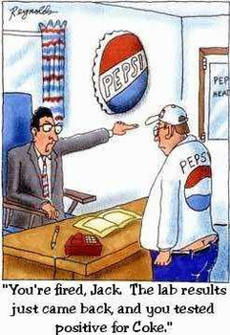

Slide 38
Drug and Alcohol Testing (6.11;R1,e)
Drug testing procedures – who gets tested:
New and readmitted students
Students who tested positive on entrance shall be retested between the 37th and 40th day after arrival on center.
Students who are suspected of using drugs at any point after arrival on center (will be ZT termination as of 05/01/2016)
Students who test positive on suspicion are retested – Will change as of 05/01/2016
Biochemical testing is never permissible on a random basis
If a student refuses to provide a specimen or has an unexcused absence from his or her follow-up drug test, he or she shall be referred to the center’s behavior management system for appropriate disciplinary action.
Students who state they are unable to produce a specimen shall be referred to the center physician or designee for follow up.

Slide 39
Change to Suspicion Screen Testing
PRH Change Notice No. 15-09 issued on 02/04/2016:
Changes for TEAP:
No suspicion intervention period
Now ANY student testing positive on suspicion at anytime will be a ZT termination
Need to educate staff/students about these change and the implications
Review new Exhibit 3-1

Slide 40
Drug/Alcohol Testing
Collection of urine for drug testing shall be in accord with chain-of-custody principles and conducted by health and wellness staff or a staff member trained in urine collection procedures.
Use the CDD.
Reinstated students shall not be subject to entry drug testing upon return to the center.
Transfer students shall not be subject to drug testing upon arrival at receiving center.
Both reinstated and transfer students shall be subject to testing for drugs upon suspicion of use only.

Slide 41
Alcohol Testing Procedures
As of 05/01/2016 – all centers will have a ‘three strikes and you are out’ alcohol policy.
PRH Change Notice No. 15-09 emphasizes holding students accountable and having proportional consequences for infractions.
There are changes that impact TEAP:
A third alcohol-use infraction (now called “Abuse of Alcohol) will result in a Level I ZT termination.
Implications:
Educate students/staff.
Intervene more quickly when students have alcohol-infractions.
Assess for substance use disorders and possible MSWR.

Slide 42
Alcohol Testing Procedures
Students who are suspected of using alcohol at any point after arrival on center are immediately tested.
Device must measure alcohol in the breath or saliva (e.g., breathalyzers or alcohol test strips/tubes/swabs).
Only administered by trained staff member (TEAP responsible for training).
All testing documented and filed in SHR.

Slide 43
Students testing positive for drug or alcohol use (6.11;R1,e(3,a)
If an intervention period takes place during a center vacation period (i.e., summer break or winter break), the intervention period is suspended and resumes the day the student is scheduled to return to the center (e.g., if a student is on day #30 of his or her intervention period at the time of the center vacation, the day count will be suspended at 30 days, and resume as day #31 the day he or she is due back on center)
Need to check CIS to determine how it was coded

Slide 44
Students testing positive for alcohol and drugs (cont.)
Readmitted students previously separated for drug use who test positive on entry or any time during their second enrollment at Job Corps are separated.
During the 45-day suspicion-intervention period, students in the driver’s education program and student drivers who fall under DOT regulations are not permitted to drive.

Slide 45
6.11;R1(e,3,d)
Students who test positive for drug use by an off-center facility are retested on center using the Job Corps nationally contracted laboratory as soon as possible, to include:
Work-based learning students who tested positive on a drug test administered by experience sites, union trades, or potential employers;
Students who tested positive on a drug test administered at a referral health facility (e.g., hospital emergency department, urgent care facility).
Student drivers who test positive for drug use under 49 CFR Part 391 DOT Federal Motor Carriers Safety Administration shall follow the same procedures outlined above for positive suspicion tests and cannot drive during this time.
Students who test positive for alcohol use on suspicion shall be referred to the TEAP specialist for assistance and the center’s student conduct system for disciplinary action.

Slide 46
Notification of Drug and Alcohol Tests
Drug and alcohol test results shall be shared only with center personnel who have a need to know for purposes of discipline, counseling, administration, and delivery of services (in accordance with 42 CFR, Part 2).
Students are informed by the TEAP specialist, center physician, or designee.
Best practice would be to notify students of both positive and negative results.
The results of the retest drug test shall be provided to the student by the 45th day after enrollment.
Alcohol test results shall be provided to the student by the person administering the test.
If a student questions the validity of a confirmed positive drug test, he or she shall be referred to the center physician or designee for counseling.

Slide 47
MSWR for Substance Use Conditions
Students may be given a MSWR for a diagnosed substance use condition, allowing the student to return to Job Corps to complete his or her training within 180 days. To return to Job Corps, proof of treatment completion from a qualified provider must be received.
A MSWR for substance use conditions can only be given if the following conditions are met:
The TEAP specialist and center director agree.
There is a documented assessment of the student’s diagnosed substance use condition by the TEAP specialist in collaboration with the center mental health consultant.
A MSWR cannot be granted in lieu of ZT separation when a positive 45-day intervention period follow-up test is reported.
If a student is placed on a MSWR during the 45-day intervention period, the intervention period is suspended and resumes the day the student is scheduled to return to the center.

Slide 48
Tobacco Use and Prevention Program (TUPP)
Centers must implement a program to prevent the onset of tobacco use and to promote tobacco-free environments and individuals.
TUPP Coordinator may or may not be TEAP Specialist.
Centers must establish a smoke-free, tobacco-free environment for the majority of the center.
Centers are encouraged to maintain an entirely tobacco-free environment, especially during the training day.

Slide 49
TUPP Requirements
All buildings and center-operated vehicles must be tobacco-free.
Tobacco products must not be sold on center.
If center operators choose to allow use of tobacco products, they must designate specific areas for tobacco use. It is required that these areas be at least 25 feet, or as required by state law, away from all building entrances.
Minor students’ access to tobacco products should be restricted as required by state law (must check your state law).
Minors who use tobacco products shall be referred to the TUPP** (not voluntary).
All services provided should be documented in the SHR.

Slide 50
TUPP Tips
Case management for tobacco cessation should be offered to all students who use tobacco products.
Designated tobacco-use areas should be located away from central locations to discourage non-smokers from congregating with smokers, and have proper receptacles.
Staff should not use tobacco in the presence of students.
Criteria for good tobacco cessation product candidates:
NOT research clear minors.
Students on Nicotine Replacement Therapy (NRT) should participate in the TUPP on center.
Students who desire to use NRT should be smoking more than 10 cigarettes per day (a half pack per day), to be eligible for the NRT program.
The students should be willing to set a date by which s/he intends to quit smoking and use NRT for support of cessation.
Finally, the NRT students should be followed weekly in the HWC to check-in with the staff and receive their one week supply of NRT.

Slide 51
More TUPP Tips
Use evidence based practices for tobacco cessation groups
example: Not on Tobacco.
Have separate groups for minors and those wanting to cease tobacco use.
Have policy for tobacco products like e-cigarettes and vape pens.

Slide 52
Guidance
Notes:
In folder

Slide 53
Comments, Questions and Concerns

