Slide 1
Job Corps Oral Health Personnel Orientation
Pamela Alston, DDS, MPP
Lead/Regional Oral Health Specialist
May 30, 2017

Slide 3
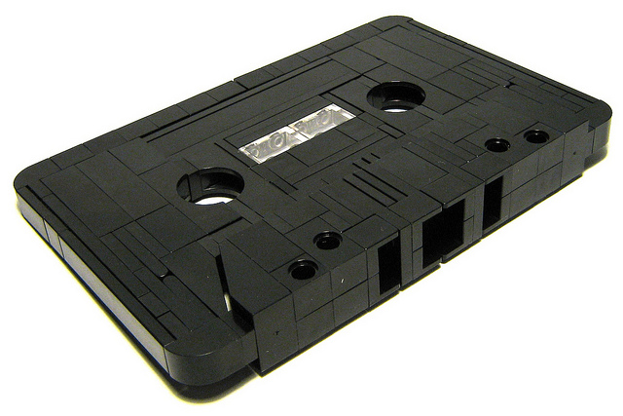

Slide 4
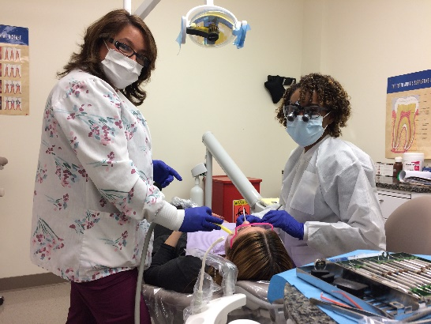
OHWP Emphasis
Early detection
Diagnosis of oral health problems
Basic oral health care
Dental hygiene
Dental disease prevention
Oral health education
PRH-6.10, R2(a)

Slide 5
Your mission should you accept it
Elevate oral health literacy levels
Motivate good oral hygiene practices
Motivate good consumerism
Motivate making healthy choices

Slide 6
Your mission should you accept it
Contribute to students’ employability

Slide 7
Oral Health and Wellness Program Delivery

Slide 8
Oral Health
Foundation for good overall health
Affects employability and employment
Affects school attendance and training
Out for reach for many

Slide 9
Low-income background
Low health literacy
Poor diets
Unavailable oral health care
Untreated oral disease

Slide 10
This webinar will:
Describe what’s expected of you
Tell you more about your mission
Share how the OHWP will be evaluated

Slide 11
Job Corps Mission
Attract eligible young adults
Train them
Teach them employability skills
Placement

Slide 12
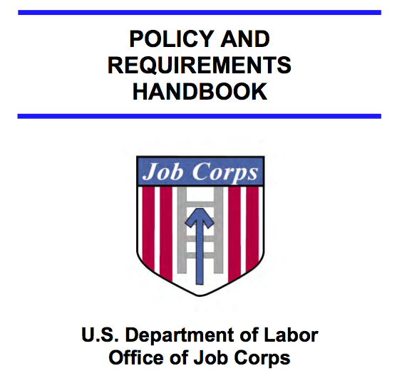
PRH-6.10, R2 Oral Health & Wellness Program
ePRH.jobcorps.gov

Slide 13
Job Corps Career Development Services System (CDSS)
Includes four CDSS periods within which health and wellness services and activities are conducted:
Outreach and Admissions (OA) Period
Career Preparation Period (CPP)
Career Development Period (CDP)
Career Transition Period (CTP)

Slide 14
Early Detection: JC Health Questionnaire
Are you under the care of a physician, dentist, or mental health professional?
How often do you go see the doctor or counselor?
In the past 2 years, have you had a serious dental problem or problems (e.g., untreated dental infections, missing teeth, unresolved severe toothaches, etc.)?

Slide 15
Basic Oral Care
Restorations
Extraction of pathological teeth
Root canal therapy on anterior and other strategic teeth
Removable prosthesis to replace missing upper anterior teeth
Nonsurgical dental hygiene care to treat periodontal disease

Slide 16
Affirmative Answers to the JC Health Questionnaire
Center File Review Team
Center dentist’s recommendation
Oral Health Specialist Review
Decision by the Regional Director

Slide 17
Early Detection Medical History Review

Slide 18
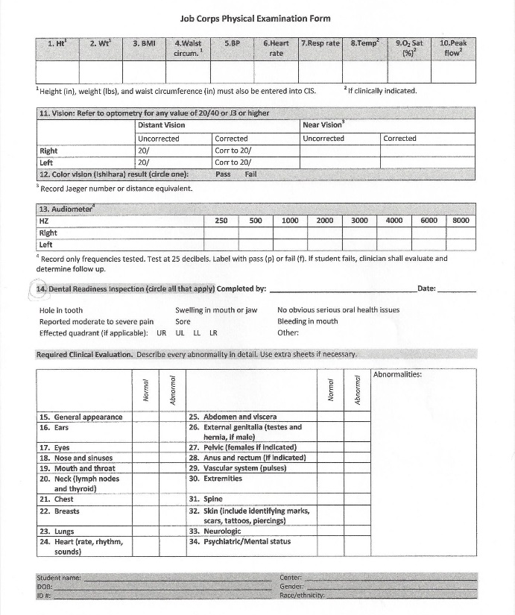
Early Detection Dental Readiness Inspection

Slide 19
Oral Exam Consent Form

Slide 20
Dental X-rays

Slide 21
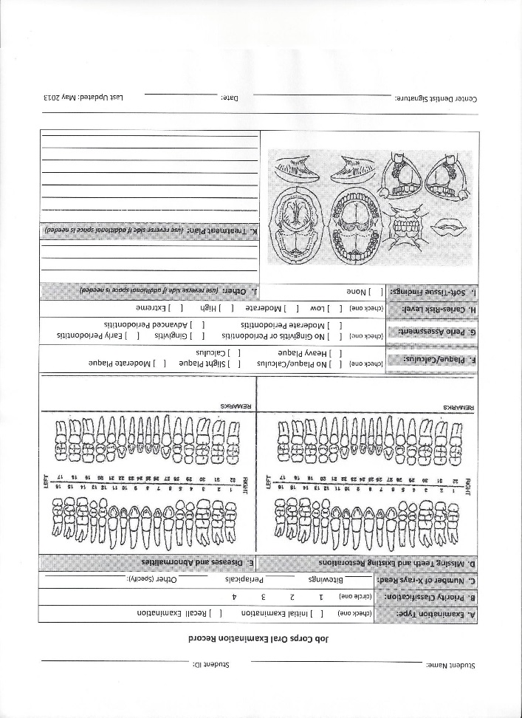
Oral Exam Form

Slide 22
Job Corps Priority Classification System of Lesions
Priority 4
Priority 4
Priority 4
Priority 3
Priority 3
Priority 2
Priority 1 or 2
Source: Andréa Ferreira Zandoná and Domenick T. Zero, “Diagnostic Tools for Early Caries Detection,” JADA, 2006, 137(12); 1675-1684, Copyright © 2006 American Dental Association. All rights reserved. Reprinted by permission.

Slide 24
Informed Consent
Summary of
treatment plan
Benefits of tx plan
Risks of not
following tx plan
Alternatives to
Tx plan
Student’s decision
Signature

Slide 25
Community Resources
Community health centers
HIS and tribal health centers
Volunteer clinics
Dental schools
Dental hygiene programs
Hospital oral surgery residency programs

Slide 26
Restorations

Slide 27
Third Molars (Wisdom Teeth)

Slide 28
Basic Oral Care
Root Canal Therapy
Stayplate

Slide 29
Dental Hygiene

Slide 30
Off-center arrangement for dental emergencies
PRH-6.10,R2(e)

Slide 31
Healthcare Guidelines
Healthcare
Guidelines
Symptomatic Management
Avulsed tooth
Oral bleeding
Oral pain
Oral infection
Knocked out tooth
Oral bleeding
Oral pain

Slide 32
Medical Separations
Interfering pre-existing condition
Complicated condition to manage
Unusually costly treatment

Slide 33
Medical Separation Types
MSWR
MS
Condition can be treated within 180 days
Can be extended
Condition not treated in 180 days
Student may reapply in 1 year

Slide 34
8. e. Do you have braces on your teeth?

Slide 35
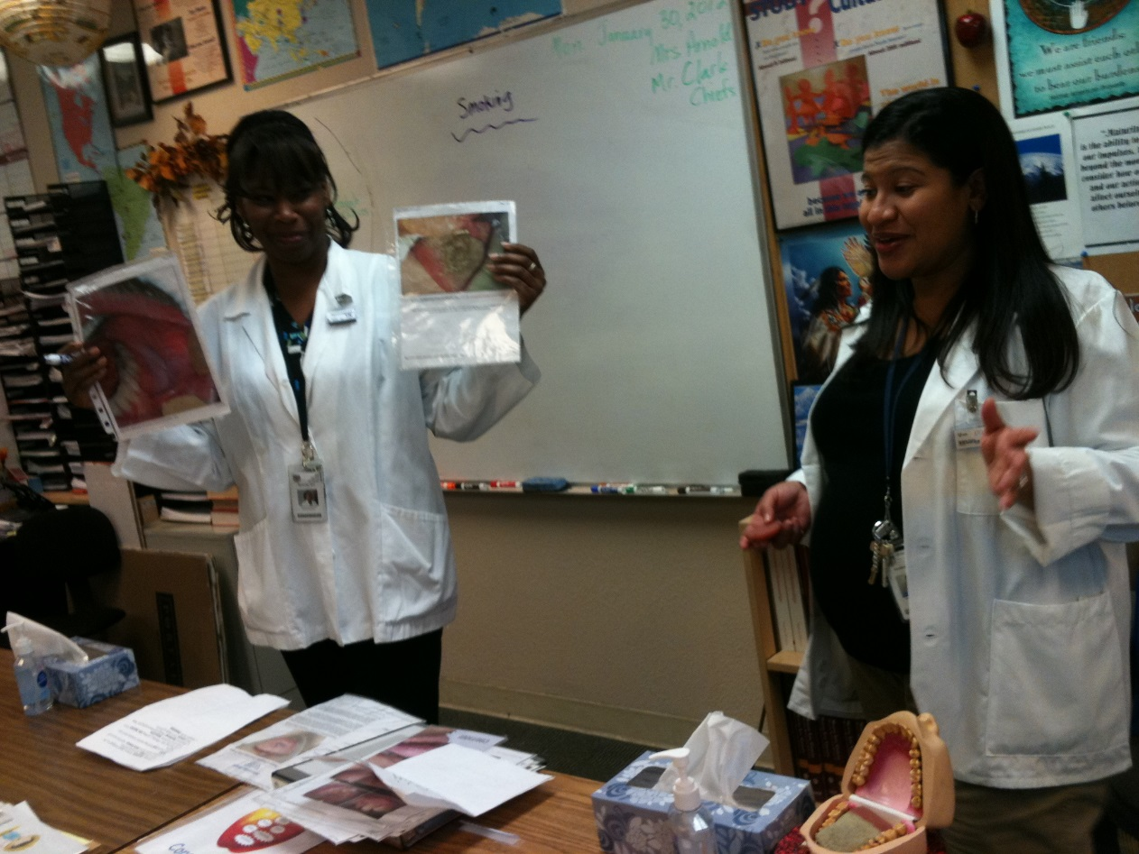
Prevention/Education
Career Preparation Period presentation

Slide 36
cdc.gov

Slide 37
Test the Autoclave at Least Weekly

Slide 38
Dental Equipment/Supplies

Slide 39
Quality Indicators
Located at the end of PRH sections
Students aware of Wellness Center
Students know how to seek care
Understand individual conditions
Understand treatment planned

Slide 40
Professional Standards of Care
Maintain licenses, registrations
Maintain current professional liability insurance
Comply with state practice acts
Document oral health encounters
Provide evidence-based care
PRH-6.12, R5

Slide 41
Program Compliance Assessments (PCAs)
Occur every 1 to 2 years
PCA team comprise Health Specialists and Assessors
Program Assessment Guide (PAG),
Policy and Requirements Handbook (PRH)

Slide 42
Health Directives
PRH Change Notices—Contain new or revised policy with instructions to delete, replace, or add pages to the PRH.
Program Instructions—Provide one-time instructions with a designated expiration date and usually require center response (e.g., survey).
Information Notices—Provide one-time announcements with information that is of interest to centers (e.g., data summaries, meeting or training announcements).

Slide 43
Job Corps Health & Wellness Website
https://supportservices.jobcorps.gov/Health/Pages/default.aspx

Slide 44
Guidance
Notes:
In folder

Slide 45
Oral Health Specialists
Provide technical assistance
Conduct center assessments
Provide training to regional and center staff
Available to answer your questions
Can help you understand policies
Assist you in meeting requirements
Conduct monthly teleconferences

Slide 46
Important Resources
PRH—The Policy and Requirements Handbook
PAG—The Program Assessment Guide
COP/SOP—Center or Standard Operating Procedures
DRG—Desk Reference Guide
Job Corps Program Instruction Notices
Oral Health personnel monthly teleconferences
Job Corps Health & Wellness website
(https://supportservices.jobcorps.gov)
Regional Oral Health Specialists

Slide 49
Life would be easier if everyone would…

