Slide 1
TEAP Hot Topics: Breathalyzers, Opiates and Elephants
Diane A. Tennies, PhD, LADC
Lead TEAP Regional Health Specialist

Slide 2
Learning Objectives
1.) Participants will be able to identify the circumstances when the medical breathalyzers are used at Job Corps.
2.) Participants will develop enhanced understanding of the implications of the opiate crisis and ways to educate staff and students.
3.) Participants will identify the characteristics of carfentanil and why it poses a risk to students (and staff).

Slide 3
TOPIC 1: Safety vs. Medical Breathalyzers
11/2016 – all centers received two Alcoblow “safety” breathalyzers to use to ensure compliance with the student conduct code (see JCDC Notice 16-093).
Information Notice 16-29 issued in 04/2017 instructed centers to ensure there was a secondary alcohol detection method available when there are medical/health concerns.

Slide 4
Information Notice: 16-29
Title: Instructions and Clarification Regarding Use of AlcoBlow Breathalyzers and Continued Use of a Secondary Alcohol Detection Method.
Centers should also maintain a secondary alcohol-detection method to use when there are health or safety concerns regarding alcohol consumption. This secondary method should allow for a quantitative measurement of the BAC.
PRH 6.11, R1 (e,2,b) indicates that acceptable alcohol-measurement devices include breathalyzers or alcohol test strips/tubes/swabs.

Slide 5
IN 16-29 (continued)
Breathalyzers are recommended, given they provide a more reliable and accurate measurement of BAC.
All breathalyzers or other alcohol detection methods should be calibrated according to the manufacturers’ required calibration schedule. Centers need to determine and follow the calibration requirements of their secondary alcohol detection method. The type of breathalyzer and calibration schedule information should be listed on the Quarterly Alcohol Report.
The center must maintain a written record any time a breathalyzer or other alcohol detection method is administered to a student. This report should be sent to the Health and Wellness Center for inclusion in the student’s health record.

Slide 6
PRH 6.11 R1 (e,2): Alcohol testing procedures
Students who are reasonably suspected of being intoxicated or consuming alcohol on center or under center supervision must be tested; this testing must take place immediately after staff suspects use.
Centers must use devices that measure alcohol in the breath or saliva (e.g., breathalyzers or alcohol test strips/tubes/swabs). Alcohol testing must only be administered by a staff member trained in the use of these testing devices. All testing must be documented and the results submitted to the health and wellness center.
If a student refuses to submit to a breathalyzer or provide a sample for alcohol testing, the student shall be presumed guilty of the Level I infraction Alcohol: Possession, consumption, or distribution while on center or under center supervision.

Slide 7
Reasonable Suspicion
How is this defined in PRH 6.11 R1 (e,2)?
“Reasonable suspicion is context specific, supported by specific and articulable facts, and may include (1) direct observation of alcohol use or behavioral signs or symptoms suggestive of alcohol use, or (2) specific reliable information that a student recently used alcohol.”
Possible Examples come from signs of intoxication.

Slide 8
Signs of Intoxication
Cognitive: mental confusion, or unresponsiveness
Gastrointestinal: nausea and/or vomiting
Behavioral: aggression and/or lack of restraint
Other Observable Symptoms: euphoria, problems with coordination, rapid involuntary eye movement, and/or slurred speech

Slide 9
Updated Process for Repeat Testing
Now recommending:
Administer test every 15 minutes until the reading is declining and the student is clinically stable. (Versus every 15 minutes until registers zero).

Slide 10
Remember
Final Step is ALWAYS documentation.
ALL administrations are to be documented and copies placed in SHR.
Also all administrations “count” when completing the Quarterly Alcohol Report (by 10th of month in October; January; April and July).

Slide 11
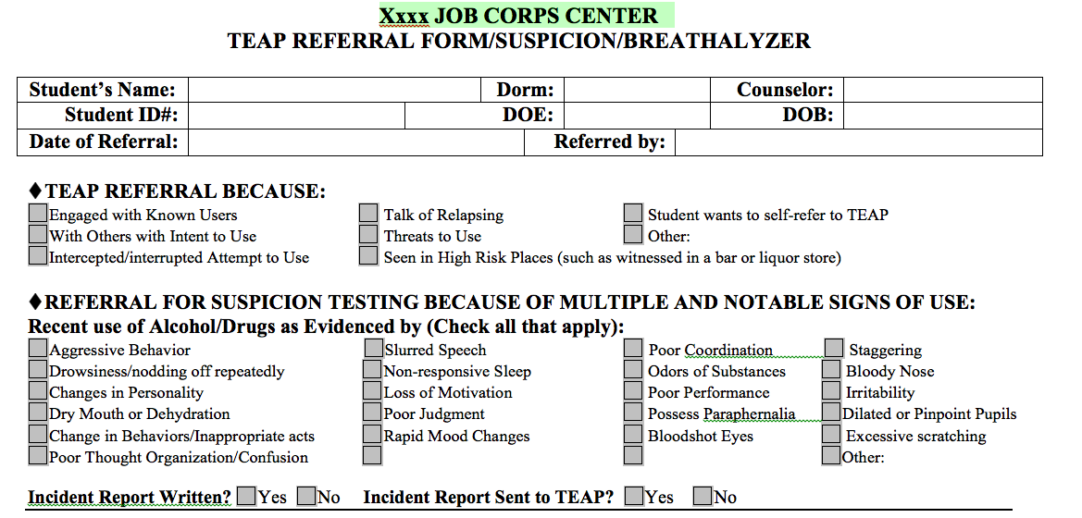

Slide 12
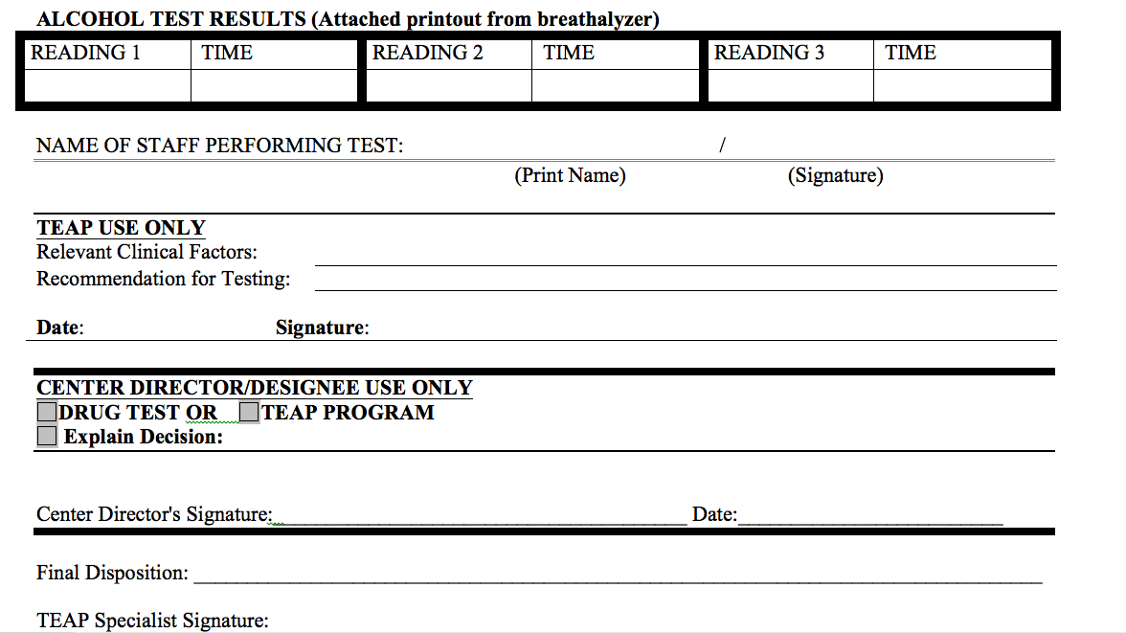

Slide 13
Topic 2: Opiates and JC
Since June 2016 - two known opiate related deaths in JC (on center).
Repeated studies have documented a strong and consistent linear relationship between opioid sales volume and morbidity (illness) and mortality (death).
Opioid-related deaths continue to accelerate.
Drug overdose now the leading cause of injury related deaths in the U.S. – more deaths than motor vehicle crashes.
This constitutes a national epidemic and public health emergency.

Slide 14
Opioid Basics
Opioids are a class of drugs that include the illicit drug heroin as well as the licit prescription pain relievers oxycodone, hydrocodone, codeine, morphine, fentanyl and others.
Opioids are chemically-related and interact with opioid receptors on nerve cells in the brain and nervous system to produce pleasurable effects and relieve pain.
Addiction is a primary, chronic and relapsing brain disease characterized by an individual pathologically pursuing reward and/or relief by substance use and other behaviors.
It is estimated that 23% of individuals who use heroin develop opioid addiction.

Slide 15
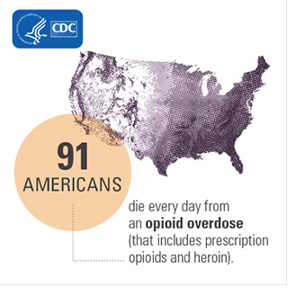
Human Impact in 2015
More than 33,000 people per year

Slide 18
Summary of Management of Opiates at Job Corps
Three Pronged Approach:
Importance of updated knowledge to educate staff and students
Updating suspicion screen/TEAP Referral form
Availability of Naloxone/Narcan for front line staff

Slide 19
Prong 1: Educating Staff and Students
Schedule regular training with ALL staff (especially front line – security/safety and residential)
Do your research/utilize TEAP specialist
Center-wide education/prevention activities
Reputable resources:
SAMHSA
NIDA: Drugabuse.gov
ASAM (American Society of Addiction Medicine)
AAFP (American Academy of Family Physicians)
Centeronaddiction.org
CDC.gov
Many others – just search

Slide 20
Prong 2: Suspicion Screen/TEAP Referral Form
Include opioid-related symptoms

Slide 21
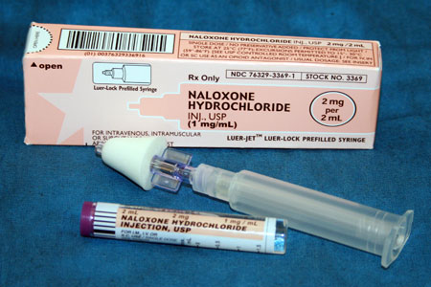
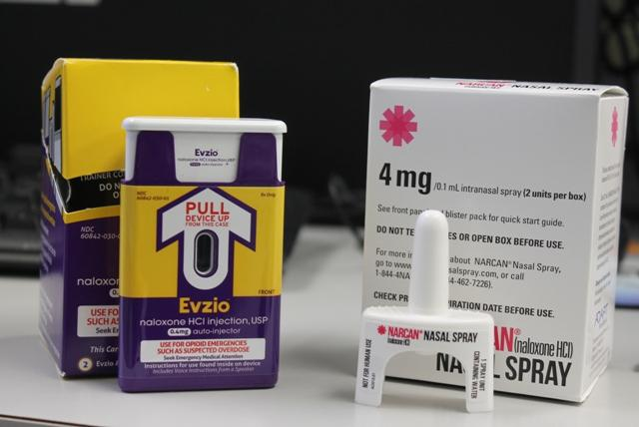
Prong 3: Narcan
Availability
Naloxone administration options

Slide 22
Information Notice 16:10
Guidance on stocking emergency supplies:
Per PRH 6.12, R14(a), Equipment and Supplies, centers should maintain emergency response kits.
A minimum of two kits are recommended to be maintained on center – one in the Health-and-Wellness Center, and one in Safety and Security with 24/7 access.
Each kit should include the suggested one, two-dose supply of Narcan, at least. Be sure to monitor expiration dates.
Other recommended items that should be in the emergency response kits include: airways and an Ambu bag, supplemental oxygen and an Automated External Defibrillator (AED), if available. Staff training in first aid/CPR should include training health and non-health staff in responding to overdoses.

Slide 23
Naloxone (Narcan®)
Retail cost:
Naloxone hydrochloride for IM injection - $11/vial or $24/nasal kit
Narcan® nasal spray - $125 for 2 doses
Evzio® auto injector with voice instructions - $3,750 per 2 dose pack
HHS Supply Service Center Perry Point MD
Low cost or no cost alternatives in your community/state

Slide 24
When Should Naloxone Be Administered?
Unconscious individual with obvious signs of recent drug use - “works”/paraphernalia
Individual exhibiting symptoms of the opioid overdose triad - check pupils, breathing, level of consciousness
Unconscious individual with known history of opioid abuse, including patients currently on “medication assisted treatment” (MAT) for opioid dependence
Self-report of opioid use in a conscious individual developing symptoms of opioid overdose

Slide 25
Time to Intervene
With opioid overdoses, the difference between surviving and dying depends on breathing and oxygen.
An opioid overdose death is rarely instantaneous; people slowly stop breathing after the drug Is used.
There may be time to intervene between when an overdose occurs and a victim dies.
Furthermore, not all overdoses are fatal. Without any intervention, some overdose victims may become unresponsive with slowed breathing, but will still take in enough oxygen to survive and wake up.

Slide 26
What if Naloxone is Mistakenly Administered?
No adverse effects in a healthy individual.
No altered mental status.
Not shown to produce tolerance or cause physical or psychological dependence.
When administered in usual doses in the absence of opioids, naloxone exhibits essentially no pharmacologic activity.

Slide 27
TOPIC 3: Carfentanil

Slide 28
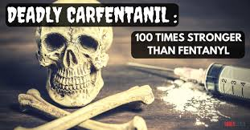
Public Health Emergency
Carfentanil is an extremely potent synthetic fentanyl analogue that is supposed to be highly restricted for veterinary use for the tranquilizing of large animals, such as elephants.
It is not approved for use in humans.
First synthesized in 1974 at Janssen Pharmaceutics.
Same drug class as other opioids such as heroin, fentanyl, and prescription drugs like Oxycodone.
100 times more powerful than Fentanyl.
Creates more potent and deadly high.
Raises serious concerns for the possibility of unintentional overdoses.

Slide 29
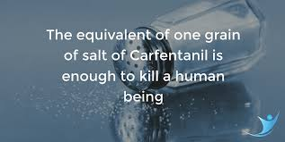

Slide 30
Job Corps Management Suggestions
Importance of updated knowledge to educate and train staff and students.
Symptom onset is rapid and from multiple exposures: IV, oral and inhalation.
Symptoms similar to other opioids, only more extreme and more rapid.
Recommend extreme caution when handling unknown substances (e.g., gloves).
Immediate access to Grab and Go Kit.

Slide 31
Learning Objectives: Revisited
1.) Participants will be able to identify the circumstances when the medical breathalyzers are used at Job Corps.
Have secondary detection method that is quantitative; trained staff test based on reasonable suspicion; and document in SHR.
2.) Participants will develop enhanced understanding of the implications of the opiate crisis and ways to educate staff and students.
Education/training is critical; update suspicious screen process and have Narcan immediately available.
3.) Participants will identify the characteristics of carfentanil and why it poses a risk to students (and staff).
Lethal in minute amounts; educate/train staff and use extreme caution if unknown substance.

Slide 32
Wrapping Up

