Slide 1

Center Mental Health Consultant (CMHC)
Orientation to Job Corps
Valerie Cherry, PhD
Lead Mental Health Specialist
Notes:
Thank you for joining the webinar today and welcome to the Job Corps family. This will be one of the most rewarding and challenging jobs you probably have had. Challenging in that you are learning a new organizational system, working with youth that have substantial life histories, and of course learning all of the acronyms we use. It will be the most rewarding as you have the opportunity to help young people navigate their mental health issues in a positive direction and develop coping skills to last a life time as they become employable individuals.
Before we get started –type the number of months or years you have been with Job Corps in the chat box so I have some idea of who is on the webinar today.
Let’s get started! STOP

Slide 2
CHAT BOX
How long have you been with Job Corps?
What game can be dangerous to your mental health?
Marbles, you don't want to lose them.

Slide 3

Job Corps’ Mission
As a national, primarily residential training program, Job Corps' mission is to attract eligible young adults, teach them the skills they need to become employable and independent, and place them in meaningful jobs, higher education, or the military.
Notes:
Job Corps is the nation’s largest residential, educational, and career technical training program for economically challenged young adults aged 16 to 24. There is no upper age limit for individuals with disabilities who are otherwise eligible. Job Corps' mission is to attract eligible young adults, teach them the skills they need to become employable and independent, and place them in meaningful jobs, higher education, or the military. Health and Wellness’ role is to support this mission by maintaining youth with manageable health conditions on center.

Slide 4
Regional Health Specialists (RHS)
Provide technical assistance to center health staff
Conduct center assessments
Provide training to regional and center staff
Available to answer your questions
Can help you understand policies
Provide up-to-date information that will assist you in your efforts to meet program requirements
Conduct monthly teleconferences
Notes:
Job Corps has 6 regional offices– Boston ( PR), Philadelphia, Atlanta, Dallas, Chicago, and San Francisco (Alaska and Hawaii). If you are not sure which region you belong to, I have a slide at the end of the presentation that will help. Every Regional Office has a regional nurse specialist, (RNS), regional medical specialist (RMS), regional mental health specialist (RMHS), regional trainee employee assistance (TEAP) specialists, regional dental specialists (RDS), and regional disability coordinators (RDCs). Your RMHS provides technical assistance to you and other center health and wellness staff members, conducts monthly teleconferences with the center mental health consultants in their region, and conduct periodic center assessments for quality and compliance with the Policy and Requirements Handbook ( ePRH).
If you know the name of your RMHS, type it in the box.

Slide 5
Program Compliance Assessments (PCAs)
Assessors and Regional Health Specialist conduct biannual compliance assessments to evaluate the delivery of Health and Wellness Program services on centers in accordance with Federal and state laws and regulations, as well as requirements in PRH Sections 6.10, 6.11, and 6.12.
Assessments will be conducted on a schedule set by the National Office of Job Corps
Notes:
Program Compliance Assessments are much like the accreditation reviews that occur at health facilities nationwide. They provide an opportunity for you to highlight the strengths of your program and for Assessors and RHSs to provide feedback about areas that could be changed or improved. You can expect to have student health records, appointment books, and other records audited during this assessment. There are Pre-PCA forms and a PCA tool available to help you prepare for the PCA on the Job Corps Health and Wellness website.- I suggest as you are preparing for your first PCA- reach out to your RMHS.

Slide 6
Important Resources
ePRH—The Policy and Requirements Handbook
PAG—The Program Assessment Guide
COP/SOP—Center or Standard Operating Procedures
DRG—Desk Reference Guide
TAGs—Technical Assistance Guides
Notes:
There are several important documents that each have their own acronym that you should be aware of and access. These include:
ePRH—The Policy and Requirements Handbook - The ePRH contains the rules by which all centers operate; I will talk more about this later. It is electronic and be found by simply typing in Job Corps ePRH in your search engine. PAG—The Program Assessment Guide- The Program Assessment Guide (PAG) is used for assessments and your mental health program is rated on these quality measures on a scale from 0-9 (unsatisfactory to exceptional). The student focus groups and individual student interviews during center assessments provide much of the basis for these quality ratings. Examples of quality measures are:
Q1. Students are aware of the center’s health care delivery system and understand how to seek on-center health care..
Q2. Students demonstrate a clear understanding of their individual health condition and treatment prescribed
Q3. Students’ health status will be maintained or improved while they are at Job Corps.
COP/SOP—Center or Standard Operating Procedures are specific to your center and outline the procedures to be used to address various issues including:
Student Death, Mental Health Emergencies, Suicide Threats, Sexual Assault- Ask your HWM about these.
DRG—Desk Reference Guide. Which I will talk about later.
TAGs—Technical Assistance Guides. TAGs can be found on the Job Corps Health and Wellness Web site, under the documents tab. The Mental Health TAG is Mental Health Disabilities TAG. Provides technical assistance to the disability coordinator, center mental health consultant, health and wellness manager, career counselor, and center physician to provide assistance with reasonable accommodation, case management, and psychotropic medication issues.

Slide 7
Health Directives
ePRH Change Notices—Contain new or revised policy with instructions to delete, replace, or add pages to the ePRH
Program Instructions—Provide one-time instructions with a designated expiration date and usually require center response (e.g., survey)
Information Notices—Provide one-time announcements with information that is of interest to centers (e.g., data summaries, meeting or training announcement)
Notes:
From time to time the National Office distributes changes, updates, and general program information. Read slide. They will be distributed as one of these directives.
Example of a ePRH change notice would be when we increased the CMHC hours from 6 to 9 –all cents required to make the increase
Program Instruction- PI 07-16: Additional Guidance and Form for Direct-Threat Assessments Attachment: 07-16a Release Date: December 11, 2007
Information Notice= IN 17-25 Upcoming Observances Related to the Mental Health-and-Wellness Program
Release Date: March 7, 2018-

Slide 8
Job Corps Career
Development Services System (CDSS)
Includes four CDSS periods within which health and wellness services and activities are conducted:
  Outreach and Admissions (OA) Period
  Career Preparation Period (CPP)
  Career Development Period (CDP)
  Career Transition Period (CTP)
Notes:
The Job Corps Career Development Services System (CDSS) is a comprehensive and integrated career management system- again with lots of acronyms. There are four CDSS periods within which health and wellness services and activities are conducted:
Outreach and Admissions (OA) Period—OA staff members explain to applicants the kinds of health and wellness services available at center and review requests for accommodations during the admissions process/
Career Preparation Period (CPP)—The CPP ensures that students are introduced to health and wellness services, are provided accommodations to fully participate in program offerings, and, if appropriate, understand and feel supported by Trainee Employee Assistance Program (TEAP) services. As the CMHC you should provide a minimum of a 1-hour presentation on mental health services available on center and brief gatekeeper training on how to recognize and respond to a mental health crisis.
Career Development Period (CDP)—The CDP ensures that career management teams coordinate with health services on health-related issues, and students perceive good health as being critical to achieving career goals.
Career Transition Period (CTP)—The CTP ensures that students understand health-related aspects of independent living, students with special needs have systems in place to support transition to and retention of employment, and post-center service providers know how to coordinate with Job Corps when needed to help graduates succeed. The Career Transition Period (CTP) is an excellent time to talk with students about life after Job Corps as well as how and where to obtain mental health services after leaving Job Corps – including medication where applicable.

Slide 9

Congratulations!
You are now responsible for a program on center!
Mental Health and Wellness Program (MHWP)
Notes:
So, congratulations You are not just the center mental health consultant, you have a program to coordinate. There is more to what you do than provide clinical services. So let’s focus on the overall goal and components of the MHWP. But before we get started, please understand that it may take up to a year to develop your MHWP and figure out how to do the tasks with limited hours. Also, it is not uncommon for you to spend the bulk of your time in direct service to students, especially if the center has been without a CMHC for awhile.

Slide 10

Notes:
Please type questions in the chat box as I go along and you can ask questions at the end of the webinar.

Slide 11
Job Corps
Health & Wellness Website
Designed for Job Corps health and wellness staff—use it to connect with your peers, get the latest information on new initiatives and training events, learn about the health and wellness program, and link to related resources
https://supportservices.jobcorps.gov/Health/Pages/default.aspx
CONNECT FROM ANYWHERE!
Notes:
This is an important slide – Here is the link to the JC Health and Wellness website that you can access from your home, your office…anywhere. This is your resource center forms, copies of previous trainings/webinars, latest JC information, etc.

Slide 12
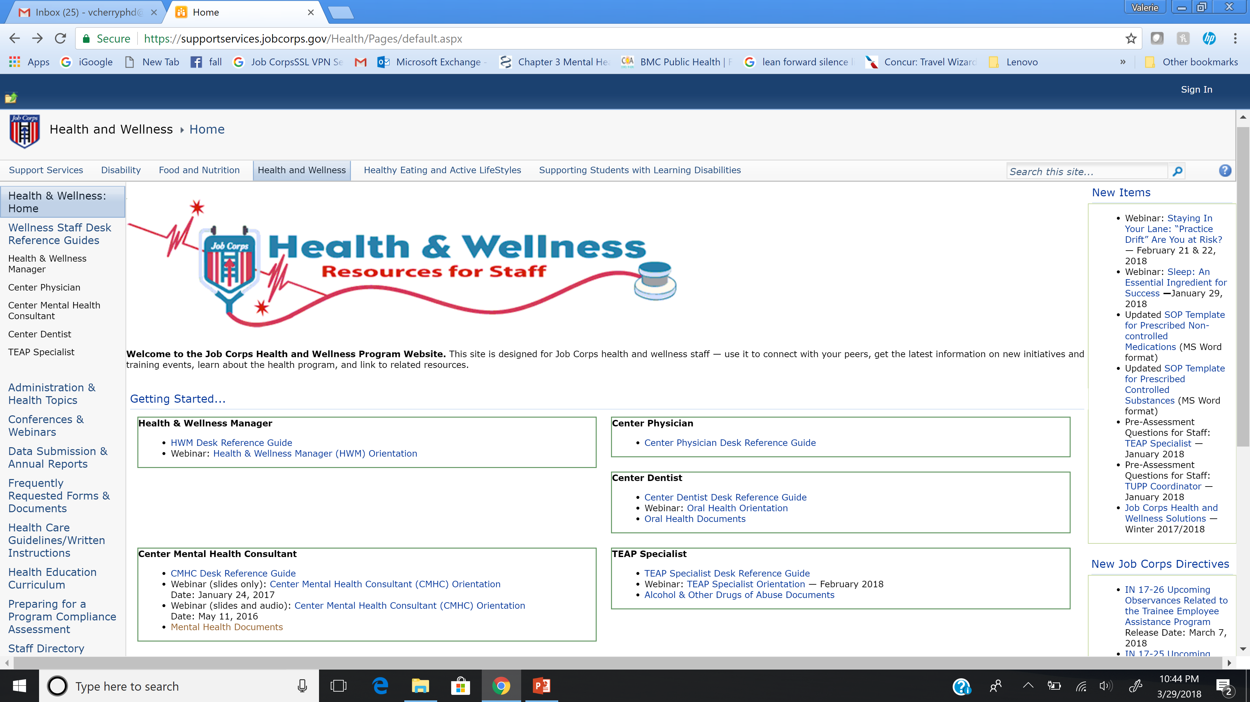

Slide 13
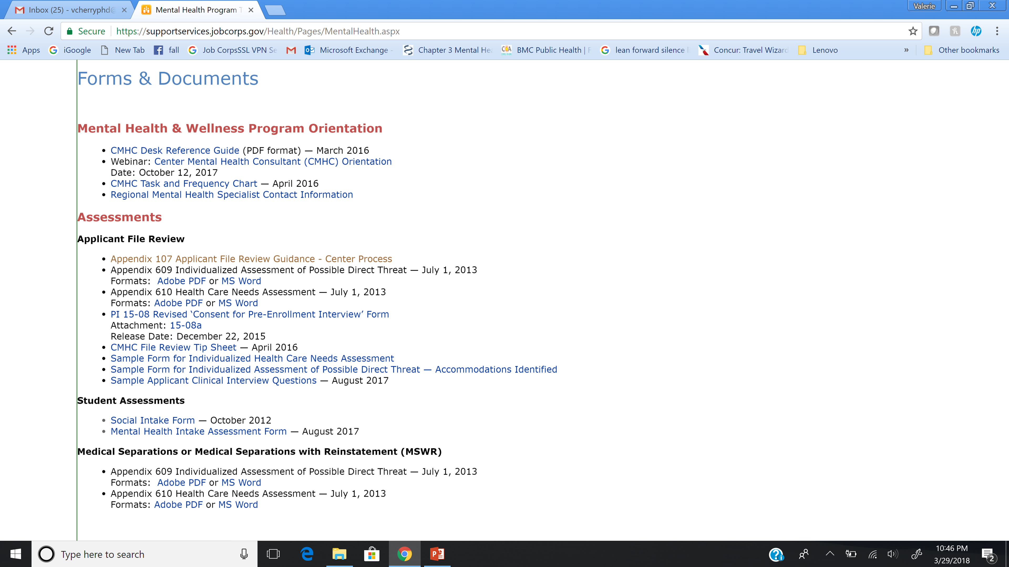

Slide 14
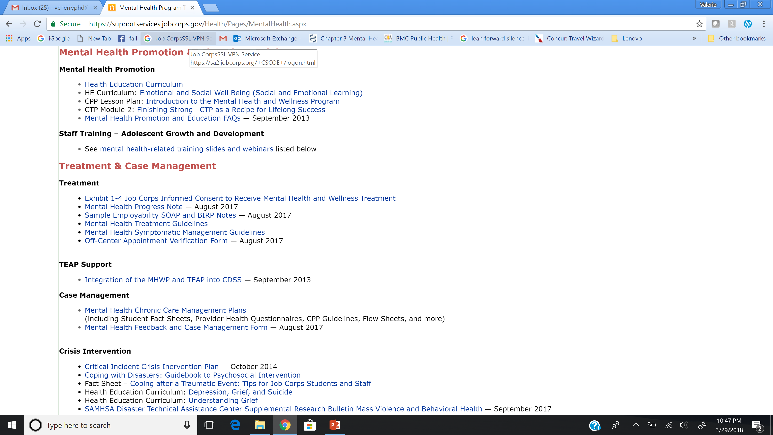

Slide 15
Mental Health and
Wellness Program
The general emphasis of the MHWP is on:
Early identification and diagnosis of mental health problems – True or False?
Basic mental health care – True or False?
Mental health promotion and education designed to help students overcome barriers to employability – True or False?
Helping students learn strategies to finish program and become employed – True or False?
Notes:
Type in the chat box if it is true or false All are true! ☺ No tricks this time.
Program includes the early identification and diagnosis of mental health problems, basic mental health care, and mental health promotion, prevention, and education designed to help students overcome barriers to employability.
The program utilizes an employee assistance program (EAP) approach that includes short-term counseling with an employability focus, referral to center support groups, and crisis intervention.

Slide 16
Who Can Coordinate the MHWP?
The Center Mental Health Consultant (CMHC)
  Independent practitioner licensed as a clinical/counseling psychologist or clinical social worker in the state of the Job Corps center where you are providing services
The minimum staffing pattern is 9 hours per 100 students per week
  For instance, if the on board strength (OBS) of your center is 300, you would be expected to work at least 27 hours each week on center
Notes:
Psychologist or social worker are the professionals for the CMHC position as outlined in the ePRH but individuals who possess another mental health license (LPC, LMFT) and are able to practice independently in the state, may be hired with a one time waiver through the National Office since these licenses are not specifically covered by the ePRH.
. Nine hours/100 students/week is the minimum required level of mental health coverage by a qualified licensed mental health professional. While this may not seem like a lot. It used to be 3 hours per 100, then it went to 4, then 6 and now 9. We are always requesting additional hours, but until then, you have to work with what we have. This is the minimum.

Slide 17
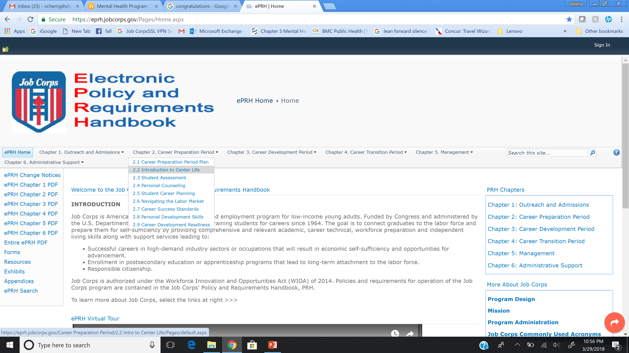
How Do You Do This?
https://eprh.jobcorps.gov/Pages/Home.aspx
Notes:
So how do you do this job - Begin with the Policy and Requirements Handbook- This can be found on the website at the address listed on the slide, but you can ask your HWM to show you.
It is a huge document- There are 6 chapters. You should focus on reading Chapter 6 (Sections 6.10-6.12) which provides policy on ensuring students receive health and wellness services, support, and education that will enhance their employability and encourage and maintain a healthy lifestyle. The other is Chapter 1 (Appendix 107 which outlines the steps in completing applicant file reviews and how to make recommendations of denial).

Slide 18
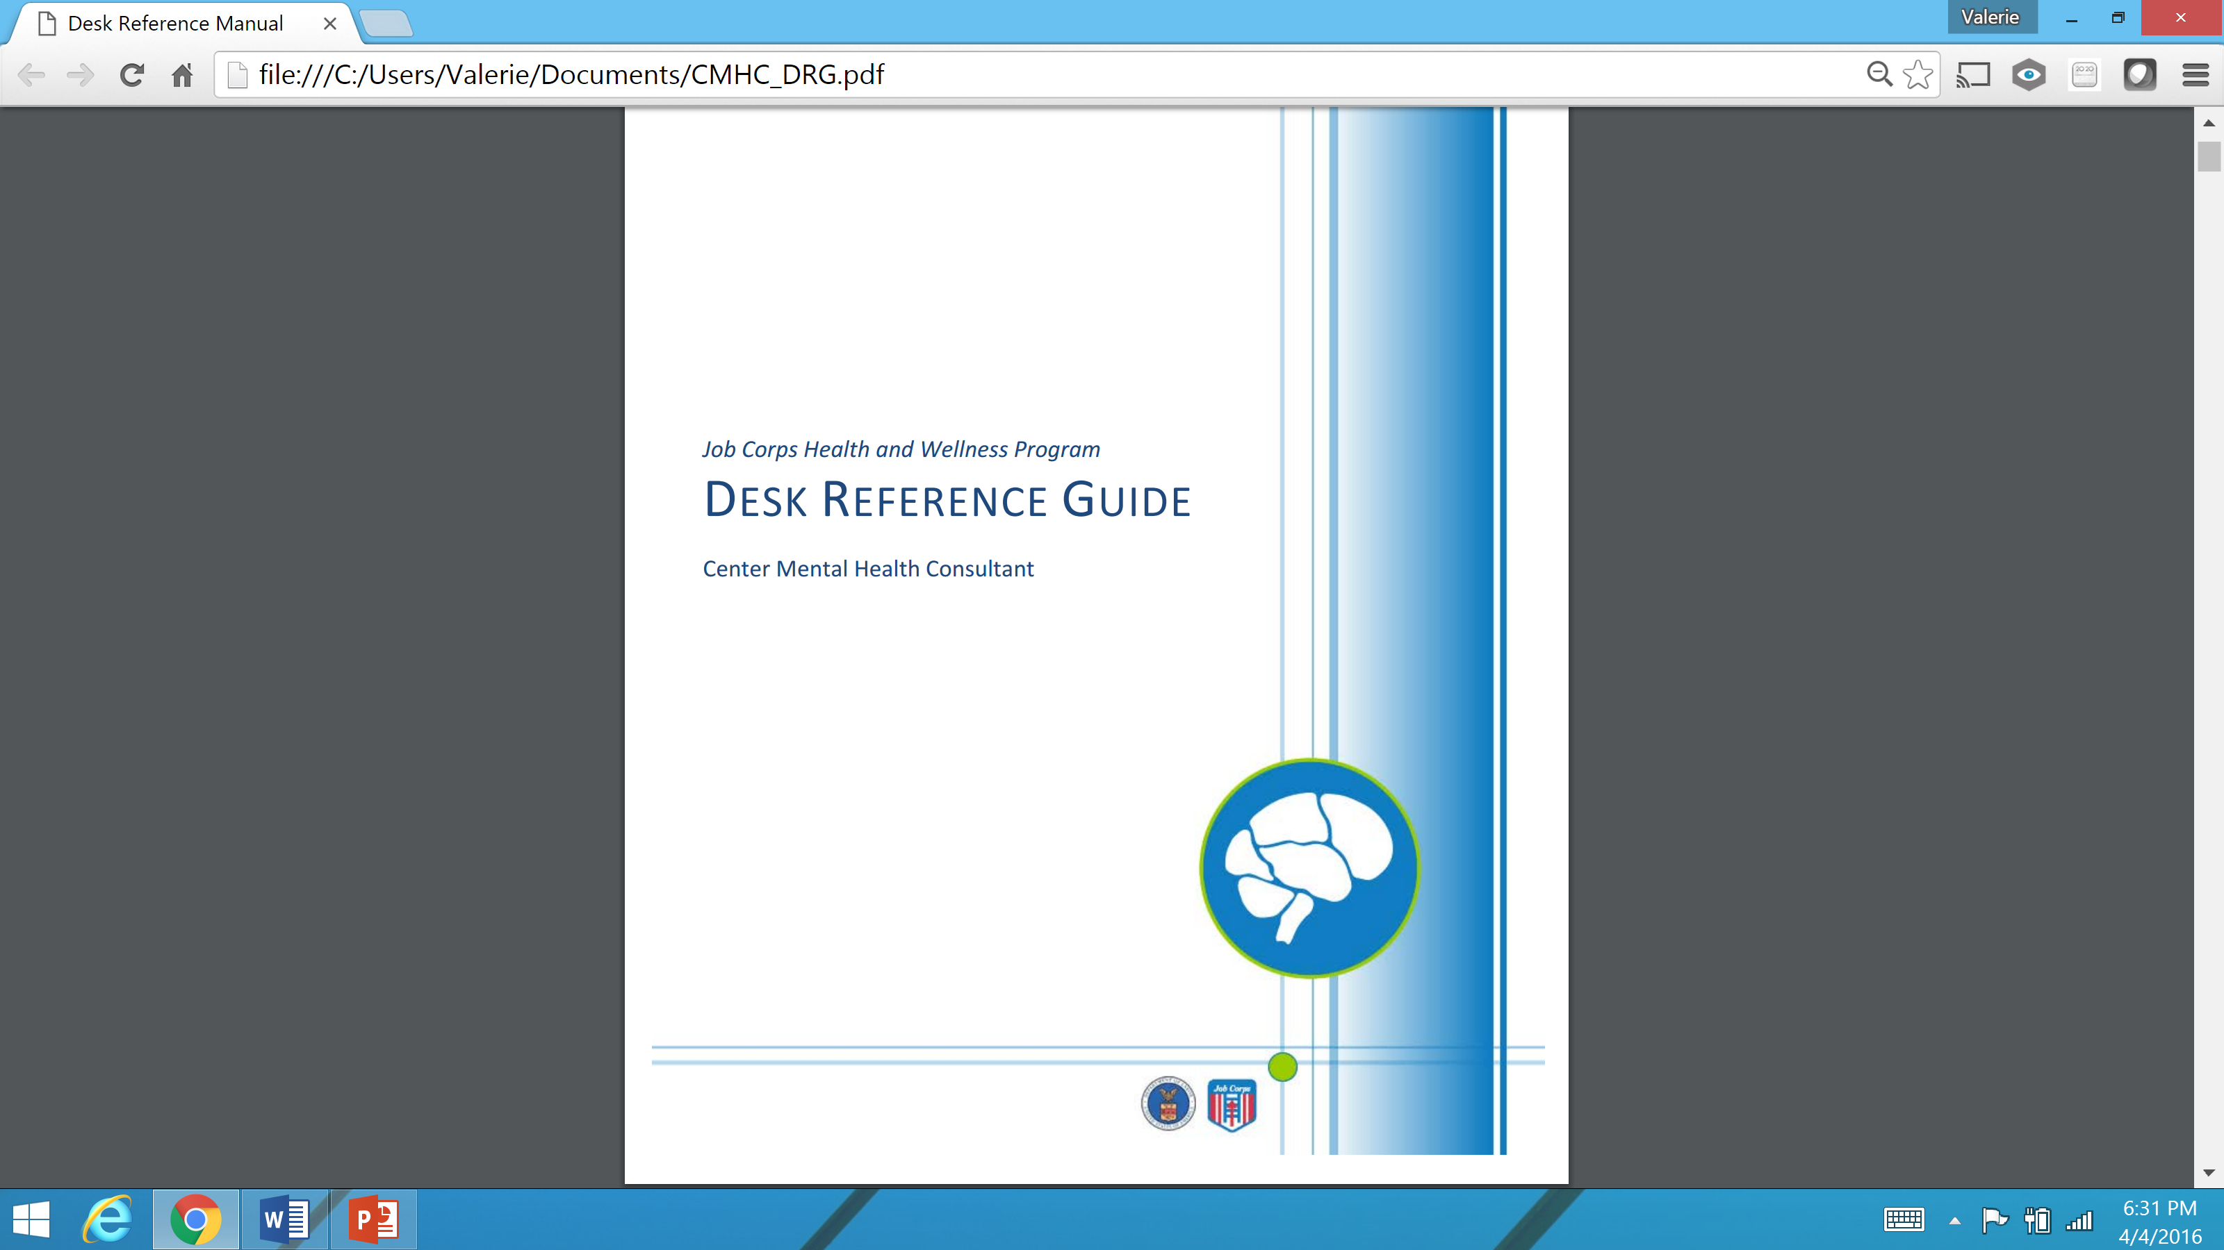
Specific Guidance
Notes:
CMHC DRG
The Desk Reference Guide (DRG) for the Center Mental Health Consultant is a valuable reference and can be downloaded from the Health and Wellness Website under the MH section. Among other useful information, it includes sample templates that you can use that can be downloaded and copied to assist with documentation of student services. Type yes or no in the chat box if you have access to this DRG.

Slide 19

Mental Health and Wellness Program Overview
ePRH 6.10, R3:
Three main components of the MHWP
  Assessment
  Mental Health Promotion and Education
  Treatment
Notes:
You can conceptualize the MHWP and your tasks in 3 areas – Assessment, MH Promotion and Education and Treatment

Slide 20

assessment
ePRH 6.10 R3 (b)
Notes:
The next slide outlines the different assessment needs on center.

Slide 21

Assessment
Evaluation of Applicant Folders
  Appendix 609—Direct Threat Assessments
  Appendix 610—Health Care Needs Assessments
Contact your RMHS
Notes:
Assessment includes:
Evaluation of Applicant Folders
Reviewing applicant file folders is an important part of your job as a CMHC. The resources listed on this slide will help provide additional information to guide you with your assessments. The HWM will forward files to you of applicants who report mental health and/or behavioral problems on the Job Corps Health Questionnaire (ETA 6-53). In addition to reviewing the file, you should interview the applicant by phone or schedule a face-to-face interview. An interview is particularly helpful when you have outdated information and need to assess the applicant’s present mental status, current stability, and general functioning.
The goal of your review is:
To evaluate the information contained in the folder and make a clinical recommendation about the current stability of the applicant’s mental health and Job Corps’ ability to provide care management.
To determine if the applicant poses a direct threat to self or others that cannot be alleviated with reasonable accommodation. If indicated, you will complete the Direct Threat Assessment form (ePRH Chapter 6, Appendix 609).
To determine whether the applicant’s health care needs are manageable at Job Corps or whether, even with reasonable accommodations, the needs are beyond Job Corps’ basic health care responsibilities. If indicated, complete the Health Care Needs Assessment form (ePRH Chapter 6, Appendix 610).
Your role is as a consultant and you can only make recommendations regarding applicant files. The center director will review your recommendation and then send this assessment to the Regional Office for final decision. This is an entire webinar on its own. Please contact your RMHSs when you are ready to complete your first recommendation for denial.

Slide 22
Assessment
Social Intake Form—review within 1 week
  To identify high risk students so effective and rapid interventions are implemented.
Intake assessments of referred students
  There are sample intake assessment forms in the CMHC DRG
  Consider use of evidenced based screening measures
    http://www.integration.samhsa.gov/clinical-practice/screening-tools
Notes:
One way to prevent a problem from escalating to a serious crisis is to plan for early intervention. Job Corps has several systems in place to help identify students that may need early intervention and support for mental health issues— the Social intake Form, the Intake Assessment and Medical Separations/MSWRs.
The Social Intake Form (SIF) –Career counselors are required to conduct an intake assessment, including student history, during the first 48 hours of enrollment. Typically this is the SIF. It is required that you review the SIF of students who indicate mental health history, current mental health problems, or who request to see the CMHC, within 1 week of arrival. Make recommendations/referrals if indicated, and sign that the form has been reviewed. When completed, the form should be filed in the student health record
You will also complete assessments on newly referred students and provide feedback to the referral source. There is a sample intake assessment form in the DRG. Not a requirement, but when appropriate when you are trying to make diagnostic decisions you may want to include specific evidenced based measures recommended by DSM 5 or you can find a list provided by SAMHSA of FREE tools at the link on the slide.
There is also Patient Health Questionnaire (PHQ-9) is the most common screening tool to identify depression. It is available in Spanish, as well as in a modified version for adolescents,
GAD-7 (Generalized Anxiety Disorder) is a 7-question screening tool that identifies whether a complete assessment for anxiety is indicated.
The Columbia-Suicide Severity Rating Scale (C-SSRS) Tools that cost - Beck Depression Inventory (BDI)-II. The BDI-II is a 21-item instrument for detecting depression that can be completed by adolescents aged 13 years and older.

Slide 23
Assessment
Assessment of Need for Medical Separation
  Medical Separation with Reinstatement (MSWR)
    Up to 6 months
  Medical Separation (straight separation)
    Can reapply after 1 year
  Use of Appendix 609 Direct Threat and Appendix 610 Health Care Needs Assessments
  See ePRH 6.12, R11 for more information on medical separations
Notes:
You will be asked to assess and make a recommendation about medical separations or MSWRs for students with mental health needs who require a higher level of care. While not a requirement, it is strongly suggested that you use the assessments listed on the slide to assist in making determinations about medical leave or separations when a student is not in agreement with a MSWR.
There are 2 types of separations- the majority of our MH separations are MSWRs that allow the student to return and pick up where they left off in the program.

Slide 24

Promotion and education
ePRH 6.10, R3 (c)
Notes:
Mental health promotion and student education expectations for the CMHC are reviewed in the next section. But lets just review your tasks for assessments-
Applicant file reviews
Review of SIFs
Intake assessment of referred students
Medical/MSWR separations.

Slide 25

Begins in CPP
1-hour presentation for all new students during CPP with 2 parts:
  Explain the mental health and wellness program, the services available, and how to make a self-referral?
  Provide students with basic skills in identifying and responding to a mental health crisis?
CPP Lesson Plan in CMHC DRG
Notes:
MH promotion and education begins in CPP. Typically there is a set time during a students first or second week, where you will make this presentation. Good news is we have developed the presentation for you and it can be found on the Job Corps health and Wellness website under the tab MH Promotion and Education Tab on the MH section.

Slide 26
Center Wide Activity
ePRH requires ONE center wide activity per year that increases mental health awareness
Collaborate with HWM and TEAP specialist
  May is Mental Health Awareness Month
  September is National Recovery Month
  September 7-13 is National Suicide Prevention Week
  October is National Bullying Prevention Month
Notes:
There should be a center wide emphasis on preventing mental health problems through providing students with education on how to deal with stress, recognizing signs of depression, and helping them learn when to ask for help. This can be done in a variety of ways, including working with health and wellness staff to hold an annual center-wide activity like celebrating May is Mental Health Month with a health fair or special presentation during student assemblies or a table in the cafeteria with MH brochures.. The TEAP specialist is also required to do center wide activities so consider a joint event.

Slide 27

Promotion And Education
Marketing Mental Health and Wellness
  Include posters in the dorms, cafeteria, classrooms, and hallways advertising mental health and wellness services
  Be visible on center: walk around, introduce yourself to students
  Include pamphlets and flyers in your office and in the health and wellness center waiting area
  Get free items from SAMHSA www.store.samhsa.gov
Notes:
All students should be familiar with the mental health and wellness program and how to access it. This can be accomplished through presentations to students during introduction to center life, handing out brochures, and supporting major mental health prevention initiatives on center like “National Depression Screening Day” or “World Mental Health Day.” The Substance Abuse and Mental Health Services Administration (SAMHSA) is an excellent resource for current information and reproducible materials.

Slide 28
Clinical Consultation and Coordination
The CMHC is required to:
  Consult with the center director, management staff, and health and wellness manager regarding mental health-related promotion and education efforts for students and staff
  Coordinate with other departments/programs on center, including, but not limited, to residential, recreation, student government association, and HEALs, to develop integrated promotion and education services
  Take lead on MH prevention activities
  Develop support and alliances for assistance
*Written documentation of the above is required
Notes:
Another important part of your role is to provide training opportunities for staff and to consult with other departments to promote a positive center environment The CMHC is required to meet with the center director once a month as well as the health and wellness manager to discuss clinical and training issues. During these meetings, trends in student health needs can be recognized and addressed, trainings for students and staff can be discussed and approved. changes or modification to the health care guidelines for staff can be discussed and approved, and health-related policies can be reviewed. Meeting minutes should be maintained and available for review during a PCA to include documentation of attendees and items discussed.
Staff development is enhanced when you work with staff members from other departments individually or in groups on applied topics. For example, you may discuss potential mental health problems encountered in the dormitories with residential living staff. Written documentation of these meetings and trainings should be maintained.
Integration of Prevention/Education via coordination with:
HEALs
SGA
Residential
Recreation
Who else?

Slide 29
Adolescent Growth and Development Staff Trainings
Minimum required five hours of annual training in adolescent growth and development for all staff.
  Effective communications, anger management, sexuality, suicide prevention, appropriate staff/student boundaries, and related social skills training, crisis intervention techniques, and safety issues.
  Trainings from previous webinars:
    https://supportservices.jobcorps.gov/Health/Pages/MentalHealth.aspx#webinars
  Work with Human Resources and consider community agencies to provide trainings as well.
Notes:
All Job Corps employees are required to complete trainings when they begin employment. In addition to required training, all Job Corps employees are required to complete 5 hours of annual training on adolescent growth and development. Sample topics are on the slide. You can contribute to adolescent growth and development staff training requirements through use of previous webinar trainings found on the Health and Wellness website
CMHCs are not expected to conduct all of these training but are encouraged to work with HR in making sure these hours are met---the CMHC may conduct the trainings or help arrange for speakers, videos, etc. Make sure HR documents as part of the Adolescent Growth Development trainings

Slide 30
Staff Training Resources
Health and Wellness website contains trainings you can access and edit for your use. https://supportservices.jobcorps.gov/health/Pages/Conferences.aspx
SafetyNet Toolkit can be accessed on the Job Corps Community website. It contains brochures, presentations, and other valuable information on Bullying, Suicide, Sexual, and Violence prevention. In CITRIX
  Click on Job Corps Community Website
  Type http://lms.jobcorps.org/Default.aspx
  Enter you email address as your login ID and password
  Type "SafetyNet Toolkit" in the Search box
  From the search results, click on the "SafetyNet Toolkit"
Notes:
Additionally, all center staff members are required to complete the Web-based prevention trainings on the SafetyNet. These trainings include suicide prevention, violence prevention, and other safety topics.. A Citrix account is required to access the system.

Slide 31
Student Training Resources
Health and Wellness Website
Emotional and Social Well Being (Social and Emotional Learning) Curriculum
Finishing Strong—Career Transition Period (CTP) as a Recipe for Lifelong Success Module
Student Health Education Curriculum
Notes:
If you are interested in doing student trainings- we have the following curriculums on the website that cover a variety of topics and could actually be used with staff as well. For example there is a really good module on handling grief in the Emotional and Social Wellbeing curriculum.

Slide 32


Treatment
ePRH 6.10,R3, (d)
Notes:
The following section will review the expectations for mental health treatment at Job Corps Centers. We know that in order to be employable which is Job Corps mission, we must take care of emotional health as well.

Slide 33
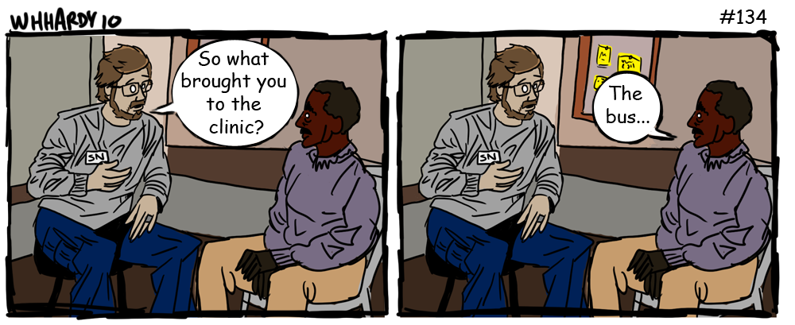
Notes:
Thought this was a funny cartoon. Sort of reminds me how as MH professional s on center we need to remember who we are serving, and the environments they may come from.

Slide 34
Authorizations and
Consent to Treat
The Job Corps Health Questionnaire ETA 6-53, authorizes basic/routine health care, is placed in the student health record (SHR).
The Mental Health and Wellness Informed Consent Form.
NEW- Consent for Pre-Enrollment Interview
Notes:
Consistent with professional and ethical standards, there must be authorizations.
The Job Corps Health Questionnaire (ETA 6-53), which authorizes basic/routine health care, is obtained by the AC and should be in the student health record (SHR) when you receive the file on center. If the student is a minor, the form should signed by the student’s parent/legal guardian
Additionally, each applicant and/or applicant guardian to Job Corps is also required to sign the Mental Health and Wellness Informed Consent Form. If applicant is a minor, should be signed by the student’s parent/legal guardian .
In the event that mental health consents are not present in the SHR, health and wellness staff should have the student sign the consent during the cursory medical examination.
Students must be informed when and why specific information will be shared with other staff. Three situations in Job Corps which warrant breaching confidentiality are: (1) a student's threat to harm self, (2) a student's threat to harm others, and (3) suspicion of child/elder abuse. In these cases, you should inform the center director and HWM in writing immediately and provide recommendations as to a course of action. Unless specifically contradicted by state law, this reporting to center management fulfills your legal responsibility to protect, inform, warn, and/or report.
Consent for Pre-Enrollment – Permission for the applicant interview-

Slide 35
Treatment
Employee Assistance Program (EAP) Focus
Brief Therapy
  Short-term counseling with focus on employability
Coordinate care with TEAP for students with co-occurring disorders
Groups
  Collaboration with counseling staff in developing and/or leading psycho-educational skill building groups to promote employability
Notes:
Remember that in JC we support students with manageable MH conditions—we are not a MH facility…although I know especially of late it does feel like we are serving students with higher needs- needs that we may not know about until they are on center. So when you are reviewing applicant files or making decisions about MSWRs –keep our model in min and whether an applicant or student can be supported within a more short term solution focused approach.
1. An employee assistance model that focuses on short term counseling with a focus on employability. Use of evidenced based cognitive behavioral interventions are suggested and fit well with this population and your limited hours on center
2. Support TEAP in coordinating care for students with co-occurring disorders.
3. Psycho-Educational Groups- Determine what groups are occurring on center by counseling or residential living staff and make recommendations for new groups Help train staff to conduct and manage psycho-educational groups. If you can lead or Co-lead groups as appropriate
Allow graduate students (if you center has a training program) to provide groups with supervision from the CMHC. Document when you refer a student to a group and whether they attend

Slide 36
Treatment
Counseling
  Regular case conferences with counselors, and other appropriate staff based on individual student needs
  What behavior information and strategies are provided to counselors?
    Documentation of Case Management and Feedback Form in CMHC DRG
Chronic Mental Health Conditions
  Mental Health Chronic Care Management Plans
    OA Provider Forms
    Student Fact Sheets
    Flow Sheets
Notes:
Counseling Component
The mental health and wellness program MUST have a counseling component that focuses on students' individual needs and progress in personal and social development, This is outlined in Chapter 2 of the ePRH. As counselors have more contact with students and are sort of like the student’s case managers regular case conferences/meetings with the career counselors is pretty important for case management of students on your caseload. The majority of centers do this weekly or every other week. Discussion of behavior in center groups, strategies/tools students are using to manage emotions, etc. Documentation of this meeting should be in the SHR – ( give examples of how this can be accomplished).- We have a form called Documentation of Case Management and Feedback on the website that can be used.
4. Chronic Mental Health Conditions
To assist you and other center staff there are mental health chronic care management plans (MHCCMPs) which provide a systematic approach to treating and managing chronic mental health conditions, such as bipolar disorder, depression, anxiety, and Autism Spectrum Disorders. Each MHCCMP includes a disorder fact sheet for students and a condition specific questionnaire sent to the applicant’s health care provider during the application process by the outreach and admissions counselor.
Mental Health Chronic Care Management Plans -Student Fact Sheets
• ADHD, Anxiety Disorders, Autism Spectrum Disorders, Bipolar Disorders, Borderline Personality Disorder, Depressive Disorders, Obsessive Compulsive Disorders, Panic Disorders, Post-Traumatic Stress Disorder, Schizophrenia Disorder, Tourette Syndrome

Slide 37
Treatment
Psychotropic Medications
  Help evaluate students already on medication and to identify other students who may need to be referred to the center physician or consulting psychiatrist for a medication evaluation.
Crisis Intervention and Psychiatric Emergencies
  Health Care Guidelines
    Treatment Guidelines
    Symptomatic Management Guidelines
Notes:
Although a detailed review of specific medications and treatments is beyond the scope of this orientation, a couple of general principles may be helpful in your role. Educate and monitor.
Mot centers maintain a list of all students with chronic illnesses including those on psychotropic medications. You should be aware of the students on psych meds on your center and those that may be having difficulties may be referred to you for check ins and assistance. Talk with your HWM and make sure there is a system in place for you to assist with check ins on students as needed. With the new medication guidance in the ePRH, there is a requirement for a monthly review with HW staff. Talk with your HWM about that as your participation in that monthly med review can meet this requirement. Make sure your name in included as being in attendance.
Crisis Intervention – you will be asked to assist when on center, There are resources we have as well when there is a traumatic event on center. Will share later in the presentation. Talk with your HWM and make sure there is an identified hospital for psych emergencies.
Mental Health Symptomatic Management Guidelines
Behavior Changes/Unusual Behavior — ​June 2017
Suicidal Behavior or Threats — June 2017
Mental Health Treatment Guidelines
Anxiety Disorders (Including Panic and Phobic Disorders) —June 2017
Attention-Deficit/Hyperactivity Disorder (ADHD) — June 2017
Depression/Bipolar Disorder — June 2017
Post-Traumatic Stress Disorder (PTSD) or Acute Stress Disorder — June 2017
Psychotic Disorders — June 2017
Suicidal Threats and Behavior — June 2017

Slide 38
Treatment
Community Referrals
  Did student sign a release for information exchange and is it documented in SHR?
Referral and Feedback System
  Sample Referral and Feedback Form in CMHC DRG
Cultural Sensitivity
Notes:
Important to have permission to share information when you recommend students off center for services.
Documentation of referral information and feedback should be included (required written referral/feedback process)
Sample referral and feedback form in CMHC DRG
Our student population is very diverse by race, ethnicity, gender expression, rural, urban, etc. - As MH professionals we have a responsibility to seek information and a develop an understanding about the students we serve. What their values are, what their traditions are, etc.
Trauma backgrounds that may also impact how they relate or do not relate to others, staff, students, being guarded, quick to react, shutting down under new and stressful situations.

Slide 39

Documentation Process and Procedure
Your assessment, treatment, and case management notes must be legible and included in the student health record.
Intake notes should indicate reason for referral, presenting problem, history of presenting problem, mental status exam, diagnostic impression, and clear treatment plan
*Sample Intake Forms in CMHC DRG
Notes:
The wellness model is a multidisciplinary treatment team approach. It is important that assessment, treatment, and case management notes are legible and part of the student health record. When writing notes remember, “If it isn’t charted, it didn’t happen.” Notes should be in the chronological record, where they can be easily found. If notes are in the mental health section, an entry must be made in the chronological record indicating that the students was seen by the CMHC and referencing the note in the mental health section.
You should review the referral and health records prior to the student intake interview. After the intake interview, document the following in the medical record: your findings, working diagnosis based on DSM if applicable, barriers to employability, and determined treatment needs If determined that the student needs assistance, develop a written care management plan and discuss necessary elements with appropriate staff.
.

Slide 40
Documentation Process and Procedure
Progress notes should indicate assessment, progress, and treatment plan
  Do the interventions connect to the student’s presenting symptoms or needs?
  Are those interventions evidenced based and support employability?
  Is there an alert system for student follow-up? What happens when students do not show?
  *Sample Progress Notes Template in CMHC DRG
Notes:
Providers are strongly encouraged to use the SOAP note (subjective information; objective data; assessment; plan ) or DAP format (diagnosis, assessment, plan). You may want to type your notes to ensure legibility. Notes aren’t helpful if they can’t be read by other wellness staff!
There is also a progress form in the CMHC DRG
Is there an alert system for student follow-up? Two weeks, monthly? What happens when students do not show- what is the system? Does it work?

Slide 41

Crisis Intervention
The CMHC is responsible for developing and providing staff training and crisis intervention for topics such as emotional reaction to HIV testing, rape, suicidal behavior, death, or other serious loss.
As CMHC, you are also responsible for drafting center procedures for emergency psychiatric situations such as suicide attempts, psychotic episodes, urgent referrals, and danger to self and others.
  Health Care Guidelines
Notes:
You can find additional information on crisis intervention on the Job Corps Health and Wellness website; click on SafetyNet; click on Suicide or Violence Prevention; then click on Critical Incident Crisis Intervention Plan.
Suicidal students should be evaluated as soon as possible. Students who are a danger to self or others must be supervised continuously until the disposition of their case is resolved

Slide 42
Role of CMHC in
Instances of Death
A Critical Incident Crisis Intervention Document is available on the Health and Wellness website at: https://supportservices.jobcorps.gov/health/Pages/CriticalIncidentCrisisInterventionPlan.aspx
Coping After A Traumatic Event Brochure
Depression, Grief, and Suicide and Understanding Grief (HE Curriculum Module)
Notes:
As the CMHC your role will be to determine the degree of emotional trauma for the center, organize crisis intervention services, and provide any grief counseling and support needed to attain a constructive resolution for students and staff. Your activities may include all or some of the following:
- Individual counseling for students who may have witnessed the death or been most affected
- Small group discussions for staff and students who were close to the deceased or who express concern over the circumstances of the death to inform them about the death and the facts surrounding it in a sensitive fashion.
- Locate counseling assistance in the community
- Keep records of students most impacted and provide follow-up services as needed.
Follow the schedule of the deceased and visit classrooms/dorms of close friends
Specific resources are listed on the slide.

Slide 43
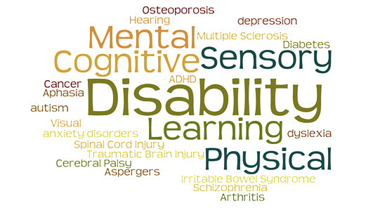
DISABILITY PROGRAM SUPPORT
ADDITIONAL AREAS

Slide 44
Disability Program Support
Job Corps is required to ensure its program and facilities are accessible and provide reasonable accommodation to individuals with disabilities to prevent discrimination on the basis of disability.
Each center should have a disability coordinator (DC) who ensures the center is providing services to students with disabilities as required by the ePRH and Workforce Innovation and Opportunity Act (WIOA),.
Notes:
As CMHC you may be asked by the disability coordinator to participate in the reasonable accommodation process for students with mental health disabilities who may require accommodations.. As part of the accommodation process, you and the DC may interview the applicant by phone or schedule a face-to-face interview.
Please note that providing educational and psychological testing is NOT considered part of the routine tasks of the CMHC and is NOT accounted for in the 9 hours per 100 students. Students who need educational and psychological testing to document a suspected disability should be referred to vocational rehabilitation or another appropriate agency. If appropriately licensed and trained CMHCs are involved in testing, they must conduct an evaluation that documents the disability (if any) that meets community standards which are included in the Desk Reference Guide.

Slide 45
ePRH 6—6.14: Disability
File Review Team (FRT)
  Typically includes the CMHC, Disability Coordinator(s), CP, TEAP to review health/mental health/AOD information of applicants for the program; Requires contact with the applicant and a clinical interview.
Reasonable Accommodation Committee (RAC)
  Led by the DCs with participation from Wellness and Academics to gather information to determine reasonable accommodation needs of applicants and students. Requires contact with the applicant and student.
Notes:
There are 2 teams that many times will consist of you, the HWM, and Disability coordinator but with different/separate functions
FRT –Read slide
RAC- Read Slide

Slide 46
Disability Program Support
Appendices 609 and 610
  Required forms for recommending denial of applicants due to direct threat or health care needs (see assessment section of presentation for details)
Appendix 107 – Applicant File Review Process for Center
*Contact your RMHS
Notes:
We talked about these forms previously. Best to contact your RMHS.

Slide 47



Additional Center Support Programs
Trainee Employee Assistance Program (TEAP)
Tobacco Use Prevention Program (TUPP)
Sexual Assault Response Team (SART)
Healthy Eating and Active Lifestyles (HEALs)
HIV/AIDs
*See ePRH Chapter 6 – 6.11 for more information
Notes:
Let’s take a look at each program in turn:
TEAP – Our AOD program on center. Work closely with the TEAP specialist.
TUPP – As the CMHC, you will be asked to support the center’s efforts to be a smoke free/tobacco free environment by working with the TUPP coordinator to develop cognitive-behavioral strategies to change the thoughts, attitudes, and actions of students toward tobacco use.. This may be accomplished by providing program resources for the TUPP coordinator and/or direct group involvement. The TEAP coordinator is often also the TUPP Coordinator.
Sexual Assault Response Team. You may also be asked to provide staff training on sexual assault awareness and prevention and serve on the SART.
If needed, provide short-term therapy may be provided, but preferably the center has a relationship with the local rape crisis center and the student can receive immediate specialized services; you may not have time to see students in direct services. Provide follow up support when the student returns after receiving outside services. Act as center liaison with the local rape crisis center. Provide HIV counseling and crisis assistance, if needed.
HEALS
Job Corps’ Healthy Eating and Active Lifestyles (HEALs) program website provides an evidence-based curriculum to educate students; guidance for food service, recreation, health and wellness staff, as well as information for instructors and residential living staff; web-based trainings and workshops; tips to integrate healthy living into the center culture; and strategies to evaluate the program. This is an excellent opportunity to apply motivational interviewing approaches to help students make healthier food and activity choices that support wellness.
HIV Management
When a student tests positive for HIV, the CMHC works with the center physician and nursing staff to communicate the results and provide short-term intervention as well as appropriate referrals for further support. HIV-positive students who are medically and psychologically able to participate in Job Corps' programs are case managed by a team that includes the center director, center physician, HWM, CMHC, and designated career counselor.

Slide 48
Useful Websites
Health and Wellness: https://supportservices.jobcorps.gov/health/Pages/default.aspx
Job Corps Disability https://supportservices.jobcorps.gov/disability/Pages/default.aspx
Job Accommodation Network (JAN) is a free service that provides information on job accommodations and the employment provisions of the Americans with Disabilities Act (ADA) http://askjan.org/
Notes:
Visit the Job Corps Health and Wellness website to review the latest information about the Job Corps health and wellness program. You will also find a section dedicated to mental health issues. The Job Cops Disability website provides useful information in completing file review and identifying mental health accommodations Also, the Job Accommodations Network provides additional information to help students with mental health challenges be successful on the job.

Slide 49
Regional Mental Health Specialists
Region 1 Peter Oropeza, PsyD
      Oropeza.Peter@jobcorps.org
  Maria Acevedo, PhD (Puerto Rico) Acevedo.Maria@jobcorps.org
Region 2 Valerie Cherry, PhD
        vcherryphd@gmail.com
Region 3 Suzanne Martin, PsyD, MPH, ABPP suzannempsyd@gmail.com
Region 4 Tamara Warner, PhD Warner.Tamara.D@jobcorps.org
Region 5 Helena Mackenzie, PhD Mackenzie.Helena@jobcorps.org
Region 6 Tamara Warner, PhD
      Warner.Tamara.D@jobcorps.org
Notes:
On this slide, you will find current contact information by region for your regional mental health consultants.

Slide 50
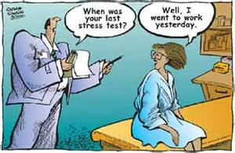
It Does Get Better!!

Slide 51

Notes:
You likely have many questions! Your Regional Mental Health Specialist can be a resource in providing technical guidance on mental health related topics. Feel free to contact them. Hopefully they will already be in touch with you to introduce themselves and answer questions. In addition, you can expect to work closely with your health and wellness manager who can introduce you to key individuals on center and can help get you set up with a Job Corps email. You’ll be surprised at how much information is available on the Health and Wellness Website that can help make your job easier!
Thank you for your work in helping Job Corps students be successful!

