Slide 1
Managing for Success: Understanding yourself, others, your department, and the organization can produce outstanding results.
Presented by Peter Oropeza, psy.D.

Slide 2
Learning Objectives
Participants will be able to:
Identify the difference between effective management versus effective leadership
Identify core values and behaviors critical to success
Identify ways to hold staff and students accountable

Slide 3
Leadership defined?
According to Merriam-Webster
The office or position of a leader. Recently assumed the leadership of the company
Capacity to lead. A politician who lacks leadership
The act or an instance of leading. leadership molds individuals into a team

Slide 4
So what is management?
Merriam-Webster gives you this:
the act or art of managing: the conducting or supervising of something (such as a business) Business improved under the management of new owners.
judicious use of means to accomplish an end is extremely cautious when it comes to money management
the collective body of those who manage or direct an enterprise. Management decided to hire more workers.

Slide 5
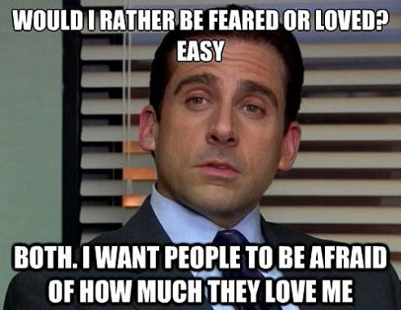

Slide 6
Leadership vs. Managing
Setting Direction vs. Planning and Budgeting
Aligning People vs. Organizing and Staffing
Motivating People vs. Controlling and Problem Solving

Slide 7
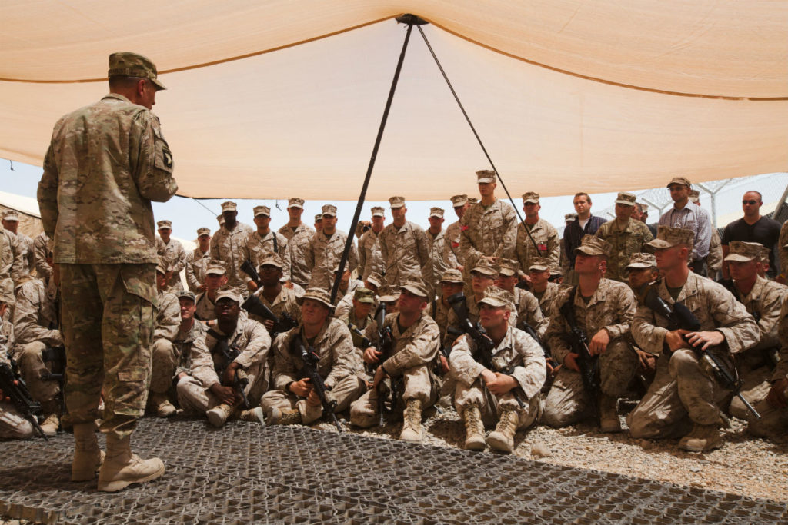

Slide 8
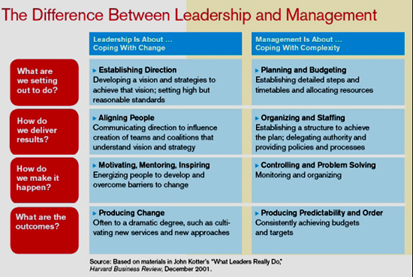

Slide 9
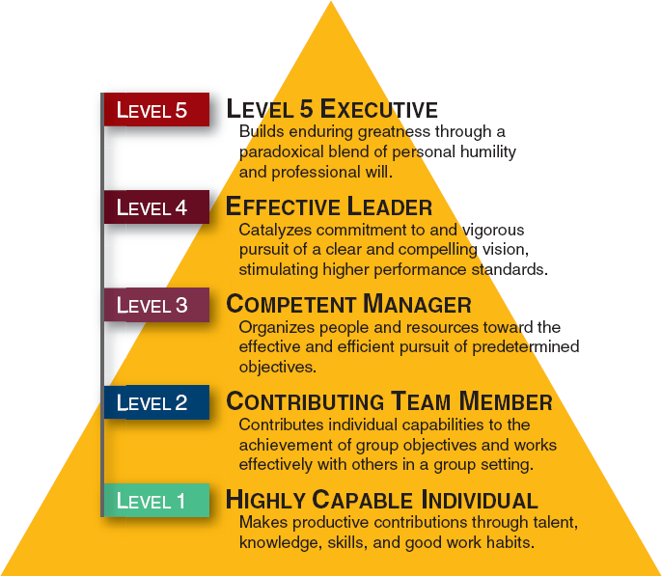

Slide 10
Question of the Day
Are leaders born or developed?

Slide 11
Know yourself
Be honest with yourself and ask these questions:
1. What are your strengths? What are your weaknesses?
2. Be specific in the following areas
Interpersonal skills
Organizational skills
Collaboration
Handing/managing conflict
Biases? Awareness of biases
Hot button triggers
Asking for feedback
Time management
Running meetings

Slide 12
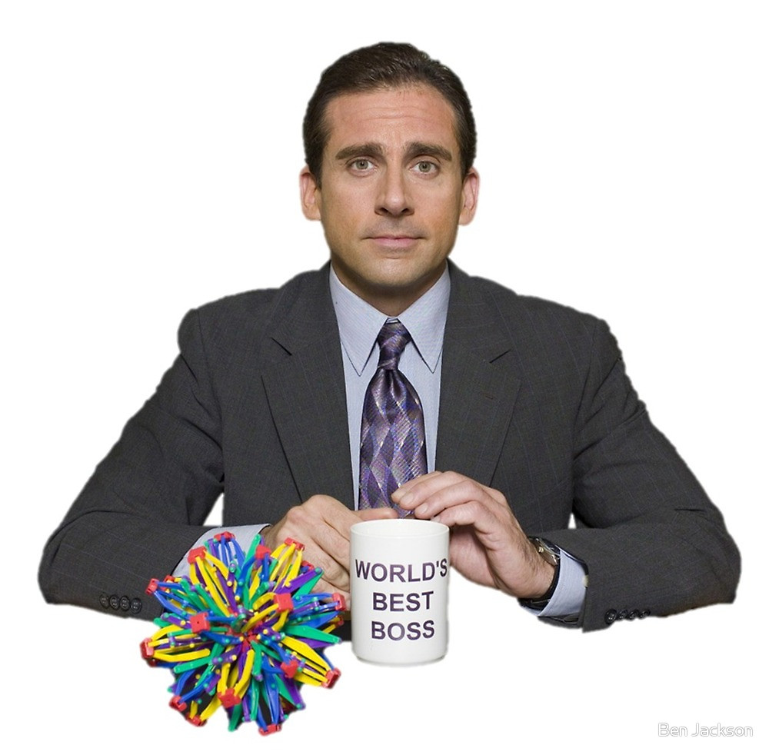

Slide 13
Core values
Dig deep! What really drives you?
What core belief do you hold that is so strong that when you do something against this belief the feeling and reaction is palpable to you?
Your core value is an essential and enduring tenet….guiding principles.
In sum, “A core longstanding, strongly held belief that influences your behavior.”

Slide 14
Types of Core Values
Truth Trust Excellence
Persistence Teamwork Responsiveness
Sincerity Quality Self-control
Power Respect Fairness
Control Candor Honesty
Courage Learning Cooperation
Honor Integrity Humor
Loyalty Collaboration Success
Security Support Peace
Relationships Justice Dependability
Wisdom Commitment Freedom

Slide 15
The Importance of Core Values
Core values are fundamental to who you are, how you act and behave, and how you relate to people
You must, as a person in a position of influence, know your core values

Slide 16
The Power of Core Values
We’ve learned that when you manage by core values, amazing things happen. You start measuring success by the quality of your relationships, your reputation for integrity, your contributions to the community, your environmental stewardship and by how much you enhance the lives of your employees, customers and communities. You begin to define success by how much you achieve and by how much you care.
—Holt Catepillar

Slide 18
The Real Meaning of Success
Think about it: What is the ultimate measure of success for a professional sports franchise? Is it a championship ring? How about a company? Is business success solely based on how many products you sell and how much profit you make?
For many organizations, these are the only ways to quantify success. But at HOLT CAT and Sports and Entertainment, we measure success a little differently.
.

Slide 19
Holt Cat Measure of Success
We measure success by how well we’re delivering on the values that are most important to us. We call this approach Values-Based Leadership (VBL) - and it’s the common bond of passion and purpose that connects HOLT CAT and the Spurs. VBL keeps us connected to our fans, our customers, and our communities

Slide 20
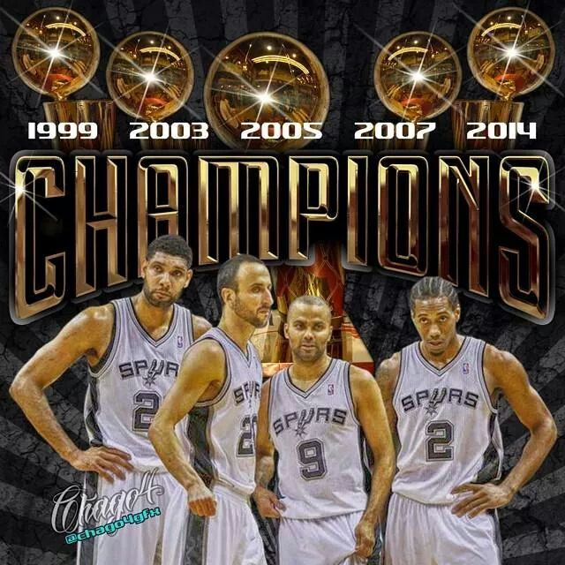

Slide 21
FROM VALUES TO ACTION
Leadership is the ability and capacity to influence others. Values-based leadership is where leaders inspire and motivate others to pursue what matters most. Values-based leaders are committed to and actively engaged in trying to make the world a better place within their individual sphere of influence.
The ultimate objective of values-based leadership is to do the right thing by influencing those you interact with to make choices and decisions which are aligned with your values and those of your organization. To become a values-based leader, the journey has three phases:
--Harry Kraemer, professor at Northwestern. Former CEO of Baxter International Inc.

Slide 22
Values Based Leadership (and Management)
Know who you are and what you stand for
Learn how to build a values-based team
Lead your sphere of influence from success to significance

Slide 23
Phase 1. Who are you?
Self-Reflection: You must reflect and identify what your values are and what matters most
Balance and perspective: The ability to see situations from multiple perspectives, including different viewpoints, to gain a holistic understanding
True Self-confidence: NOT narcisstically, but accepting yourself in total including your strengths and weaknesses, and importantly, focusing on continuous self-improvement
Genuine Humility: Know your values, appreciate the value in each person in the organization, and treat everyone respectfully

Slide 24
Phase 2: Build a Value Based Team
Lead with values
Develop talent
Set clear direction
Communicate well
Build engagement
Execute

Slide 25
Phase 3: Lead Your Sphere of Influence—From Success to Significance
The courage to lead through change, controversy, and crisis
Be socially responsible

Slide 26
Holding Others Accountable?

Slide 27
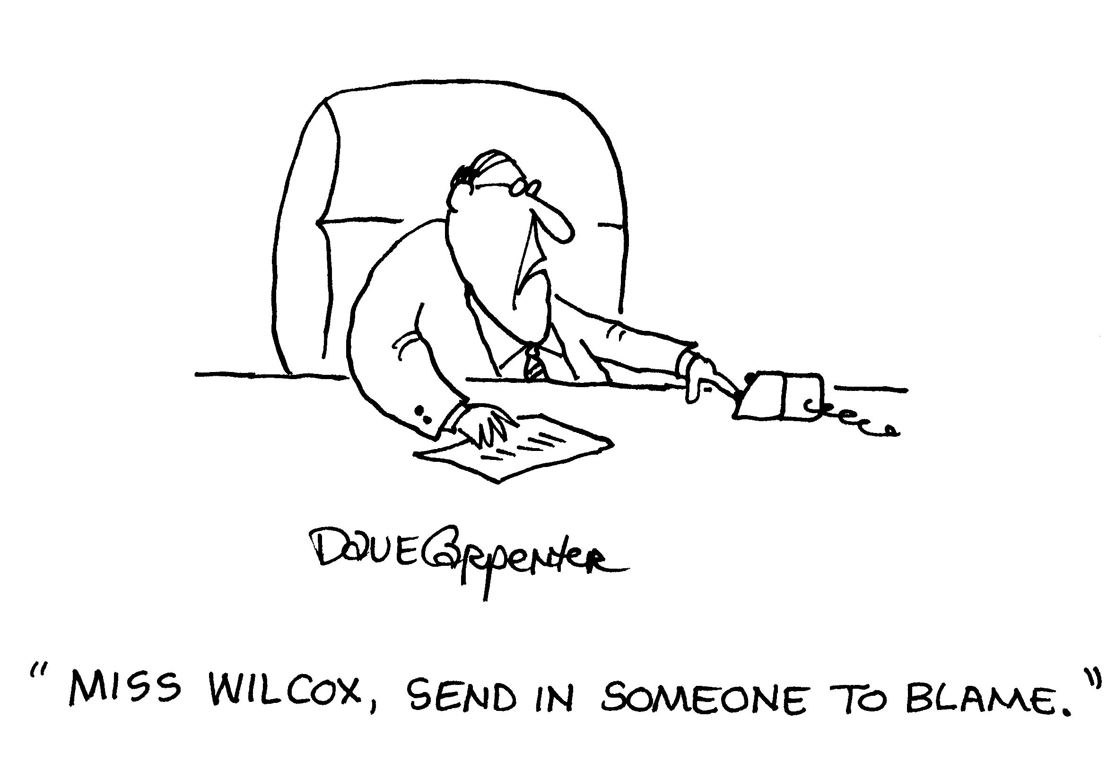

Slide 28
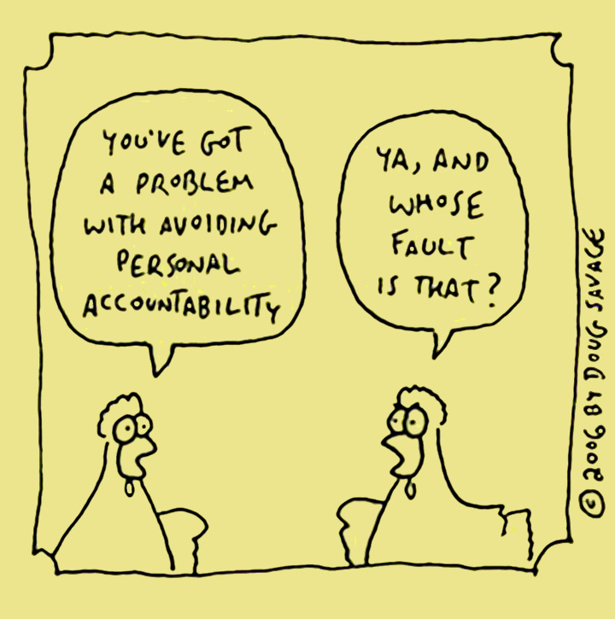

Slide 29
Accountability
Know yourself and hold yourself accountable.
1. Seek feedback from others about your behavior.
2. Ask about the efficiency and effectiveness of your meetings. Both individually and in a group.
3. What are your teams shared values?
4. How are these shared values defined in behavioral terms? E.g. Respect as a value? Does everyone have agreement as to what respectful behavior looks like?
Notes:
If I took another poll question right now and asked each of you this simple question: In modern times, say the last 50 to 100 years, is society more violent or less violent than any other time throughout history?
1. Think about this, we have WWI, WWII, Korean War, Vietnam War, mass slaughtering's, terrorism, etc.

Slide 30
Holding others accountable
1. How good and effective is your training?
2. How well do you actively coach team members?
3. Do team members understand the shared values of your group?
4. How do students view your team/department? Do they understand the values? Do they share them?

Slide 31
Your View of Team Members
Do you view team members as someone who does a job?
Or do you view them as someone who helps change lives?

Slide 32
View of Students
How do you view students? As people who should comply with your rules?
Or as people who want to do better in life and benefit from your interactions with them?

Slide 33
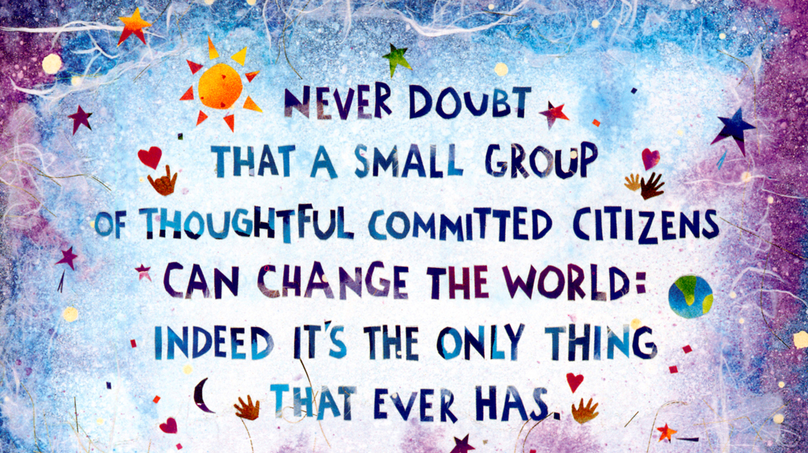

Slide 34
QUESTIONS?

