Slide 2
PrEP and PEP
After this presentation, participants will be able to:
Identify students at increased risk for HIV infection
Implement CDC recommendations for PrEP & PEP (and know what the acronyms stand for!)

Slide 3
Why relevant?

Slide 4
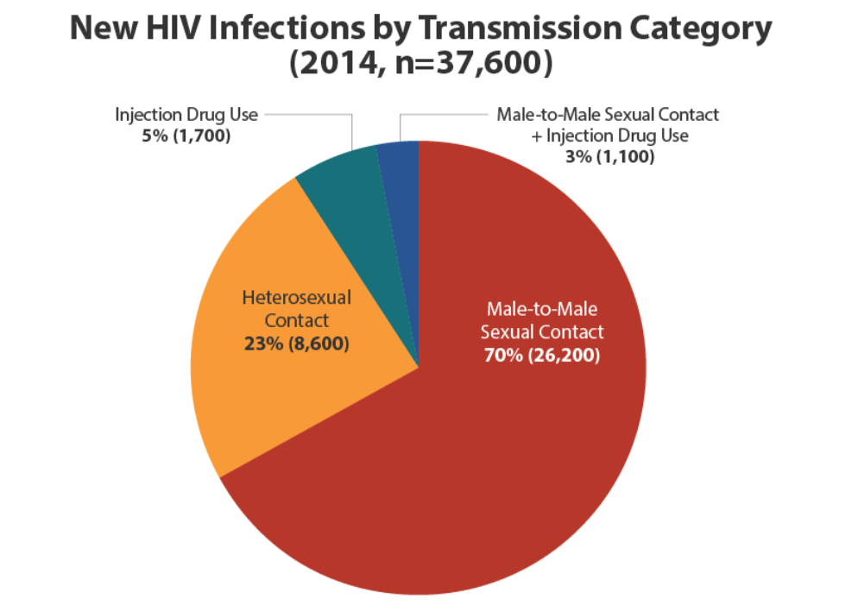
Why relevant?

Slide 5
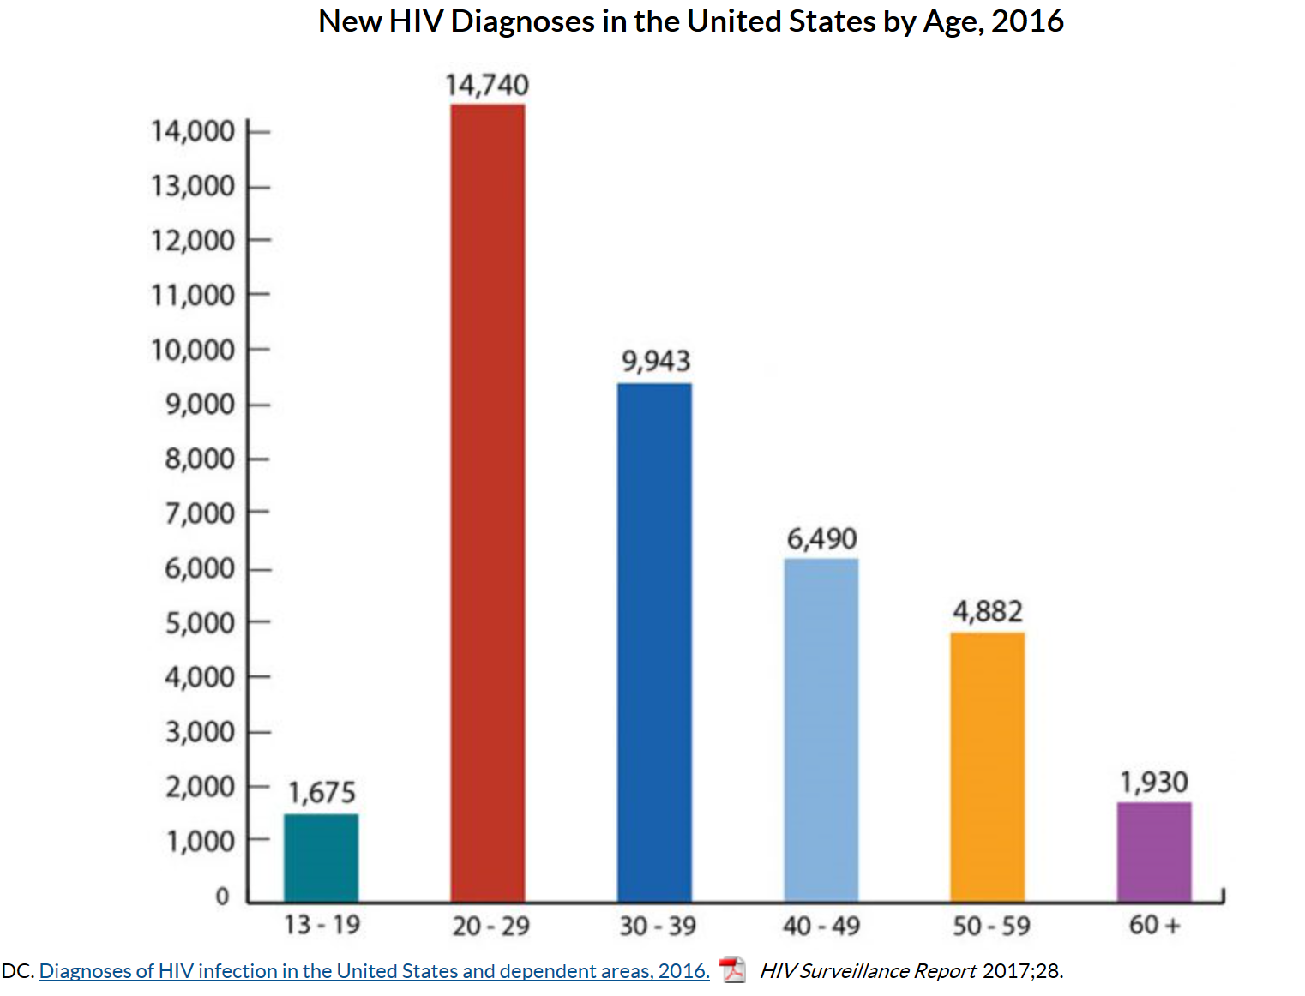
Why relevant?

Slide 6
Act against HIV!

Slide 7
Poll Question
What are the indications for HIV testing in Job Corps?

Slide 8
Discuss sexual behavior:
Choose less risky behaviors & get tested and treated for STIs
Anal Sex
Receptive partner – 13x risk
Insertive partner
Vaginal Sex
Oral Sex

Slide 9
Condom use – correct and consistent:
Latex or polyurethane male condom
Use with water or silicone based lubricant
Reduces risk with insertive anal sex with HIV positive partner by 63%
Reduces risk with receptive anal sex with HIV positive partner by 72%
Heterosexual male and female- reduces risk by 80%

Slide 10
Medication for prevention:
Pre-exposure prophylaxis (PrEP)
Post-exposure prophylaxis (PEP)
Treatment as Prevention (TasP)

Slide 11
PrEP:
Pre-Exposure Prophylaxis
Tenofovir disoproxil fumarate (TDF) 300 mg and emtricitabine (FTC) 200 mg daily pill (Truvada)
The once daily combination pill is the only FDA approved PrEP

Slide 12
PrEP:
If taken consistently, can reduce risk of contracting HIV from sex by more than 90%

Slide 13
PrEP – for whom recommended*?
Sexually active MSM at substantial risk of HIV acquisition (IA)
Heterosexually active men and women at substantial risk for HIV acquisition (IA)
Persons who inject drugs at substantial risk for HIV acquisition (IA)
*as one preventive option

Slide 14
What is “substantial risk”?
MSM
HIV positive sexual partner
Recent bacterial STI
High number sex partners
History of inconsistent or no condom use
Sex worker

Slide 15
What is “substantial risk”?
Heterosexual men or women
HIV positive sexual partner
Recent bacterial STI
High number sex partners
History of inconsistent or no condom use
Sex worker
In high HIV prevalence area or network

Slide 16
What is “substantial risk”?
Persons who inject drugs
HIV positive injecting partner
Sharing injection equipment

Slide 17
PrEP – lab testing before start
Must rule out acute or chronic HIV infection HIV test
No signs or symptoms of acute HIV
Normal kidney function
No contraindicated medications
Document Hep B status or vaccination

Slide 18
PrEP – follow up
HIV testing every 3 months to rule out new infection as 2 drug therapy inadequate for treatment
Medication adherence counseling
Risk reduction counseling
Assess renal function at 3 months then every 6 months
Bacterial STI testing every 3 months

Slide 19
PrEP – financial
Insurance variable coverage
PrEP medication assistance programs:
https://www.truvada.com/
Local health department

Slide 20
Pre-exposure prophylaxis (PrEP):
U.S. Public Health Service Preexposure prophylaxis for the prevention of HIV infection in the United States – 2017 Update. A clinical practice guideline
National Clinicians Consultation Center PrEPline at 855-448-7737 http://nccc.ucsf.edu/clinician-consultation/prep-pre-exposure-prophylaxis/

Slide 21
Non-occupational Post-exposure prophylaxis (nPEP):
Rapidly evaluate if student presents <72 hours after non-occupational exposure that presents substantial risk for HIV acquisition

Slide 22
Non-occupational Post-exposure prophylaxis (nPEP):
Test HIV status at baseline to ensure negative
nPEP recommended if source known to be HIV positive & reported exposure presents substantial risk for transmission
nPEP not recommended if reported exposure presents no substantial risk for transmission
Case-by-case if unknown status of source and reported exposure substantial risk of positive

Slide 23
Non-occupational Post-exposure prophylaxis (nPEP):
28-day course of 3 drug antiretroviral regimen
Tenofovir (300 mg) and emtricitabine (200mg) once daily (Truvada)
Plus
Raltegravir (400 mg) twice daily OR dolutegravir (50 mg) once daily

Slide 24
Non-occupational Post-exposure prophylaxis (nPEP):
Include evaluation for other health issues including STIs, pregnancy, trauma, hep B and C
Include risk reduction counseling and evaluation for PrEP if ongoing behavioral risk factors

Slide 25
Treatment as Prevention (TasP)

Slide 26
PrEP and PEP
After this presentation, participants will be able to:
Identify students at increased risk for HIV infection
Implement CDC recommendations for PrEP & PEP (and know what the acronyms stand for!)

