Slide 1
TEAP Hot Topics: Marijuana, Drug Testing and Surprising Uses for Household Products
Christy Hicks, CSW/LCADC
November 2018

Slide 2
Learning Objectives
Learning Objectives: 1.) Participants will be able to identify two or more ways that marijuana use has changed in the last five years. 2.) Participants will name the five new drugs in Job Corps’ expanded drug panel and the reasons for confirmatory testing. 3.) Participants will identify two or more ways that household items can be used to obtain an altered state of consciousness.

Slide 3
Hot Topic I: Marijuana: Evolving Product and Policy
Most widely used illicit drug in United States
New surveys show that more than 50% of adults have tried marijuana in their lifetime
A majority of Americans believe that using marijuana is “socially acceptable”
In PY 2016 (July 2016 though June 2017) 29.3% of students entering Job Corps tested positive for one of the five drugs in the DOT panel (marijuana, PCP, cocaine, amphetamines and opiates)
Compared to 26.3% of students testing positive on entry in PY 2012
See Maris Poll (http://maristpoll.marist.edu/yahoo-newsmarist-poll/#sthash.ssJjHonu.dpbs)

Slide 4
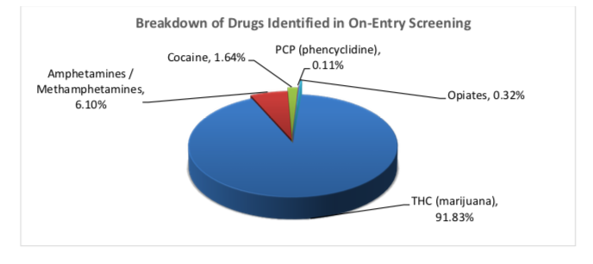
As you can tell from this graph – the vast majority of those testing positive are for marijuana (about 92%)

Slide 5
Marijuana Policy has Changed
31 States and the District of Columbia have broadly legalized marijuana in some form
This map current as of 10/19/2018

Slide 6
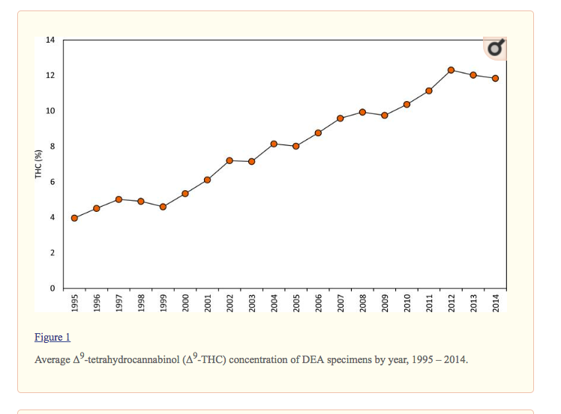
Policy is Changing but so is the Product
The amount of the psychoactive substance in marijuana has been substantially increasing from around 4% to now triple that at 12%
Reference: ElSohly, M., Mehmedic, Z., Foster, S., Gon, C., Chandra, S., & Church, J. C. (2016). Changes in cannabis potency over the last 2 decades (1995–2014): analysis of current data in the United States. Biological psychiatry, 79(7), 613-619.

Slide 7
What Does Increase in Potency Mean?
Industry is not regulated (for most part) and no transparency about contents or potency
Higher the THC means stronger effect on brain
More likely to consume excessive doses (especially with edibles)
Leads to more adverse clinical effects, such as psychotic reactions
Increase in emergency department visits (seen in Colorado especially)
CDD reports that despite increased potencies that the 37 to 40 day time period remains long enough for the vast majority of students to produce a negative sample if they abstain from marijuana use

Slide 8
Contaminants are Increasing as Well
Biological contaminants like mold and bacteria are not surprising
Many other contaminants:
Butane (used in production)
Heavy metals (lead and mercury)
Chemical pollutants (arsenic and nitrates)
Pesticides
This could contribute to adverse consequences for students

Slide 9
Marijuana and Cannabidiol – Things are Changing
As a refresher - CBD is a chemical component of the Cannabis sativa plant (marijuana) but does not cause intoxication or euphoria that comes from tetrahydrocannabinol (THC)
Both marijuana and cannabidiol (CBD) are classified as schedule 1 drugs
Definition: Schedule 1 drugs are defined by the federal government as drugs with no currently accepted medical use and a high potential for abuse. Schedule 1 drugs are the most dangerous drugs of all the drug schedules with potentially severe psychological or physical dependence
In June 2018 the US FDA approved the first ever CBD-based medication, Epidiolex, which is an oral solution for treatment of rare forms of seizures and epilepsy
The FDA has indicated that they may approve other specific CBD-based medications that demonstrate efficacy

Slide 10
Summary I
Marijuana is changing in terms of:
Our social attitudes about its use
Steady increases in the past five years for students testing positive on entry to Job Corps (from 23% to 29%)
Increased access due to legalization
Increased potency and contaminants
Increased adverse effects with increased ED visits
Research showing increased medical uses as well
But remain illegal at federal level at this time
Continue to educate students about marijuana as a barrier to employability

Slide 11
Hot Topic II: Expanded Urine Toxicology Screen
As of 09/18/2018 – Job Corps expanded from a DOT 5 panel urine drug test (UDS) to a DOT 10 panel UDS.
Why did this occur?
Primarily due to the opioid crisis
Old panel (marijuana, cocaine, amphetamine, PCP and opiates) did not test for current drugs of abuse being used
Only tested for naturally occurring opiates like opium and morphine but did not test for synthetic or semi—synthetic opioids
There were other drugs being abused as well that we needed to detect and offer intervention services

Slide 12
The New Panel
In addition to marijuana, cocaine, PCP, amphetamines and opiates, Job Corps now tests for:
Barbiturates (e.g. phenobarbital)
Benzodiazepines (e.g. valium, Xanax)
Fentanyl (rarely legitimately prescribed for this population but heroin is often cut with fentanyl)
Hydrocodone/Hydromorphone (e.g. Vicodin)
Oxycodone/Oxymorphone (e.g. Dilaudid)

Slide 13
What is Important to Know?
Most of these drugs have legitimate medical purposes
Usually for pain management
They might be prescribed to JC students after a dental or surgical procedure
A student could test positive because of this type of prescription
If this is the case, then make a note in the SHR as to this being the reason for the positive
Only those testing positive because of illicit drug use are entered into the TEAP program
Each center must have procedures in place to ensure those students testing positive and are in TEAP because of their illicit drug use
We already have a system for this that should be utilized

Slide 14
Chain of Custody Procedures
Chain of Custody Procedures address this already
This has always been in place for Amphetamines (as large number of those testing positive are due to ADHD medication)
Procedure:
Ask students what drugs they are taking when collecting the UDS
Verify this medications by talking with prescriber, reviewing the prescription or the medication bottle
Consider having a chain of custody form where you can write in the student’s current presciptions
Check the SHR for current prescriptions

Slide 15
Review of Collection Procedures
“A reliable result begins with a good supervised collection which includes an accurately identified and clearly labeled donor sample” from the CDD
Supervised collection is controlling the surroundings to ensure that the individual provides their own urine to reduce possibility of adulteration
Observed collection is watching the urine stream leave the body and enter the cup
All collections must be, at minimum, supervised
Centers may decide to use observed collection procedures when a sample was provided that was adulterated or if it is their standard practice

Slide 16
Supervised Urine Collection Procedures
The TEAP Desk Reference Guide (DRG) offers the following guidance:
Remove cleaning products from the collection room
Turn off additional water sources
Place a blue chemical in the toilet tank to color the water
Have the student wash (with water only) hands and clean under nails
Have the student remove outer garments (e.g., coats, sweaters, jackets)
Prohibit bags, packages, or purses in the collection area
Have the student provide the specimen while in an examination gown (if urine collection is part of a medical exam)
TEAP specialist or nurse stand close to the door to be aware of unusual sounds
Have student hand specimen directly to staff

Slide 17
Most Importantly
The most important action to determine if the sample has been adulterated or that it is the student’s urine is:
Performing visual and temperature checks on every sample
The UDS temperature should fall between 90.5°F and 99° F
Inspect the UDS: visually it should appear free of possible contaminants

Slide 18
Collection Essentials: Failure to Do These May Cause Rejection of Sample
Regarding the Security Tape:
Whoever collected the UDS must sign and date the security tape
Student must sign tape as well
Signatures must be legible
Secure tape over top and do not cover bar code or expiration date
Sample Volume: fill tube to label top
Barcode Label:
All parts of label visible
Correct label type: “TOX Secure Yellow V9”
Correct donor (student) name, date and ID
Label in line with tube

Slide 19
Next Steps
UDS positive then CDD recommends calling them for questions
Meet with the student to discuss the results
Assess whether the student’s substance use will interfere with training
Consider need for off-center supports (such as treatment) or MSWR
Consider intensifying intervention services to provide additional support
Contact your regional TEAP health specialist (Diane or Christy) for further guidance
Document in the SHR your process and clinical decisions

Slide 20
Screening versus Confirmatory Testing
CDD procedure for drug testing has two steps
First is the screening test and if that is positive then a confirmatory test is completed using GS-MS (Gas Chromotography – Mass Spectromentry)
Most of the time – if a test is done at a hospital or other locations, it is only a screening test and there are too many false positives and cross reactivity (like with poppy seeds) which is why ePRH requires that CDD must be used for all drug testing
Results received are qualitative (either positive or negative) only

Slide 21
Summary II
The UDS panel has expanded to include 10 drugs, including opioids as well as barbiturates and benzodiazepines
This is to address the drugs that students may be abusing as well as the opioid crisis
Ensure that proper chain of custody procedures are followed to make sure that the test result is not due to a legitimate prescription
Ensure a system is in place to decrease the likelihood that a sample is adulterated
Further assess and offer services to those students testing positive
Contact the CDD or the regional TEAP health specialist with questions

Slide 22
III. Surprising Uses for Household Products
Everyday items found in the kitchen, bathroom, office and garage can be used to alter mood and get “high”
May be popular alternatives to illicit drugs due to availability and low cost
Can cause serious health risks and even death
Most common form of use is as an inhalant
This age group at highest risk for using these substances in this way

Slide 23
Nutmeg
Common spice
Used in baking – most of us will be eating it this holiday season as in pumpkin pie
It has a darker side: Ingesting about 5 teaspoons causes hallucinogenic effects due to the ingredient myristicin
Symptoms can last up to two days
Most common adverse effects are nausea, vomiting, diarrhea, and rapid heart rate
Using nutmeg in this fashion is extremely dangerous, and most people who do this end up hospitalized

Slide 24
Cough Medicine (e.g., Robitussin and Nyquil)
Contain the ingredient dextromethorphan (DXM)
Cough medicines and DXM are one of the most frequently abused household medications
Stores often require identification to purchase them
Causes euphoria and hallucinations that can last up to six hours
Can be combined with alcohol and marijuana which increases risk of negative effects
Causes chemically-induced psychosis with other side effects: sweating, nausea, vomiting, anxiety, paranoia, decreased motor skills, elevated blood pressure and sedation
These items are typically not allowed at Job Corps
Train staff to be looking for empty bottles of cough medicine as well as monitoring students if they are bringing this back onto center

Slide 25
Allergy Medications
Some allergy medications contain antihistamines which are often abused for the sedative effects
Effect is intensified greatly when mixed with other central nervous system depressants such as Xanax, Valium or alcohol
Most common side effects are: heavy sedation, confusion, elevated heart rate, nausea, double vision, dry mouth and loss of appetite
With repeated abuse, some long-term side effects include seizures, glaucoma and cardiovascular disease
Same precautions should occur at Job Corps – train staff to be checking for empty boxes or bottles
Most centers do not allow students to possess these without permission of HWC

Slide 26
Liquid Hand Sanitizers
Hand sanitizers are mainly alcohol (62%) and made from isopropyl alcohol
This type of alcohol is metabolized differently in the body and poses significant health risks that include vomiting, diarrhea, pain, and bleeding in the stomach and intestines if ingested
It can also lead to dehydration, low blood pressure, shock, and coma
Isopropyl alcohol can also be toxic when inhaled
Individuals consuming this type of alcohol will feel the effects much quicker and are at increased risk for alcohol poisoning
To address this issue – many centers have only foam hand sanitizer available as the acohol cannot be easily separated from this type of product
Staff should be educated about implications if students bringing large amounts back to center

Slide 27
Inhalants
Abuse of inhalants refers to any substance that cuts off supply of oxygen to the brain
Inhaling gas or vapor to get high is not new but availability makes it popular with this age group and that it does now show up on drug testing
‘Huffing’ been known to cause Sudden Sniffing Death Syndrome, which refers to instantaneous death following an episode of inhalant abuse
Commonly abused products: computer cleaners, mothballs, permanent markers, nail polish remover, rubber cement, hair spray, spray deodorant, spray paint, paint thinner, insecticide spray, gasoline, lighter fluid, canned whip cream, propane and helium
Symptoms include headaches, muscle spasms, gastrointestinal pain, violent mood swings, nausea, hearing loss, decreased motor skills, numbness and permanent brain damage
Most of these products are not allowed at Job Corps but train staff to be mindful of symptoms

Slide 28
Summary III:
Common household products can be used to alter mood and “get high”
These include kitchen items (nutmeg), as well as cleaning solutions, gasoline, hand sanitizer, cough syrup and many others
TEAP specialists should provide training to staff and students about the risk associated with inhalant use and misuse of household products
Staff should be trained to recognize signs of this type of drug use and the suspicion screen form should list symptoms

