Slide 1



Suicide Prevention In
Job Corps
What’s Going On And What Can We Do About It?
Valerie Cherry, PhD
Lead/Region 2 Mental Health Specialist
Julie Klinger-Luht, MPH
Humanitas
November 26, 2019

Slide 2

Webinar Overview
National Trends
Job Corps Specific Data
Risk Factors & Warning Signs of Youth Suicide
Protective Factors
Core Components of a Culturally Sensitive Job Corps Suicide Prevention Program
  Planning, Training, Environment, Early Identification, Assessment, Intervention, and Postvention
2
Notes:
Throughout a student’s Job Corps career, data on selected health indicators—sexually transmitted infections (Chlamydia, HIV infection), drug and alcohol use, medical separations, student deaths, and disabilities—are collected on a national level. Analysis of these indicators and comparison to U.S. national data sets provides an opportunity to assess the effectiveness of current Job Corps policies and practices and to identify opportunities for improving health and wellness services and student health outcomes.

Slide 3

Why does a person choose suicide?
Notes:
Suicide is an attempt to solve a problem of intense emotional pain when a student feels trapped, helpless and have impaired problem-solving skills.
Less of a wish to die but to escape the intense emotional pain generated from what appears to be an inescapable solution.
Suicide is seen as the solution to a perceived insolvable problem that is no longer tolerable.

Slide 4
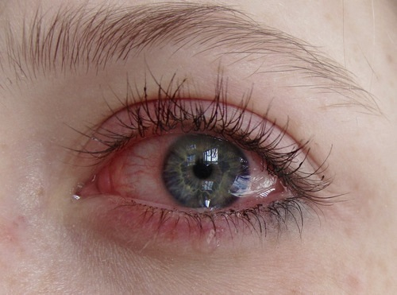
Depression Through a Teen’s Eye
“And no matter what I say, I am not okay. I might never be "okay". I might never be the same way I was before, and it's scary. Have you ever gotten that question- "Are you afraid of dying?" I have. And every time I get asked that I answer them no- I'm afraid of what life has become in my eyes, and every day is a struggle. I'm afraid that I'll never get to see the old me again. So no, I'm not afraid of dying, but instead of living.”

Slide 5

National Trends
Job Corps is microcosm of a larger national crisis!
5

Slide 6
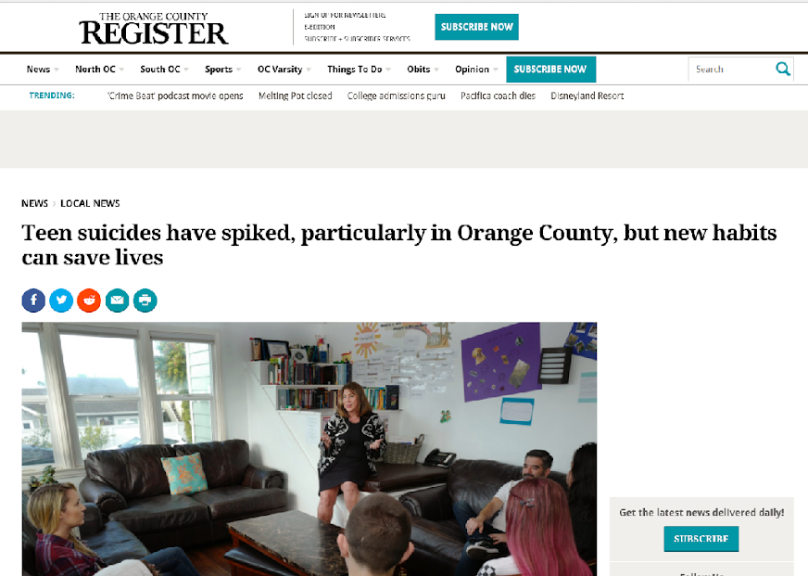
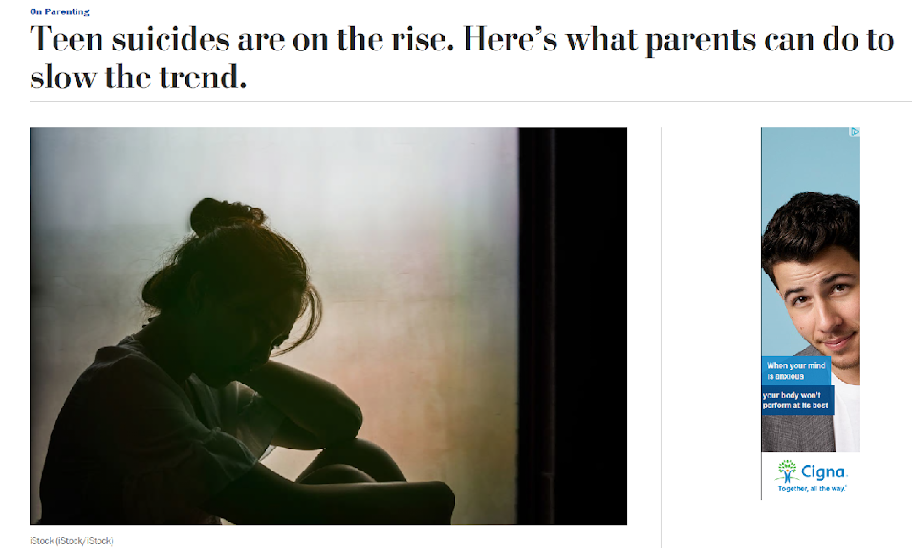
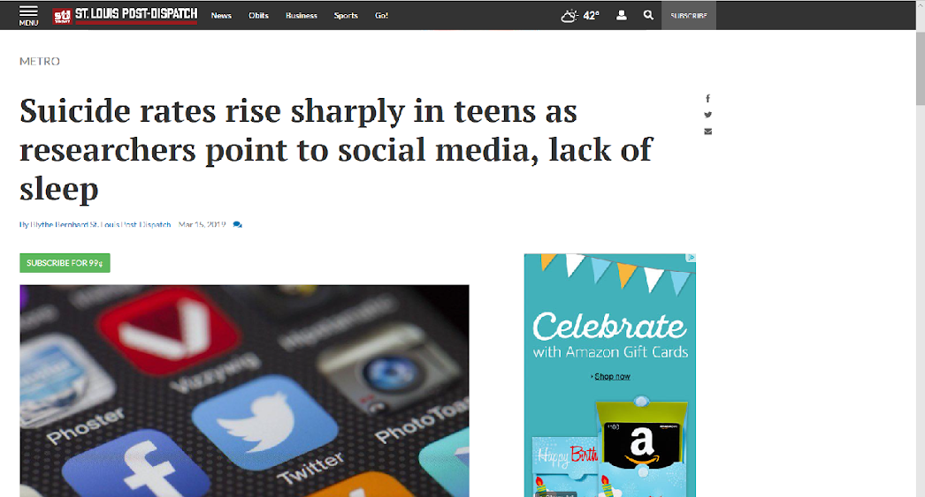
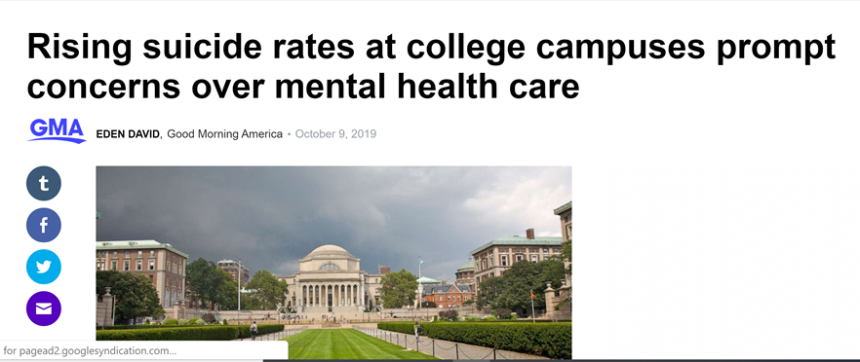

Slide 7

“Success usually comes to those who are too busy to be looking for it.”
Spike in suicidality between the ages of 15 and 24
Second cause of death among Job Corps aged students
Until the age of 25, rational thinking and the ability to regulate emotions/impulses are still developing
Source: American Association for Suicide Prevention. https://afsp.org/about-suicide/suicide-statistics/
7

Slide 8





Lifestyle Factors
Substance Use
Suicides and drug overdoses kill American adults at twice the rate today as they did just 17 years ago, and opioids are a key contributor to that rise
Diet and Sleep
Depression, post-traumatic stress disorder (PTSD), panic disorder, and schizophrenia more likely to have suicidal behaviors if sleep disturbed
Digital World
An increasingly digital world that replaces face-to-face connection and may contribute to sensations of loneliness and isolation
Cyberbullying
Online bullying is on the rise
Marino, C., Gini, G., Vieno, A., & Spada, M. M. (2018). The associations between problematic Facebook use, psychological distress and well-being among adolescents and young adults: A systematic review and meta-analysis. Journal of Affective Disorders, 226, 274-281. doi:10.1016/j.jad.2017.10.007
8
Notes:
Experimenting with substances-
Suicides and drug overdoses kill American adults at twice the rate today as they did just 17 years ago, and opioids are a key contributor to that rise.
Not eating very well, or sleeping very well,-
Depression, post-traumatic stress disorder (PTSD), panic disorder, and schizophrenia more likely to have suicidal behaviors if sleep disturbed
An increasingly digital world that replaces face-to-face connection and may contribute to sensations of loneliness and isolation. – Feeling left out- Everyone else’s life is great –Poor Social skills
Meta Analysis with 23 independent samples 13,929 participants - Positive correlation between problematic Facebook use and psychological distress
curriculum and information.
. Cyberbullying

Slide 9
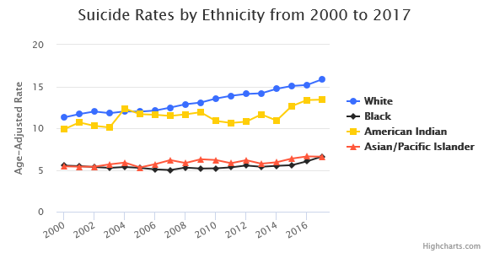
Rates by Ethnicity
Sharpest increase in White people.
Native Americans have increased and decreased
Similar rates for Black, Asians, and Pacific Islanders
Rise in suicides for Black people in the last 2 years
Source: American Association for Suicide Prevention. https://afsp.org/about-suicide/suicide-statistics/

Slide 10

Suicide Rates in African American Females
182%
Females used hanging/
suffocation (56%) or firearms (21%)
2001 to 2017
2017
94,760 AA females made suicide attempts serious enough that they had to be treated by health professionals
Price, J.H. & Khubchandani, J (2019). The Changing Characteristics of African-American Adolescent Suicides, 2001–2017. J Community Health 44: 756. https://doi.org/10.1007/s10900-019-00678-x

Slide 11

Suicide Rates in African American Males
60%
Likely to use firearms (52%) or to hang/suffocate themselves (34%)
2001 to 2017
2017
68,528 AA males made suicide attempts serious enough that they had to be treated by health professionals

Slide 12

Job Corps Specific Data
What mental health/psychiatric disorder is highest among students receiving a MSWR in Job Corps?
12
Notes:
The highest category for mental health MSWRs is Depressive Disorders, which increased almost 6 percentage points from the last PY (15.4 percent in PY 2017; 21.1 percent in PY 2018). This is consistent with research that indicates the prevalence of adults with a major depressive episode was highest among individuals aged 18-25.

Slide 13
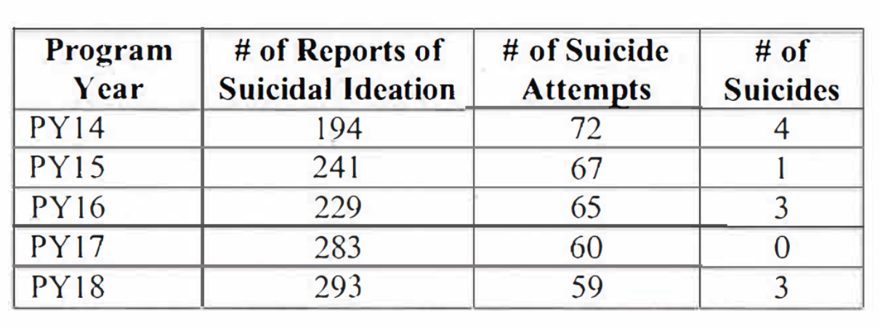
Suicide-related Incidents in Job Corps
Comparison of PY 2014 through PY 2018

Slide 14
Suicides of Job Corps Students
All male
PY15-PY18 only
  Five white, one Hispanic/Latino, one black
  The average age was 19
  Average length of stay in the program was 206 days, with a range of 7 days to 516 days

Slide 15
3 Suicides in PY19 YTD
19-year-old Native Hawaiian/Pacific Islander student | 24-year-old White student | 21-year-old African American student
1
2
3
4
All were hanging/suffocation on center (shower, closet, back of dorm room door).
All had mental health histories.
All were male.
All had relationship issues and difficulty sleeping.
42

Slide 16
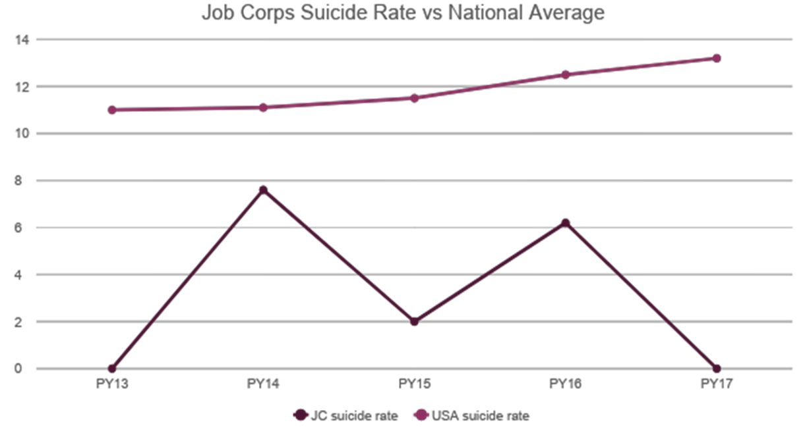
Scope of the Problem: Suicide Rates in Job Corps Lower Than National Averages
Notes:
Intervening with Suicidal/Self-injurious Youth
2011
Richard Lieberman School Mental Health Suicide Prevention Services
16

Slide 17

Risk Factors and Warning Signs
17

Slide 18


Risk Factors
Risk factors are characteristics or conditions that increase the chance that a youth may try to take their life.
18

Slide 19

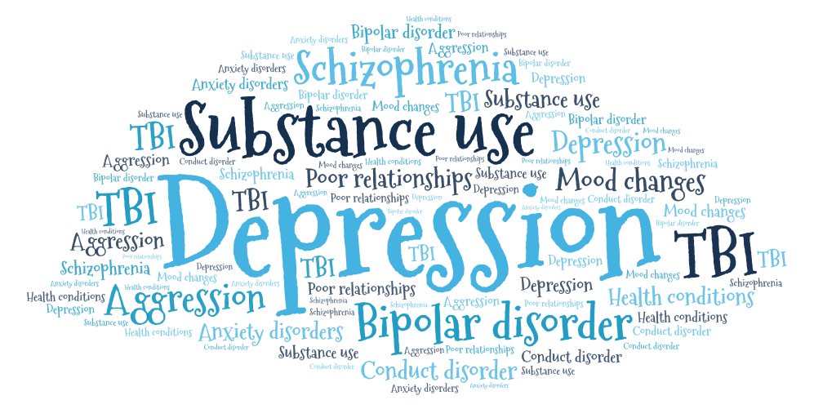
Health Factors
Notes:
Health Factors
Mental health conditions
Depression
Substance use problems
Bipolar disorder
Schizophrenia
Personality traits of aggression, mood changes and poor relationships
Conduct disorder
Anxiety disorders
Serious physical health conditions including pain
Traumatic brain injury

Slide 20

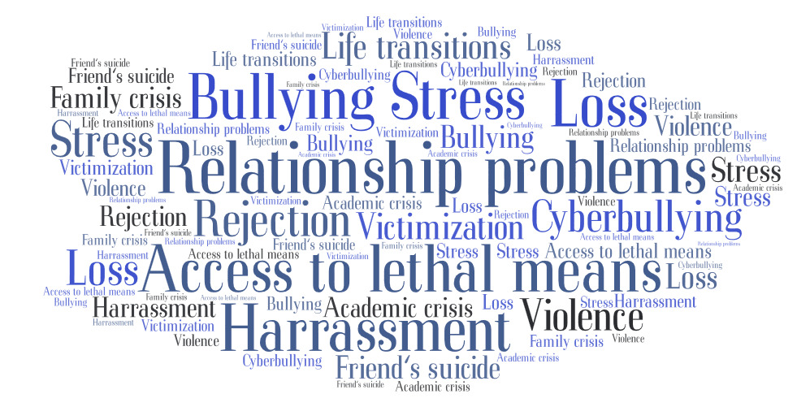
Environmental Factors
Notes:
Access to lethal means including firearms and drugs
Prolonged stress, such as harassment, bullying, cyberbullying ,relationship problems
Stressful life events, like rejection, dignity, other life transitions or loss
Exposure to another person’s suicide, or to graphic or sensationalized accounts of suicide
Victimization/exposure to violence
Center crisis (disciplinary, academic)
Family crisis (abuse, domestic violence, running away, argument with parents)

Slide 21

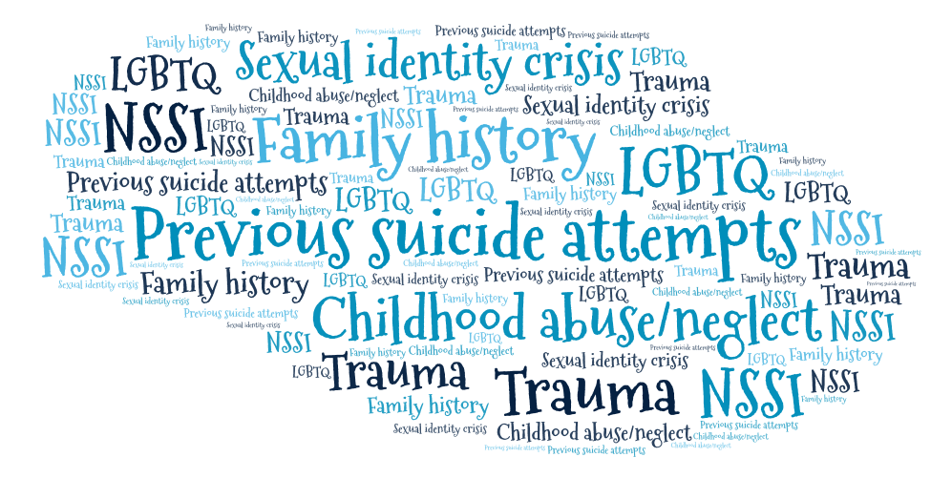
Historical Factors
Notes:
Historical Factors
Previous suicide attempts
Family history of suicide
Childhood abuse, neglect or trauma
Non-Suicidal Self Injury
Sexual identity crisis
Gay, lesbian, bisexual or transgender sexual orientation

Slide 22

Warning Signs
Look for changes in behavior or the presence of entirely new behaviors.
22

Slide 23




Warning Signs
Talk/Text/Social Media
Killing themselves, hopeless, no reason to live, burden, trapped, unbearable pain, profound sense of loneliness, alienation and isolation, sense of fearlessness
Behavior
Increased use of alcohol or drugs, looking for a way to end their lives, withdrawing from activities, isolating from family and friends, sleeping too much or too little, visiting or calling people to say goodbye, giving away prized possessions, aggression, fatigue, risk-taking behaviors
Mood
Depression, anxiety, loss of interest, irritability, humiliation/shame, agitation/anger, relief/sudden improvement
23
Notes:
Talk/Text/Social Media
If a person talks, texts or posts about:
Killing themselves
Feeling hopeless
Having no reason to live
Being a burden to others
Feeling trapped
Unbearable pain
Profound sense of loneliness, alienation and isolation
Sense of fearlessness
Behavior
Behaviors that may signal risk, especially if related to a painful event, loss or change:
Increased use of alcohol or drugs
Looking for a way to end their lives, such as searching online for methods
Withdrawing from activities
Isolating from family and friends
Sleeping too much or too little
Visiting or calling people to say goodbye
Giving away prized possessions
Aggression
Fatigue
Risk-taking behaviors such as gun play, choking game) Ineffective coping mechanisms
Inadequate problem-solving skills
.
Mood
People who are considering suicide often display one or more of the following moods:
Depression
Anxiety
Loss of interest
Irritability
Humiliation/Shame
Agitation/Anger
Relief/Sudden Improvement

Slide 24

https://www.preventyouthsuicide.org/
What are other risk factors or warning signs for our students?
Notes:
Take it seriously. Almost 80% of all suicides give some warning of their intentions.
Most important thing to look at is a change of behavior after a loss or change.

Slide 25


Protective Factors
Characteristics that make it less likely that students will consider, attempt, or die by suicide.
25

Slide 26

Protective Factors
Contact with a caring adult
Access to and care for mental/physical/substance disorders
Awareness of crisis hotline resources
Strong sense of belonging and connection
Family warmth, stability, support and acceptance
Sense of positive connection or participation in a program
https://www.cdc.gov/violenceprevention/suicide/riskprotectivefactors.html

Slide 27

Other Protective Factors
Restricted access to highly lethal means
Resilience/Positive self-esteem and strong problem-solving and conflict resolution skills
Cultural, spiritual and religious beliefs that discourage suicide and support self-preservation
Which ones do you think Job Corps provides? Type in Chat Box!

Slide 28


Core Components of a Culturally Sensitive Program
Planning, Training, Environment, Early Identification, Assessment, Intervention and Postvention
28

Slide 29
Planning
Center operating procedure for handling psychiatric emergencies.
Critical Incident Response Team and Plan.
Become more aware of the various cultures that exist within your center and its impact on suicide prevention activities.
  Know the traditions, rituals, and belief systems of your diverse population. Obtain community resources to meet diverse needs, including LGBTQ resources.
Seek input from your students. They are the EYES and EARS on/off center and on social media!
Expand Y2Y program to address suicide prevention and response. Peer-to-peer educational campaigns like "Seize the Awkward" and #BetheOneTo
Utilize SIR system for surveillance.

Slide 30

Health Care Guidelines Training
Provide Gatekeeper training for non-health staff, especially the residential advisors, counselors, trade instructors, and academic staff.
Ensure ALL staff view this recorded webinar
Ensure ALL staff complete the required annual online SafetyNet training
Ensure CMHCs are conducting Gatekeeper training with ALL new students as part of CPP
Notes:
=
Ensure ALL staff complete the required annual online SafetyNet training
Job Corps Program Instruction Notice 19-04 Promoting Student Safety Through Suicide Awareness and Prevention and Reminder to Complete Mandatory SafetyNet Training.
Ensure CMHCs are conducting Gatekeeper training with ALL new students as part of CPP.
Training outline is on the Health and Wellness website.
Provide Gatekeeper training for non-health staff, especially the residential advisors, counselors, trade instructors, and academic staff at next all staff training and for new hires.
Training PowerPoint can be downloaded after webinar
Health Care Guidelines Training
Treatment Guideline for Health Staff and Symptomatic Management Guideline for Non-Health Staff for Suicide Attempts/Threats on the Health and Wellness website.

Slide 31
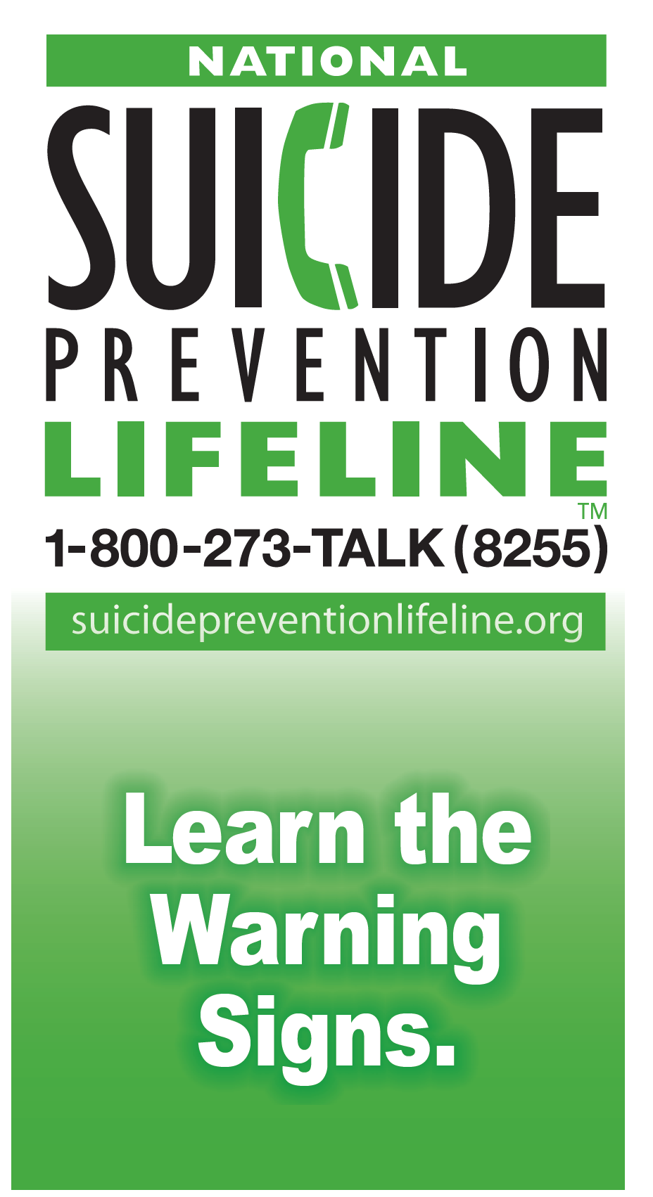
Environmental Actions
Continue to remove access to means via thorough security checks and dorm room checks.
Consider break away rods for showers, closets, lockers.
Ensure students have information on national hotline.
  Free Wallet Cards- https://store.samhsa.gov/product/National-Suicide-Prevention-Lifeline-Wallet-Card-Suicide-Prevention-Learn-the-Warning-Signs/SVP13-0126

Slide 32
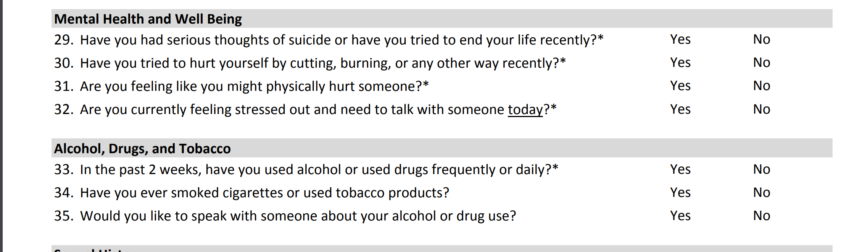
Clinical Areas - Early Identification
Applicants
  ETA 6-53 Health Questionnaire
  Applicant File Review Process
    Appendix 107 – Applicant File Review Guidance – Center process
Students
  ETA 6-53 Health Questionnaire
  Health History Form
    Mental Health and TEAP Alert Questions
  Social Intake Form

Slide 33
Assessment
Suicide Assessment Five Step Evaluation & Triage
Identify Risk Factors
Identify Protective Factors
Conduct Suicide Inquiry
  Ideations, Plan, Behavior, and Intent
Determine Risk Level/Intervention
  Next Slide
Document
  Assessment of risk, rationale, intervention, and follow-up.
    Off-center psychiatric evaluation
    Possible MSWR
If CMHC or CP is not on center, student would be sent to crisis unit or ER for evaluation per center operating procedure.

Slide 34
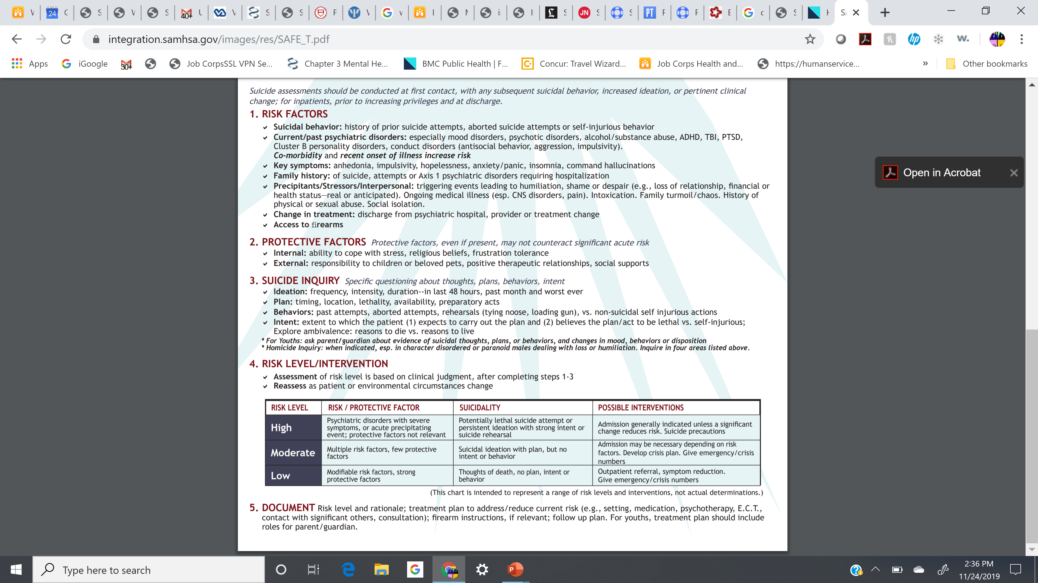
Expand with use of evidence-based screening tools for depression, anxiety, and suicide risk.
Patient Health Questionnaire – 9 (PHQ-9) and modified PHQ-9 for Adolescents
Generalized Anxiety Disorder Scale – 7 (GAD-7)
Columbia-Suicide Severity Rating Scale (C-SSRS)
Adolescent Suicide Assessment Protocol (ASAP-20)

Slide 35

Gatekeeper Training
Staff and student roles as gatekeepers in suicide prevention and intervention
35

Slide 36

What can we do?
Gatekeeper Training
Gatekeepers are responsible center staff who spend time with students that might be vulnerable to depression and suicidal thoughts and student peers.
Research indicates that gatekeeper training can impact four important factors—knowledge, perceptions about depression and suicide prevention, reluctance, and self-efficacy—and that changes in these factors can influence intervention behavior.
There are several programs: SOS, QPR, MHFA, Psychological First Aid and more!
Kuhlman, S. T., Walch, S. E., Bauer, K. N., & Glenn, A. D. (2017). Intention to enact and enactment of gatekeeper behaviors for suicide prevention: An application of the theory of planned behavior. Prevention Science, 18, 704–715.

Slide 37

Question-Persuade-Refer (QPR)
Anyone can learn to ask the right questions to help a depressed and/or suicidal student or staff member
Depression is an illness, like heart disease, and suicidal thoughts are a crisis in that illness, like a heart attack
You would not leave a heart attack victim lying on the sidewalk – many have been trained in CPR
The QPR program (N = 2,389), participants in QPR demonstrated knowledge and suicide prevention behavior gains compared with control groups.
QPR-SAMHSA’s National Registry for Evidence-Based Programs and practices (NREPP)
Hangartner, R. B., Totura, C. M. W., Labouliere, C. D., Gryglewicz, K., and Karver, M. S. (2018). Benchmarking the “Question, Persuade, Refer” program against evaluations of established suicide prevention gatekeeper trainings. Suicide Life Threat. Behav. doi: 10.1111/sltb.12430 print].

Slide 38

First Step:
Acknowledge the Student’s Distress
“I’ve noticed you’ve seemed less interested in your work and you’ve been spending more time alone.”
“Coming to JC can be really hard and a lot of students miss their families. I’m worried about you because you’ve seemed really down.”
Actively listen
Be attentive
Don’t interrupt
Don’t condemn depression or suicide
Don’t judge
Quiet your own fears

Slide 39

How to Ask the Suicide Question
Less Direct Approach:
  “Have you been unhappy lately?
  Have you been very unhappy lately?
  Have you been so very unhappy lately that you’ve been thinking about ending your life?”
  “Do you ever wish you could go to sleep and never wake up?”

Slide 40

How to Ask the Suicide Question
Direct Approach:
  “You know, when people are as upset as you seem to be, they sometimes wish they were dead. I’m wondering if you’re feeling that way, too?”
  “You look pretty miserable, I wonder if you’re thinking about suicide?”
  “Are you thinking about killing yourself?”
NOTE: If you cannot ask the question, find someone who can.

Slide 41



How to Persuade Someone to Stay Alive
Listen to the problem and give them your full attention
Remember, suicide is not the problem, only the solution to a perceived insoluble problem
Do not rush to judgment
Offer hope in any form
Then say: “I’m concerned about you.”
Then ask:
          “Will you go with me to get help?”
          “Will you let me help you get help?”
          “I care about you and I want to take you to the Wellness Center to get more help…”
          “Will you let me make you an appointment with…”

Slide 42
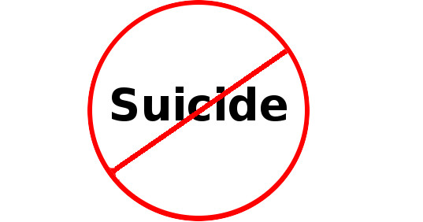
Refer
Depressed and suicidal young people often believe they cannot be helped, so you may have to do more.
The best referral involves taking the student directly to someone who can help.
If the student refuses help, you may need to get other staff involved. While arranging for help, stay with the person.
    Don’t worry about breaking trust or being disloyal
    Don’t worry that you may not have “enough” information to call for help
    Get help!

Slide 43

Kelly
Kelly is 19-year-old bisexual female who has been at Job Corps for three months.
While surfing Facebook she learned that her girlfriend back home is involved in another relationship.
After that, Kelly gets a positive suspicion test for alcohol and is placed in TEAP.
Kelly used to play on the center’s volleyball team but is now refusing to go to the gym or play.
One evening Kelly gets into a heated verbal argument with roommate and is now going before the CRB. Kelly has stopped talking much with staff or students.
Notes:
Given that you knew Kelly, and were aware of the distress, which of the following would be the best response?
Wait and see how things go because relationship stuff happens all the time at Job Corps.
If I knew about the girlfriend problems, I would talk to Kelly to see if they were alright. I would ask Kelly if she felt depressed or suicidal. If Kelly said yes, I would escort her to see the Counselor or stay with her until I could get someone from Wellness.
Because of Kelly’s alcohol abuse and current relationship with the TEAP specialist, I would inform the TEAP specialist that something was troubling Kelly. I would make referral and suggest that the TEAP specialist talk to Kelly since they have a relationship.

Slide 44

Shawn
Shawn is A 19-year-old American Indian/Native American male and is close to graduating from Job Corps. He came in as a homeless student. He had difficulty learning in the trade and some disciplinary problems but he will graduate in about 4 weeks. A couple of days ago, he received a call from his mother saying that he can’t come live with her and he got really upset.
You approach Shawn and he states that no one understands him, things never get better, and that his life is crap.
What do you say next and why?

Slide 45


Helping Shawn
ACKNOWLEDGE DISTRESS
Right now it feels like nothing is going right for you…
You’re not sure how all this is going to work out…
ASK THE SUICIDE QUESTION
Indirect: Sometimes when life feels like crap people wish they could go to sleep and not wake up. Have you been feeling that way?
Direct: Are you having thoughts of killing yourself?
45

Slide 46




Staff role in Postvention
Center Administration
Provide honest and timely information
Honor the family's request for privacy
Meet with the students’ friends, family, and others who knew the student well to identify a meaningful and safe way to acknowledge the loss, one that ideally encourages other students who may be struggling to seek help
In commemorating the student, it is important to focus on the life of the person rather than the death and method
Health and Wellness, Counseling, and Residential Staff
Identify vulnerable students for immediate support/evaluation
Make sure staff know how and when to make the appropriate referrals
Connect students with systems of support
Provide education about grief and stress
All Staff
Encourage the ventilation of feelings
Reinforce strengths and positive coping strategies
46
Notes:
Talk/Text/Social Media
If a person talks, texts or posts about:
Killing themselves
Feeling hopeless
Having no reason to live
Being a burden to others
Feeling trapped
Unbearable pain
Profound sense of loneliness, alienation and isolation
Sense of fearlessness
Behavior
Behaviors that may signal risk, especially if related to a painful event, loss or change:
Increased use of alcohol or drugs
Looking for a way to end their lives, such as searching online for methods
Withdrawing from activities
Isolating from family and friends
Sleeping too much or too little
Visiting or calling people to say goodbye
Giving away prized possessions
Aggression
Fatigue
Risk-taking behaviors such as gun play, choking game) Ineffective coping mechanisms
Inadequate problem-solving skills
.
Mood
People who are considering suicide often display one or more of the following moods:
Depression
Anxiety
Loss of interest
Irritability
Humiliation/Shame
Agitation/Anger
Relief/Sudden Improvement

Slide 47

Suicide is about despair, and the only cure for despair is hope. We can prevent suicide by recognizing the warning signs, asking the question, and helping our students regain hope.

Slide 48





Next steps
Ensure ALL staff view this webinar
Implement suggestions and use resources in this webinar.
SafetyNet Training
Located in LMS in Citrix
GateKeeper Training for Students
Ensure CMHCs are conducting Gatekeeper training with ALL new students as part of CPP. Training outline is on the Health and Wellness website.
Gatekeeper Training for Non-Health Staff
Especially the residential advisors, counselors, trade instructors, and academic staff. Do at next all staff training and for new hires.
Center-wide Activities
Engage students to develop culturally sensitive center-wide suicide prevention activities. Peers are powerful!
48

Slide 49
Resources
Job Corps Resources
FREE Screening Tools
Job Corps Health Care Guidelines
Job Corps New Student CPP Training
Job Corps Appendix 107 – Applicant File Review
Job Corps Critical Incident Crisis Intervention Plan
.
C-SSRS: Columbia-suicide severity rating scale
PHQ: Patient Health Questionnaires Generalized Anxiety Disorder Scale–7(GAD-7)
CES-DC: Center for Epidemiologic Studies-Depression Scale
MFQ: Mood and Feelings Questionnaire
DSRS: Depression Self-Rating Scale
KADS: Kutcher Adolescent Depression Scale
SDQ: Strengths and Difficulties Questionnaire
49

Slide 50
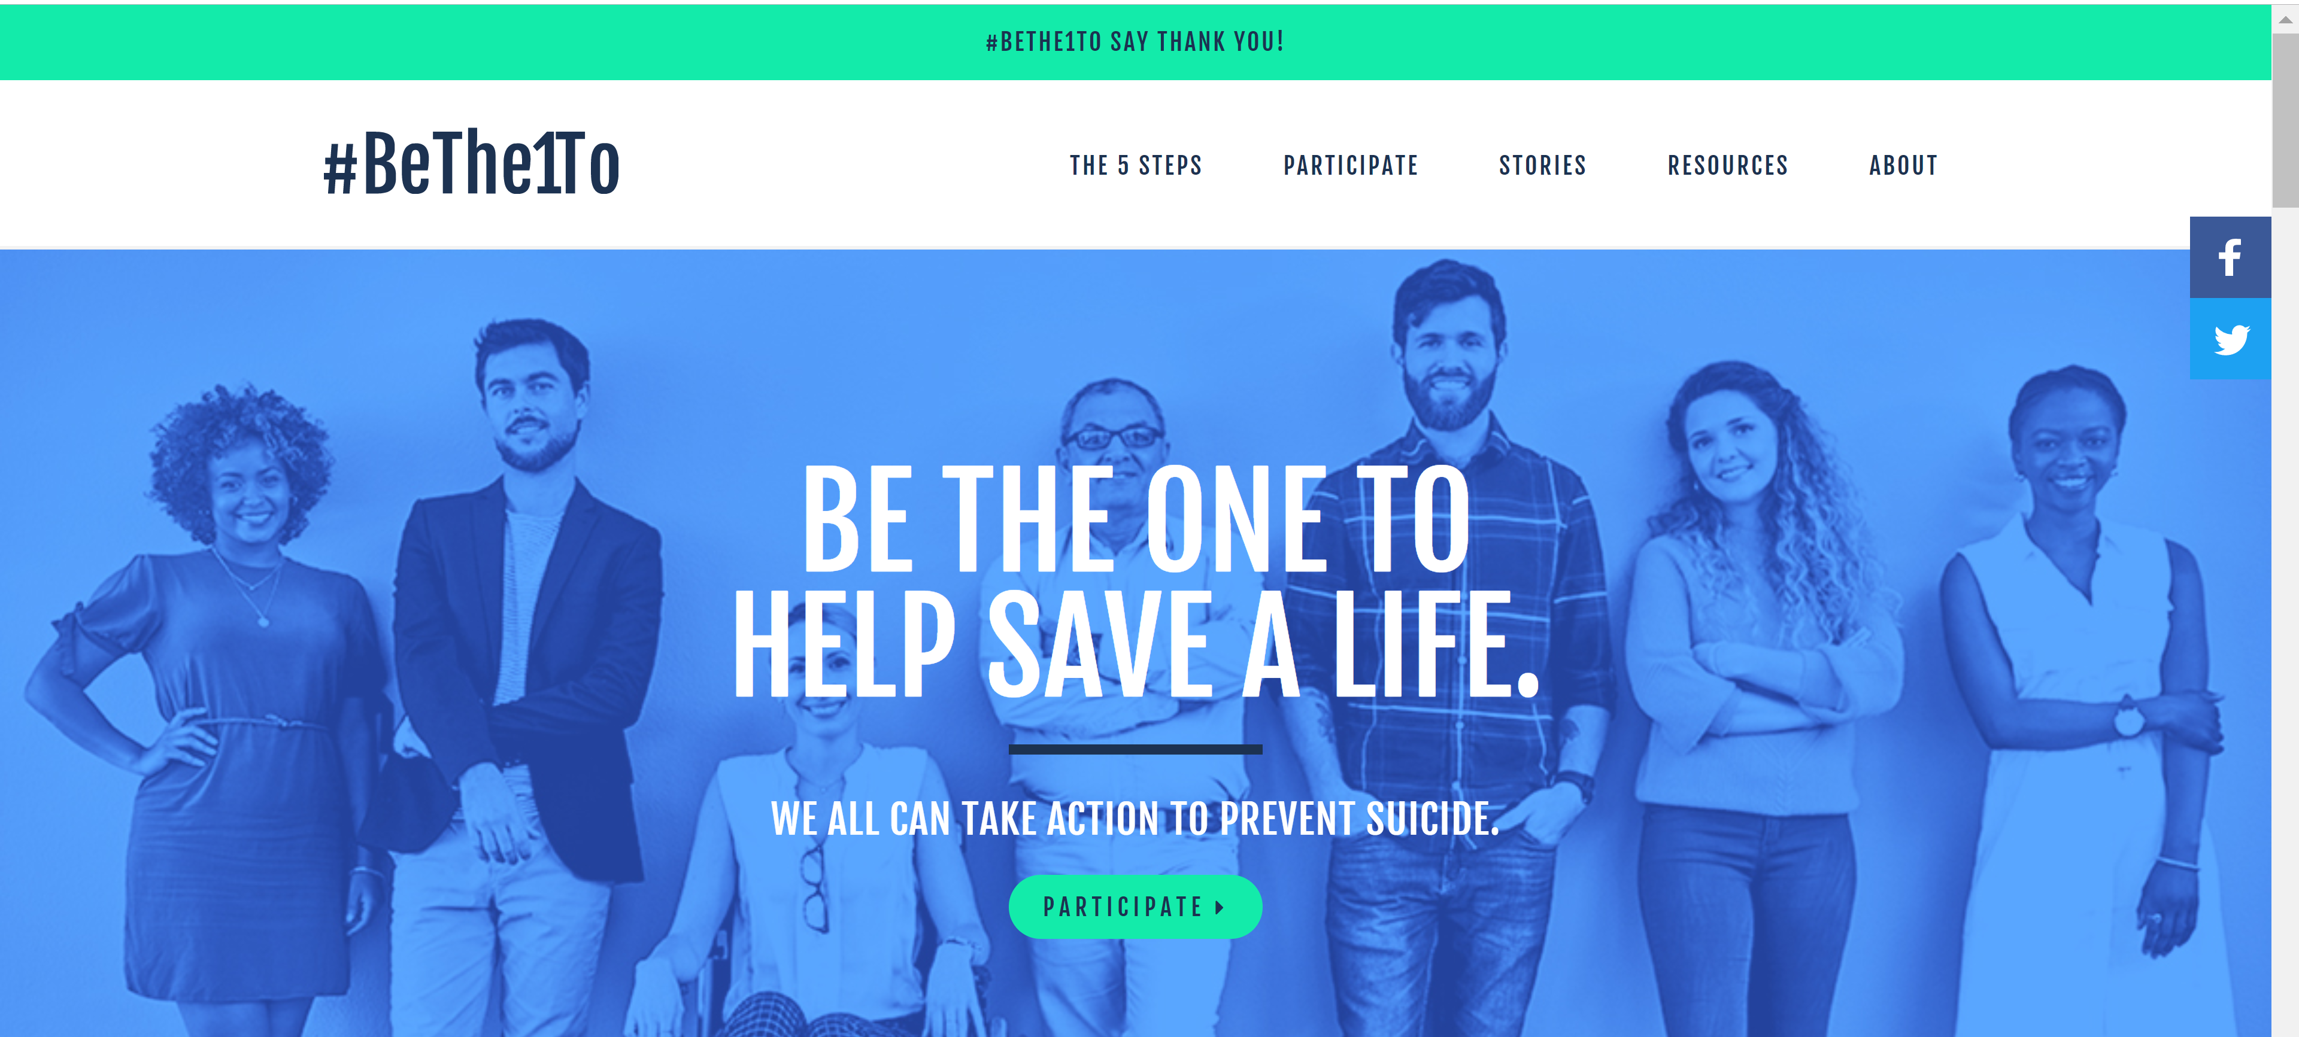
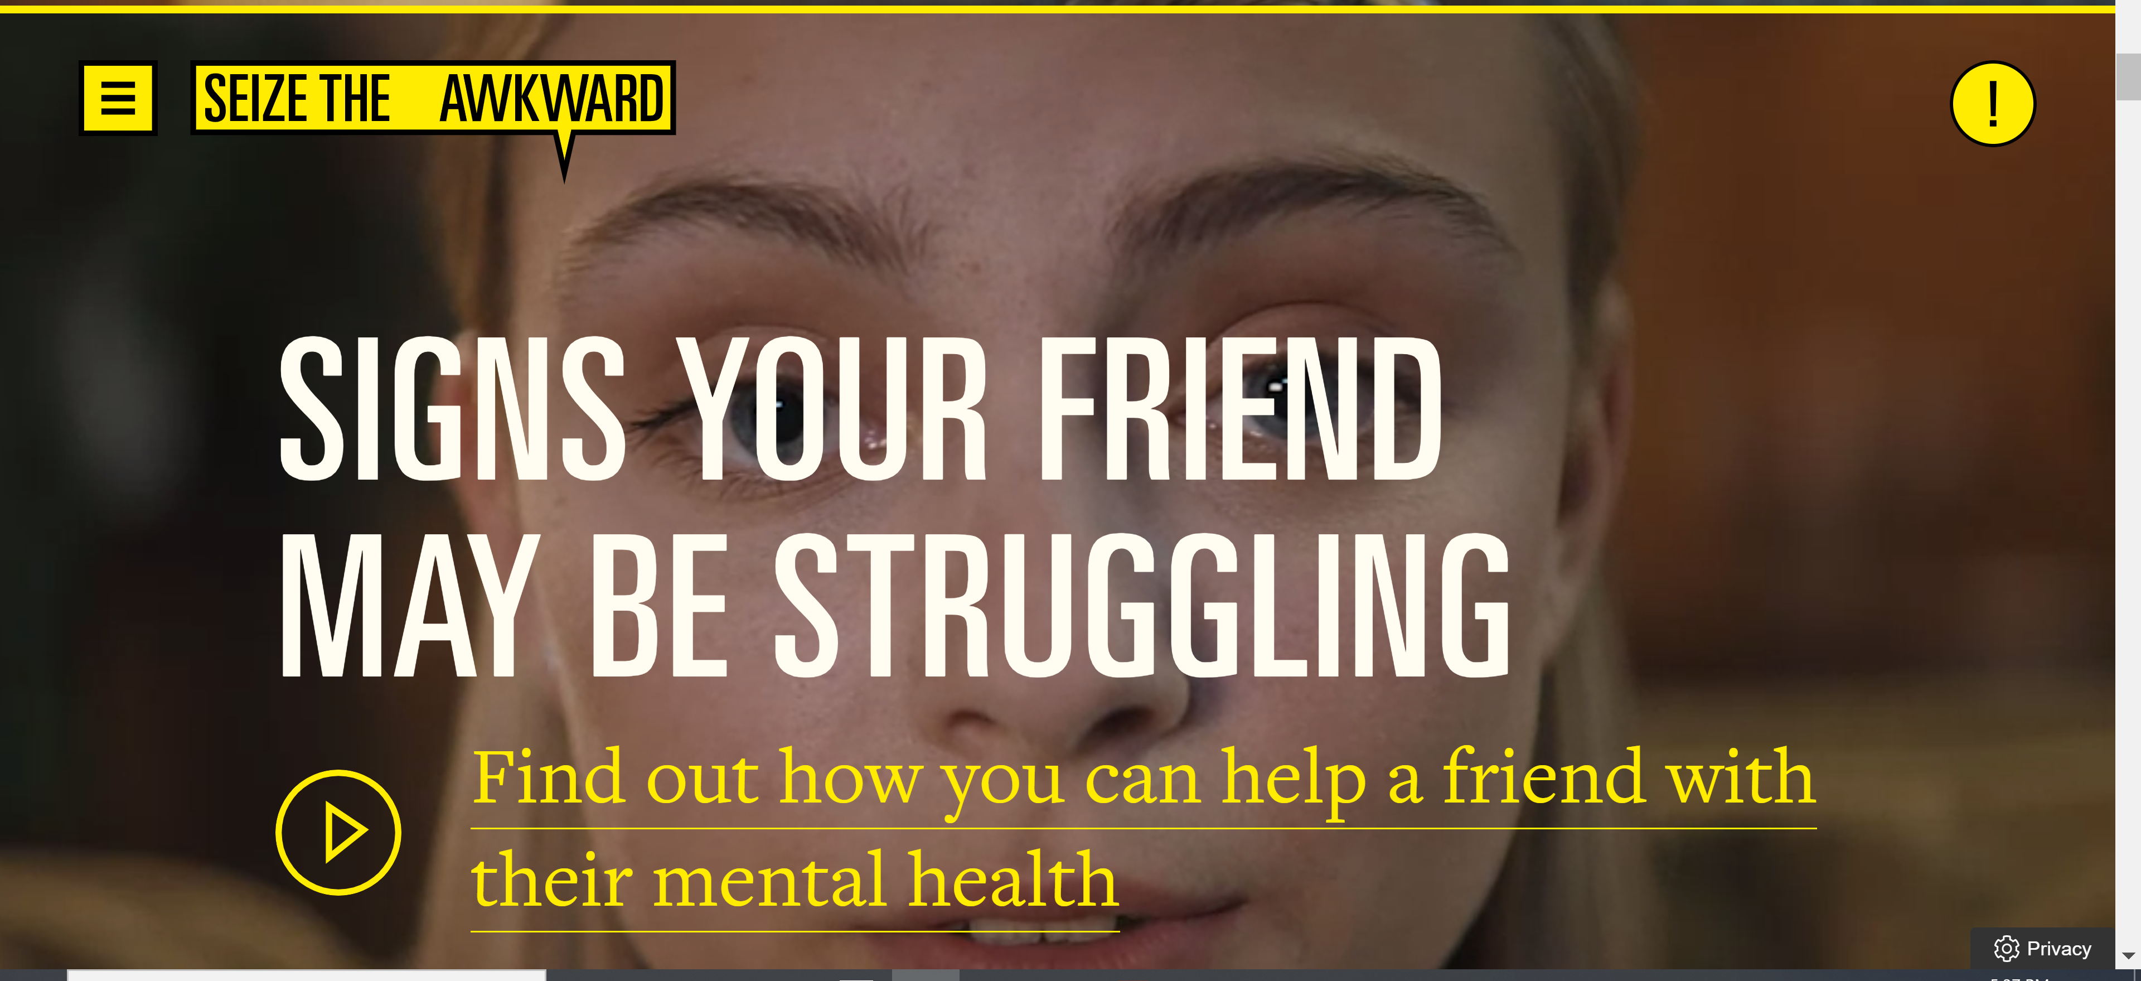
Peer-to-Peer Initiatives
#BeThe1To
https://www.bethe1to.com
Seize The Awkward
https://seizetheawkward.org

Slide 51

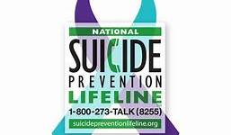

Hotlines
Trevor Project
866-4-U-TREVOR
National Lifeline
800.273.TALK
SPRC
www.sprc.org

Slide 52


