Slide 1
Ways to Make the Most of the Expanded TEAP Hours
Diane Tennies, PhD, LADC
Boston, Philadelphia,
San Francisco Regions

Slide 2
Learning Objectives
Participants will:
1) understand the history and rationale for the necessity of the expanded hours.
2) be able to expand center wide educational activities to ensure ePRH requirements are met and even exceeded.
3) identify two ways to immediately intensify TEAP intervention services.

Slide 3
Job Corps’ Mission
As a national primarily residential training program. Job Corps’ mission is to attract eligible young adults, teach them the skills they need to become employable and independent, and place them in meaningful jobs, higher education, or the military.

Slide 4
History of the Evolution to TEAP
Job Corps started in 1964 with LBJ and around late 1980s saw increasing aware of need for substance-related services
Different Names:
Substance Use and Abuse Program (SUAP)
Alcohol and Other Drugs of Abuse (AODA)
Trainee Employee Assistance Program (TEAP)
Through January 2013 all centers had at least 1 full-time TEAP (with centers of 500 or more students having additional time)
Then went to a formulary of 6 hours of TEAP per 100 students so a center of 300 students went from 40 hours to 18 hours of TEAP services (PRH Change Notice 12-10)
Also increased requirements for prevention/education services

Slide 5
What Changed?
Lost more than 80% of TEAP specialists
Lost the ‘institutional’ memory
Decreased visibility of the program
Increased focus on drug-testing component only
Less individual sessions
Nurses or other collecting UDSs
On the PCAs consistently saw concerns for:
Limited center-wide education
No CDP and CTP
Limited assessment of high risk students
Limited Relapse Prevention
Poor documentation

Slide 6
All at at time when….

Slide 8
ePRH Change Notice 18-07
Released in 12/2018
Noted that from PY2011 through PY2017:
Saw increase in entry positives from 23.3 to 30.3 percent
Safety/security concern given relationship to interpersonal violence and other high-risk behaviors
TEAP specialist hours increased to 15 hours per 100 students per week
An expansion in hours: “Will allow for all students exhibiting risk for substance use, not just those testing positive on entrance, to receive increased and more individualized and comprehensive services related to substance use thereby increasing their probability of success and optimizing safety/security on center.”

Slide 9
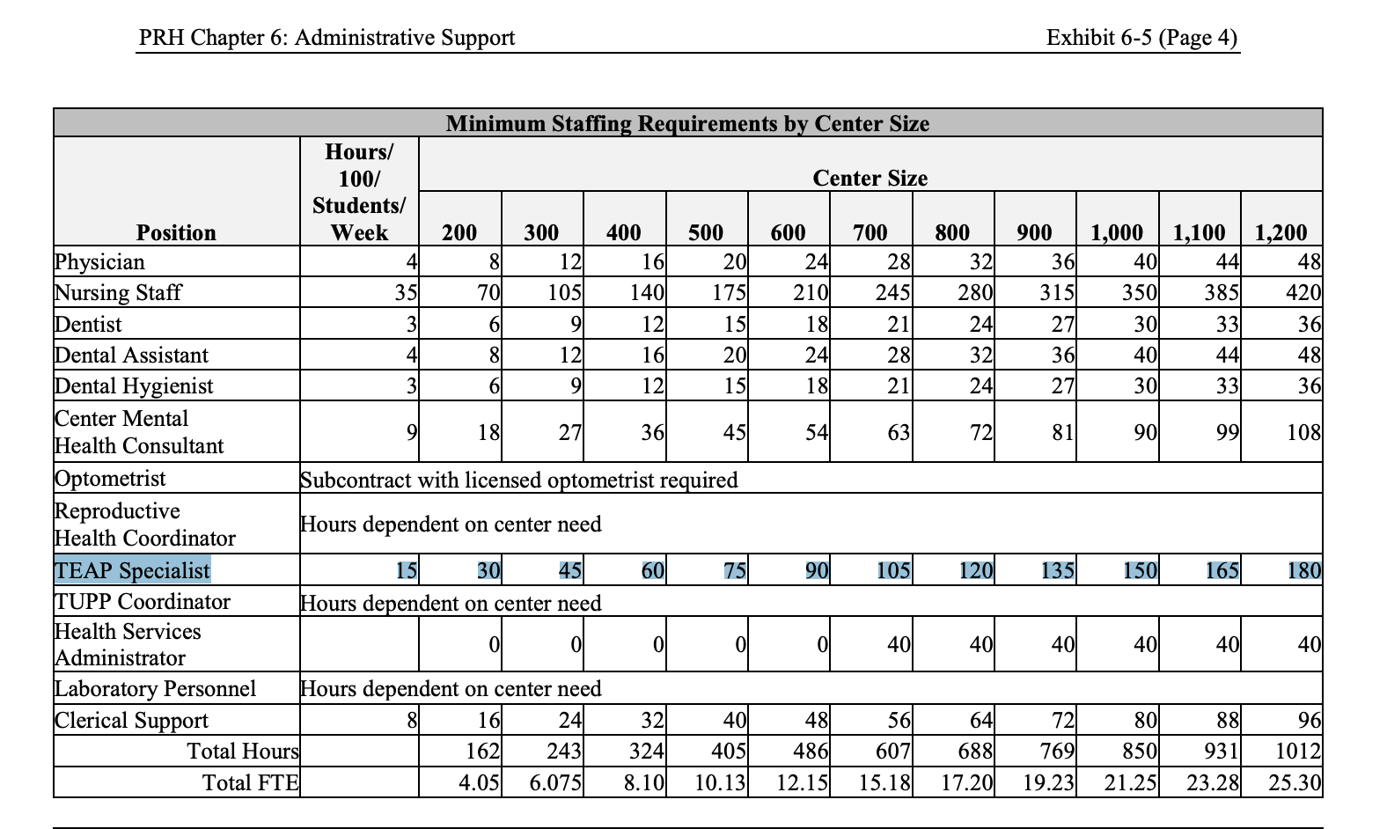
>266 students means a FTE

Slide 10
What Does This Mean?
Notice said: “Increased and more individualized and comprehensive services”
Practically what does this means?
Increased visibility/more energy
More time for center-wide activities/CDP/CTP
Increased focus on at-risk students through assessment and involvement
Expanded RP program/intensify intervention services
Increased Collaboration
CMHC
HEALs
Suspicion screening process/TEAP referrals
Training
Applicant File Review
TUPP expansion or even just implementation
TEAP best practices
Documentation

Slide 11
No excuse to not be very
familiar with these
resources:

Slide 12
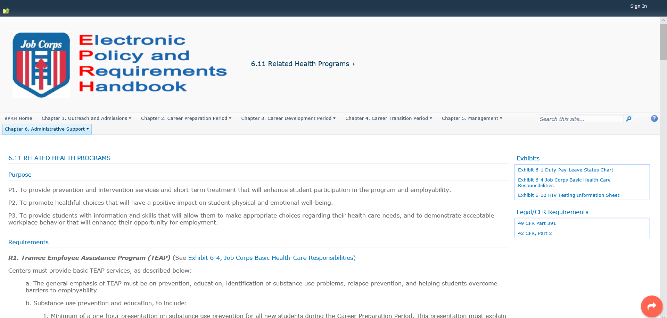

Slide 14
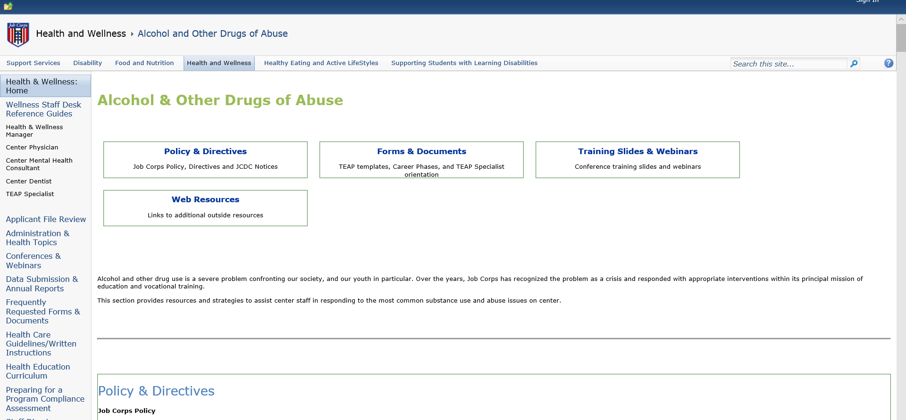

Slide 15
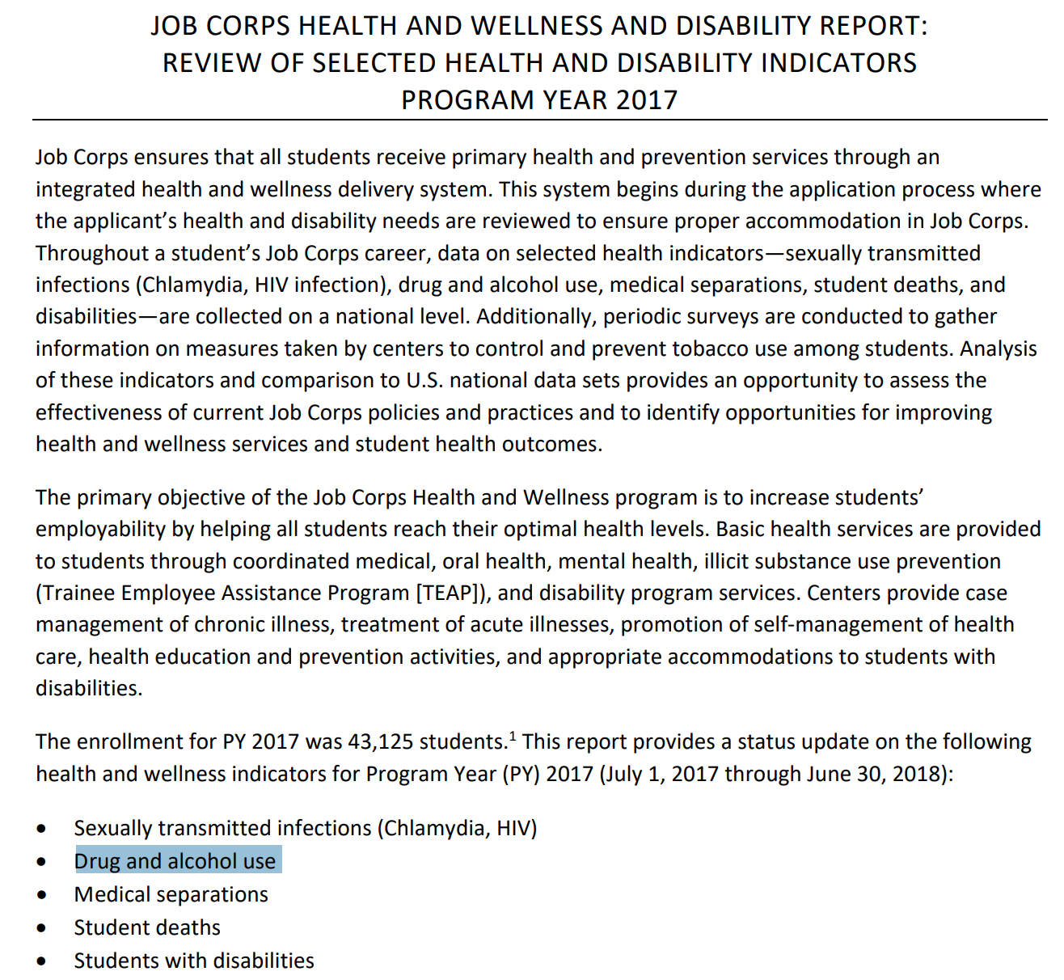

Slide 16
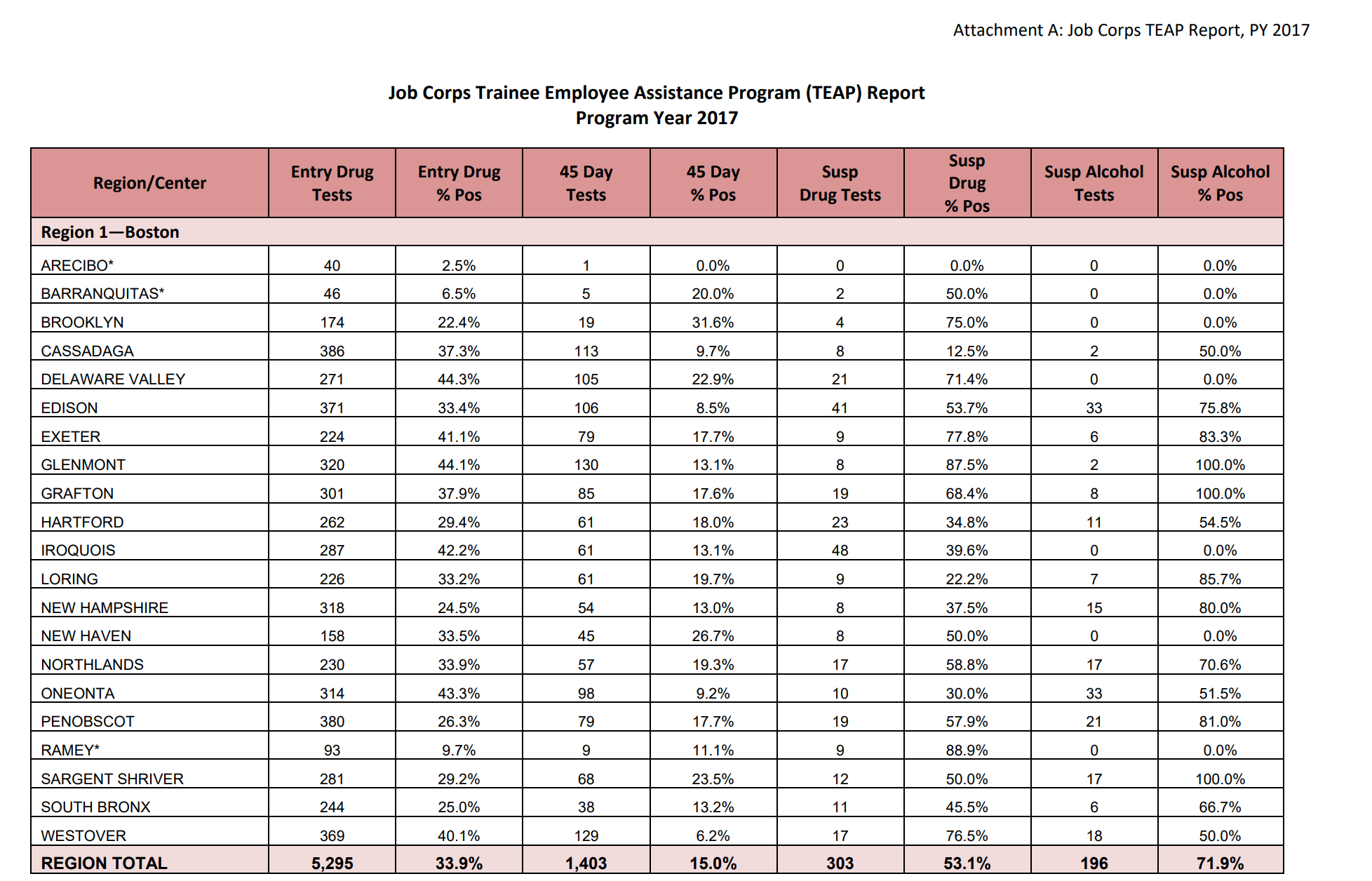

Slide 17
Increased Visibility
How to be more visible:
Be ”out and about”
If it is happening on center - be part of it
Welcoming new students/Involvement with OA process
Cafeteria/Tabling
Consider hours – residential?
Recreation – consider working out with students
Use of electronics to increase ‘footprint’
Newsletters
Email blasts
”electronic bulletin boards”
Other ideas?

Slide 18
More Time for Center-Wide Activities
Requirement is minimum of 3 center-wide activities annually
Allows more time to find community speakers
Review materials ahead of time
Remember our students have history of trauma – provide support when sensitive topic
Collaborate with other departments
Best practice – monthly activities
Research monthly themes (we have a handout ☺)
CDP/CTP
Use templates
Increase frequency
Take pictures/notebook/handouts

Slide 19
Increased Focus and Support for At-Risk Students
Review of SIF (CRAFFT) and sign within 7 days
Utilize “formalized assessment measures” for this population
Offer voluntary assistance and follow-up periodically
Repeat exposure pays off
Get trained and use Motivational Interviewing
MSWR process – you must be involved
Conduct assessment
Collaborate with CMHC
What about “super users”?

Slide 20
Expanded Relapse Prevention Services
Expanding services to those after first 45 days to increase retention
These are ways to immediately intensify the intervention services*
Access to self-help meetings
On versus off center
Level of supervision/support
Online resources
Integrated into Intervention groups (when was last time you updated materials and made fresh copies?)
Separate RP group
Open groups (more support focused)*
Google what new in RP
More individualized sessions with students*

Slide 21
Increased Collaboration
Regular meetings with CMHC
Attend case management conference (and document in SHR)
TEAP is required member for HEALs
Training requirements
Identification of “reasonable suspicion”
Importance of TEAP referral
Narcan – online training at: https://www.getnaloxonenow.org/
Health Care Guidelines (HCG) and Symptomatic Management Guidelines (SMG)
Treatment Guidelines for Health Staff for Acute Alcohol Intoxication, Alcohol or Drug Use Behavior and Intranasal Narcan for Suspected Opioid Overdose
Suspicion screen process
Updated form (see website)
Involvement of TEAP for clinical information

Slide 22
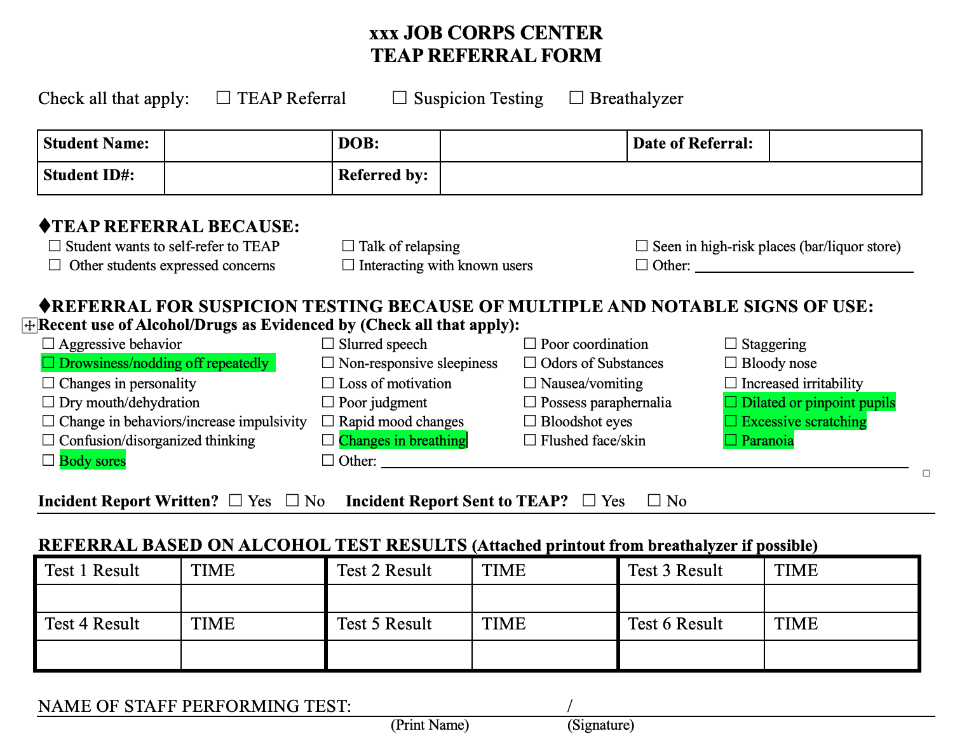
As an Example:

Slide 23
Other TEAP Best Practices to Consider
Developing and expanding peer mentoring
Including more ‘completers’ in intervention groups
Separate mandatory versus voluntary TUPP groups
Expand community partners
Expand center alliances
Expand management alliances (consider being part of CD monthly meeting)

Slide 24
Applicant File Review
See the webinar on the JC Community Website called, “All you ever wanted to know about AFR and TEAP.”
Use only Appendix 610 – Health Care Needs Assessment.
If there are TEAP-related issues – then TEAP specialist MUST be involved and sign HCNA.
Focus on current functioning and what interferes with ability to benefit from training at JC.
Contact Diane or Christy as the process may seem daunting but is easily accomplished so that file is not returned to your center.

Slide 25
Tobacco Use and Prevention Program (TUPP)
Centers must implement a program to prevent the onset of tobacco use and to promote tobacco-free environments and individuals.
TUPP Coordinator may or may not be TEAP Specialist.
Centers must establish a smoke-free, tobacco-free environment for the majority of the center.
Centers are encouraged to maintain an entirely tobacco-free environment, especially during the training day.

Slide 26
TUPP Ideas
Case management for tobacco cessation should be offered to all students who use tobacco products.
Staff should not use tobacco in the presence of students.
Criteria for those who may benefit from nicotine replacements therapy (NRT):
It is unclear from the research that minors benefit from NRT and they tend to keep using tobacco while using the NRT
Students on NRT should participate in the TUPP on center.
Students who desire to use NRT should be smoking more than 10 cigarettes per day (a half pack per day), to be eligible for the NRT program.
The students should be willing to set a date by which s/he intends to quit smoking and use NRT for support of cessation.
Finally, the NRT students should be followed weekly in the HWC to check-in with the staff and receive their one week supply of NRT.

Slide 27
More TUPP Ideas
Designated tobacco-use areas should be located away from central locations to discourage non-tobacco users from congregating with tobacco users, and have proper receptacles.
Use evidence based practices for tobacco cessation groups
example: Not on Tobacco.
Have separate groups for minors and those wanting to cease tobacco use.
Have policy for tobacco products like e-cigarettes and vape pens

Slide 28
Documentation
Any time have clinical contact with student – not a suggestion
Make the SHR ‘tell the story’ – in TEAP section
Includes Assessments (signed)
Templates on website to assist
Required components:
Content
Individualized
Plan
Dated/signed

Slide 29
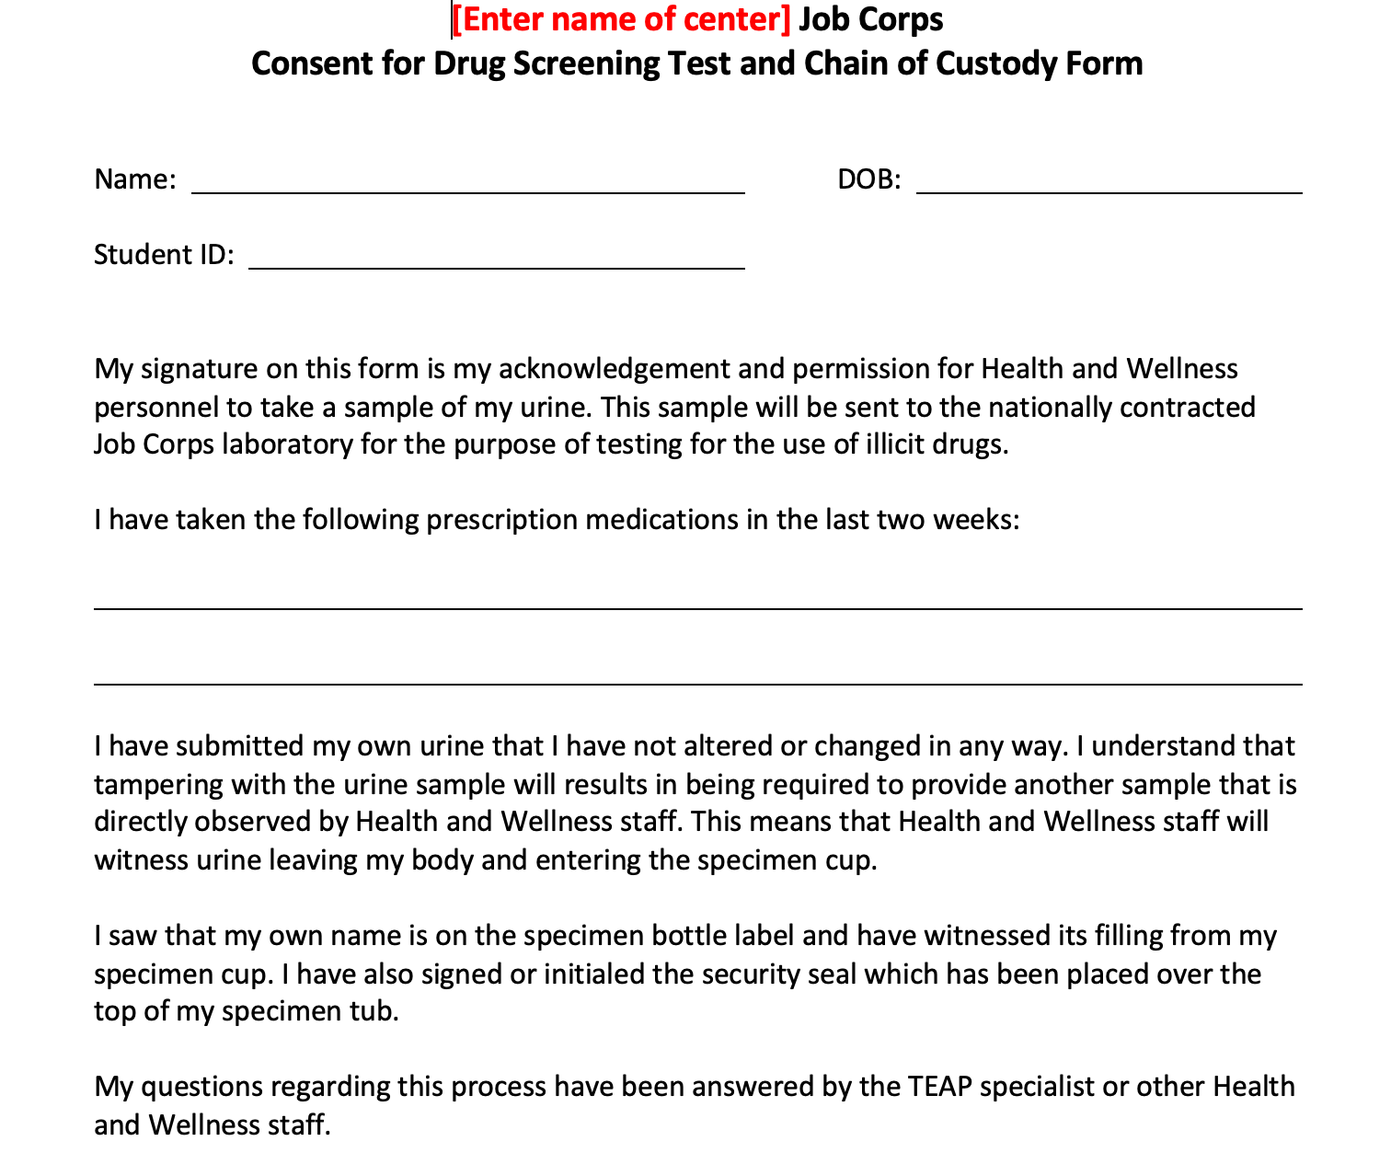

Slide 30
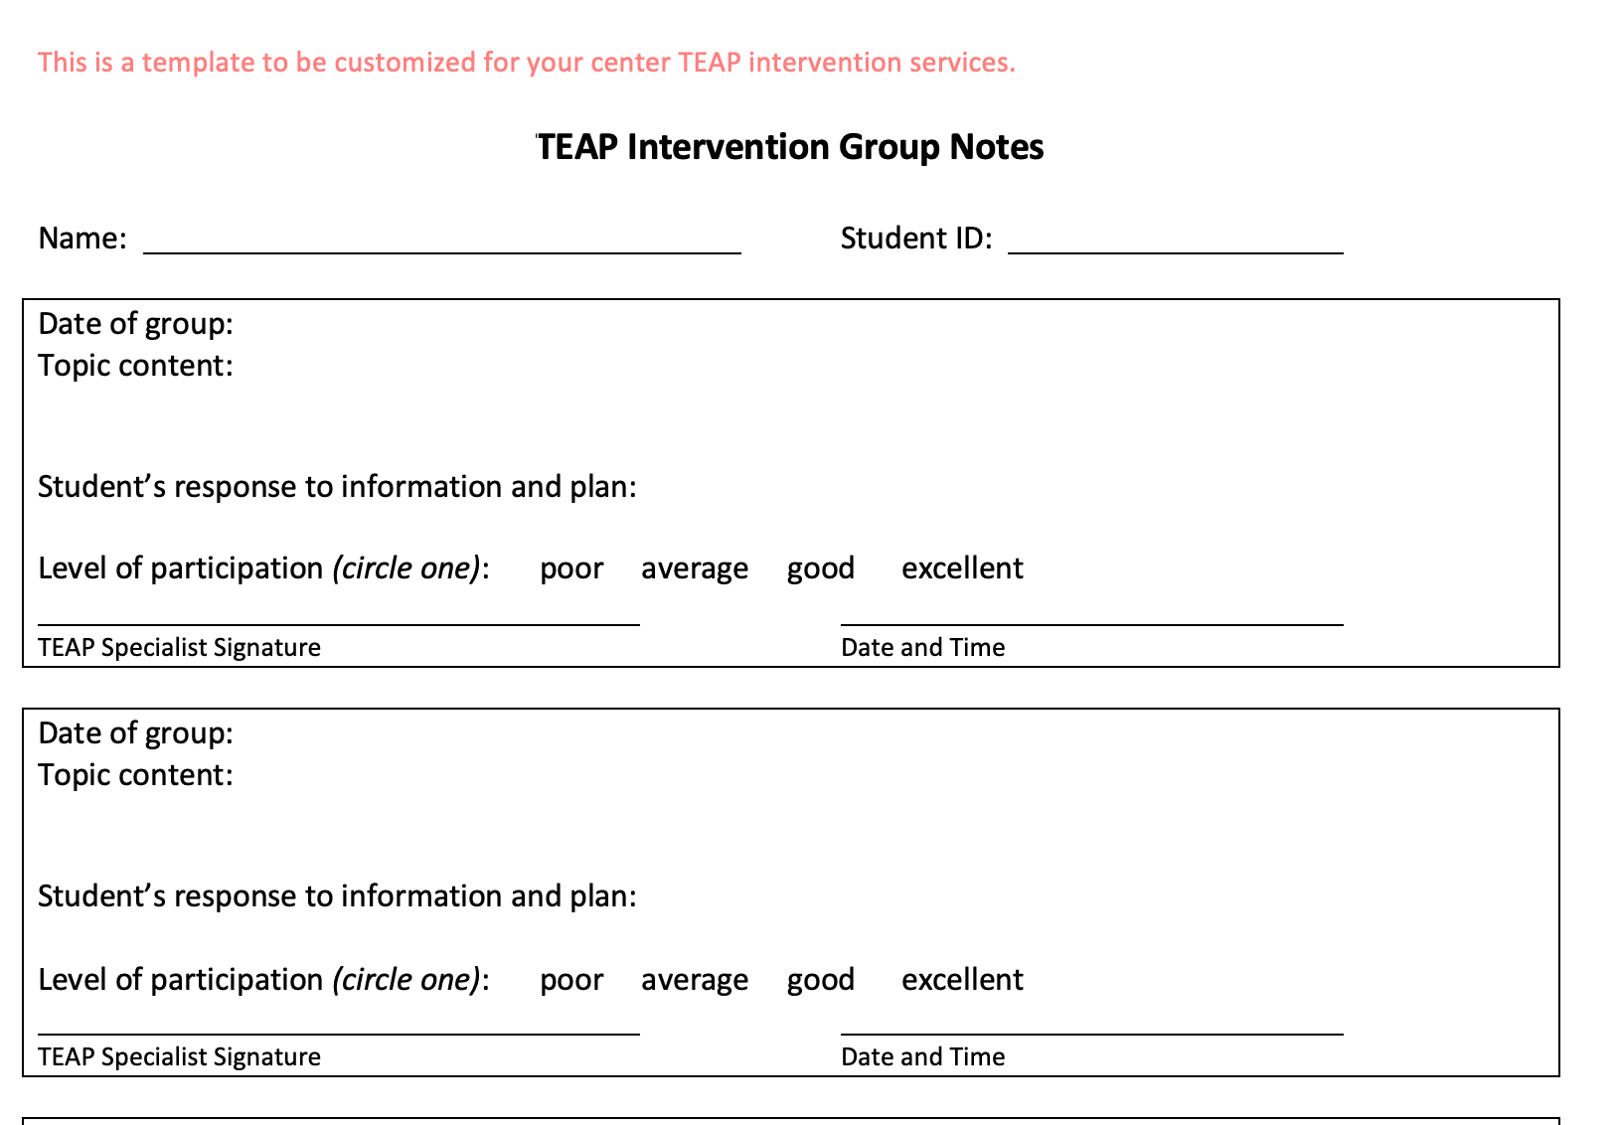

Slide 32
QUESTIONS?

