Slide 1
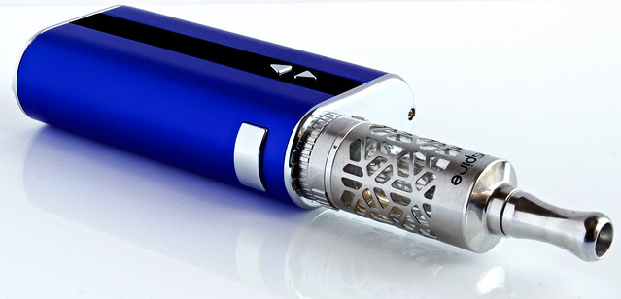
Vaping and eCigarettes
Diane Tennies PhD, LADC, Lead TEAP Specialist
John Kulig MD, MPH, Lead Medical Specialist
Office of Job Corps
November 4th, 2019

Slide 2
Learning Objectives
Describe the epidemiology of vaping among youth
Describe e-cigarette and vaping associated lung illness (EVALI) including demographics, clinical features, and etiology
Explain current CDC advice on vaping and EVALI prevention
List recommendations on what Job Corps Center can do

Slide 3


Slide 4
Junaid Khan, a heart and lung surgeon in California says in the Summer 2019 he completed his first surgery related to teen vaping injury on young healthy 18-year-old male. Patient had a collapsed lung related to blisters which had formed and ruptured.
Teenager later revealed he had
purchased a marijuana vape pen
from a pop up shop at a rock concert.

Slide 5
Brief Intro to Tobacco and Nicotine Use
For thousands of years, people have enjoyed the effects that smoking tobacco leaves (ingesting nicotine) provides.
In 1798 - Dr. Benjamin Rush was one of the first to label tobacco smoking "offensive" and correctly pointed out it caused “incurable diseases" and cancers.
1800s – lip cancer cases reported
Photograph from 1865
1950s saw increase in health concerns

Slide 6
Earliest Vaping
James Robinson obtained a patent on “electronic vaporizer” in 1927.
He asserted that the device made it easier to inhale vapors "without any possibility of being burned.”

Slide 7
Vaping: Another Attempt
Herbert Gilbert proposed the “smokeless non-tobacco cigarette” – filed for a patent in April 1963.
But he could not find any manufacturers interested.

Slide 8
Modern Vaping
In 2003 Chinese smoker and pharmacist Hon Lik introduced the modern e-cigarette and is credited with being the “inventor.”
He smoked three packs per day and said he was motivated to find a “safer” alternative to cigarettes after his father died of lung cancer.
He had the idea to use a high frequency ultrasound-emitting element to vaporize a forced stream of liquid containing nicotine into a vapor.

Slide 9
Modern Vaping Evolution
Around 2006, vaping was introduced in Europe and quickly spread to United States.
In 2008 the World Health Organization (WHO) asserted: “As far as WHO is aware, no rigorous, peer-reviewed studies have been conducted showing that the electronic cigarette is a safe and effective nicotine replacement therapy."

Slide 10
Into the United States
N’Joy was an early manufacturer and introduced the product in the United States.
They went bankrupt in 2016 as they struggled to find a strong consumer base as adult smokers were not interested.
Early e-cigarettes were cost-prohibitive for most.
But then…what about youth??

Slide 15
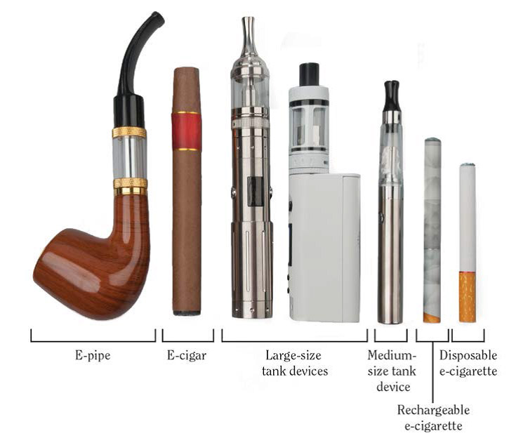

Slide 17
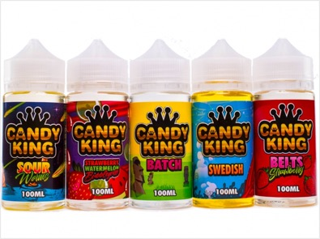


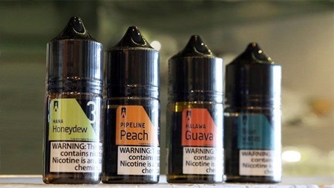
Flavorings

Slide 18
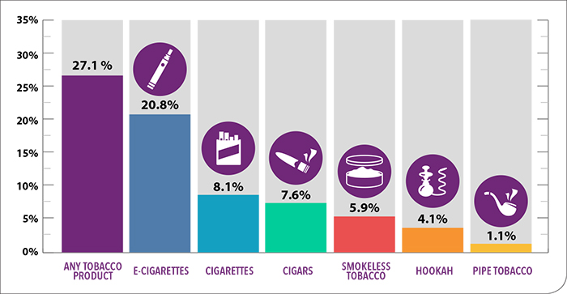
Tobacco Product Use Among High School Students – 2018

Slide 19
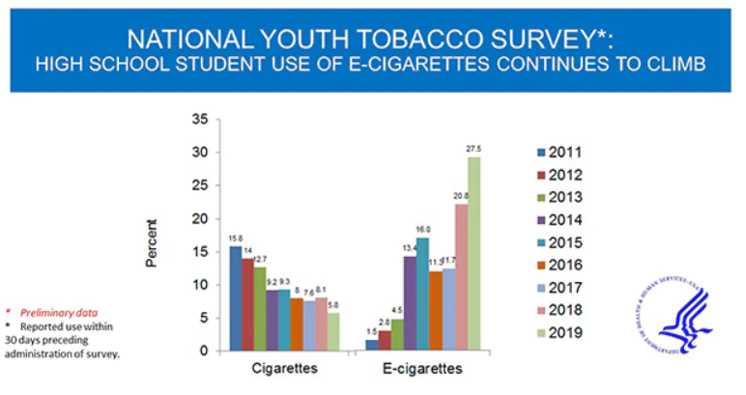

Slide 20
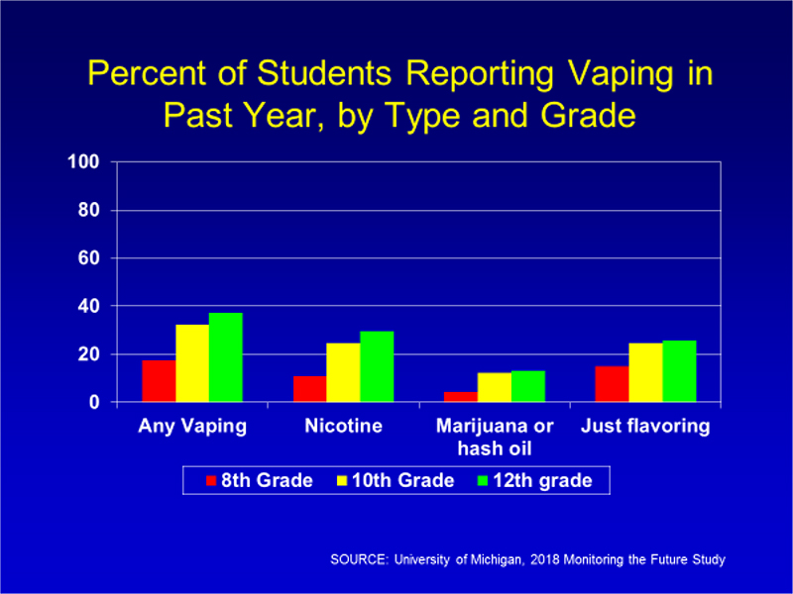

Slide 22
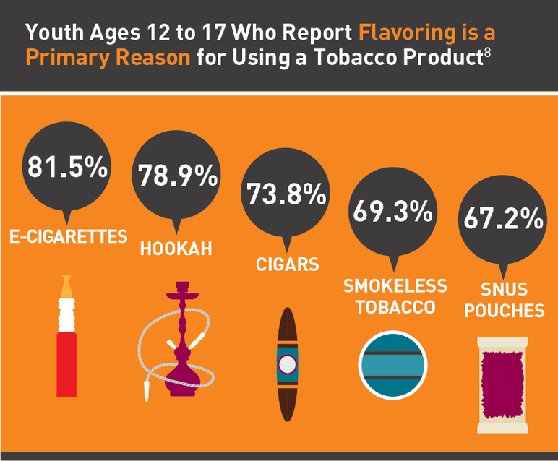

Slide 23
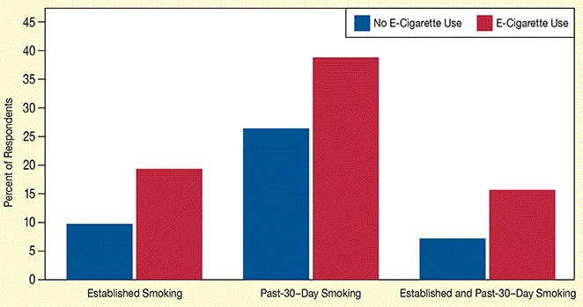
Tobacco-Smoking Habits of Adolescent Users and Nonusers of E-Cigarettes
Chaffee, B.W., Watkins, S.L., and Glantz, S.A. Electronic cigarette use and progression from experimentation to established smoking. Pediatrics 141(4):e20173594, 2018

Slide 24
Harm Reduction?
"E-cigarettes may serve to re-normalize the use of combustible cigarettes, decreasing the motivation to quit.”
    Dr. Heather Kimmel - NIDA’s Epidemiology Research Branch
"The evidence clearly shows that e-cigarettes do not help smokers cease tobacco use and are expanding the tobacco epidemic by attracting low-risk youth, many of whom advance to conventional cigarettes. Harm reduction, the fundamental assumption used to justify e-cigarettes, is wrong."
    Kulik, M.C., Lisha, N.E., and Glantz, S.A. E-cigarettes associated with depressed smoking cessation: A cross-sectional study of 28 European Union countries. American Journal of Preventive Medicine 54(4):603-609, 2018.

Slide 25
Marketed as Harm Reduction
Vaping is less harmful than smoking BUT still not safe.
E-cigarettes are just as addictive as regular cigarettes.
While marketed to help quit smoking, e-cigarettes are not Food and Drug Administration (FDA) approved as smoking cessation devices.
A recent study found that most people who intended to use e-cigarettes to kick the nicotine habit ended up continuing to smoke both traditional and e-cigarettes.
In the light of the EVALI outbreak, the CDC advises adults who use e-cigarettes for smoking cessation to weigh the risks and benefits and consider use of other FDA approved options.

Slide 26
Most Current Conclusion on Vaping for Tobacco Cessation
2019 article in New England Journal of Medicine found that while E-cigarettes are commonly used in attempts to stop smoking, evidence is limited regarding their effectiveness as compared with that of nicotine products approved as smoking-cessation treatments.
Hajek, P., Phillips-Waller, A., Przulj, D., Pesola, F., Myers Smith, K., Bisal, N.,
... & Ross, L. (2019). A randomized trial of e-cigarettes versus nicotine-
replacement therapy. New England Journal of Medicine, 380(7), 629-637.

Slide 27
EVALI

Slide 28
New Onset of Vaping-Associated Severe Lung Disease
Initial cases and hospitalizations first noted in summer 2019.
More than half of those with lung injuries (55%) are in the age range of Job Corps students.
Lung damage reportedly resembles chemical burns, such as occur in toxic chemical spills or mustard gas used as a chemical weapon in World War I.
As of November 20, 2019, 2,290 lung injury cases associated with the use of e-cigarette or vaping products have been reported to CDC.
Forty-seven (47) deaths have been confirmed.
One patient required a double lung transplant.

Slide 30
E-cigarette or vaping associated lung injury (EVALI)
  All EVALI patients report a history of using e-cigarette or vaping products.
  THC is present in most of the samples tested by FDA to date, and most patients report a history of using THC-containing e-cigarette or vaping products.
  The latest national and state findings suggest THC-containing e-cigarette or vaping products, particularly from informal sources like friends, or family, or in-person or online dealers, are linked to most of the cases and play a major role in the outbreak.

Slide 31
Possible Etiology of EVALI
CDC has identified vitamin E acetate as a chemical of concern among people with e-cigarette or vaping product use associated lung injury (EVALI).
Recent CDC laboratory testing of bronchoalveolar lavage (BAL) fluid samples (fluid samples collected from the lungs) from 29 patients with EVALI submitted to CDC from 10 states found vitamin E acetate in all of the samples.
Vitamin E acetate is used as an additive, most notably as a honey-like thickening agent in THC-containing e-cigarette or vaping products.

Slide 32
CDC Recommendations
CDC recommends that people should not use THC-containing e-cigarette or vaping products, particularly from informal sources like friends, or family, or in-person or online dealers.
Vitamin E acetate should not be added to e-cigarette or vaping products.
People should not add any substances to e-cigarette or vaping products that are not intended by the manufacturer, including products purchased through retail establishments.

Slide 33
What Job Corps can do
Wellness staff provide education on vaping and its dangers during encounters with students.
TEAP specialists include this material in the CPP presentation as well as other classes.
Ban e-cigarettes/vaping items on Job Corps Centers as contraband not allowed on center.
Train security staff to recognize vaping products, especially JUULs.
Ensure that students found in possession of vaping items or who report use are referred to the TUPP for intervention.

Slide 34
Use available local and federal materials for education efforts.

Slide 35


