Slide 1
A NEW DIRECTION: CHANGING THE MOUTH’S pH BALANCE
Notes:
Good morning or good afternoon everyone. I hope you are looking forward to some new idea’s or for some of you a refresher coarse on what you may already know. I am always amazed in my practice when I meet patients from other practices in town or other states even. How little Cari’s risk assessment is done. So with that said I thought it would be fitting to start us off with a statement of…

Slide 2
Rethinking Our Approach
Are Caries a whole body disease
OR
A disease of the tooth surface
?
Notes:
Think about this question and your answer to yourself. Moving forward remember the answer I will give and what you thought, how are you treating your patient with the answer I will give you vs. the answer you gave yourself. There is no right or wrong answer. This is just how we approach our patients care.

Slide 3
CAMBRA, Caries Management by Risk Assessment
Allows us to broaden our approach on a centuries old disease. Revamping the way we look at decay.
Treating “Caries” not as a tooth surface disease but, as a whole body disease.
Notes:
Cambra became to me a name that meant looking at dentistry differently. Although I think it wasn’t used much because it was too complicated. It is and can be very simple.

Slide 4
CARIFREE &
DR. KIM KUTSCH
Photo –Kutsch & Renyer Family Cosmetic Dentistry
Notes:
Dr. Kutsch changed the way dental professionals and patients look at Caries. He took this disease and whipped everyone's glasses clean so we may see a newer, proven way of treating the Oral cavity. Why treat the cause if we can’t solve the problem was his question. Much of todays information came from him, his research and ingenuity. I strongly encourage you to go onto Carifree.com and watch his free video’s, read study’s and research. He give a wealth of information away for free that can help you better your patients care.

Slide 5
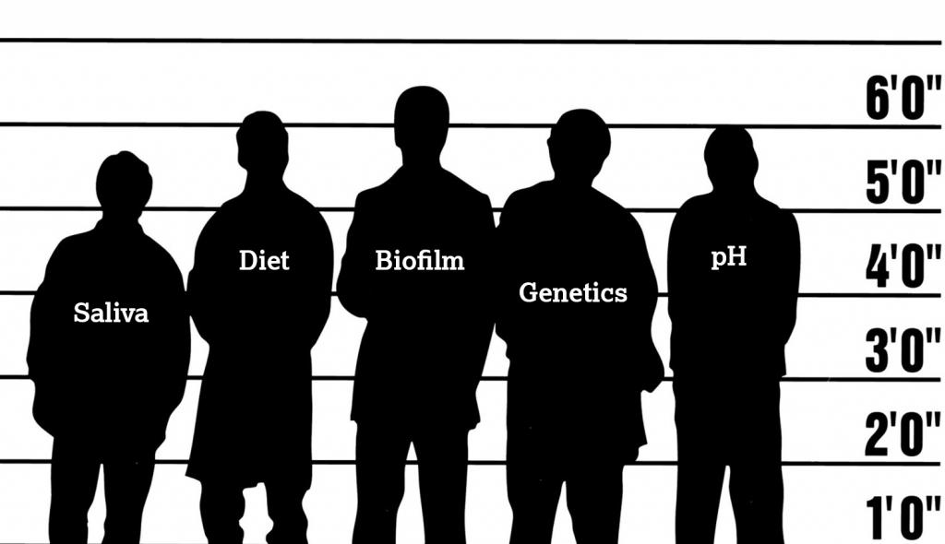
THE USUAL SUSPECTS
Photo Compliments of Carifree.com-The Usual -Suspect
Notes:
What we have learned about decay is that it has patterns. These 5 characters have the leading role in what causes decay.

Slide 6
SALIVA
Notes:
Saliva plays many important roles in the mouth. Its calcium & phosphate help to maintain mineral content of teeth. It has protective proteins, antibodies, enzymes for digestion, lubrication for chewing, and electrolytes for buffering pH. Often more times than not we are lacking in saliva for various reasons….

Slide 7
HYDRATION
GENETIC’S
SUBSTANCE
ABUSE
pH+
MEDICATION
DIET
DISEASE
BUFFERING
COMPACITY
Notes:
Sjogren’s Sydrome=disease, medication=many, not forgetting herbal supplements , Pot isn’t so innocent=substance abuse, diet=higher fiber shown better saliva flow. Childhood obesity has been linked to low saliva flow, hydration=water vs gator aid, buffering=what saliva does. Lack of it we see a direct correlation to decay. Genetics- we tie into next.

Slide 8
Saliva is used to transport nutrition, bacterial waste, & recolonize?????
BIOFILMS

Slide 9
BIOFILM
Dental plaque
Notes:
By now everyone has heard of these. Plaque is for the most part the bi-product of biofilms

Slide 10
Where do we see biofilms?
Notes:
They are everywhere! We see them on kitchen surfaces, bathrooms, fish tanks, coffee mugs, and in our mouth. Biofilm diseases to date don’t have cures. For example HIV

Slide 11
WHAT ARE BIOFLIMS?
“Communities of micro-organisms encased within an extra cellular polymeric slime (Eps) matrix living on surfaces.”(1)
The slime layer is its defense system.
Forms when bacteria are exposed to a wet surface.
Cannot be washed off with water or saliva.
Feeds off the same foods as we do.

Slide 12
How Do Biofilms Lead To Cavitation?
Notes:
They LOVE ACID! Biofilms Studies have shown that good bacteria when taken over long enough by Acid producing bacteria will too become acid producers. Leading to demineralization…leading to decay. Side note. If you will look at this picture it doesn’t really show any decay. Perio, yes. The pH+ of this mouth and its Biofilm type would be interesting to know.

Slide 13
PH
Notes:
The largest monster in the room. If this is controlled all the other problems go away!

Slide 14
DEMINERALIZATION
Anaerobic, acid-producing bacteria in plaque biofilm produce and increase amount of acid due to fermentation, causing the pH of the biofilm to lower and demineralization to occur.
Once demineralization occurs, hydroxy and fluorapatite become unstable in the tooth and are leached out. Bacteria enter the tooth and a cavity is born.
Notes:
5.5 pH or lower this can happen [ Ca+ Phosphate and Fluoride, come together to form Hydroxy Apaptite{Ca+PO3- is in your Saliva, fluoride is in your diet} Something to note if someone is low in Ca+PO3- you can through all the fluoride at them you want and it wont help the teeth. That is why I am a large fan of Clinpro 5000….(go over)

Slide 15
LOW pH
This is the most important fact to understand. Without an acidic environment (pH of 4.8 and lower) there would be no demineralization and cavitation.
Notes:
5.5 the Hydrox Fluora apatite becomes unstable and 4.8 demineralization starts to occur. Here’s a question for everyone… How long does a mouth take to recover from and acid state? (20 min average some study’s say 15 min)

Slide 16
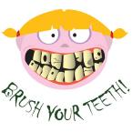
WHAT CREATES A LOWER pH
Initial changes in environment due to any one factor: saliva flow decreases, poor diet, or poor homecare, can lead to an acidic pH in the mouth.
Notes:
What tips the balance? This can be different for everybody. Mine was coffee ( go over this). So when speaking to a pt. really check with their diet...this should be one of the largest parts of your Cari’s Assessment….Diet and Habits. The simplest things or thing can add up to larger issues. One Soda a day…how long do you take to drink it?

Slide 17
No one particular bacteria species causes carious lesions.
“good biofilm bacteria” have been found to adapt and produce acid once the pH drops as well.

Slide 18
DIET
What we eat is what we BECOME!
Notes:
This is even more evident in other mammals. Dogs feed on a raw diet have less decay and perio than when fed on Kibble. Refined processed foods help no one.

Slide 19
Eat Closer to the
SOURCE
Notes:
Refined carbs vs. Complex carbs. Biofilms like to feed on simple carbs and starch. At our clinic we have whole fruit’s out for students to take. They love them! Simplify the understanding so they can make better choices. A mom thinks apple juice is a serving of fruits…NO!

Slide 20
THE CARIES BALANCE
DIET
CARIES
POOR DIET/FERMENTABLE CARBOHYDRATES
COMPROMISED SALIVA FLOW
FLUORIDE, CALCIUM, & PHOSPHATE
NO CARIES
HEALTHY SALIVA FLOW
ANTIMICROBIALS
BACTERIAL INFECTION
Notes:
This slide is reflects diet like pH and it importance. W/O a good diet we compromise Saliva, increase the wrong bacteria.

Slide 21
GENETICS
WHO’S GENE’S AM I WEARING?
Notes:
A popular thing to do these days. 21 & me, NV has a genetic data base they are collecting called “Healthy NV”..So what does this mean to you and me? Can we determine our children's future with Gene mapping?

Slide 22
Does the Sweet Tooth Gene Exist?
Notes:
Research seems to say yes. Taste may be a hereditary factor relating to the genotype TAS2R38. Here sweet/sucrose seem to be preferred in children found with this rather than say water or milk. In a nutshell they object to bitter taste of many green vegetables. LZL2 a gene for defensive bacterolytic enzymes…children with this genetic deficiency will only express decay only in the mandibular canines. Vitamin D receptor genes noted in some cultures it was linked to decay while in other only gingivitis.

Slide 23
So what does all this mean?
Notes:
Not a whole lot at this point and time. Genetics is a growing field with new discoveries each day. We can’t change our gene’s we can only live with them. Knowing what genetic markers we have can help treat possible health issues. However, we are still faced with environmental factors that may or may not cause the gene to express in different ways.

Slide 24
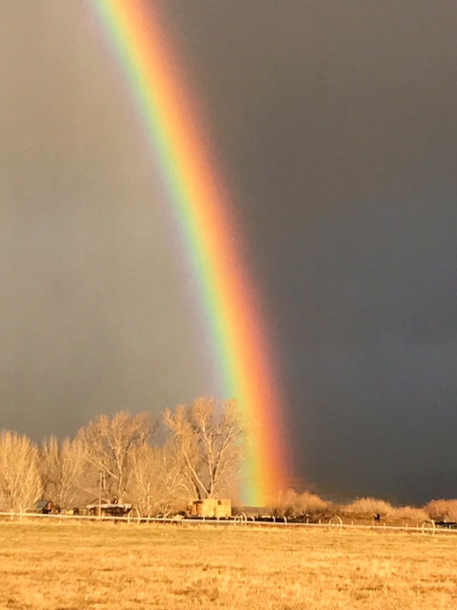
Role of Therapeutics
Notes:
Not all Dental products are created equally.

Slide 25
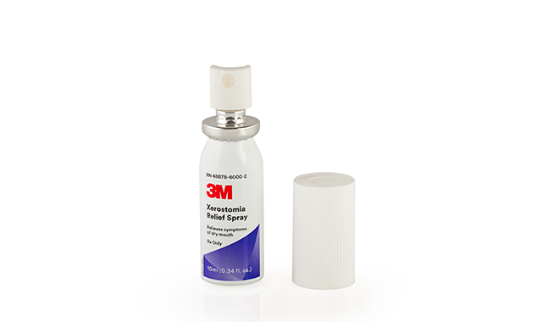
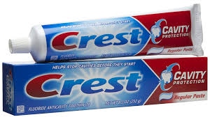
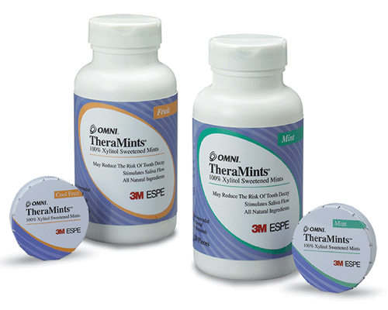
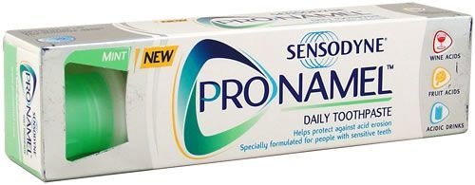
Notes:
These are my go to guys.

Slide 26
1. pH+ of 6.8 2. NO Sodium Lauryl Sulfate 3. Low abrasive of 11
Notes:
1. Remember we want to keep the mouth above 5.5 pH+ 2. is the foaming agent found in all products that foam, it is cancer causing 3. I equate this to polishing a car with a soft wash cloth vs. coarse sandpaper when I speak with my students. Toothpaste regulates abrasive 0 to 250. All whitening, Tarter control toothpaste are 200 or higher. Crest Pro Health, Colgate Total, and Crest 3D Whitening toothpaste are your 3 most aggressive toothpaste on the market.

Slide 27
1. Low abrasive 2. pH+ 6.8
Notes:
1. Abrasive around 20 I believe. 2. We want to stay away from Gel’s the are chemical bombs that lower toothpaste pH+. This product does have Sodium Lauryl Sulfate

Slide 28
1. Designed to combat Xerostomia 2. Mouth wash is pH+ balanced with no alcohol 3. Toothpaste is pH+ of 6.0 & abrasive of 11
Notes:
Oral balance is a good product for your mouth breathers. It’s constancy is like egg whites. I have patients rub their tissues with this before bedtime.

Slide 29
1. This is a Rx- Patterson and Schein stock it 2. pH+ balanced 3. Calcium Phosphate and Fluoride in one 4. Low abrasive
Notes:
3M products are excellent products to use. Very well thought out. Not easy to Rx as they aren’t in all pharmacies. Costco carries them out here. Why is Ca3(PO4)2 with Fluoride important? We can through all the fluoride at a patient we want but, without the right amount of CA3(PO4)2 in our Saliva we can not get uptake into the tooth. Ca3(PO4)2 forms with Fluoride to produce the Hydroxi Apatite crystals.

Slide 30
1. 100% Xylitol! 2. Natural sweetener that DOES NOT feed bacteria 3. Excellent price point for 520 breath mints.
Notes:
Xylitol is a natural sweetener found in cornhusk, beats, and Birch Tree’s. It does not feed bacteria or raise blood sugar. Study’s have worked back and forth on how affect in decay prevention Xylitol actually is. On average 4 pieces of gum or 0.72 mg daily can reduce carie’s risk by half. Researchers have found that mothers chewing Xylitol gum 3 months after deliver until children were 2 years old, had a 70% reduction in decay. Even better if using Xylitol wipes on breast before nursing.

Slide 31
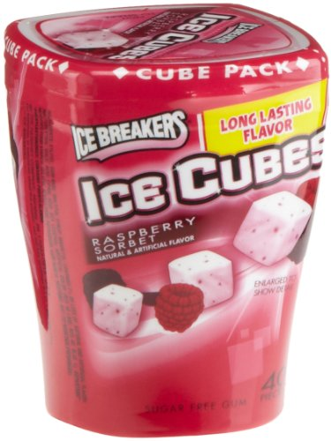
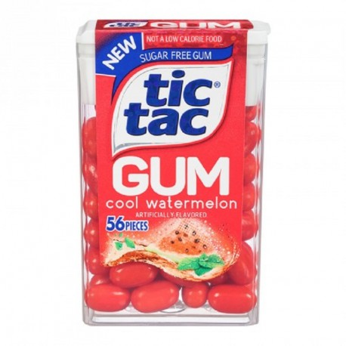
Notes:
Important note Xylitol has to be the number one ingredient! Gum’s like Trident claim Xylitol however, it is too low in the ingredient list to matter. Gum’s to recommend are Ice Cubes, Mentos Gum, Tick Tac. Any product that the 1st ingredient is Xylitol.

Slide 32
1. Brand New on the market for Dry Mouth! 2. Clinical studies show 92% of patients saw improvement. 3. A Rx
Notes:
This is hot off the press! Only out about or just under a year. I have not used it with a patient yet. Draw back, one Pharmacy produces it and will send to Job Corps or directly to patient. Insurance coverage said to be good. Cost around $35 w/o insurance for 2 canisters. Last u to 4 hours. It is a lipid based spray. Call your 3M rep and inquire about it.

Slide 33
Doxycycline 20mg Sig: i BID Disp: 60 Refills: 2 Doxycycline 100mg Sig: i BID Disp: 28 Refills: 0
Notes:
Doxycycline less than 50 mg a day acts as an Enzyme inhibitor and not an “antibiotic”. Collagenase is an enzyme produced when bacteria invade the tissue producing inflammation (C reactive protein). Collagenase is directly responsible for tissue destruction. Placing your patient on Doxycycline 20mg suppress Enzymes thus reducing inflammation. It does not create antibiotic resistance and is tolerated well. A patient can be on this from 30 days to 9 months, with a 4 month residual affect after 9 months as Doxy binds to the bone. Draw back with Job Corps students is compliance for long periods. Doxy for Acne is a different story they can see themselves…the mouth is forgotten. Doxy 100 mg acts differently and is where the mouth improvements were first noted with Acne patients. It will help to solve the boggy mess of tissues and bleeding for patient and reduce your anesthetic use. I did case study’s with the drug then called PerioStat and can tell you this can do miracle with perio.

Slide 34
Brochures
Notes:
Free and very nicely done check out the gov. site. Or ADA

Slide 35
At The End of The Day
Understand Patients sense of “self”
What is their dental I.Q.
How do they view the dental profession
Be an active participant on campus
Notes:
When your done being a super hero remember these 4 points for your patients at Job Corps.

Slide 36
Understanding their sense of “self”
These students are acutely aware of what they don’t have. Loss of teeth and replacement with bridge work, flippers, dentures, or even implants is seen not only as physically diminishing, but as placing them at the very bottom of the socio-economic totem pole.
Notes:
Time and time again I see this. I had a student that had a bombed out mouth. He wouldn’t let us pull his root tips for denture. So we had to continually treat abscesses one tooth at a time because he viewed dentures as a complete failure. Another student horizontally fractured the root of #7. He continually delayed treatment because he expressed that loosing a tooth and replacement with a flipper, bridge or even implant to him was going as low as he could go. He said he came to job corp. to better his life not to go any lower.

Slide 37
What is their Dental I.Q.
Be careful of dental jargon.
Do they understand basic oral hygiene?
Words like plaque, tarter, calculus, periodontal disease, or root canal, are all foreign to the majority of Job Corps population.
Have them demonstrate their homecare skills. Understanding the environment from which they came. If they moved a lot, lived on the streets, or had a history of substance abuse, oral hygiene was most likely not a taught skill or priority.

Slide 38
How Patients View Dentistry
Notes:
A majority of our population has either had a bad experience or been told it will the worst experience of their life!

Slide 39
Be An Active Participant On Campus
Classrooms.
Keep information simple, understandable, and impactful.
Walk the campus grounds.
This allows students to see you outside the clinic, and ask questions in a non-clinical setting. Wear street clothes!
Participate in other campus programs.
At my center I lecture in weight management class, diabetes clinics, tobacco cessation programs, etc. Always relating dentistry to the field I am participating in.
Host motivational speakers.
Gruen Von Behrens with the help of local sponsors recently visited our campus and spoke about the effects of tobacco use.
Notes:
Use Stem wall for plumbing student with fractured root of #7.
I understand we are on limited budgets, but many communities have programs willing to sponsor youth programs.

Slide 40
References
Center for Genomic Sciences, West Penn Allagheny Health Systems. http://www.centerforgenomicsciences.org/research/biofilm.html.
Marsh, P.D. “Dental Plaque as a Biofilm and a Microbial Community- Implications for Health and Disease.” BMC Oral Health. 2006. 6(Suppl 1) : 514.
Marquis, M.E. “Oxygen Metabolism, Oxidative Stress and Acid-Base Physiology of Dental Plaque Biofilms.” Journal of Industrial Microbiology. Vol 15. p. 198-207.
Young, Douglas A., et al. “Curing the Silent Epidemic: Caries Management in the 21st Century and Beyond.” CDA. Vol 35, 10. p. 681-85.
Nield-Gehrig, Jill S. “Dental Plaque Biofilms.” http://www.dentalcarestamford.com
Frutiger, Anna. “Dental Plaque Biofilms.” http://www.microbewiki.Kenyon.edu/index.php/Dental_Plaque_Biofilms.com
Garcia-Godoy, Franklin and Hicks, John M. “Maintaining the Integrity of the Enamel Surface: The Role of Dental Biofilm, Saliva and Preventive Agents in Enamel Demineralization and Remineralization.” JADA. 2008; 139;2S-34S
Kutsch, V. Kim, and Milicich, Graeme. “Understanding the Biofilm Battle.” http://carifree.com/dentists/online downloads. html. Recorded June 2, 2009.

Slide 41
9. Kutsch, K., DR. (2018, September 25). The Usual Suspects. Retrieved from carifree.com 10. Mennella, J. A., PHD, Pepino, Y., PHD, & Reed, D., PHD. (2005, February). Genetic and Environmental Determinants of Bitter Perception and Sweet Preferences. Retrieved from https://www.ncbi.nlm.nih.gov/pmc/articles/PMC1397914/ 11. Rethinking Our Approach to Caries Disease. (2018, September 27). Retrieved from https://carifree.com/2018/09/27/a-different-way-to-treat-caries-disease/ 12. Kutsch, K., DDMD, & Young, D., DDS. (2011, October). New Directions in the Etiology of Dental Caries Disease. Journal of the California Dental Association, 716-721. 13. 3M Oral Care. (2018). 3M Science. Applied to Life[Brochure]. 14. CollaGenex. (2001). Treating Adult Periodontal Disease[Brochure].

