Slide 1
COVID-19: Making Sense of the Guidelines
Sara Mackenzie, MD, MPH
Region 6 Regional Medical Specialist
Julie Klinger-Luht, MPH
Humanitas
This Photo by Unknown Author is licensed under CC BY-SA

Slide 2
Questions (and an answer)
Why are masks (and distancing) required on center?
Why is quarantine 14 days?
Why is isolation 10 days?
Bonus question: why is testing not needed for clearance?
Lessons learned: stop COVID on YOUR center!
This Photo by Unknown Author is licensed under CC BY

Slide 3
Chain of Infection
SARS-CoV-2
Novel
RNA virus
Exits the body
Respiratory droplets
Transmission
Primarily droplets
(cough, sneeze, talking)
Less common:
Aerosol
Surfaces
Enters the body
Contact with mouth or nose mucosa
Person factors
Age
Underlying health conditions

Slide 4
Breaking links – slows or stops the spread!
SARS-CoV-2
Exits the body
Transmission
Enters the body
Person factors

Slide 5
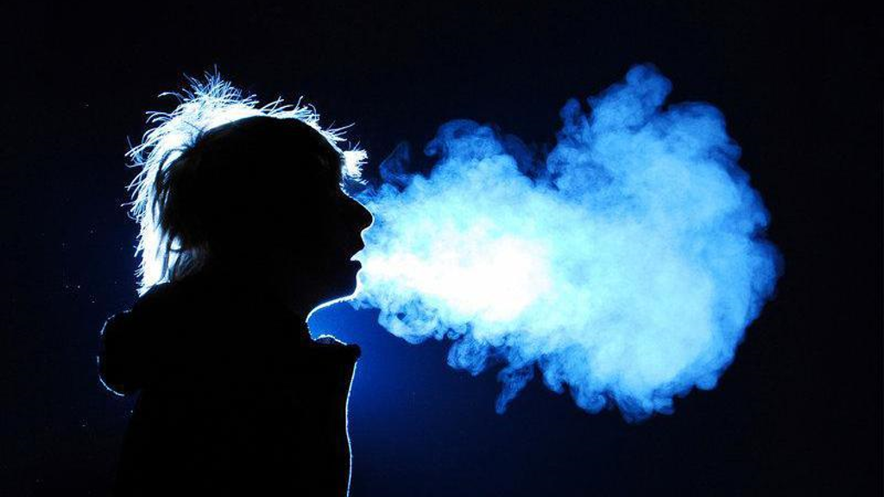
Why are masks (and distancing) required on center?
Exit Transmission Entry

Slide 6
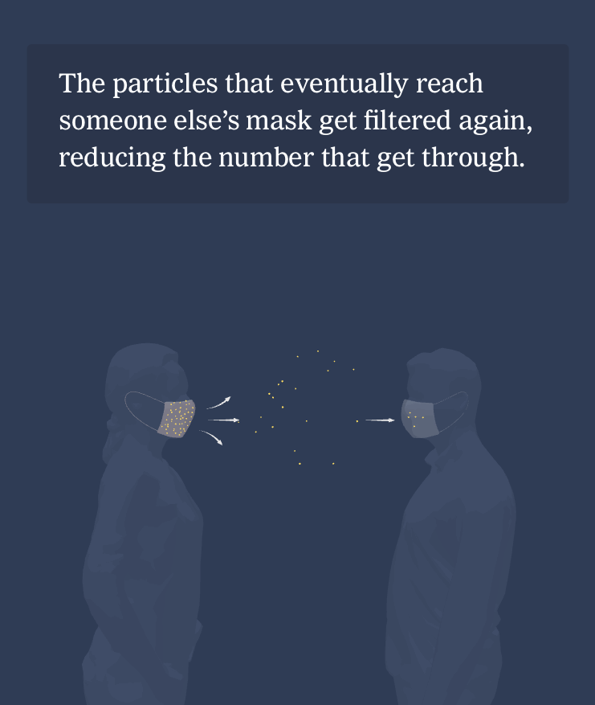

Slide 7
SARS-CoV-2:
Symptoms
Incubation:
2-14 days
(median 5 days)
Viral shedding:
for up to 10 days after symptom onset (for most)
Some will have mild to no symptoms
May shed 48 hours PRIOR to onset of symptoms
Exposure:
“Close contact” – within 6 feet for >15 minutes/24 hours

Slide 8
Why is quarantine 14 days?
QUARANTINE
Incubation:
2-14 days
(median 5 days)

Slide 9
Why is isolation 10 days?
QUARANTINE
Symptoms
Incubation:
2-14 days
(median 5 days)
ISOLATION
Viral shedding:
for up to 10 days after symptom onset (for most)
Some will have mild to no symptoms (start 10 days with positive test)
May shed 48 hours PRIOR to onset of symptoms

Slide 10
Indoors vs Outdoors

Slide 11
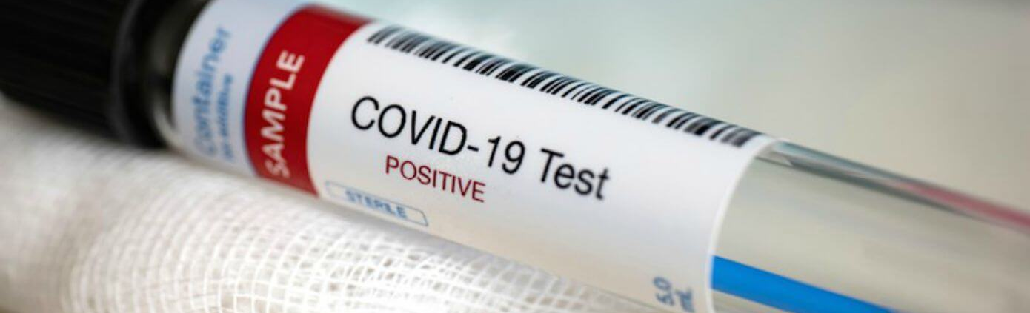
Bonus Q: Why is testing not needed for clearance?
Testing can detect dead viral parts
Testing can detect levels of virus that can no longer transmit
With rare exception, do not test someone who has had confirmed COVID-19 in the past 3 months.
This Photo by Unknown Author is licensed under CC BY

Slide 12
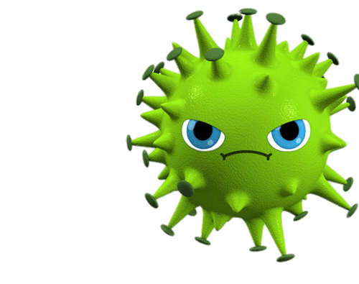
Stop COVID-19 on your Center
This Photo by Unknown Author is licensed under CC BY-NC

Slide 13
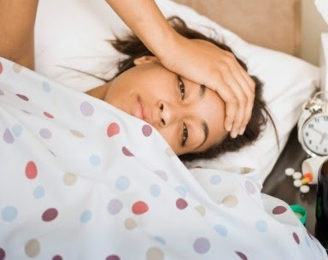
Stay home if you’re sick!
Symptom screening
No repercussions for staying home
This Photo by Unknown Author is licensed under CC BY-NC-ND

Slide 14
No Staff Gatherings
Teambuilding
Birthday parties
This Photo by Unknown Author is licensed under CC BY-SA-NC

Slide 15
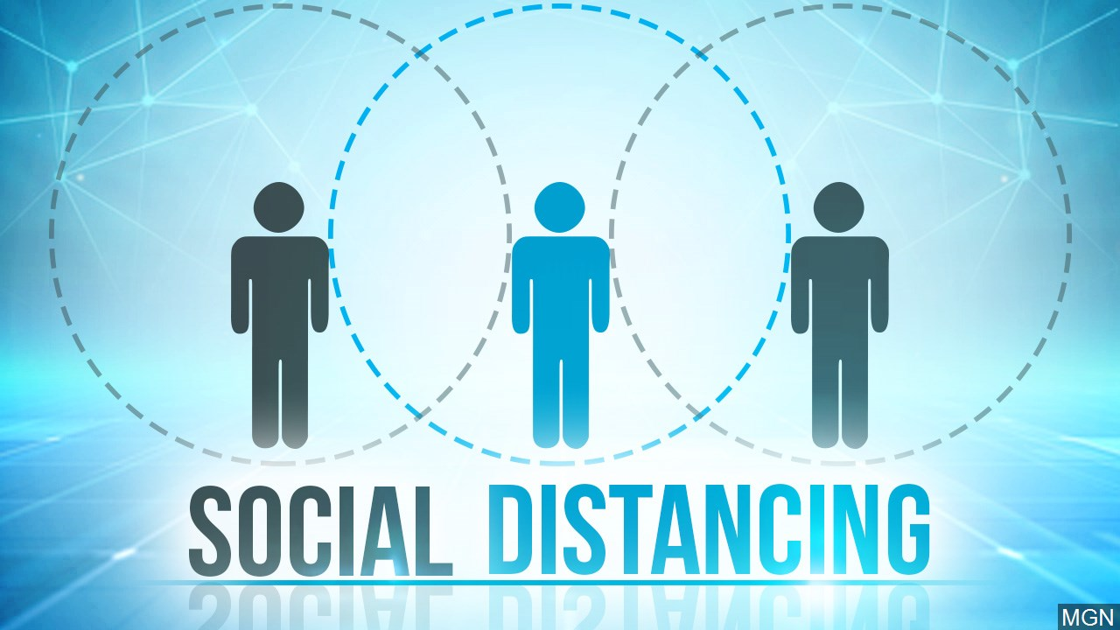
Treat Everyone Like They Are Positive
A lot of asymptomatic positive staff
<6 ft for 15 minutes over 24 hours
This Photo by Unknown author is licensed under CC BY.

Slide 16
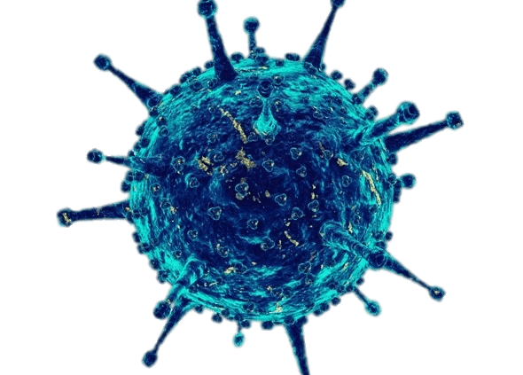
Don't Let Your Guard Down
Staff are going to pose the biggest risk
This Photo by Unknown author is licensed under CC BY-NC.

Slide 17
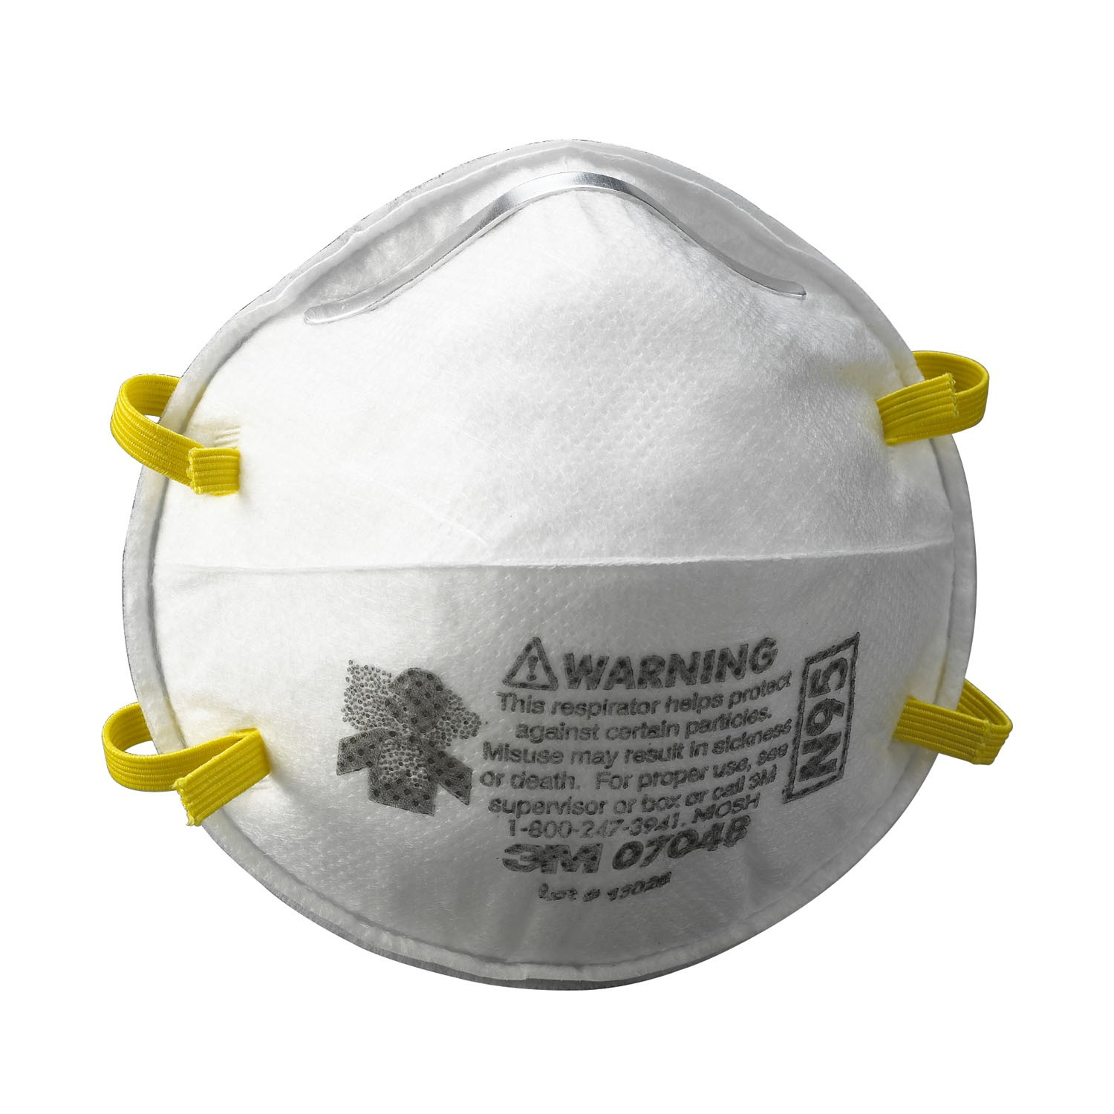
Protect Your Essential Staff
N95 masks
Staggered shifts
Less people in a single location
Cohort staff
No office sharing
Remote work as needed
This Photo by Unknown Author is licensed under CC BY-SA

Slide 18
Timing of Testing
5-7 days after exposure
Health and Wellness staff

Slide 19
Follow Guidelines
Physical distancing
Wear a mask
Wash hands/hand sanitizer
Clean and disinfect

