Slide 1
Symptom Tracker and Attestation and Emotional Wellbeing Checklist
+ Google Forms Demo

Slide 2
Symptom Tracker and Attestation
Do you currently have any symptoms of COVID-19 (fever of greater than 100.4°F, feeling feverish (chills, sweating), new cough, difficulty breathing, sore throat, muscle aches or body aches, vomiting or diarrhea, new loss of taste or smell)?
Have you had close contact with a person who has a diagnosed or suspected case of COVID-19 in the last 14 days?
This Photo by Unknown Author is licensed under CC BY-NC-ND
Notes:
Two questions.
Purpose is to screen people who are symptomatic for covid or who have had an exposure.
Serves staff and students with a daily reminder.

Slide 3
Frequency
All staff and students everyday
Students in quarantine/isolation 2x/day

Slide 4
Staff & non-residential students need to complete the Symptom Tracker and Attestation prior to entering center. Residential students need to complete prior to leaving dormitory.
This Photo by Unknown Author is licensed under CC BY-SA

Slide 5
Responding to “yes” answers
If a staff member or student responds affirmatively to either question on the attestation, they must remain isolated, and notify the appropriate staff member.
Vendors and visitors should be screened in person and will not be allowed on center if they respond affirmatively or have a temperature above 100.4º F.
This Photo by Unknown Author is licensed under CC BY

Slide 6
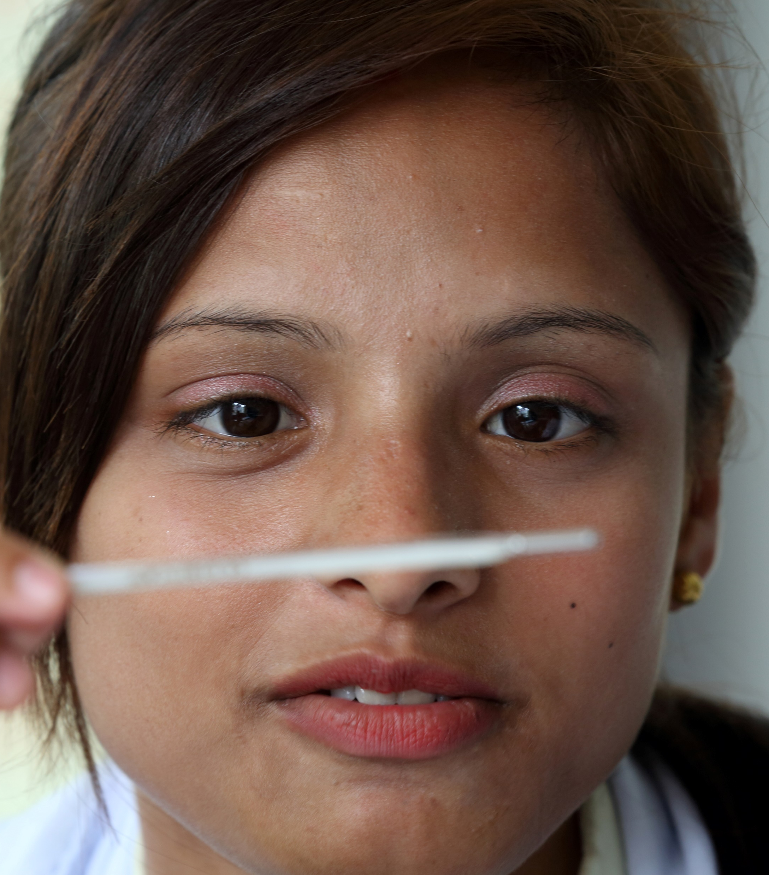
PIN 20-11
Each center is required to have students/staff complete daily symptom monitoring.
Method is up to center
Paper
Checklist
Google Forms
This Photo by Unknown Author is licensed under CC BY-SA

Slide 8
Checklist (include date)
 | Temperature | Do you currently have any symptoms of COVID-19)? | Have you had close contact with a person who has a diagnosed or suspected case of COVID-19 in the last 14 days?
Abraham, Dwight | 98.6 | No | No
Brown, Sandra
Davis, Eliza | 97.8 | Yes | No
Jones, D’Andre
Michaels, Sonny
Smith, Zena
Young, Joshua
Notes:
This could be at security gate for staff and in dormitories for residential students. Security or the RA could complete this in person.

Slide 9
Data Ownership and Storage
For students, HW is responsible
For staff, center determines who is responsible (supervisor, security, admin, HR, etc.)
This Photo by Unknown Author is licensed under CC BY
Notes:
Generating a lot of information. Keep records, either on Google Forms or paper based.

Slide 10
Confidentiality
Need-to-know
This Photo by Unknown Author is licensed under CC BY-NC
Notes:
This information should remain confidential and be shared only with staff with a need-to-know. This could include dormitory staff, and employee’s supervisors.

Slide 11
Back-Up
Provide back-up person in case a of absence.
This Photo by Unknown Author is licensed under CC BY-SA
Notes:
Especially if you are doing this electronically, think through the structure of who has access to information. Everyone in charge of this should have a back up person identified.

Slide 12
Center-Wide Monitoring
How many staff and students have COVID-19 symptoms or exposure?
Early alert system
This Photo by Unknown Author is licensed under CC BY-SA-NC
Notes:
A monitoring system should allow for central oversight so administration knows center-wide how many staff/students are experiencing symptoms of COVID-19 on a daily basis.

Slide 13
Tracking Missing Entries
Ensure a system is in place to track/identify on a daily basis staff and students who HAVE NOT completed the Symptom Tracker and Attestation.
This Photo by Unknown Author is licensed under CC BY

Slide 14
Students Daily Emotional Wellness Checklist
Only for students in quarantine or isolation
Completed once per day
This Photo by Unknown Author is licensed under CC BY

Slide 15
Data Ownership
A member of the Health and Wellness Center staff will create the Daily Emotional Wellness Center Checklist on Google Forms and will own the data.
The Health and Wellness Manager (HWM) or their designee and the Center Mental Health Consultant(s) (CMHC) should have access. There should also be a back-up person.
This Photo by Unknown Author is licensed under CC BY-SA
Notes:
–

Slide 16
Review
The CMHC(s) will review the checklists each day that they are on center.
If the CMHC is not on center, the checklist will be reviewed by the HWM or their designee.
This Photo by Unknown Author is licensed under CC BY-SA-NC
Notes:
–

Slide 17
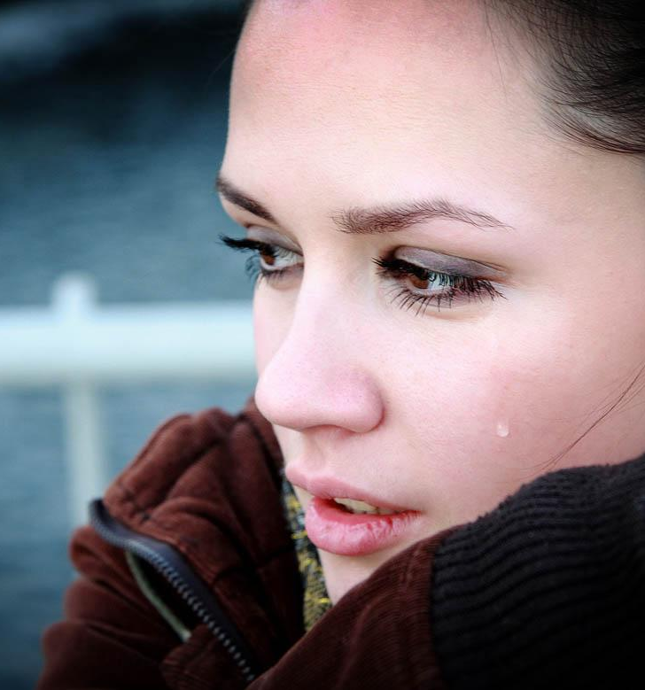
Follow-Up to the Checklist
“Fair” or “poor” or “I would like to talk to someone from the Health and Wellness Center”
Method of follow up
This Photo by Unknown Author is licensed under CC BY-NC-ND
Notes:
If a student has selected “fair” or “poor” for one or more items or has selected the option “I would like to talk to someone from the Health and Wellness Center,” then the CMHC or another designated health and wellness staff member will follow-up with the student on the same day.
Follow-up may occur by phone, via a HIPAA-compliant videoconferencing platform such as WebEx or Google Meet, or in person with masks and physical distancing.

Slide 18
After the Initial Follow-Up
Notes:
The CMHC will determine whether additional assessment is needed and develop a treatment plan, if appropriate, and document this in the Student Health Record (SHR). If a different health and wellness staff member does the initial follow-up, the staff member will document their findings in the SHR and convey this information to the CMHC at the first opportunity. If the Center Mental Health Consultant has concerns about the student’s safety and believes they pose a risk to self or others, the center should follow its Standard Operating Procedure (SOP) for Mental Health Emergencies. At centers where the CMHC provides on-call services, the CMHC should be consulted as soon as possible about the student’s mental health crisis so that CMHC can advise the center and develop a plan for follow-up. Develop a plan and document

