Slide 1
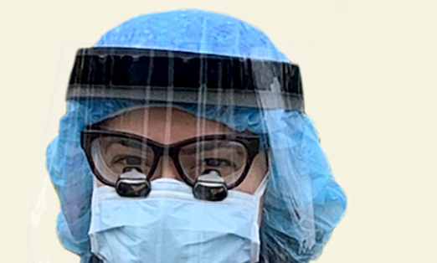
Updated CDC Guidance for Dental Settings During COVID-19 Pamela Alston, DDS, Lead Oral Health Specialist

Slide 2
Webinar Objectives
1) To learn CDC recommendations for provision of oral health care to patients with COVID-19 and to patients without COVID-19
2) To learn CDC guidelines for providing care in a way that minimizes harm to patients
3) To learn CDC guidelines for protecting personnel from potential exposure to COVID-19

Slide 3
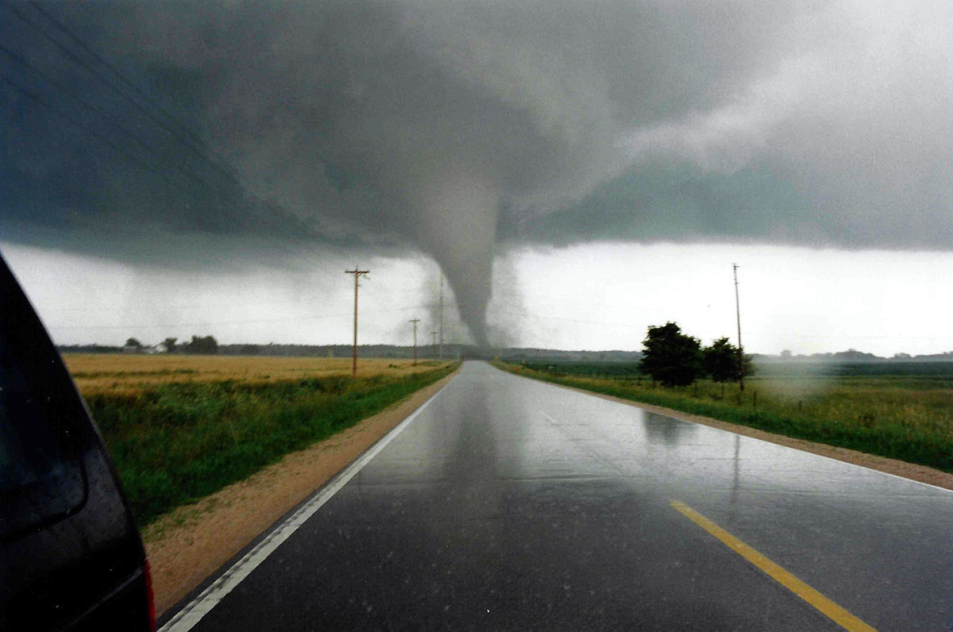
Tracking COVID-19 is a lot like tracking a Tornado
This Photo by Unknown Author is licensed under CC BY-SA

Slide 4
What is known about the Corona Virus
Person to person transmission during close exposure
Transmitted through respiratory droplets
Transmission through contact surfaces
Transmission through respirable particles
Can persist in aerosols for hours

Slide 5
Oral Health Personnel
OSHA categorizes oral health personnel as very high risk when performing aerosol generating procedures
Rotary dental instruments create a visible spray
The spray contains particle droplets
No confirmed cases of COVID-19 transmitted in a dental setting
OHP have the potential for direct or indirect exposure to patients or infectious materials including:
body substances
contaminated medical supplies, devices, and equipment
contaminated environmental surfaces
contaminated air

Slide 6
Dentistry work tasks associated with exposure medium & high risk levels
Medium Risk
High Risk
Urgent or emergency dental care, not involving aerosol-generating procedures to well patients (i.e., to members of the general public who are not known or suspected COVID-19 patients).
Providing emergency dental care not involving aerosol-generating procedures to a known or suspected COVID-19 patient.
Performing aerosol-generating procedures on well patients.

Slide 7
CDC’s Guidelines for Infection Control in Dental Health Care Settings—2003
Non-regulatory
Provide overall guidance on infection prevention practices for dental health care personnel.
Represent the minimum standard of practice recommended for safe care in all dental settings
Designed to prevent transmission of infectious agents among patients and dental health care personnel in dental settings.
Accessed at:
https://www.cdc.gov/mmwr/PDF/rr/rr5217.pdf

Slide 8
CDC’s Interim Infection Prevention and Control Guidance for Dental Settings
CDC’s Interim Guidance supplements the 2003 Guidance
“Interim” indicates that the guidelines were developed using less thorough processes
CDC issued CDC's Interim Guidance in 2020 for Dental Settings in March, April, May and June
The latest guidance was issued June 3rd

Slide 9
CDC Interim Infection Prevention and Control Guidance for Dental Settings
Initially recommended that only dentists only perform emergency evaluations and urgent care
Used the American Dental Association’s definitions for emergency & urgent conditions
2 reasons for delaying elective visits and procedures--to protect oral health personnel and to preserve PPE
Removed recommendation that all elective procedures be postponed on May 18, 2020

Slide 10
Health Care System Caveats for Providing Elective Services
Must operate without crisis standards
Ensure adequate staffing
Must have PPE and other supplies available
Must have a plan in the case of a community surge in transmissions

Slide 11
CDC’s Guiding Principle
CDC’s guiding principle is that dental settings should balance the need to provide necessary services with the need to minimize risk to patients and oral health personnel.

Slide 12
Getting Ready to Reopen
Take inventory to decide on supply of PPE and supplies
(2 weeks of PPE in clinic)
Learn about facility screening practice for COVID-19
Know what methods will be in place to reduce/eliminate aerosol production
Decide the logistics for
social distancing among patients and the dental team

Slide 13
Getting the dental facility ready
Dental unit waterlines (DUWL)
Autoclaves and instrument cleaning equipment
Air compressor, vacuum and suction lines, radiography equipment, high-tech equipment, amalgam separators, and other dental equipment: Follow protocol for recommended maintenance per manufacturer IFU.
Get the ventilation system checked

Slide 14
When Oral Health Personnel Return
As part of routine practice, monitor selves for fever and symptoms consistent with COVID-19.
Provide for oral health personnel to stay home when ill or under quarantine without jeopardizing job security.
If fever (T≥100.0˚F) or symptoms consistent with COVID-19 develop while at work, keep cloth face covering or facemask on, inform supervisor, and leave the workplace.

Slide 15
When Oral Health Personnel Return
Evaluate the necessity of the dental care based on urgency
Prioritize care that was previously postponed
Prioritize dental conditions likely to lead to dental emergencies if treatment is not provided in a timely manner.
Provide essential preventive care taking measures to minimize aerosol generation.
Consider minimally invasive restorative techniques

Slide 16
Aggressive Source Control* Measures
Perform fever and symptom tracking.
Require everyone to wear a cloth face covering while in the dental facility, regardless of symptoms.
Instruct patients to perform hand hygiene before and after they touch or adjust their cloth face covering
Have appropriate triage, evaluation, and isolation of individuals who report symptoms should still occur.
*Source control presumes everyone is infected and sets forth measures that might help reduce the risk of transmission of SARS CoV-2.

Slide 17
Personal Protective Equipment
Dental procedures not involving aerosol-generating procedures
Work clothing, such as scrubs, lab coat, and/or smock, or a gown
Gloves
Eye protection (e.g., goggles, face shield)
Face mask (e.g., surgical mask)
Dental procedures that may or are known to generate aerosols
Gloves
Gown
Eye protection (e.g., goggles, face shield)
NIOSH-certified, disposable N95 filtering facepiece respirator or better*

Slide 18
Respirators
Recommended for oral health personnel during the COVID-19
N95 respirators or respirators that offer a higher level of protection should be used instead of a facemask when performing or present for an aerosol generating procedure
Must be in the context of a complete respiratory protection program in accordance with OSHA Respiratory Protection standard (29 CFR 1910.134)
OSHA has issued temporary enforcement guidance regarding discretion, e.g., enforcement discretion for required annual fit testing

Slide 19
Extended Use of Facemasks and Respirators
Should only be undertaken when the facility is at contingency or crisis capacity and has reasonably implemented all applicable administrative and engineering controls.
Such controls include selectively canceling elective and non-urgent procedures and appointments for which PPE is typically used by DHCP
Extended use of PPE is not intended to encourage dental facilities to practice at a normal patient volume during a PPE shortage, but only to be implemented in the short term when other controls have been exhausted.
Once the supply of PPE has increased, facilities should return to standard procedures.

Slide 20
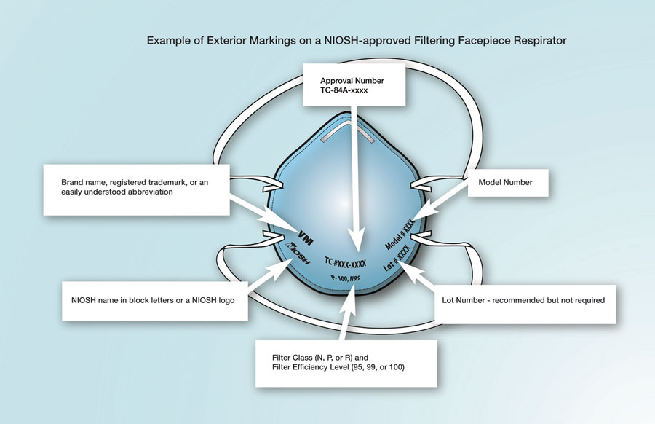

Slide 21
Eye Protection
Put on eye protection (i.e., goggles or a disposable face shield that covers the front and sides of the face) upon entry to the patient room or care area, if not already wearing as part of extended use or reuse strategies to optimize to optimize PPE supply.
Personal eyeglasses and contact lenses are NOT considered adequate eye protection.
Reusable eye protection (e.g., goggles or loupes) must be cleaned and disinfected according to manufacturer’s reprocessing instructions prior to re-use.

Slide 22
Gloves
Put on clean, non-sterile gloves upon entry into the patient room or care area.
Change gloves if they become torn or heavily contaminated during the patient visit.
Remove and discard gloves when leaving the patient room or care area and immediately perform hand hygiene.

Slide 23
Gowns
Put on a clean isolation gown upon entry into the patient room or area.
Change the gown if it becomes soiled and after aerosol generating procedures
If there are shortages of gowns, they should be prioritized for:
aerosol generating procedures
care activities where splashes and sprays are anticipated

Slide 24
Head covers and shoe covers
Not considered PPE
Heads are close enough for droplets and aerosols to land on
Shoes touch floors where droplets land

Slide 25
Precautions When Performing Aerosol Generating Procedures (AGPs)
Perform AGP cautiously and avoid if possible
If performed, the following should occur:
wear an N95 mask, eye protection, gloves, and a gown
AGPs should ideally take place in an Airborne Infection Isolation Room
Use high volume intraoral suction
Use extraoral vacuum unit between patient’s mouth and provider’s face
An air purification filtration/UV germicidal irradiation system

Slide 26
Environmental Infection Control
Ensure that environmental cleaning and disinfection procedures are followed consistently and correctly.
Routine cleaning and disinfection procedures (e.g., using cleaners and water to pre-clean surfaces prior to applying an EPA-registered, disinfectant
Consult List N: Disinfectants for Use Against SARS-CoV-2 (COVID-19) Go to: https://www.epa.gov/pesticide-registration/list-n-disinfectants-use-against-sars-cov-2-covid-19

Slide 27
Disinfection
Wait 15 minutes after completion of clinical care and exit of each patient to begin to clean and disinfect room surfaces.
Appropriate PPE should be worn for all activities involving potential exposure to patient body fluids, contaminated surfaces and equipment, and hazardous chemicals (e.g. disinfectants).
Puncture resistant/utility gloves, masks, eye protection and gowns should be worn while handling contaminated instruments.
Patients should be scheduled in a manner that allows for complete disinfection of operatories. It is recommended to increase patient appointment time
Do not double-book appointments.
Barriers should be used when possible, especially for hard-to-clean surfaces (e.g. light switches, computer, mouse, dental unit) and changed between patients.

Slide 28
“During the reopening process, centers must abide by federal, state, and local regulations regarding physical distancing, size of group gatherings, and wearing face masks by following whichever regulations are the most restrictive. In some cases, PRH requirements may not be able to be met because they are in conflict with regulations.”

Slide 29
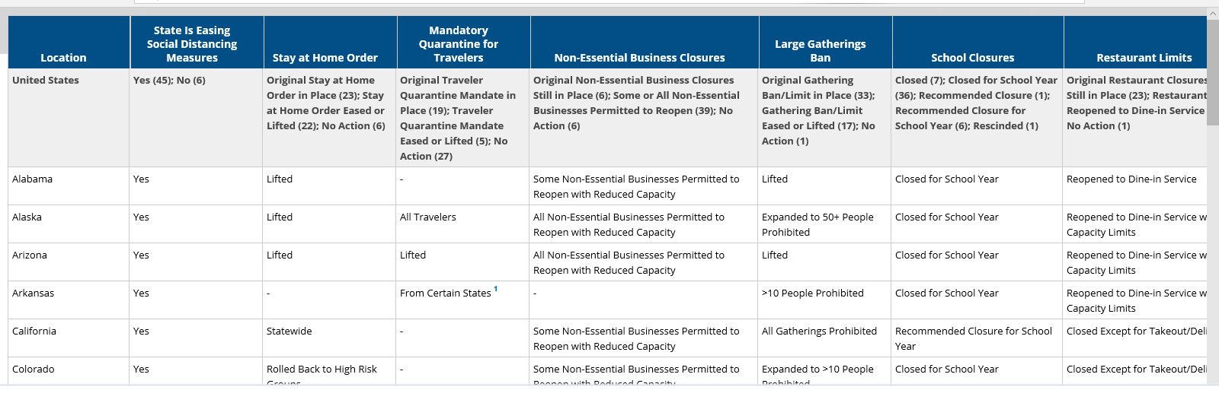
State Actions and Policy Actions to Address the Corona Virus
Reference: www.kff.org

Slide 30
“Until more is known about how COVID-19 spreads, OSHA recommends—”
Using a combination of standard precautions, contact precautions, and contact precautions.
Performing patient care that does not involve aerosol-generating procedures on individuals without suspected or confirmed COVID-19
Follow OSHA's Bloodborne Pathogens (29 CFR 1910.1030) standard
Follow Personal Protective Equipment (29 CFR 1910.132) standard
Follow OSHA’s Respiratory Protection (29 CFR 1910.134) standard

Slide 31
References
ADHA Interim Guidance on Returning to Work
CDC’s Interim Infection Prevention and Control Recommendations for Patients with Suspected or Confirmed Coronavirus Disease 2019 (COVID-19) in Healthcare Settings
CDC’s Guidelines for Infection Control in Dental Health Care Settings – 2003
CDC’s Interim Infection Prevention and Control Guidance for Dental Settings During the COVID-19 Response (May 19, 2020)

