Slide 1
Well being in the time of covid-19
Sara Mackenzie, MD, MPH
Valerie Cherry, PhD

Slide 2
Learning Objectives
At the end of the webinar participants will be able to:
Identify how COVID-19 spreads
Describe how to protect yourself, staff and students
Identify healthy strategies to cope with anxiety due to COVID-19

Slide 3
Why COVID-19 is not the flu

Slide 4
Possible presentations:
Asymptomatic – unclear how common; one study 13% of children
Mild to moderate disease (81%)
Severe disease (14%)
Critical (5%)
Medium time to dyspnea – 5-8 days
Median time to acute respiratory distress syndrome – 8-12 days
Median time to ICU admission – 10-12 days

Slide 5
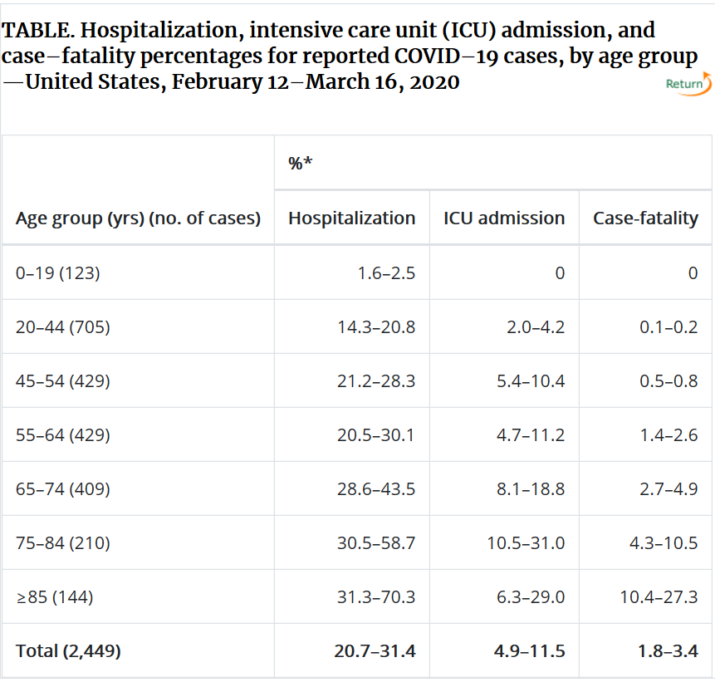
Why Job Corps students are less likely to have severe complications:
Greater risk in persons with underlying health conditions than without
Without health condition (0.9%)
Diabetes mellitus (7.3%)
Chronic lung disease (6%)
Cardiovascular disease (10.5%)
Hypertension (6%)
Cancer (6%)
www.cdc.gov/coronavirus
Notes:
Severe Outcomes Among Patients with Coronavirus Disease 2019 (COVID-19) — United States, February 12–March 16, 2020. MMWR Morb Mortal Wkly Rep 2020;69:343-346. DOI: http://dx.doi.org/10.15585/mmwr.mm6912e2external icon

Slide 6
Isolation & quarantine:
Isolation – if suspected or confirmed disease
For 7 days after symptom onset or 72 hours after resolution of symptoms
Quarantine – if exposed to someone with suspected to confirmed disease
For 14 days after exposure (because incubation 2-14 days!)

Slide 7
Testing:
Center staff must work with their local health departments
Priority 1: hospitalized patients and symptomatic health care workers
Priority 2: long-term care facilities with symptoms, 65 and older with symptoms, underlying health conditions and symptoms, first responders with symptoms
Priority 3: as resources allow, critical infrastructure works, other with symptoms, health care workers and first responders, individuals with mild symptoms in areas with high covid hospitalizations
Non-priority: people without symptoms!

Slide 8
Personal Protective Equipment Health Setting
Gowns
Gloves – non-sterile, disposably examination gloves
N95 respirator, surgical mask
Eye protection –
face shield

Slide 9
Center pandemic response plan
Planning and coordination
Infection control policies and procedures
Essential services
Health department contact information

Slide 10
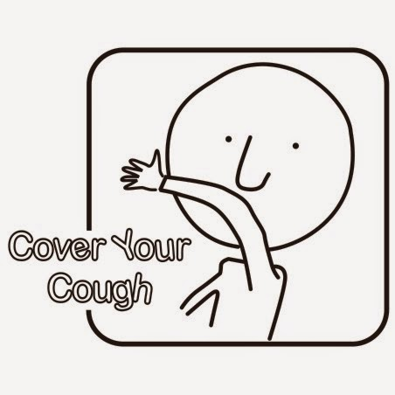
What we all need to do:

Slide 11
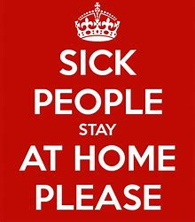
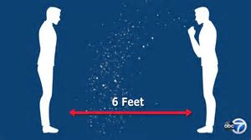
What we all need to do:
Interpersonally

Slide 12
What we all need to do:
Clean “high touch” areas frequently
Establish relationships with care facilities and local public health agencies
Maintain physical distancing
Notes:
Clean “high touch” areas frequently
Establish relationships with care facilities and local public health agencies
Maintain physical distancing

Slide 13
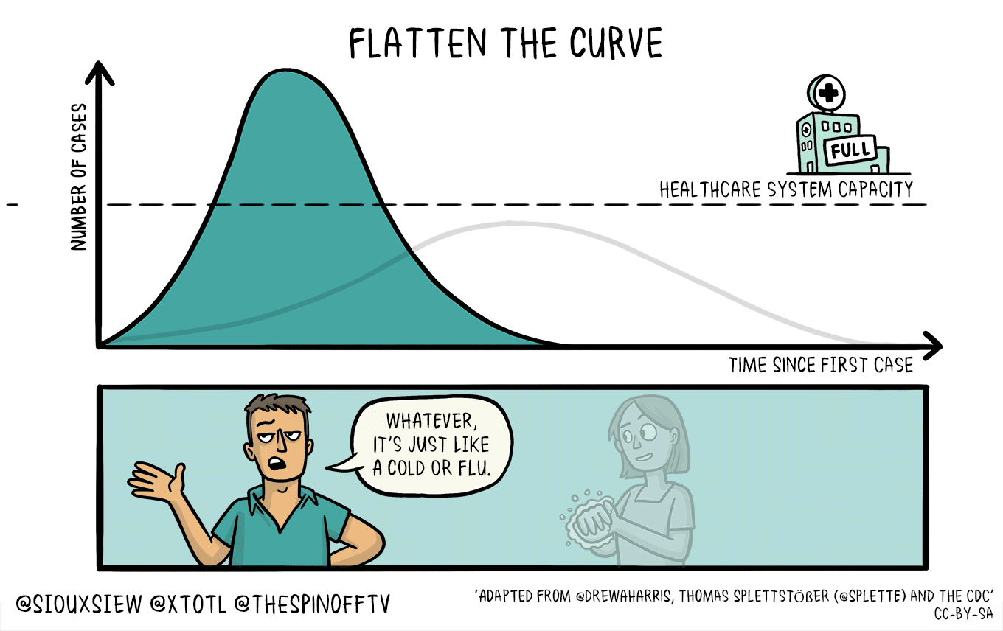

Slide 14
healthy strategies to cope with anxiety due to COVID-19

Slide 15
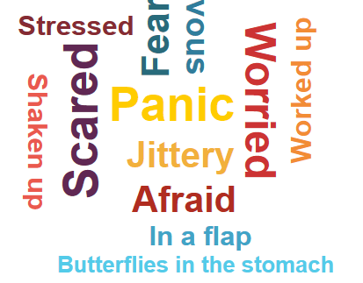
ANXIETY IS PART OF BEING HUMAN
These feelings are helpful to stay alert:
Save yourself from possible threats,
Make better decisions and,
more prepared for what is to come.
WHAT DOES IT LOOK LIKE?...

Slide 16
Everyone reacts differently to stressful situations like COVID-19 outbreak……
Worry about
Your health
Health of others
Time off from work
Caring for your family
Frustration about
Loneliness
Anger
The uncertainty
Boredom
Food
Finances
Education/Job
Self-medicate/soothe
Alcohol
Insomnia
Drugs
Netflix/Hulu
Symptoms of depression
Social Media
Tobacco
Stigmatization
Obsessions
Abandonment
Mourning
Grief

Slide 17
When is anxiety a problem?

Slide 18
American Psychiatric Association Poll The surveys were collected from a nationally representative sample of 1,004 adults during the period March 18-19, 2020. The margin of error is +/- 3.1% at the 95% confidence level.
36% of Americans reported that the novel coronavirus is having a serious impact on their mental health
59% felt the coronavirus is having a serious impact on their day-to-day lives. Almost half were worried about running out of food, medicine and/or supplies
57% were concerned that the coronavirus will have a serious negative impact on their finances
Notes:
These findings are from an American Psychiatric Association-sponsored poll conducted online via a Porter Novelli PN View: 360 survey using Engine’s online CARAVAN® Omnibus survey. The surveys were collected from a nationally representative sample of 1,004 adults during the period March 18-19, 2020. The margin of error is +/- 3.1% at the 95% confidence level.

Slide 19
Behavioral results also showed:
19% reported having trouble sleeping;
8% consumed more alcohol or other drugs/substances;
12% reported increased fighting with a partner or loved ones, primarily because of being stuck at home together; and
24% reported trouble concentrating on other things because they were focused on the coronavirus.

Slide 20
Online Research Study: Psychological Impact and Coping During COVID-19
Research Center: Ferkauf Graduate School of Psychology (Yeshiva University) Principal Investigator: Dr. Tracy Prout, PhD
The purpose of the study is to learn more about the psychological impact of the coronavirus/COVID-19 and how people are coping with the pandemic and its consequences.
You must be at least 18 years old and fluent in English to participate.
Participation involves completing a survey online.
The expected length of participation is 20-30 minutes.
All responses are anonymous.
bit.ly/covid-study
This study has been reviewed and approved by the Western Institutional Review Board.

Slide 21
HEALTHY COPING STRATEGIES Psychological research points to ways to cope during difficult times
Maintain a day-to-day routine where possible
2
Limit social media/news and use reliable sources
1
Stay virtually connected with others
3
Take care of yourself
Maintain a healthy lifestyle
4
Seek professional help
5
Brooks SK, Webster RK, Smith LE, et al. (2020). The psychological impact of quarantine and how to reduce it: rapid review of the evidence. Lancet; 395: 912-20

Slide 22
Shift From Fear and Anxiety to Gratitude and Hope
Pay Attention to How You Think
Create Certainty for Yourself
Be Grateful
Help others
RELAXATION
MINDFULNESS
Karns CM, Moore WE III and Mayr U. (2017). The Cultivation of Pure Altruism via Gratitude: A Functional MRI Study of Change with Gratitude Practice. Front. Hum. Neurosci. 11:599. doi: 10.3389/fnhum.2017.00599

Slide 23
PREPARING FOR STUDENTS TO RETURN
Mixed Emotions
Is It Really Safe?
New Normal
Routine
IDEAS

Slide 24
Be Prepared
Grief, Mental Health, and Substance Use Resources
Staff training
Trauma-informed care
Identification of students who may need additional support
Importance of routine and structure
Reassure students and staff the center is cleaned/sanitized before they return so they can feel safe on center.
Plan for a welcome back event
Plan for how social media might be used to help disseminate important and accurate information, when needed

Slide 25
On Return
Coping with COVID-19 brochure
Wellness checks for medication compliance, level of trauma, suicidal thoughts, AOD use
Brief presentation during business meeting
Schedule meetings with students in small groups (Dorms)
Practical coping strategies
Use simple relaxation and distraction skills
What have student used before to cope
Write a list of people they can turn to for support
Write a list of things they are looking forward to
Focus on personal and educational goals in Job Corps
Back to Routine
This Photo by Unknown Author is licensed under CC BY-SA-NC

Slide 26
Digital Therapy
Download the Calm app for free: https://cal.mn/YouTube

Slide 27
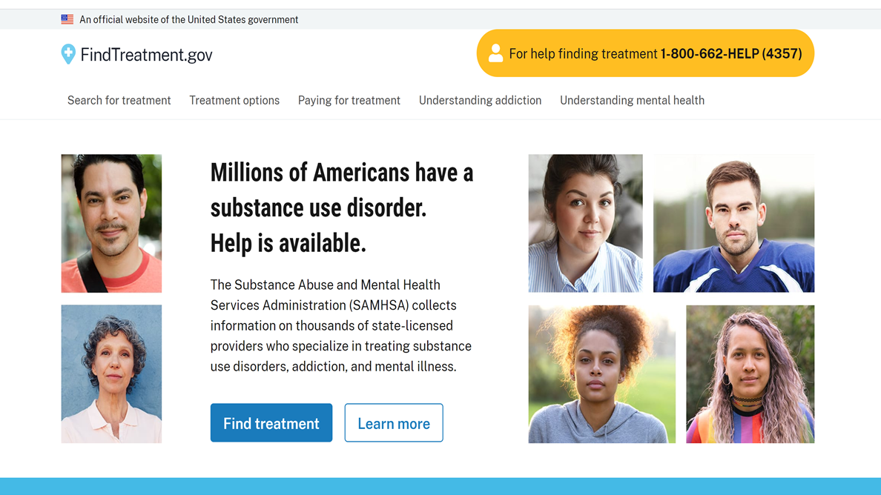
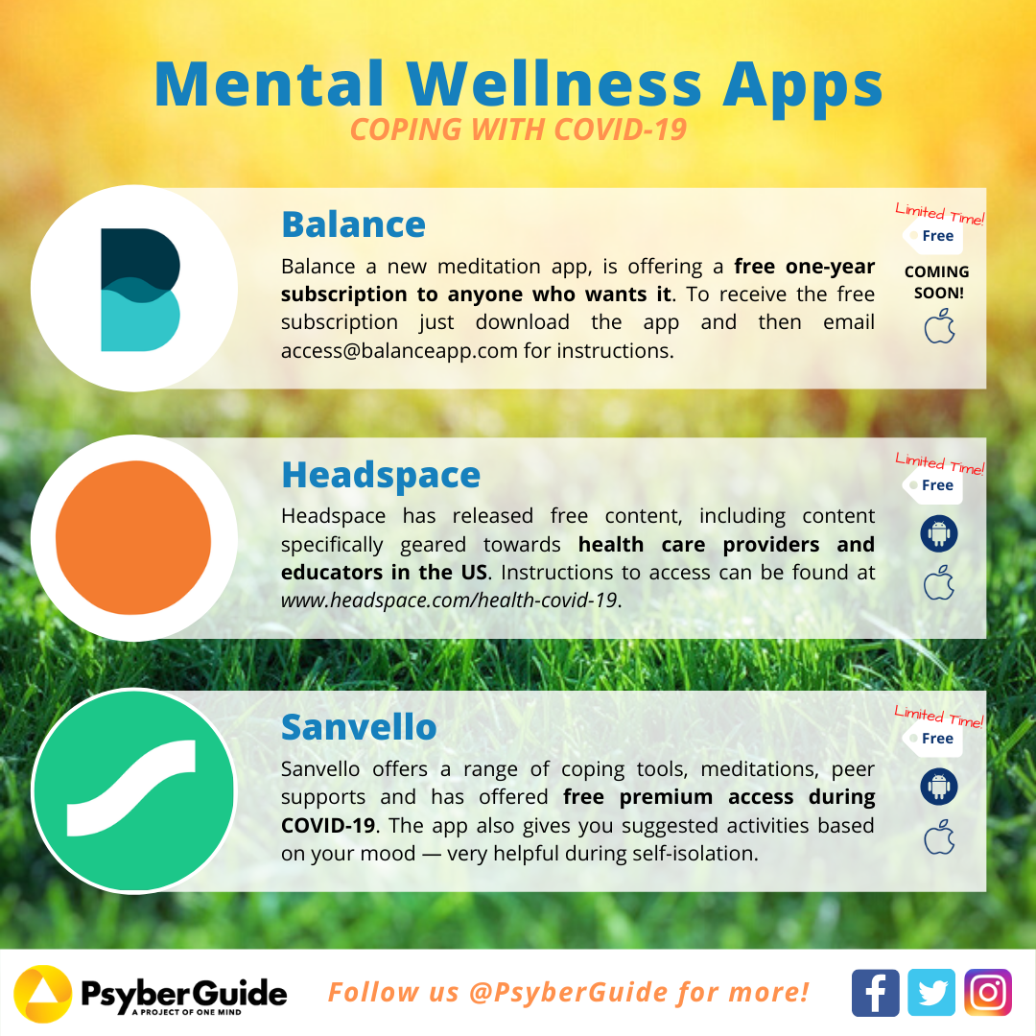
Additional Resources

Slide 28
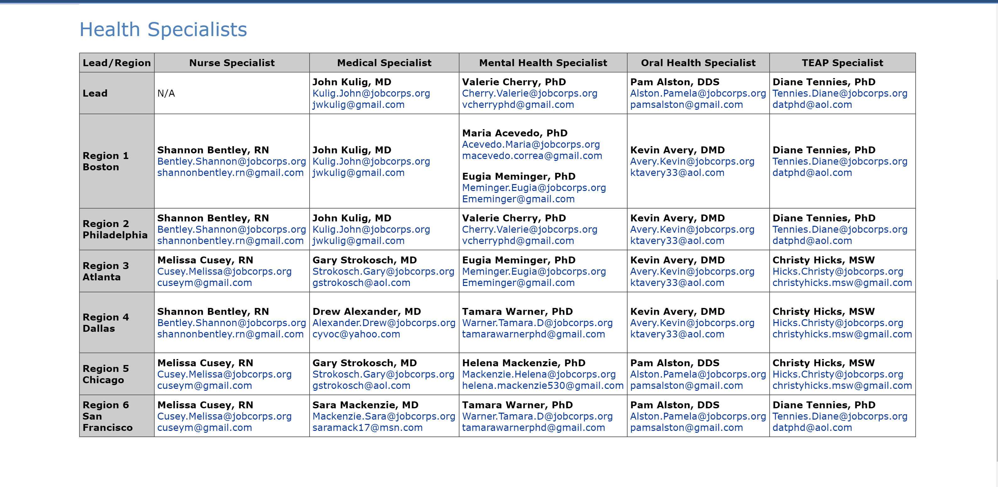

Slide 29
Questions?

