Slide 1
Sun Exposure and Skin Cancer: Know Your ABCDEs
Presenters:
Chris Kuhn, Center Director, Oneonta Job Corps Center
John Kulig, MD, MPH, Lead Medical Specialist, Humanitas
May 19, 2022

Slide 2
Overview
This webinar will provide a review of the different types of skin cancer, recognition of skin cancer and educational resources for skin cancer prevention.
A melanoma survivor will discuss his case and offer suggestions for skin cancer prevention in Job Corps.

Slide 3
Learning Objectives
Participants will be able to:
1. Recognize the relationship between rising rates of skin cancer and sun exposure.
2. Explain the signs and symptoms of skin cancer and the meaning of the acronym "ABCDE."
3. Describe educational resources and strategies to communicate skin cancer prevention information for Job Corps students.

Slide 5
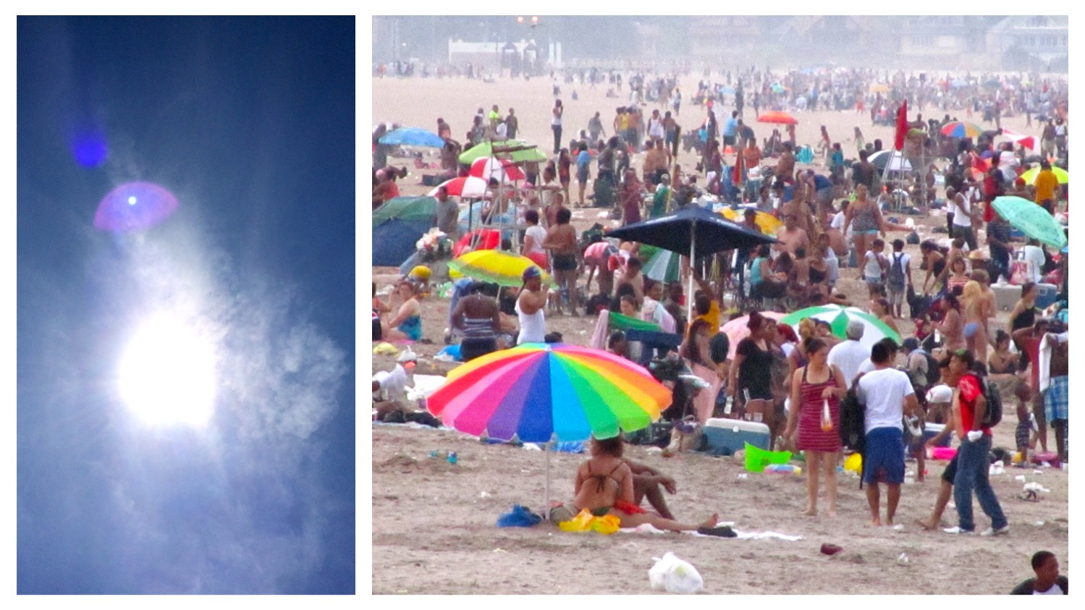

Slide 7
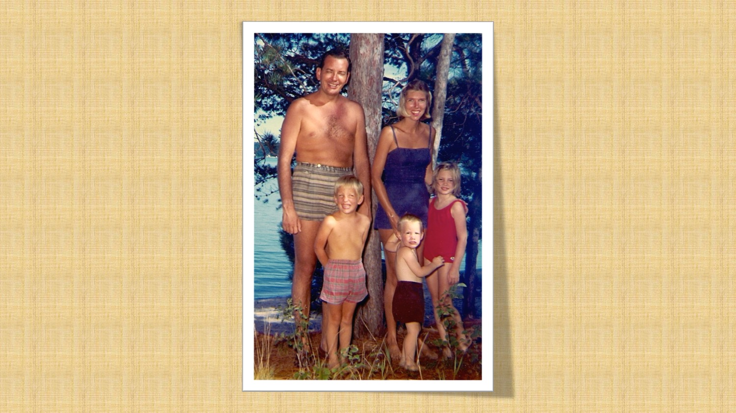

Slide 10
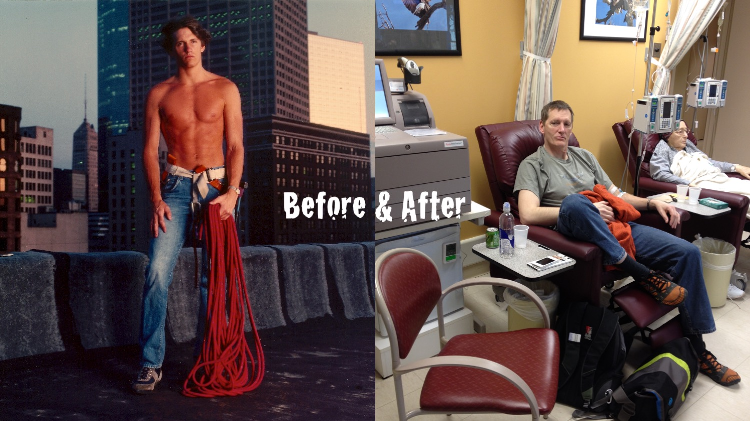

Slide 11
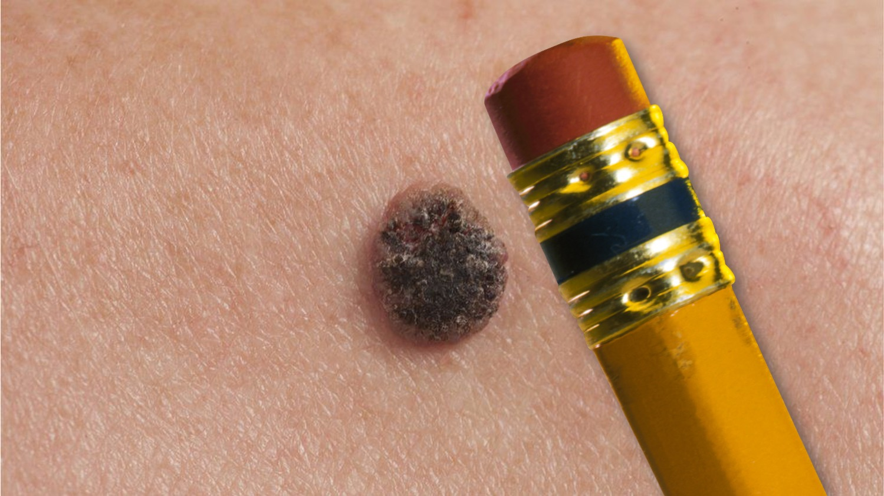

Slide 13
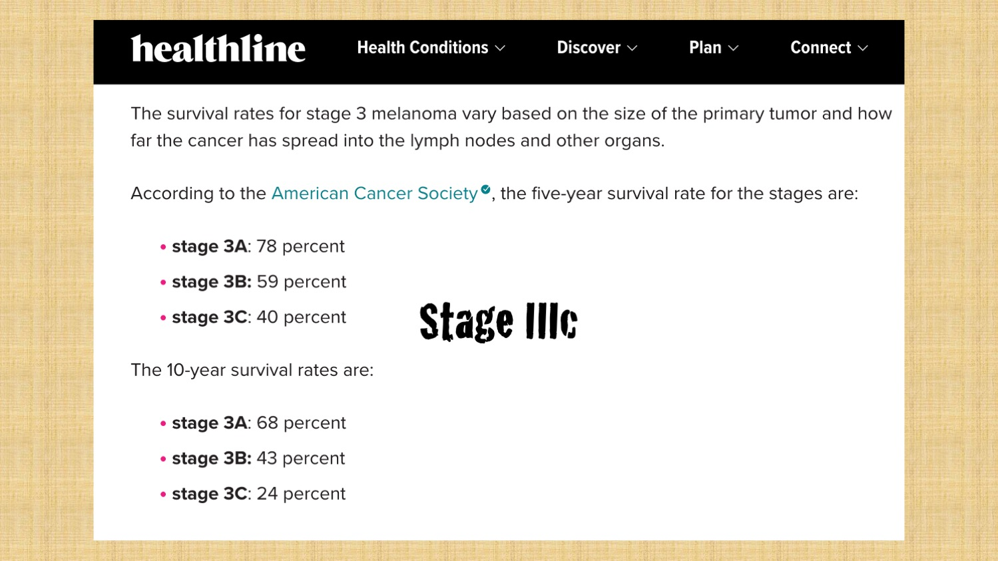

Slide 15
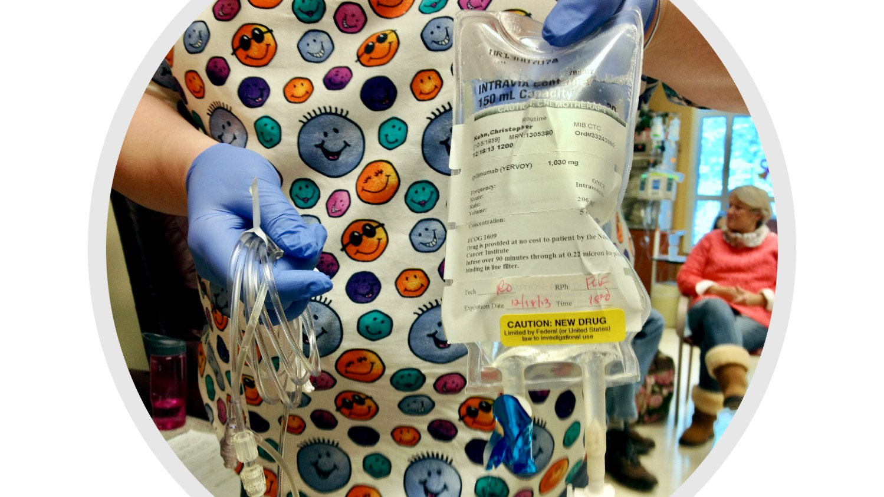

Slide 16
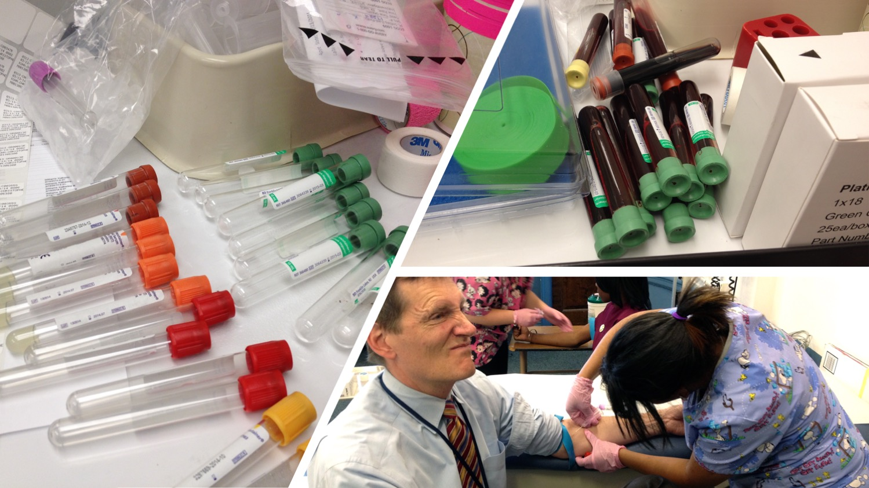

Slide 17
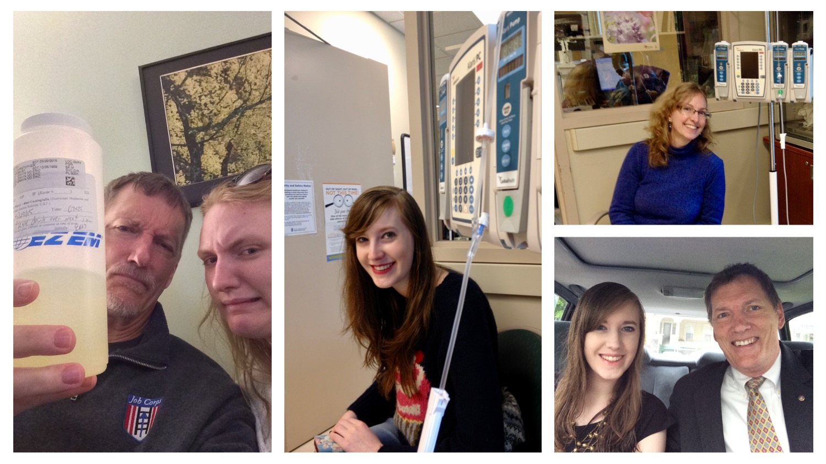

Slide 18
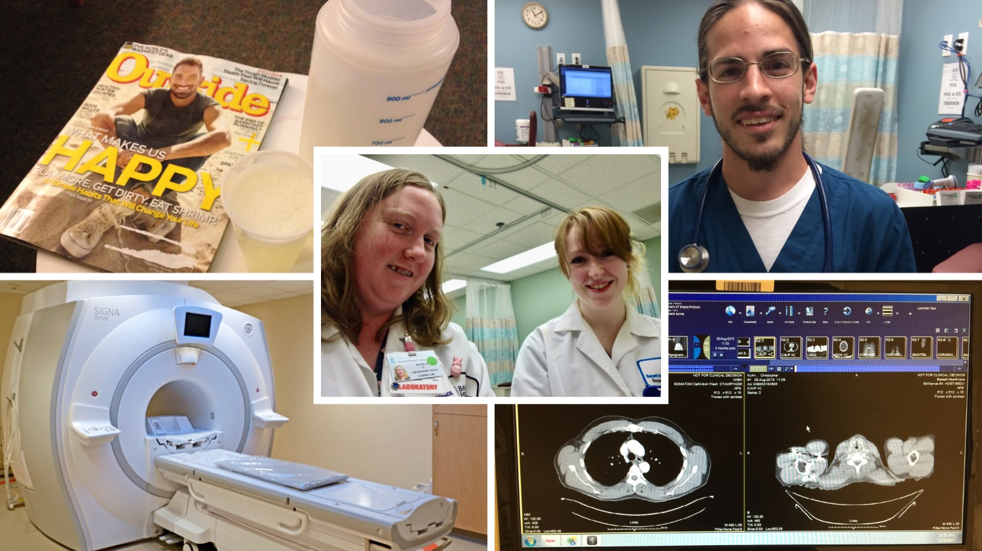

Slide 19
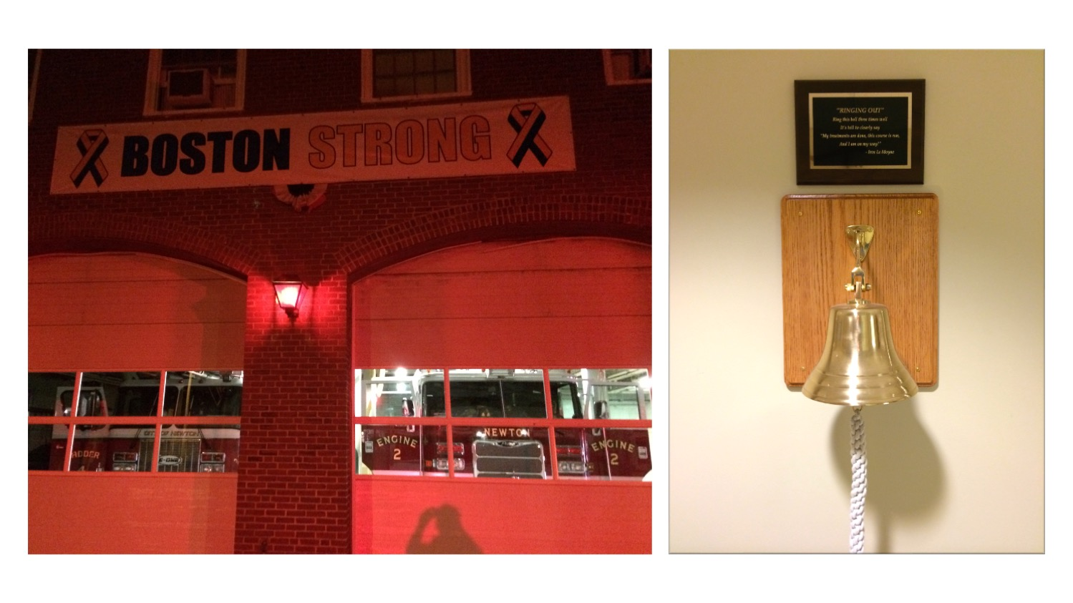

Slide 20
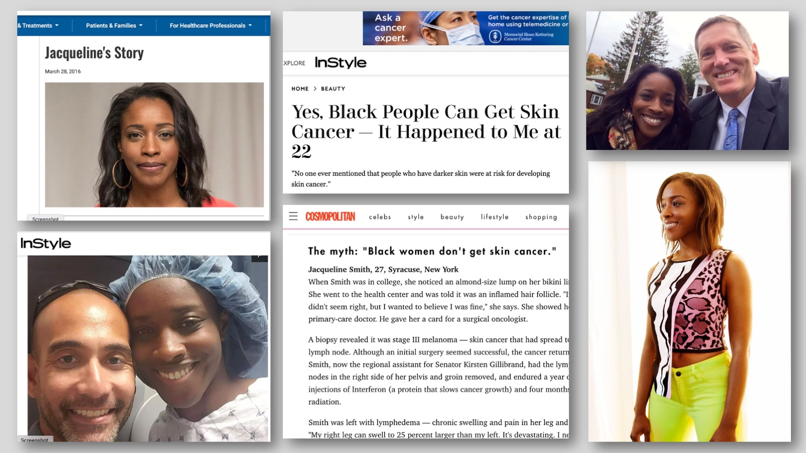

Slide 21
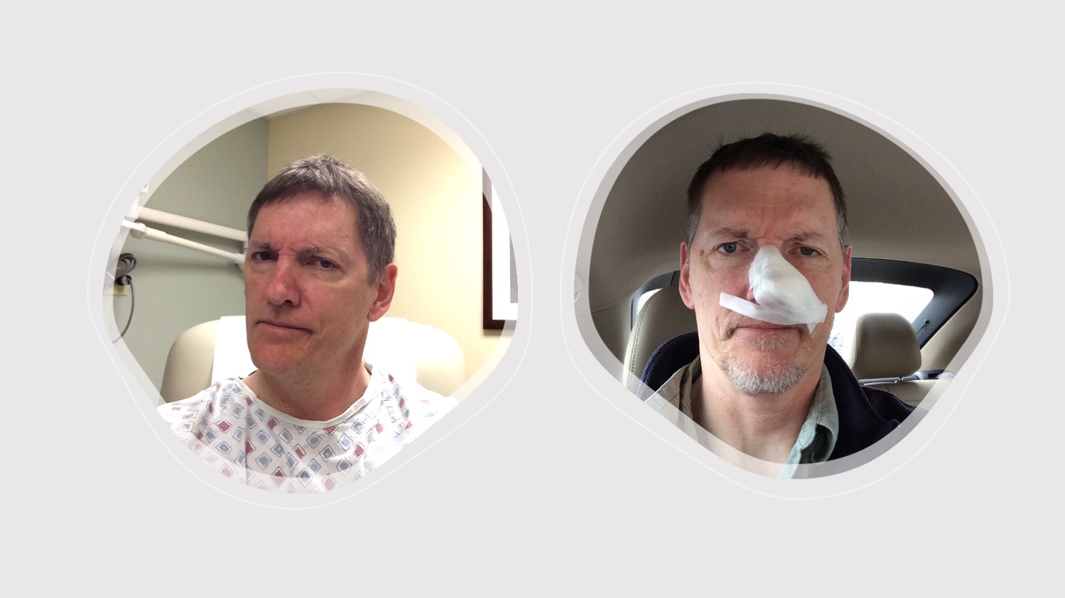

Slide 22
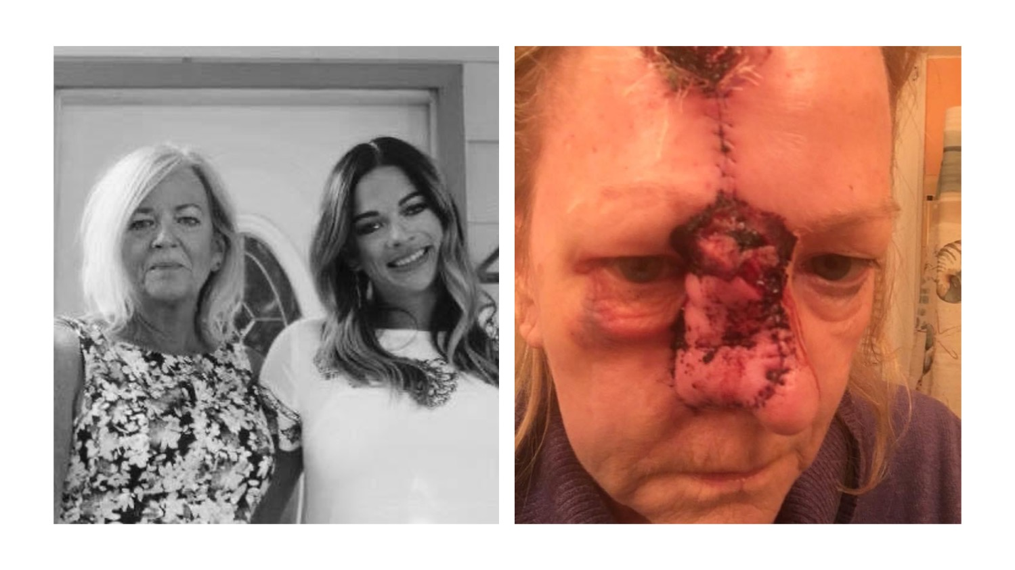

Slide 23
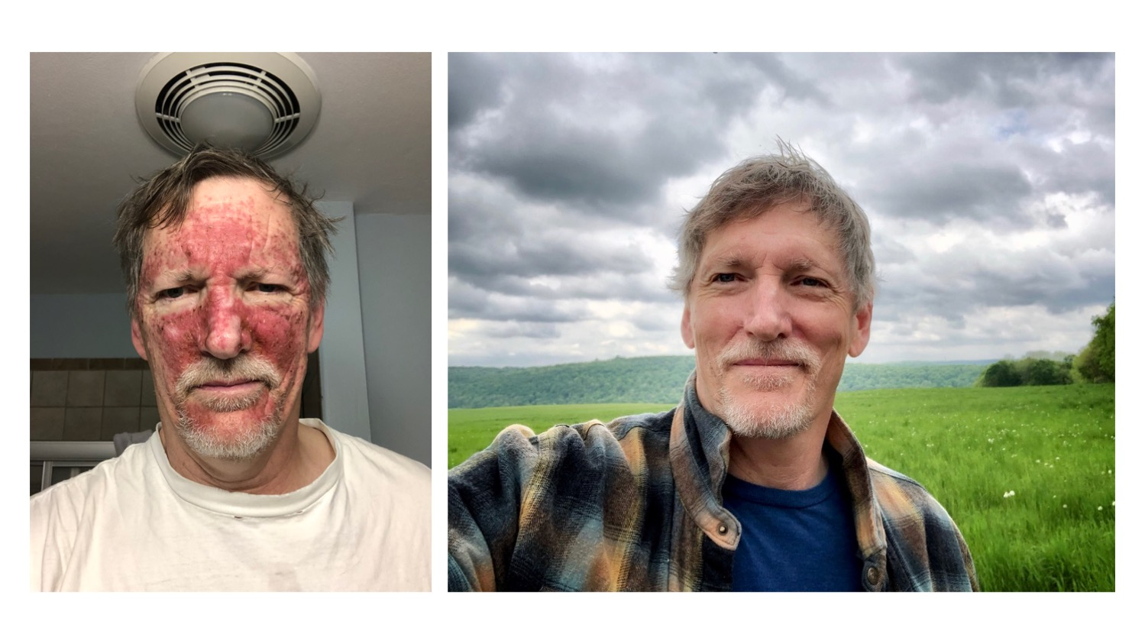

Slide 27
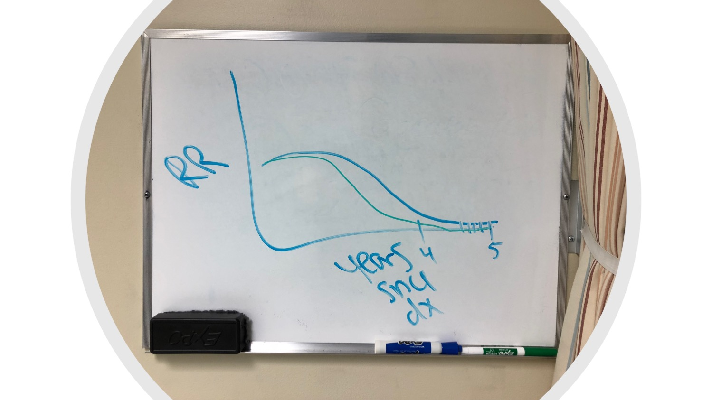

Slide 30
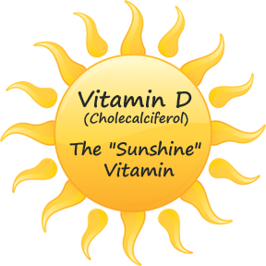
Factors influencing production of vitamin D in skin
Skin color and current tan level
Amount of time spent in the sun
Weather conditions: cloud cover and pollution, ozone layer, surface reflection
Latitude and elevation
Season
Time of day
Use of sunscreen
Clothing, hats
Adequate vitamin D can be obtained safely through food and dietary supplements

Slide 31
Harmful effects of sun exposure
Tanning is the body’s response to skin damage from ultraviolet (UV) radiation from the sun
Sunburn – 1st (redness) and 2nd degree (blisters)
Dehydration/heat injury/heat stroke
Corneal damage to the eyes
Drug sensitivity reactions
Premature skin aging/wrinkles/age spots
Solar urticaria (hives) - rare

Slide 32
Harmful effects of sun exposure
Sunburn can occur in less than 15 minutes, but may not appear for another 2 to 4 hours
Skin cancer – most common of all cancers – 90% caused by sun exposure
“Sustaining 5 or more sunburns in youth increases lifetime melanoma risk by 80%.” [Skin Cancer Foundation]

Slide 34
Types of skin cancer
Basal Cell Carcinoma
about 8 out of 10 of all skin cancers
usually develop on areas exposed to the sun, especially the head and neck
Squamous Cell Carcinoma
tend to grow slowly
usually occur on sun-exposed areas of the body, such as the face, ears, neck,
lips, and backs of the hands
Melanoma
much less common than basal cell and squamous cell skin cancers, but far more
dangerous
trunk (chest and back) is the most common site in men; legs are the most
common site in women; neck and face are other common sites

Slide 35
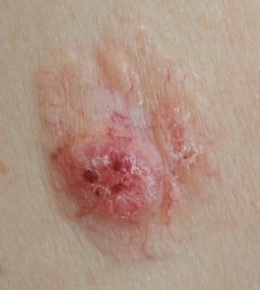
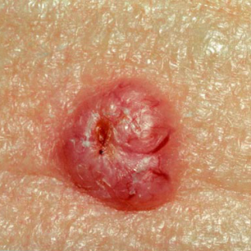
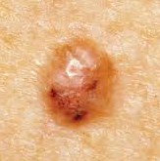
Basal Cell Carcinoma

Slide 36
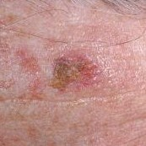
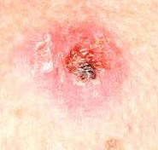
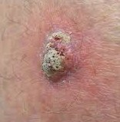
Squamous Cell Carcinoma

Slide 37
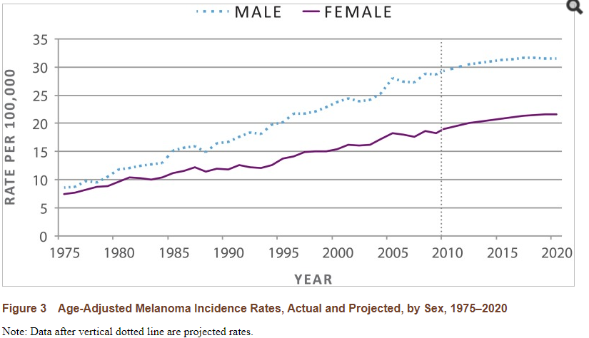

Slide 38
How common is skin cancer?
The National Cancer Institute SEER Program projects there will be 106,110 new cases of skin melanomas and 7,180 deaths in 2021.
In 2018, there were an estimated 1.3 million people living with melanoma of the skin in the U.S.
About 4.3 million people are treated for basal cell cancer and squamous cell skin cancer in the U.S. every year, according to a report from the Office of the Surgeon General.
FDA

Slide 39
Melanoma rates
Incidence of melanoma in the U.S. has grown over 320% since 1975
Five year survival 99% with stage I disease, but only 30% with stage IV disease

Slide 40
Skin Cancer in African Americans
African Americans are less likely than members of other racial and ethnic groups in the United States to develop skin cancer
Melanomas occur mainly on body sites that are not pigmented, such as the palms of the hands, the soles of the feet, and the skin beneath the nails as well as the mucous membranes of the mouth, nasal passages, and genitals
Outcome of skin cancer is often poorer in African Americans because the disease is often diagnosed at a more advanced stage

Slide 42
Question
Which internationally famous singer, songwriter and musician died at age 36 of malignant melanoma that presented under the nail of a toe?

Slide 44
ABCDE for Melanoma

Slide 45
What about E?
Evolution (or Change)
evolution of a nevus has become the most important factor to
consider when it comes to diagnosing a melanoma
Elevation
elevation changes are critical because, when the thickness of a
melanoma exceeds 1 mm, the chance of internal spread increases

Slide 46
And now F and G!
Properties of nodular melanomas
E = ELEVATED
Early elevation above the skin surface
F = FIRM
Firm to the touch, not flabby
G = GROWING
Continues growing more than two to three weeks

Slide 47
Nodular Melanomas
Nodular melanomas are typically dome-shaped and lacking in the ABCD properties, making visual diagnosis more difficult
http://www.skincheck.org/

Slide 48
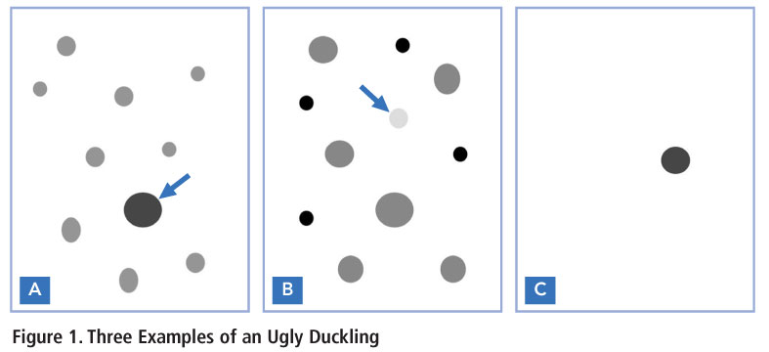
The “Ugly Duckling” Sign
Based upon the observation that nevi in the same individual tend to resemble one another and that malignant melanoma often deviates from this nevus pattern.

Slide 49
Prevention
Melanoma can be prevented by reducing ultraviolet radiation exposure from sunbathing and indoor tanning and increasing the use of sun protection.

Slide 50
Summary of USPSTF Recommendations and Evidence
Population | Recommendation | Grade B
Children, Adolescents, and Young Adults aged 10 to 24, Fair Skinned | The U.S. Preventive Services Task Force (USPSTF) recommends counseling children, adolescents, and young adults aged 10 to 24 years who have fair skin about minimizing their exposure to ultraviolet radiation to reduce risk for skin cancer. | The USPSTF recommends the service. There is high certainty that the net benefit is moderate or there is moderate certainty that the net benefit is moderate to substantial.

Slide 51
CDC Recommendations
Stay in the shade, especially during midday hours from 10 am to 4 pm DST.
Wear clothing that covers your arms and legs.
Wear a hat with a wide brim to shade your face, head, ears, and neck.
Wear sunglasses that wrap around and block both UVA and UVB rays.
Use broad-spectrum sunscreen with sun protection factor (SPF) 15 or higher, and both UVA and UVB protection.
Avoid indoor tanning.
http://www.cdc.gov/cancer/skin/basic_info/prevention.htm

Slide 52
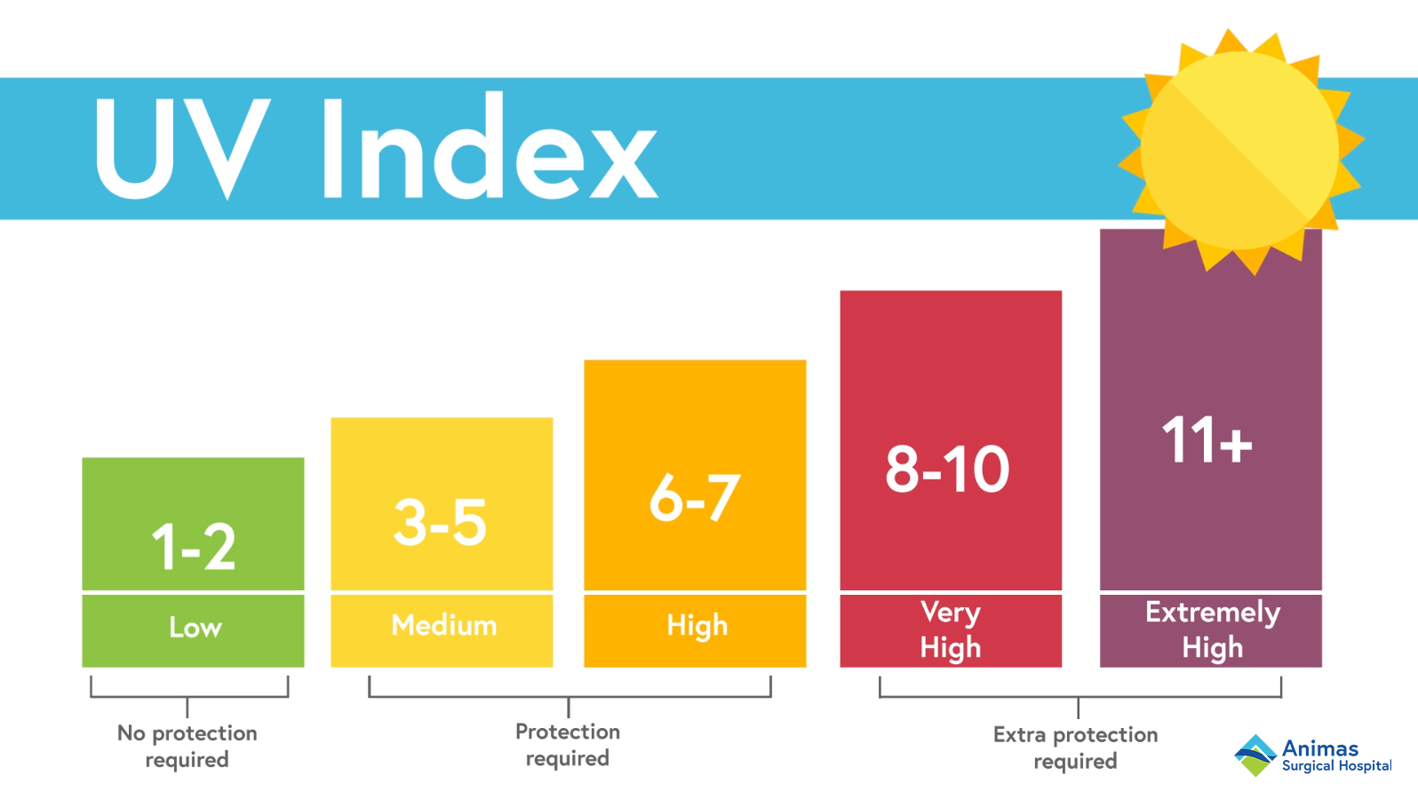

Slide 53
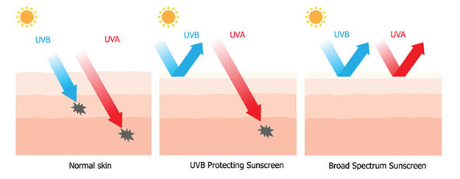

Slide 54
Sunscreens
Sun protection factor (SPF)
degree of protection against the ultraviolet B (UVB) rays that cause sunburn
SPF 15 filters out 94% of the sun’s UVB rays. SPF 30 protects the skin from 97% of the UVB rays – no need for SPF > 30
must apply at least every 2-3 hours

Slide 55
Simple rules to prevent sunburns
When possible, dress in cool, comfortable clothing that covers the body, such as
lightweight cotton pants, long-sleeved shirts, and hats.
Select clothes made with a tight weave; they protect better than clothes with a looser weave. If you're not sure how tight a fabric's weave is, hold it up to see how much light shines through. The less light, the better. Or you can look for protective clothing labeled with an Ultraviolet Protection Factor (UPF).
Wear a hat with an all-around 3-inch brim to shield the face, ears, and back of the neck.
Limit your sun exposure between 10:00 am and 4:00 pm when UV rays are strongest.
Wear sunglasses with at least 99% UV protection.
Use sunscreen.

Slide 56
Sunscreens

Slide 57
How to choose a sunscreen
Sunscreen can help protect the skin from sunburn and some skin cancers but only if used correctly.
Keep in mind that sunscreen should be used for sun protection, not as a reason to stay in the sun longer.
Use a sunscreen that says "broad-spectrum" on the label; that means it will screen out both UVB and UVA rays.
Use a broad-spectrum sunscreen with a sun protection factor (SPF) of at least 15 (up to SPF 50). An SPF of 15-30 should be fine for most people.
If possible, avoid the sunscreen ingredient oxybenzone because of concerns about mild hormonal properties. Remember, though, that it's important to take steps to prevent sunburn, so using any sunscreen is better than not using sunscreen at all.
For sensitive areas of the body, such as the nose, cheeks, tops of the ears, and shoulders, choose a sunscreen with zinc oxide or titanium dioxide. These products may stay visible on the skin even after you rub them in, and some come in colors.

Slide 58
How to apply sunscreen
Use enough sunscreen to cover all exposed areas, especially the face, nose, ears, feet, hands, and even backs of the knees. Rub it in well.
Put sunscreen on 15 to 30 minutes before going outdoors. It needs time to absorb into the skin.
Use sunscreen any time you spend time outdoors. Remember that you can get sunburn even on cloudy days because up to 80% of the sun's UV rays can get through the clouds. Also, UV rays can bounce back from water, sand, snow, and concrete, so make sure you're protected.
Reapply sunscreen every 2 hours and after swimming, sweating, or drying off with a towel. Because most people use too little sunscreen, make sure to apply a generous amount.

Slide 59
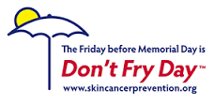
Slip! Slop! Slap! Wrap!
Slip on a shirt
Slop on sunscreen with SPF 15 or higher
Slap on a wide-brimmed hat
Wrap on sunglasses

Slide 60
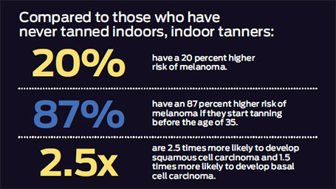
Tanning Beds

Slide 61
Risks of Indoor Tanning
Classified as a Class I human carcinogen by WHO in 2009
400,000 cases of skin cancer may be related to indoor tanning in the United States each year: 245,000 basal cell carcinomas, 168,000 squamous cell carcinomas, and 6,000 melanomas (2014)
Tanning at younger ages appears to be more strongly related to lifetime skin cancer risk

Slide 62
Early Detection
Self-examination once a month
Annual dermatology visit if high risk:
Fair skin, freckling, red or blonde hair
Family history of melanoma
Atypical moles/dysplastic nevi
Frequent sunburns/indoor tanning
Weakened immune system
Greater risk in women < age 45 years
Greater risk in men > age 45 years

Slide 63
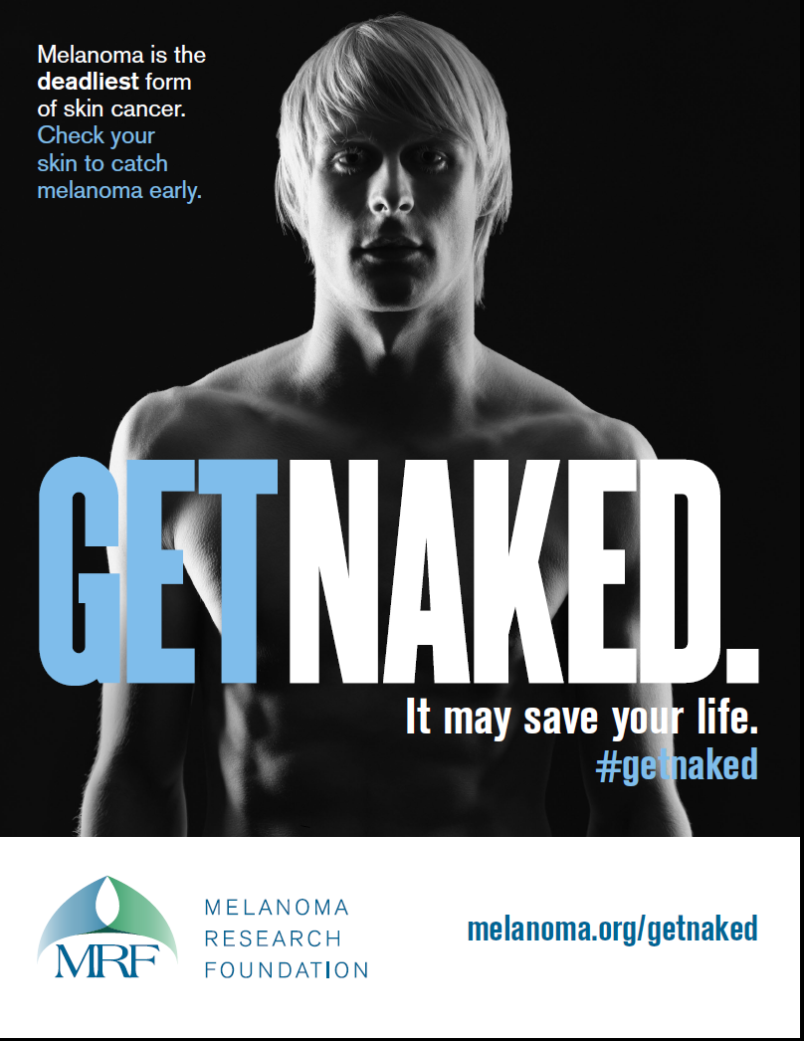

Slide 64
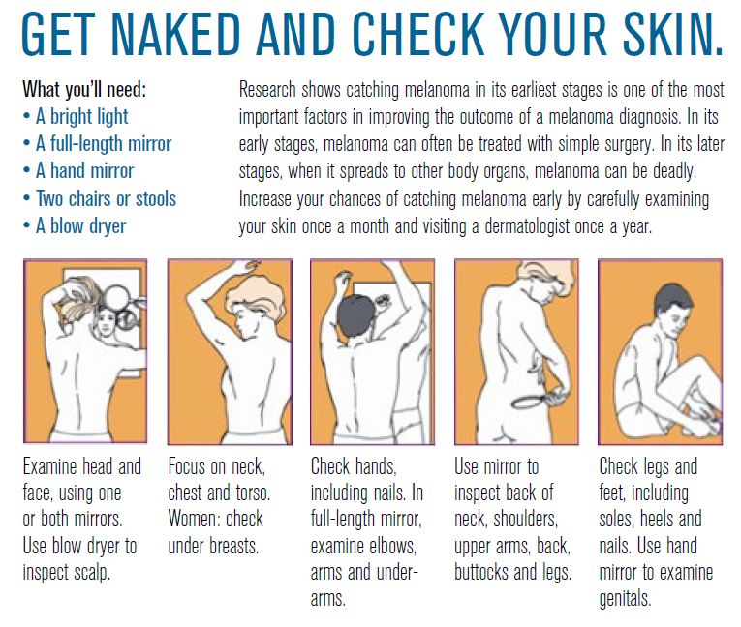

Slide 65
Prevention on Job Corps Centers
May Is Skin Cancer Awareness Month
Educational presentations, pamphlets, posters
Sunscreen with SPF 30 available at no cost from the Wellness Center
Schedule outdoor vocational and recreational activities to minimize direct sun exposure
Hydration to prevent heat injury

Slide 67
Resources
http://www.skincancer.org/
http://www.skincheck.org/
http://www.cdc.gov/cancer/skin/basic_info/sun-safety.htm
http://www.cdc.gov/cancer/skin/call_to_action/index.htm
http://www.fda.gov/ForConsumers/ConsumerUpdates/ucm049090.htm#Slop

