Slide 1
Facilitator: Dr. Eugia Meminger Regions 1 and 3 Regional Mental Health Specialist
Why this topic?
Type in the chat what type of groups you are doing at your centers?

Slide 2
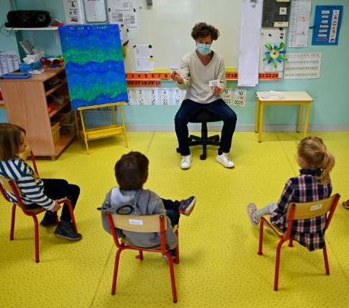
Making Groups Work in Job Corps
Dr. Janet Negley, San Jose JCC
Dr. Karyn Felder Moore, Woodstock JCC
Mr. Arnold Cox, Westover JCC

Slide 3
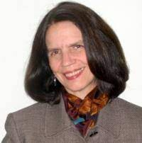
“Chill and Chat” A group for students that are socially shy/on the spectrum/have no friends
Dr. Janet Negley, CMHC
San Jose Job Corps Center

Slide 4
Brief Overview of Group Basics
Groups can be an effective way to deliver MH services at Job Corps.
Groups can be informational or skill building groups OR they can be process oriented. Most research finds a combination of both has the best outcomes.
Therapeutic action in groups can happen in many ways:
from the leader imparting information
members getting to see others having similar experiences
members growing from hearing/watching others struggle and finding solutions
members developing a sense of themselves as helpers and increasing their sense of interpersonal worth
members experiencing a sense of belonging and safety in a social setting
members learning new interpersonal skills in a learn-by-doing way
members developing trust in others so they can share feelings and be heard

Slide 5
What Does the Group Leader Do?
Group leaders establish and maintain the emotional climate of the group, help the group set behavioral norms
They model ways to give compassionate responses, manage tough questions and comments, and deal with conflict in an immediate but emotionally centered way
Group leaders encourage members to interact with each other, help create safety in giving and receiving feedback
Group leaders pay attention to 1. the action in the group as a whole, 2. interpersonal action between people and 3. individual’s reaction and emotions

Slide 6
Special Issues with Groups at Job Corps
Selection of group members needs to match the group being offered.
Is it open, are there flyers to announce the group starting, do referrals come from the guidance counselors, does each group member have a short individual session first explaining the group? Can students sign themselves up?
A group in a closed community has unique challenges different from groups in which members only see each other in group.
We aren’t a treatment center where we can plan for conflicts in group to be addressed in the next group session: tensions can erupt in the dorm that night. What is your action plan for this?
Notes:
Anger Management, both student sign up and referrals; Healthy Relationships, public sign ups; LGBTQ, start with social activity, private sign ups

Slide 7
Special Issues with Groups at Job Corps
The classic confidentiality standard of “keeping all disclosures within the group” may not be reasonable; might be better to have the standard, “don’t share anything you don’t want to be repeated”.
When can groups be held? During class time, after class, after dinner? Do your students come to the Health and Wellness center for other appointments?
Can you get buy in from the CD, the Academic manager, the counseling manager that group time is essential for the student’s future employment?
Groups at JC are safest with two group leaders: who will be your co-therapist? Can you co-lead with guidance counselors or interns? Can the interns co-lead?
Notes:
Anger Management, both student sign up and referrals; Healthy Relationships, public sign ups; LGBTQ, start with social activity, private sign ups

Slide 8
Purpose is to provide group support and social development opportunities for trainees who are shy, socially anxious or on the spectrum in a slow moving, organized and safe way; for students that need a quieter, no drama setting.
Group member selection is key. Students have to be referred. Students are individually oriented to the group before the group starts. Students can join mid-way but are carefully introduced after prior discussion with standing group members since some members on the spectrum might be sensitive to change.
Therapeutic action of the group is primarily through process. We don’t offer specific social skills in lesson plans but aim for students to increase social comfort and new skills by participating in structured activities with their peers. We start with easy activities first, challenging activities come later, such as paring off in twos for a discussion.
Notes:
Comment about social shyness vs social anxiety vs introverts; unique characteristics of those on the spectrum; how the group addresses all these concerns

Slide 9
We let the group members come up with their own group “rules” at the start of group and ask for volunteers to repeat them in subsequent sessions as the group develops. We always include the rule that no one has to talk if they don’t want to.
Group lasts longer than others (sometimes more than six months) so process can develop slowly.
Notes:
Comment about social shyness vs social anxiety vs introverts; unique characteristics of those on the spectrum; how the group addresses all these concerns

Slide 10
Structure That Has Worked Well
Start all sessions with a check in. Stick with one format for at least six weeks before changing it up.
Favorite: Rose, Thorn and Bud check in: rose, a highlight, success, small win, or something positive that happened; thorn, a challenge you experienced or something you can use more support with and bud, a new idea that has blossomed or something you are looking forward to knowing more about or experiencing. One can always PASS.

Slide 11
Structure That Has Worked Well
Favorite endings of group:
How was group for you today: session rating scale (thumbs up if you liked it, thumb to the side if it was fine, and thumbs down if it wasn’t your favorite). Totally nonverbal feedback.
Ring a bell or gong and listen to it until the sound completely fades to nothing.
Later on: ”Share one thing you’d prefer to leave here and one thing you’d like to take with you.”

Slide 12
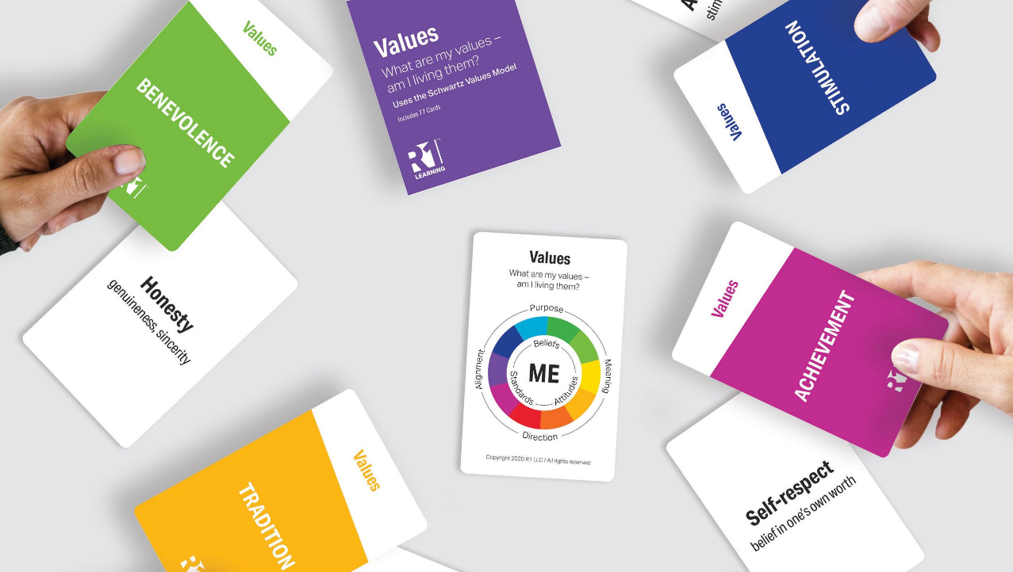
Activities/Content That Has Worked Well
Art: leaving anonymous sidewalk chalk images on campus, drawn together
Collage boxes: images of what is public on the outside, what is private on the inside; share as it comfortable
Draw picture of what inspires you; share if comfortable
Game: two truths and a lie; charades of favorite movies; blindfold walk outside with group instructions
Values Card Sort: share the one value you are most comfortable sharing
Notes:
Most meetings include two planned activities, including one mindfulness experience. (food and taste; diaphragmatic breathing; 5 senses, breathing and listening to music, mindful outdoor walking) There is also one planned activity that requires some cooperation and/or sharing.

Slide 13
Activities/Content That Has Worked Well
Discussion/talking ideas: (can ask directly or put the questions in a hat and randomly draw on them)
If you were an animal, what would you be? What superpower do you wish you could have? Would you rather be a boss or an employee? If you could make one rule that everyone in the world would follow, what would it be? What’s a hobby or skill that you would like to learn? If you lost everything but could keep three things, what would they be?
Later on:
Pick a year in your life and tell us everything you remember? What is one thing you are good at and one thing that is a challenge? What question would you like to ask everyone in the room? (better to put this one anonymously in the hat)

Slide 14
Top 11 questions/comments to help group process increasing levels of interpersonal challenge
How was this activity/discussion/event for you? Did you like it? Not like it?
Does anyone feel/think the same?
Has anyone had a different experience?
Are you willing to hear from someone else who has the same challenge and found something that helped them out?
What do you appreciate about (other person in the group)?
What can the group do to help you?
Notes:
“I never knew I could have friends”; “I am going to run for SGA office now”; “At least someone understands me”

Slide 15
Top 11 questions/comments to help group process increasing levels of interpersonal challenge
That discussion/question seemed to move you: what are you thinking/feeling?
What do you need from the group right now?
What’s it like for the group when X talks about that?
What do you wish the group would notice about you? About what you are feeling or thinking right now? What do you wish they would say to you? Ask you?
I’m noticing that the group got quiet? What do you think is going on?
Notes:
“I never knew I could have friends”; “I am going to run for SGA office now”; “At least someone understands me”

Slide 16
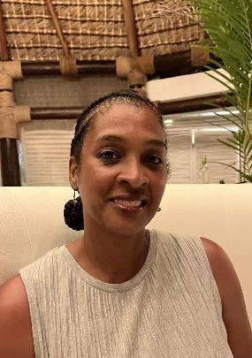
M.I.N.O.R.S!
A 6-week skills-building process group for minors
Dr. Karyn Felder Moore, CMHC
Woodstock Job Corps Center

Slide 17
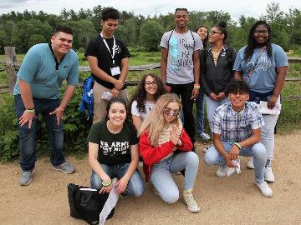
M.I.N.O.R.S. Support Group
Participants: All Woodstock Job Corp young adult minors (ages 16 & 17).
Purpose: To create a safe, supportive environment for self expression and development of essential social and life skills; namely: Mentoring/Modeling, Independent living skills, Nurturing self, Opportunities, Respect/Responsibility, and Success!

Slide 18
Group Guidelines
Each student will attend a minimum of 6 encounters to address each of the primary objectives (M.I.N.O.R.S!).
Each student will actively participate in discussion and sharing of personal experiences, suggestions and ideas.
Each student will get to know at least one new person.
Each student will be prepared to “mentor” another new minor by the time s/he has completed the 6 sessions (fulfillment is optional)

Slide 19
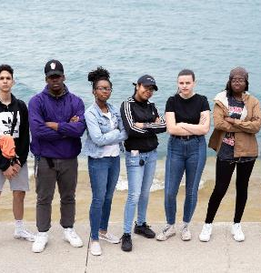
M.I.N.O.R.S.
Mentoring/Modeling – week 1
Each student is encouraged to identify a suitable mentor on center and to model appropriate (i.e., employable) behavior.
Independent Living Skills – week 2
We discuss what it means to be “independent” and practical steps they can take now in preparation for life after Job Corps (i.e., budgeting, laundry, open savings acct, PT job or WBL)

Slide 20
M.I.N.O.R.S.
Students are encouraged to take pride in themselves, set goals and rewards. The goal is for each student to readily identify 3 healthy coping skill and/or self-care practices.
Discover what opportunities await you at JC. Make a point to pursue at least 3 during your tenure (i.e., joining a club, drivers ed., volunteer service)
Nurturing Self – week 3
Opportunity – week 4

Slide 21
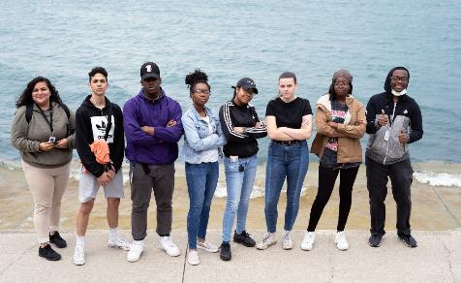
M.I.N.O.R.S.
Respect/Responsibility – week 5
Webster defines respect as the special esteem or consideration in which one holds another person or thing, the state or quality of being esteemed, to feel or show consideration to.
Success – week 6
Students define what it means to be successful – at JC and in life. Students leave with a broader, more inclusive definition of success.

Slide 22
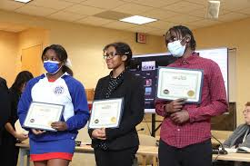
Certificate
After each student has completed the 6 components, they receive a Certificate of Completion.
Some students are recommended as “student mentors” or “buddies”.
Some students are recommended for monthly student awards.
Students needing additional support and/or not suited for group may meet 1:1 with CMHC.

Slide 23
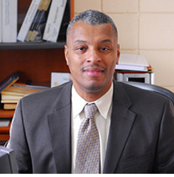
MENS GRIT SUPPORT GROUP What Does It Mean To Have GRIT ?
Presented by:
Arnold D. Cox, CMHC
Westover Job Corps Center

Slide 24
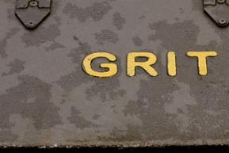
How it Started:
My background
The definition of GRIT:
- Growth: Exploring Time Lines
- Resilience: How to Stay Committed
- Integrity: This is a Reflection of You
- Tenacity: Learn What It Takes to Succeed !!!!
Making the positive connection between GRIT and successful program completion!

Slide 25
Evolution of an Idea:
Developing a group that focuses on:
- engaging in self-care and compassion
- improving coping skills/persisting after setbacks
- avoiding destructive anger/distinguishing between aggression and healthy expressions of anger
- addressing and combatting toxic masculinity
- successful completion of the program

Slide 26
Ground Rules
Confidentiality
Respect
Participation
Taking risks by expressing feelings/thoughts/ideas
Giving support and getting feedback
Time Management
Absolutely No Cell Phones !!! PLEASE !!!!

Slide 27
Group Topics
Concepts in Action (5 Different Sets of Skills):
Thinking Skills, Research Skills, Communication Skills, Social Skills, Self-Management Skills
Responding to Opportunities
Time Lines
Choices vs. Chances
In Order To Be Better, Where Going To Have To Do Better
Courage, Resilience, Commitment to Change, Being Successful

Slide 28
Group Topics – cont. Everyday we’re given choices and chances Make the right choices and we don’t need to ask for chances
7 levels of financial freedom (growth):
- clarity
- self-sufficiency
- breathing room
- stability
- living expenses
-financial independence
- abundant wealth

Slide 29
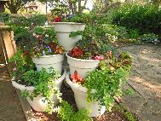
Group Growth Building Activities
Group dinner with focus on:
- wearing a suit/tie for dinner out
- responses from the community
- improving self-image
- role modeling
Community Gardening Project
Team building events at Pine Brook Camp/Conference Center
State Police, Local Police, FBI and first African American U.S. Marshal(John Gibbons) Panel Discussion (Black Boys Matter Summit) adcprevention.net
John Gibbons was appointed by President Barack Obama as the first black U.S. Marshal of Massachusetts

Slide 30
Group Feedback
“Our group has been about overcoming adversity and struggles to gain success. We all have things in our past that we’ve had to endure, but by making the right choices, anyone can attain success.”
“My biggest takeout from this group is that struggle is mutual…your future is determined by how you face obstacles.”
“Men’s feelings and emotions are not always properly acknowledged and a lot of us go through the same things and we should be there for each other in our time of need.”
“One thing that really touched me was that everyone has their own goals and are heavy about getting to that successful point in their lives.”

Slide 31
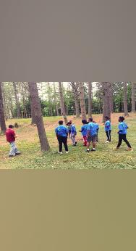
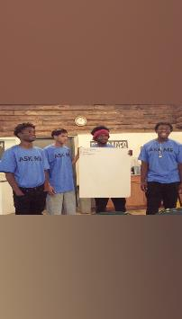
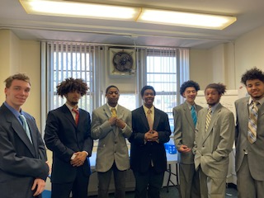
GROUP GROWTH BUILDING ACTIVIES Pinebrook Camp & Conference Center

Slide 32
THANK YOU FOR ATTENDING!

