Slide 1
Using technology to connect with your students
Saima Hussain, LCSW
Notes:
Hello Everyone! Thank you for being here.
My name is Saima Hussain. I am one of 3 of Mental Health consultants at NTXJC. I work alongside Dr. Kevin Steede who has been here for almost 30 years and Michelle Buckner, LPSC who has been a wonderful addition and brought a wealth of knowledge to our program.
Our normal center census is 560 students. However, like many of you, we are still slowly rebuilding that number. We currently have about 130 students on center.
We have experimented a little bit with social media with our students. We have slowed down a bit but we do still feel this is a great tool to use with the students.
Just a gentle reminder as we gett into this training, I am not an expert on this topic but I do have some guidance and data to guide you in the this direction.

Slide 2
Advantages of utilizing social media and mental health applications
Teach students to utilize mental health tools on their devices
Supplemental program/applications that can walk students through meditation, grounding and breathwork
You can borrow content from other providers
Access to different voices, perspectives and personalities
Visual tools to help students absorb mental health lingo, practices and methods
Notes:
I wanted to start by talking through some of the advantages and benefits to introducing technology or social media with your students
You can approach it as a tool to enhance or supplement what you are already doing. It is not meant to replace anything or be a stand alone product.
You can have a great session with a student where you discuss breath work and then you can share with them a link to a breathing video.
For students, who think they are alone in the process you can share a video by a popular influencer or celebrity which discusses something similar they are going through.
The tools can be visual cues and reminders.
When borrowing content, you can pull from big national level mental health organizations – we have utilized pre created content from RAINN and MHA
mh providers with good content
Some celebrities talking about everyday mental health
If you choose to create custom content, you can really make it authentic to your treatment modality and approach.

Slide 3
Types of Technology
Social Media
Web based applications which allow someone to create a user profile that is customizable to their preference. It can be used for personal or business use.
Includes
Facebook
Twitter
Instagram
Tik TOK
You tube
Phone apps
Applications which can be downloaded to a device.
Calm
Headspace
Meditopia
Notes:
Now - when are talking about promoting mental health we can use two different types of technology.
Social Media
Phone Apps
Social media consists of those products that are utilized as social networking tool. Facebook, twitter, Instagram, tik tok and you tube are the main products utilized by our students. They are interactive, two way communication driven products. They are all a little bit different and have different variations of user friendliness.
Facebook: The world’s largest social network, with more than 1.55 billion monthly active users (as of the third quarter of 2015). Users create a personal profile, add other users as friends, and exchange messages, including status updates. Brands create pages and Facebook users can “like” brands’ pages.
Instagram/TIKTOK: A free photo and video sharing app that allows users to apply digital filters, frames and special effects to their photos and then share them on a variety of social networking sites. these two are working very hard to differentiate from each other but they are very similar.
YouTube/Netflix Video hosting and watching websites. we utilized this for our wellness program the most
PHONE APPS are going be tools that can be downloaded by a user/phone. They have a variety of tools built into them. Ive listed some popular ones. However, there are so many more and many in development.
Now, for our center we introduced technology in the early days of the covid pandemic, it started off with the Google classroom, and we would post from various links into the classroom. Those links included tube videos, tik tok videos and links to Instagram posts. During the google classroom days, We would add a quiz within the assignment to see if they were really listening. Because the classroom was interactive we were able to see what kind of take always they had and how they responded to the content.
We kind of tuned into the themes or types of videos that had the greatest response. and we tried to offer more of that. From that experience, we learned that what we think as a provider might be incredibly usefule – like a video with lots of actionable tools, is not what always received the most feedback. we did see really good engagement with videos that had a pop culture icon, influencer or celebrity talking. Im sharing this video with you because I think it was interesting to see, this video has almost 3 million views and she doesn’t really offer that much clarity. yet, it started a healhty conversation for the students because of who she is.

Slide 4
Notes:
https://youtu.be/_XFd0RLKQWA
Link Video to billie eilish. No I chose to share this video with you because, I personally don’t thing the content is very actionable or strong. However, our students really engaged with this video because of who she is and I think even because of the way she is still not very clear about her message but that she is kinda figuring it out.
When you are ready to develop your own content, you can really gear it to what works for you. I think Karon does a great job of explaingin that
Show second video of Syndey here....
Demonstrating the difference in styles but similar messaging.

Slide 5
Generation Z Usage trends for social media applications
Notes:
Lets look at what the data says about GEN Z usage of social media apps and video streaming apps. To clarify, Generation Z, is the generational cohort following millennials, born between the late 1990s and early 2010s. They are about 12 –22 years of age in 2022.
They are considered digital natives.
They are very informed on varying causes. They like to feel part of multiples communities and really pride themselves on connection. Social networking is the norm for them. After graduation from school, they arent chasing people down to sign their yearbooks. They might just find them on instagram or tik tok and hit follow.
It is a very relevant tool for students on or off center, in your care, who most likely are already spending up to 3 hours per day on social media and or usings apps.
IFor Generation Z, as we have seen, the main spur to consumption is the search for truth, in both a personal and a communal form (Exhibit 2). This generation feels comfortable not having only one way to be itself. Its search for authenticity generates greater freedom of expression and greater openness to understanding different kinds of people.

Slide 6
Generation Z Usage trends
Notes:
This slide shows that Instragram is checked daily by 65% of gen z.
And similary You tube is 62%
Which means there is a really good chance you can grab their attention if you give it a try. they like being connected to various groups / organizatinos.

Slide 7
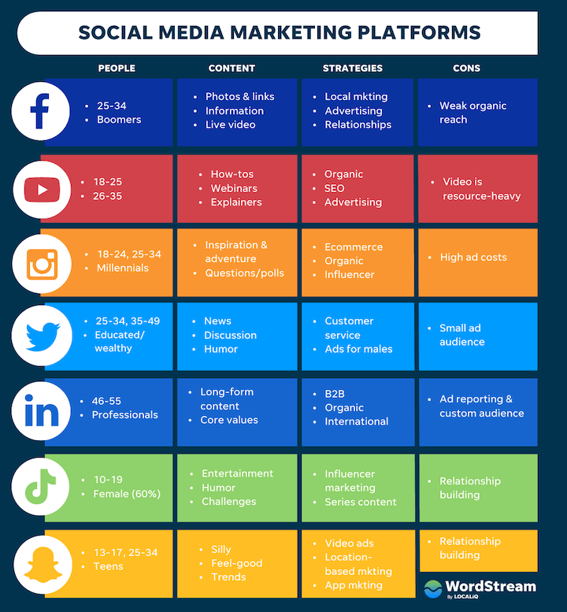
Choosing your platform
Notes:
This chart kind of helps you take a look at the major differences between the most commonly used apps.

Slide 8
How to create a profile
User name
Email
Password
Use a phone from which you can create content.
Notes:
Share Sydney’s video here.

Slide 9
Things to consider for your profile
Personal or for JC only
How do I maintain licensure ethics and code
What kind of content do I want to share?
Notifications
News feed
Wellness content
How tos
Have fun with it!
Notes:
Do I want to be in the video?
Do I want to talk about a theme that I have been seeing recently?
Do I want to focus on relationship management, conflict resoltuion or coping skills

Slide 10
How to get the center director and staff involved?
Talk to them about your goals
Show them the feedback from students
Ask for their participation
Use your platforms to talk about other things happening on campus
Create content that can serve your community

Slide 11
Questions

