Slide 1
Program Update Q&A: COVID and Opioids

Slide 2
Policy Changes
PIN 22-17: Ending of COVID-19 State of Emergency
1
PIN 22-16: Responding to Opioid Overdose
2
Upon release, prior COVID-19 PINs no longer active
3
Notes:
Hopefully you have had time to review PIN 22-17 Ending of the COVID-19 State of Emergency, and PIN 22-16 Responding to Opioid Overdose.
We are going to share some highlights of the PINs, then spend most of this webinar going through components of the Infectious Disease and Medical Emergency Components of the Emergency Action Plan. This plan is required in both PINs. We’ll also have plenty of time for questions.

Slide 3
PIN 22-17 Highlights
Pandemic and Infectious Disease included in Emergency Action Plan
Mask Wearing
Exposure to COVID-19
Isolation for COVID-19
Reporting, Contact Tracing, and Outbreak Response
COVID-19 Testing
Vaccinations
Leave Status
Notes:
Sara PIN addresses these major categories. Job Aid is guide to implement policy – don't need to do anything more with it specifically;
Does anyone have any questions about the COVID PIN content they would like us to address right now?

Slide 4
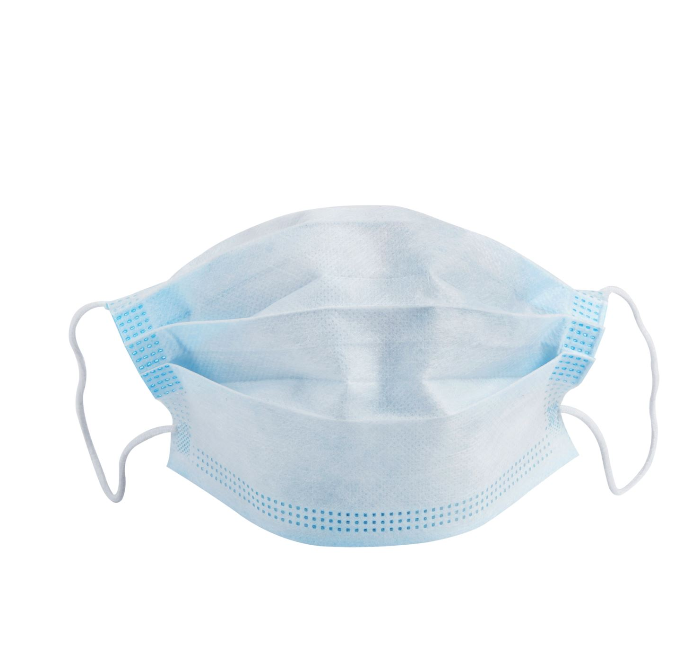
General Mask Wearing
If CDC COVID-19 hospitalization rates are high in the county where the center is located, all people on center must wear high-quality masks or respirators while indoors (except in dormitory rooms)

Slide 5
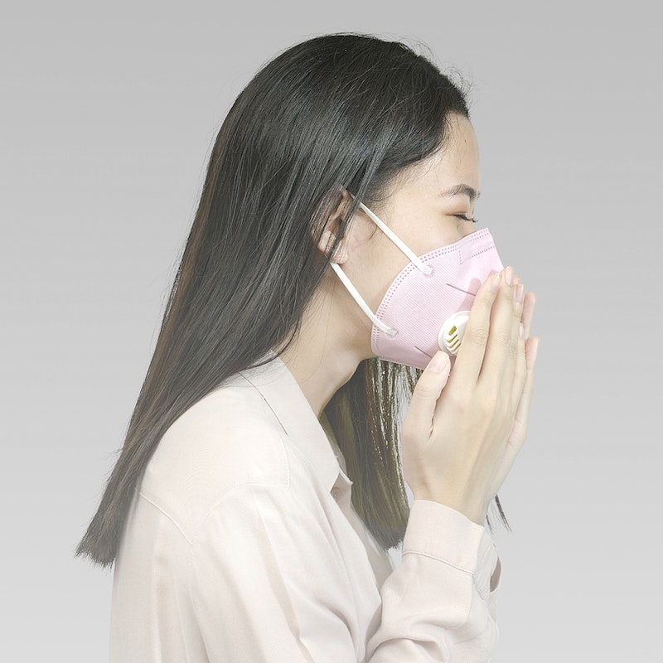
Health and Wellness Facility Masking
When masking is required for the rest of the center
When a student is symptomatic
When a healthcare provider is treating a symptomatic student
Additionally, must adhere to local or state Health Facility masking requirements if more restrictive than CDC guidance

Slide 6
Other Mask Wearing Guidance
Center may implement general masking in response to an on-center outbreak in consultation with Regional Office and Health Support Contractor
Individuals are required to mask if:
Confirmed COVID-19
Identified close contact exposure to COVID-19
Individuals should be supported if choose to wear a mask

Slide 7
Exposure to COVID-19
Follow CDC Guidance
Mask as soon as exposure is identified and continue masking for 10 full days
Test student as soon as possible upon identification of CCE with an NAAT (Abbott ID Now)
Test student again at least 5 full days (i.e., Day 6) after exposure or if symptoms develop with an NAAT

Slide 8
Isolation for Person with COVID-19
Follow
Follow CDC Guidance
Maintain
Maintain isolation rooms for students with COVID-19
Engage
If OBS no longer allows sufficient designated space, engage student and roommates in rooming decisions
Isolate
Isolate for 5 full days and release if asymptomatic or symptoms improving
Mask
Mask until day 11 when indoors after release from isolation

Slide 9
Reporting, Contact Tracing, and Response
Submit an SIR for every COVID-19 case within 24 hours
Infectious Disease Response Committee must promptly identify close contact exposures
Notify CCEs and provide education to CCE regarding required procedures
Clean and disinfect exposed areas
Monitor COVID-19 outbreaks on center and implement mitigating measures as necessary

Slide 10
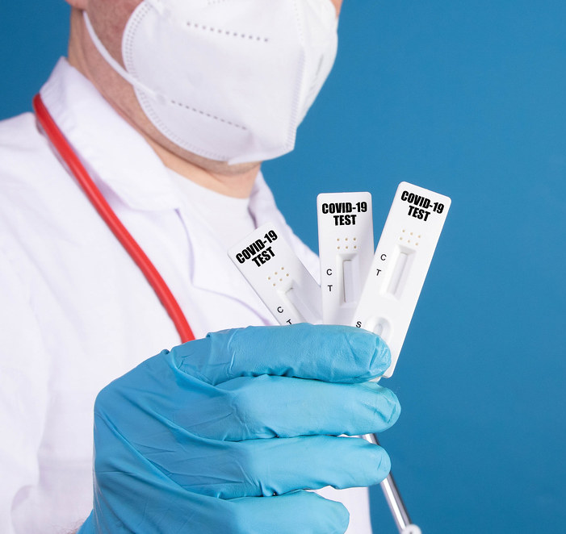
COVID-19 Testing
Continue to complete weekly test supply inventory survey
Request supplies through regional office
Student with symptoms of COVID-19
Identified Close Contact Exposures
As soon as possible
At least 5 full days (Day 6) after last exposure
This Photo by Unknown Author is licensed under CC BY

Slide 11
Covid-19 Vaccination
Continue to promote and support access to COVID-19 vaccination
Ensure students’ vaccination records are obtained and maintained consistent with Job Corps policies for vaccinations

Slide 12
Physical Property
High-touch surfaces must be cleaned regularly
Areas must be disinfected with an EPA-registered disinfecting product when someone has been ill in the area
Centers no longer need direction signage; however, should maintain general health guidance reminders

Slide 13
Leave Status
Students may use “Not Present for Duty- Administrative Leave With Pay” for COVID-19-related illness absences

Slide 14
No Longer Required
Daily attestations
COVID-19 vaccination data entry into CITRIX
Antigen testing prior to release from isolation

Slide 15
PIN 22-16 Highlights
Medical Emergencies included in Emergency Action Plan
New staff training requirements
Narcan and life-saving device availability requirements
New student training requirements
Notes:
Diane PIN addresses these major categories. Does anyone have any questions about the Opioid Overdose PIN content they would like us to address right now?

Slide 16
Overarching Message: When in doubt, use Narcan
Communicate to all staff, in writing, that Narcan MUST be administered to any student who is unconscious or exhibiting other signs of an opioid overdose unless there is an obvious alternative cause (e.g., choking on food).

Slide 17
Signs of Opioid Overdose
Small, constricted “pinpoint” pupils
Falling asleep or losing consciousness
Slow, weak, or no breathing
Choking or gurgling sounds
Limp body
Cold and/or clammy skin
Discolored skin (especially in lips and nails)
Notes:
Make sure most of these are also on the TEAP Referral/Suspicion Screen form

Slide 18
Closer Look at Training Requirements
Staff Training Requirements
Student Training Requirements
Signs of overdose and response steps
Narcan administration
Including center-specific Narcan protocols
Identifying opioids symptoms
CPR & First Aid
Signs of overdose and response steps
Role of synthetic opioids in overdose deaths and risk with use of any illicit drugs
Narcan administration
Including center-specific Narcan protocols
Identifying opioids symptoms
Notes:
Note only difference is CPR/First Aid

Slide 19
Narcan Locations
Health and Wellness Center in the Medical Emergency Response Grab-and-Go Kit
Safety and Security Office in the First Aid Emergency Grab-and-Go Response Kit (accessible 24/7)
Each dormitory
Recreation
Academic and trade buildings/areas
In a portable kit for transportation vehicles
Notes:
To include in your EAP; ALSO – how sustainable is your plan? Spreadsheet/Log to track expiration dates. Think staff time efficiencies. Use template (Job Aid) as your guide.

Slide 20
Notes:
Resources available

Slide 21
Notes:
From CDC

Slide 22
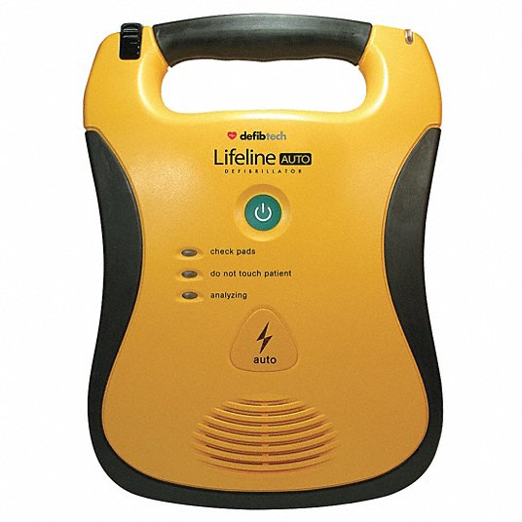
Wall-Mounted Narcan and AEDs
Notes:
For Consideration

Slide 23
Emergency Action Plan
PRH Chapter 5, Section 5.1., R18, a(1)
Infectious Disease and Medical Emergency Components
Template is found with PIN 22-16 Attachment A
Notes:
Julie Infectious disease and medical emergency plan is PART of EAP

Slide 24
Infectious Disease and Medical Emergency Plan
Center-specific plan for medical and infectious disease emergencies
Due on or before June 19 & annually thereafter
Submit to COR and Regional Nurse Specialist for review and approval
Template contains minimum required items – strongly recommend using template
Notes:
Julie Strongly recommend using template!!!

Slide 25
Notes:
Sara Center must reflect on what they actually did during pandemic response. Use the experience we have just gone through to develop plans that realistically can be followed in future emergency situations.
Roles and Responsibilities: this section is intended for center to identify who will actually perform the tasks in the table; list by job title (not individual name) and there may be more than person identified as back up.

Slide 26
Notes:
Communication is critical in any emergency situation. The center has many audiences with whom they need to communicate: on-center staff, on-center students, off-center staff and students, regional office and national office. In the context of infectious disease and medical emergency planning, they also have responsibilities to communicate with the local health department.
Consider the strategies you used during COVID-19, what worked? What was challenging and you think you could plan to do better?

Slide 27
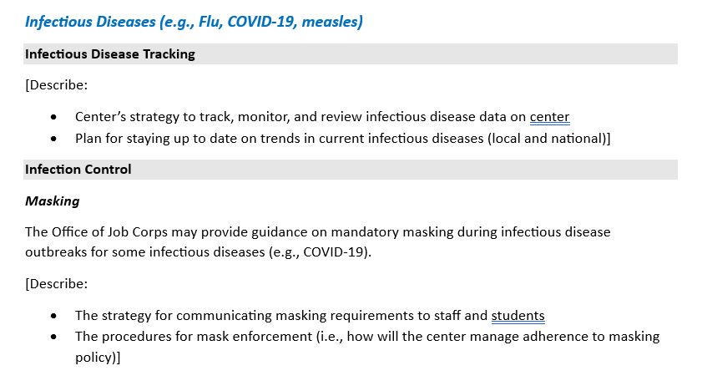
Notes:
We may see a resurgence of COVID-19 in the fall or as new variants develop. We may also have other infectious diseases impacting local communities (i.e. measles, MPox, tuberculosis). What strategies will the center use to track, monitor and review diseases on center and in local community? Think about – how will you know that you have a problem with rapid spread or a need for containment or action?
In the other sections that follow, the plan asks you to consider different mitigating measures that can reduce infectious disease spread. Sometimes these will be requirements implemented by the National Office or they may be requirements by local public health or they may be optional mitigation measures. Consider how you communicated changing requirements to staff and students- what worked? What will you do differently? Include this in your plan.

Slide 28
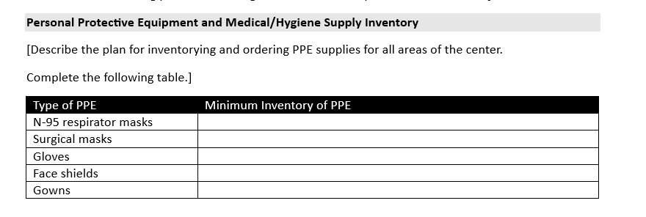
Notes:
PPE was critical during the COVID-19 pandemic. What many realized is we did not have enough supplies prior to the pandemic. Consider the specific location and context of your center and your experience getting PPE supplies at present and during the pandemic. Consider supply needs for the health and wellness facility and for general campus. Your minimum inventory for each item should fall somewhere between what you had as inventory in a pre-pandemic world and what were required during the height of the pandemic (see PIN 19-18 if helpful). Each center may have slightly different minimums per 100 students.

Slide 29
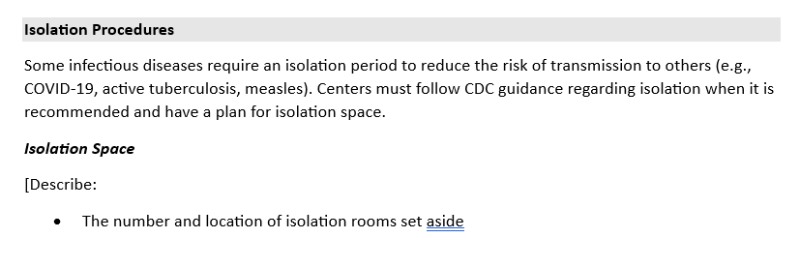
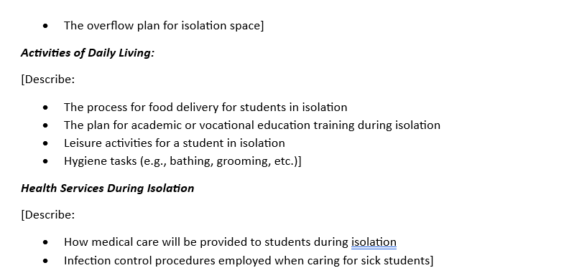
Notes:
Center may reduce their number of isolation rooms/spaces at this time. However, as OBS increases, the center must have a plan in place for how they will manage isolation needs that may arise due to infectious diseases, such as COVID-19, active TB, measles, chicken pox. All centers should continue to have a limited number of rooms available for isolation requirements and a plan for how they will manage if they have an outbreak of a disease that requires isolation but exceeds the capacity of the reserved rooms.
Consider what worked well for your center to provide for students who require isolation. What will you continue? What could you improve? Incorporate those into the plan while it is fresh in your mind!

Slide 30
Notes:
How will you perform contact tracing on center? Who will continue to be trained to support these needs? how will you infectious disease response team work as a cohesive group? Who will be staying aware of local mandated reportable diseases and interfacing with the health department to meet requirements? How does you health department require notification (i.e. phone call, online report,)

Slide 31
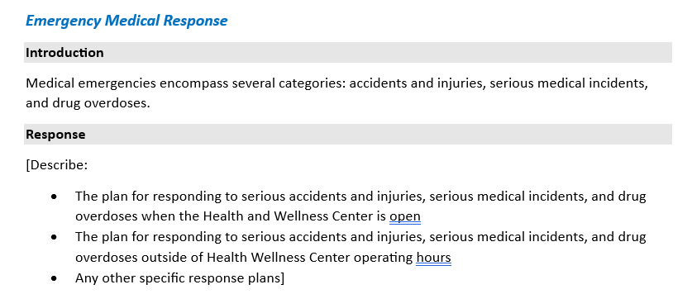
Notes:
Diane Planning for emergency medical response is an essential part of health and safety on centers. There are a wide range of potential emergencies centers may face including accidents, injuries, serious medical incidents and drug overdose.
Planning in advance how the center will manage the "unexpected" will allow people to be more prepared when it occurs.
Centers have different staffing during the work day and after hours. Responsibilities will need to shift based on staff available. Consider how you will respond when you have health and wellness staff potentially available and when they are not on center.
Each center has a different physical structure and you know best how to manage based on your local resources, including facilities, geographic structure, and EMS response time. You need to describe here what you plan to do in different scenarios.

Slide 32
Notes:
Now that you have planned how you expect people to respond, you need to ensure that you have a training protocol in place that you will follow so staff and students are trained on the protocols and have the skills to act.

Slide 33
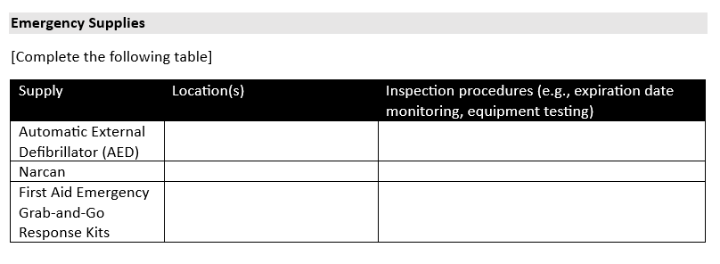
Notes:
You will also need emergency supplies available to support emergency response. This table is to help you think through how many of the specific items you need and where they are best located so that staff and students have access to the emergency equipment and can rapidly respond as necessary.

Slide 34
Medical Emergency and Infectious Disease Plan Submission
By Monday, June 19
Via email
To COR and Regional Nurse Specialist (Shannon Bentley or Melissa Cusey)
Notes:
Final Medical Emergency and Infectious Disease plans must be submitted by Monday, June 19 via email to the center’s COR and to the Regional Nurse Specialist (Shannon Bentley or Melissa Cusey).

