Slide 1

Suicide Prevention:
Spotlight on Peer Education
August 2023
Valerie Cherry, PhD, Lead Mental Health Specialist
Tamara Warner, PhD, Regional Mental Health Specialist

Slide 2
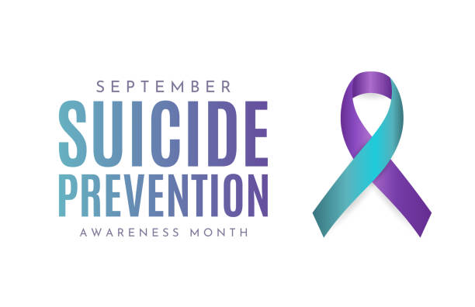

Slide 3

Learning Objectives
Describe the role of peer educators in center suicide prevention efforts
Discuss how “words matter” when discussing suicide-related thoughts and behaviors
Connect the latest statistics on youth suicide to center suicide prevention efforts

Slide 4

This webinar discusses suicide, and some people might find it disturbing.
If you need to leave the webinar, please do.
If you need emotional support, contact your center’s Employee Assistance Program (EAP) or call 988.
August 2023
4

Slide 5
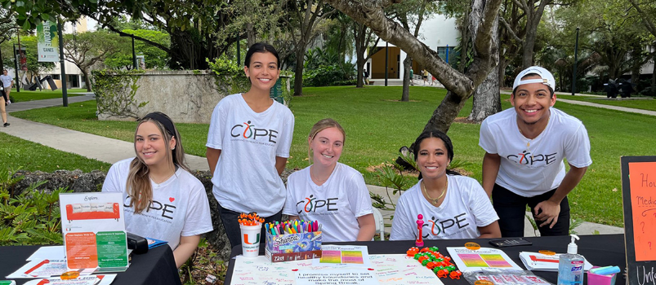
SUICIDE PREVENTION AND
PEER EDUCATION

Slide 6

What Is A Peer Educator?
Notes:
Let’s start with understanding the definition of a peer educator. This may seem like a question with an obvious answer but let’s look closer.

Slide 7
Answer
A peer is someone of equal standing with you in a group. They are accessible and share an ability to influence each other.
A peer educator provides information and education on various topics through interactive programming, role modeling and outreach initiatives.
Notes:
-

Slide 8
Why Peer Education?
Peer
Learning
Students
Social Learning Theory
Serves as a good role model
Shares accurate information
Receives peer education support from staff
Have shared identity traits
Share similar backgrounds & experiences
Diffusion of Innovation Theory
August 2023
8

Slide 9
Why Peer Education?
Learning Theory
Participatory
Multi-modal teaching for different learning types
Not just lecturing or quizzes
Peers can reinforce learning through repeated sharing
Peer educator can teach peers new things
Feelings of empowerment
Builds self-efficacy
Theory of Participatory Education
August 2023
9

Slide 10
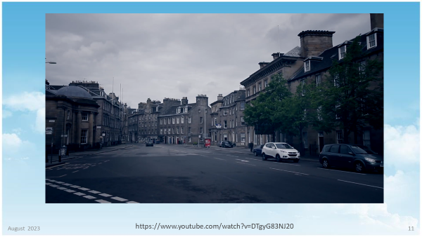
PEER EDUCATION VIDEO

Slide 11
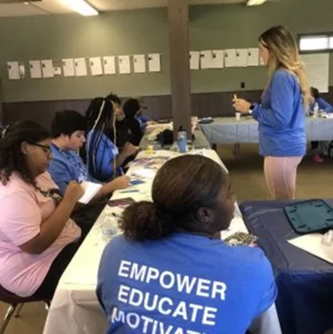
"I have learned about so many different on and off-campus resources as well as different training processes that can be beneficial to the campus community”
"The peer educator program has allowed me to create wellness-based events and connect students to resources that enrich their lives."
"The peer education program provided me with valuable team working and networking skills which increased my confidence as a student leader.”
“As a peer educator I have learned how to share helpful information with my peers”
Notes:
This slide has additional comments from peer educators. Read the slide
As a peer educator I have learned how to share helpful information with my peers”
The peer educator program has allowed me to create wellness-based events and connect students to resources that enrich their lives

Slide 12
Peer Education Studies
(Dodd et al., 2022 and Aguliar et al., 2023)
Positive Outcomes
Positive student–staff interactions
Knowledge of suicide warning signs
Help-seeking behavior
Skills to respond to peers in distress
Notes:
Does it work – yes - when we look at two recent studies related to peer education and suicide prevention positive outcomes were identified. Increase in knowing and responding to suicide warning signs and ways to respond to a peer in distress. It can help increase the help seeking behaviors of peers and improve student staff interactions. Peer education is considered an evidence based approach for suicide prevention.

Slide 13

Peer Education Studies
(Dodd et al., 2022 and Aguliar et al., 2023)
Potential Barriers
School buy in
Time constraints
Low peer leader engagement
Need for additional guidance from adult staff

Slide 14
Advantages of Peer Education
Can Change Social and Group Norms
Culturally Appropriate
Positive Center Culture
Retention
Reduce Crises
Individual Development
August 2023
14

Slide 15

How Can Job Corps Support Suicide Prevention Using Peer Educators?
Notes:
So how can you have peer educators on center for suicide prevention. Here is the answer

Slide 16

www.jcyouth2youth.com
Job Corps Youth 2 Youth Ambassador Program
Y2Y Website
Notes:
Everyone should be aware of Job Corps Youth 2 Youth – Y2Y Youth Ambassador Program- It was announced on June 16, 2023
As a message from the National Director Rachel Torres. Her message to centers was that we need student ambassadors on each campus who will step up and focus on creating a positive and supportive culture on their campus. Working with other students, these ambassadors will increase awareness of student safety and well-being through student-to-student initiatives and programs. There is a dedicated website with resources on the slide.

Slide 17

Y2Y Ambassadors Peer Education
Talk about violence, drug use and mental health in our community.
Empower one another with the support and know-how to prevent violence and drug use, as well as promote positive mental health.
Share solutions and encourage conversation to help support our community.
Notes:
The Y2Y Ambassador Program’s goals can fit nicely as a mission for a peer education program – talk about mental health, promote positive mental health and support the entire campus community.

Slide 18


GETTING STARTED

Slide 19


NASPA Certified Peer Educator Training
1. Identify Staff Member(s) to Assist Y2Y Ambassador Group and Provide Training
Role of peer education
  Listening skills
  Programming and presentation skills
  Recognizing the role of diversity and inclusivity
  Response and referral skills

Slide 20
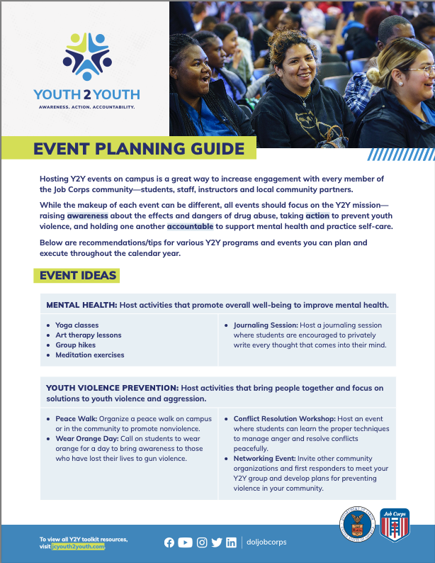
Next Steps
2. Y2Y Ambassador Group Meeting
  Brainstorm ideas for center suicide prevention and awareness and mental health events.
3. Role-Play Activities to Practice How to Help a Peer
  How to recognize the signs of someone who may be of harm to themselves or others and how to refer for help.

Slide 21
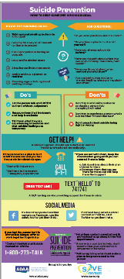
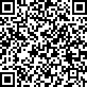
Suicide Prevention Education Activities
Peer Pop Up Tabling Events Around Center
Hand out information on suicide awareness and prevention
Include a mental health app download station
  https://adaa.org/sites/default/files/downloads/ADAA%20and%20SAVE%20Infographic%202021.pdf
https://supportservices.jobcorps.gov/health/Pages/SuicidePrevention.aspx

Slide 22
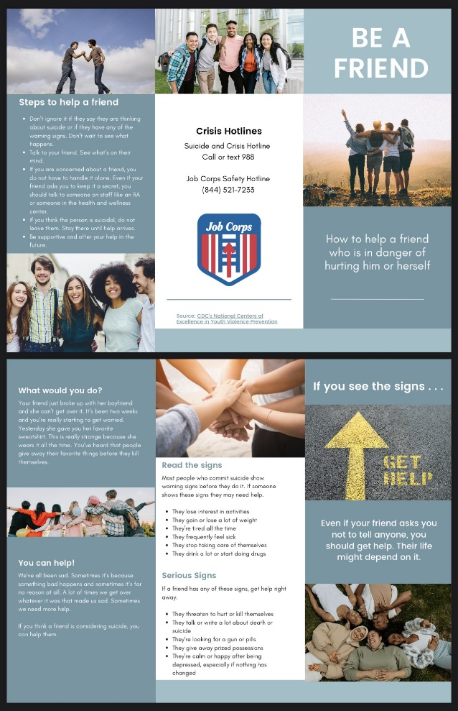
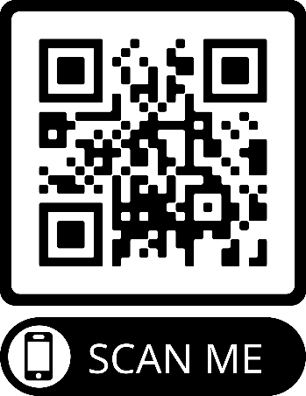
  Knowing How To Recognize The Signs of a Peer Who May Be Harm Themselves or Others and How To Get Them Help!
https://supportservices.jobcorps.gov/health/Documents/Suicide/Be_a_Friend_brochure.pdf

Slide 23

SOS SIGNS OF SUICIDE
HIGH SCHOOL PROGRAM VIDEO
https://www.youtube.com/watch?v=jiEJnJTYaPw

Slide 24
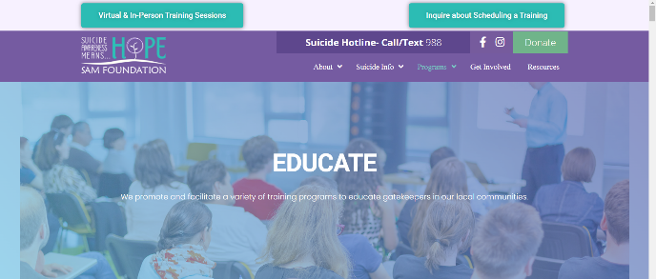
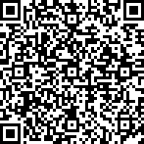
The SAM Foundation acts as a link to multiple organizations that provide suicide awareness and prevention training.
Notes:
There are several evidence based gatekeeper trainings a center can explore for the Y2Y ambassadors or for all students and staff. I am excited about this resource and wanted to share, The SAM foundation is named after SAM who died by suicide in 2002 and his family created this foundation to stop the silent epidemic of suicide. Scan the QR code and click on samfound.org when it comes up.

Slide 25
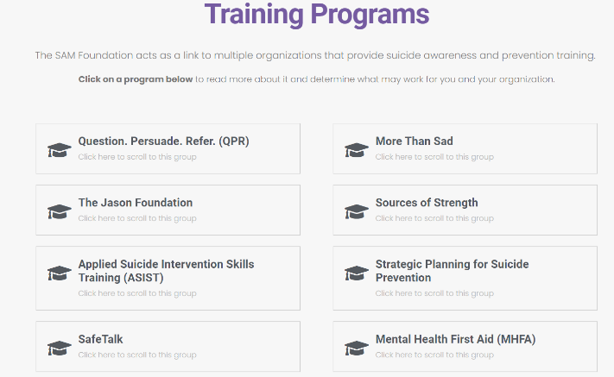

SAM TRAINING PROGRAMS
Notes:
What I really like about this resource is it will give you information on several training programs ( QPR, MHFA, Sources of Strength) AND some of them have free training available through this foundation. Encourage you to explore this website.

Slide 26

BEYOND September!
Mindful Mondays
Peer-Led weekly event to spread kindness, daily affirmations and the little things that boost positivity in students.
Messages of Hope
Notes:
Now we can all agree that Suicide prevention is not just September it is all year long.
Some ideas for the Y2Y ambassadors to considers – sponsor a weekly mindful Mondays share affirmation or positive mental health tips in a newsletter, via email blast, during dorm meeting, business meetings, Create yard signs to post around campus to share messages of hope. Activity that extends suicide prevention efforts beyond September.

Slide 27
Real Y2Y Center Examples
Sierra Nevada
The primary staff person supporting Y2Y is the Recreational Manager with assistance from a CMHC who is certified in Youth Mental Health First Aid (MHFA) and a TEAP Specialist who is a trained peer-to-peer specialist.
Utilizing Signs of Suicide (S.O.S.) training.
Weber Basin
Three staff are involved: CSO supports violence prevention, TEAP for substance use, and CMHC for mental health. CMHC helps with administrative tasks like creating class passes and arranging transportation and financial support.
The group has decided to work on a project for “developing empathy” and is exploring community service projects such as volunteering at a homeless shelter for kids, an animal shelter or a nursing homes.
Notes:
To close out this section, here is a slide with a couple of real examples of centers starting to incorporate Y2Y programming, peer educations and promoting positive mental health including suicide prevention. While I read these, if you have started working with Y2Y for suicide prevention activities, feel free to share in the chat.
Y2Y can be a natural vehicle already in place to support peer education efforts for suicide prevention! Now let’s take a closer look at other important areas related to suicide and suicide prevention.

Slide 28
WORDS MATTER
How to talk about suicide in a hopeful, respectful way has the power to save lives.
Notes:
The next section deals with how to talk about suicide in a hopeful, respectful way has the power to save lives. Suicide and suicide attempts are difficult subjects to talk about. It is my hope that this section on “Words Matter” will make that easier and in a way that is respectful and offers hope to those who are struggling with living. It’s worth emphasizing that those who are struggling with suicidal thoughts and urges typically do not want to die – they are struggling with the pain of living.

Slide 29
We strive to avoid anything that …
Reinforces stereotypes, prejudice or discrimination against people with mental illness and suicidal ideation
Implies that mental illness makes people more creative, fragile or violent
Refers to or defines people by their diagnoses
Notes:
In general, here are some guidelines that can help you choose your words more carefully.
We want to strive to avoid anything that …
Reinforces stereotypes, prejudice or discrimination against people with mental illness and suicidal ideation
Implies that mental illness makes people more creative, fragile or violent. We often hear about incidents in the news that suggest that mental illness was the *cause* of a violent act, but the fact is that people with mental illness are more likely to be VICTIMS of violence rather than perpetrators of violence.
Refers to or defines people by their diagnoses. An example would be calling some “schizophrenic” rather than saying that the person has schizophrenia.

Slide 30
We strive to …
Be DIRECT.
Talking to someone about suicide WILL NOT cause or increase suicidal thoughts. It can help someone feel LESS isolated and scared
Be HOPEFUL.
People can and do get better. If the person gets the help they need, the quality of their life will likely improve.
ENCOURAGE
the person to seek help. The goal of talking about suicide is to CONNECT them to someone who can help.
Notes:
Choosing our words carefully is about more than avoiding stigmatizing terms. The language we use can also have a positive effect, which makes choosing the right words just as important as avoiding the wrong ones. Here are some guidelines about how we want to strive to talk about suicide.
Be DIRECT. We know from strong research that talking to someone about suicide won’t cause or increase suicidal thoughts or cause the person to act on them. Asking someone if they are thinking about suicide can help them feel less isolated and scared.
These are some general guidelines. On the next few slides, I’d like to share some specific suggestions about how we can talk about suicide and mental illness in hopeful and respectful ways.

Slide 31

INSTEAD OF THIS
commit or committed suicide
Notes:
Instead of saying …

Slide 32
INSTEAD OF THIS
commit or committed suicide
SAY THIS
died by suicide
death by suicide
lost their life to suicide

Slide 33
INSTEAD OF THIS
commit or committed suicide
SAY THIS
died by suicide
death by suicide
lost their life to suicide
“Commit” implies that suicide is a sin or crime, reinforcing the stigma that it’s a selfish act and personal choice
Neutral phrasing helps strip away the shame/blame element
WHY
Notes:
The reason that we want to use phrases liked “died by suicide” or “lost their life to suicide” is because the word COMMIT
Implies that suicide is a sin or a crime
Reinforce the stigma that suicide is a selfish act and a personal choice
In addition, neutral phrasing helps to strip away the shame and blame element – which often occurs because we are trying to distance ourselves from the discomfort related to suicidal thoughts and behaviors.

Slide 34

INSTEAD OF THIS
successful/unsuccessful suicide
completed/failed suicide
Notes:
Instead of saying that a suicide was “successful” or “unsuccessful” or completed suicide or failed suicide…

Slide 35
INSTEAD OF THIS
successful/unsuccessful suicide
completed/failed suicide
SAY THIS
died by suicide, survived/lived through a suicide attempt
fatal/non-fatal suicidal behavior
fatal/non-fatal suicide attempt

Slide 36
INSTEAD OF THIS
successful/unsuccessful suicide
completed/failed suicide
SAY THIS
died by suicide, survived/lived through a suicide attempt
fatal/non-fatal suicidal behavior
fatal/non-fatal suicide attempt
WHY
Notion of “successful” suicide frames a very tragic outcome as an achievement or something positive
Neutral phrasing is factual – a suicide attempt is either fatal or not
Notes:
Can a suicide ever be considered “successful”? The notion of “successful” suicide frames a very tragic outcome as an achievement or something positive.
Again, the use of neutral phrasing is designed to be factual – a suicide attempt is either fatal or it’s not.

Slide 37

INSTEAD OF THIS
[Name] is suicidal.
Notes:
Instead of saying that ”Tamara is suicidal”…

Slide 38
INSTEAD OF THIS
SAY THIS
[Name] is …
facing suicide
is thinking of suicide
has suffered suicidal thoughts
has experienced suicidal thoughts
[Name] is suicidal.
Notes:
It would be better to say “Tamara” is
facing suicide
is thinking of suicide
has suffered suicidal thoughts
has experienced suicidal thoughts

Slide 39
INSTEAD OF THIS
SAY THIS
[Name] is …
facing suicide
is thinking of suicide
has suffered suicidal thoughts
has experienced suicidal thoughts
No one wants to be defined by their experience with suicide. The person is more than their suicidal thoughts.
[Name] is suicidal.
WHY
Notes:
Why? No one wants to be defined by their experience with suicide. The person is more than their suicidal thoughts.
Think of this way: We never say that some who has cancer is “cancerous.” We don’t say, “My neighbor is cancerous.” We say, “My neighbor has cancer.” or “My neighbor is battling cancer.” It is the same for the person who is struggling with suicidal thoughts.

Slide 40

INSTEAD OF THIS
They’re schizophrenic.
She’s bipolar.
The mentally ill
<Substance> addicts
Notes:
Here’s the last one. Instead of saying:
“They’re schizophrenic” or “She’s bipolar.”
Or referring to “The mentally ill.” or ”Cocaine addicts” or “Meth addicts”…

Slide 41
INSTEAD OF THIS
SAY THIS
They’re schizophrenic.
She’s bipolar.
The mentally ill
<Substance> addicts
They
… have schizophrenia or bipolar disorder.
...are living with schizophrenia or bipolar disorder
People with mental illness
People addicted to <substance>
People with/living with addiction

Slide 42
INSTEAD OF THIS
SAY THIS
Putting the condition before the person reduces their identity to their diagnosis. People aren’t their illness. They have an illness.
People-first language shows respect for the person.
They’re schizophrenic.
She’s bipolar.
The mentally ill
<Substance> addicts
They
… have schizophrenia or bipolar disorder.
...are living with schizophrenia or bipolar disorder
People with mental illness
People addicted to <substance>
People with/living with addiction
WHY

Slide 43

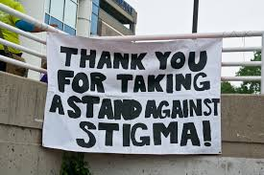
If your life has been touched by suicide, you know that words matter.
Notes:
The discussion about hopeful and respectful language is NOT a matter of “political correctness” as some may be thinking. It is a matter of reducing the stigma that prevents people from seeking help when they are struggling with life. If your life has been touched by suicide, then you know that words matter.

Slide 44
WHERE THINGS STAND NOW WITH YOUTH SUICIDE

Slide 45
Test Your Knowledge
Type your answer in the chat box!
Current Statistics about Youth Suicide
True
False
Notes:
The data come from the Centers for Disease Control and Prevention (CDC). We have a resources slide at the end of the presentation with specific sources. The most recent statistics available are for 2020 and 2021. Some of the provisional data for 2022 has just been released.

Slide 46
Test Your Knowledge
Question 1:
More than 20% of teens have seriously considered suicide.
True
False

Slide 47

Question 1:
There is a trend of increased suicidal ideation during past 10 years. In 2021, the rate was 22%.
True
Notes:
YRBS survey of high school every 2 years. Has been going up between 2011 to 2021.
Among high school girls, 30% had seriously considered suicide.

Slide 48
Question 2:
Suicide is one of the top 3 leading causes of death among 15- to 24-year-olds.
True
False

Slide 49
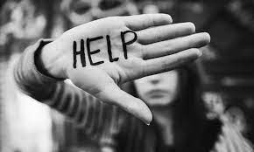
Question 2:
In 2020, suicide was the 3rd leading cause of death for 15- to 24-year-olds. In some years, it has been the 2nd leading cause of death.
True
Unintentional injury
15,117
Homicide
6,466
Suicide
6,062
2020
Notes:
In some years, suicide is the 2nd leading of cause of death. You can see for 2020, the deaths by homicide and deaths by suicide are just over 6,000 each. Only 400 deaths separated the two causes.

Slide 50
Question 3:
Compared to other age groups between 10 and 85+ years old, youth ages 15 to 24 have the highest suicide rates.
True
False
Notes:
Compared to age groups
10-14
25-34
35-44
45-54
55-64
65-74
75-84
85+

Slide 51
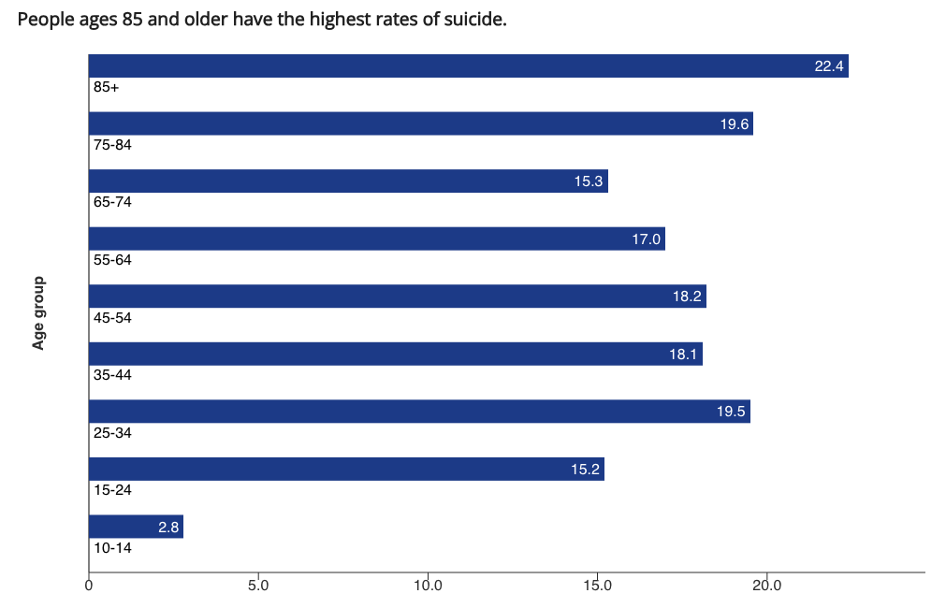
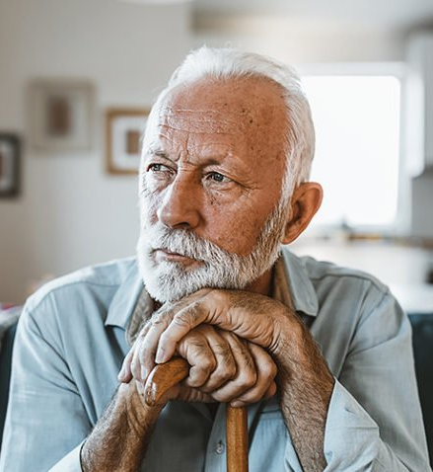
Question 3:
People ages 85 and older have the highest rates of suicide.
False
22.4 per 100,000
15.2 per 100,000
2021
Notes:
The red arrow shows the rates for people ages 85 and older. The rate is 22.4 per 100,000. The green arrow shows the rate for 15- to 24-year-olds. The rate in 2021 was15.2 per 100,000. And if you look among all the age groups, it is the lowest rate, with the exception of 10- to 14-year-olds. This doesn’t mean that we should not be concerned about the rate of suicide among youth; it means that we need to work to prevent suicide among people of all ages.

Slide 52
Question 4:
Female teens have a higher risk of suicide compared to male teens of the same age.
True
False

Slide 53
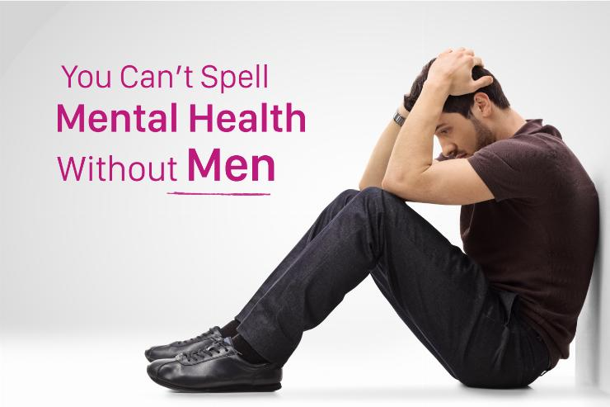

Question 4:
More females attempt suicide, but males are almost 4 times more likely to die by suicide.
False
23.9
6.1
Notes:
The bar graph compares how many young people die by suicide by sex. The rate for females is 6.1 per 100,000 while the rate for males is an astonishing 23.9 per 100,000.
Men make up 50% of the population but 80% of suicide deaths. Mental Health America (MHA) announced the first Men’s Mental Health Month in June 2023, which is represented by a green ribbon.

Slide 54
Question 5:
Which racial/ethnic group has the highest rate of suicide among youth ages 12-17?
a. White
b. Black
c. Hispanic
d. Asian
e. American Indian/Alaskan Native (AIAN)

Slide 55


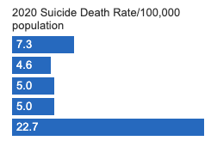
Question 5:
e. AIAN
American Indian/Alaskan Native (AIAN) youth have, by far, the highest rate of suicide. In 2020, the rate was 3 times higher than that of White youth.
Ages 12 to 17
Notes:
American Indian/Alaskan Native (AIAN) youth have, by far, the highest rate of suicide. In 2020, the rate was 3 times higher than that of White youth.
This bar graph shows the rates of suicide in 2020 by ethnic group among youth ages 12 to 17. The the top bar for White youth shows a rate of 7.3 per 100,000 in 2020. The bottom bar for American Indian/Alaskan Native youth was 22.7 per 100,000.

Slide 56
Question 6:
LGBTQ+ teens at a higher risk for suicide than others in their age group.
True
False

Slide 57




Question 6:
True
In 2021, 20% of LGBTQ+ teens attempted suicide.
Notes:
20% means that 1 in 5 LGBTQ+ youth people tried to end their lives. This does not consider other demographic factors such as race/ethnicity and assigned sex at birth. It is likely that, sadly, the rate of attempted suicide is even higher in some subgroups of LGBTQ youth.

Slide 58
Question 7:
From 2018 to 2021, this group experienced the largest increase (37%) in suicides among youth ages 10-24 years old.
From 2000 to 2020, this group had a shocking 78% increase in suicides among youth ages 10-19 years old.
a. White
b. Black
c. Hispanic
d. Asian
e. American Indian/Alaskan Native (AIAN)

Slide 59

Question 7:
In a short 3-year period, among 10- to 24-year-olds, deaths by suicide jumped 37%. (2018-2021)
In a 20-year-period, among 10- to 19-year olds, deaths by suicide have skyrocketed, increasing by 78%. (2000-2020)
b. Black youth
Notes:
These shocking statistics have only been released in the past year or so as researchers dig deeper into the data. Most mental health professionals, and certainly African-American mental health professionals, have been shocked quite frankly. Researchers are beginning to explore and unravel the factors contributing to these heart-breaking, and in many cases, preventable deaths.

Slide 60
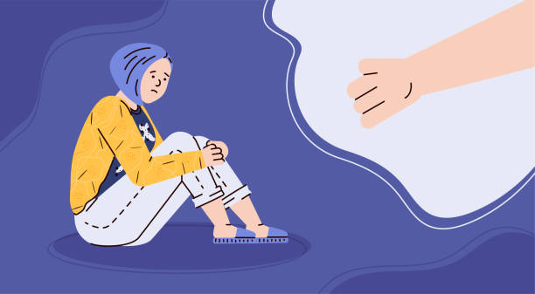
What Did We Learn?
The picture of youth suicide is complicated.
Some groups are at higher risk than others --
Males
AIAN
LGBTQ+
Black youth
There are many societal factors that contribute to youth suicide and reports of young people feeling persistently sad and hopeless.
Engaging peers is one of the best ways to link young people who need help with the help that they need.
Notes:
We tend to suicide as a problem with the individual – did they have a mental illness, what was going on their particular life? But the fact is that that there are many factors at the societal level as well as community, school, and family factors that impact the rate of suicide deaths. We didn’t have time to discuss those today.

Slide 61
Job Corps is Protective Against Suicide
Notes:
We can’t end this webinar without pointing out that Job Corps can be a protective factor for many youth to prevent suicides. This bar graph table spans PYs 2012 to 2021. The Program Year for Job Corps from July 1 through June 30th of the following year. PY 2020 has been omitted due to Job Corps shutting down during the COVID-19 pandemic and not having reliable data.

Slide 62

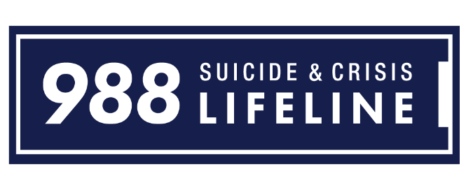

Resources
Deaf/Hard of Hearing:
711, then 988
Voice, text, and chat 988lifeline.org/chat/
90% of texters considering suicide reported that the conversation they had with the counselors was helpful (Gould et al., 2022)
LGBTQ+ youth can access affirming support: press 3 when calling or text Q to 988.
Notes:
July 16th marked the one-year anniversary

Slide 63
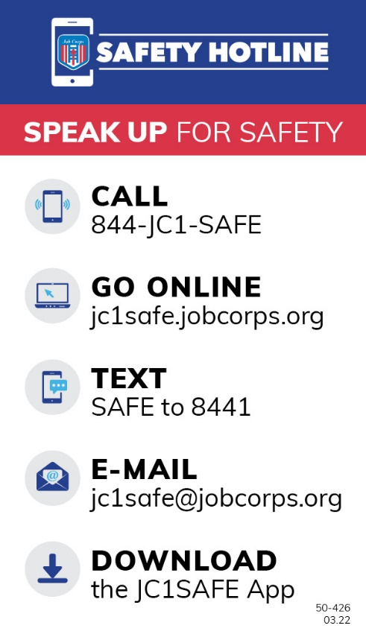
Job Corps Safety Hotline
Available since 2018
Added to PRH in PY 2021 (PRH Change Notice 21-06)
PRH 5.3 R13 created a training requirement for all staff and for all students during CPP and through monthly reminders
Notes:
From PRH CN21-06:
PRH 5.3 R13 Safety Hotline Education
A new requirement, “R13 Safety Hotline Education” was added to Section 5.3 Safety and Security. The new requirement reads:
Use of the Job Corps’ national, toll-free Safety Hotline is the right of all students, staff, and visitors on the Job Corps Center premises. To support hotline usage among all center stakeholders, centers must ensure:
All staff are adequately trained, understanding how to support and respond to questions by students regarding the Safety Hotline.
Response team members are trained to triage tips, perform follow-up actions, and provide updates in the web-based Safety Hotline portal.
All students are introduced to the Safety Hotline during the Career Preparation Period through the Safety Hotline orientation video.
All students receive a monthly reminder on the purpose and use of the hotline.
Adequately promote the Safety Hotline by:
Providing wallet cards containing Safety Hotline information to each student during CPP.
Promoting the use of the Safety Hotline App during CPP.
Provide wallet cards containing Safety Hotline information to each staff member upon hire.

Slide 64






Peer Support
Apps
Instagram
@peersupportspace (for 18+)
Mental illness, substance misuse, neurodivergence, disability, grief & trauma
Focus on Black, Latinx, immigrant, LGBTQ+ & disabled “folx”
Calm Harm
Mood Tools
“Warmlines”
Trained peers to listen & give support
NOT a crisis line, not all are 24/7
warmline.org/ has directory of numbers by state
Virtual Hope Box
Safety Plan
Notes:
Resources for Peer Support –

Slide 65

PEER EDUCATORS
https://www.activeminds.org/
https://hopesquad.com/
https://mhanational.org/tools-2-thrive
Aguilar, T., Espelage, D. L., Valido, A., Woolweaver, A. B., Drescher, A., Plyler, V., ... & LoMurray, S. (2023). Lessons learned from implementing Sources of Strength: A qualitative examination of a peer-led suicide prevention program. School Mental Health, 1-14. doi: 10.1007/s12310-023-09587-w
Dodd, S., Widnall, E., Russell, A. E., Simmonds, R., Limmer, M., & Kidger, J. (2022). School-based peer education interventions to improve health: a global systematic review of effectiveness. BMC Public Health 22, 2247. doi: 10.1186/s12889-022-14688-3
WORDS MATTER
Centre for Addiction and Mental Health. Words Matter. https://www.camh.ca/en/today-campaign/help-and-resources/words-matter
SUICIDE STATISTICS
Center for Disease Control and Prevention. Youth Risk Behavior Survey Data Summary & Trends Report: 2011-2021. https://www.cdc.gov/healthyyouth/data/yrbs/yrbs_data_summary_and_trends.htm
Center for Disease Control and Prevention. Disparities in Suicide. Retrieved on August 16, 2023, from
https://www.cdc.gov/suicide/facts/disparities-in-suicide.html
Stone, D. M., Mack, K. A., & Qualters, J. (2023). Notes from the Field: Recent Changes in Suicide Rates, by Race and Ethnicity and Age Group — United States, 2021. Morbidity and Mortality Weekly Report, 72, 160–162. doi: 10.15585/mmwr.mm7206a4
Selected References
Notes:
Additional resources and references for the webinar – you can explore at your leisure

Slide 66
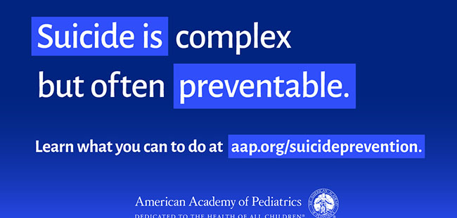
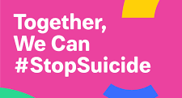

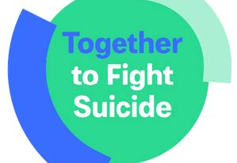
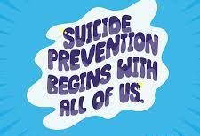


Slide 67

Thank you for your attention.

