Slide 1
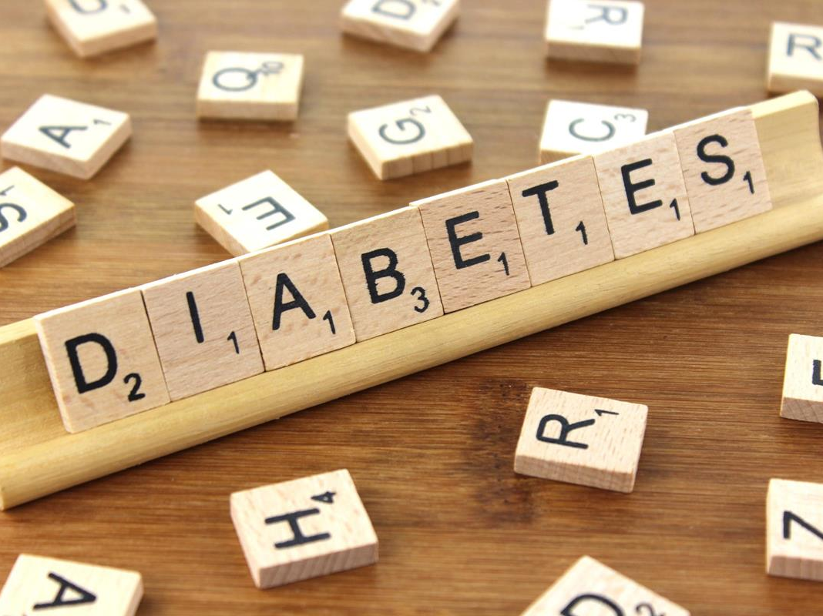
Diabetes Mellitus
Type 1: Gary Strokosch, MD, Regions III & V Medical Specialist
Type 2: Drew Alexander, MD, Region IV Medical Specialist
March 28, 2024
This Photo by Unknown Author is licensed under CC BY-SA
Notes:
Greetings, I am Dr. Gary Strokosch and serve as the regional medical specialist for Regions 3 and 5, Atlanta and Chicago. My co-presenter today is Dr. Drew Alexander who serves as the regional medical specialist for Region 4, Dallas. We will discuss the two main types of diabetes. I will start this webinar covering Type 1 and about half-way through, I will turn it over to Drew to cover Type 2.

Slide 2
Two Main Types of Diabetes
Type 1: formerly known as insulin-dependent diabetes mellitus (IDDM) or juvenile onset diabetes
Type 2: formerly known as non-insulin-dependent diabetes mellitus (NIDDM) or adult onset diabetes
Notes:
The classification of diabetes on this slide was proposed by the American Diabetes Association (ADA) in 1997 and adopted by the World Health Organization in 1999 and remained unchanged after a reassessment in 2006. This slide is a simplification of the classes of diabetes and doesn’t include secondary diabetes, i.e.., Type 3 diabetes from pancreatic diseases (such as cystic fibrosis or chronic pancreatitis); or Type 4 from pregnancy (knows as gestational diabetes). We will not discuss these latter tow Types (3 and 4). On the next slide, we will review a little information about the etiology of Type 1 and 2 diabetes.

Slide 3
Two Main Types of Diabetes
Type 1 due to: autoimmune beta-cell destruction, usually leading to absolute insulin deficiency.
Type 2 due to: non-autoimmune progressive loss of adequate insulin secretion, frequently on the background of insulin resistance.
This Photo by Unknown Author is licensed under CC BY-SA
Notes:
Type 1 is due to autoimmune beta-cell destruction, usually leading to a rapid-onset of absolute insulin deficiency. Although this occurs primarily in children, this phenomenon can occur in adults as well – known as Latent Autoimmune Diabetes in Adults, or LADA. Type 2 diabetes is due to (1) non-autoimmune (2) progressive loss of adequate beta-cell insulin secretion, with (3) insulin resistance (and metabolic syndrome). Although Type 2 usually occurs in adults, this type of diabetes can occur in children and is called Maturity-Onset Diabetes of the Young or MODY. On the next slide, we will zero in on Type 1 diabetes.

Slide 4
What Causes Type 1 Diabetes?
Type 1 diabetes is cause by an absolute deficiency of insulin, a hormone which is produced in the beta cells of the Islets of Langerhans in the pancreas.
Although poorly understood, it is likely that:
(1) some environmental factor is involved which triggers
(2) a selective autoimmune destruction of the beta cells
(3) in a genetically predisposed individual.
This Photo by Unknown Author is licensed under CC BY
Notes:
The autoimmune etiology is mostly limited to Caucasian populations, for whatever reason. As I mentioned earlier, other factors affecting pancreatic beta cell function can result in diabetes that presents exactly the same way as autoimmune Type 1 diabetes, e.g., pancreatitis or cystic fibrosis; or even exposure to chemicals or certain drugs, such as glucocorticoids.
Whatever the pathogenesis, type 1 diabetes is usually diagnosed in children, adolescents or young adults. There is a steady rise in incidence in the onset of Type 1 throughout childhood with the peak occurring slightly earlier in girls (at 11 years of age) than in boys (at 14 years of age), coincident with puberty.
Regarding genetics, the risk of developing Type 1 diabetes increases with the number of family members with the condition. The background risk in the general population is 0.4% but increases to a whopping 65-70% for a monozygotic twin whose twin develops diabetes under the age of 5 years. On the next slide, we will see that Type 1 much less common on JC centers than Type 2.

Slide 5
Type 1 Diabetes
Type 1 accounts for only 10% of all cases of diabetes but demands daily treatment with insulin.
Type 1 new patients experience a variety of symptoms during a brief latency period.
Notes:
Most students with diabetes on center or applying to JC will have Type 2 diabetes, whether or not they know it. Most of the time, JC students with Type 1 diabetes will have already been diagnosed and prescribed an insulin management plan prior to applying to JC. On rare occasions, a student may develop Type 1 diabetes after entry into JC and we will discuss the symptoms that occur during the onset of Type 1 diabetes in a few minutes.

Slide 6
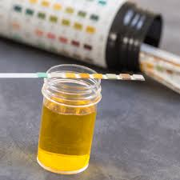
Making a Diagnosis
HgA1C ≥6.5%
FBS (≥ 8 hours fasting) ≥126 mg/dL
2-hour OGTT ≥ 200 mg/dL
One random BS ≥ 200 mg/dL value is all that is needed in a patient with classical symptoms of diabetes.
The diagnosis of diabetes should never be made based solely on glycosuria.
Notes:
The gold standard test for diabetes is the oral glucose tolerance test (OGTT), seen in bullet #3. However, this test requires (1) an overnight fast followed (2) by a 75-gram glucose drink, with (3) blood glucose samples taken before the drink and 2-hours afterwards. This test is much too cumbersome for most JCCs and it’s much more practical to perform a simple A1C or fasting blood sugar FBS, noted in bullets #1 and #2 on the slide. Note that the Fasting Blood Sugar in bullet #2 can only be accurate if there has been legitimate fasting for 8-hours, the A1C test is the easiest and most reliable test to perform on center which can be drawn at any time of the day and regardless of when the student last ate.
Regarding bullet #5, the blood glucose level required to cause glucose to spill in the urine is call the renal threshold. That level of blood glucose varies from patient to patient, requiring a blood glucose range of between roughly 150 to 250 mg/dL to be exceeded before glucose spills in the urine. The AVERAGE renal threshold is about 180 mg/dL before urine spilling occurs. Renal glycosuria, meaning a positive glucose on a urinalysis (obtained on all entering students) warrants obtaining additional history and collecting a diagnostic test for diabetes, just discussed. TIME for a ZEBRA: about 1/33,000 people have a familial defect in the kidney’s proximal tubules and have glucose in their urine all the time, in the absence of other renal or endocrine conditions. These patients are asymptomatic and are found randomly on urinalysis.
On the next slide we look a little closer at interpreting blood sugar values from bullets #2 and #3 on this slide.

Slide 7
Glucose Testing
Impaired Glucose Tolerance
Fasting Glucose (FBS) | 75 gm Glucose Tolerance (OGTT)
110-125 mg/dL | 140-200 mg/dL
Diabetes
Fasting Glucose (FBS) | 75 gm Glucose Tolerance (OGTT)
>125 mg/dL | >200 mg/dL
Notes:
To reiterate, all that is needed is one fasting (≥ 8 hours) blood sugar (FBS) of more than 125 mg/dL.
This slide notes the criteria for the diagnosis of diabetes and the in-between state of “impaired fasting glycemia” or “impaired glucose tolerance”.
The HgA_{1c} level needed to establish a diagnosis of diabetes is addressed on the following slide.

Slide 8
A1C
HbA1C
Hemoglobin A1C
Glucohemoglobin
Glycohemoglobin
Glycosylated Hemoglobin
Notes:
A1C is known by several names, as seen in small print on the slide – “HbA1C, Hemoglobin A1C, Glucohemoglobin, Glycohemoglobin, and Glycosylated Hemoglobin. But, despite 5 different names used in printed literature, It is most commonly called “A1C” as noted in the center of the slide. Remember, if the value is ≥6.5%, it is diagnostic of diabetes. A1C physiology is described on the next slide.

Slide 9
A1C
Glucose becomes attached to hemoglobin in a non-enzymatic fashion, dependent on the average blood glucose concentration.
HbA1C is a measure of integrated glucose control over the preceding 2-3 months, reflecting the average life of a red blood cell (RBC).
Notes:
The average life cycle of a human RBC is approximately 120 days. Generally, by that time, the cell is worn out and damaged. RBCs pass through both the spleen and liver, where macrophages break them down.
Be aware that A1C results may be adversely affected by severe anemia or hemoglobinopathies, such as sickle cell disease, where the life span of the RBCs is less than the normal 120 days.

Slide 10
A1C → EAG
The Estimated Average Glucose is calculated with the following formula:
(28.7 X A1C) – 46.7
Notes:
This is for the math nerds out there. There is a simple formula for helping to interpret the A1C results by converting A1C to the Estimated Average Glucose. I am certain that you all have this formula memorized and use it all the time. OR, maybe you would rather use a table as depicted on the next slide.

Slide 11
A1C
HbA1c | Glucose mg/dL
5% | 97 (76-120)
6% | 126 (100-152)
7% | 154 (123-185)
8% | 183 (147-217)
9% | 212 (170-249)
10% | 240 (193-282)
11% | 269 (217-314)
12% | 298 (240-347)
13% | 326 (260-380)
14% | 355 (290-410)
15% | 384 (310-440)
“risk” of diabetes:
5.7-6.4%
“diagnostic” of diabetes:
≥6.5%
Notes:
This table helps to interpret an A1C value and correlate it with an estimated average glucose for the past 2-3 months. As noted on the left of the slide, ≥6.5% is diagnostic of diabetes and levels of 5.7-6.4% indicate increased risk for future diabetes.
The ADA guidelines advise that the A1C test be performed at least two times a year in patients with diabetes that are meeting treatment goals and quarterly in patients with diabetes whose therapy has recently changed or that are not meeting treatment goals – this is probably the case with most students with diabetes. This recommendation for quarterly A1C testing should be incorporated in the Chronic Care Management Plan for students with diabetes. Let's talk about presenting symptoms for Type 1.

Slide 12
Presenting Symptoms
Polyuria / Nocturia
Thirst
Polydipsia
Polyphagia
Weight Loss
Ketoacidosis
Notes:
The hyperglycemia, or high blood sugar, exceeds the renal threshold for glucose at about 180 mg/dL on average and the kidneys start spilling glucose in large quantities. This acts as an osmotic diuretic causing the polyuria, including nocturia. Patients become thirsty and begin to drink large volumes of fluids.
Insulin is used to transport glucose across cell membranes and when the glucose is not able to enter cells for nourishment it causes increased hunger and eating to no avail. The patient has muscle wasting and loses weight. Patients become dehydrated and malnourished, causing them to be drowsy and fatigued and the shift of fluids causes blurry vision. Patients also become susceptible to infections (such as cutaneous candida infections, causing balanitis in males or vulvovaginitis in females). These myriad of symptoms progress over days to weeks and eventually lead to diabetic ketoacidosis (DKA), a dangerous metabolic state that requires emergency treatment in the hospital.

Slide 13
DIABETIC KETOACIDOSIS: Rapid Onset Life-threatening
Consists of hyperglycemia, ketosis and acidosis.
10-25% of episodes of DKA are seen in new patients presenting for the first time
30-40% of episodes are from infections
The rest are from stopping insulin
1-2% mortality during each DKA episode!
Notes:
It is uncommon for a student to develop Type 1 diabetes WHILE enrolled in JC. JC students with diabetes who develop DKA while enrolled in JC have either (1) a significant infection or (2) they are just not talking their insulin as prescribed. Diabetic students who get infections, such a gastroenteritis, sometimes mistakenly stop their insulin during the episode of illness due to being unable to eat. However, insulin requirements persist and are often increased during an acute illness. Students who stop their insulin for any reason risk experience DKA and the associated morbidity and mortality.
A word of caution is in order. Beware of a oversimplified explanations for repeated episodes of DKA in the history of a student with diabetes, such as “I’m just a brittle diabetic.” I have heard this explanation many times with patients and I am not sure I believe in the concept of "brittle diabetes."

Slide 14
MORTALITY
Prior to 1921 the development of Type 1 diabetes meant an almost certain death shortly after diagnosis.
A significant proportion of deaths in young diabetics are attributable to DKA.
Later deaths from diabetes are more commonly associated with long-term cardiovascular and renal disease.
Notes:
It was a slow progression of discoveries that lead to a treatment for diabetes. In 1776 Matthew Dobson showed that urinary sweetness was caused by sugar and associated with a high blood sugar. In 1869 Paul Langerhans discovered the pancreatic islets that bear his name. In 1889 Oskar Minkowski removed the pancreas from a dog and discovered that the animal developed diabetes. In 1893 Edouard Laguesse showed that Langerhan’s islets were the endocrine tissue of the pancreas.
The Game Changer for treating diabetes occurred in 1921 with the discovery of insulin. It was during the 1920s that the first patients with diabetes were treated with insulin.

Slide 15
Long-Term Complications
Retinopathy: most common cause of blindness in people of working age
Nephropathy: 20-44% of all new patients needing renal replacement therapy have diabetes
Erectile Dysfunction: may affect up to 50% of men with long-standing diabetes
Macrovascular Disease: 2- to 3-fold increased risk of coronary heart disease and stroke
Foot Problems: 15% of people with diabetes develop foot ulcers; 5-15% of people with diabetic foot ulcers need amputations
Notes:
None of these problems listed on the slide will probably be seen in JC students with type 1 diabetes. Most affected students will not have had their disease long enough. Good control of their blood sugar will help stave off or lesson these complications.

Slide 16
Treatment
Insulin
Management of CHO intake
Exercise
Notes:
In many ways, the treatment of Type 1 diabetes is more straight forward than the treatment of Type 2, as Dr. Alexander will demonstrate in a few minutes. Years ago, the treatment of Type 1 diabetes included complicated dietary prescriptions to try to match the insulin regimen. It was a rare adolescent that was able to do that successfully. The tables have turned, and treatment is now much more about knowing what the patient has eaten, usually counting carbs, and matching the insulin treatment to the eating patterns. Short- and long-acting insulins are usually used in some combination each day. In the third bullet, you can see that students with diabetes are perfect candidates for the HEALs Program.

Slide 17
Insulin Development
1921–1922
In the U.S. the original insulin was from bovine and later porcine sources
1982
Biosynthetic insulin was introduced
1996
Analogue insulin was introduced
Notes:
1921: Bovine (cattle) insulin is 3 amino acids different than human insulin and was the first animal insulin to be used in the US. Porcine (pork) insulin is 1 amino acid different than human insulin, and both are active on the human receptor. Other animal sources were also used, such as shark insulin in Japan.
1982: Biosynthetic insulin was developed by Arthur Riggs at Genentech in 1978 and FDA approved in 1982. Biosynthetic human insulin is synthesized by E. Coli which has been genetically altered with recombinant DNA to produce biosynthetic human insulin.
1996: Through genetic engineering of the underlying DNA, the amino acid sequence of human insulin can be changed to alter its absorption, distribution, metabolism, and excretion characteristics. These are referred to as analogue insulins.

Slide 18
Insulin Names
Generic
Brand
aspart
glulisine
lispro
regular
NPH
determir
glargine
Novolog
Apidra
Humalog
Humulin R / Novolin R
Humulin N / Novolin N
Levemir
Lantus
Notes:
This is a partial and old list of uncombined insulins on the market today. I went online this week and counted 41 different solo or combination insulin products on the market. Insulins are usually better known by the brand names, so this list is a helpful reference when trying to sort out what a student has been taking at home. There are several additional products that are a combination of two different insulins and I will show you a slide of that in a minute.
You may have noticed that the list is organized by the speed and duration of their action, the fastest acting and shortest duration of action at the top and the slowest acting and longest duration at the bottom, as summarized on the next slide.

Slide 19
Insulin Names
Acting | Generic | Brand
Rapid | Aspart | Novolog
 | Glulisine | Apidra
 | Lispro | Humalog
Short | Regular | Humulin R/Novolin R
Intermed. | NPH | Humulin N/Novolin N
Long | Determir | Levemir
 | Glargine | Lantus
Notes:
Though there are some differences between the three rapid acting insulin types and between the two long-acting types, the differences are rather small and they should be lumped together for simplicity. Again, I have not mentioned the combination insulins, but lets first define the “action” of insulin on the next two slides.

Slide 20
Insulin Action
Rapid Acting
Novolog
Apidra
Humalog
Short Acting
Humulin R
Novolin R
Onset: 15-30 min
Peak: ½-2 hrs
Duration: <6 hrs
Onset: 30-60 min
Peak: 2-4 hrs
Duration: 6-12 hrs
Notes:
Again, only the brand name is used on this slide and the next. You can see that when a rapid acting insulin is injected at meal time, it is gone by the next meal. With short acting insulin there is some overlap.
However, the use of rapid acting insulin over short acting insulin is the norm these days.

Slide 21
Insulin Action
Intermed. Acting
NPH
Long Acting
Levemir
Lantus
Onset: 1-2 hrs
Peak: 4-14 hrs
Duration: 10-24 hrs
Onset: 1 hr
Peak: none
Duration: 6-24 hrs
Notes:
Depending on the patient, the intermediate and long-acting insulin covers from a half day to a whole day. In practice, many pediatric endocrinologists prescribe dosing twice-a-day for these long acting insulin products, whereas adult endocrinologists usually prescribe once-a-day dosing of this insulin, usually at bedtime.

Slide 22
Pre-mixed Insulins with Biphasic Action
Novolog mix: aspart protamine / aspart
70/30 mix (vials and pens)
Humalog mix: lispro protamine / lispro
50/50 mix (vials and pens)
75/25 mix (vials and pens)
Novolin mix: NPH / regular
70/30 mix (vials)
Humulin mix: NPH / regular
70/30 mix (vials and pens)
50/50 mix (discontinued in US)
Notes:
NPH appears for the first time on this slide. NPH stands for neutral protamine Hagedorn and is an intermediate acting insulin. In 1936, Hans Christian Hagedorn and B. Norman Jensen discovered that the effects of injected insulin could be prolonged by the addition of protamine which is obtained from the “milt” or semen of river trout! Just what you wanted to know.
Eventually, all animal insulin was replaced by biosynthetic human insulin which is also complexed with protamine to form NPH. NPH remains on the market today because manufacturers sell a variety of premixed insulin formulations. Some diabetic JC students come into JC on these mixtures of insulins.

Slide 23
Treatment Regimens
Pre-mixed insulin twice daily
(2 shots daily)
Basal-bolus regimen with rapid-acting insulin at the three meals and long-acting insulin at bedtime (4 shots daily)
Continuous subcutaneous insulin infusion (CSII) or insulin pumps
(1 needle insertion every 3 days)
Notes:
Treatment regimens come in roughly 3 varieties. Of course, any combination of insulin can be used as long as the patient achieves good glucose control!
One of the simplest regimens is twice daily mixed insulin, containing both rapid/short acting plus intermediate acting insulin, given before breakfast and the evening meal. However, the fixed ratios are inflexible and achieves poorer control than the regimen in the second bullet on the slide.
Basal bolus regimes are the treatment of choice for type 1 diabetics but requires 4 injections daily. Either short or rapid acting insulin can be used for the 3 meals plus a bedtime dose of long-acting insulin.
The 3rd bullet refers to the increasing use of insulin pumps.

Slide 24
Injection Sites

Slide 25
Injection Site Side Effects
Lipohypertrophy: when insulin is repeatedly injected into the same site there can be a local effect that leads to lumps at the site and compromises absorption of insulin at that site.
Lipoatrophy: immunoglobulin G immune complexes against insulin can form and produce atrophy as well as compromise the action of insulin
Notes:
In adipose tissue insulin suppresses fat breakdown and promotes fat synthesis, thus leading to lipohypertrophy at repeated injection sites. These sites become less painful and are usually used because of physical convenience. However, this interferes with the absorption of the injected insulin and compromises glucose control.
Until biosynthetic human insulin was available in the early 1980s, most insulin used in the US was a combination of beef and pork. If allergy was suspected, patients would be switched to pure pork insulin. Despite solving most of these problems with the availability of biosynthetic insulin, a small number of patients develop immune responses to analogue insulin being injected (since 1996) and they experience local atrophy at the site of injection.
A few words about insulin pumps, glucose sensors, and cell phones.

Slide 26
Omnipod Insulin Pump
Notes:
The Omnipod pump system has no connecting tubing, and the oval shape pod is loaded with about 3 days of insulin. It was remotely controlled by a handheld device, though most pumps can now be controlled with a cell phone. The pod is discarded after it runs out of insulin and a new one is loaded and attached to the skin with the adhesive. This slide shows an older model and the Insulet Company has replaced it with a smaller device. A needle extends into and retracts from the skin, leaving a small catheter in the subcutaneous space beneath the pod. The pod is watertight and can be worn while bathing or swimming. A second brand of pump is next.

Slide 27
Medtronics Insulin Pump
Notes:
The Medtronics products have been around for a long time and this version of the pump is worn on the belt or can be clipped indiscreetly under the clothing. The tubing is seen coming out of the upper end of the pump where the reservoir resides with about 3 days supply of insulin. The plastic reservoir screws out of the pump and a new one is filled and screwed in place. On this slide the tubing is seen to “disappear” beneath the clothing where it is connected to a small administrative device. The reservoir and tubing are seen in the next slide.

Slide 28
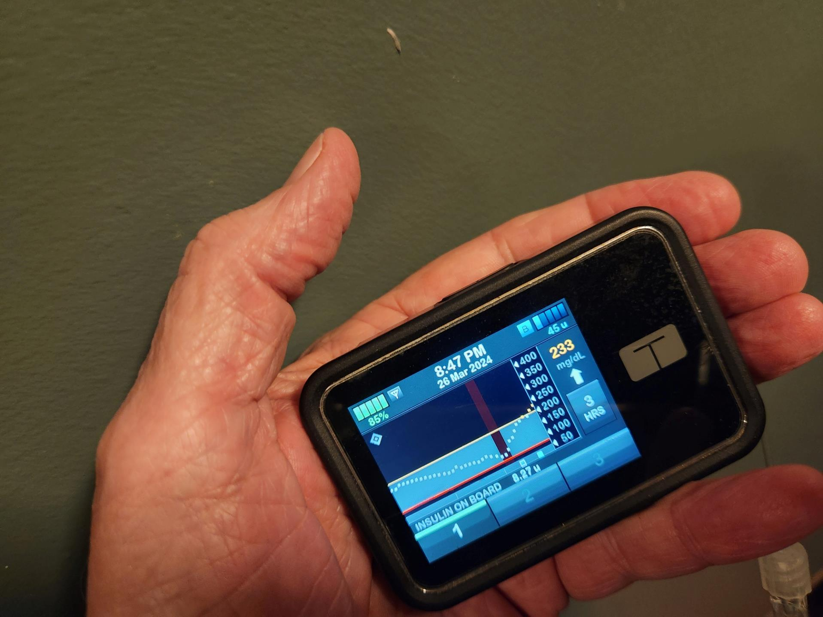
Tandem T:SLIM X2 with Control-IQ
Notes:
The third pump brand is the Tandem pump with the ability to stop the flow of insulin if the sensor reads a low value and add extra insulin if the glucose level goes up too high. It also communicates with cell phones and bolus insulin can be remotely triggered with the cell phone. This pump integrates with a couple of models of glucose sensors. Here are a few.

Slide 29
Medtronics Connections
Notes:
The reservoir resides in the pump and is attached by the connecting tubing to the insertion device, seen in the picture. Both are replaced after 3 days of use. The catheters come in varying lengths and allow patients to wear the inserted catheter nearly anywhere and track the tubing indiscreetly under the clothing. The pump and tubing must be disconnected for bathing or swimming, but the subcutaneous catheter attached to the skin is not damaged by water.

Slide 30
Dexcom G7 Sensor
Notes:
Dexcom has been periodically upgrading its sensors and this G7 model was recently approved. Like other sensors, it monitors subcutaneous glucose and transmits the data to a pump, which in turn communicates with a cell phone. This is the size of a silver dollar.

Slide 31
Abbott FreeStyle Libre 2 Plus Sensor
Notes:
Abbott produces the FreeStyle sensors and this Libre 2 Plus will work with the Tandem pump to add and subtract insulin as needed. However, for large intake of carbohydrates, such as at mealtime, the user dials up a bolus of insulin on his or her cell phone to administer the bolus, putting in the amount of carbohydrate and allowing the pump to calculate the right amount of insulin.
A word about hypoglycemia.

Slide 32
Hypoglycemia
When blood glucose falls below 63 mg/dL
The most common side effect of insulin
A barrier to obtaining optimal glycemic control
Most Type 1 patients will experience several mild episodes weekly and 1-2 severe episodes per year needing outside help
It occurs more frequently in young patients and those under very tight glycemic control
Notes:
A word about hypoglycemia. As glucose concentration falls below the normal range, secretion of the insulin antagonist, glucagon, normally increases from the alpha cells of the islets. At the same time, a number of other insulin antagonists or “counter-regulatory” hormones are released, including norepinephrine, cortisol and growth hormone. However, in diabetes these combined protective mechanisms are unavailable because of abnormal islet cell function or defective counter-regulatory hormone secretion.
Also, with recurrent hypoglycemia and longer duration of diabetes, the magnitude of the counter-regulatory hormone response and other sympathetic nervous system responses to hypoglycemia become blunted.
One more slide on hypoglycemia, then on to Dr. Alexander.

Slide 33
Hypoglycemia Signs/Symptoms
Autonomic
Sweating
Pins & needles
Feeling hot
Shakiness
Anxiety
Palpitations
Pallor
Neuroglycopenic
Difficulty speaking
Loss of concentration
Drowsiness
Dizziness
Hemiplegia
Fits (seizures)
Coma
Non-specific
Nausea
Hunger
Weakness
Notes:
It is important to recognize the signs and symptoms of hypoglycemia. Autonomic symptoms occur because of activation of both the adrenergic and cholinergic parts of the autonomic nervous system, while neuroglycopenic (a big word) symptoms result from inadequate glucose supply to the brain, leading to neurological dysfunction.
Glucose is an obligate fuel for the brain under normal physiological conditions and the brain accounts for 50% of whole-body glucose utilization. The brain cannot synthesize or store glucose and it requires a constant supply of glucose from the circulation.
Under normal circumstances the development of autonomic symptoms precedes neuroglycopenic symptoms and prompts corrective action before cognitive impairment begins. But a blunting of these responses places the patient at considerable risk of being unaware of how close to being unconscious they are when hypoglycemic. Endocrinologists sometimes categorize patients as “sensitive” or “insensitive” to hypoglycemia, the latter person being unable to recognize the early signs of hypoglycemia and at risk for more severe symptoms.
Time for Type 2 diabetes.

Slide 34
Type 2
Drew Alexander, MD

Slide 35
Objectives
Understand Prediabetes and the impact of Lifestyle and Wellness
Incorporate Center Lifestyle and Wellness to delay/divert DM2.
Be able to Define DM2 and know the role of an index of suspicion.
Be familiar with DM2: Screening, Treatment, Management.
Be familiar with DM: Chronic Care Management and AFR.

Slide 36
CDC DIABETES U.S. Report Card

Slide 39
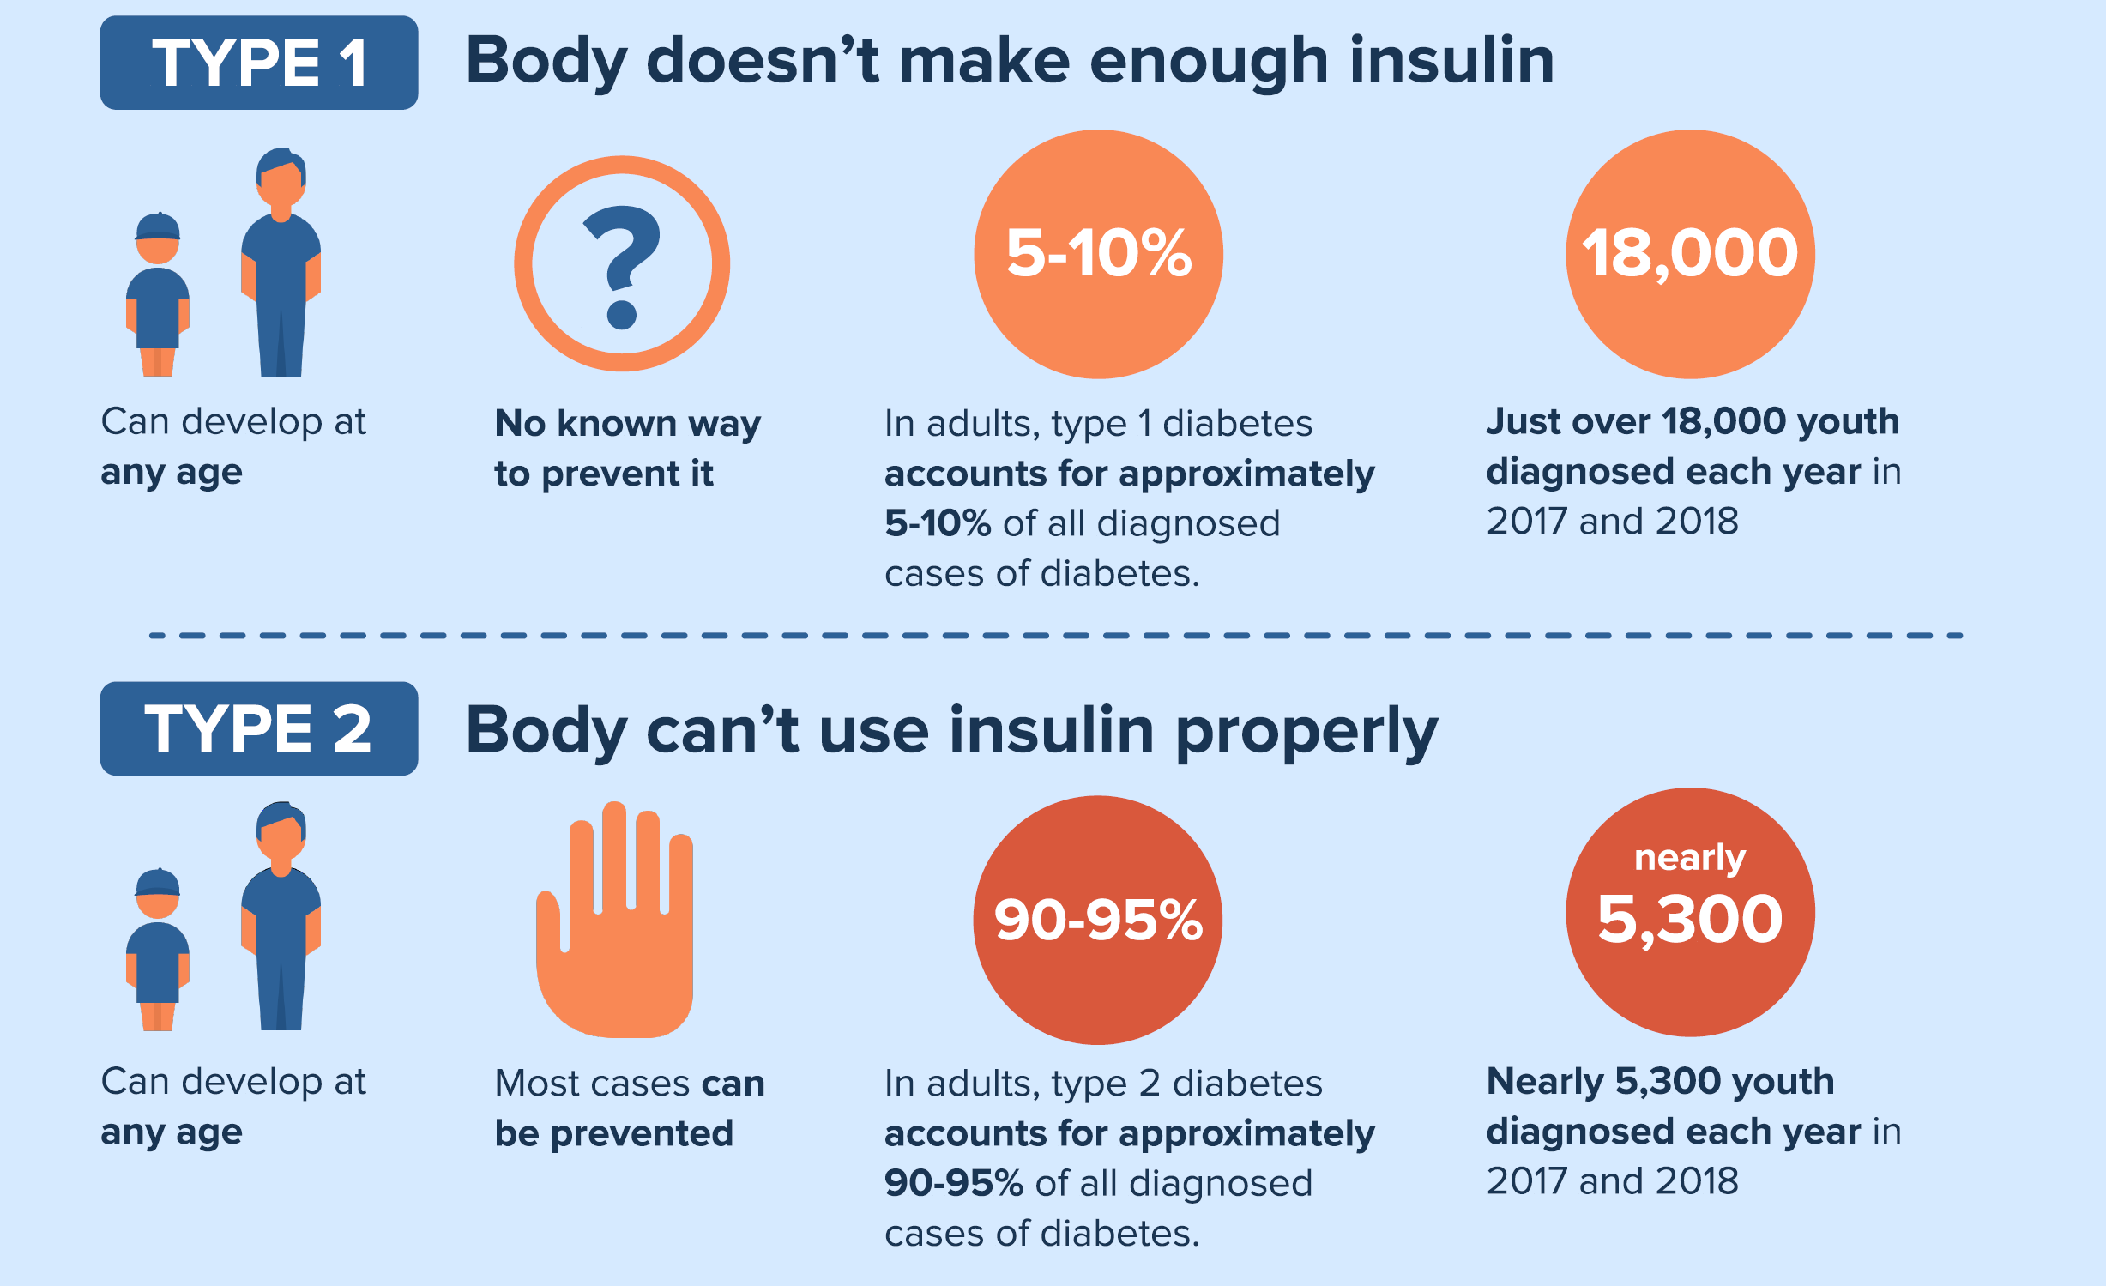

Slide 41
Prediabetes and Diabetes Facts
98 Million US residents are PREDIABETIC.
33% of those with PREDIABETES are unaware.
$413 billion are spent annually on DIABETES care.
Optimal Lifestyle (LS) and Wellness (Well) remits Prediabetes.
As Lifestyle and Wellness measures fail DM management begins.

Slide 42
Defining Prediabetes
Initially prediabetes is asymptomatic, requiring index of suspicion.
It is defined as borderline elevation of serum glucose.
Lifestyle Risks include stress, poor sleep/diet, lack of exercise.
Symptoms may include: fatigue, altered appetite, neuro, visual.
Findings may include: inconsistent glucosuria and blood glucose.
Acanthosis Nigricans: increased pigmentation of neck /skin folds.

Slide 43
Education, Lifestyle (LS) and Wellness (Well)
Develop patient/community programs on JCC to teach on DM2.
Market and Promote programs that increase AWARENESS.
Diabetes untreated results in a 60% reduced life expectancy.
Wellness is an optimal goal for all, especially for employability.
HEALS is a JC Program that addresses LS/Well on centers.
Awareness in Academic, Vocational, Civic and Health Spaces.
Addressing and changing LS/Well can delay/divert drug treatment.

Slide 44
Changing Hearts and Minds (and Behaviors)
Repetition
Community
Enjoyment
Values

Slide 45
DM2: Diabetes Mellitus Type 2
Physical disorder involving the body’s use of insulin.
DM2 is affected by genetic, cultural, behavioral and other factors.
LS risk factors: Overweight, underactive, poor diet, age 45+ yrs.
All ages included: 5,300 youth/yr, 95% of DM cases are T2.
Classic Symptoms: Polydipsia. Polyuria. Nocturia
Other Symptoms: Hunger, Fatigue, Neuropathy, Visual Change, Agitation, HA, GI upset.

Slide 46
DM2: Screening
Index of Suspicion: 1. LS Risk Factors. 2. Early Symptoms.
Regularly for Prediabetes, 35+yo, obesity, FH, gestational DM.
Hemoglobin A1C: 5.7% to 6.4% Pre// 6.5% + DM2. (on 2 tests)
Fasting Blood Sugar: 100-125 mg/dL Pre// 126+ mg/dL DM2.
Repeated Random Blood Glucose Elevation: 200 mg/dL.
Glucosuria.
Oral Glucose Tolerance*: 140-199 mg/dL Pre; 200 mg/dL @2+ hrs.

Slide 47
DM2: Oral Pharmaceuticals and Management
Actively engage the patient clinically. (continuity may be optimal)
When preventive measures fail, begin pharmacy treatment
Metformin: Lowers liver glucose production and sensitivity to insulin (monitor B₁₂).
Sulfonylureas: Increases Insulin Secretion.
Glinides: Stim Pancreas to Increase Insulin Secretion.
Thiazolidinediones: Increase Tissue sensitivity to Insulin.
(Major AE’s).
GLP1 receptor agonist: Slows digestion, Lowers BS.
SGLT2 inhibitors: Increase Renal Excretion of Glucose. (Major AE’s).

Slide 48
Insulin Therapy
Types
Delivery
Rapid Acting
Regular (short) Acting
Intermediate Acting
Long Acting
Ultra Long Acting
Syringe
Pen
Pump
Inhaler
Jet Injector
Artificial Pancreas

Slide 49
DM1 and DM2: Chronic Care Management
Actively involve a clinical team as you direct the RX plan.
Clinicians monitor screen, prescribe and oversee patient care.
Involve community specialists and resources as indicated.
Wellness Staff monitor, screen, assess RX and alert as needed.
HEALS for LS/Well: Nutrition. Athletics. Dorm Life. Home Life.
Consider MH to enhance global behavioral change.
Consider Dental Staff for comorbid conditions and LS support.
Educate and advise students regarding support systems after JC.
Keep Wellbeing and Employability as priorities.

Slide 50
Applicant File Review Does It Exceed Basic Care? (PRH 2.3, R11; Exhibit 2-4)
Treatment of Type 1 diabetes is not optional and without treatment will inevitably lead to death, as happened prior to 1921.
Some new patients have a “grace period” of weeks or months with minimal need for insulin after starting treatment; management plans change frequently during the first few months of treatment and can require repeated adjustments of insulin timing and dose.
Remember, highly effective self-management by an adolescent patient is unlikely and is not the criterion for entry into JC.
Notes:
Students who are in denial about their diagnosis of Type 1 diabetes and refuse to take insulin regularly are not ready for JC, or employment for that matter. Their ability to fully participate in the program would be seriously compromised and they may bounce in and out of DKA and exceed our concept of Basic Health Care, defined in PRH 2.3, R11, Exhibit 2-3 (note the PRH reference in red on the slide.
Note that applicants who have been very recently diagnosed with diabetes will have frequent changes in their management and take a few months to stabiize.
An elevated A1C level is not a criterion for denial of entry.

Slide 51
References / Questions
CDC: www.cdc.gov/diabetes/basics/type2.html
ADA: www.diabetes.org
ADA: https://diabetesjournals.org/care/issue/47/Supplement_1
Healthline: www.healthline.com/health/thpe-2-diabetes
Medscape: www.medscape.org/diabetes&endocrinology
NIH: www.niddk.nih.gov

Slide 52
American Diabetes Association
Standards of Care in Diabetes - 2024

