Slide 1
Integrative collaborative care model: Anxiety Disorders
Drew Alexander, M.D.
María Acevedo, Ph. D.
Molly Rosinski, MEd

Slide 2
Describe the gut-brain connection with clinical anxiety
Demonstrate the mutual impact between cognitive / data overload and clinical anxiety
Enumerate strategies to prevent or reduce cognitive / data overload
Identify and describe disability accommodation considerations for students with clinical anxiety
Develop an understanding of the Integrative Collaborative Care Model
OBJECTIVES
Notes:
Read topics on slide

Slide 3
ANXIETY:
Rhythmic: Sensory stimuli that heighten awareness and prompt one to regulate and manage fear and/or unknown threats.
Pathologic: Persistent and intense sensory stimuli that overload the regulation and management of fear and/or unkown threats disrupting life function.
Notes:
As a review, it is important to differentiate between the Healthy Anxiety Neurosis characterized by - sensory stimuli that heighten awareness to manage the of loss of control due to threatening or unknown circumstances and the Pathologic Anxiety – characterized by Sensory stimuli that persist in worry, fear or inability to function regarding threatening or unknow circumstances.

Slide 4
Basic Science supporting Anxiety
A balance of Neurotransmitters regulates our perception, including affect and mood.
Glutamate is the primary driver of anxiety and is counterbalanced by GABA. Think of this as a car accelerator and braking system.
Lifestyle mindfulness and medication serve as inhibitors or brakes for excessive glutamate production.
Secondary neurotransmitters work in similar fashion.

Slide 5
ANXIETY DISORDER TYPES Diagnostic and Statistical Manual 5 – Text Revision (DSM 5TR)
CATEGORY
SYMPTOM
Generalized Anxiety Disorder
Panic Disorder
Specific Phobia
Agoraphobia
Anxiety Disorder due to another medical condition
Long term disruption, poor self-regulation
Overwhelming sense of impending dread
Fear induced disruption, poor self-regulation
Response to being away from a safe environment
Associated with other health conditions
Notes:
Note: PTSD is not listed as an anxiety disorder in the DSM5-TR –it is under trauma and stress related disorders.
Also Panic Disorder can happen when there is no clear danger or trigger. Does not have to have a trigger.
Lastly, consider that not all students come to JC with separation anxiety that would rise to the level of a diagnosis of separation anxiety disorder, but definitely may have some level of homesickness or anxiety about being away from family and being in a new environment.

Slide 6
Anxiety Disorder Types (Continued)
CATEGORY
SYMPTOM
Separation Anxiety Disorder
Selective (Mutism)
Social Anxiety Disorder
Substance/Medication-Induced Anxiety Disorder
Prolonged / unresolved grief in relationship loss
Less common/Pedi prominent speech suppression
Worry or avoid social activities
Intense feeling of worry or fear that are out or proportion

Slide 7
Meet Emma -18-year-old that presents:
Constant elevated levels of anxiety
Smoking relapse
Stomach aches
JC Health History Form (HHF)
Notes:
Meet Emma – our hypothetical case - an 18-year-old student that have been on center a week and a half.
In the JC Health History Form (HHF)– Completed within 48 hours of a student’s arrival - under Disease and Conditions the interviewer nurse checked Anxiety – on the note section wrote “Constant elevated levels of anxiety, smoking relapsed, discontinued previous mental health treatment, complained of stomach aches, student stated “stomach feels like a tumble washing machine when super anxious,””.
Under the Mental Health and Well Being section of the HHF Emma answered Yes to asterisk/ alert question # 32 – that asks are you currently feeling stressed out and need to talk with someone today?

Slide 8
Self-medication
SOOTHING BEHAVIOR
PSYCHOSTIMULANT
Food and Beverage
Erotic
Communcation and Media (Phone/ Internet)
Behavioral Escapes (Gambling)
Nicotine
Alcohol
Marijuana
Prescriptions
OTC

Slide 9
Referred to TUPP for an orientation on tobacco cessation
Referred to CMHC for a comprehensive intake to determine diagnosis

Slide 10
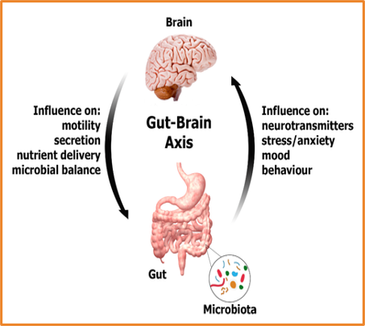
Gut Brain Axis
Physical and chemical bio-connections, gut to brain.
Vagal Nerve
Neurotransmitters
Immune Regulators
Inflammation
Microbiota

Slide 11
ANXIETY: common Neurotransmitters
CHEMICAL ACTIVATOR
ACTION
GABA
Serotonin
Norepinephrine
Atypical Antipsychotics
Homeostasis to modulate anxiety
Enhancing mood, reducing anxiety
Modulates reduction of fear / worry,
Modulates all above plus.....

Slide 12
Maintaining Wellness: 4 Pillars
Quality Sleep
Daily aerobic / anerobic exercise
Health Nutritionally Balanced Diet
Mindfulness (beyond organization and intent)

Slide 13
Stressors disrupting Lifestyle
Insomnia
Sedentary life / injury
Elevated HR/BP
Inattention, distraction
Sleep
Exercise
Diet
Mindfulness

Slide 14
ANXIETY: Pharmacology
MEDICATION CLASS
EXAMPLES
Benzodiazepine (GABA)
SSRI (Serotonin)
SNRI (Norepinephrine)
Antihistamine (Histamine 1 & 2)
Atypical Antipsychotics
Lorazepam, Xanax, Valium
Prozac, Lexapro, Wellbutrin, Zoloft
Cymbalta, Atomoxetime, Qelbree
Benadryl, Hydroxyzine
Abilify, Risperdal. Seroquel, Zyprexa

Slide 15
Attention – media – Control
Attention valued as a 21st century commodity.
Cognitive Load [data absorption] in a digital world
Data overload leading to stress and anxiety.

Slide 16
THE MUTUAL IMPACT BETWEEN COGNITIVE OVERLOAD AND CLINICAL ANXIETY
Notes:
Thank you - Dr. Alexander.
I will be discussing the mutual impact between cognitive overload and clinical anxiety.
But before I start the discussion, I would like to invite the audience to participate in an activity using numbers. Please, look for something to write on the numbers.

Slide 17
TIME - 41 seconds
Notes:
Please know that we will exit the PPT presentation to have access another tab before initiating the activity.
We are ready!
Here are the instructions:
You will have 41 seconds to write the sequence of numbers when counting down from 100 by subtracting 5 – until you reach 0.
Molly:
Ready, START!
STOP!
I ask the audience - How does having the music playing during the activity made you feel? Please write your answers in the chat box.

Slide 18
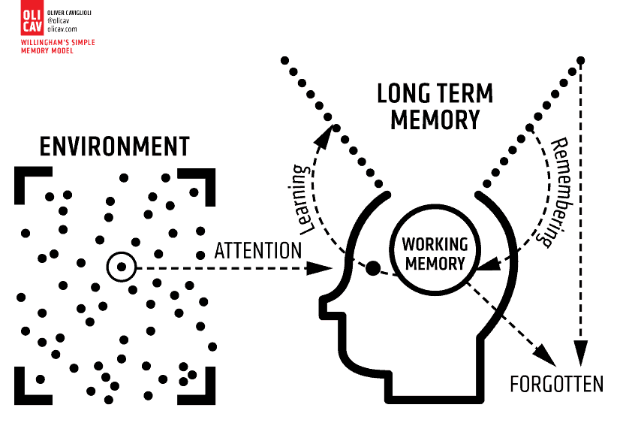
COGNITIVE LOAD THEORY (CLT)
LONG TERM MEMORY
SCHEMA REHEARSING LEADS TO
ENCODING &
STORING
ENVIRONMENT
CONSTRUCTING
SCHEMAS
SENSORY MEMORY
WORKING MEOMORY (WM)
FILTERS INFORMATION
FORGOTTEN
INFORMATION
OLI CAV Oliver Caviglioli. - Willingham’s simple Memory Model. https://www.olicav.com/posters/kfjy9acxwmmqp6sro7rqq1hwpyxn77
Notes:
I will start my presentation by discussing Educational psychologist’s John Sweller - Cognitive Load Theory (CLT) - a model of human information processing.
CLT describes memory as having 3 main parts:
Sensory memory
Working memory
Long term memory
The diagram on the slide represents CLT – it explains that when we take information from the environment through our senses it enters the Sensory Memory that is responsible of filtering out what is consider irrelevant information and passes selected information on to our Working Memory.
Working Memory is a short-term store to process new information and cognitive tasks. It can typically learn/process 5 to 9 pieces or chunks of information at any given time. Our Working Memory either forgets information or categorizes it to construct schemas for storing in our Long-term Memory.
Long-term Memory stores information “schemas”, which organize and hold information based on how we use it – for e.g. behavioral schemas – include how to drive a car or cook your favorite meal; self-schemas – include our beliefs, experiences and generalization about ourself.
The more we use/rehearse these schemas, contributes to encoding and storing, making it easier to remember them for problem solving and decision-making.
In other words, Long-term Memory is the large memory store of past events and information that has been internalized.
CLT then defines Cognitive Load as the amount of information our working memory can process at any given time.
Considering that our working memory is a limited resource – if we diminish its short-term store, we may have a harder time learning new information and completing tasks.

Slide 19
3 Types of Cognitive load
Intrinsic Load =
Inherit complexity/
difficulty of the task
Extraneous Load =
Distractions /
Irrelevant Content
Germane Load =
WM links information schemas to Long Term Memory
Notes:
In summary, CLT is all about how the intake of new information can burden our cognitive capacity, more specifically our working memory capacity.
Therefore, the higher the cognitive load the lower the percentage of information that can be stored on Long Term Memory due to the Working Memory being overwhelmed.
From an educational perspective CLT differentiates 3 types of cognitive load:
•Intrinsic load – refers to the load imposed due to the inherit complexity or difficulty of the task or information we’re trying to learn – the harder it is to understand the tasks/ the information, the heavier the cognitive load will be.
For example - some of you may feel a moderate amount of intrinsic load during this presentation if you have heard some of the information before - making it easier to understand.
In another example some of us might feel a heavier intrinsic load if we are trying to figure out how to assemble furniture based on vague instructions.
•Extraneous load – refers to the method in which the task/information is presented, refers to any external stimuli that do not contribute to the learning task itself. It includes distracting or irrelevant content, that can force out information we want to commit to long-term memory.
Examples include that while working on a task someone interrupt you to ask you a question or your smart watch vibrates with a text or working in a room that is uncomfortably hot or cold or listening to disorganized material that contains irrelevant information.
•Germane load – is a positive load – refers to the capacity of working memory to process, understand, categorize, and construct schemas to link - new information - with information in the long- term memory.
The other aspect of germane load is activation of schemas. Remember that “schemas are like scripts for a complex set of behaviors or concepts…you have schemas for almost every aspect of your life, and it helps you to process a lot of information, including new information, quickly.
For example, you have a schema for fast food restaurants.
If I mention that I am going to a fast-food restaurant for lunch and ask if you want anything, you immediately have a sense for the general type of food available and the approximate costs.
On the other hand – If I am returning from a fast-food restaurant and say that I got a tasty T-bone steak and garlic mashed potatoes, you would become confused, as that does not fit the schema for fast food.
Teachers/instructors/lecturers should attempt to activate a relevant schema to make the new information easy to process for the learner.
It would be helpful to say, “this new information is kind of like….”. This will activate a schema and reduce germane load.” (Zakrajsek, T. Apr 24, 2023)

Slide 20
3 TYPES OF COGNITIVE LOAD
space
for
UNDERSTANDING & CONSTRUCTING
SCHEMAS
space for UNDERSTANDING & CONSTRUCTING SCHEMAS
GERMANE
LOAD
GERMANE
LOAD
METHOD
of delivery – distractions/
irrelevant content
METHOD
of delivery – distractions/
irrelevant content
EXTRANEOUS
LOAD
EXTRANEOUS
LOAD
LESS
WORKING MEMORY CAPACITY
MORE
WORKING MEMORY CAPACITY
Complexity of INFORMATION
Complexity
of
INFORMATION
INTRINSIC
LOAD
INTRINSIC
LOAD
Notes:
The diagrams in this slide indicate that these 3 types of cognitive load build upon each other.
The pyramid on the left side indicates that Too Much of intrinsic and extraneous load may not leave enough Working Memory to deal with germane memory – in essence there is less Working Memory capacity.
The pyramid on the right indicates that Working Memory will be Better Able to deal with germane load considering that there is less intrinsic and extraneous load – representing more Working Memory capacity.

Slide 21
WHAT IS COGNITIVE OVERLOAD?
When demand placed on Working Memory ​
exceeds its capacity.
Notes:
Then, what is cognitive overload? Is when the demand placed on working memory exceeds its capacity.

Slide 22
What is Data / Information OVERLOAD?
The state of being overwhelmed by the amount
of data presented for one’s attention or processing
Too much data for decision making
Constant inundation of data from many sources of information
Notes:
What is Data Overload – also known as Information Overload – is “the state of being overwhelmed by the amount of data presented for one’s attention or processing – it refers not only to situations involving too much data for a given decision – which can present different complexity levels - but also the constant inundation of data from many sources of information (emails, social media, spams, online videos, news feeds, news alerts, advertising, texting, apps, etc.) that is characteristic of modern life.” (Wigmore, I., 2019)
Data / Information Overload reduces our capacity to function effectively, which can lead to:
Poverty of attention
Failure to filter out unnecessary, not wanted, or surplus information
Priority derailment – impacting productivity
Sleep disruption
Poor or impulse decisions, decision fatigue or to the inability to make
decisions – which is sometimes referred to as analysis paralysis.
(Wigmore, I., 2019)
Data / Information Overload is also known as Infobesity or infoxication.

Slide 23
Cognitive & Data / Information OVERLOAD
Can lead to:
Clinical Anxiety
Cognitive Fatigue
Information Fatigue
Avoidance Behavior
Notes:
Cognitive Overload & Data Overload are positively related to Anxiety - When an individual is confronting a cognitively overstimulated environment or being overwhelmed by data can be easily distracted, and can feel worried, stressed out, which can lead to Clinical Anxiety.
When Cognitive Overloaded an individual can also experience Cognitive Fatigue –– is when an individual challenges the limited resource of working memory by - working or studying for long hours with few or no breaks, engaging in intense training schedule sacrificing sleep and a good diet, spending a lot of time each day dealing with overwhelming responsibilities or devoting a lot of mental energy each day to thinking through problems, worries – that results in a decline in cognitive performance.
In the Data Overload context, the term Cognitive Fatigue is known as Information Fatigue.
Experiencing anxiety and cognitive / information fatigue as results of cognitive overload, can lead to Avoidance Behavior – to cope with events perceived as threatening or highly stressful.

Slide 24
COGNITIVE / DATA
OVERLOAD
ANXIETY
MEDIATED
BY ANXIETY
COGNITIVE / DATA
FATIGUE
THE EFFECT OF
COGNITIVE / DATA
OVERLOAD
Notes:
We can say that as Cognitive / Data Overload increase, so those Anxiety.
And that the effect of Cognitive / Data Overload on Cognitive / Information Fatigue is fully mediated by Anxiety.

Slide 25
DOES CLINICAL ANXIETY IMPACTS
WORKING MEMORY?
Response: Yes
Notes:
The last question we need to address is – Does Clinical Anxiety impacts working memory?
The response is YES.
It has been proven that Clinical Anxiety has harmful effects on cognitive processes, specially Working Memory.
Studies have shown that when people experience high levels of anxiety, their working memory capacity suffers – this occurs because more cognitive energy is devoted to managing the anxiety – disrupting the executive resources capacity to focus on elements of the Working Memory. (Vytal, et. al.).

Slide 26
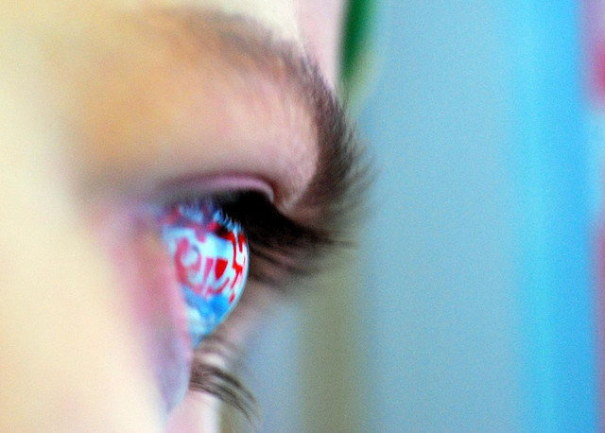
NEW BEHAVIORAL ADDICTIONS & PHOBIA
Cell Phone Addiction
Internet Addiction Disorder
Nomophobia (NO MObile PHone PhoBIA)
Fear Of Missing Out (FOMO)
Notes:
It is pertinent to highlight that the scientific community have identified new behavioral addictions – characterized by an overuse and overly dependance on the internet or other online services – these are classified as:
Cell Phone (Smartphone) Addiction
Internet Addiction Disorder, also known as Problematic or Pathological Internet Use, Compulsive Internet Use, iDisorder or Cyber Addiction,
Neither of these addictions are yet recognized by the Diagnostic and Statistical Manual (DSM) of Mental Disorders as researches need to learn more about these addictive behaviors.
However, researchers have identified a few key traits. These include:
Excessive use – typically more than 2 hours a day is considered excessive social media use and more than 38 hours a week online is considered excessive use
Common symptoms of withdrawal – such as restlessness, anger, irritability, concentration difficulties, sleep problems, and craving access to the cell phone or other device
Increased tolerance – which implies the need to increase screen time to continue experiencing the same gratifying pleasure
Interference on everyday tasks, relationships, activities, and responsibilities
Researchers are also studying a new phobia - that as well has not yet found a formal place within the DSM – Nomophobia – the fear of being out of the reach of a cell phone service or being without a cell phone – due to the cell phone being lost, broken or forgotten.
Also includes Fear Of Missing Out (FOMO) hating to feel out of the loop or thinking important news/information have been missed out.
Research so far has established that is very difficult to differentiate whether nomophobia is due to cell phone addiction or existing anxiety disorders manifest as Nomophobia symptoms.

Slide 27
(SIF)
MENTAL HEALTH CASE MANAGEMENT FORM
HOW WILL CMHC SUPPORT EMMA?
Notes:
How will the Center Mental Health Consultant (CMHC) support Emma?
By meeting Emma after being brought out to the Health and Wellness Center by the nurse after completing the Health History Form (HHF) due to Emma asking to see someone today.
Before performing the crisis intervention, the CMHC reviewed the HHF and Social Intake Form as well as the accompanying referral - both completed by the CPP counselor within 48 hours of the student’s arrival on center.
After completing the crisis intervention, the CMHC determined that Emma could remain on center as there were no risk factors/behaviors and informs their decision to the HWD and CPP counselor.
Then proceeds to conduct a comprehensive intake assessment.
From the assessment CMHC made the diagnosis of General Anxiety.
Emma experiences constant worries in a broad range of scenarios:
Financial – Their father is unemployed
Poor social support system - Just after arriving on center their boyfriend back home ended things out of the blue – Emma’s support system only consist of family members – have no friends
Difficulties with social integration – On her free time Emma is constantly immersed on the internet to avoid interactions with their JC peers or uses social media to connect with family members.
Academic – Emma dropout in 10th grade – and is struggling with understanding academic/trade lessons
To address this issues the CMHC beside offering Cognitive-Behavioral psychotherapy, teaching emotion regulation mindfulness exercises, and discussing cognitive/data overload prevention strategies, they will:
Refer Emma to the medical staff if after 3 sessions they does not demonstrate symptoms improvement - to receive an orientation on psychotropic medication options.
If medication is prescribed the CMHC is required to follow-up with Emma if
nursing staff reports that they is non-adherent.
Refer Emma to the Disability Coordinator by completing the Disability Coordinator Referral Form for the consideration of disability accommodations.
And discuss and develop with Emma’s counselor a case management plan during the case management meeting; that will be documented on the Case Management Form. Due to Emma needing support with social integration and clarification of duties/responsibilities - following the need-to-know principle - the plan will include:
The Recreational Manager since Emma indicated that she was involved in sports while in HS and
The Residential Manager

Slide 28
TO PREVENT/REDUCE COGNITVE / DATA OVERLOAD EMPHASIZE THE IMPORTANCE OF….
Breaking multitasking
habit
Filtering sources
Intentionally limiting exposure to data
Practicing intermittent digital fasting / digital detoxes
Starting and ending the day screen free
Notes:
To help Emma or other students prevent or reduce Cognitive / Data Overload centers can emphasize the importance of:
Breaking the multitasking habit: Multitasking is a significant cause of cognitive overload as it involves working on 2 or more tasks simultaneously – switching between tasks. Explain to students that when engaged in demanding or highly demanding multitasks attention divides tiring the brain making it less efficient and prone to errors, decreasing productivity, and negatively impacting the ability to make smart decisions.
Advice students to concentrate on one demanding task at a time without distractions. To avoid the temptation of engaging in digital activities - recommend students shutting off electronic devices or at least the notifications/email alerts.
Filtering sources – Invite students to evaluate the quality, relevance, and credibility of the sources before completely reading or watching them.
Intentionally limiting exposure to data - Motivate students to practice being selective about the amount of data demanding their attention. Encourage them to set aside specific times to engage in digital activities – an option to achieve this goal is using apps that limit screen time.
Practicing intermittent digital fasting or digital detoxes – By turning off electronic devices – an investing time to:
Practice recreational activities
Improve Mental Wellbeing
Connect with other people
Starting and ending the day screen free – Recommend students shutting off notifications/email alerts or better yet turning off electronic devices at least 1 hour before bedtime.
Finally, emphasize the importance of Seeking help – Strongly encourage students who are unsure how to initiate preventive actions or are unable to make changes to seek support by reaching out to their counselors or visiting the Health and Wellness Center to coordinate an appointment with the CMHC.
I have completed my participation. Molly I am turning it over to you.

Slide 29
DISABILITY ACCOMMODATION CONSIDERATIONS FOR STUDENTS WITH CLINICAL ANXIETY
Notes:
Over the next several slides I will discuss DA and support strategies to help individuals with anxiety disorder who may experience difficulties with daily living tasks

Slide 30
QUESTIONS TO CONSIDER BEFORE DETERMINING APPROPRIATE DISABILITY ACCOMMODATIONS
What limitations is this student experiencing?
How do these limitations affect the student in academics, career tech, cafeteria, dorms, recreation?
What specific tasks are problematic because of these limitations?
What disability accommodations will reduce or eliminate these problems?
Notes:
Before I get into examples of DA, it is important to take a moment to reflect on several questions to make sure you are addressing the specific needs of the student. Everyone's functional limitations will differ. How anxiety manifests for one person will not be the same in how it manifests for another person. DA consideration must be individualized and based on the individual’s functional limitations.
Remember the student with the anxiety disorder is the best person to ask about their struggles or barriers. Engage in a conversation with them. These questions can help guide your conversation.
1.What limitations is this student experiencing? – Ask them to share what struggles they have with daily living tasks. For example, do they struggle with focusing/concentrating, memory issues, completing tasks, difficulty with change just to name a few functional limitations that may be associated with someone who has an anxiety disorder.
a) Remember to think about how these limitations will affect the student in all areas on center – DA consideration should be center-wide – for someone who struggles with working memory/details is there a need
for DA in the dorm in addition to academics?
b) What are the specific tasks in the dorms that may affect an individual struggling with working memory? Is it related to remembering tasks or chores that need to be done nightly?
2.Finally, what DA can be provided to help? Do tasks/directions need to be broken down into smaller steps, give directions one at a time? Provide a visual of daily tasks. Just to list a few examples of possible DA to consider.
Contact your disability coordinator on center when considering DA for a student with an anxiety disorder so that the disability accommodation interactive process can take place.

Slide 31
Let’s Look at Some General Accommodations
Provide
…breaks for the student to use self-calming or anxiety-reducing techniques taught by the CMHC.
Allow
…the student to have a self-calming object or picture on hand.
Allow
…the student to see assigned staff mentor or go to Wellness.
Notes:
Now, lets look at some general DA that may help to reduce or remove barriers for an individual with an anxiety disorder
Provide breaks throughout the day - Is there a specific time in the day this will be needed? As we learned a person with an anxiety disorder may experience cognitive overload and taking a break to use self-calming techniques or to step outside for fresh air may be very beneficial to their daily functioning.
Allow student to have a self-calming object/fidget item or a picture that can help relax them throughout the day when symptoms of their anxiety disorder may be triggered
Allow student to talk to their identified trusted or safe person on center to help reduce anxiety symptoms when heightened.

Slide 32
Specific Functional Limitations Crowds/Groups
Allow
…student to sit in classroom where they are the most comfortable.
Allow
…student to sit near an exit or back of the room during large meetings such as assemblies.
Allow student to leave the assembly to go to a designated area for a break.
Pair
…with student buddy during group activities.
Allow
…student to leave each class a few minutes early to arrive at next location before the bell rings.
Notes:
Some ways we can accommodate for anxiety in crowds/groups…
Allow student to sit in classroom where they are the most comfortable – Knowing they can sit in the back of the classroom, near the door or near the window can ease some of the struggle/anxiety of being in a group setting.
Same with allowing the student to sit near the exit or back of the room during large group meetings or assemblies – try to be proactive in setting up possibly solutions to stressful environments to eliminate or reduce the anxiety that can be caused by being in crowds/groups
Use a buddy system to help the individual to feel safe and secure that someone is there to help guide and support them
If the congestion and noise of passing between classes causes anxiety then allow student to leave class a few minutes early to get to their next location
Some simple and reasonable adjustments to physical layout or adjustments to schedule can make a big difference in the physical symptoms someone may be feeling in crowds/groups

Slide 33
Specific Functional Limitations Crowds/Groups
Allow
Give
…student to present information just to teacher, instructor, residential advisor instead of in front of the group.
…the student an agreed upon signal before calling on them to answer or demonstrate something and/or give them option to use and “opt out” signal.
Notes:
A couple more ways to accommodate for anxiety when in crowds or groups…
If speaking to a group or in front of a class is part of their symptoms of their anxiety disorder, then allow student to present information just to the teacher instead of in front of the group or give the student an agreed upon signal before calling on them to answer questions. Maybe the student can be given an opt out signal. Keep in mind, there are many ways for a student to share their knowledge without it having to be in front of a group.

Slide 34
Specific Functional Limitations Learning-related
Provide
Check-in
Allow
…visual supports such as: planners, copies of notes, color coded tabs or highlighters for step-by-step directions.
…frequently for understanding and to check emotional temperature.
…extra time on assignments and tests (if documentation supports disability status and the specific functional limitations).
Notes:
Here we have some ways to accommodate for learning-related functional limitations related to anxiety…
Visual supports such as planners, copies of notes, color coded tab, highlighters can be very beneficial for someone who has difficulty with focusing/concentrating, memory issues, difficulty completing tasks due to their anxiety disorder
Frequently check in – they may be less likely to let you know when they are struggling so being aware of their need for check ins may be very helpful in reducing their anxiety in your setting
Allow for extra time on tests and assignments to help reduce their anxiety of time limits or their difficulty with concentrating – important to remember that documentation needs to support the need for extra time on standardized assessments and tests.

Slide 35
Specific Functional Limitations Cognitive overload
Reduce/
Eliminate
Reduce
Eliminate
…distractions from the surroundings as they take student’s attention away from the task at hand.
…visual clutter so allow for focus on the task and not distracted by visual information around them.
…other activities going on in the same area and unnecessary noise.
Notes:
Here we have some ways to accommodate for cognitive overload functional limitations related to anxiety…
Consider the surroundings:
Reduce or eliminate distractions - Distractions from the surroundings take student’s attention away from the task at hand.
Reduce visual clutter minimizing information posted on classroom walls - leaving only information that students really need to see constantly.
Provide good lighting. Allow a student to use a divider or preferential seating to avoid an area in the classroom or setting with lots of visual clutter
Eliminate any other activities going in the same area and unnecessary noises.
If students would like to play music in class – deliberately choose when – listening to music can motivate students to finish certain tasks.
But remember that playing music while working on an academic assignment can add significant extraneous cognitive load to some students.
Provide noise cancelling headphones to keep unnecessary noise to a minimal

Slide 36
avoid cognitive overload when presenting information
Highlight a clear path
Break it down into shorter deadlines
Organize information into smaller chunks
Prioritize important information
Notes:
To avoid Cognitive Overload instructors/teachers/professionals offering a lecture to students should keep in mind that organization and presentation of information make a difference.
Presenting information in a clear and concise manner - removing unnecessary information, pictures and summarizing paragraphs - minimizes visual distractions. This allows students to have extra capacity to invest in the actual learning and integration of concepts instead.
Other strategies are:
If a there are too many choices – highlight a clear path.
2. If task will take too long – Break it down with shorter deadlines.
3. If the task is too difficult – organize the information into smaller chunks– this would help students to see the different aspects of the task - reduces feelings of being overwhelmed by its volume or complexity, enabling the student to slowly gain more knowledge and draw links between each step. Also remember that the sense of accomplishment after completing each step is an incentive to work for the final goal.
4. Try to avoid presenting too much information at once – but if you are Prioritize important information.

Slide 37
Effective Supports!
Exercise as an accommodation:
Provide schedule adjustments to allow for exercising.
Open the gym during lunch.
Set up mid-morning / mid-afternoon breaks for walking or other forms of exercise.
Establish support groups for exercise purposes.
Provide movement breaks.
Notes:
Let’s talk about areas of effective supports: Exercise and on the next slide mindfulness practices. These are easily implemented supports and they are cost effective (e.g., FREE), they are portable meaning the student can take these strategies/accommodations into work and life situations after Job Corps, and they can be effective in reducing manifestations/symptoms such that the individual may be able to access and participate successfully in the program.
Provide schedule adjustments to allow for exercising.
Open the gym during lunch
Set up mid-morning / mid-afternoon breaks for walking or other forms of exercise.
Establish support groups for exercise purposes (can even be lead by student leaders and serve many purposes).
Provide movement breaks.
Think about how these accommodations may produce a side benefit in relation to other conditions - also who doesn’t benefit from exercise and movement – this is a good practice for all students and staff

Slide 38
Mindfulness practices
Mindfulness practices as an accommodation:
Provide schedule adjustments to allow for visits to CMHC to practice or learn mindfulness/other self-regulation techniques.
Start meditation and yoga groups on center that the student can spend a short time in during the day or after the training day.
Provide breaks and encourage practice of mindfulness activities.
Pair with peer buddy to encourage practice of mindfulness activities.
Notes:
What is meant by “Mindfulness”? Research supports mindfulness as a strategy for self-regulation:
Mindfulness helps a person become more aware of their feelings (not having less emotions) and this in turn, improves executive functioning and impulse control.
Mindfulness can be taught in classes, by CPP teachers, individually by counselors, in groups.
Forms of mindfulness:
Awareness of body exercises
Progressive Muscle Relaxation
Mindful eating/Mindful walking/Finding body safe spots
Awareness of breath scripts
Awareness of thoughts scripts
Awareness of perceptions in the here and now – becoming more aware of the present moment and putting focus on it can help reduce some of the anxiety about what is to come or what has happened
When practicing mindfulness • Turn off digital devices– To minimize distractions so full attention can be directed on practicing these activities.
Addressing the functional limitations for a student with an anxiety disorder and providing disability accommodations will help the student be successful in the Job Corps Program and will allow them to have strategies/tools/appropriate disability accommodations to take with them as they enter into the workforce and life beyond JC. ​
​
​Now I am going to turn it over to Dr. Alexander to share with you the Integrative Collaborative Care Model.

Slide 39
INTEGRATIVE COLLABORATIVE CARE MODEL
Behavioral change lifestyle interventions:
Physical activity, Sleep, Diet, Alcohol reduction, Smoking Cessation
Nutraceutical:
Omega-3 fatty acids, Select amino-acids/vitamins/mineral
Mind-body therapies:
Mindfulness-based techniques, Yoga, Tai Chi
Human Well Being
Conventional mental health +
medical care
Notes:
We have just presented how JC centers are implementing an Integrative Collaborative Care Model.
This model reflects the current trend of people, including JC students, seeking concurrent treatments for their mental health problems. It integrates the
Conventional mental health and medical care - appropriate prescription of psychotropic drugs and/or the provision of evidence-based psychological therapies,
Behavioral change lifestyle interventions – related to diet, physical activity, sleep hygiene, alcohol reduction, smoking cessation
Consumption of Nutraceutical ingredients – these are extracts, concentrates or combinations of vitamins, minerals, botanicals herbs, or dietary substances that “are use to supplement the diet increasing the total dietary intake”.
Practice of Mind-body therapies - mindfulness-based techniques, yoga, Tai Chi
The Integrative Collaborative Care Model also values the “collaborative” component that is based on the multidisciplinary approach where communication between its members is crucial to offer concerted integrative care services. A Multidisciplinary team at JC centers could include:
Counselors – as case managers
HW staff - CP/NP/PA, nursing staff (including Weight management program), dentist/dental hygienist/dental assistant, CMHCs, TEAP specialist, TUPP coordinators
Recreational managers/staff
Off center primary care practitioner - Medical specialists or other health professionals
JC centers go further by integrating active disability programs that consider accommodations and the use of AT for students with a disability. Disability coordinators as well as instructors play vital roles in the identification of accommodations and implementing the use of AT, respectively.
We encourage centers to keep on the good work implementing this Integrative Collaborative Care Model!

Slide 41
Health History Form
Mental Health Referral and Feedback Form​
TEAP/TUPP Ref​erral Form
Social Intake Form
Mental Health Intake Assessment Form Fillable Form
Disability Referral ​Form
Mental Health Case Management Form

Slide 42
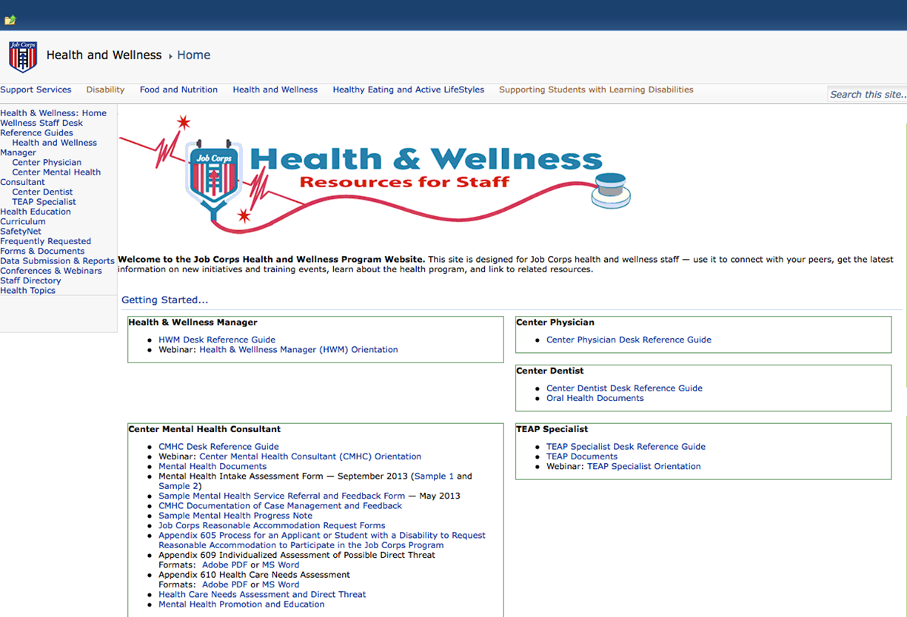
Job Corps Health Website
https://supportservices.jobcorps.gov/Health/Pages/default.aspx

Slide 43
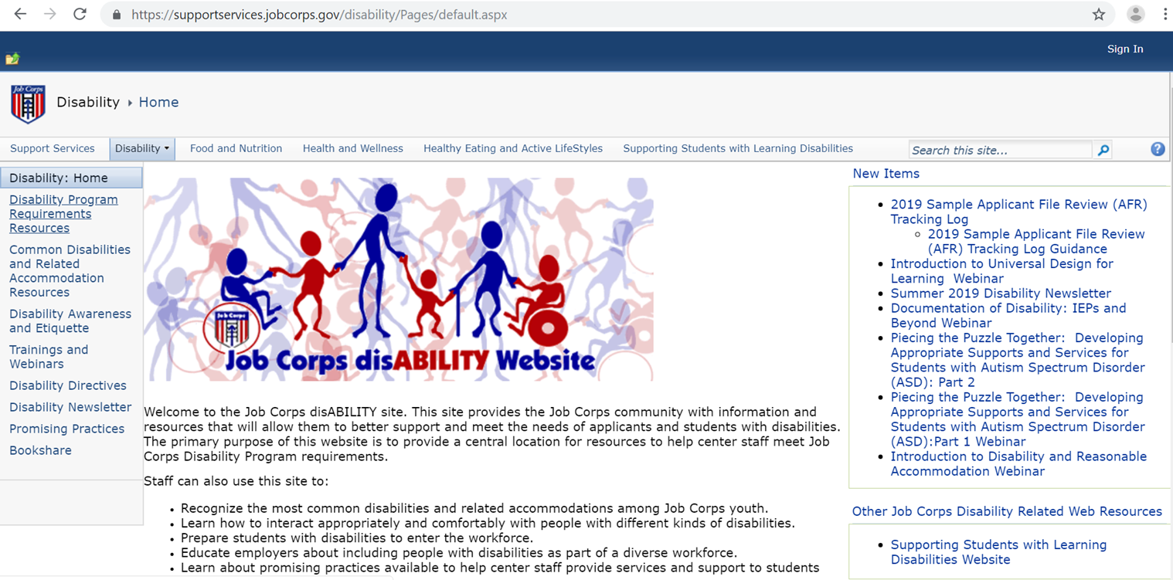
Job Corps Disability website https://supportservices.jobcorps.gov/disability/Pages/default.aspx

Slide 44
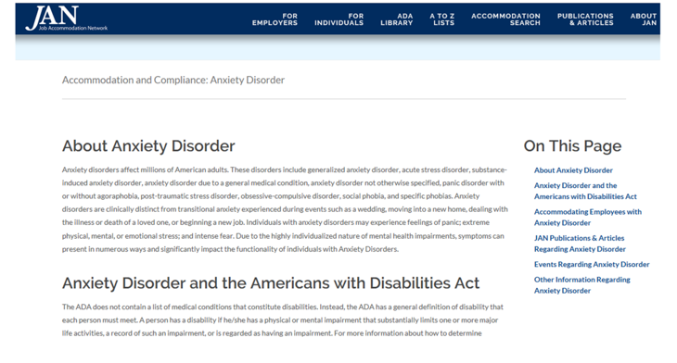
JOB ACCOMMODATION NETWORK (JAN)
https://askjan.org/disabilities/Anxiety-Disorder.cfm?cssearch=6489910_1 http://askjan.org

Slide 45
References
Anxiety disorders and GABA neurotransmission: a disturbance of modulation – PMC https://www.ncbi.nlm.nih.gov/pmc/articles/PMC4303399/
Cognitive Load Theory: A guide to applying cognitive load theory to your teaching. Medical College of Wisconsin, Office of Education Improvement. May 2022. https://www.mcw.edu/-/media/MCW/Education/Academic-Affairs/OEI/Faculty-Quick-Guides/Cognitive-Load-Theory.pdf
Cognitive Load Theory – The Definitive Guide. Becton Loveless, April 14, 2023. https://www.educationcorner.com/cognitive-load-theory/
Cognitive Overload, Anxiety, Cognitive Fatigue, Avoidance Behavior and Data Literacy in Big Data environments. Information Processing & Management. Giudice da Silva Cezar, B. & Gastaud Macada, A. Volume 60, Issue 6, November 2023, 103482. https://doi.org/10.1016/j.ipm.2023.103482
Ee, C., Lake, J., Firth, J. et al. An integrative collaborative care model for people with mental illness and physical comorbidities. Int J Ment Health Syst 14, 83 (2020). https://doi.org/10.1186/s13033-020-00410-6
Finlay, K. Getty Images. Internet Addiction Disorder: What you need to know about IAD. Last medically reviewed February 21, 2022. https://psychcentral.com/addictions/net-addiction
Fung, K., Alden, L.E., Sernasie C. Social anxiety and the acquisition of anxiety towards self-attributes. Cogn. Emot. 2021;35:680-689. https://doi.org/10.1080/02699931.2020.1868979
InnerDrive 4 Ways to overcome cognitive overload in your students. Written by the InnerDrive team/ Edited by Bradley Busch.
King ALS, Valença AM, Silva AC, Sancassiani F, Machado S, Nardi AE. “Nomophobia”: Impact of cell phone use interfering with symptoms and emotions of individuals with panic disorder compared with a control group. Clin Pract Epidemiol Mental Health. 2014;10:28–35 DOI: 10.2174/1745017901410010028 https://pubmed.ncbi.nlm.nih.gov/24669231/

Slide 46
References
Lisica, D., Koso-Drljević, M., Stürmer, B., Džubur, A., & Valt, C. (2022). Working memory impairment in relation to the severity of anxiety symptoms. Cognition and Emotion, 36(6), 1093–1108. https://doi.org/10.1080/02699931.2022.2081535.
Lukasik, K. M., Waris, O., Soveri, A., Lehtonen, M., & Laine, M. (2019). The Relationship of Anxiety and Stress With Working Memory Performance in a Large Non-depressed Sample. Frontiers in psychology, 10, 4. https://doi.org/10.3389/fpsyg.2019.00004
Meister, A. & Dael, N. Do You Have a Phone Addiction? Harvard Business Review February 12, 2024. https://hbr.org/2024/02/do-you-have-a-phone-addiction
Moran T. P. (2016). Anxiety and working memory capacity: A meta-analysis and narrative review. Psychological bulletin, 142(8), 831–864. https://doi.org/10.1037/bul0000051
Pharmacological treatment of anxiety disorders: Current treatments and future directions – PMC https://www.ncbi.nlm.nih.gov/pmc/articles/PMC3539724/
Vytal, Katherine E., Comwell, Brian R., Letkiewicz, Allison M., Arkin, Nicole E., and Grillon, Christian. (March 2013). The complex interaction between anxiety and cognition: insight from spatial and verbal working memory. Frontiers in Human Neuroscience, Volume 7, Article 93.
Wigmore, I. (2019) Definition information overload. https://www.techtarget.com/whatis/definition/information-overload#:~:text=Information%20overload%20is%20a%20state,is%20characteristic%20of%20modern%20life.
What to do when cognitive overload threatens your productivity: Today’s knowledge workers are drowning in…well, knowledge. Productivity. G. Smith & L. Parker. July 27, 2022. https://www.atlassian.com/blog/productivity/cognitive-overload
Y. Guo et al. Information avoidance behavior on social network sites: Information irrelevance, overload, and the moderating role of time pressure International Journal of Information Management (2020). https://www.sciencedirect.com/science/article/abs/pii/S0268401219308503
Zakrajsek, T. Cognitive Load: A fundamental key to student learning. The Scholarly Teacher, University of North Carolina at Chapel Hill. Updated Apr 24, 2023. https://www.scholarlyteacher.com/post/cognitive-load-a-fundamental-key-to-student-learning

