Slide 1

CMHC Orientation Part 2:
Applicant File Review (AFR)
Liz Jarski, LCSW
Regional Mental Health Consultant
July 2024
Notes:
Welcome to today’s webinar: Applicant File Review for CMHCs.

Slide 2
Objectives
1
2
3
4
List resources available for AFR guidance
Outline the 8 steps of the center AFR process
Summarize applicant interview considerations
Explain how to complete Form 2-05 Health Care Needs Assessment (HCNA)
Notes:
Here are the 4 objectives for today’s webinar. Today, we will:
Provide a list resources available for AFR guidance
Outline the 8 steps of the AFR process
Summarize important considerations related to preparing, scheduling and conducting an applicant interview
Explain how to complete Form 2-05: Health Care Needs Assessment

Slide 3
AFR Resources
https://supportservices.jobcorps.gov/health/Pages/NeedsAssessmentDirectThreat.aspx
AFR Guide for CMHCs – Part 1 Overview
AFR Guide for CMHCs – Part 2: Guidance for Form 2-04 and Form 2-05
Your RMHS is your best source of guidance for AFR.
Please reach out to us!
AFR “Tools”
Sample completed DTAs and HCNAs
Sample Applicant Interview Questions
Documents to create templates of your own
Pre-DAP Meeting Forms for DTA and HCNA
Notes:
There are many AFR resources that are available on the Health and Wellness website. The slides shows the link to the AFR web page where everything you’ve ever wanted to complete this process is available to you.
Among the resources that you will find on the website are:
A comprehensive 2-part AFR Guide for CMHCs
Part 1 of this guide provides an overview of the entire AFR process as well as guidance about reviewing documents in the applicant e-Folder, interview considerations and more.
Part 2 provides step-by-step guidance on completing Form 2-04 Individualized Assessment of Possible Direct Threat or Form 2-05, the Healthcare Needs Assessment. If you’re looking through part 2 specifically for HCNA guidance, that begins on page 22
There are also many more AFR tools available on the AFR webpage:
Sample completed DTAs and HCNAs
Sample Applicant Interview Questions, which you can use to guide your clinical interview with applicants, if you’d like
A document with the items from the ETA 653 and other sections of the HCNA so you can create templates if that is helpful for you
Documents to help guide the disability accommodation process within the AFR
Guidance and samples related to reviewing school disability documents, like IEPs, for those don’t have as much familiarity with those
These guidance documents will not cover every situation you will encounter when doing applicant file reviews. Your Regional Mental Health Specialist is always your best source of guidance for AFR. So please reach out to us to discuss any challenging scenarios or questions that come up.

Slide 4

PRH Policies Related to AFR
Chapter 1.5
Center Applicant File Review and Disability Program
Center Applicant File Review
Exhibit 1-1 Job Corps Eligibility Requirements
Form 1-06 Center File Review Forms
Form 2-04 Individualized Assessment of Possible Direct Threat
Form 2-05 Health Care Needs Assessment
Exhibit 2-4 Job Corps Basic Health Care Responsibilities
Appendix 201 Communicating with Individuals with Disabilities
Disability Program
Appendix 201 Communicating with Individuals with Disabilities
Form 2-03 Procedures for Providing Reasonable Accommodation, Reasonable Modification in Policies, Practices, or Procedures, and Auxiliary Aids and Services for Participation in the Job Corps Program
Notes:
Today’s webinar will not cover absolutely everything that you need to know about AFR. This slides shows the key PRH policies related to AFR that you need to be familiar with. And again, when you download the presentation and put in slide show mode - these are live links to take you to these policies for both Applicant File Review listed on the top of the slide and the Disability Program on the bottom.

Slide 5

AFR Outcomes
What are the possible outcomes after a young person applies to Job Corps?
Notes:
Let’s start by considering all the possible outcomes related to a young person’s application after they apply to Job Corps.

Slide 6
Application Outcomes
1. Center Enrollment
2.
3.
Recommendation
of Denial
Eligibility
Issues
Movement of Applicant Files
4.
Even with Admissions assistance
Direct Threat Assessment (DTA)
(Form 2-04)
New Information
Applicant-Initiated Withdrawal
Disability Status
Incomplete Application
Health Care Needs Assessment (HCNA)
(Form 2-05)
Residential Setting/ Hospitalization
Health Care Needs Assessment (HCNA)
Alternate Center
(Form 2-05)
Error in Initial Eligibility Review
Notes:
After Admission services electronically sends a completed application to a center via CIS (Center Information Systems), there are 10 different possible outcomes.
The first and most common outcome is that the center decides to enroll an applicant in the program. The conditional enrollment that the applicant was given after completing their application now becomes a true enrollment.
A second outcome shown in the column on the left in green is a that recommendation of denial is made. Those 3 scenarios are what we will focus on today and include the direct threat assessment, healthcare needs assessment, and referral to an alternate center.
There are third set of outcomes related to eligibility as seen in the middle column in blue.
Finally, there a set of outcomes shown in purple which are related to withdrawals, incomplete applications, the applicant being in a residential setting/hospital and errors in the initial eligibility review.
When questions related to the items in blue and purple come up, centers are STRONGLY ENCOURAGED to contact their Regional Disability Coordinator for consultation to make sure PRH policies are being followed.

Slide 7

AFR Process Steps
What are steps that centers must take when reviewing applicant files?
Notes:
Let’s look at the steps centers must take when reviewing applicant files.

Slide 8
AFR Process Steps for Centers
STEP 1
STEP 2
STEP 3
Records staff logs receipt of applicant file and tracks its movement.
HWD does initial review & approves enrollment or refers file for additional review.
HWD refers the file to one or more qualified health professionals (QHPs) for review.
STEP 6
STEP 5
STEP 4
If applicant is an individual with a disability, the disability accommodation process (DAP) must occur.
If needed, applicant is interviewed, then QHP makes decision: 1) to enroll or 2) recommend denial, or 3) refer file to region for eligibility review.
QHP(s) review file & determine whether applicant interview is needed to make an enrollment decision.
Notes:
There are 8 steps in the AFR process at the center level. Whether an applicant file needs to go through all 8 steps depends on whether the applicant is an individual with a disability. This slide shows the first 6 steps.
In Step 1, the file arrives on the center electronically and the Records department logs receipt of it from Admissions and begins tracking it as it moves through the AFR process.
In Step 2, the Health and Wellness Director does an initial review of every applicant file.
Step 3: The HWD can decide that the file needs no additional review and approve enrollment of the applicant. Or the HWD can decide to refer the file to one or more qualified health professionals (QHPs)- which may include the CMHC, for additional review. The Qualified Health Professional could include other members of wellness or outside providers, but for this presentation, we’ll be focusing on the CMHC role.
Step 4: The CMHC reviews the applicant file and determines whether an interview with the applicant is needed to make an enrollment decision. An applicant can be enrolled without an interview, but if the CMHC thinks that a recommendation of denial may be needed, an applicant interview is required.
Step 5: After conducting the applicant interview, the CMHC can make a decision to enroll an applicant or recommend denial. If you have decided to recommend denial, this is when you would start to complete Form 2-05 HCNA or Form 2-04 DTA. If the applicant is NOT an individual with a disability, the AFR process stops after Step 5.
If, however, the applicant IS an individual with a disability, then in Step 6 the disability accommodation process or DAP for short must occur.

Slide 9
AFR Process Steps for Centers
STEP 7
STEP 8
QHP(s) who recommend denial consider whether accommodations would sufficiently remove or reduce barriers to enrollment.
Recommendation of denial using Form 2-04 or Form 2-05 is forwarded to the Regional Office (RO) for review. RO makes final determination of the applicant’s status.
Notes:
In Step 7, the decision is made to recommend denial, and you must consider whether the disability accommodations identified would sufficiently remove or reduce the barriers to allow the applicant to enroll. If the answer is no, they would not, then you would finish up the HCNA or DTA.
Step 8 is when the file is finished at the center and submitted for Regional Review. There it is reviewed by both the disability team and the health team. The Regional Office makes the final decision about the applicant’s enrollment status.
In step 7, you have made a decision to recommend denial, and you consider whether disability accommodations would sufficiently remove or reduce the barriers to enable the applicant to enroll. If this answer is no, the disability accommodations would NOT sufficiently remove or reduce the barriers to enrollment, then you would complete Form 2-05 or Form 2-04 and, in Step 8, submit the recommendation of denial to the Job Corps Regional Office. There the recommendation of denial goes through the 2-step review process -administrative review with the disability team and then a clinical review with the health team. The Regional Office then makes the final determination about the applicant’s status.
So, as you can see, there are many steps involved but it does become easier the more you do it..

Slide 10
Timelines
The applicant’s e-Folder must be processed within 30 calendar days from receipt by center per the PRH.
You should be assigned the file no later than 3-4 days after it is made available to the center.
  An extension can be requested from the center’s Regional Program Manager.
  However, waiting for outside records is not justification enough.
If the file is in “Regional Review” and has been returned for completion of some process concern or clinical issue, the file must be completed and returned to the sender within 10 business days.
Notes:
A few timelines to be aware of:
The entire AFR process that we just outlined must be completed by a center within 30 calendar days from receipt of the file, per the PRH
In order to make this happen, you’ll want to get access to the folder as soon as possible, definitely within 3-4 days after it’s arrived on center.
If it is going to take your center longer than 30 days to complete the file review, a request for an extension can be made to the Regional Office. However, waiting on outside records is not enough of a reason to justify an extension for a file. It is important to start your file review early in the 30 days so that you can conduct the applicant interview and determine if you need additional records, as we all know it can take providers sometimes up to several weeks to process those requests and get the records to you.
Another timeline to be aware of is that if you get a request for additional information or corrections from the Regional File Review team, you have 10 business days to get that completed and returned for review.

Slide 11
Recommending Denial of Enrollment
Direct Threat to Others
Health Care Needs
The applicant poses a direct threat (significant risk of substantial harm).to the health or safety of others, including students and staff. Risk cannot be eliminated or reduced by disability accommodations
The applicant has mental health care needs that exceed what can be provided at Job Corps as part of Basic Health Care Responsibilities (Exhibit 2-4)..
Use Form 2-04 Individualized Assessment of Possible Direct Threat
Use Form 2-05 Health Care Needs Assessment
Notes:
As you are completing your file review, it’s important to know that there are 2 and only 2 reasons that centers can recommend that an applicant be denied enrollment in Job Corps.
The first is if the applicant’s condition or disability poses a direct threat to others. One of the eligibility criteria for Job Corps is that an applicant not pose a direct threat to the health or safety of others, including students and staff. Federal disability nondiscrimination laws define a “direct threat” as a significant risk of substantial harm to the health and safety of others that cannot be eliminated or reduced by disability accommodations. This federal definition of direct threat only includes a threat of harm to others, not self.
The other, and far more common, reason to recommend denial is if the applicant has mental health needs that exceed what can be provided at Job Corps as part of the Basic Health Care Responsibilities outlined in Exhibit 2-4. For the Mental Health and Wellness Program (MWHP) these basic services include:
Short term counseling
Referral to center support groups
Crisis intervention
Referral to off-center providers, if available
Access to prescription medication is also included in basic health services on the medical side.
So if what the applicant needs to manage their mental health is beyond these services, you may consider a recommendation of denial.
Applicants cannot be denied enrollment due to academic needs or deficits, accessibility issues, or perceived inability to complete part of the program (like earning their high school diploma or completing a trade).

Slide 12

Considerations for the Applicant Interview
What are some things to consider when preparing for, scheduling, and conducting an applicant interview?
Notes:
It’s important to remember that the review of each applicant must be an individualized assessment. There are no symptoms or diagnoses that would lead to an automatic denial for an applicant. If after reviewing any available records, a CMHC is considering making a recommendation of denial, an applicant interview must be conducted and is the most important part of the AFR process.

Slide 13
Applicant Interview Requirements
  The interview is the most important part of your assessment
  particularly if there are no records or other documents to review.
The applicant interview must be interactive
REQUIRED for all recommendations of denial.
A decision to enroll an applicant can be made without conducting an interview.
MUST be conducted by the CMHC for recommendations of denial related to mental health and/or behavioral difficulties.
Should NOT be conducted as part of the Disability Accommodation Process (DAP) for legal reasons.
Notes:
The applicant interview is ESSENTIAL for putting all of the information from the file review into current context and make a determination about the need for a recommendation of denial. It is the single most important part of your clinical assessment, particularly if there are no records or other documents to review in the applicant file. In that case, the basis for and the strength of the recommendation of denial will rest solely on the quality of the interview.
3 things that you should know about the interactive clinical interview are that:
It is required if you are submitting a recommendation for denial. An HCNA cannot be completed and submitted if you did not interview the applicant.
If a recommendation of denial is being made to due to health care needs related to mental health and/or behavioral difficulties, the health care needs assessment, including the applicant interview, must be conducted by the CMHC.
Applicant interviews should NOT be completed as part of the Disability Accommodation Process (DAP). The applicant assessment and DAP, or consideration of disability accommodations, are two separate processes and must be so for legal reasons. BUT, it is often helpful to schedule the DAP immediately following the applicant interview to minimize difficulties with scheduling and to reduce the burden on the applicant.
What that can look like is the CMHC completing the clinical interview, and then letting the applicant know that the interview portion of the call is complete, and that the discussion will now shift to possible accommodations related to their healthcare needs. It must be clear that these are 2 separate pieces.

Slide 14



Applicant Interview Format
In person
Videoconference
Telephone
Consider doing a video-based or in person interview if you anticipate that an applicant may have communication difficulties due to a cognitive limitations and/or speech or language problems.
More complete assessment
More options for providing communication accommodations
Notes:
Applicant interviews can be conducted in person, by videoconference, or by telephone.
Videoconference and in-person interviews are encouraged, so that you make direct observations of the applicant’s appearance and behavior and get a more complete picture of the applicant and how they are functioning. A video-based or in person assessment should be considered if you anticipate that an applicant may have communication difficulties due to cognitive limitations and/or speech or language problems. These formats allow you to do a more complete assessment and it gives you more options in terms of providing communication accommodations such as writing down questions or allowing the applicant to respond by writing. We’ll talk more about communication accommodations in a few minutes.

Slide 15
Scheduling Applicant Interviews
Make at least 2 attempts to schedule an interview with an applicant.
Unable to reach an applicant? Contact the Admissions staff for assistance.
  Try all the telephone numbers provided on the ETA 652 Job Corps Applicant Data Sheet.
  Leave messages with specific timeframes and a deadline to return your call.
Found at the top of the ETA 652 Job Corps Applicant Data Sheet.
Email is recommended for ease of documentation.
Provide Admissions staff with specific days/times when you are available to interview the applicant.
Document your efforts to reach the applicant & your contacts with Admissions staff.
Ask your HWD about how to document AFR activities at your center.
Notes:
When scheduling an interview with applicant, you must make at least 2 attempts to reach them.
Be sure to try all of the telephone numbers provided on the ETA 652 Job Corps Applicant Data Sheet.
When leaving messages for applicants, provide specific timeframes and a deadline for returning your call (Please give me a call back between the hours of 8 and 5, and I’ll need to hear back from you by Friday, April 5th)
If you are unable to reach the applicant to schedule an interview – if, for example, none of the numbers on the ETA 652 work or the applicant has not returned messages -- contact the applicant’s Admissions staff person for assistance. The name and phone number of the admissions staff person an be found at the top of the ETA-652. We recommend using email for contacting Admission staff and email addresses can be found in Outlook in the email directory. In your message to Admissions staff, you should provide specific days/times when you are available to interview the applicant and request their assistance with making contact.
You need to make sure you document your efforts to reach the applicant and any contacts that you have with Admissions staff. Ask your HWD how AFR activities should be documented at your center – it could be on a SF-600 Form, a center-specific tracking log, or in some other way.

Slide 16

Interviewing Minors
Consent for a pre-enrollment interview is signed as part of the application process, so there is no need to obtain additional consent, but limits of confidentiality should be explained.
Scheduling an interview: invite a minor’s parent/guardian to participate, but their participation is NOT required.
Politely ask the parent/guardian to wait to provide their input AFTER the applicant has an opportunity to respond to each question.
  Do this at the beginning before the interview starts.
  Provide reminders as needed.
  Also applies to applicants with cognitive and/or language difficulties.
Notes:
Here are also a few considerations when it comes to interviewing minor applicants and those applicants with cognitive and/or language difficulties
During the application process, the applicant or the parent/guardian of a minor applicant, signs a consent for a pre-enrollment interview. So there is no need for you to obtain additional consent.
When scheduling an interview with a minor applicant, the parent/guardian should be invited to participate, but the participation of the parent/guardian is not required. It is required that the applicant participate in the interactive components of the AFR process- which includes the interview and DAP. These cannot be completed without the applicant.
If the parent/guardian chooses to be on the phone or in the room during the interview, politely ask them to wait to provide their input until AFTER the applicant has an opportunity to respond to each question. Explain that this is important so that you can see how well the applicant functions independently since they will be expected to function independently at Job Corps.

Slide 17

Conducting an Applicant Interview
Communication Accommodations
Determine if the applicant or parent/guardian may need communication accommodations, including translation services.
Nondiscrimination regulations mandate that centers communicate effectively with applicants with disabilities during the application process.
Simplify language/rephrase question
Give extra processing time to both absorb info & respond to questions
Use slower rate of speech
Ask the applicant to repeat back information to confirm understanding
Provide handouts of questions and information
Allow written communication/responses
Interview face-to-face in lieu of phone
Use pictures or other symbols to convey meaning
Use interpreters, hearing assisted devices, text-to-speech technology
Notes:
While scheduling the interview and during the first few minutes of the interview, try to determine if the applicant or the parent/guardian of the applicant may need communication accommodations, including translation services.
You can do this by:
Listening carefully to the applicant’s speech and language – how they express themselves and how well they seem to understand and respond to the questions being asked.
This is important because as part of nondiscrimination regulations, centers are required to communicate effectively with applicants with disabilities during the application process so that an applicant can participate in the process to the maximum extent possible.
Examples of communication accommodations that you can provide to applicant are listed on the slide and include things like using simpler language, allowing written responses, checking for understanding. The AFR Guide Part 1 has more details about communication accommodations that you can review.

Slide 18
Preparing for an Applicant Interview
You can only ask about
DISCLOSED
mental health diagnoses, conditions, symptoms, and behaviors
Asking about non-disclosed information could constitute unauthorized collection of data, potentially resulting in an admissions process that is biased and unfair
(Program Instruction 14-24)
You need to prepare for the applicant interview by carefully reviewing all the relevant information in the applicant’s e-Folder so you know what to ask about during the interview.
Notes:
When conducting an applicant interview, you can only ask an applicant about disclosed diagnoses, conditions, symptoms and behaviors. These may be reported on the ETA-653 or found in other records in the applicant e-folder which may include medical or mental health records, school disability documents, or CCMPs. Asking about undisclosed information can potentially be seen as making the process biased and unfair.
You need to prepare for the applicant interview by carefully reviewing all the relevant information in the applicant’s e-Folder, so you know what to ask about during your interview. There is a detailed section in the AFR Guide for CMHCs Part 1 that discusses reviewing documents in the applicant e-Folder in CIS as well as guidance about conducting the interview itself, and I encourage you to look through this section.
One of the resources that I mentioned at the beginning of the webinar is the Sample Applicant Interview Questions. This tool was specifically developed to help CMHCs capture the information needed to support a recommendation of denial. We recommend using these questions, or at least being familiar with them, so you have an idea of the types of questions that may be helpful to ask.
Some CMHCs focus their interview on the diagnoses and treatment history. While this is very important, we also encourage you to also ask questions about their school and work history. Questions about why they are no longer attending school, how they have gotten along with people at previous jobs, maybe why they were fired from their most recent job can provide a lot of insight into how the applicant is doing and may provide information to support the recommendation of denial.

Slide 19

Conducting an Applicant Interview
  Focus on CURRENT*
  symptoms, behaviors and functioning
  Frequency severity, and chronicity
  Whether/how symptoms interfere with functioning
  Current treatments and adherence
  Coping strategies
  A recommendation of denial cannot be based on historical information.
  The applicant must have current symptoms and behaviors that require treatment now.
* past 6 to 12 months
19
Notes:
During the interview, ask about all disclosed behaviors and conditions that may be relevant in evaluating whether the applicant poses a direct threat to others or has health care needs that exceed what Job Corps can provide. This includes asking about potentially sensitive information such as involvement with the criminal justice system and inappropriate sexual behaviors, so consider in advance how you approach sensitive topics.
If new mental health/disability information or legal involvement is disclosed during the interview that was not reported on the ETA-653 or in records, then you can and should ask follow-up questions about the newly disclosed information.
The applicant interview should focus mainly on the applicant’s current functioning by looking at their symptoms and behaviors. By current, we generally mean the past 6 to 12 months. But the closer to the time of the interview, the better.
When symptoms or behavioral concerns are disclosed, you’ll want to gather more information about them. Specifically:
How frequently do symptoms occur, how severe are the symptoms?
Whether or how the symptoms and behaviors are interfering with current functioning (so are they having difficulty with social behavior, managing stress, regulating emotions? And what does this look like for them?)
Do they have any current treatment and how adherent are they with the treatment program (do they take their meds and attend their appts)?
What are the applicant’s coping strategies? How does the applicant manage their symptoms? Remember that not everyone who is experiencing symptoms requires ongoing treatment.
The reason it is so important to focus on specific symptoms and behaviors the applicant is CURRENTLY experiencing is because a recommendation of denial cannot be based on historical information alone.

Slide 20
Recommending Enrollment
Notes:
After you’ve completed your interview- you have two choices
Recommend enrollment for the applicant
Make a recommendation of denial
Let’s talk briefly about how to document a recommendation of enrollment.

Slide 21
Recommending enrollment for an applicant
There are a few times during the the AFR process that you may recommend that an applicant be enrolled in the program:
  During the initial review of the file
  Following an applicant interview
Documenting a recommendation of acceptance can occur in several ways:
  The SF-600, lined progress note form
  A file review form used by your center
  A document or form you create
    Documentation related to the acceptance of an applicant should be placed in the Student Health Record (SHR) upon their arrival on center.
Notes:
There are two main times in the AFR process that you may recommend that an applicant be enrolled to the Job Corps program.
The first is during the initial review of the file- You may review the ETA-653 and then all available medical and disability documents, including the CCMP, and decide that you need no further information to make a decision and recommend enrollment for the applicant.
Or after you review all the records, you may not be sure about the current healthcare needs of the current. You would then conduct an applicant interview, and may decide that the applicant’s healthcare needs are manageable with the services available at Job Corps, and that they should be enrolled in the program.
Documenting a recommendation of enrollment can occur in several ways:
The SF-600, lined progress note form
A file review form used by your center
On a word document or form you create
You’d just include a brief summary of your review of the file and your interview, and include your recommendation that they be accepted to the program.
*Regardless of how it is documented, it should be placed in the student health record when that student arrives. Make sure it’s being documented on a form that remains in wellness and is not circulated anywhere else on center.

Slide 22
Completing Form 2-05
Step-by-Step Guidance
Common Mistakes to Avoid
Notes:
The other scenario is that after talking with the applicant, you may feel that a recommendation of denial is needed. Either because they pose a direct threat to others or because their healthcare needs are more than what can be provided for at Job Corps.
We’re going to focus the remaining time on the denials due to healthcare needs, by walking through form 2-05, the Healthcare Needs Assessment.

Slide 23
Document Communication Accommodations
Interview Conducted By: ☐Telephone ☐ In Person ☐ Videoconference
List/explain any reasonable accommodation, reasonable modification to policies, practices, or procedures and auxiliary aids and services to include effective communication supports/accommodations offered and/or provided during the applicant file review process (applicants), and/or completion of the health care needs assessment process (applicants/students). If not provided, please explain below. See Form 2-03, Procedures for Providing Reasonable Accommodation, Reasonable Modification in Policies, Practices or Procedures and Auxiliary Aids and Services for Participation in the Job Corps Program.
The applicant was provided with communication accommodations including: repetition and rephrasing of questions, simplified language, and additional time for responses. OR - Applicant did not exhibit any difficulties in communication or comprehension and no communication accommodations were needed.
The first item must be completed to document any communication supports or accommodations that were offered or provided during the AFR process. DO NOT leave this box blank!
Notes:
On the next several slides, we’re going to be looking at specific sections of the HCNA form and reviewing how to complete them.
At the very beginning of the document, you check one of the boxes to indicate how the interview was conducted – by phone, in person, or via video conference.
The first box on the HCNA is related to communication accommodations that were provided to the applicant during the file review process. This box must be completed to document any communication supports or accommodations (RA/RM/AAS) that were offered or provided during the AFR process or to explain why they were not provided. DO NOT LEAVE THIS BOX BLANK. It must indicate whether the applicant was provided with any communication accommodations.
We have a couple examples here of how this box could be completed. The first is an example where the applicant did need communication accommodations, which included things like using simplified language and repeating questions.
The second example is one where the applicant was able to communicate effectively and comprehend the questions being asked, so was not in need of any communication accommodations.

Slide 24
HCNA Question 1A
Summarize the Clinical Information that forms the basis for your recommendation of denial.
4 Sources of Clinical Information:
ETA-653 Job Corps Health Questionnaire items
Applicant File Review Summary
Chronic Care Management Plan (CCMP) Provider Form
Applicant Interview Summary
Notes:
As you know, the HCNA can be used for both students and applicants. Today, we will focus on it’s use for applicants, which is covered in question 1A. You will leave the boxes in Question 1B blank.
Question 1A is where you summarize all the information in the file and the applicant interview that serves as the basis for your recommendation of denial. There are 4 sources of clinical information that are summarized in this section:
the ETA-653 Job Corps Health Questionnaire
the summary of your review of all the applicant’s records
the summary of the content of the Chronic Care Management Plan or CCMP, if there are any
and the summary of your applicant interview.
In many cases, you will not have all 4 pieces of information. Some files will not include medical records or disability documents. Some files will not include CCMPs, particularly if the applicant is not currently receiving treatment from any providers.
In the cases where there are no records or CCMPs, your applicant interview summary needs to be particularly strong.

Slide 25
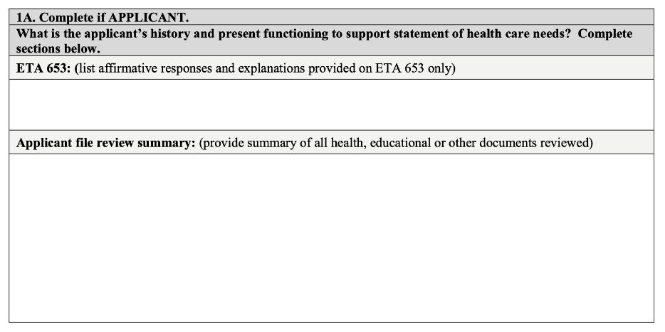
HCNA Question 1A
Notes:
Here is a screenshot of the first part of Question 1A that shows where to summarize the ETA 653 and your record review. For each section of the form, there are instructions listed for you in the gray bars.

Slide 26
Question 1A: ETA 653 Health Questionnaire
Just list the items as they are
Do list all relevant items marked “yes” on the ETA-653
Do include explanations that are relevant to the recommendation of denial.
Do NOT add to or embellish the items in any way, such as including information from the records.
Notes:
The ETA 653 section is one of the easiest to complete.
For this section:
List the items the applicant endorsed (marked “yes”) on the ETA-653 that are relevant to the recommendation of denial.
Also include comments and explanations from the ETA-653 form, if related to the recommendation of denial. If it only says something like, “see records,” you don’t need to include that.
Do NOT add to or embellish the items in any way, such as including information from the records. Just state exactly what the responses on the form are.

Slide 27
ETA 653 Example
1A. Complete if APPLICANT.
What is the applicant’s history and present functioning to support statement of health care needs? Complete sections below.
ETA 653: (list affirmative responses and explanations provided on ETA 653 only)
Has been prescribed medication (Zyprexa 2.5 mg twice daily, hydroxyzine 50 mg as needed every 6 hours, trazodone 100 mg at bedtime) Is still taking medications listed above Sees a counselor for a mental health issue, weekly (Sees counselor “Jackie” at Meridian Behavioral Health every 2-3 weeks) Behavioral and Mental Health Conditions: Anxiety Attention Deficit/Hyperactivity Disorder (ADD or AD/HD) Bipolar Disorder (Anxiety and Bipolar Disorder were diagnosed during hospitalization in 2023. ADHD diagnosed in elementary school, does not take any medications for this.)
Notes:
Here is an example with the ETA 653 section completed. As you can see, only a few items the applicant marked with a “yes” response are listed here, along with the comments from the admissions staff.
You can see that only items related to the applicant’s mental health are included in this list, though they may have marked “yes” to other items on the form. Remember, you only have to include those items that are related to the reason for denial.

Slide 28
Applicant File Review Summary
  Review all medical records and non-health disability documents in the e-folder.
  Only summarize those records that are recent (last 12 months) and relevant in supporting the recommendation of denial.
    These may include:
Medical records
Mental health records
School disability documents (IEP, 504 Plan, Behavior Intervention Plans, etc.)
Just list all other other documents that are not recent or relevant to the recommendation of denial.
University Behavioral Health records, 6/30/22 to 7/15/22
Jonestown Medical Clinic, primary care provider, 6/1/20 to 2/6/22
Example:
Notes:
The next section is the Applicant File Review Summary (also known as the “record review”). In this section, you provide a summary those records that are recent (generally the last 12 months) and relevant to the recommendation of denial including
Medical and mental health records
School disability documents (IEP, 504 Plan, Behavior Intervention Plans, psychoeducational evaluations, etc.)
Now all records in the file may not be relevant for your recommendation of denial. An example might be records from a primary care provider that contain no or very little mental health information. Or records from a hospitalization 2 years ago. In cases like these, you just list the title of the document or the record source, to indicate that it was reviewed. A general header, with date or date range, for each record source is sufficient. Examples are shown in the purple box on the slide.

Slide 29
Recommendations for Summarizing Records
Use bullets to summarize information. Create a header for each document with dates, type of document, and name of the facility/provider. List documents in reverse chronological order (most recent document first). For medical/mental health records, include: Significant history (usually in the “Presenting Problem,” “Chief Complaint,” or “History of Present Illness (HPI)” section) Diagnoses Current medications and adherence Hospitalizations/self-harm behaviors Assessment/Plan (follow-up, medication changes, referrals) | Don’t recreate entire medical records. Summarize the most relevant information only. Don’t write “See enclosed.” All relevant information must be summarized on the form. Don’t include any information about CCMP(s). There is a separate section for CCMPs. Don’t summarize records that are not recent or relevant to the recommendation of denial.
Notes:
Here are some recommendations about how to summarize records.
A few key takeaways:
Do not write “see enclosed.” You must summarize all relevant information in the File Review Summary itself. The HCNA must be able to stand on its own without reference to any other documents. Think of it this way: if an applicant wanted to appeal their denial, the HCNA is going to be the primary document used to defend the recommendation of denial.
Don’t recreate entire medical records. Summarize the most relevant information only.
Don’t spend your time summarizing records that are either old or irrelevant to the recommendation of denial. Focus your efforts instead on summarizing just those recent records that contain evidence of the applicant’s current functional limitations/symptoms/behaviors. If a summary of only one or two included record sources captures that evidence, then that is sufficient.
We recommend that you create headings for the different documents reviewed, and use bullet points to organize the information.

Slide 30
Applicant File Review Example
Applicant file review summary: (provide summary of all health, educational or other documents reviewed)
Mercy Psychiatric Hospital, 12/1-12/10/23 Reason for admission: Suicidal ideation and self-harm History of Present Illness: Applicant has been hospitalized 3 times in the past 2 years for suicidal ideation. Has been trialed on multiple psychiatric medications, not currently taking any medication or in therapy. Diagnoses: Major Depressive Disorder, moderate, recurrent episode; Generalized Anxiety Disorder Plan: intake for therapy and medication management at Mercy Outpatient,12/15/23 9/20/23 IEP Transferred to alternative high school in August 2023 due to poor school attendance Eligibility category: Learning Disability Current Behavioral Concerns: poor school attendance, often behind on assignments and requires staff support to organize/prioritize tasks and catch up on missing work. Difficulty initiating tasks, requires prompting to begin or continue working. Without support, they become upset and will shut down or walk out of the classroom. Mercy Outpatient Psychiatry, 10/1/20-6/1/21 Hometown Health, primary care, 1/1/20-11/1/22
List, don’t summarize, records that are not recent or relevant!
Notes:
Here is an example of an applicant file review section with our recommended formatting. You can see that it includes bullets, headers with dates and document descriptions, and the newest items are listed first.
This example summaries for two record sources for the applicant- a recent hospitalization, which is also the most recent mental health record available, and the applicant’s current IEP plan. Both of these documents provide information about the current concerns/symptoms/behaviors that are barriers to the applicant enrolling at Job Corps.
At the bottom of this section, the additional records that were in the applicant’s e-folder are simply listed. These are both older record sources and therefore, have very little impact on our assessment of the applicant’s current functioning.

Slide 31
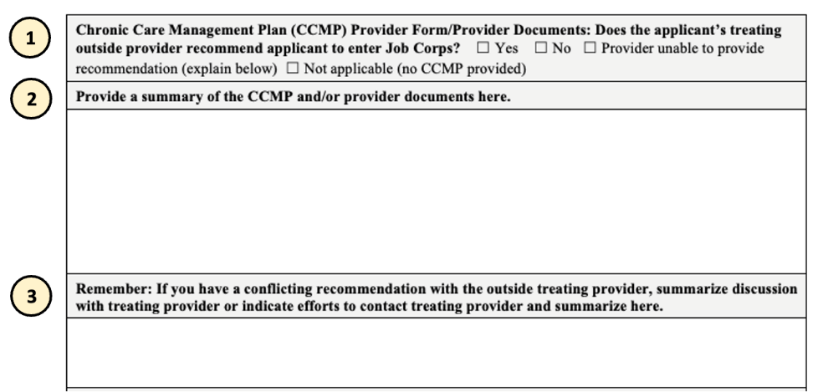
Question 1A: Chronic Care Management Plan (CCMP)
The CCMP section has 3 sections.
Notes:
After you’ve completed the record review, the section for summarizing Chronic Care Management Plans or CCMPs is next. This has 3 sections and each spells out exactly what information is needed.
Let’s look at each section.

Slide 32
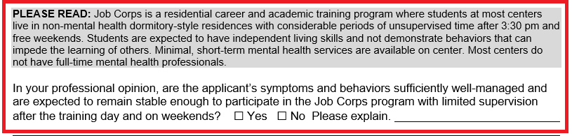
CCMP - Section 1
Chronic Care Management Plan (CCMP) Provider Form/Provider Documents: Does the applicant’s treating outside provider recommend applicant to enter Job Corps? ☐ Yes ☐ No ☐ Provider unable to provide recommendation (explain below) ☐ Not applicable (no CCMP provided)
To answer this, look at the final question on the CCMP:
Notes:
For the first section, the instructions state: Does the applicant’s treating outside provider recommend applicant to enter Job Corps?
This question refers to the last question of every CCMP, shown here in the red box.
Specifically it states:
In your professional opinion, are the applicant’s symptoms and behaviors sufficiently well-managed and are expected to remain stable enough to participate in the Job Corps program with limited supervision after the training day and on weekends? ☐ Yes ☐ No Please explain.
Just above the question shaded in gray is a brief description of Job Corps to provide some context for the question because there are a lot of misconceptions among providers and those in the community about what Job Corps is and what centers can provide.

Slide 33
CCMP – Section 1
Chronic Care Management Plan (CCMP) Provider Form/Provider Documents: Does the applicant’s treating outside provider recommend applicant to enter Job Corps? ☐ Yes ☐ No ☐ Provider unable to provide recommendation (explain below) ☐ Not applicable (no CCMP provided)
Check one of the boxes to indicate whether the applicant’s provider recommended the applicant to enter Job Corps in the last question of the CCMP.
Yes = Provider recommended applicant
No = Provider did not recommend
Provider unable to provide recommendation (explain below)
Not applicable = No CCMP provided
A box must be checked even if there is no CCMP.
Notes:
To complete this section, there are 4 checkboxes for you to choose from:
Yes = Which you would mark if on that last question of the CCMP, the provider marked “yes”
No = Provider marked “no”
Provider unable to provide recommendation (explain below)
Not applicable = No CCMP provided
Note that a box must be checked even if there is no CCMP in the e-Folder.

Slide 34
CCMP – Section 1
Provider unable to provide recommendation (explain below)
There is no response to the last question of the CCMP (left blank or omitted).
Provider writes in a response like “unsure.”
The provider sent a letter or memo rather than a CCMP.
For the explanation, write something like:
“Recommendation question was left blank.”
“Provider did not check a box and wrote in ‘unsure’.”
”Provider provided a letter rather than a CCMP.”
Notes:
You may be wondering when you would check the box for “provider unable to provide recommendation”?
There are at least 3 situations when you would check this:
There is no response to the last question (left blank or omitted).
Provider writes in a response like “unsure.”
The provider sent a letter or memo rather than a CCMP, so there is no yes or no to the question of entering Job Corps
For the explanation section, write something like:
“Recommendation question was left blank.”
“Provider did not check a box and wrote in ‘unsure’.”
”Provider provided a letter rather than a CCMP.”

Slide 35
CCMP - Section 2
Provide a summary of the CCMP and/or provider documents here.
Provide a summary of the CCMP or another provider document
Use bullets to summarize the most relevant information in the CCMP
A letter from a provider should be treated the same as a CCMP.
Notes:
Once you’ve made a selection, you move on to the second section, where you provide a summary of the CCMP form or other provider document.
Again, we recommend using bullets to summarize the relevant information in the CCMP. I’ll show you an example in a moment.
Remember that a letter, memo or any other kind of narrative document from a provider should be treated the same as a CCMP and summarized in this section.

Slide 36
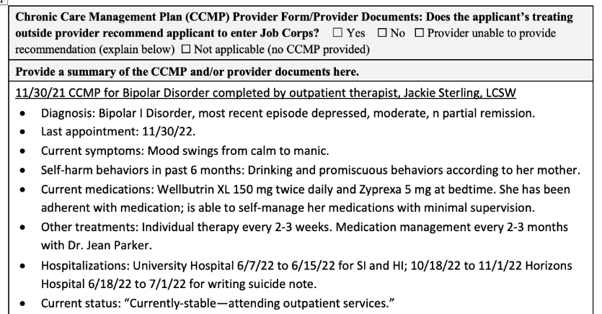
CCMP Summary Example
X
TIP: Use the AFR Tools- Form 2-05 HCNA Template Items, to pull all the “stems” into your HCNA.
Notes:
Here’s an example of a CCMP Summary. I just included the first few questions in this screenshot so that we can read it better. In your summaries, you’ll include all the relevant information from the provider.
A tip to help you complete this section more quickly, is to use the document called “AFR Tools- Form 2-05 HCNA Template Items,” which has stems for all the questions on the CCMP. You can then copy and paste this into the HCNA rather than typing them out every time.

Slide 37
CCMP - Section 3
Remember: If you have a conflicting recommendation with the outside treating provider, summarize discussion with treating provider or indicate efforts to contact treating provider and summarize here.
If the provider recommends the applicant for Job Corps (marks the “yes” box for the last question of the CCMP), contacting the CCMP provider to discuss their recommendation is required.
Why? Because the provider’s recommendation differs from yours, and presumably the provider knows the applicant better than you as the CMHC (but, of course, the provider does not know Job Corps as well as you do).
You must make at least 2 efforts to contact provider.
Summarize your discussion with provider (including the date and name of the provider) OR document at least 2 efforts to reach provider.
Notes:
The third part of the CCMP section instructs, “If the provider recommends the applicant for Job Corps (by marking the “yes” box for the last question of the CCMP), then contacting the CCMP provider to discuss their recommendation is required.
You’ll need to make at least 2 attempts to contact the provider. And then include a summary of your discussion with the provider, or document these 2 attempts in this section.
What is the purpose of contacting the provider? The purpose is two-fold:
The first is to provide education about Job Corps and discuss the provider’s recommendation. You will want to inform them about the limited mental health services available to students in an EAP model and share whether or not community mental health services are available in your area. You will want to provide education about the limited supervision for medication administration and activities of daily living (ADLs). And then ask if based on this information you have provided about Job Corps, would the provider still recommend the applicant for the program?
You will also want to clarify or get more information about unclear or one-word responses on CCMP, particularly how stable the applicant’s current symptoms are, prognosis with and without treatment, and ongoing treatment needs. Be sure to ask about any restrictions/limitations and accommodation recommendations.
The purpose is not necessarily to get the provider to change his/her mind. It’s OK if the provider still recommends the applicant for Job Corps after your brief discussion. The point is that your recommendation conflicts with that of the provider, and you reached out to get a better understanding of why this might be the case.

Slide 38
Remember: If you have a conflicting recommendation with the outside treating provider, summarize discussion with treating provider or indicate efforts to contact treating provider and summarize here.
CMHC contacted the applicant’s provider (therapist) on 1/27/22. Provider indicated that applicant still has a “’I-can-do-whatever-I-want-to-do-when-I-want-to-do-it’ attitude.” Provider also stated that applicant is drinking alcohol to cope with life. The provider thought that the change in environment that Job Corps would provide would be good for the applicant because the applicant’s relationship with her mother is not good.
CCMP Provider Contact Examples
Remember: If you have a conflicting recommendation with the outside treating provider, summarize discussion with treating provider or indicate efforts to contact treating provider and summarize here.
CMHC attempted to contact the applicant’s provider. Messages were left for Jackie Sterling on 11/17/22 at and on 11/20/22. The provider did not return any messages.
Notes:
Here are 2 examples – the first is one where the CMHC was able to reach the provider and have a conversation.
The second box shows a situation in which the CMHC was unable to get in contact with the provider and you can see that they documented their two attempts to do so here.

Slide 39
Recommendations for Interview Summary
Use bullets to summarize information. Start with the demographic information: Age Date of interview Current living situation You may want to use headers to break the interview into sections. Behavioral Observations/Mental Status Exam Interview Content Summary | Highlight the current functional limitations, symptoms, behavioral concerns you noted during the interview. Recommended to use the Sample Applicant Interview Questions available on the Health and Wellness website. The table (question 13 on page 4) is especially helpful for capturing the functional limitation information.
Notes:
The 4th and final section of Question 1A is the Applicant Interview Summary. The instructions state: Please include current impressions from clinical interview. This may include, but not be limited to, a mini mental status exam, current level of functioning, and areas of strengths and weaknesses. This section is where the information that you compiled in the clinical interview goes.
We’re not going to review any example interview summaries today, but there are several different examples available on the AFR webpage for you to check out.
Instead, we’re going to review a few recommendations to guide your completion of this section:
As with the other sections so far, you can use bullet points to summarize your information.
You may also want to use headers to break the interview into sections. Our examples show the information separated into the categories of Behavioral Observations/Mental Status Exam and Interview Content Summary.
You want to focus the interview summary on your observations (mental status exam) of the applicant during the interview and on any current functional limitations, symptoms and behaviors that were reported by the applicant and/or other interview participant. This is the most important information from the interview.
It’s recommended that you utilize the sample applicant interview questions for your clinical interviews. However, if you use nothing else from this document, I really encourage you to use the table, which is question #13, for 2 reasons:
Asking an applicant specific questions tends to elicit more information than asking them about general symptoms associated with a condition. We’ve seen HCNAs where the applicant denied all symptoms, but then provided answers to these behavioral questions that indicated a high level of symptoms that were occurring frequently.
Another reason to use this table of questions, is that they were designed to help you answer question 2, which we will go to next.

Slide 40
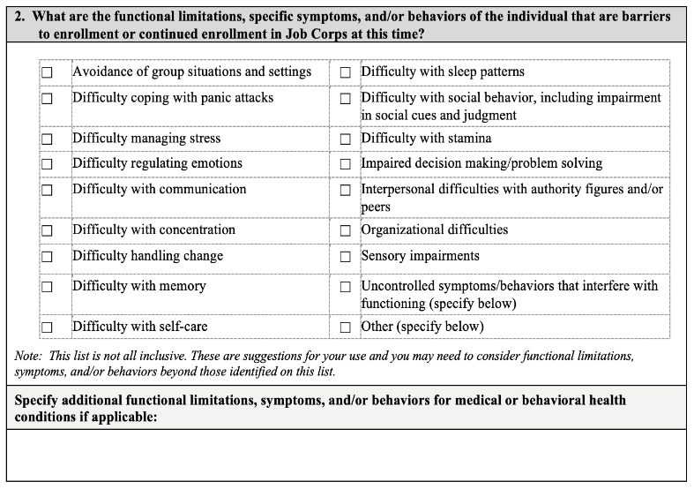
Question 2: Barriers to Enrollment
Functional limitations
Symptoms
Behaviors
that applicant is currently experiencing or exhibiting.
Support for each checkbox should be found in Question 1A.
Must specify/add details here.
Notes:
Questions 2 and 3 are where you make the case for a recommendation of denial, and are the most important sections on the HCNA.
Question 2 is where you identify the current Barriers to Enrollment for the applicant. You will check the boxes that correspond to functional limitations, symptoms or behaviors that the applicant is currently experiencing or exhibiting that are barriers to enrollment.
For each identified functional limitation, symptom, or behavior, there must be evidence to support it in Question 1A – which includes the clinical interview summary, a CCMP, a conversation with a provider or in recent records (medical/mental health, IEP, 504 Plan, etc.). So if stamina is a concern that is checked, someone should be able to go back to question 1A and find that concern noted somewhere in the records or your interview.
Remember that we only mark the current or recent functional limitations. Concerns from 2 or 3 years ago in an IEP or hospital discharge would not be considered recent and wouldn’t necessarily get recorded here.
You also only have to mark the concerns that are causing significant issues. If the applicant reports having a panic attack once in the last year, you likely wouldn’t mark that as a functional limitation.
If the applicant reports symptoms or behaviors that do not fit into any of these categories provided, you should use one of the last two checkboxes on the list and then write in the symptoms or behaviors in space provided below the table. Remember that these last two options, uncontrolled symptoms/behaviors that interfere with functioning and “other” are only needed for those symptoms or behaviors that don’t fit into another category. Some times that you may use these are for concerns like impulsive behaviors, significant aggression or substance use, inappropriate sexual behaviors, psychosis and paranoia. If you select one of these choices, you must explain in the box below what the specific symptoms/behaviors are.

Slide 41
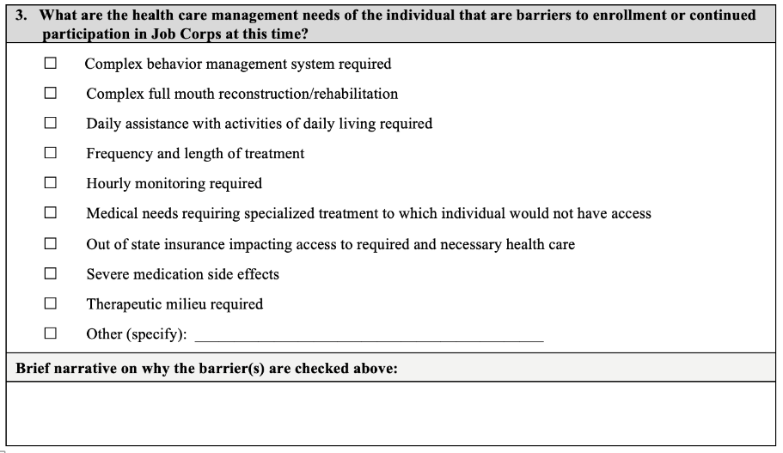
Question 3: Health Care Management Needs
“Other” should rarely be used
In the Brief Narrative, describe the specific treatments you are recommending for the applicant (that correspond to the checkboxes you selected).
Notes:
Once you’re identified the barriers to enrollment in Question 2, then you move to identifying the healthcare management needs that the applicant has due to these symptoms and behaviors.
Question 3 asks, ”What are the health care management needs of the individual that are barriers to enrollment or continued participation in Job Corps at this time?”
In this section, you simply check the boxes that correspond to the general category of healthcare management needs the applicant has. You may check 1 option, or there may be 2 or more that apply to the applicant’s situation.
The choices represent your recommendation(s) about the applicant’s current treatment needs. You want to think in terms of what treatment or services would you recommend for this applicant if you were completing a mental health intake for them.
The checkboxes are just general categories of treatment. For each checkbox, you will need to describe the treatment need more specifically in the Brief Narrative section.
You’ll note that the “other” option is last on this check list and should rarely, if ever, be used. You would only use it if the applicant requires a healthcare service or support that is not listed above and would then need to list what that type of service is. You do not use “other” to explain symptoms or concerns.

Slide 42
Question 3: Brief Narrative
  Checkbox (as many as apply)
  Narrative Examples
  Frequency and length of treatment
  Psychotherapy – Weekly? Biweekly?
  Medication mgmt. – monthly (more often due to nonadherence with symptoms)?
  or 3 months (until new regimen is stable)?
  Intensive outpatient program (IOP)
  Therapeutic milieu required
  Inpatient for symptom stabilization
  Partial Hospitalization Program (PHP)
  Residential Treatment
  Dual Diagnosis Program
  Complex behavior management system beyond Job Corps current system
  Hourly monitoring (elopement risk, unpredictable symptoms)
  Frequent redirection/prompting
  Interventions from Behavior Intervention Plan in IEP
Notes:
Here are some examples of a Healthcare Management Needs box you might check and what you might write in the brief narrative section. As the name implies, this narrative should be brief. Just explain what services or supports the applicant needs in a sentence or two.
The most commonly checked box is “Frequency and length of treatment.” This choice makes sense given that many applicants have a chronic history of mental health problems and are in need of ongoing treatment. In the narrative section, you would then explain what you mean by “frequency and length of treatment.” It could be that the applicant requires psychotherapy, it may be medication management plus therapy, or some other type of outpatient services.
The same goes with ”therapeutic milieu required,” which is probably the 2nd most common box checked. A therapeutic milieu could refer to inpatient hospitalization for symptom stabilization. It could mean a partial hospitalization program, residential treatment, or a dual-diagnosis program. These are all just examples.
This section is not where you are recommending denial for the applicant, that comes later– just focus on what the current healthcare needs of the applicant are, not whether or not Job Corps can meet them.

Slide 43
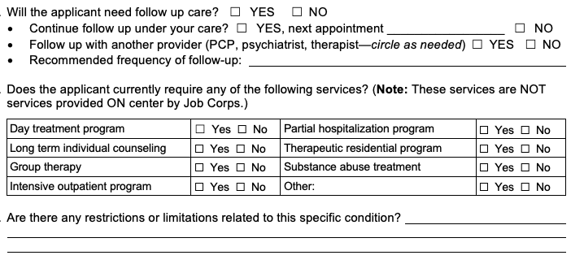
Question 3: Brief Narrative
The Brief Narrative section should be completed using complete sentences rather than bullets.
CCMP Follow-Up Treatment Questions
Always include the CCMP provider’s recommendations for follow-up care and additional services
Include restrictions and limitations (if relevant).
Notes:
A few final tips about the Brief Narrative section:
It should be completed using complete sentences rather than bullets.
If there is a CCMP in the e-Folder, always include the provider’s recommendations for follow-up care and additional services. Which is marked with the green arrow in the screenshot on this slide.
There may also be relevant information in the restrictions/limitations section of the CCMP located right below the treatment recommendations, shown here with the blue arrow. If so, you can include that here.

Slide 44
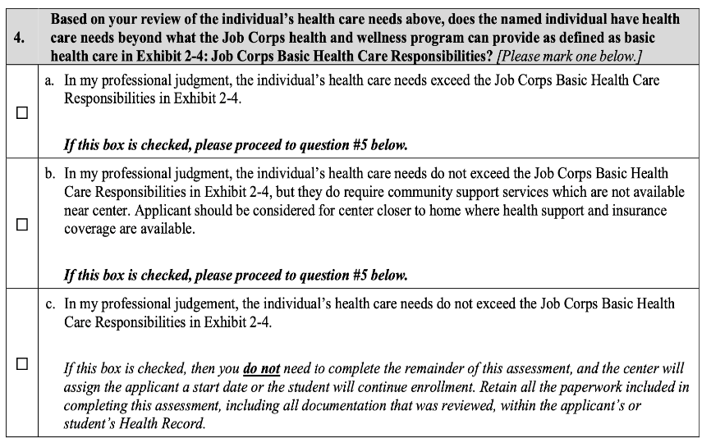
Question 4: Make Your Clinical Decision
If “b” is checked for alternate center, question 7 must also be completed.
Notes:
In Question 4, you indicate your recommendation based on your clinical assessment of the applicant’s health care needs.
For the HCNA, there are 3 choices:
The applicant’s health care needs exceed the Job Corps Basic Health Care Responsibilities in Exhibit 2-4 (first checkbox)
The applicant’s health care needs do not exceed the Job Corps Basic Health Care Responsibilities in Exhibit 2-4 but they do require community support services which are not available near center. This is the second checkbox and is referred to as the “alternate center recommendation”, or
The applicant’s health care needs do not exceed the Job Corps Basic Health Care Responsibilities in Exhibit 2-4 (third checkbox). This means that you are recommending enrollment for the applicant. Although this is an option on the form, please know that you do not need to complete an HCNA to document acceptance of the applicant. Another method, as we discussed earlier, will be much faster and more efficient.
If choice “b” is checked for alternate center, question 7 must also be completed and we’ll go over that at the very end.

Slide 45
Question 5: Applicant’s Disability Status
5. | Consideration of Reasonable Accommodation, Reasonable Modification in Policies, Practices or Procedures, and Auxiliary Aids and Services
Is the applicant or student a person with a disability (a physical or mental impairment that substantially limits one or more of their major life activities)? If no, skip to #6 to recommend denial for an applicant or MSWR for a student. If no and recommending an alternate center for an applicant go to #7(a and c). If yes, then continue to Post-Health Care Needs Assessment Disability Accommodation Review. |  | Yes | ☐ | No | ☐
Notes:
Question 5 has a “Yes/No” checkbox to identify whether the applicant is an individual with a disability.
If “Yes,” proceed to Post-Health Care Needs Assessment Reasonable Accommodation Review.
If “No,” the applicant is not an individual with a disability, and you skip the Reasonable Accommodation Review portion of the form.

Slide 46

Disability
Accommodation Process (DAP)
If an applicant is an individual with a disability, Job Corps must consider accommodations that may reduce or remove the barriers to enrollment in the program.
Accommodations are broken into 3 categories:
Reasonable accommodations
Reasonable modification in policies, practices, and procedures
Auxiliary aids and services
RA/RM/AAS
Notes:
The next step in the file review is the disability accommodation process or DAP. If an applicant is an individual with a disability, Job Corps must consider accommodations that may reduce or remove the barriers to enrollment in the program.
The options for accommodations are broken into 3 categories:
Reasonable accommodations
Reasonable modification in policies, practices, and procedures
Auxiliary aids and services, which includes effective communications
Altogether, we refer to these as RA/RM/AAS. We’ll continue to refer to them as “disability accommodations” for short.

Slide 47
DAP – 2 Step Process
The Disability Accommodation Process (DAP) is a 2-step process to identify and discuss possible RA/RM/AAS that may remove of reduce the direct threat or health care barriers to enrollment.
Step 1
Step 2
In collaboration with the Disability Coordinator (DC), you must identify possible RA/RM/AAS that may reduce or remove the barriers to enrollment
The CMHC and/or DC engages in an interactive discussion about RA/RM/AAS and document whether the applicant accepted or declined each of the offered supports.
Notes:
The Disability Accommodation Process (DAP) is a 2-step process to identify and discuss possible accommodations may remove or reduce the direct threat to others or health care barriers to enrollment
In Step 1, the CMHC, in collaboration with the Disability Coordinator (DC)- together must identify possible accommodation that may reduce or remove the barriers to enrollment. So for all the functional limitations, or barriers to enrollment, you identified earlier in the process, you’re going to look at what possible accommodations may help.
In Step 2, the CMHC or DC, or both, engage in an interactive Discussion with the applicant on the accommodations identified and document whether the applicant accepted or declined each of the offered supports.

Slide 48
Preparing for the DAP Discussion
Sources of Possible Accommodations
Symptoms, Behaviors & Functional Limitations
HCNA Question #2
School Disability documents
IEP, 504 Plan, Behavior Intervention Plan, psychological evaluations
    Only discuss accommodations relevant to the symptoms, behaviors and functional limitations that are the basis for recommendation of denial.
CCMP(s):
Restrictions/Limitations
Accommodations
RA/RM that you propose
Experience with students with disabilities at your center
Research on the JC Disability website or the Job Accommodation Network (JAN) at https://askjan.org/
Applicant mentions/requests
Form
During the interview
Consult with your Regional Disability Coordinator (RDIC)
Notes:
In preparation for the DAP meeting with the applicant, you will need to work with your DC to identify potential accommodations to discuss with the applicant. There are several sources that you can use to identify possible accommodations:
You must always identify accommodations for the symptoms, behaviors and functional limitations identified in Question 2 of the HCNA. Question 2 and the DAP table should match up when you’re complete
The CCMP has 2 places to look:
Restrictions/limitations (example “noise and crowded spaces can trigger panic attacks”)
Accommodations: last question on every CCMP
Any accommodations that the applicant (or anyone acting on behalf of the applicant such as a parent, therapist, etc.) mentions or requests such as a single dorm room or emotional support animal due to anxiety
4. School disability documents such as an IEP, 504 Plan, Behavior Intervention Plan, or psychological evaluations
5. Any accommodations that you propose or identify based on:
What has worked for students with disabilities on your center
Research on the JC Disability website or the Job Accommodation Network (JAN) at https://askjan.org
Consultation with your Regional Disability Coordinator (RDIC)
It is important to remember that you only need to discuss accommodations relevant to the symptoms, behaviors and functional limitations that are the basis for the recommendation of denial. For example, academic accommodations in an IEP such as extended time on tests do not need to be discussed in this meeting because they are not relevant to the reason you are making a recommendation of denial.

Slide 49
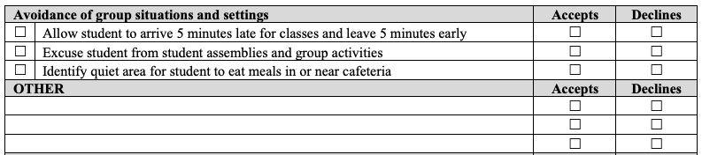
Completing the DAP Table
Add other suggestions for this functional limitation here.
Step 1
Step 2
For each functional limitation checked in Question 2, you identify the RA/RM/AAS to be discussed by checking the box(es) in the first column of the left of the table and/or adding suggestions in the Other section.
Discuss the RA/RM/AAS, then document whether the applicant accepted or declined each of the offered supports is done by checking either “Accepts” or “Declines” in the columns on the right side of the table.
Notes:
The conversation regarding disability accommodations will be documented on the HCNA in the DAP table.
Here is an example of the first functional limitation on the Post assessment – avoidance of group situation and settings.
There are two steps you’ll complete for each category of functional limitations identified.
Step 1: For each symptom, behavior, or functional limitation identified in Question 2 of the HCNA, you will identify the disability accommodations that should be discussed by yourself as the CMHC or the Disability Coordinator, by checking the boxes in the first column on the left of the table. You may also add suggestions in the other section located below the list of suggested accommodations for each category.
After you and the DC discuss the suggested disability accommodations, then an interactive interview is held with the applicant. Any accommodations that the applicant accepts, will be marked with a checkmark in the “accepts” column and any that they decline, will be marked with a checkmark in the “declines column.”

Slide 50
Consideration of Alternate Accommodations
Applicant interview summary: Include current impressions from clinical interview. This may include, but not be limited to, a mini mental status exam, current level of functioning, and areas of strengths and weaknesses.
The applicant stated that he has “social anxiety” and reported that he would have an issue having roommates or having people around while he slept. He stated “I would want to have a curtain so no one can see me sleeping.” I have insecurities about me sleeping.” The interviewer informed the student that the night dorm staff are required to do bed checks periodically throughout the night to ensure safety. The interviewer inquired about the applicant’s triggers to stress. He reported that he is stressed when “someone yells” and “doesn’t do loud noises.” Applicant reported that he manages stress by putting in his headphones. He also holds his “emotional support dolls.” He expanded on this by stating that he keeps a doll in his backpack and “will just pull out the doll and hold it to calm down.”
 | Avoidance of group situations and settings | Accept | Decline
☐ | Allow student to arrive 5 minutes late for classes and leave 5 minutes early | ☐ | ☐
☒ | Excuse student from student assemblies and group activities | ☐ | ☒
☐ | Identify quiet area for student to eat meals in or near cafeteria | ☐ | ☐
 | OTHER | Accept | Decline
☒ | Ensure that the student’s assigned bed is against either wall, rather than the middle of the room. | ☒ | ☐
☒ | Limit number of roommates | ☒ | ☐
 | Difficulty managing stress | Accept | Decline
☒ | Allow breaks as needed to practice stress reduction techniques | ☒ | ☐
☐ | Modify education/work schedule as needed | ☐ | ☐
☐ | Identify support person on center and allow student to reach out to person as needed | ☐ | ☐
 | OTHER | Accept | Decline
☒ | Allow use of emotional support doll | ☒ | ☐
☒ | Utilize white noise to buffer startle response | ☒ | ☐
Notes:
It’s important to remember that the accommodations pre-filled in the DAP table on the HCNA are just options to consider when conducting a DAP with an applicant. You should individual this section to meet the needs of the applicant, just as we individual our assessments.
This slide shows a recent example from a center, in which the applicant expresses concerns and made request for accommodations during the interview, which the CMHC correctly documented in their interview summary.
The DAP table then reflects the accommodations that were considered by the center to creatively address the concerns brought up and requests made by the applicant.

Slide 51
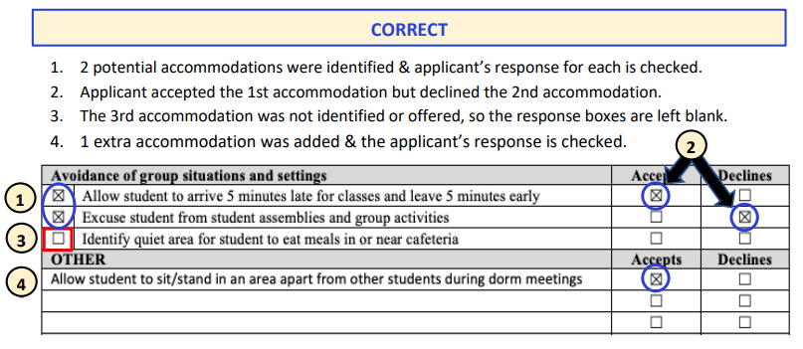
Avoid Common Mistakes
Be sure to consider RA/RM/AAS for every functional limitation identified in Question 2.
Do not consider RA/RM/AAS for functional limitations that were not identified in Question 2.
If a box is checked on the left, then a box must be checked on the right.
If an RA/RM/AAS is written in the OTHER section, a box must be checked on the right.
Document whether the applicant accepts, declines, or if there is agreement to modify a proposed RA or RM.
Notes:
The screenshot on this page shows the correct way to complete this section.
A few reminders to help you navigate this section of the form:
-Be sure to consider accommodations for every functional limitation identified in question 2. Remember that these two sections should match up fairly well when you are done.
-Do not offer or consider accommodations for functional limitations that do not apply to this applicant. So if they have no issues with sleep, you do not consider accommodations for sleep.
-If a box is checked as “identified” on the left, then there must be a checkmark in the columns in the right- either accepts or declines
-If an accommodation is added in the other section, a box must be checked to the right.

Slide 52
DAP – Unable to Identify RA/RM/AAS
Almost always leave this box blank.
Fairly rare cases: the symptoms or behaviors associated with a condition are so frequent or severe that you, as the QHP, in collaboration with the DC, are unable to identify any disability accommodations appropriate to support the applicant. If so, an explanation must be provided in this box.
Complete this section if the qualified health professional, in collaboration with the Disability Coordinator, has been unable to identify any RA/RM/AAS appropriate to support this applicant/student to sufficiently reduce or remove the barriers to enrollment or to remaining in the Job Corps program. Provide explanation/justification below.
The applicant has a current and extensive history of aggression and violence that is escalating in frequency and severity.
Notes:
After all the checkboxes, there are spaces to document 2 sets of situations that may come up during the DAP. You will not use either one often, and it is perfectly fine to leave it blank on the completed assessment.
There will be some fairly rare cases where the symptoms or behaviors associated with a condition are so frequent or severe that you as the QHP, in collaboration with the DC, are unable to identify any disability accommodations appropriate to support the applicant / to sufficiently reduce or remove the barriers to enrollment. If so, an explanation must be provided in this box.
An example narrative is provided in the box: “The applicant has a current and/or extensive history of aggression and violence that is escalating in frequency and severity.”

Slide 53
DAP – Special Considerations & Applicant Input
Almost always leave this box blank.
Special Considerations: Used to document specific accommodation requests by the applicant such as a single dorm room or an emotional support animal.
Applicant’s Input: Used to document unusual responses such as when an applicant does not want or is unable to discuss accommodations or when applicant refuses all supports offered.
Summarize any special considerations and findings as well as the applicant’s or student’s input related to RA/RM/AAS ONLY. For example, if the applicant/student does not wish to discuss RA/RM/AAS, document that information below.
When the DC called the applicant, they did not want to participate in discussion about accommodations. Applicant was short and hostile on the phone, stating, “I’ve only got a few minutes for this.” Applicant refused all accommodations offered.
Notes:
As with the last section, this box is almost always going to be left blank.
The second box is used to document special Considerations and Applicant Input:
Special Considerations would include specific accommodation requests by the applicant such as a single dorm room or an emotional support animal – You would also need to note in this box any outcomes related to the accommodation requested. So maybe the applicant requested a single room, but there are none available, so the center offered a room with 2 roommates, and the applicant agreed to that. That would need to be specified here.
In terms of applicant’s input: if the applicant does not want or is unable to discuss accommodations or if an applicant refuses all supports offered, those types of unusual responses should be documented here. An example narrative related to the refusal to discuss accommodations is shown in the box on this slide.

Slide 54
Question 6A: Clinical Summary
6. | Clinical and Disability Accommodation Process (DAP) Summary
Clinical Summary: Summarize information from the file, clinical interview and/or discussions with providers to support the health care needs assessment.
The applicant currently has a number of unmanaged symptoms including mood instability, impulsivity, risky behaviors, irritability, and running away from home. Applicant has had two psychiatric hospitalizations in the past year as well as outpatient treatment without significant improvement in symptoms. This is a safety concern. During the interview, applicant minimized recent suicidal and homicidal behaviors. Applicant will require long-term ongoing mental health treatment for serious mental illness. Applicant has poor insight into their condition and refused all accommodations that would help to mitigate the barriers to enrollment.
Notes:
The clinical summary should provide a general recap of the information used to support your assessment that the applicant currently has health care needs that exceed what can be provided for at Job Corps. It should be no longer than a paragraph or two. There is no need to summarize all the clinical information from Question 1A. You can think of the clinical summary as the “big picture” or the “bottom line” about why you are recommending denial of enrollment for the applicant.
Here is an example of a Clinical Summary.
A few things you should note:
The information here is non-clinical and is focused on the main barriers to enrollment. Instead of stating the applicant is diagnosed with Major Depressive Disorder and Alcohol use disorder and is on four psychotropic meds, it focuses on the behaviors and symptoms that are concerns like mood instability, impulsivity, and irritability. And explains why those would impair the applicant’s ability to participate in the program. In this case it’s because the applicant has had significant treatment without improvement and remains in need of long-term treatment.

Slide 55
Question 6B: DAP Summary
TIP: These exact statements can be found in the HCNA Template Items, and can be used in this section.
Notes:
The DAP summary provides a statement explaining why the disability accommodations are not sufficient to reduce or remove the barriers to enrollment. It, too, should be very general without getting into specifics.
This slide includes some examples of a DAP Summary. You can write this as a brief narrative summary shown at the top, or using bullet points as show in the second half of the box.
This is another time that you may want to use the AFR Tools- Form 2-05 HCNA Template Items. All the bullet points (and more) that you see in the example are typed for you and you can paste them directly into the HCNA (making sure they apply to this applicant’s situation, of course).

Slide 56
Question 7: Alternate Center Recommendation
7. | APPLICANT ONLY- IF RECOMMENDING AN ALTERNATE CENTER (if selected “b” in item 4)
Clinical and Disability Accommodation Process (DAP) Summary
Clinical Summary: Summarize information from the file, clinical interview and/or discussions with providers to support the health care needs assessment.
Disability Accommodation Process (DAP) Summary: If RA/RM/AAS were identified above, include a detailed explanation for why these supports would NOT sufficiently reduce the barriers to allow for enrollment to YOUR center.
Document efforts to secure community support near center in the space below. (Include name of organizations/facilities and specific individuals contacted and why access is not available near center.)
Notes:
If you are making a recommendation for the applicant to attend an alternate center, you will need to complete question 7, instead of question 6. As you can see box A, the clinical summary, is the same as in question 6. Box B is again the DAP summary, though it is slightly different, as you need to be specific to why the accommodations are not sufficient at your particular center. And then in part C, you must show that you tried to find the support the student would need at your center and determined that it is not available.
You may be wondering when you would recommend an alternate center for student?
It is in those times when you do NOT think the applicant’s health care needs exceed what the Job Corps program as a whole can provide, but they DO EXCEED what can be provided at YOUR CENTER. Centers vary in the availability of community mental health resources for referrals to off-center providers based on a number of factors including:
the location of a center (how rural it is) and access to specific resources
the availability of health insurance coverage for Job Corps students
One important difference to note with the recommendation of an alternate center is that you have a shortened time frame to complete the assessment- the HCNA must be completed within 15 days instead of the usual 30. Then, the alternate center, has the remaining 15 days to review the file and do their own assessment.

Slide 57
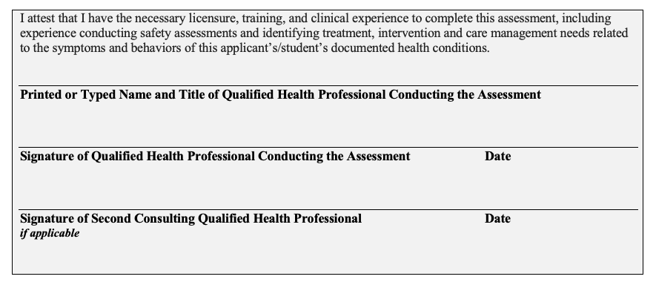
Signature Box with Attestation
If revisions are required during the Regional Review process,
the updated version must also be signed.
Notes:
The last box on the HCNA is a signature box that must be signed by the QHP(s) who completed the assessment and recommended denial. If more than one QHP completed an assessment, only those who are recommending denial would sign in this box.
This must be an actual physical or electronic signature (picture of a signature or with adobe sign) but cannot just be your name typed on the line. Make sure your signature is legible! If you are the second consulting QHP and it is not, then write out your name and title beside your signature.
In this signature section, you are also attesting to having the necessary licensure, training, and clinical experience to complete the assessment.

Slide 58
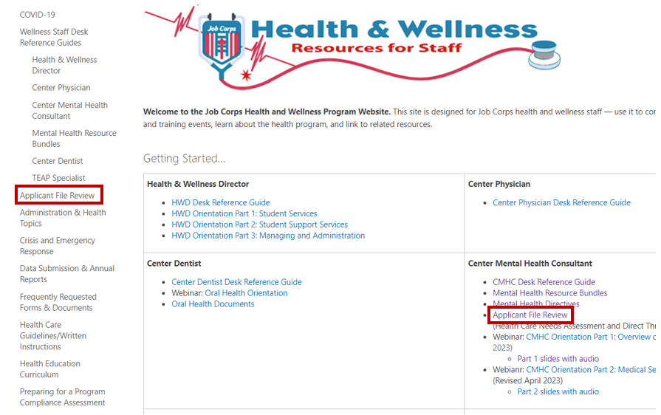
Health and Wellness Support Website https://supportservices.jobcorps.gov/health/Pages/default.aspx
Notes:
Reminder to access the Health and Wellness Website for additional resources and guidance documents.
On the homepage, you can click either of these locations marked in red to be taken to the AFR web page.

Slide 59
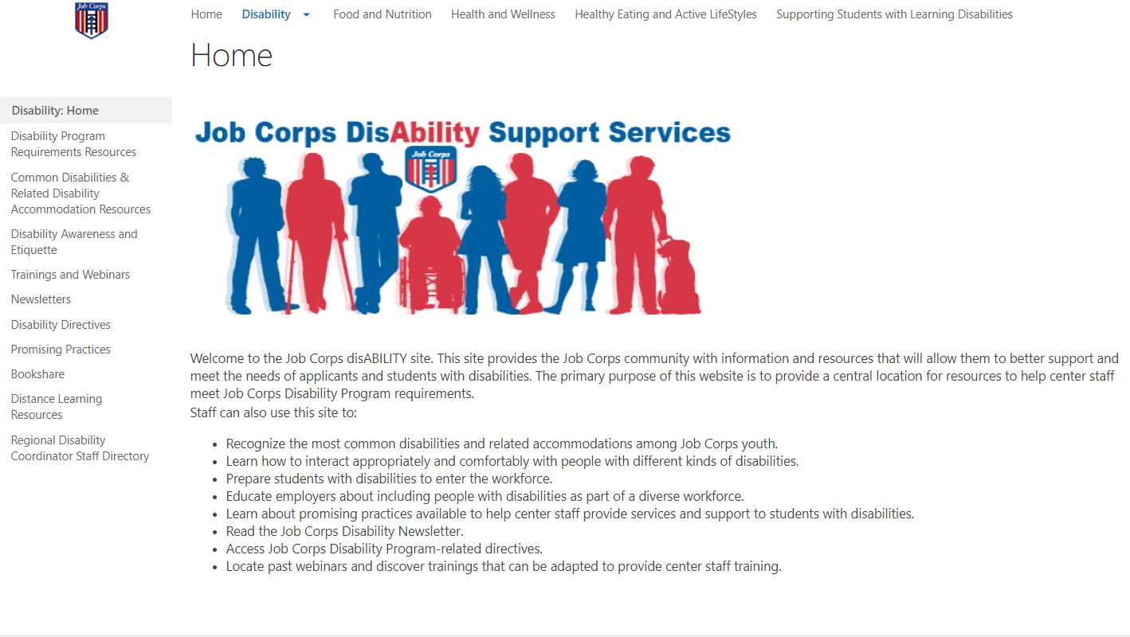
Disability Support Website https://supportservices.jobcorps.gov/disability/Pages/default.aspx
Notes:
The Disability Support website is also one that you should check out. They have so much information that is helpful in learning how to support students with disabilities and related to the accommodation process for both students and applicants.

Slide 60
Regional Mental Health Specialists
Boston - Liz Jarski, LCSW Boston (Puerto Rico) – Maria Acevedo, PhD
​Philadelphia - Valerie Cherry, PhD
​Atlanta - Liz Jarski, LCSW
​Dallas - Tamara Warner, PhD
​Chicago - Helena MacKenzie, PhD
​San Francisco - Tamara Warner, PhD
Notes:
Here are your Regional Mental Health Specialists

Slide 61
Regional Disability Coordinators
Boston - Kristen Philbrook
​Philadelphia - Angela Jenkins
​Atlanta - Stephanie Karras
​Dallas - Alyssa Purificacion Olivas
​Chicago - Sharon Hong
​San Francisco - Stephanie Karras
Notes:
Here are the Regional Disability Coordinators

Slide 62
Thank You

