Slide 1
Center Mental Health Consultant Orientation Part 1- Overview of PRH Requirements
Welcome to Job Corps!
Notes:
Review who is in attendance and welcome! Ask attendees to type how long they have been in JC in the chat box.
Please type questions in the chat box as I go along, and you can also ask questions at the end of the webinar.
This is part 1 of our 3 part CMHC orientation series. Part 2, which will be offered ______ covers the Applicant File Review process for CMHCs. Part 3, which will be offered ______ covers the MSWR process for CMHCs. It is imperative that you attend all three live orientations or listen/read the slides, which can be found on the HW website.

Slide 2
Job Corps’ Mission
To educate and train motivated young people for successful careers in the nation’s fastest-growing industries.
Notes:
One of the first things to understand about JC and your role is the mission.
READ SLIDE
JC’s focus is on helping youth become employable and independent…As the CMHC, your focus is on helping students manage and improve mental health symptoms so that they can maintain employability.

Slide 3
Health & Wellness Organization
Health and Wellness Program
Health and Wellness Director (HWD)
Often also serves as a Disability Co-Coordinator
Center Physician (CP) or Nurse Practitioner (NP)/ Physician Assistant (PA)
Nurses (RN, LPN)
[Medical records clerk]
Oral Health and Wellness Program
Center Dentist, Dental Hygienist, Dental Assistant
Mental Health and Wellness Program (MWHP)
Center Mental Health Consultant (CMHC)
Trainee Employee Assistance Program (TEAP)
Trainee Employee Assistance Program (TEAP) specialist
Tobacco Use and Prevention Program (TUPP)
Staffing levels are based on the center’s On Board Strength (OBS) – total number of students
Notes:
The Job Corps program understands the importance of physical and emotional health in employability, which is why every center has a HW center, which includes four different health programs overseen administratively by the Health and Wellness Director. Regardless of center size, all centers have a full time Health & Wellness Director, or HWD. The HWD will also likely serve as the disability coordinator within wellness, with the Academic manager serving as the disability coordinator within academics.
In addition to a HWD, every center has a primary medical provider – usually this is a Center Physician but it could also be a Nurse Practitioner or a Physician Assistant. There will be at least one nurse (or more) depending on the number of students on center. Some centers, but not all, have a Medical Records Clerk, who often helps with filing and scheduling.
Then there is the Oral Health and Wellness Program consisting of a Center Dentist along with a dental hygienist or dental assistant.
There is the Mental Health and Wellness Program, which is managed by you, the CMHC.
The Trainee Employee Assistance Program provides services for students with substance use concerns. The person who oversees it is called the TEAP specialist (in some places it is called TEE-AP) . At most, but not all centers, the TEAP also runs the Tobacco Use and Prevention Program, or TUPP.
Finally, there are a number of related health programs that are managed by various wellness staff.
Let's now talk about your role and responsibilities as a CMHC

Slide 4
Your Role as a CMHC [PRH Chapter 2.3, R4 MHWP]
Mental Health Matters
3 Sets of Tasks for implementing a
Job Corps Mental Health and Wellness Program
ASSESSMENT
TREATMENT
MENTAL HEALTH PROMOTION & EDUCATION
Notes:
First, it's important to note that, depending on the size of your center, you may be the lone CMHC or you may be one of several CMHCs. If you have co-CMHCs you will want to talk and collaborate with each other and sort out the division of the job tasks. [The PRH requires 20 hours/per 100 students of CMHC time, so if your center has an OBS of 200, there should be 40 hours of CMHC time each week.]
Let’s now take a closer look at your role as CMHC. Generally, the CMHC responsibilities can be broken into three (3) major tasks:
Assessment (Clinical)
Treatment (Clinical, Administrative)
Mental Health Promotion and Education (Consultative).
While many CMHCs are familiar with and anticipate working in a clinical– or treatment-- capacity, it is equally important to become familiar with and comfortable working in consultative and administrative roles, as those are important aspects of the CMHC position. In fact, about half of your time will be spent in non-direct care activities involving consultation, training, and administrative types of tasks.
You'll notice a reference at the top of this slide to the PRH or the Policy and Requirements Handbook (https://prh.jobcorps.gov/). The PRH describes all the required components for the entire Job Corps program, including your role as CMHC. I’ll provide more information about the PRH toward the end of this webinar, but remember, if you ever have trouble finding a resource, like the PRH, you can always ask your HWD, co-CMHC, or RMHS to show you.

Slide 5
Your Role as a CMHC: ASSESSMENT [PRH Chapter 2.3, R4 MHWP]
Assessment Tasks:
Applicant File Review (AFR) – covered in orientation Part 2
Screening All New Students (Social Intake Form—SIF)
Intake/Diagnostic Assessments
Medical Separation With Reinstatement Rights (MSWR) – covered in orientation Part 3
Notes:
ASSESSMENT (Clinical function)
So, let’s start with ASSESSMENT and what we consider to be the CMHC assessment-related tasks in Job Corps. There are four main assessment related tasks.
The first, Applicant File Review, refers to your role in reviewing the files of applicants who have applied to Job Corps and have a history of mental health difficulties. AFR is the process where you conduct an assessment to determine if there are any safety or health concerns. This is a detailed process, which will not be covered in todays webinar; but will be covered in depth in Part 2 of the CMHC Orientation Series.
The second main assessment task is SCREENING all students by reviewing the Social Intake Form (SIF) to determine if they have mental health needs and would benefit from meeting with a CMHC.
If the SIF (or a staff referral) indicates possible mental health difficulties, then you will then likely schedule an appointment to meet with the student and conduct an intake/more thorough clinical assessment, which is the third type of assessment task.
Finally, the fourth assessment related task relates to a medical separation-- you may assess a student who is experiencing significant mental health difficulties and struggling to fully participate in the program and recommend that they be temporarily separated from the program to obtain more intensive mental health services needed to stabilize their condition. This process is called Medical Separation with Reinstatement Rights, or MSWR. Like the AFR process, the MSWR process is somewhat complex and will not be covered today, but in the 3rd webinar of this orientation series.
So, let’s get started by talking more about the important role of the Social Intake Form (SIF).

Slide 6
Your Role as a CMHC: ASSESSMENT [PRH Chapter 2.3, R4 MHWP]
Screening All New Students
Review and sign SIFs (Social Intake Form) within one week of entry
Review the ETA 653, Health History and Physical Exam Forms prior to meeting with referred students
Notes:
ASSESSMENT (Clinical function)
Because early identification of students who need mental health support is a priority in Job Corps, one of your first and most important tasks is screening or assessment of all NEW students. Within the first 48 hours of a new student arriving on center, the PRH requires that the Counseling staff interview them and complete the Social Intake Form, or SIF. The SIF must then be reviewed and signed by you within 1 week of the NEW student’s entry into the program if any mental health indicators are marked (Most CMHCs review and sign ALL SIFs). The TEAP specialist is required to sign ALL SIFs, which means that you, the CMHC, and the TEAP specialist must coordinate with counseling to ensure these timelines are met. The timeline is key because it ensures you are rapidly made aware of any pressing mental health concerns.
In addition to the SIF, all students complete a Health Questionnaire (ETA 653) prior to entry and a Health History Form and a Physical Exam once on center. When students are referred to you or you’re meeting with them based on their SIF responses, It’s important that you review their ETA 653, Physical Examination and Health History forms, which will be filed in the SHR. It is not uncommon for students to share information on one form, but not on another (or with one staff member and not with another). Again, the point is to identify potential mental health needs to avoid escalating crisis situations.

Slide 7
Notes:
This is a screen shot of the SIF (social intake form), which starts with basic demographic and social information. Again, this should be completed by the counselors in an individual session with each new student within 48 hours of them arriving on center.

Slide 8
Social Intake Form
Mental Health Information
Signatures and Referrals
Notes:
The SIF has mental health related questions that you'll want to be familiar with. For instance, this page lists common mental health symptoms, grouped by area. Again, the counselor will ask the student about these symptoms and then check off any reported.
On the right side of the slide, you'll see the last page of the SIF, which has lines for staff signatures. When you sign the form, you are acknowledging that you have reviewed the information and that, if a student has endorsed symptoms suggesting a need for urgent or immediate mental health intervention, that you will prioritize and attend to that student as the symptoms warrant.
The Referral section, found below the signature lines, should indicate if a student is being referred for mental health, TEAP or other services. Be careful that you don’t rely solely on the referral section to determine if you need to see a student. It is important that you carefully review symptoms and use your clinical judgment about whether to schedule with a student. BOTH you and the counselors can complete the referral section (for instance, perhaps the counselor did not check “referral” but you believe a referral to you is indicated, then YOU can check the box and follow up with the student).
.

Slide 9
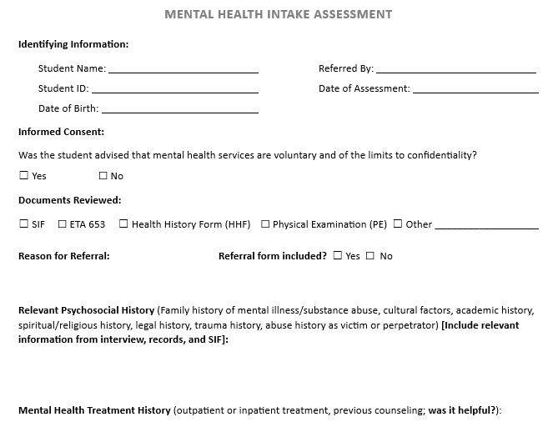
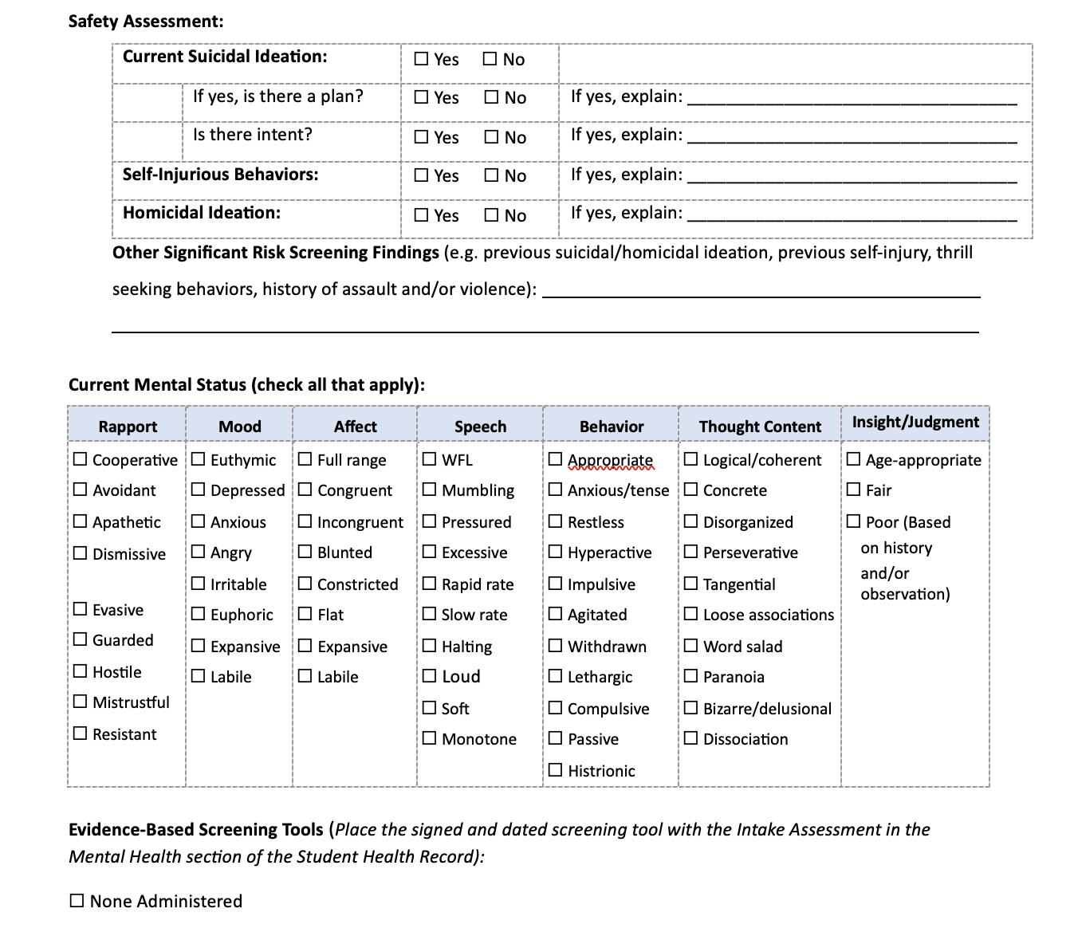
Mental Health Intake Assessment Form
Notes:
If a student could potentially benefit from mental health support based on the SIF (or based on a staff referral, or self-referral), it is strongly recommended that you complete an intake assessment/diagnostic assessment during your initial visit with the referred student. Many Job Corps students have significant histories of mental health difficulties and conducting a diagnostic assessment allows you to clearly document their mental health needs and provide recommendations. An intake is recommended whether you plan to see the student for short-term therapy or occasional drop-in visits. An intake is also important in documenting your awareness of a student's history and your recommended plan, even if the student is currently stable or declines recommended services.
You may want to use evidence-based screening tools such as the PHQ-9, GAD-7, or Columbia Suicide Severity Rating Scale (C-SSRS). These measures are not required, but you may ask students to voluntarily complete them as they can be helpful in identifying current symptoms and their severity. If you use screening tools, make sure they are scored and interpreted in the SHR.
We have a recommended mental health intake assessment form on the H&W website, which we strongly urge you to utilize. You can see a screenshot of that form here. If you choose to use your own intake form, make sure your form includes key areas found in a diagnostic intake such as the Reason for Referral and current symptoms, Relevant Psychosocial History, Mental Health Treatment History, Brief Medical/medication history, and a Mental Status Exam, including a safety assessment.

Slide 10
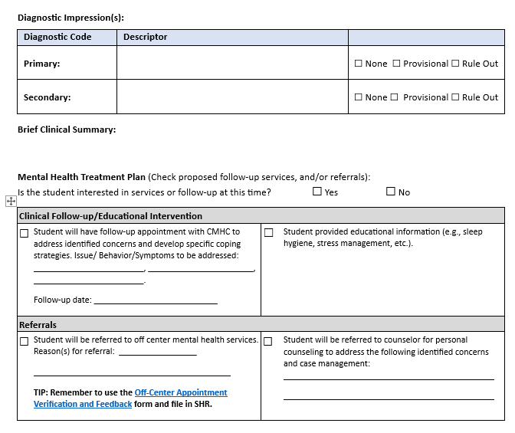
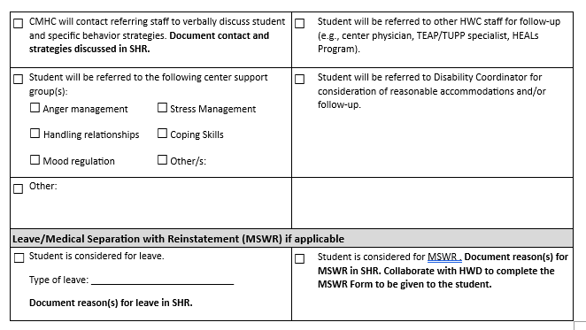
Mental Health Intake Assessment Form
Notes:
The recommended MH intake assessment form also includes a Mental Health Treatment Plan section. This section has you identify the plan regarding:
Clinical Follow-up (with CMHC)/Educational Intervention (providing educational information such as a Student Fact Sheet),
Referrals (on and off-center), or
Leave/MSWR
Now we are going to shift from ASSESSMENT related tasks to TREATMENT components of the MHWP. Any questions before we do that?

Slide 11
Your Role as a CMHC: TREATMENT
[PRH Chapter 2.3, R4 MHWP]
Employee Assistance Program (EAP) Model
Short-term therapy with focus on employability
Use of brief CBT and other Evidence-based Approaches
On/Off Center Referrals and Feedback
Referral to center support programs/groups
Referral to community provider
Request for ROI to coordinate care
Be familiar with community resources
Notes:
Once you’ve met with a student and completed a mental health intake assessment, you may recommend that they follow up with you for treatment/therapy on center. It’s important to remember that Job Corps utilizes an EAP Model, which consists of short-term counseling with a focus on employability. A brief therapy model focuses on skills and solution-focused (or problem-focused) treatment aimed at identifying the impact of mental health difficulties on employment and helping remove those barriers. We encourage you to use evidence-based approaches like brief/focused CBT, DBT skills, and mindfulness-based approaches.
You also may also refer students to on-center skills-based psychoeducational groups led by career counselors or you may decide to lead therapy groups yourself (FYI: it is not a PRH requirement that CMHCs lead groups).
There are times when you may conduct an intake assessment with a student and determine that they need more intensive, specialized (e.g., DBT) and/or long-term therapy services than an EAP model provides. Students with mental health needs beyond the basic care provided by JC should be referred to an off-center provider/agency. These services may be ‘virtual’ OR in–person and your center should provide transportation for in-person services. Your role would be to support the student until the off-center services are in place.
If a student is referred off-center for mental health services, it’s important that you request the student sign a Release of Information (ROI) so that you and the off-center provider can coordinate, as needed. Initial contact with the off-center provider to request that they inform you of any significant change in the student’s emotional wellbeing and inform you if the student fails multiple appointments or discontinues services.
You may also need to refer students off center for a medication evaluation by a psychiatrist. Your CP should initiate basic psychotropic medications; however, if a student has a complicated presentation or a CP is not comfortable initiating medications, then the student should be referred to an off-center psychiatric provider.
There is a tracking form on the HW website that can assist you in keeping track of students’ adherence to treatment with off-center providers. It’s called the Off Center Appointment Verification Form and can be found in the TREATMENT section of the Mental Health Resource Bundles web page. That form is typically used to track off-center medication/medical appointments, but can be used to track therapy appointments, if needed.
To aid in your documentation, let’s take a look at some forms that we recommend you use to document your work, like the Progress Notes and the Referral and Feedback form.

Slide 12
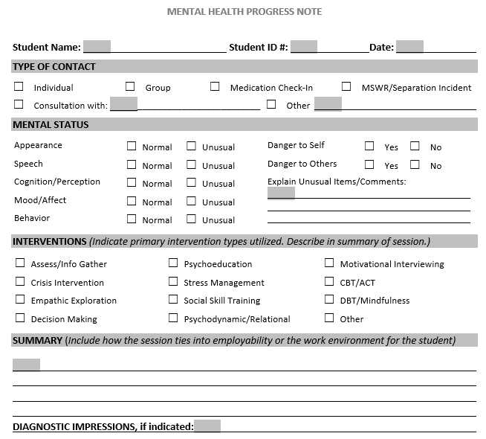
Treatment/Progress Note
Notes:
This form is on the HW website and can be used to document a student’s individual or group therapy sessions (it can also be used to document other things per boxes at top, but we'll stick with the therapeutic sessions for now).
This form has many check boxes so that it’s easy to complete, and there’s a brief summary section where the content and process of the session should be noted.
If a diagnostic change was made (either you might add a diagnosis or you might change the diagnosis that you initially provided on the diagnostic assessment), be sure to note it on your session note.
If you prefer, you can create your own therapy note form, however, it should have, at a minimum, the same components of this form.

Slide 13
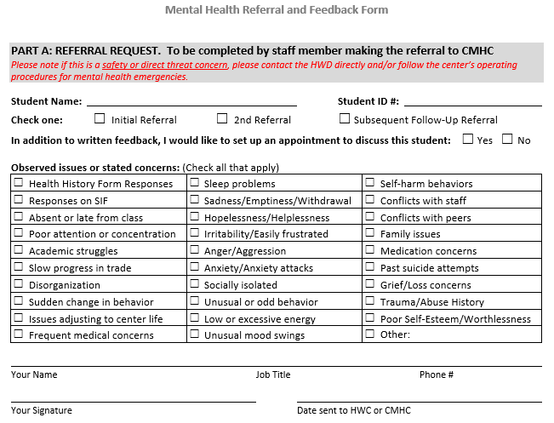
On Center Referral and Feedback Form
Notes:
The students you work with will often often be referred to you by teachers, trade-instructors, as well as your colleagues within the HWC. In some cases, these referrals may be somewhat informal, for instance, a staff may see you walking across campus and suggest you follow up with a student. Or your CP might catch you in the hallway and request that you meet with a student. Some staff might send you student referrals via JC email.
It’s important to know that the PRH requires two things when it comes to referrals: first, that you have a way to document (in writing) when a referral occurs AND second, that the referral source is given feedback. Documentation of referrals and feedback is key because it ensures that there is follow through (e.g., a student doesn’t fall through the cracks) and that we are working as a team to support students. To meet the PRH requirements you MUST document BOTH the referral and feedback in the individual SHR.
So how do you do that? There is a recommended Referral and Feedback Form on the HW website, which you see a screenshot of here. This is a recommended (not required) form. However, it’s important to remember that if you don’t use this form, your system MUST meet both PRH requirements described above. The Referral and Feedback form can be used by Counselors, HWC staff, TEAP or any other center staff who want to make referrals to the CMHC, OR if the CMHC wants to refer to Counselor groups. You can see here that the first page has check boxes to indicate why the referral is occurring (e.g., the symptoms/behaviors of concern). It’s also important that the original referral and feedback form is filed in the SHR and a copy is sent to the referral source, documenting that the feedback occurred.

Slide 14
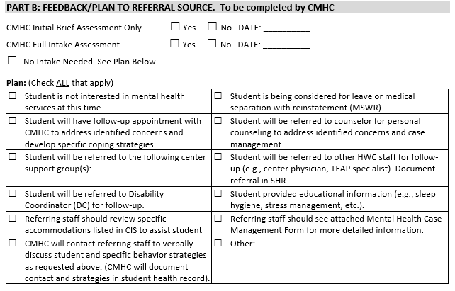
Return: Referral and Feedback Form
Notes:
This screen shot shows the second section or Part B of the Referral and Feedback Form, where you, the CMHC provide feedback to the referrer. Part B is where you let the referral source know what you did, the next steps for the student, or steps they should take, when appropriate. Some options included on this form are:
That you saw or attempted to see the student but the student is not interested in mental health services
You have scheduled a follow-up appointment for the student
Referring staff should review specific accommodations listed in CIS to assist student
You are referring the student to the Disability Coordinator or to the counselor or to a group, etc.

Slide 15
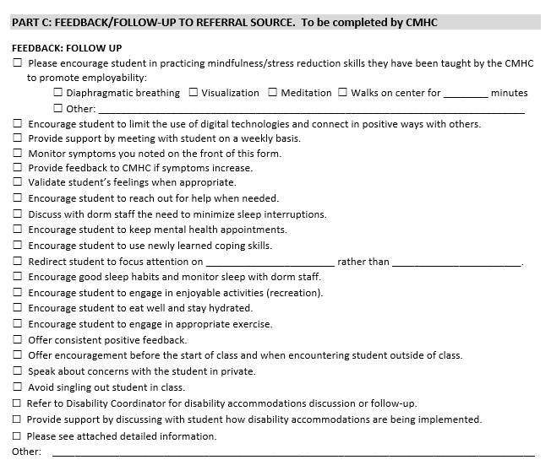
Return: Referral and Feedback Form
Notes:
This is the last page, Part C of the Referral and Feedback Form, which is where you provide what we call “behavioral feedback” to the referral source -- recommendations about the action steps the referral source can take to support the student. Examples include things such as:
☐ Encourage student to limit the use of digital technologies and connect in positive ways with others.
☐ Monitor symptoms you noted on the front of this form.
☐ Provide feedback to CMHC if symptoms increase.
☐ Encourage student to keep mental health appointments.
☐ Encourage student to use newly learned coping skills.
☐ Encourage good sleep habits and monitor sleep with dorm staff.
☐ Encourage student to engage in enjoyable activities (recreation).
☐ Encourage student to eat well and stay hydrated.
☐ Encourage student to engage in appropriate exercise.
☐ Offer consistent positive feedback.
Remember: If a student is referred off center, it will be important to: have the student sign a release of information form and for you to contact the provider and discuss ways to collaborate/receive updates. You should also follow up with the provider to track student progress and medication changes (if necessary). Remember that the Off Center Appointment Verification Form available on the Health and Wellness Website, can be used to track these off-center appointments and services.
SO PLEASE REMEMBER: Student referrals and feedback MUST be documented in the SHR.
Now, more about Treatment…

Slide 16
Your Role as a CMHC: TREATMENT
[PRH Chapter 2.3, R4 MHWP]
Collaboration with TEAP
Students with co-occurring mental health and substance use conditions
Collaboration with Counseling Staff
Case Management/Case Conference
Often includes TEAP specialist
Psychoeducational groups
CMHC provides clinical input to groups and lead groups by counselors
Crisis Management (counselors)
Crisis Intervention (CMHC, licensed clinical provider)
Notes:
Continuing with TREATMENT (Clinical function)
In addition to your individual meetings with students, the PRH requires that you:
Collaborate with TEAP: Many JC students have co-occurring mental and chemical health diagnoses, which is why it's important that you collaborate regularly with the TEAP specialist/s. On many centers, the CMHC and TEAP specialist both attend the counseling meetings, which is one way to document collaboration.
Collaborate with Counseling Staff:
The PRH requires that the CMHC meet regularly with the counseling staff to review students who may be of concern. Most centers have a weekly case management meeting that is attended by all the counselors, the CMHC, and, as just mentioned, the TEAP specialist. Counselors can discuss students who they have concerns about and make referrals to the CMHC and/or TEAP. The CMHC can provide feedback regarding students they are working with and request input from counselors about how students are doing on center. Of importance, the PRH requires that any clinically relevant information discussed at the case management meeting is documented in the individual SHR. We’ll look at the recommended case management form, which can be used to document these discussions, on the next slide.
In addition to the case management meeting, part of the CMHCs role includes helping Counselors develop Psychoeducational Groups such as strengthening coping skills or anger management by providing clinical input. The PRH does not require that CMHCs lead their own groups; however, CMHCs, as licensed providers, can develop treatment/therapy groups, if desired.
Finally, counselors often help support students when crises occur on center. Their role involves de-escalating situations and providing support until the licensed clinical provider can assess the student or the student can be referred for an off-center emergent assessment. It's key that counselors receive training in the Symptomatic Management Guidelines and the MH Emergency SOP, if your center has one, as they will often be the first responders to crises. Again, the counselors, as unlicensed staff, will not provide assessment or intervention, which is your role as the licensed clinician.

Slide 17
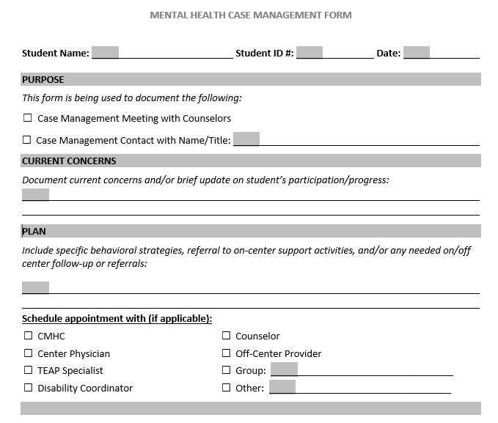
Collaboration with Counseling Staff [PRH Chapter 2.3, R4, d(4)] Case Management/Case Conference
Notes:
This is the form that I referenced on the last slide that you might choose to use to document clinically relevant information discussed during your case management meetings with the counselors. You can find this form on the HW website.
This form is designed to be easily completed by either you or a counselor while you are discussing a student during the case management meeting. This form should be signed by the person completing the form, and the original version should be filed in the Student’s Health Record (SHR) in the MH or CMHC section.

Slide 18
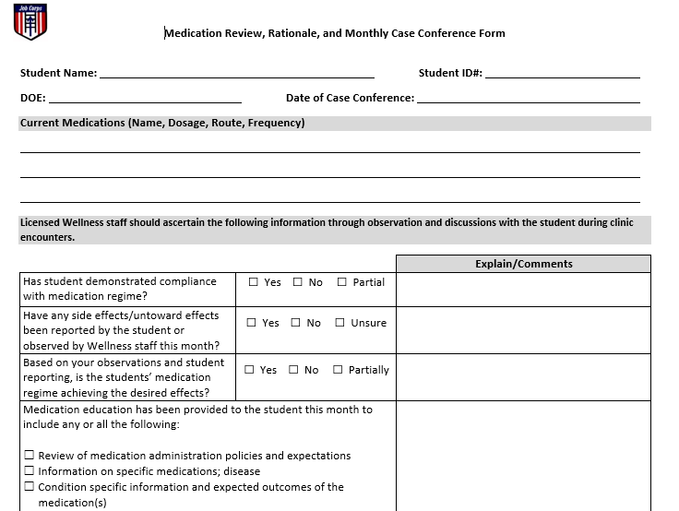
Your Role as a CMHC:
TREATMENT [PRH Chapter 2.3, R4 MHWP]
Collaboration with CP, HWC staff on Psychotropic Medication Monitoring
Notes:
There is one final collaborative treatment process to mention: Monthly Monitoring of students who are prescribed psychotropic medications.
The PRH requires that students’ who are prescribed medications, including psychotropics, be reviewed on a monthly basis by the HWD and the center’s relevant prescribing health professional (CP, NP). As the CMHC, you may also be involved in monitoring students who are prescribed psychotropic medications. Your involvement could take several different forms:
You may be asked to participate in the monthly medication review meetings and share information about students you work with
Medical or nursing staff may refer students to you for diagnostic clarification to assist the CP in prescribing psychotropic medication
You may be asked to meet with students who exhibit poor medication compliance
There are different ways this medication coordination/collaboration may be documented:
If you participate in the monthly medication review meeting with the HWD and CP, your signature would be on the medication monitoring form (a screenshot of this form is on the slide with hyperlink)
If you meet with students separately prior to the monthly medication review, you would document medication related discussions on your MH Progress Note by checking the “medication monitoring” checkbox and then writing a note on SF-600 to share key medication related information with other health staff.
It’s important that each center have a process for monthly monitoring of students on medication. Ask your HWD about your center's process and how you can be involved and make sure your involvement is documented.

Slide 19
Your Role as a CMHC:
TREATMENT [PRH Chapter 2.3, R4 MHWP]
Crisis Intervention
Have a plan, consult with CD and HWD
After Hours Mental Health Emergency: Strongly recommend developing a center specific SOP for Mental Health Emergencies
Will you take on-call coverage? What does your contract indicate?
Supporting Students/Staff AFTER a crisis has occurred, Critical Incident Crisis Intervention Plan on H&W Support Website
Know your community resources
Crisis Center, Mobile Crisis Response Team, sexual assault services, domestic violence, day/partial day treatment programs, homeless STs, substance use treatment
Notes:
TREATMENT (Clinical function)
Crisis Intervention is an important aspect of the CMHC role.
It's important to plan ahead for how to manage crisis situations on center: Different types:
Crisis/mental health emergency when you are on center—this is the most straightforward because you will use your clinical skills to assess the student and make a recommendation regarding the most appropriate plan (e.g., student will follow up with you for therapy; be transported to hospital for evaluation; be placed on leave or MSWR, so forth).
After-hours crisis/mental health emergency when you are not on center and not available
First, it’s important to understand whether your contract states that you are available 24/7 for mental health emergencies. If you are not available, it's essential that your HWD/center RN (or whomever is on-call for emergencies) is aware of the mental health crisis plan for after hours emergencies.
We strongly recommend each center develop a Standard Operating Procedure (SOP) for Mental Health Emergencies, which lays out the steps staff should take in the event of an after- hours crisis (e.g., is there a local crisis response team? Which hospital/ER should student be transported to? So forth). You can find a draft of a SOP for MH Emergencies on the HW website and via hyperlink on slide.
How to support students/staff AFTER a crisis has occurred: this might look differently depending on the situation. In some cases, you might meet individually with a student who experienced a crisis that only impacted them (e.g., such as a sexual assault). In other instances, you might meet with a small group of students who all witnessed or were impacted by a traumatic event (accident in trade that impacts a group of students). Occasionally, a center may experience a traumatic event that has a wide impact, such as a student or staff death on center or a natural disaster that impacts the whole center. In those instances, it’s important to implement a Center-wide intervention. There is a crisis intervention/debriefing document, which is called the Critical Incident Crisis Intervention Plan, to help guide you and the center through crisis situations that have broader impacts on your center.
We strongly recommend you contact your RMHS if there is a critical incident on your center. Your RMHS can provide you with support and necessary resources.
One final point: we strongly recommend you know and connect with your community resources (read SLIDE last bullet)

Slide 20
Your Role as a CMHC:
Mental Health Promotion and Education
[PRH Chapter 2.3, R4 MHWP]
CPP Presentation (not to be conducted by HWD or other staff)
Overview of MH Services
Intro to CMHC hours on center, scheduling appointments, and provides basic skills in identifying and responding to a mental health crisis
For CPP Presentation, a PPT template is available on Health and Wellness Support Website
Annual Center-Wide Activity
Examples: February is Teen Dating Violence Awareness and Prevention Month, May is Mental Health Awareness Month
See Mental Health and Wellness Program-Related Observances on the HW website
Notes:
Now we’re going to shift from the treatment related responsibilities of the mental health program and discuss the third, and final component of the CMHC Role: MENTAL HEALTH PROMOTION AND EDUCATION Activities (Consultative function)
The PRH requires the following:
During the Career Preparation Period (CPP), you (the CMHC) will meet with each new student input group together to introduce yourself and provide an overview of the mental health program. Your presentation will also include a brief “gatekeeper/Mental Health First Aid” type of training as well as information on how to access the Job Corps Safety Hotline information (844-JC1-SAFE). This is typically the first contact you’ll have with students as they arrive on center.
There is a CPP presentation PPT template on the H&W website that you can use, or you can develop your own presentation, as long as it includes the required elements.
The PRH also requires that CMHC(s) provide at least one Center-Wide mental health prevention/education activity each year. CMHCs meet this requirement in a lot of different ways—you might celebrate Suicide Prevention Awareness Month in September by developing a center-wide activity; you might do a mental health related activity during Mental Health Awareness month, which is in May. Be creative and talk with your co-CMHCs and HWD for ideas. There is also a list of mental health related monthly observances on the HW website with link on the slide.

Slide 21
Integrated Programming with Other Center Departments
TEAP/TUPP, HEALs, SART, residential, recreation
Consultation with Center Director (PRH 5.1, R35)
Monthly meeting with CD.
Discuss clinical and organizational issues
Minutes are used to document meetings
Notes:
Part of the Consulting role of the CMHC is coordinating with other departments on center and developing Integrated Programming There are a lot of different ways in which you might be involved in Integrated Programming. For instance, you might hold a joint program/activity with TEAP/TUPP; you may join the Healthy Eating and Active Lifestyles (HEALs) committee and help integrate mental health into programming. You may provide input or develop a training as part of the Sexual Assault Response Team (SART). The idea is you’ll be collaborating with staff across center. We recommend that you make a binder and keep track of your annual mental health education and promotion event/s and the different trainings and collaboration you do with other departments. This will help you remember everything that you’ve done and you can share this information when your center has a site visit.
In addition to integrated programming, The PRH also requires that you and the CD meet monthly (PRH 5.1, R35)
This Monthly meeting/Consultation with Center Director might focus on any MH trends you’ve noticed on center. You might ask for things you need or believe would strengthen the MH program. You might also discuss specific students who have extenuating mental health circumstances and might have specific needs. Remember your role is key to developing an emotionally healthy culture on center and this meeting with the CD helps you build that relationship so you can collaborate and have support for the MH program. Your CP is also required to have a monthly meeting with the CP so some centers have both you and the CP meet with the CD together. Minutes should be kept of this meeting.

Slide 22
Staff Training
Adolescent Growth and Development – 5 hours required annually, often over winter break
SafetyNet (self-guided study on prevention of suicide, bullying, relationship violence) can count for 3 of the 5 hours of training
Many resources on the Health & Wellness Support Website, including
Trauma-Informed Approach (TIA) webinar and additional resources for staff training
Can also use outside/community presenters
Notes:
MENTAL HEALTH PROMOTION AND EDUCATION (Consultative/Administrative function)
A final piece of the CMHC position involves providing Staff Training. All staff are required to have 5 hours of Adolescent Growth and Development Training annually. Pre-recorded SafetyNet trainings can provide 3 of those 5 hours, but you will often be asked to do other trainings on topics that feel relevant for staff at your center. Adolescent Growth and Development is defined broadly, you may do a presentation on handling challenging student behaviors; or how to use motivational interviewing with students; or strategies for staff in working with anxious students; or helping staff with burnout/compassion fatigue from working with students many of whom have significant trauma histories. You might also consider providing a staff training on crisis responding. Finally, there is an excellent webinar designed to introduce staff to a Trauma Informed Approach and we strongly encourage you to provide this as part of your annual staff training. The webinar has detailed notes that allow you to walk staff through the training even if you don't have much experience in teaching a Trauma Informed Approach and there are additional tools, all of which can be found on the HW website (link above).

Slide 23
Standard Operating Procedures (SOPs) and Center Operating Procedures (COPs)
SOPs are documents required by JC to ensure that centers are meeting compliance requirements and have policies & procedures in place for different situations.
The Health and Wellness Program (HWP) has 4 required SOPs. The only one that includes the CMHC is the Staffing SOP.
Additional recommended COPs:
Mental Health and Wellness Program (MHWP)
Mental Health Emergencies
Template on HW website
Talk with your HWD to obtain and review copies of relevant SOPs/COPs.
Notes:
Job Corps has developed guidance documents to ensure that centers are meeting compliance requirements--these are called SOPs (Standard Operating Procedure) or Center Operating Procedure (COPs) (same thing). The main SOP for you to be aware of is an optional (but strongly recommended) SOP for Mental Health Emergencies, which we discussed earlier on the webinar. There is a link to a draft template on this slide.

Slide 24
Job Corps Health Care Guidelines
Written documents of accepted practices for managing common health problems
Must be reviewed, approved and signed annually by the appropriate provider.
Treatment Guidelines (TGs)
Symptomatic Management Guidelines (SMGs)
Health Staff
8 TGs for Mental Health
Anxiety Disorders (Including Panic & Phobic Disorders)
AD/HD
Bipolar Disorder
Depressive Disorders
PTSD or Acute Stress Disorder
Psychotic Disorders
Suicidal Self-Directed Violence
Non-Suicidal Self Injury Behavior
Non-Health Staff
3 SMGs for Mental Health
Behavior Changes/Unusual Behavior
Suicidal Self-Directed Violence
Non-Suicidal Self-Injury
Talk with your HWD so you can review current HCGs
Notes:
The PRH also requires that centers have Health Care Guidelines, which must be reviewed, approved and signed annually by the appropriate health provider. Your HWD should ask you to review and sign the mental health related HCGs each year.
Health Care Guidelines are broken up into 2 types.
The first are Treatment Guidelines for Health Staff, which are documents that basically guide health staff in managing different medical, mental health, and dental treatments. There are 8 mental health related TGs (see dx on slide).
2) The Symptomatic Management Guidelines are for non-health staff. They direct non-health staff (like residential advisors, security, so forth) on what to do in different emergent situations when no health staff are present on center. There are 3 SMGs for MH (read titles in slide)
We won’t go into the HCGs on this webinar today, but please ask your HWD to review your centers and follow up with your RMHS if you have any questions.

Slide 25
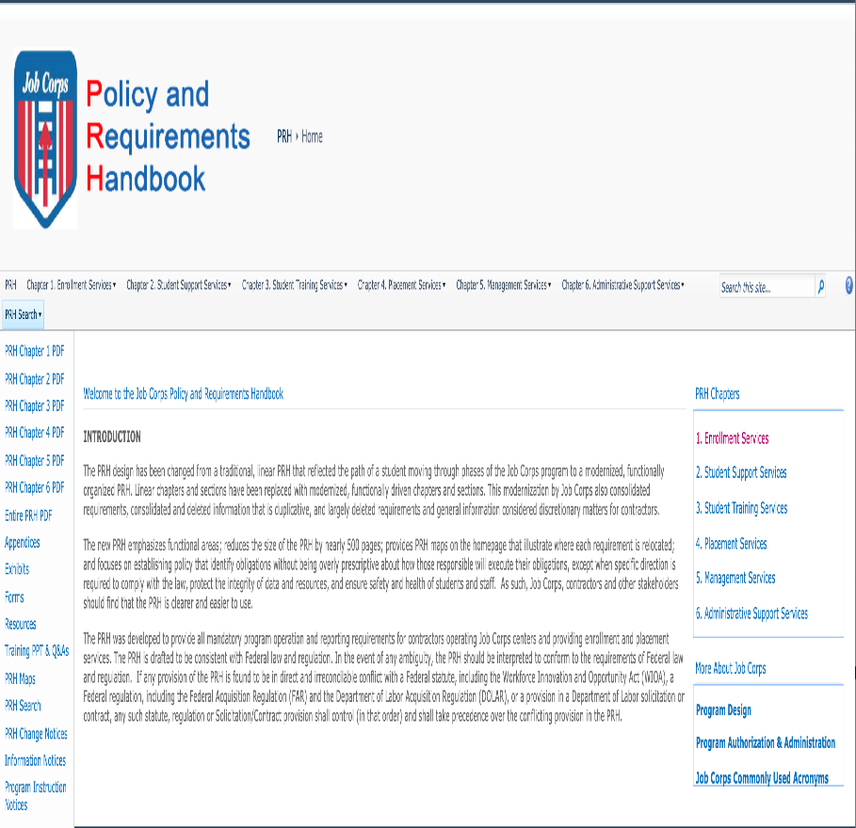
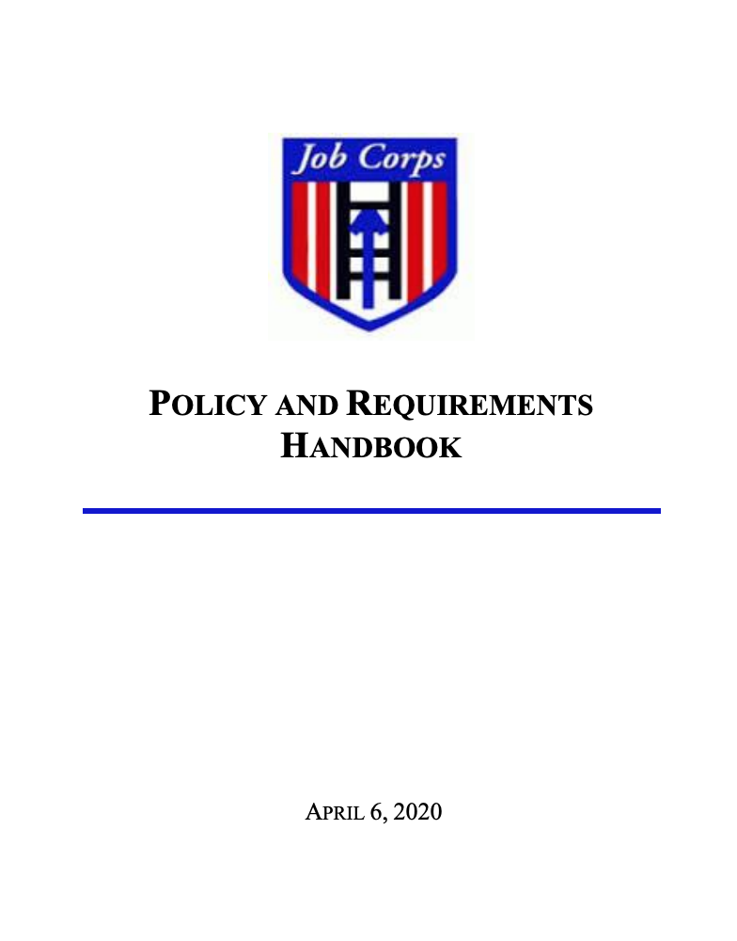
Policy and Requirement Handbook (PRH) Desk Reference Guide (DRG)
Notes:
Finally I just want to spend a few moments pointing out a few key resources.
First, is the PRH or “policy and requirements handbook,” which includes all the required components for the entire Job Corps program. This can be found online at the address listed on the slide. You can also simply type Job Corps PRH in your search engine and you will find this document online. The PRH is a huge document, which is divided into 6 chapters. You should focus on reading Chapter 2 (Section 2.3), which focuses on ensuring students receive health and wellness services, support, and education. The other chapter to focus on is Chapter 1, which outlines the steps in completing applicant file reviews and how to complete recommendations of denial.
Second, is the CMHC Desk Reference Guide (DRG), which explains in detail how to implement all the PRH requirements for the mental health program. You can access the CMHC DRG on the HW website via the link above. You'll notice that within the DRG document are hyperlinks that take you to the sample templates, as well as recommended and required forms. You can then download these forms to use on your center.
Please type yes or no in the chat box if you have reviewed the DRG.

Slide 26
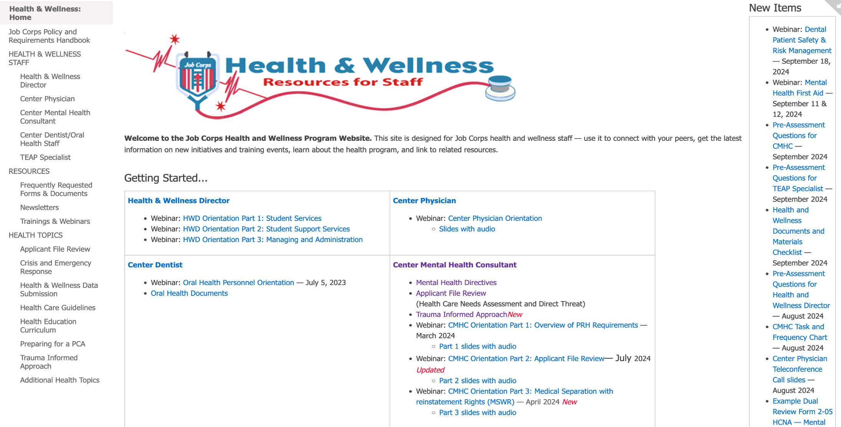
Health and Wellness Support Website
https://supportservices.jobcorps.gov/Health/Pages/default.aspx
Notes:
SUPER IMPORTANTLY, This is a snapshot of the HW website home page which can be accessed outside of JC using the link at the bottom of the slide. (You can also find the HW website simply by googling "Job Corps Health Support.")
The best way to access ALL the CMHC resources is to click the Center Mental Health Consultant link on the left side of the page (next to the blue arrow). The first bullet under Center Mental Health Consultant heading will take you to the DRG and you can download a copy onto your computer.
The second bullet takes you to the “Mental Health Resource Bundles” web page that we will look at more closely on the next slide.
The fourth bullet has all the information, guidance and forms you will need to complete Applicant File Reviews
The fifth bullet links to the brand-new Trauma Informed Approach web page mentioned earlier.
Clicking on the final three bullets will download the CMHC Orientation slides Part 1, Part 2, and Part 3, respectively.

Slide 27
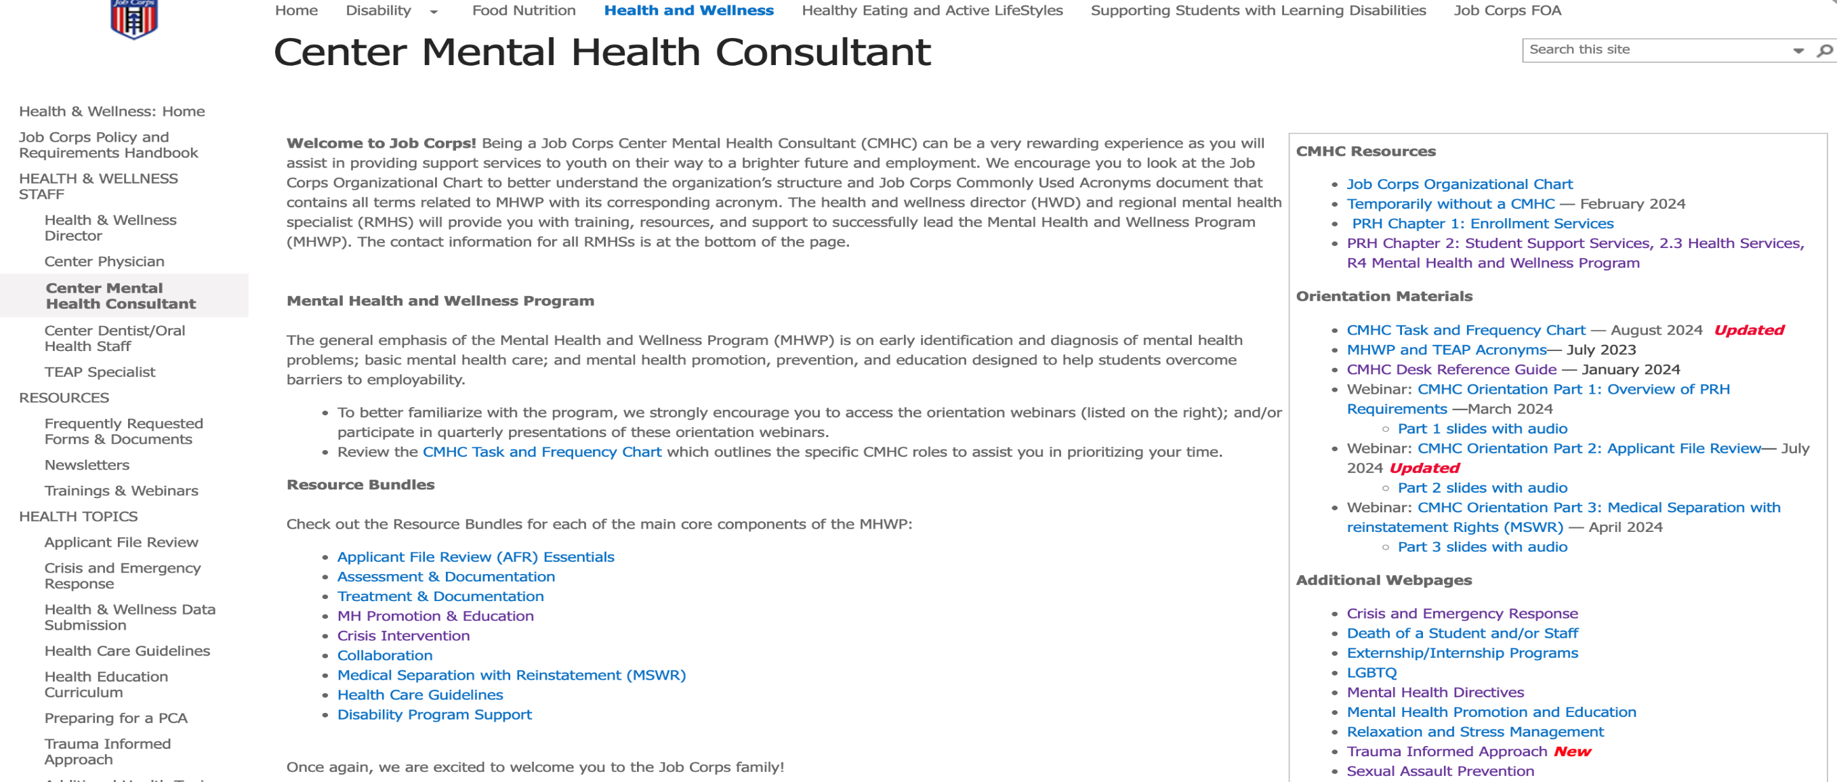
CMHC Resource Bundles
https://supportservices.jobcorps.gov/health/Pages/CMHC.aspx
Notes:
Once you are on the CMHC main page (link at bottom of slide), you’ll see the CMHC Resource Bundles (blue arrow), which is where you will find the most important resources related to different topics. There are 9 resources bundles. Each bundle contains an overview, guidance, and working documents to assist you in developing a comprehensive MHWP that meets all requirements based on Job Corps’ Policy and Requirements Handbook (PRH).
The topics covered by the 9 bundles are:
Applicant File Review (AFR) Essentials
Assessment & Documentation
Treatment & Documentation
MH Promotion & Education
Crisis Intervention
Collaboration
Medical Separation with Reinstatement (MSWR)
Health Care Guidelines
Disability Program Support
At the ORANGE arrow are some general CMHC Resources, specifically
Job Corps Organizational Chart
MHWP and TEAP Acronyms
PRH Chapter 2, 2.3 Mental Health and Wellness Program
CMHC Task and Frequency Chart
CMHC Desk Reference Guide
Three-part CMHC orientation series

Slide 28
Q & A What’s Next?
Download
Download Power Point and Review It
Go
Go to the HW website and review the DRG and the forms discussed today!
Reach out
Reach out to your RMHS often!!!
Notes:
So what next!? First, I realize this is a lot of information so take time to digest it and know that it will likely take you 6-12 months to feel really comfortable with all the different mental health related requirements. I recommend you download this PowerPoint and review it again and make sure to check out the HW website and review the DRG and other forms we discussed today. Your HWD and co-CMHC/s are also great resources. And always know you can reach out to your Regional Health Specialist with questions!

Slide 29
Regional Mental Health Specialists (RMHS)
Region 1 (Boston)
Elizabeth Jarski, LCSW
Maria Acevedo, PhD (Puerto Rico)
Lead/Region 2 (Philadelphia)
Valerie Cherry, PhD
Region 3 (Atlanta)
Elizabeth Jarski, LCSW
Regions 4 (Dallas) & 6 (San Francisco)
Tamara D. Warner, PhD
Region 5 (Chicago)
Helena Mackenzie, PhD, LP
Notes:
Here is a list of the RMHS names for each region.
Job Corps has 6 regional offices– Boston ( PR), Philadelphia, Atlanta, Dallas, Chicago, and San Francisco (includes Alaska and Hawaii). Every Regional Office has a regional nurse specialist, (RNS), regional medical specialist (RMS), regional mental health specialist (RMHS), regional trainee employee assistance (TEAP) specialists, regional dental specialists (RDS), and regional disability coordinators (RDCs).
Your RMHS provides technical assistance to you and other center health and wellness staff members, conducts monthly teleconferences with the center mental health consultants (CMHCs) in their region, and conducts periodic center assessments for quality and compliance with the Policy and Requirements Handbook (PRH).
***********OPTIONAL*********************
If you are not sure of what region you are in or who your regional mental health specialist is, please type your name in the chat box and your center and I’ll follow up to connect you with your RMHS.

Slide 30
Please Plan to Attend: CMHC Orientation Part 2: Applicant File Review CMHC Orientation Part 3: Medical Separation with Reinstatement Rights (MSWR)
Notes:
CMHC Orientation Part 2 on AFR will be on Tuesday 10/22 at 2 ET
CMHC Orientation Part 3 on MSWR will be on Thursday 11/14 at 2 ET
If you want to review the slides from today’s presentation (or listen to it again!) it should be uploaded to the H&W website within the next week.
Thank you all!

