Slide 1
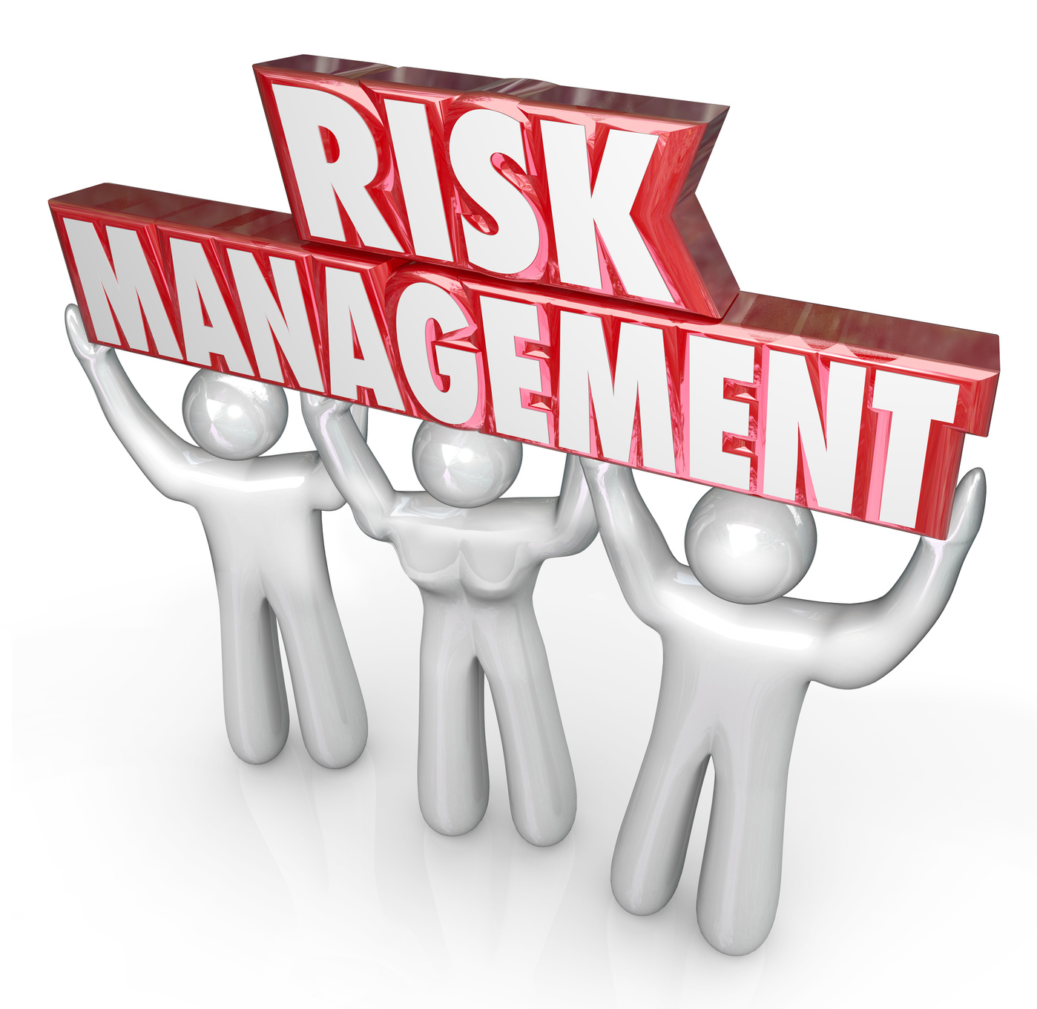
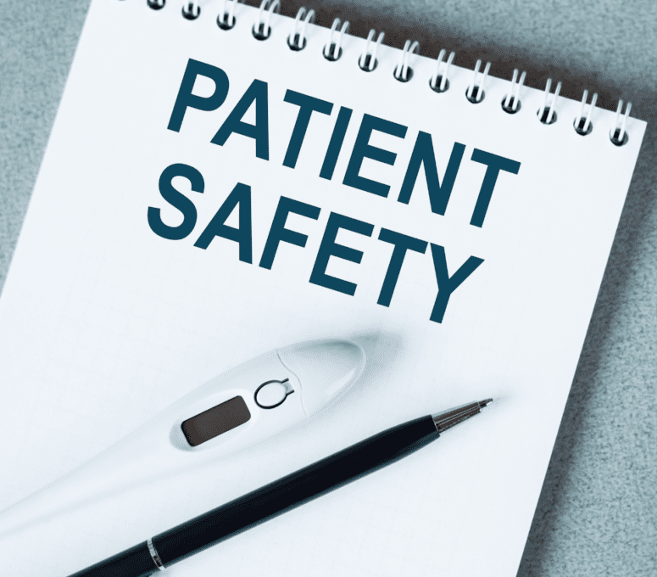
Dental Patient Safety & Risk Management
Pamela Alston, DDS, MPP, FACD, Lead Oral Health Specialist September 18, 2024
Please Note: As Dr. Alston is not an attorney, she will not be addressing the legal aspects
of the topic matter.

Slide 2
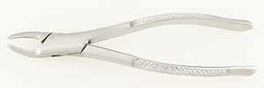
Mystery of the Missing Tooth
Note: This is not the actual image depicted in the account.

Slide 3
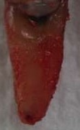
Mystery Solved: Tooth located in the Maxillary Sinus

Slide 5
Webinar objectives
Explore the oral health care risks to patients
Learn steps that oral health teams can take to advance patient safety and risk management
Learn how a commitment to quality improvement can make a difference in patient care

Slide 6
“Patient Safety”
“the absence of preventable harm to patients and reduction of risk of unnecessary harm associated with health care to an acceptable minimum”
“avoiding harm from the care that is intended to help”—National Advisory Group on the Safety of Patients in England (2103)

Slide 7
“Risk Management”
“the attempt to identify, evaluate, and deal with problems which may cause harm to patients”

Slide 8
2000 Institute of Medicine study
Titled, “To Err is Human: Building a Safer Health System”
Documented 40,000 – 98,000 people dying annually from medical errors
Public shock generated attention by the health care system
Public safety improvement continues to gain momentum today
Reference: Yansane A, Walji MF, Kalenderian E, Introducing Safety in Dentistry: Perspectives and Directions,
Journal of the California Dental Association, Vol. 47, No. 7, (July 2019)

Slide 9
Public Safety Objectives
to help avoid preventable adverse events
To limit the impact of adverse events
To avoid the occurrence of any possible complications

Slide 10
Definitions
“Adverse events”—events, situations, or conditions that result in accidents, errors and complications
“Close call”—an event, situation, or condition that could have resulted in an injury, accident or illness, but did not, either by chance or through timely intervention
”Incident”—any unexpected issue that occurs during the workday that not rise to the level of an adverse event
“Health care errors”—unintended acts, either of omission or of commission
“Latent risks”—features of the way in which you deliver oral health care that can allow or even encourage an adverse event to occur while you are providing care.

Slide 11
Examples of Latent Risks
Lack of instruments and supplies for a complicated extraction
Malfunctional X-ray system (e.g, broken X-ray processor)
Ineffective way of clinical information transmission

Slide 12
Prevent adverse events by addressing latent risks
Ensure that you have the essential equipment and supplies
Be prepared to offer the justification for equipment and supply requests
Notify the Health and Wellness Director of latent risks proactively

Slide 13
Patient safety is linked to quality care
The ideal is all possible risk factors are controlled
OHP see clear relationships between quality of treatment and success of outcomes
Compliance with guidelines and protocols reduces the possibility of errors and adverse events

Slide 14
Prescribing Errors
Error in the indication for a medication
Failure to read the Student Health Record beforehand
Unaware of allergies
Unaware of drug interactions
Wrong dose
Duplication of medication

Slide 15
Errors Related to Invasive Procedures
Errors in treatment planning sometimes associated with lack of X-ray capability
Errors in the type of procedure performed
Patient error
Wrong-site error
X-rays mounted wrong
Errors in monitoring and control of patients after treatment
Post-surgical infections
Failure to prescribe antibiotics when needed

Slide 16
Adverse event types and frequency
Reference: Yansane A, Walji M, Kolederian E, Introducing Safety in Dentistry: Perspectives and Directions,
Journal of the California Dental Association, 47:7, page 436 (July 2019)

Slide 17
Breakdown of causes of errors
Reference: Yansane A, Walji M, Kolederian E, Introducing Safety in Dentistry: Perspectives and Directions,
Journal of the California Dental Association, 47:7, page 436 (July 2019)

Slide 20
Manufacturer & User Facility Device Experience (MAUDE)
The FDA maintains a database of reports from health care of device related adverse events.
Over a 15 year period, MAUDE found that the most frequently reported AE types were injuries and device malfunctions.
Reference: Yansane A, Walji MF, Kalenderian E, Introducing Safety in Dentistry: Perspectives and Directions,
Journal of the California Dental Association, Vol. 47, No. 7, (July 2019)

Slide 21
Culture of Patient Safety
Characterized by oral health personnel who communicate with each other and with other Wellness and center personnel based on mutual trust, by shared perceptions of the importance of safety and by trust in the effectiveness of measure for prevention
the product of individual and group values, attitudes, perceptions, skills and patterns of behavior which lead to commitment, style and ability in the management of the health and safety of the dental facility with the support of the HWD.
reflects an attitude that should permeate all the tasks of oral health personnel.

Slide 22
Culture of Safety vs. Culture of Blame
A culture of patient safety is totally different from a culture of blame.
A culture of blame is actually an obstacle to the development of a mature safety climate.
A culture of safety identifies the ‘latent system mistakes’ that can lead to errors by the whole oral health team.
A culture of safety compels you to share your experiences, both good and bad, with the oral health team members

Slide 23
Statistics on Adverse Event Case Reports Reviewed
Investigators did a retrospective review of 270 case reports.
The largest types of harm reported were delayed and unnecessary treatment or disease progression after misdiagnoses.
Nearly 1 in 4 patients experienced a permanent harm adverse event.
Approximately 1 in 10 cases resulted in the death of the affected patient.
Reference: Yansane A, Walji MF, Kalenderian E, Introducing Safety in Dentistry: Perspectives and Directions,
Journal of the California Dental Association, Vol. 47, No. 7, (July 2019)

Slide 24
The Possibility of Accidents
Accidents—random events, causing unforeseen and unexpected damage to patients
the dental chair malfunctions and the student falls.
a heavy or sharp instruments or apparatus falls on the chest of a student while it is passed over the chest of the student.
A tongue is cut by a sharp instrument
A bur is ingested due to using a 25 year-old handpiece that cannot hold the bur in place
A piece of amalgam hits the cornea of a student not wearing eye protection

Slide 25
Near misses
Near misses--situations where the conditions indicated the likeness of an error or injury, but none occurred.

Slide 26
“Red Lines”
“red lines”—safety instructions over which you should not step in everyday practice except for exceptional reasons
Have the rule that red line stepped over in the course of providing care must be justified in the SHR
Do not perform a root canal treatment without a rubber dam.
Never re-use containers designed for single use only.
Never use expired materials.
Never prescribe a medication without consulting the SHR and without directly asking the student about allergies or other health problems.
Never pass instruments over a student’s chest.
Never use a curing light without giving the student eye protection.
Center dentists should not attempt procedures without a dental assistant that require 4 hands. Can you imagine giving an injection to a fearful patient without a dental assistant’s aid? Any other instructions?

Slide 27
A Culture of Safety is an ethical obligation
A strategy is try to minimize or avoid the occurrence of any possible complications when an adverse events, accident or error occurs
A strategy is to prevent future adverse events, accidents, and errors

Slide 28
Notes:
.

Slide 29
PRH-2.3, R19. Continuous Quality Improvement—Center health staff must employ mechanisms to document quality of care provided, and document quality improvement activities.
Root cause analysis—an analytical approach to identify the source factors responsible for the adverse effects and provide solutions.
Plan-Do-Study-Act (PDSA) method—a procedure to map out their quality improvement objectives, how to measure them and which measure would be most effective in assessing whether a change has been observed.

Slide 30
Be prudent
The standard of care in dentistry starts with the question, “What could a reasonable and prudent dentist do under the same or under similar circumstances?”
A prudent dentist, dental hygienist and dental assistant show good and careful judgment when handling practical matters.
An action is called a prudent action if it is the wise thing to do under the existing circumstances, if it is a wise and well-thought-through decision or action.

Slide 31
Ways to meet the standard of care
Remain current on evidence-based clinical guidelines, new methods, materials, and treatments.
Belong to a professional organization
Read the professional literature
Seek out presentations, webinars and on-demand content related to risk management and patient safety.
Licensed personnel may find useful information available from your professional liability insurers or licensing boards.

Slide 32
Ways to meet the standard of care
Stay up to date on evidence-based clinical guidelines, evidence-based dentistry and dental hygiene and evidence assessment.
Reassess your documentation practices.
Make sure that you are comfortable with the informed consent process.
Take time to take a breath, assess and recognize your successes.

Slide 33
Share experiences in patient safety

Slide 34
Informed Consent
Informed consent is not a form that is signed giving consent.
It is a discussion about the benefits, alternatives, and risks of procedures and allows time for questions and answers.
A signed informed consent form just documents the conversation.

Slide 35
“The path to patient safety is long and will never reach a final destination.”

Slide 37
References
Zentz RR, Elevating the Conversation: Safety and Risk Management in Dental Practice, Journal of the California Dental Association, Vol. 52, No. 1(2024)
Yamalik N, Perez BP, Patient Safety and Dentistry: What do we need to know? Fundamentals of patient safety, the safety culture and implementation of patient safety measures in dental practice, International Dental Journal 62: 189-196 (2012)
Yansane A, Walji MF, Kalenderian E, Introducing Safety in Dentistry: Perspectives and Directions, Journal of the California Dental Association, Vol. 47, No. 7, (July 2019)

