Slide 1

Mental Health
First Aid in Job Corps

Slide 2


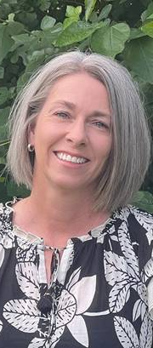
Leah Bentfield Program Manager MHFA Maryland
Dr. Cassaundra T. Wimes CMHC
Miami JCC
Caren Roth, LISW
CMHC
Ottumwa JCC

Slide 3
Mental Health First Aid
Leah Bentfield
Program Manager, MHFA Maryland
Mental Health Association of Maryland

Slide 4
A Mental Health Crisis
In 2019-2020, 20.78% of adults were experiencing a mental illness. That is equivalent to over 50 million Americans.
The vast majority of individuals with a substance use disorder in the U.S. are not receiving treatment. 15.35% of adults had a substance use disorder in the past year. Of them, 93.5% did not receive any form of treatment.
Millions of adults in the U.S. experience serious thoughts of suicide, with the highest rate among multiracial individuals. The percentage of adults reporting serious thoughts of suicide is 4.84%, totaling over 12.1 million individuals.
11% of adults who identified with two or more races reported
serious thoughts of suicide in 2020 – 6% higher than the average
among all adults.
2023 The State Of Mental Health In America, Mental Health America
Notes:
These first couple of slides are for presenting the problem. To persuade people, you have to tell a story and show what issues we’re trying to solve. Statistics help people visualize what exactly is wrong and how Mental Health First Aid can be part of the answer.

Slide 5

And That’s Not All…
Health problems in college-age students rose nearly 50% between 2013 and 2021, with over 60% of students meeting the criteria for one or more mental health problems.
Healthy Minds studied over 95,000 college students in 2022:
  40% screened positive for depression or an anxiety disorders.
  15% had suicidal ideation in the
  past year.
  47% had a lifetime diagnosis of any mental disorder.
Notes:
Make note of your sources in case people inquire.

Slide 6
Unique Needs of Emerging Adults
25% of young adults feel they lack companionship or feel left out, while 30% feel isolated from others often.
Youth with highly perceived public stigma around mental health treatment and suicidality are at significantly greater odds of having experienced suicidal ideation, planning and attempts within the past 12 months.
Students who are undocumented or on temporary documentation experience worse psychosocial wellbeing than students with permanent status or visas.
Barriers to Care:
Stigma about mental health challenges.
A negative experience with a therapist.
Lack of access, availability, and culturally appropriate care.
The financial burden.
Notes:
Youth with highly perceived public stigma - most often our racial minoritized students, including Black, Asian, Asian American, Latinx, Multiracial, Arab, Arab American, American Indian, Alaska Natives students.

Slide 7


Importance of Mental Health Across Communities
22.7% of people in non-metropolitan counties experienced a mental health condition.
The main barriers to mental health care in rural areas are the lack of available providers, higher rates of mental health stigma, lack of privacy, and the need for culturally relevant care.
LGBTQ+ teens are six times more likely to experience symptoms of depression than non-LGBTQ+ identifying teens.
23% of Native Americans reported experiencing discrimination in a health care setting.
In 2019, the leading cause of death for Native Hawaiians and Pacific Islanders ages 15-24 was suicide.
Notes:
1 https://www.samhsa.gov/data/report/2020-nsduh-detailed-tables
2 Substance Abuse and Mental Health Services Administration. (2022). Results from the 2021 National Survey on Drug Use and Health: Detailed Tables. Center for Behavioral Health Statistics and Quality, Substance Abuse and Mental Health Services Administration. https://www.samhsa.gov/data/report/2021-nsduh-detailed-tables
3 Mack, B., Whetsell, H., & Graves, J. M. (2022). National Rural Health Association Policy Brief: Mental health in rural areas. https://www.ruralhealth.us/NRHA/media/Emerge_NRHA/Advocacy/Policy%20documents/NRHA-Mental-health-in-rural-areas-policy-brief-2022.pdf

Slide 8
What can we do?

Slide 9

The Awkward Conversation

Slide 10
Mental Health First Aid
Mental Health First Aid is a skills-based training course that teaches participants about mental health and substance-use challenges.
Create a new path of resilience and wellbeing.
Increase the learner’s own mental health literacy and confidence when intervening.
Reduce stigma and discrimination.
Improve overall psychological safety.
Address mental health and substance use concerns with family, friends, colleagues, peers, and students.
Notes:
Help offered to a person developing a mental health challenge.
Like CPR, given until appropriate treatment and support are received.
Works to increase mental health literacy and decrease mental health stigma. Especially when a community, workplace, or school can reach at least 10% saturation with MHFAiders – creates an environment of care, curiosity, and conversation. Shared language.
Not a substitute for counseling, medical care, peer support or other professional treatment.

Slide 11
Where Mental Health First Aid Can Help

Slide 12

What Participants Learn
Risk factors and warning signs of mental health and substance use challenges.
Information on depression, anxiety, trauma, psychosis and substance use.
A 5-step Action Plan to help someone developing a mental health or substance use challenge.
Available evidence-based professional, peer and self-help resources.
Notes:
1 https://www.samhsa.gov/data/report/2020-nsduh-detailed-tables
2 Substance Abuse and Mental Health Services Administration. (2022). Results from the 2021 National Survey on Drug Use and Health: Detailed Tables. Center for Behavioral Health Statistics and Quality, Substance Abuse and Mental Health Services Administration. https://www.samhsa.gov/data/report/2021-nsduh-detailed-tables
3 Mack, B., Whetsell, H., & Graves, J. M. (2022). National Rural Health Association Policy Brief: Mental health in rural areas. https://www.ruralhealth.us/NRHA/media/Emerge_NRHA/Advocacy/Policy%20documents/NRHA-Mental-health-in-rural-areas-policy-brief-2022.pdf

Slide 13

MHFA Community Specific Courses
Mental Health First Aid is a skills-based training course that teaches participants about mental health and substance-use challenges.
Youth Mental Health First Aid (for adults assisting youth)
Teen Mental Health First Aid (peer-to-peer)
Y/MHFA in Chinese, Khmer, Korean, and Spanish
Notes:
YMHFA is designed to teach parents, family members, caregivers, teachers, school staff, neighbors, health and human services workers, and other caring citizens how to help an adolescent (age 12-18) who is experiencing a mental health or addictions challenge or is in crisis. This training is primarily designed for adults who regularly interact with young people.
Opportunities to further discuss: typical adolescent development, anxiety, depression, substance use, disorders in which psychosis may occur, disruptive behavior disorders (including AD/HD), and eating disorders.
Teen: Implemented differently, which an identified implementation site with the goal to create a shared language in a shared environment. This means that an entire cohort of students must be trained (all 9th graders) or an entire youth serving group (ages 14-18). 10% of staff need to be trained in YMHFA and parents must be met with in advance of these trainings.
You won’t find a tMHFA class to “pop in to” but may be something your local school district would be interested in implementing.

Slide 14


How to Get Involved
Take a Youth or Adult Mental Health First Aid Training
Dual certification
Become an Instructor
Everyone = Be a Mental Health Champion!

Slide 15
Maryland: MHFAMaryland.org
Missouri: MHFAMissouri.org
Nationally: MentalHealthFirstAid.org
JOB CORPS INFORMATION NOTICE NO. 22-09
Mental Health First Aid Training Resources
Sign Up Now
Notes:
Classes are offered online, in shortened in-person sessions called “blended”, and fully in person (for those of you who are sick of Zoom calls)
Some states have state-wide programs (Texas, Colorado, and North Carolina) but like Maryland, they may be for targeted populations.

Slide 16
Leah Bentfield
Program Manager, MHFA Maryland
Mental Health Association of Maryland
e. LBentfield@mhamd.org

Slide 17



Miami job corps center
Youth mental health first aid
Dr. Cassaundra Wimes

Slide 18

MIAMI JOB CORPS CENTER
YOUTH MENTAL HEALTH FIRST AID
YMHFA TRAINING BEGAN IN 2018
85 STAFF MEMBERS COMPLETED
CMHC TEAM REQUIREMENTS: YMHFA, TF-CBT, AND FLORIDA MANDATORY REPORTER TRAINING
METHOD (FREE):
  IN-PERSON LOCAL COMMUNITY PARTNER
  ONLINE PROVIDERS (Talkable Communities, EPIC)
  FUTURE GOAL: PROVIDE IN-HOUSE TRAINING

Slide 19
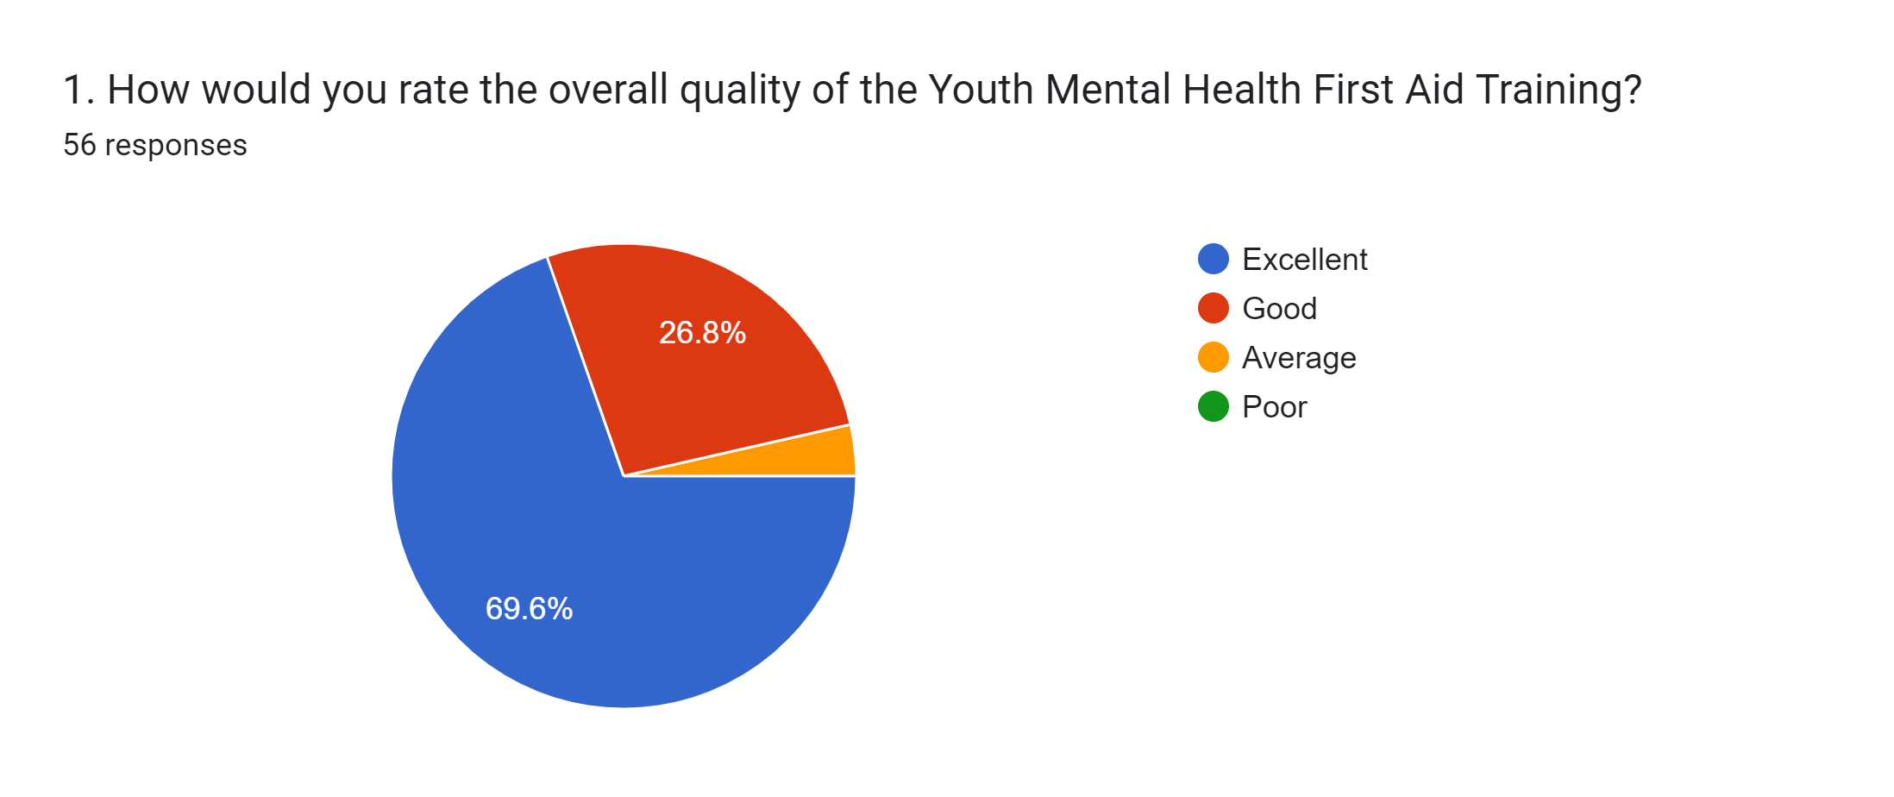
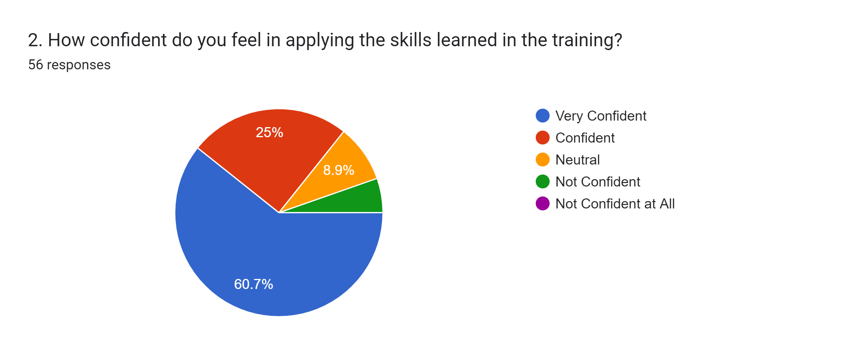
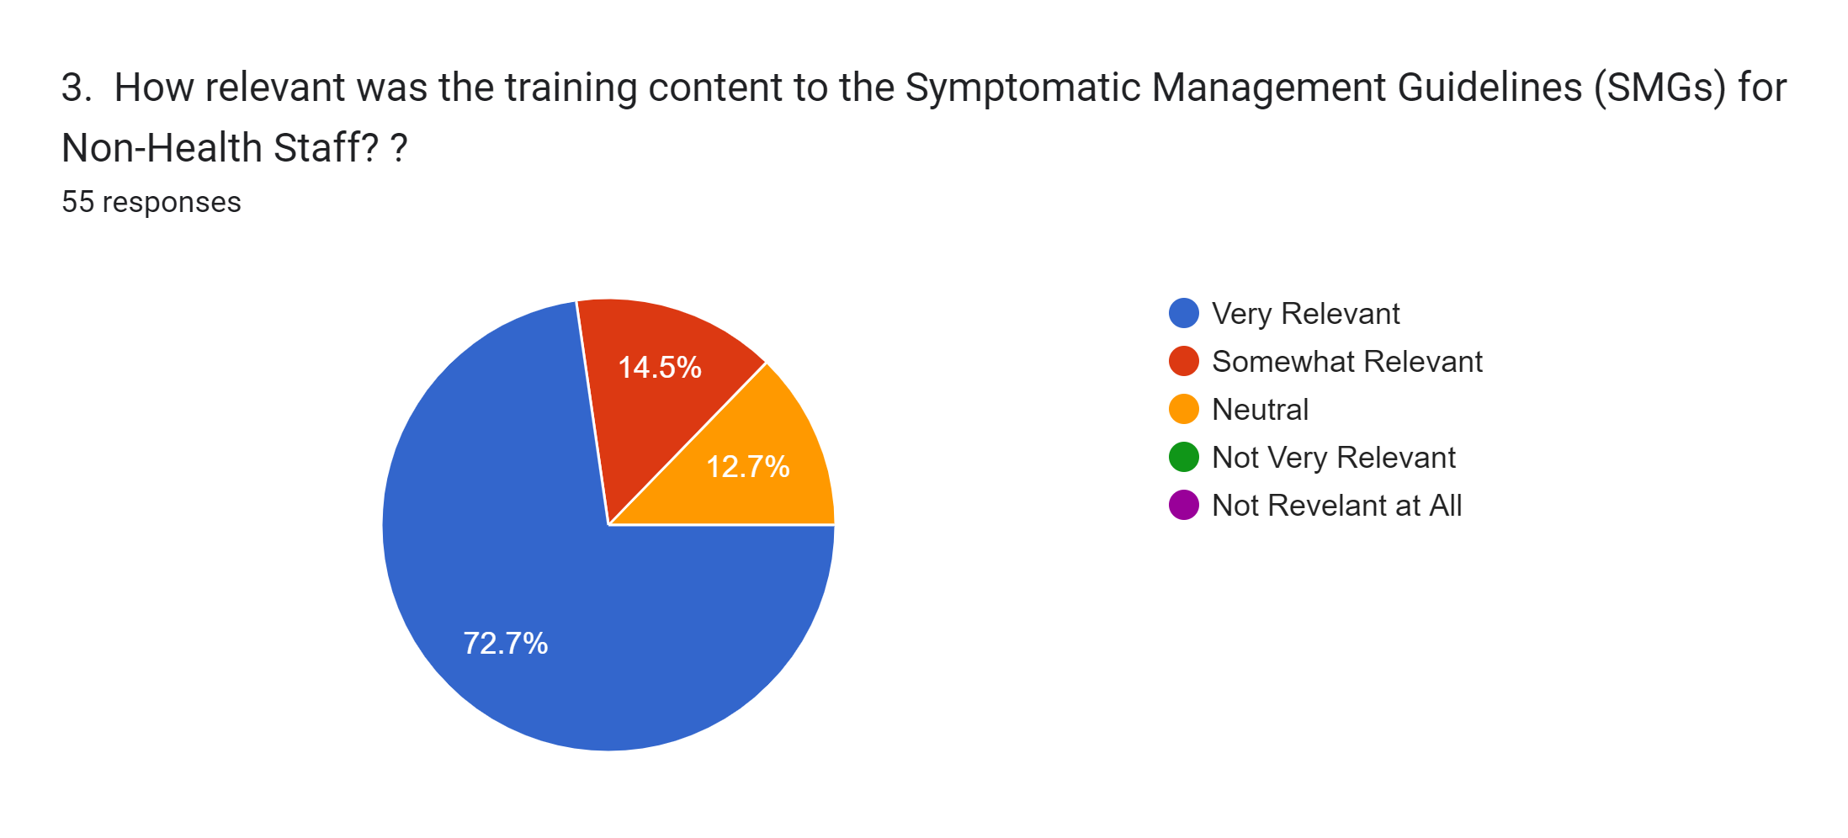
YMHFA Survey Results

Slide 20
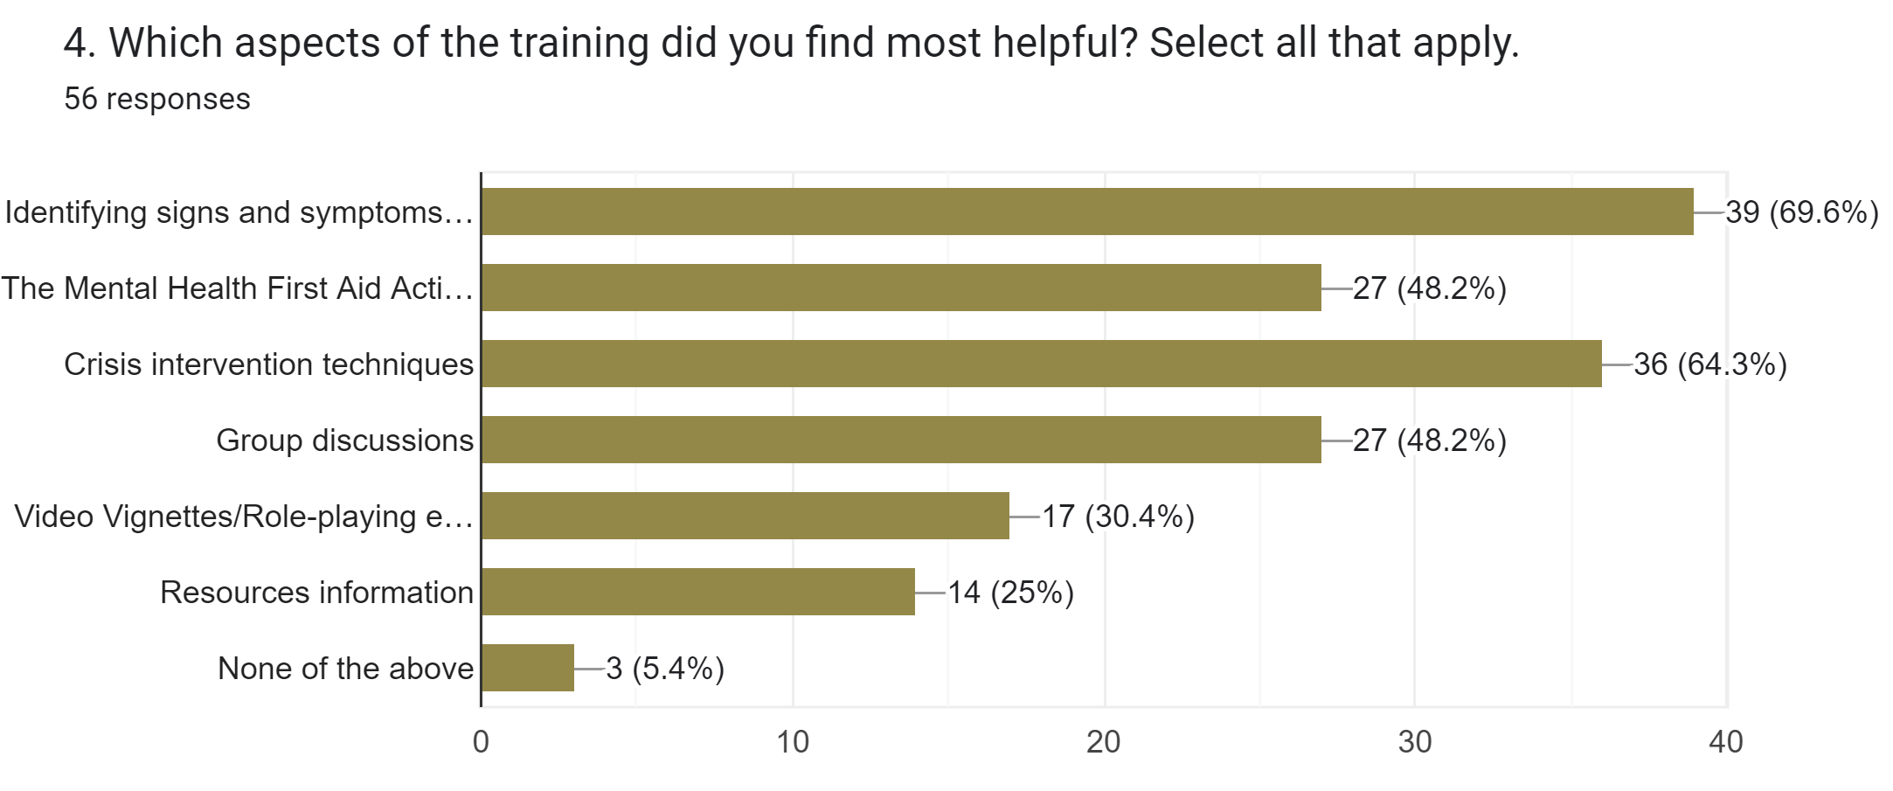
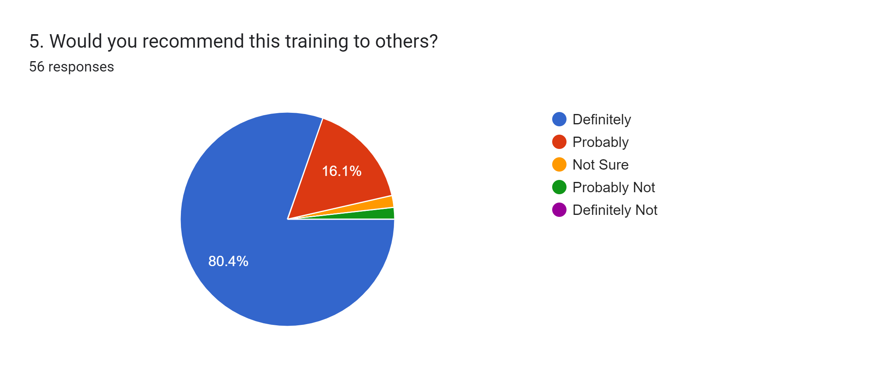
YMHFA Survey Results

Slide 21


THANK YOU!
Dr. Cassaundra Wimes
Center Mental Health Consultant (CMHC)
Qualified Supervisor
My contact information is:
Email: wimes.cassaundra@jobcorps.org
Phone: 305-620-3127

Slide 22
Mental Health First Aid
Ottumwa Job Corps Center

Slide 23
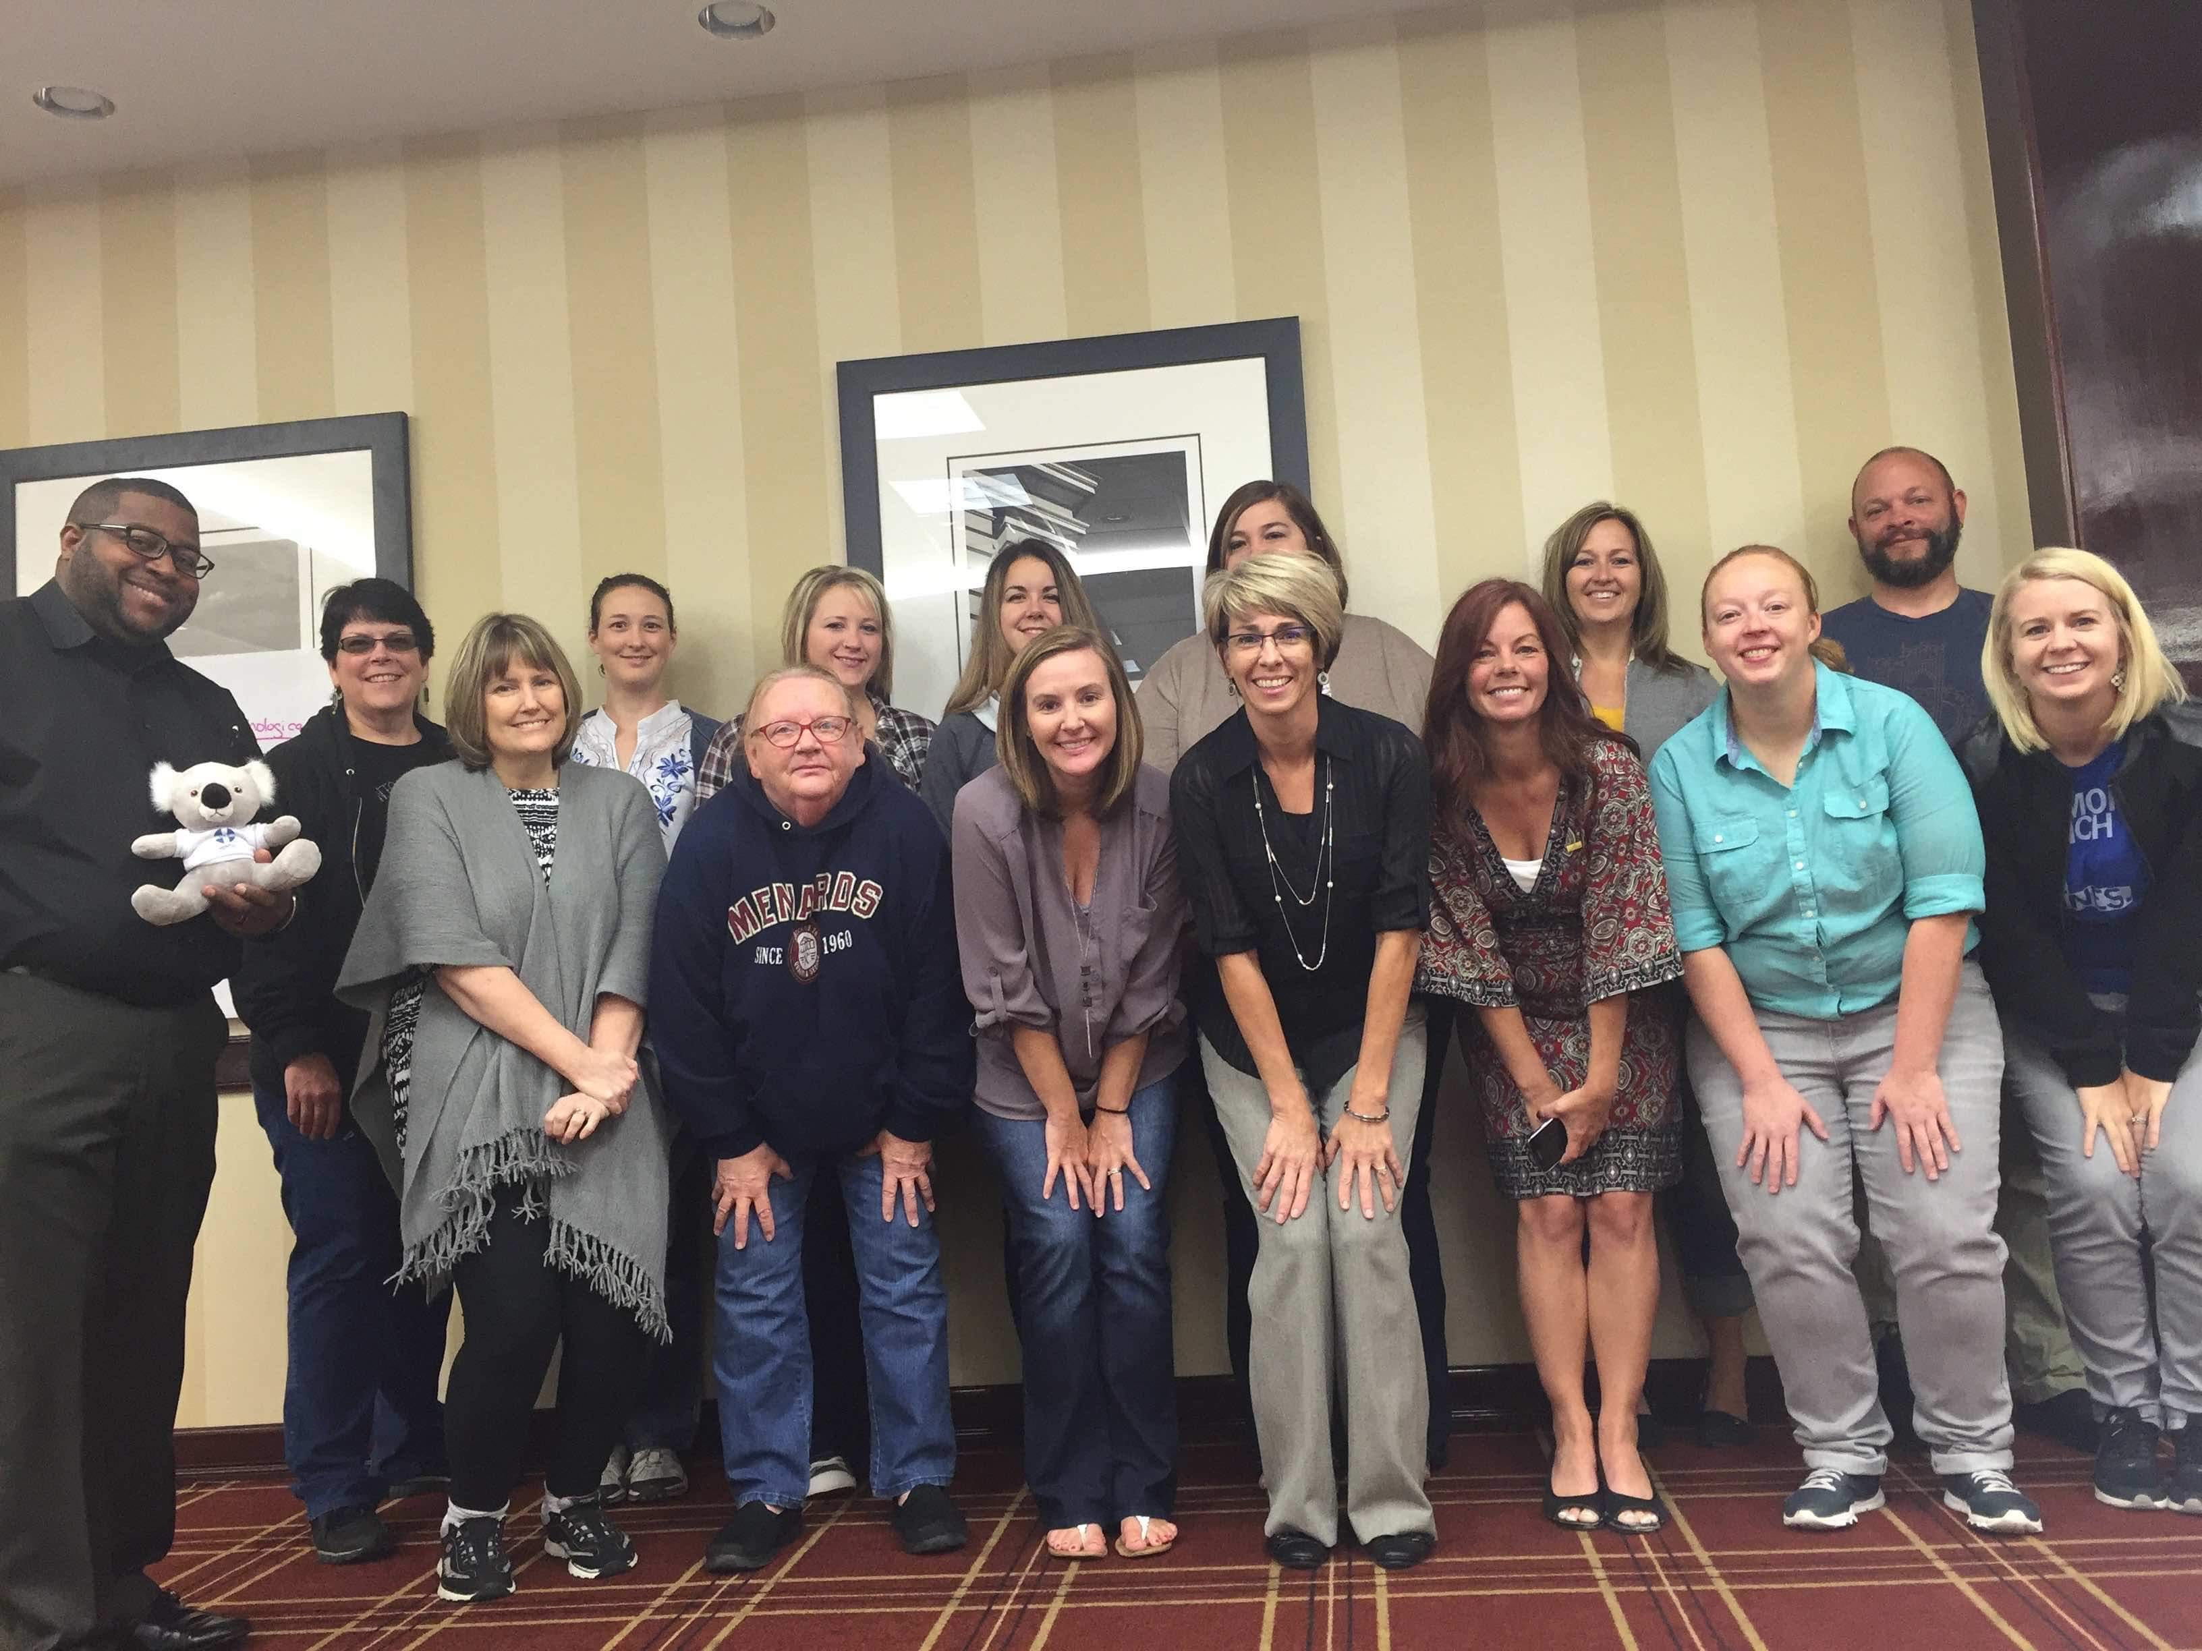
Mental Health First Aid
Ottumwa Job Corps Center
2016 – Began MHFA training
Training for all new staff

Slide 25
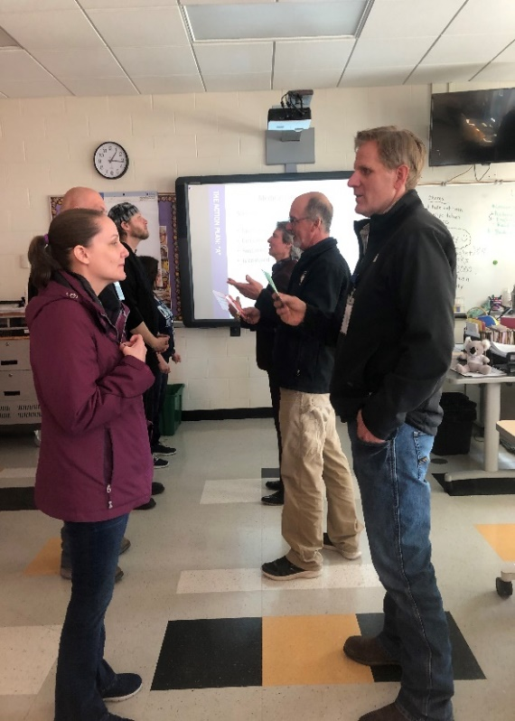
Staff Comments
“Learning the signs to look out for and better understand how mental health issues occur. I think this helps people see trainees and colleagues with compassion and less ‘difficult.’”
“To have a better understanding of mental health and how to help so we can help our trainees.”
“Learning how to deal with different behaviors, and knowing the why’s.”
“Being able to identify initial signs in someone even if they don’t know they are having issues themselves, having the confidence to bring it up to someone even if they might seem defensive at first, it allows them to know that you are there to help.”
“Getting all staff on the same page with terminology and appropriate crisis response.”
“A practical way to support our community with mental health concerns that is easy to follow.”

Slide 26
Mental Health First Aid
Ottumwa Job Corps Center
Mental Health First Aid has been an excellent training for our staff at OJCC. It has provided a basic foundation of mental health knowledge that helps bridge the gap between staff who may have previous experience and those who have little to none. It is a solid foundation on which the Center can then build off of. Implementing this training has increased the knowledge and confidence of our non-health staff, especially those staff working outside of normal business hours. Essential staff now have the “tools” to identify, and better handle mental health situations, which has decreased the number of phone calls that have gone to the on call nurses. The confidence of staff, along with consistency in how all staff handle mental health situations creates a safer culture on the Center; students feel safer.
Mandi Noll, BSN, RN, HWD

Slide 27

Why MHFA?
Common language
Common tools to use
Work together
Improved mental health and wellness

Slide 28
Questions

