Slide 1
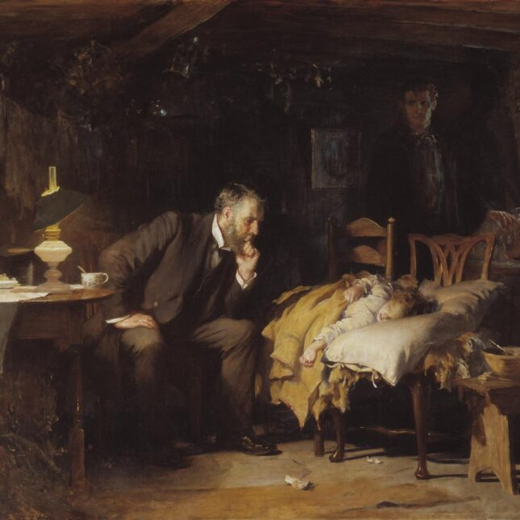
Mitigating Oral Cancer Risk Factors
Leveraging Interdisciplinary Approach and Behavior Modification for Young Adult Health
April 09 – April 10, 2024, Job Corps Webinar
Presenter: Razan Baabdullah, BDS, MS, FRCDC Assistant Professor of Oral and Maxillofacial Surgery
Moderator: Brian Swann, DDS, MPH
Lecturer on Oral Health Policy and Epidemiology

Slide 2
Objectives
Promote cessation of smoking, vaping, and excessive drinking to reduce associated health risks.
Implement behavior modification strategies based on theories to encourage positive lifestyle changes.
Increase awareness of the importance of routine oral cancer screening for early detection.
Emphasize effective communication in healthcare to enhance patient engagement and understanding.
Strengthen the chain of care by prioritizing prompt consultations and follow-up on referrals for improved outcomes.

Slide 3
40 seconds

Slide 4
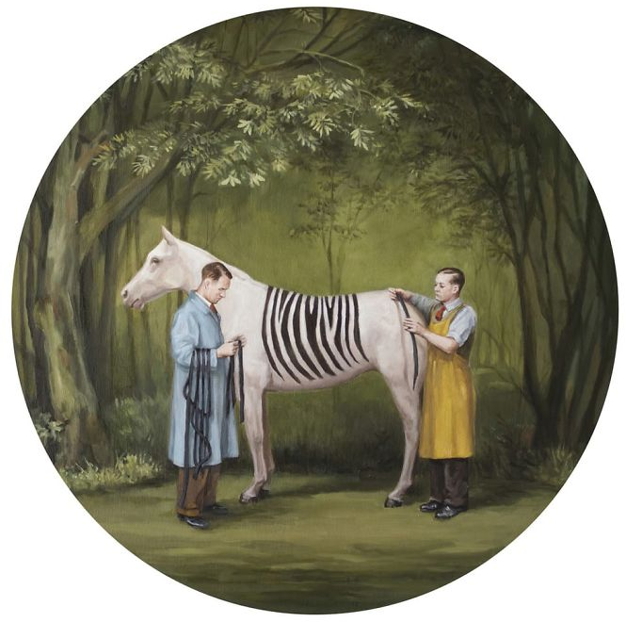
Painting by Toni Hamel
Notes:
Behaviors are complex, necessitating continual attention and nurture. Overcoming detrimental habits demands the collective effort of both oneself, as the agent initiating change, and the supportive individuals within one's social sphere. It calls for an interconnected web of support and compassion (chain of care).

Slide 5
“Sexually transmitted oral HPV infection (HPV-16) has recently been recognized as an increasingly important risk factor for oropharyngeal cancer. In the United States, the prevalence of oropharyngeal cancer due to oral HPV infection is probably as high as 80% to 95%”
“The overall prevalence of oral HPV infection is estimated to be 6.9% in adults aged 14 to 69 years in the United States. ”
USPSTF Oral Cancer Screening Recommendation: https://www.uspreventiveservicestaskforce.org/uspstf/recommendation/oral-cancer-screening
Notes:
USPSTF
https://www.uspreventiveservicestaskforce.org/uspstf/recommendation/oral-cancer-screening

Slide 6
In the US, HPV+ oropharyngeal cancer has outpaced other HPV+ cancer such as cervical cancer. ¹
HPV- oropharyngeal cancer
From 2.0 to 1.0 case/ 100,000 individuals
HPV+ oropharyngeal cancer
>3-fold
From 0.8 to 2.6 cases/100,000 individuals
1988 – 2004 ²
1. Ndon S, Singh A, Ha PK, Aswani J, Chan JY, Xu MJ. Human Papillomavirus-Associated Oropharyngeal Cancer: Global Epidemiology and Public Policy Implications. Cancers (Basel). 2023 Aug 13;15(16):4080. doi: 10.3390/cancers15164080. PMID: 37627108; PMCID: PMC10452639.
2. USPSTF Oral Cancer Screening Recommendation: https://www.uspreventiveservicestaskforce.org/uspstf/recommendation/oral-cancer-screening
Notes:
USPSTF
https://www.uspreventiveservicestaskforce.org/uspstf/recommendation/oral-cancer-screening

Slide 7
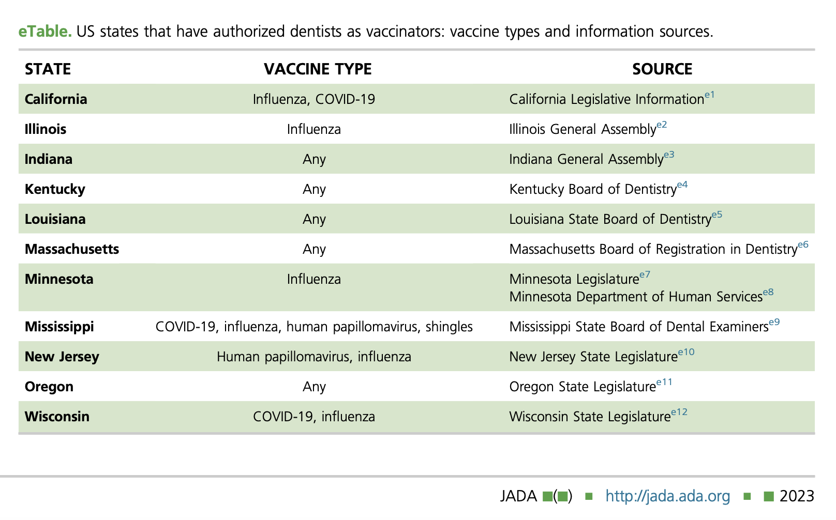
Villa A, Saremi M, Klausner JD, Murphy ME. Oral health care practitioners as vaccine administrators: The scenario in the United States. J Am Dent Assoc. 2023 Sep 15:S0002-8177(23)00487-7. doi: 10.1016/j.adaj.2023.08.006. Epub ahead of print. PMID: 37715780.

Slide 8
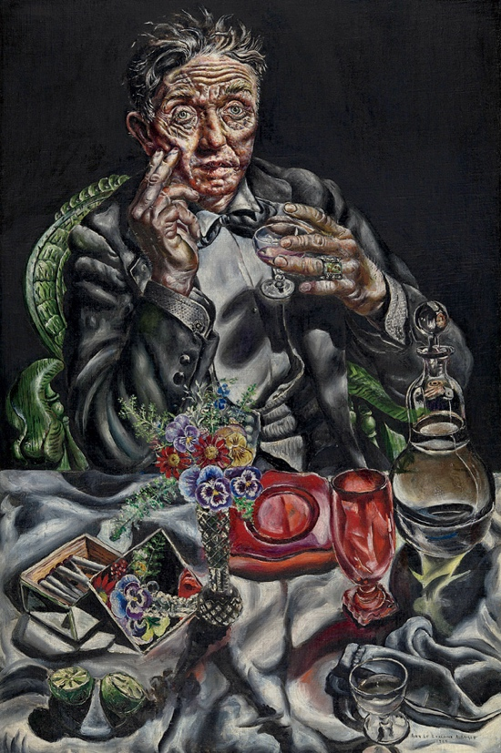
Risk factors
Painting by Ivan Albright

Slide 9
Approximately 90% of oral cancers are caused by smoking, alcohol consumption, and poor nutrition. ¹
Combining tobacco use with alcohol consumption augments the risk of oral cancer by thirty times. ²
USPSTF: “up to 75% of cases of oral cancer may be attributable to tobacco and alcohol use.” ³
1. Johnson N. Tobacco use and oral cancer: a global perspective. J Dent Educ. 2001;65(4):328-339.
2. American Cancer Society. Risk Factors for Oral Cavity and Oropharyngeal Cancers. https://www.cancer.org/cancer/oral-cavity-and-oropharyngeal-cancer/causes-risks-prevention/risk-factors.html. Published 2021. Accessed April 13, 2023.
3. Moyer VA; U.S. Preventive Services Task Force. Screening for oral cancer: U.S. Preventive Services Task Force recommendation statement. Ann Intern Med. 2014 Jan 7;160(1):55-60. doi: 10.7326/M13-2568. PMID: 24276469.

Slide 10
Intention to take action in the next 6M
Intention to take action within 30 days +behavioral actions already taken
<6M
No intention to take action within 6M
>6M
Picture obtained from: https://www.collidu.com/presentation-transtheoretical-change-model
Notes:
Source: https://www.collidu.com/presentation-transtheoretical-change-model
This circular not linear and each stage require different intervention

Slide 11
A change in any behavior is a process not a single event
Notes:
We see patients more than once. Not a single event

Slide 12
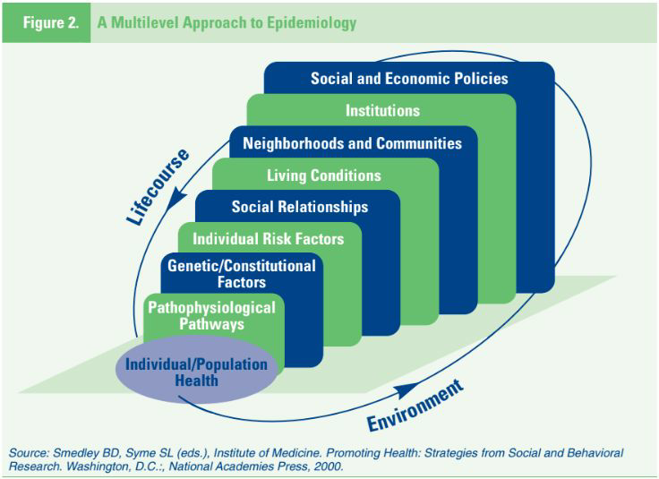

Slide 13
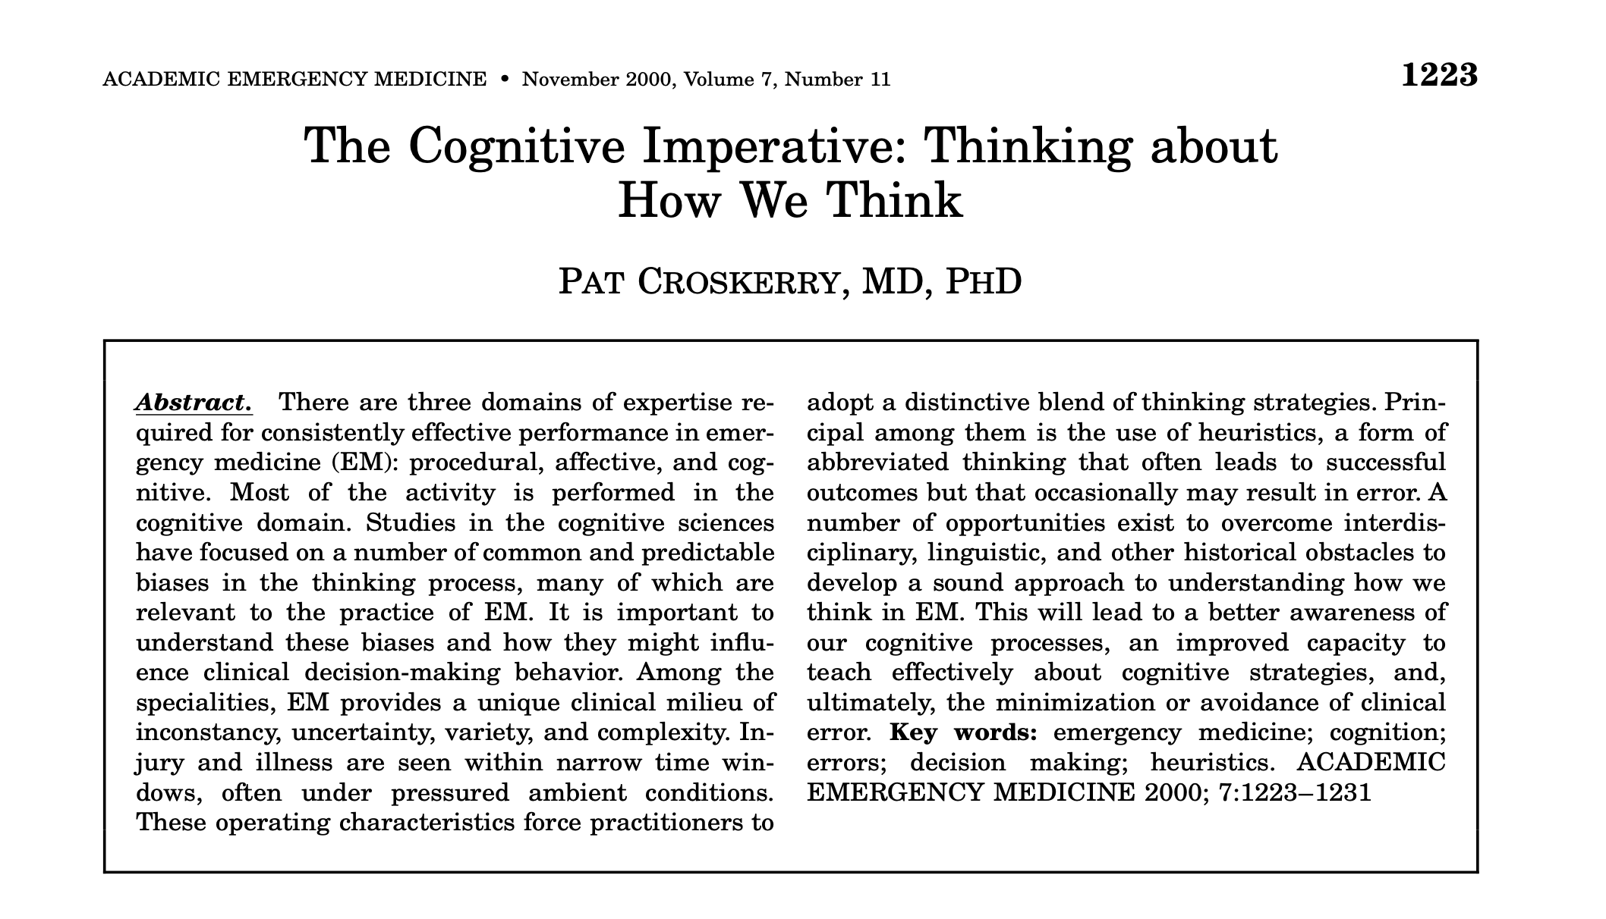
Notes:
Cognitive dimension of clinical decision-making

Slide 14
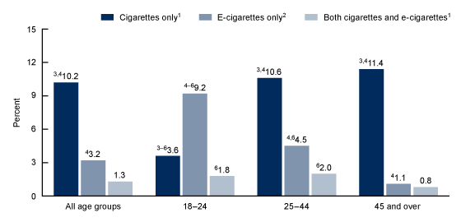
E-cigarettes
Age Groups
The age group that’s most significantly impacted by vaping in the US is 18-24.
Adults between 18 and 44 years old were more inclined to use both e-cigarettes and cigarettes concurrently compared to those 45 and older.
Screenshot and info obtained from: https://www.cdc.gov/nchs/products/databriefs/db475.htm
Notes:
https://www.cdc.gov/nchs/products/databriefs/db475.htm

Slide 15
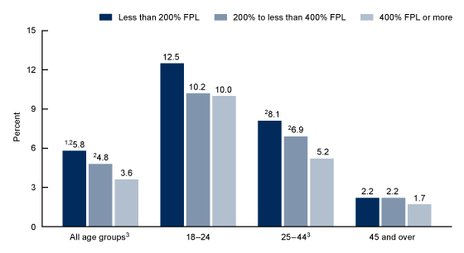
E-cigarettes
SES
Screenshot from: https://www.cdc.gov/nchs/products/databriefs/db475.htm
Notes:
https://www.cdc.gov/nchs/products/databriefs/db475.htm
“The percentage of adults who used e-cigarettes generally decreased as family income increased.”

Slide 16
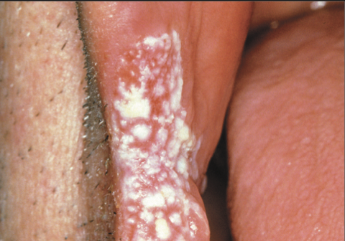
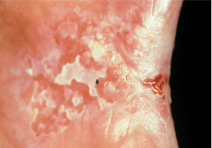
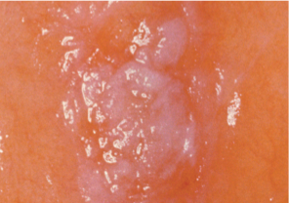
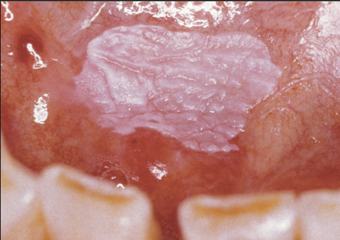
Photos obtained from Detecting Oral Cancer: A guide for healthcare professionals, National Institute of Dental and Craniofacial Research August 2020
Notes:
Precancerous lesions
Photos obtained from Detecting Oral Cancer: A guide for healthcare professionals, National Institute of Dental and Craniofacial Research August 2020

Slide 17
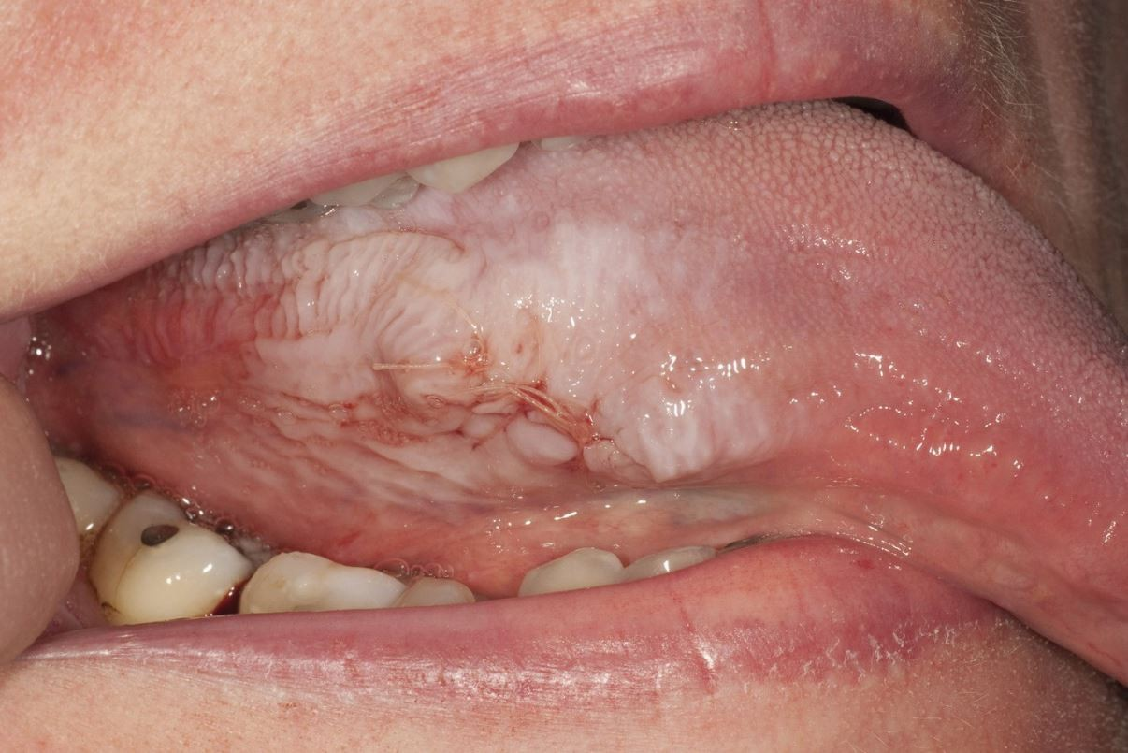
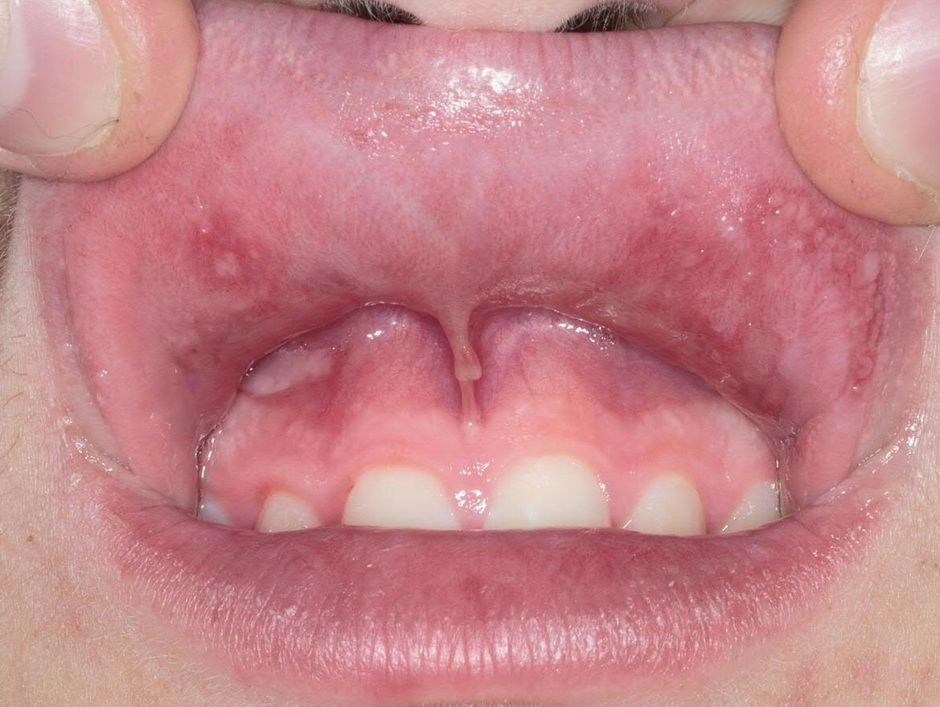
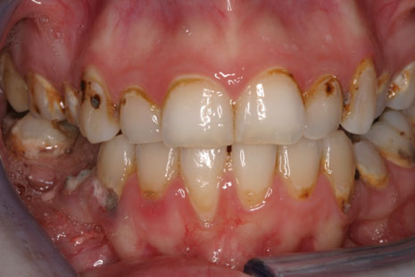
2
1
3
4
Effect of vaping on oral mucosa
Photos obtained from:
https://www.nature.com/articles/s41415-020-1530-x
https://onlinelibrary.wiley.com/doi/abs/10.1111/pde.14101
https://drneilzane.com/vaping-and-oral-health-its-worse-than-you-think/
https://onlinelibrary.wiley.com/doi/abs/10.1111/ors.12499
Notes:
Effect of vaping on oral mucosa
Photos obtained from:
https://www.nature.com/articles/s41415-020-1530-x
https://onlinelibrary.wiley.com/doi/abs/10.1111/pde.14101
https://drneilzane.com/vaping-and-oral-health-its-worse-than-you-think/
https://onlinelibrary.wiley.com/doi/abs/10.1111/ors.12499

Slide 18
Why bother?

Slide 19
Oral Cancer Awareness Month

Slide 23
Create more entry points
Train more healthcare providers to screen for oral cancer

Slide 24
What can we do?
Oil painting by Samuel Luke Fildes
Notes:
"The Doctor," oil painting by Samuel Luke Fildes

Slide 25
This is Quitting text-message program
Within the first five weeks:
13,421 teens + 13,750 young adults enrolled
Set a quit date (the day of enrollment)
teens (69%) and young adults (74%)
2 weeks “reduced or stopped using e-cigarettes”
60.8%
3 months “quit vaping for 30-days or longer”
15.5%
Source: https://truthinitiative.org/research-resources/quitting-smoking-vaping/more-half-young-people-consider-quitting-vaping-2022-new

Slide 26
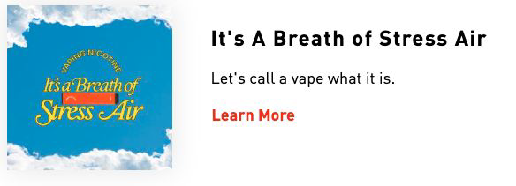
FRAMING

Slide 27
Appealing to Emotion
CDC: Tips from former smokers -- Tammy W.
CDC: Tips from former smokers – Christine

Slide 28
Why Communication Matters in Healthcare?
Rapport
Influence behavior
Social change
Patient satisfaction = everyone’s happy = less complaints

Slide 29
How much time do we spend with our patients?
Primary healthcare:
In a global systematic review, patient consultation times varied significantly, ranging from 48 seconds in Bangladesh to 22.5 minutes in Sweden.
half of the world's population (across 18 countries) spends 5 minutes or less on average during consultation visits with primary healthcare physicians.
Irving G, Neves AL, Dambha-Miller H, Oishi A, Tagashira H, Verho A, Holden J. International variations in primary care physician consultation time: a systematic review of 67 countries. BMJ Open. 2017 Nov 8;7(10):e017902. doi: 10.1136/bmjopen-2017-017902. PMID: 29118053; PMCID: PMC5695512.

Slide 30
Chain of care
Dental hygienist
Tobacco use prevention program
dentist
PCP
Nurses
Behaviorist
Specialists
Notes:
see something say something - ask you patient about quitting smoking- refer your patient - follow up on the referral “I recognize because I have observed your behavior” -- Dr. Swann “you’re the one we have been waiting for”

Slide 31
AI generated painting - source: https://www.craiyon.com/image/ySqgO87-TIa1Uvl3u3k4MQ
Notes:
Swiss cheese: the importance of chain of care. Work as a team. Catch what someone else missed. And they will catch what you missed.

Slide 32
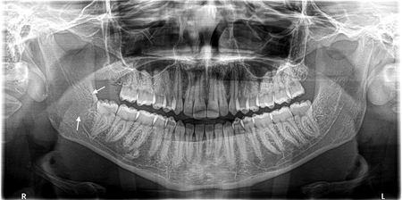
Case obtained from: Razan Baabdullah, Jordan Gigliotti, Nicholas Makhoul, and Sungmi Jung. 6/7/2021. “Desmoid Fibromatosis of the Maxillofacial Region: A Case Report and Review of the Literature.” Oral Health

Slide 33
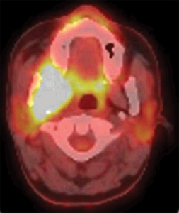
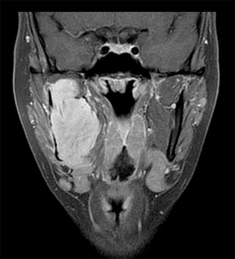
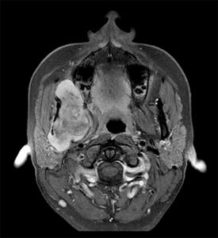
Case obtained from: Razan Baabdullah, Jordan Gigliotti, Nicholas Makhoul, and Sungmi Jung. 6/7/2021. “Desmoid Fibromatosis of the Maxillofacial Region: A Case Report and Review of the Literature.” Oral Health

Slide 34
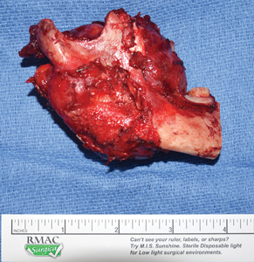
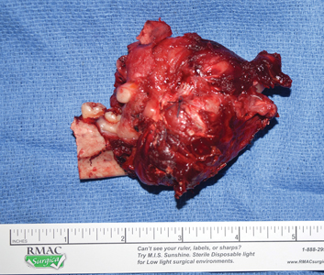
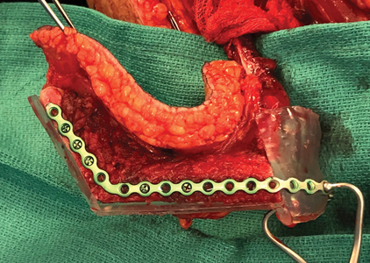
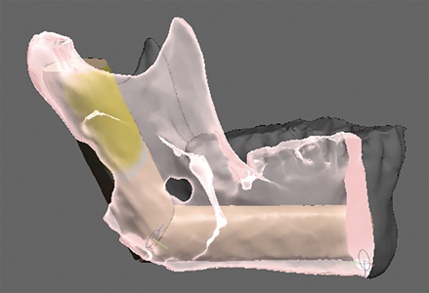
Case obtained from: Razan Baabdullah, Jordan Gigliotti, Nicholas Makhoul, and Sungmi Jung. 6/7/2021. “Desmoid Fibromatosis of the Maxillofacial Region: A Case Report and Review of the Literature.” Oral Health

Slide 35
Chain of care
Dental hygienist
Tobacco use prevention program
dentist
PCP
Nurses
Behaviorist
Specialists
Notes:
see something say something - ask you patient about quitting smoking- refer your patient - follow up on the referral “I recognize because I have observed your behavior” -- Dr. Swann “you’re the one we have been waiting for”

Slide 36
Job Corps Resources
I. Mental Health and Wellness Program (PRH 2.3-7, R5,6)
- Health History Form
- Student Health Record
- Mental Health Intake Assessment form
- Short term counseling
- Long term counseling referred out
- Focus on employability

Slide 37
Job Corps Resources
II. Trainee Employee Assistance Program (TEAP) ( PRH2.3-7, R5,6)
- Health History Form
- Student Health Record
- Interventions, refer off Center
- Motivational interviewing
- No counseling
- Desk Reference Guide - summary
III. Tobacco Use Prevention Program (TUPP) (PRH 2.3-5, R5,6)
- Health History Form
- Student Health Record
- Quality varies across Centers
- PRH - no specific programs listed

Slide 38
Job Corps Resources
V. Topics
- assessment
- treatment
- education
- intervention strategies
- documentation
- support services
- referrals – on and off Center
- opportunities for collaboration
IV. Vaccination Vaccines for children- public health offering all recommended vaccines (free vaccination for students aged 18 and under)

Slide 39
Questions? Thoughts?
Thank you!

