Slide 1
Student Satisfaction in HWC
Jason Young, RN
Julie Luht, MPH
Notes:
Julie
Today Jason and I are going to talk about strategies to increase student satisfaction in the Health and Wellness center. This was part of the presentation at the recent NCJA conference. We were running a little short on time so decided it would be beneficial to repeat it for the people who were there and also to share it with a wider audience.

Slide 2
Job Corps 2.0 Pillars
1 | Modernize Student Enrollment
2 | Foster a Positive Student Experience
3 | Modernize Training Programs
4 | Develop Meaningful Partnerships
5 | Ensure Successful Transition to Employment
6 | Enhance Federal Oversight of Center Operations
7 | Rebrand Job Corps
Notes:
Julie
You may be familiar with the Job Corps 2.0 pillars. As Job Corps moves forward, one of the central goals is to foster a positive student experience. This is measured by student’s perception of the program. We want students to be satisfied with the services they receive in all areas of center, so they are more successful in completing the Job Corps program.

Slide 3
Agenda
Healthcare industry standards
Student survey takeaways
Value-added services
Notes:
Julie
We’re going to share several tips and tricks with you during this presentation. We’re going to review some healthcare industry standards, takeaways from the student satisfaction survey, and then share some value added services with you.

Slide 4
Healthcare Industry Customer Service Standards
Notes:
Jason
We’re going to start by looking at the lessons learned in the healthcare industry. Incorporating these industry standards will improve all of the student satisfaction indicators and provide better services in general for students.

Slide 5
Student Safety
Protect students from harm
Prevent medical mistakes and injuries
Quality improvement
Care coordination
Monitoring outcomes
Notes:
Jason
Let’s first look at student safety.
Student safety is defined as freedom from accidental or preventable injuries produced by medical care. Having a positive student safety culture can help reduce medical errors and increase productivity among healthcare staff. Healthcare providers should take steps to protect patients from harm, including preventing medical mistakes and injuries, so students can trust the health and wellness to provide them with high-quality care.
Effective student safety interventions focus on reducing the risk of student harm, engaging students in quality improvement, improving care coordination between providers, and monitoring outcomes of student safety events. Investing in student safety can positively impact health outcomes, reduce costs related to student harm, improve system efficiency, and help reassure students and restore their trust in health and wellness.

Slide 6
Effectiveness
Collaboration in treatment plans
Teamwork
Notes:
Jason
For a health and wellness team to be effective, each member of the team needs to be familiar with each other’s responsibility in completing student treatment plans. Each individual in wellness needs to understand the duties of each team member to work effectively, increasing the team’s skills as duties sometimes overlap. As part of the wellness team, appreciation develops for the roles of each wellness team member as all work together in the best interest of the student.

Slide 7
Student-centeredness
Dignity and respect
Involve in all healthcare decisions
Notes:
Jason
Student-centered care involves treating a student receiving healthcare with dignity and respect and involving them in all decisions about their health. Every student has unique individual needs. Healthcare providers must look at the individual and have students play active roles in their own care. This concept is especially important for those with chronic conditions that require life-long monitoring and care.

Slide 8
Timeliness
Provide care quickly after a need is identified
Consider barriers
Notes:
Jason
Timeliness in healthcare is the system's capacity to provide care quickly after a need is recognized. One of the most common complaints among students is delivery of care.
Delays in treatment are not only frustrating but also may be life-threatening in severe cases.
Healthcare systems should consider the barriers that prevent or delay treatment and focus on breaking down these barriers to allow students to receive diagnosis, treatment, or even preventive care in a timely manner.
Manage why an issue is now perceived to be urgent.

Slide 9
Efficiency
Commitment to treatment plans and delivery of care
Delegation
Notes:
Jason
Health and wellness teams “committed” to treatment plans and delivery of care to the student tend to be more efficient and utilize resources better. When the team approach is adopted by the health care providers, our centers become more successful in treating our students, improving student employability, and reducing student and staff turnover. Efficiency is realized even more when the health and wellness team is empowered or delegated to perform actions that fit their skill and resources.

Slide 10
Notes:
Jason
Health equity is the state in which everyone has a fair and just opportunity to attain their highest level of health. This is where we at Job Corps distance ourselves from others. We know there are examples of explicit and implicit biases in the healthcare system that impact our student's health outcomes. Our multidisciplinary healthcare teams at Job Corps look for ways to deliver quality healthcare and remove these biases that may have prevented our students from accessing the quality care they deserve or need.
Job Corps is unique, in that, we offer availability of mental health, medical health, oral health, and substance abuse treatment. This improves employability and prepares our students for life after Job Corps, setting a stable health foundation.

Slide 11
The Students’ Perception
Student Experience Assessment results
February 2024
Notes:
Julie
So, how are we doing? The recent trends haven’t been great.
This is how we measure our student’s satisfaction with health and wellness services.
Do we clearly explain available health services?
Do we help students understand their healthcare needs?
Do we treat students with respect?
Do we protect student’s privacy?
Do we teach students to manage their health better?
Are we available to students when they need services?
Do we help students get services off center?
Each of those measures is trending downward. Let’s get started with some practical ways to raise these scores.

Slide 12
Reflection
Why do you think student satisfaction in the HWC has decreased?
Notes:
Julie
Many times our first inclination when we see negative perceptions is to argue the perception. But there’s usually a hint of truth. Why do you think that student satisfaction in the HWC has decreased?

Slide 13
Expectation
Notes:
Julie
Overarching in many of the student satisfaction measures is that expectations aren’t meeting reality.
The purpose of the student introduction to health services is to set realistic expectations. The concept of reality falling short of expectations is something that we have all experienced.
It’s like when you go into Burger King and order a burger that looks delicious on the menu and a tiny little smushed burger comes out.
I have a recent experience with this. I ordered this fireball prop for a large online retailer for a project. This is what the picture looked like in the ad.

Slide 14
Reality
Notes:
Julie
This is what I got: a Christmas ball with some battery-operated lights, wrapped in a red plastic tablecloth. The reality definitely did not meet my expectations. This is what it feels like when students expect more services than Job Corps offers.

Slide 15
Share
This Photo by Unknown Author is licensed under CC BY-SA
Notes:
Julie
We know you all have stories about this. It’s a really common experience. Tell us about a time this happened to you.
How did you feel?

Slide 16
Notes:
Julie
Disappointment is the gap that exists between expectation and reality. Give that a moment to sink in. We’ve clearly set ourselves up for a lower student satisfaction score the moment we set their expectations higher than the reality. That can be during the admissions period when we’re trying to sell students on coming to center. It can also be during student introduction to health services.

Slide 17
Fix It
Notes:
Julie
The simplest way to fix this is to tell students the truth. This is important all the time, but especially vital early on.
We haven't earned our students’ trust upon enrollment. We earn that trust through availability, communication, respect, education, and quality care. We can see from recent student satisfaction surveys that in our student's eyes, we are not meeting their expectations.
Explain why it is the way it is.

Slide 18
Qs 1,6,7,8: Clearly Explain Health Services
Include:
All available services (Q1)
Services Job Corps does not provide (Q1)
Open hours (Q 6 & 7)
When off-center care is available (Q 8)
Notes:
Julie
Starting with the introduction to health services. This should include both what Job Corps provides, and just importantly, what Job Corps does not provide. Ensure this is consistent and direct communication.
This is also a great opportunity to set expectations about HW open hours, services available during the training day, and accessing off center care.

Slide 19
Notes:
Julie
But what if you did a great job explaining health services and the students didn’t hear you?
Admissions services told students exactly what to expect
H&W staff provided a complete explanation.
Maybe students were distracted. Maybe we present students with more information than they can digest all while they are experiencing a major life change? What if the rumor mill is in full effect saying that we offer cosmetic surgery?
You did everything right and still– more than 30% of your students said that H&W services weren’t explained adequately. They think HW should be open on weekends and they should be able to walk in during the training day.
What do you do then?

Slide 20
Hack #1:
“Did I clearly explain available health services to you? Or do you have any questions that I can answer?”
Notes:
Jason
Here’s the hack.
You repeat the satisfaction question back to the students. Ask “Did I clearly explain available health services to you? Or do you have any questions that I can answer?”
Then answer questions. If they say that they are clear on services. Say it again. “I’m glad that I was able to clearly explain health services to you. If you think of any questions please come back to me, so I can clear them up.”
This does two things. It gives you the chance to raise your score by correcting the problem. It also helps the student to recognize the wording in the question.

Slide 21
Hack #2:
Use Your Wellness Committee, SGA, and Peer Mentors
Notes:
Jason
The second hack is to you’re your wellness committee, SGA, and peer mentors to reinforce the message.
People need to hear the same message over and over in order to internalize the message. After somewhere between 3-9 repetitions, most people internalize the message and take action. Use all of your available options to create repetition.

Slide 22
Q2 & 5: Understand and Manage Health Care Needs
Knowledge about diagnosis and treatment
Empower student to control their treatment
Improvements in clinical outcomes
Notes:
Julie
Providing your students with the necessary information is critical to achieving a positive student experience within health and wellness. A student will feel empowered when he or she leaves your office with more knowledge about his or her diagnosis and treatment options. Educate the student on ways they can impact their treatment, thus empowering them. Studies have revealed that greater patient empowerment leads to better patient adherence, which leads to improvements in student satisfaction and clinical outcomes.

Slide 23
The Same Hack
[Explain healthcare needs and plan.]
“Do you feel like you understand your healthcare needs? Or do you have any questions that I can answer?”
“Do you have any questions about our plan to manage your health?”
Notes:
Luckily, questions 2 and 5 have the same hack as question #1. Check in with the student! Make sure they understand and hear these words over and over. Do this at every visit.
Invite the student to come back with any questions.

Slide 24
Q3: Respecting the Student
Notes:
Julie
Question number 3 has to do with whether the student feels like they have been treated with respect.
Displaying respect for students is part of the foundation of excellent healthcare. Respect is the intentional act of showing consideration for another person's interests and well-being. The health and wellness team recognizes another human being as someone with their own likes and dislikes, thoughts and ideas, and values and morals.

Slide 25
Respectful Communication
Listen to student concerns and barriers
Notes:
Julie and Jason
A health and wellness team who takes time to listen and understand student concerns and barriers are better prepared to address issues as they arise, which results in better student outcomes.
In contrast, poor communication, or lack of communication in a health and wellness department can lead to distrust among students, misunderstanding of care directions, and failed treatment protocols.
A connected health and wellness team will provide explanation of services, education on treatment, and answer questions as they arise.
Tie into how you want your children to be talked to.

Slide 26
Barriers to Respect
Not listening to concerns or answering questions
Failing to make eye contact
Not following up on promises made
Disregard for the student and/or staff beliefs
Absence of resources or equipment to provide quality care
Lack of professionalism
Notes:
Julie
The following are common barriers to respect:
Not listening to concerns or answering questions
Failing to make eye contact
Not following up on promises made
Disregard for the student and/or staff beliefs
Absence of resources or equipment to provide quality care
Lack of professionalism

Slide 27
Frequent Utilizers
Solutions:
Give scheduled visits
Involve CMHC
Ask questions
Notes:
Jason
One area where respect sometimes breaks down is when H&W staff become annoyed at students who are frequent utilizers of health services. Students might inappropriately overuse healthcare for a few reasons. Often, staff jump to the conclusion that students frequent the HWC because they want to get out of class. Sometimes this is true. Other times, they are dealing with an issue, like anxiety and are working up the courage to talk about the issue. There are a few ways to handle this concern. First, consider giving the student scheduled visits to talk about their health concerns. This can start out weekly and then gradually decrease. Sometimes knowing a visit is scheduled helps alleviate some anxiety. If the student is still visiting the HWC frequently, involve the CMHC. Perhaps the CMHC can get to the route of the issue. And, of course, ask questions, keeping in mind that often the reason the student is actually overusing health services is not the reason that they are giving when they come in.

Slide 28
Q 4: Privacy
Talk about how you protect it
Never, ever talk about a student in front of other students
Notes:
Julie
Our centers are protecting confidentiality. A lot of times students don’t see the safeguards put in place.
First, talk to students about how you protect their privacy. Talk about the locked file cabinets and how seriously you take privacy concerns.
You also don’t really get a slip-up when it comes to privacy, so be diligent. As soon as the perception becomes that a student’s health privacy isn’t protected, this goes down the tubes.
Never, ever talk about a student in front of other students. This is where I’ve seen the confidentiality violated. Sometimes it’s talking to a student about their own health in front of others.

Slide 29
Q 6 & 7: H&W Staff Availability
Differentiate the HWC from the school nurse model
Be available
Be visible
Notes:
Julie
These questions are a little tricky. In fact, our HWC model is not to be always available for walk ins. And then we ask students to rate our availability during the training day. That’s actually a tricky question, because our policy is to handle appointments and emergencies during the training day, but not walk-ins. This is different from what students have experienced in the past. In school, there was most likely a school nurse they could visit at any time when they weren’t feeling well. One of our jobs is to communicate that our model is different- it’s less like school and more like the workplace.
Making ourselves available to the students is a crucial first step in earning respect from our students. Yes, there will be times the students have to be educated on walk-in hours and appointment times, but this can be accomplished through respectful dialogue and open conversation.
We might be unaware of why the student wasn't able to arrive on time. Let's try and be understanding.

Slide 30
Add Some Perks
Notes:
Julie
We’ve now addressed how to meet the baseline measures on the survey, but there’s a whole world of value-added services. Patient satisfaction increases when you add some perks. These could be programs, they could be additional comforts. They could be based on the results of a needs assessment. We’re going to share a few perks that centers are providing to students on the next few slides.

Slide 31
Trauma Informed Approach
What happened to you vs.
What’s wrong with you
Notes:
Julie
A Trauma Informed Approach has worked well on so many Job Corps centers. This isn’t a tangible perk that students can see, but it is a cultural shift that goes a long way.
We know that many of our students come from childhoods filled with trauma. Many witnessed violence. Some had insecure housing. Some were victims of abuse. This is why we talk about a trauma informed approach so often.
If you take away one new practice from this presentation, take away this. When confronted with undesirable student behavior, come at it with an approach of what happened to you versus what’s wrong with you. Treating students in this manner has the potential to effect student satisfaction in all areas, both within wellness and throughout center.

Slide 32
Flatwoods Zen Den
Notes:
Some Job Corps centers have done really cool things to give students a bit of luxury on center. Here’s Flatwoods Zen Den, a tranquil relaxation and meditation area.

Slide 33
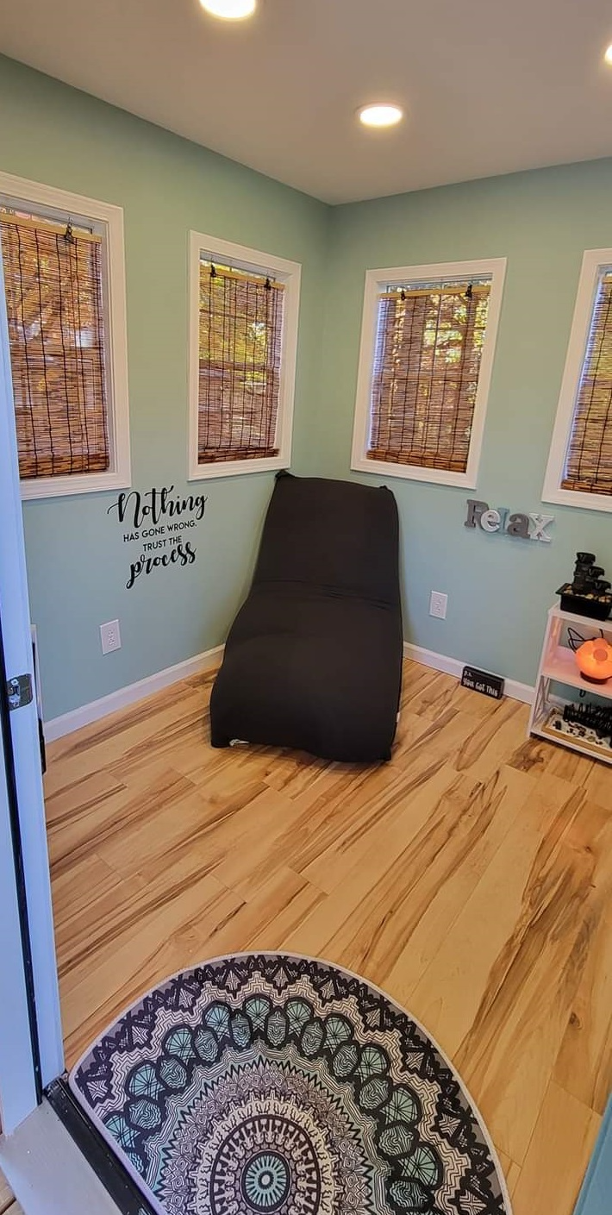
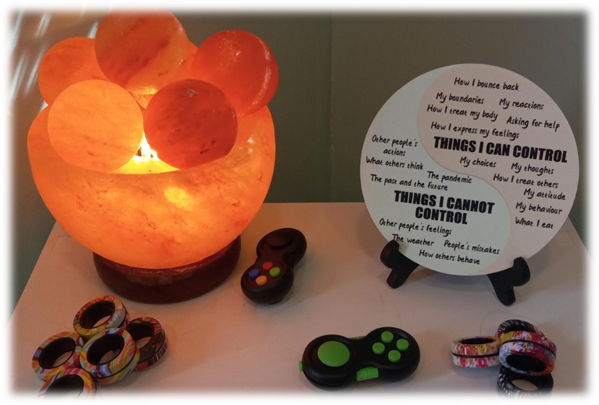
A look on the Inside……….
Notes:
Inside the Zen Den, you will find:
Bean bag
Rocking chair
Himalayan salt lamps
Wind chime
Water fountain
Art materials

Slide 34
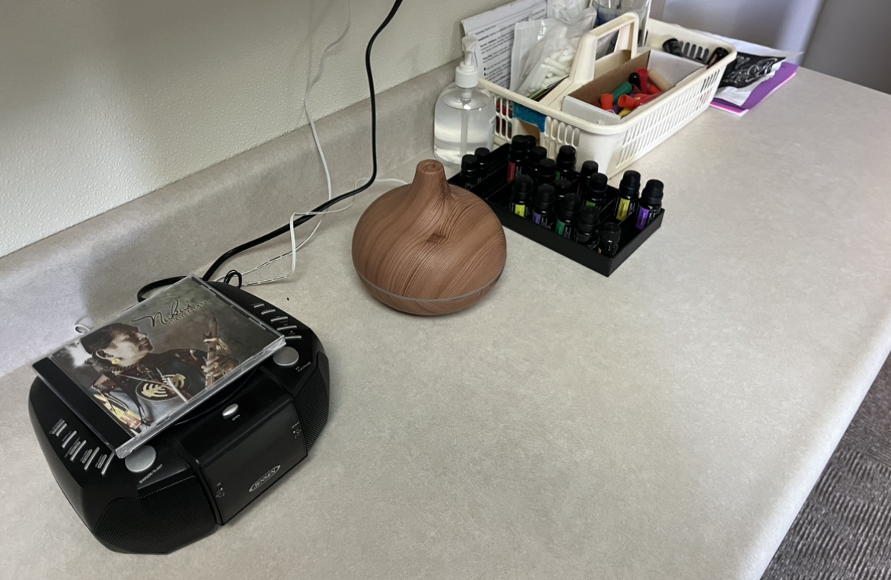
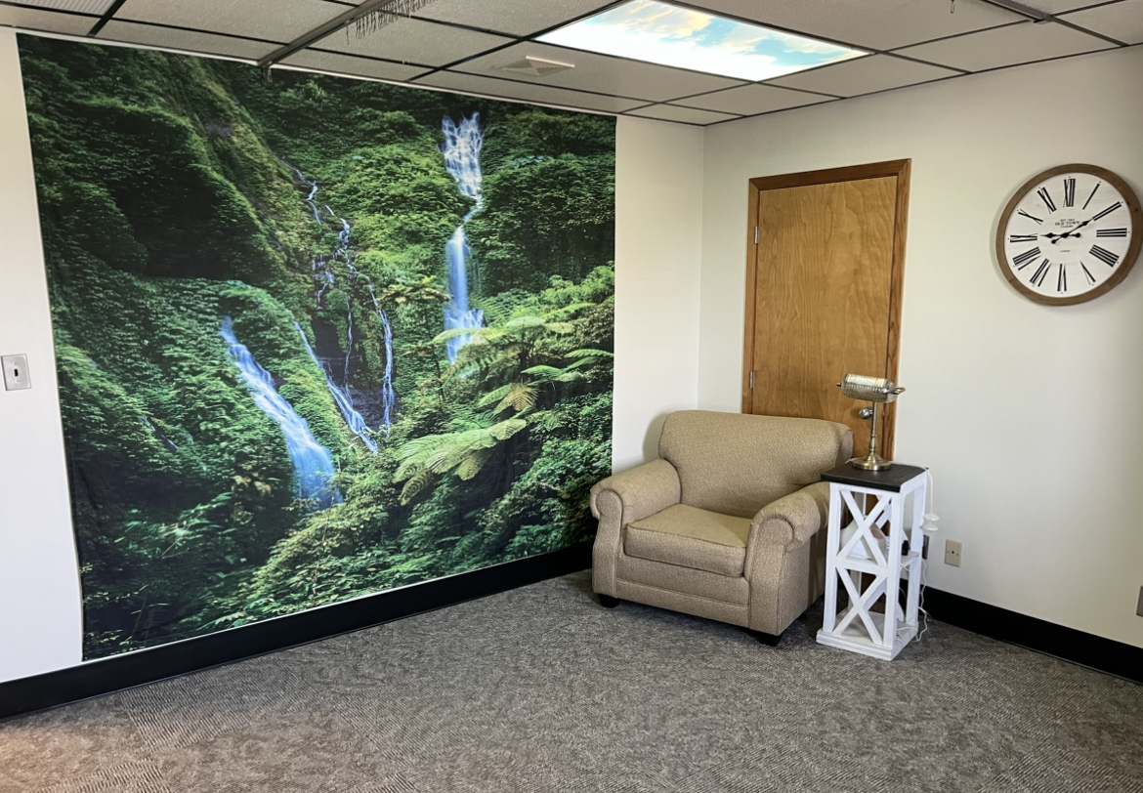
Earle C. Clements Relaxation and Lactation Room
Notes:
Here’s EC Clements Relaxation and Lactation room, a place when student can relax. And student who are breastfeeding babies can pump mink privately during the training day.

Slide 35
What are you doing?

Slide 36
Questions?

