Slide 1
Suspicion Drug Screen Process: What it is and What it is Not
Diane A. Tennies, PhD, LADC
Lead TEAP Health Specialist – Humanitas
March 2024

Slide 2
Summary and Learning Objectives
Focus on how to screen a student suspected of impairment because of active drug use.
Discuss the process given changes in the ZT policy related to the determination of active/current use of THC after arrival on center.
Learning Objectives:
1.) Identify what has changed given new ZT changes.
2.) Review the importance of being drug-free in the workplace and the impact on employability.
3.) Identify the three steps associated with the suspicion screen process that are behavior-based.
4.) Outline the necessary/Required participants involved in the suspicion screen process.

Slide 3
Before We Get Started…

Slide 4
It is…National Drug and Alcohol Facts Week®
NDAFW is an annual health observance about the science of drug use and addiction among youth.
NDAFW provides an opportunity to bring together scientists, students, educators, healthcare providers, and community partners to help advance the science and address youth drug and alcohol use in communities and nationwide.

Slide 5
Suspicion Drug Screen: What has Not Changed
Job Corps remains a Drug Free program and use of mood-altering substances (including cannabis) is not allowed after entrance to the program.
All other aspects of the ZT policy remain the same.
The suspicion screen process remains the same.
Nanogram levels are only to utilized for the follow-up UDS and NOT for the suspicion UDS.
Notes:
Read Slide

Slide 6
Identifying Impairment: Employer Processes
Recognizing impairment in employees and conducting drug testing is about workplace safety and worker health:
All employment sites have informal and formal processes for identification of impaired workers.
Substance impairment may lead to 3.5 times more accidents.
40% of employee theft is caused by drug abuse according to the U.S. Department of Justice.
National Council on Alcoholism and Drug Dependence (NCADD) reported 70% of the 14.8 million Americans who misuse drugs are employed.
Substance misuse increases likelihood of an employee missing eight or more workdays annually.
50% of workmen compensation claims are substance use-related
Substance use contributes to lowering productivity (by 33 percent)
See https://nida.nih.gov/

Slide 7
Drug Testing Benefits – Data to share with Students
Drug Testing employees prevents and detects workplace drug misuse
Reduces employee healthcare costs
Improves employee morale, productivity, and performance
Decreased absenteeism, accidents, downtime, turnover, and theft
Complies with state or federal regulations
Assist to identify and refer employees with drug and/or alcohol problems
Overall provide a safer workplace for employees

Slide 8
Suspicion Screen Process
Replicates workplace practices
Teaches healthy workplace procedures through modeling
Enhances Job Corps as a safe and healthy employment and residential site

Slide 9
The Components of an Effective Suspicious Screening Process
Training the staff on the process – ESSENTIAL
SOP for direction/guidance
Clear and detailed form (TEAP Referral Form)
Follow your process
Assess referred students and provide TEAP services (if applicable)
Multiple and Notable Observable signs

Slide 10
Urine Toxicology Testing: What are the Drugs?
Marijuana (Cannabinoids / THC)
Cocaine (Benzoylecgonine)
Opiates (Codeine, Morphine, 6-AM (Heroin metabolite))
Amphetamines (including methamphetamines)
Phencyclidine (PCP)
Barbiturates
Benzodiazepines
Fentanyl
Hydrocodone/Hydromorphone (Vicodin)
Oxycodone/Oxymorphone (Percocet, OxyContin)

Slide 12
Who is to be Referred for Suspicion Screening?
Any student identified with notable and multiple signs of impairment.
Depending on type of impairment – may be for urine drug test or alcohol test (breathalyzer)
PRH 2.3 R5 g 1(g): Both reinstated and transfer students shall be subject to testing for drugs only upon reasonable suspicion of use.

Slide 13
PRH Regarding Suspicion Screen Drug Testing: Drug Testing
PRH 2.3 R5 (TEAP) in Section g 1 (a)(3):
Students who are reasonably suspected of using drugs at any point after arrival on center must be tested; this testing must take place as soon as possible after staff suspects use.
(NOTE: Reasonable suspicion is context specific, supported by specific and articulable facts, and may include (1) direct observation of drug use or behavioral signs or symptoms suggestive of drug use, or (2) specific reliable information that a student recently used drugs.)

Slide 14
PRH Regarding Suspicion Screen Drug Testing: Alcohol Testing
PRH 2.3 R5 g 2 is about alcohol testing:
(a.) Students who are reasonably suspected of being intoxicated or consuming alcohol on center or under center supervision must be tested; this testing must take place immediately after staff suspects use. (b) Centers must use devices that measure alcohol in the breath or saliva (e.g., breathalyzers or alcohol test strips/tubes/swabs). Alcohol testing must only be administered by a staff member trained in the use of these testing devices.
All testing must be documented, and the results submitted to the health and wellness center.
(c.) If a student refuses to submit to a breathalyzer or provide a sample for alcohol testing, the student shall be presumed guilty of the Level I infraction Alcohol: Possession, consumption, or distribution while on center or under center supervision.

Slide 15
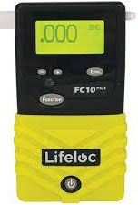
PI 22-02 Life Loc Breathalyzer Utilization
Required use
Requires Annual Calibration (at minimum)
Must have a way of determine blood alcohol concentration if Life Loc unavailable/not used

Slide 16
Other References to Suspicion Screen Process in the PRH 2.3 R5 g 3
(f): Students who test positive for drug use by an off-center facility must be retested on center using the Job Corps nationally contracted laboratory as soon as possible, to include:
(1) Work-based learning students who tested positive on a drug test administered by
experience sites, union trades, or potential employers;
(2) Students who tested positive on a drug test administered at a referral health facility (e.g.,
hospital emergency department, urgent care facility).
This retest by the Job Corps nationally contracted laboratory must be classified as a suspicion-of-drug-use test. For students who test positive for drug use on this retest, centers must follow fact-finding board procedures outlined at Exhibits 2-1 and 2-2.
(g) Student drivers who test positive for drug use under 49 CFR Part 382 DOT Federal Motor Carriers Safety Administration must follow the same procedures outlined as for positive suspicion tests.
In addition, during the intervention period, student drivers who fall under DOT regulations are not permitted to drive.
Students who test positive for alcohol use on suspicion must be referred to the TEAP Specialist for assistance and the center’s student conduct system for disciplinary action.

Slide 17
What Does Reasonably Suspected Mean?

Slide 18
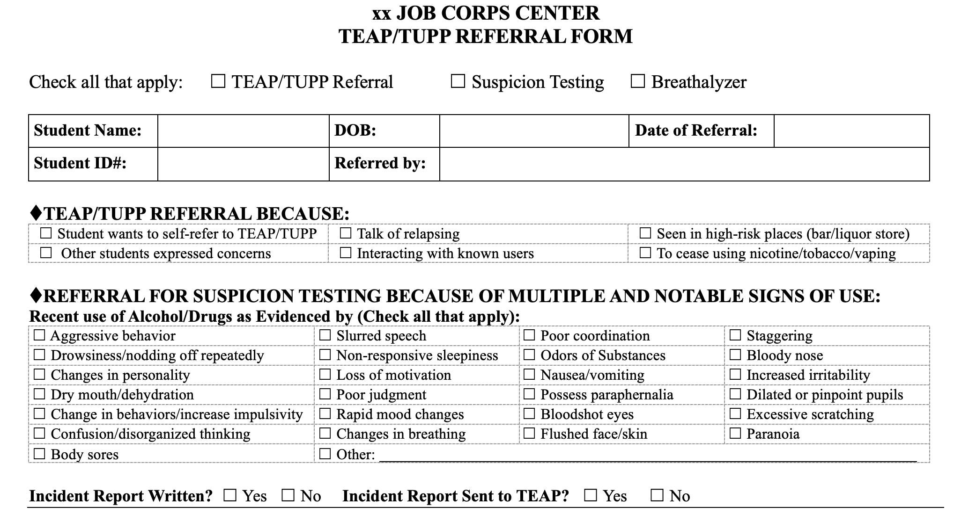

Slide 20
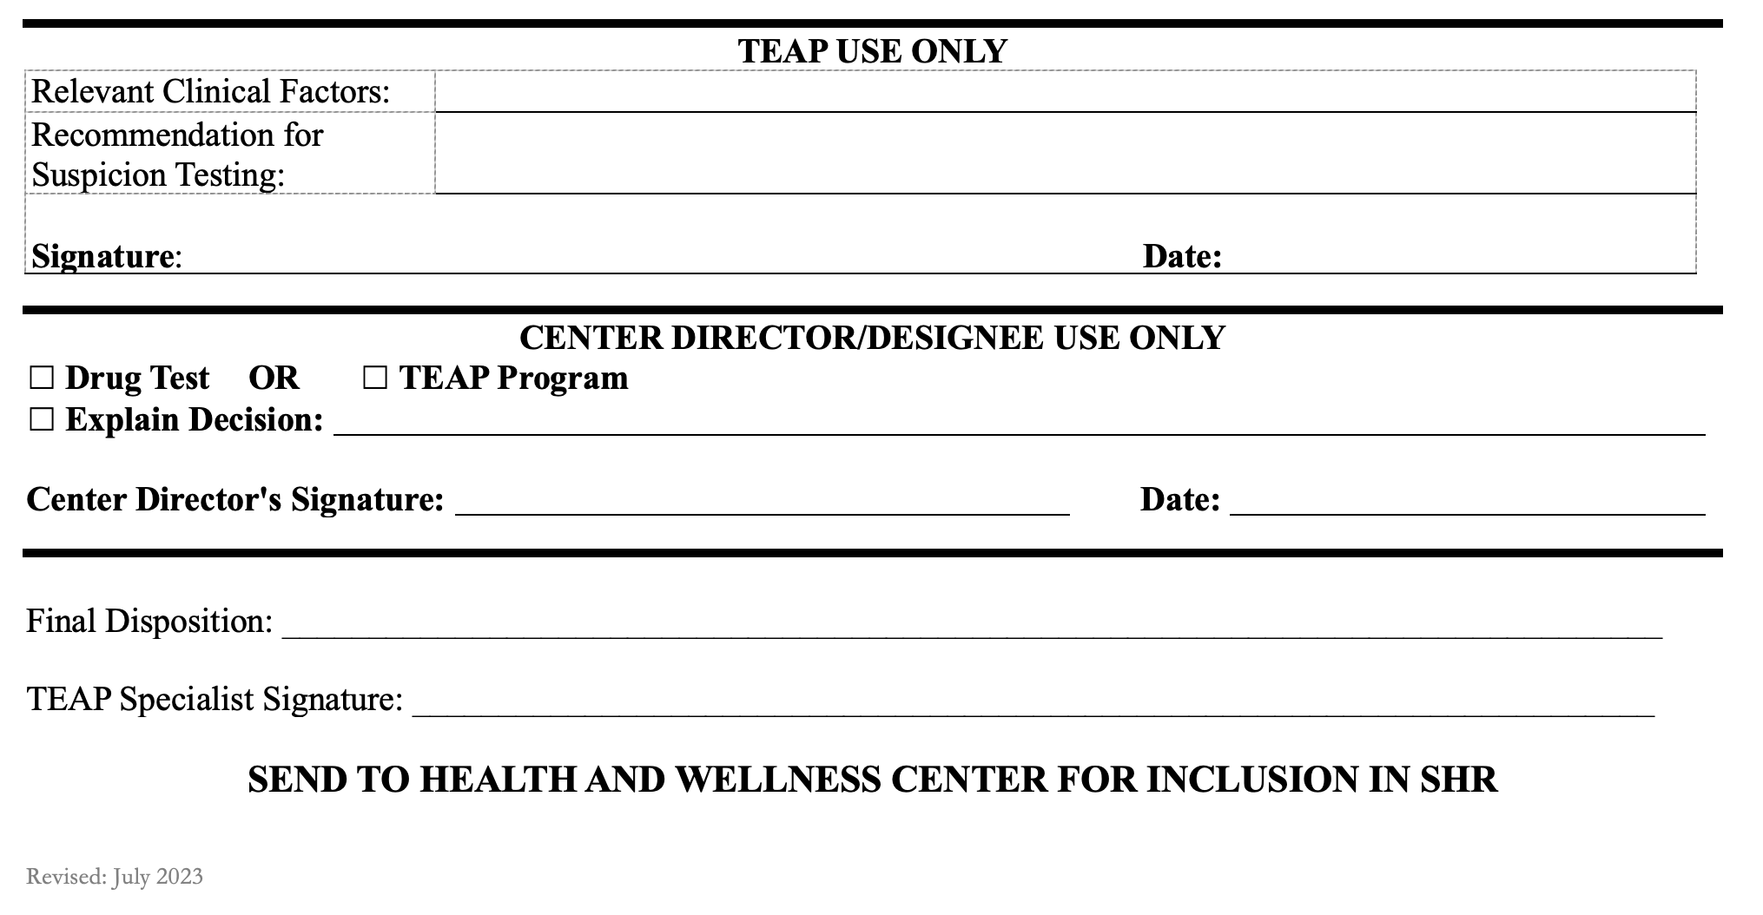

Slide 21
Disciplinary Code Intersection (Updated Exhibit 2.1)

Slide 22
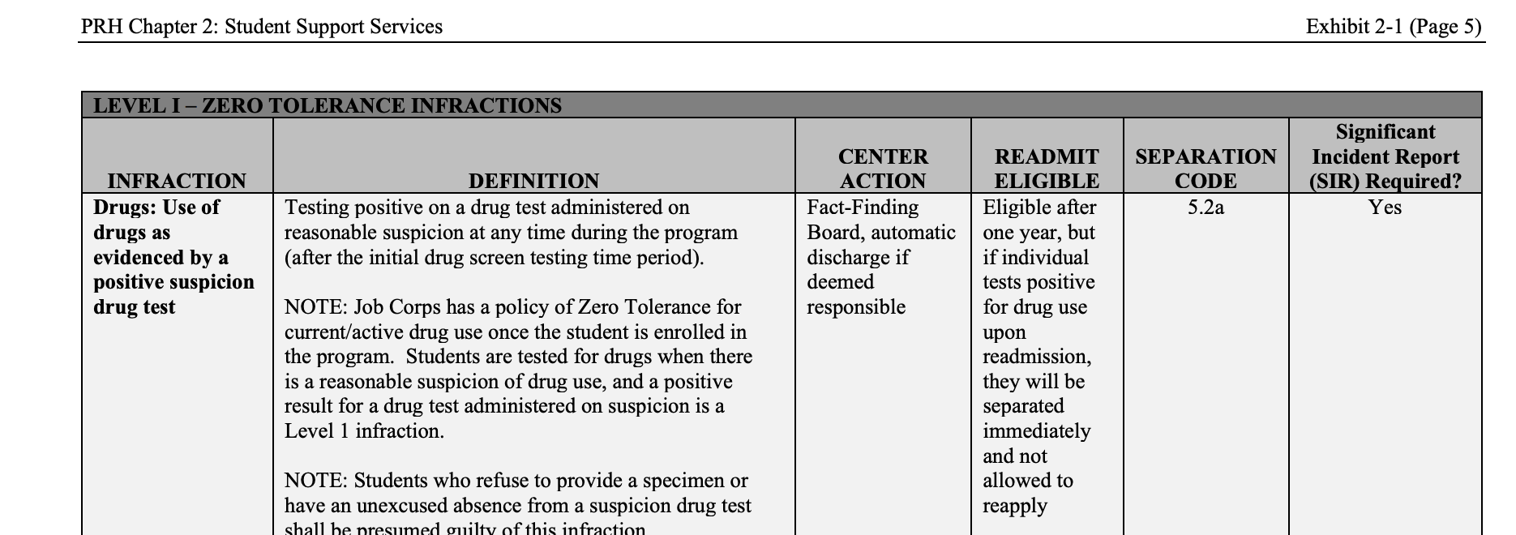

Slide 23
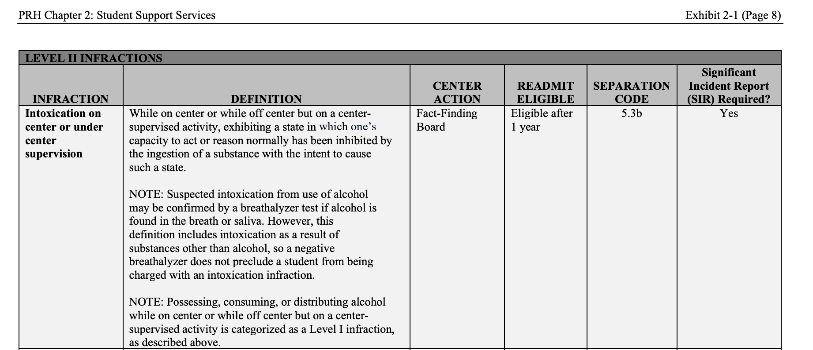

Slide 24
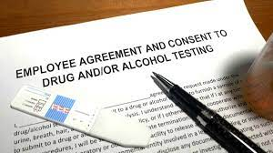
Drug Testing Requirements and Recommendations

Slide 25
Decrease the Likelihood of Adulteration
Providing a private area for specimen collection
Remove all cleaning products from the collection room area
Perform visual and temperature checks. The sample temperature should fall between 90.5 F and 99 F
Visually should appear free of possible contaminants
Turn off additional water sources in the immediate collection area, if possible
Place a blue chemical in the toilet tank to color the water
Have the student wash (with water only) hands and clean under nails and give student a paper towel for hand drying before they provide their sample

Slide 26
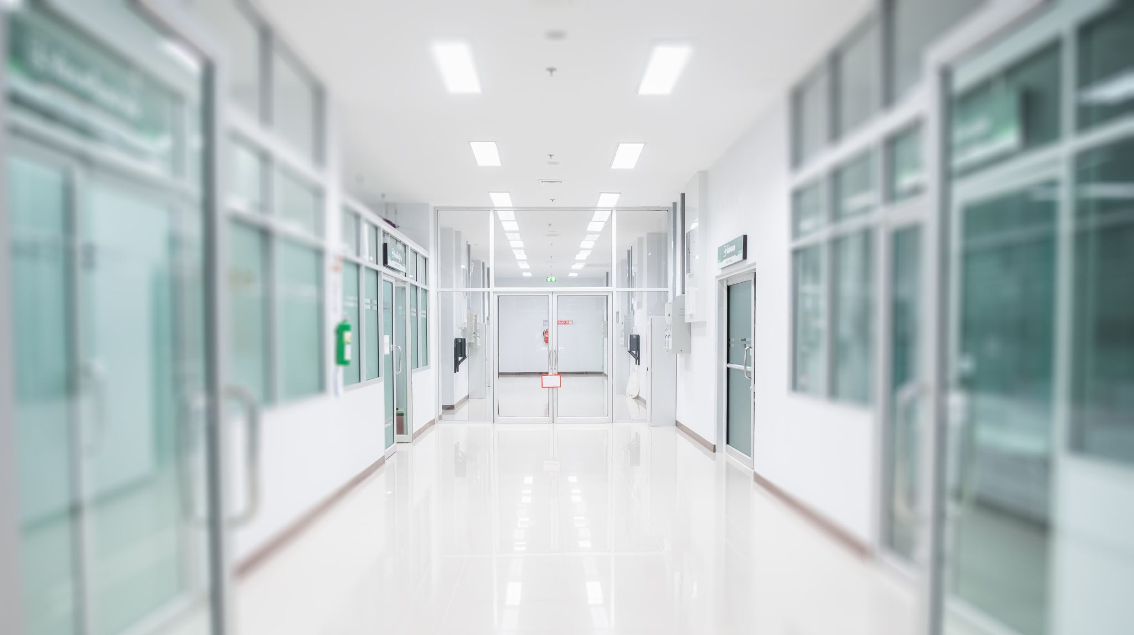
Detection of Adulteration Attempts via Supervised Screening
Have the student remove outer garments (e.g., coats, sweaters, jackets)
Prohibit bags, packages, or purses in the collection area
Have the student provide the specimen while in an examination gown, if urine collection is part of a medical exam
Have collection personnel stand close to the door and be aware of unusual sounds when conducting a routine supervised collection
Make sure the student hands the specimen directly and immediately to collection personnel

Slide 27
Supervised versus Observed Collection
Observed defined as: Watching the urine stream leave the body and enter the specimen container
Observed only recommended if concerns about adulteration as it is intrusive and staff time-intensive
Have clear and consistently implemented SOP about supervised versus observed urine collection

Slide 28
Chain of Custody is Key to Drug Testing Integrity
Chain of Custody Definition: The course of action of documenting the management and storage of a specimen from the moment a donor gives the specimen to the collector to the final destination of the specimen and the review and reporting of the result.
Document when there are concerns regarding the integrity of the specimen.
Supervising the collection process and ensuring that there is strict adherence to chain of custody principles

Slide 29
Next Steps if Suspicion Screen Results are a Confirmed Positive
Is there a medical explanation?
New PRH clarification (2.3 R5 g 1(f): The Center Physician must determine whether a positive confirmed drug test is due to valid prescription use (e.g., the student has prescribed medication for an amphetamine for ADHD or an opioid for an oral health procedure)
Under Federal law, no valid prescription can be provided for drugs that are classified as Schedule I of the Controlled Substances Act even if they are obtained by prescription under state law
If so, the Center Physician will document the positive drug test as “due to legitimate medical use.” In this instance, the student is not referred to intervention services, and the follow-up retesting would not occur
Consult with toxicology professionals, if needed
If no medical explanation, then is a violation of the ZT policy and student is to be terminated
Document justification for decision and process in SHR

Slide 30
Next Steps if Suspicion Screen is Confirmed Negative
Review results with the student
Further assessment
MSWR
CMHC Referral
Heals Referral
Offer voluntary relapse prevention service
Brief interventions, using SBIRT or motivational interviewing
Document in SHR

Slide 31
Alcohol Testing Procedures
Students who are suspected of being under the influence of alcohol while on center are immediately tested.
Use the Lifeloc Breathalyzer (see PI 22-02) or other professional breathalyzer that measures BAC.
Only administered by trained staff member (TEAP responsible for ensuring training occurs).
All breathalyzer testing (even negative results) is documented and then filed in SHR.

Slide 32
Resources

Slide 35
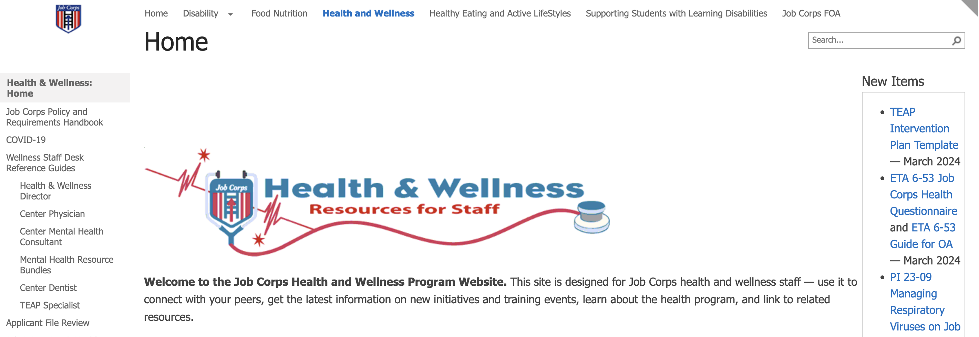

Slide 36
Contact your Regional Health Specialist
Atlanta, Dallas and Chicago regions:
Christy Hicks, LCADC/CSW at: Christy.Hicks@humanitas.com
Boston, Philadelphia, and San Francisco regions:
Diane Tennies, PhD, LADC at Diane.Tennies@humanitas.com

Slide 37
Learning Objectives Achieved
1.) Identify what has changed given the updated ZT policy.
Suspicion screen process remains the same and Job Corps remains drug-free. There are minor changes in the PRH that were reviewed.
2.) Review the importance of being drug-free in the workplace and the impact on employability.
Safer workplace and healthier employees.
3.) Identify the three steps associated with the suspicion screen process that are behavior-based.
Train staff; staff identify reasonable suspicion; complete TEAP referral (or comparable form) with these specific behaviors listed.
4.) Outline the necessary/required participants involved in the suspicion screen process.
Front line staff (safety/security/residential/recreational/HWC (TEAP specialist or designee) and CD (or designee).

