Slide 1
Job Corps TEAP Specialist Orientation
Christy Hicks, LCADC/CSW
Atlanta, Dallas, Chicago Regions
Diane Tennies, PhD, LADC
Boston, Philadelphia,
San Francisco Regions
Updated 05/2024

Slide 2
Job Corps’ Mission
As a national primarily residential training program, Job Corps’ mission is to attract eligible young adults, teach them the skills they need to become employable and independent, and place them in meaningful jobs, higher education, or the military.

Slide 3
Regional Health Specialist (RHS) Tasks
Provide technical assistance by answering questions via email, text, or phone
Conduct center Health & Wellness Program Compliance Assessments (PCAs)
Provide training to regional and center staff
Assist with understanding and implementing policies
Provide up-to-date information to assist in meeting program requirements
Conduct monthly teleconferences

Slide 4
Health & Wellness Program Compliance Assessments (PCAs)
Approximately every 3 years, assessors from Humanitas, Inc., Job Corps’ Health Support Contractor, visit each center.
The assessors conduct a review of your center’s Health and Wellness Program with a focus on compliance with Job Corps’ Policy and Requirements Handbook (PRH).

Slide 5
Important Resources
PRH- The Policy and Requirements Handbook
https://prh.jobcorps.gov/Pages/Home.aspx
https://supportservices.jobcorps.gov/health/Pages/PreparingForPCA.aspx
COP/SOP- Center or Standard Operating Procedure
https://supportservices.jobcorps.gov/health/Pages/Documents.aspx#sop
DRG- Desk Reference Guide
https://supportservices.jobcorps.gov/health/Pages/DRG-TEAP.aspx

Slide 6
PRH

Slide 8
Health Directives
PRH Change Notices- Contain new or revised policy with instructions to delete, replace, or add pages to the PRH (e.g., PRH CN #23-03 Revisions to the PRH to Amend Job Corps’ Zero Tolerance Policy Regarding Marijuana)
Program Instructions- Provide one-time instructions with a designated effective date and usually require center action/response (e.g., PI 22-16 Responding to Opioid Overdose in Job Corps)
Information Notices- Provide one-time announcements with information that is of importance to centers (e.g., IN 19-04 Trainee Employee Assistance Program (TEAP)-Related Observances)

Slide 9
Job Corps Health and Wellness Website
Designated for Job Corps Health and Wellness Staff
Most up-to-date version of the PRH can be found here.
Use it to connect with your peers, get the latest information on new initiatives and training events, learn about the health and wellness program, and links to related resources.
https://supportservices.jobcorps.gov/health/Pages/default.aspx

Slide 10
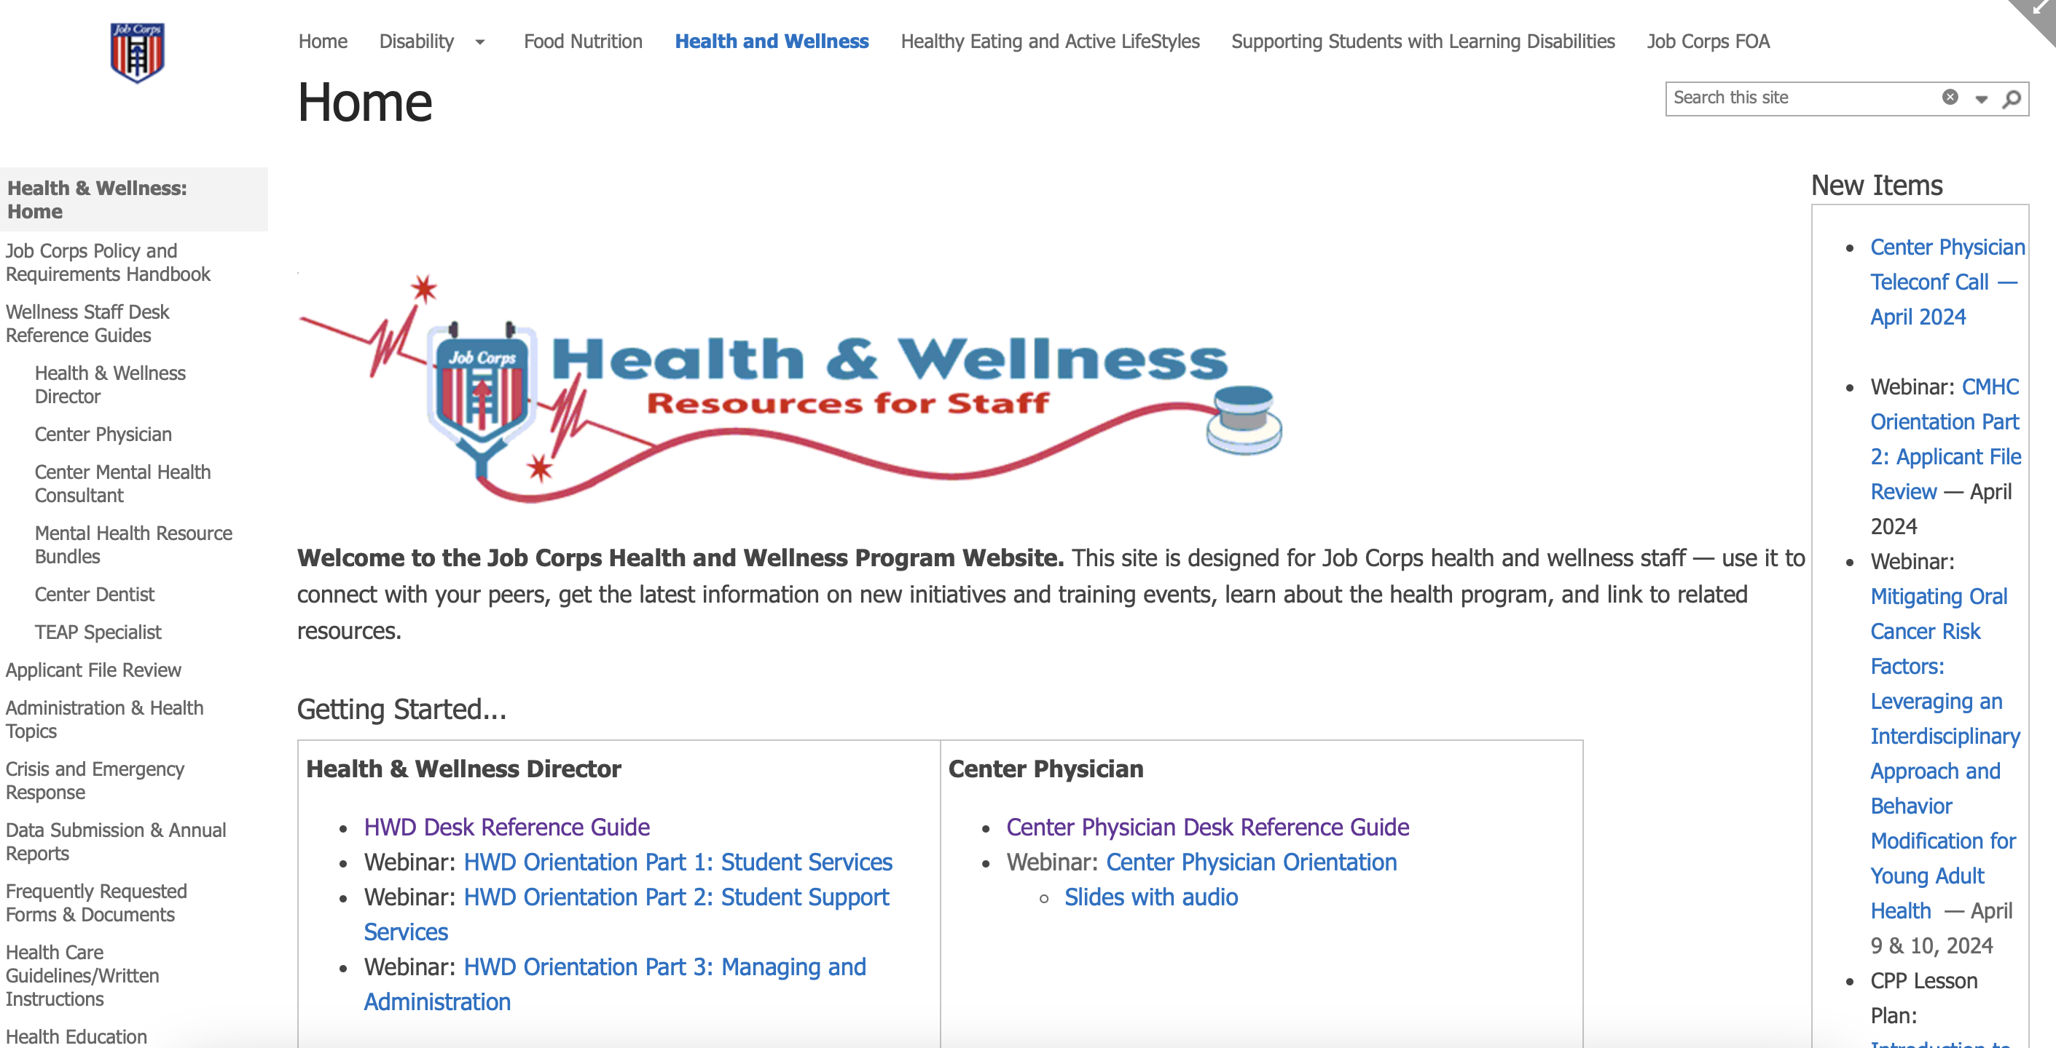

Slide 11
Job Corps Career Development Services System (CDSS)
Includes four CDSS periods within which health and wellness services and activities are conducted:
Outreach and Admissions (OA) Period
Career Preparation Period (CPP)
Career Development Period (CDP)
Career Transition Period (CTP)

Slide 12
What is the Overall TEAP Goal?
Assist students in developing appropriate health and wellness practices that will enhance their ability to obtain/maintain employment. This includes prevention, education, identification of substance use problems, relapse prevention, and supportive services.

Slide 13
TEAP Hours
TEAP Specialist: 15 hours/100 students/week is the minimum required level of TEAP coverage by a qualified TEAP Specialist (see PRH Exhibit 5-5)
Of the minimum required coverage per week, 50 percent must be used for a combination of the following activities: prevention and education for students and staff; consultation to center director, CMHC, and other staff; and annual trainings. All TEAP services defined as basic health services in PRH Exhibit 2-4 must be provided on center by the TEAP Specialist.

Slide 14
TEAP Qualifications
PRH Exhibit 5-3 - To be qualified means: “Active, unrestricted substance abuse license or certification that meets minimum state licensing or certification requirements to practice in the state where the center is located”
TEAP Specialists must meet minimum staffing qualifications listed in PRH Exhibit 5-3, or obtain a National Office issued waiver.
To obtain this waiver, a request that includes the professional development plan which identifies the steps and time-frames necessary to obtain the state-issued credential must be submitted (see PRH 5.2, R5(e1)).
A National Office approved waiver is only in place for one year. You must complete the credentialling requirements within that timeframe and submit a copy of the state-issued credential to the Regional Office.

Slide 15
TEAP Responsibilities and Guidance
Located in PRH 2.3, R5
Also:
PRH Exhibit 2-4 Job Corps Basic Health Care Responsibilities
TEAP Specialist Desk Reference Guide
PRH Exhibit 2.1 Infraction Levels, Definitions and Appropriate Center Actions

Slide 17
TEAP and TUPP Components
Prevention/Education (TEAP and TUPP)
Being visible
Center wide activities
CPP
CDP
CTP
Coordination with other staff
TUPP activities for all students
Assessment (This is in part why credentials are necessary)
Applicant File Review, ETA 6-53
Social Intake Form (CRAFFT)
Use of Formalized Assessment Measures (Evidence Based)
MSWR

Slide 18
General Emphasis of TEAP PRH 2.3, R5(a)
The general emphasis of TEAP shall be on
Prevention
Education
Identification of substance abuse problems
Relapse prevention
Supportive services to enhance students’ health, wellness, and access to quality employment

Slide 19
Prevention and Education Services PRH 2.3, R5(b)
Minimum of one-hour presentation on substance use prevention for all new students during the Career Preparation Period (CPP).
The presentation must explain:
TEAP prevention, education, and intervention services
Job Corps drug and alcohol testing requirements and procedures
The consequences of testing positive for drug or alcohol use while in Job Corps
Data on national trends regarding substance use
Alternative activities to drug use, alcohol use and consequences, TUPP
Presentations on managing substance misuse, abuse, and dependency symptoms and issues in the workplace for students during CDP and CTP.

Slide 20
Prevention and Education Services PRH 2.3, R5(b) Cont.
At least three annual center-wide substance use prevention and education activities.
Clinical consultation with Center Director, management staff, Center Mental Health Consultant, and Health and Wellness Director regarding substance use prevention and education efforts for students and staff.
Coordination with other departments/ programs on center, to develop integrated prevention and education services to include, but not limited to:
Recreation
Residential
Student Government Association
Healthy Eating and Active Lifestyles (HEALs)

Slide 21
Assessment for identification of students at risk for substance use problems PRH 2.3, R5(c)
Review of Social Intake Form (SIF) or intake assessment of all students performed by counseling staff within one week of arrival; this includes the CRAFFT screener. (You must document the CRAFFT score, your clinical judgement, and recommendations either on the SIF or in a note in the student health record.)
Administering a formalized assessment (SASSI, MAST, DAST, etc.) if the student is at an increased risk for substance use based on the responses on the SIF or review of other medical records.

Slide 22
Social Intake Form

Slide 23
Scoring the CRAFFT Screening Tool
SCORING INSTRUCTIONS
CRAFFT Scoring: Each “yes” response in Part B scores 1 point. A total score of 2 or higher is a positive screen, indicating a need for additional assessment.

Slide 24
Intervention Period- Day 37-40 PRH 2.3, R5(d)
Mandatory intervention services must be provided for any student who:
Tests positive on the initial urine drug test
Assessed to be at-risk for substance use problems or has a high probability of substance use disorder based on the formalized assessment

Slide 25
What is mandatory?
Seven sessions of intervention services (two individual, five groups at a min). All sessions must be interactive, evidence based, and include motivational interviewing. Topics must include at a minimum:
Basic information regarding current drugs of use and misuse (e.g., marijuana, alcohol, tobacco/nicotine, fentanyl, abuse of prescription drugs, and drug use trends
Short-term and long-term effects and consequences of drug use on health and employability;
Identification of triggers for substance use;
Relapse prevention to include development of coping and resistance skills;
Development of alternative activities in order to remain abstinent from drugs or alcohol in social situations, and;
Availability of referrals and community resources.

Slide 26
What else is mandatory?
Minimum of 15 hours or recreational activity.
Regular student case management meetings between the TEAP Specialist, CMHC, counselors, and other appropriate staff with a need-to-know based on individual student needs. Clinically relevant information exchanged, and follow-up plans must be documented in the student health record.
Referrals to off-center substance use professionals/agencies for ongoing treatment, and/or specialized services, as needed.

Slide 27
Relapse Prevention Services PRH 2.3, R5(e)
Relapse Prevention services to include:
Group(s), support services, and activities available to all students at any time during enrollment.
Utilization of support services (e.g., AA/NA local meetings, online self-help meetings) available to all students at any time during enrollment.
An additional minimum of five mandatory sessions provided by the TEAP Specialist for those students who tested positive for marijuana [THC] on the follow-up drug test, but who were retained on center because the Job Corps Center determined that the follow-up positive test was due to residual use (see PRH 2.3, R5(g,3,c)).

Slide 28
Other Relapse Prevention Ideas
Develop individualized RP plans
Bring guest speakers from community to center
Newsletters and electronic communications
Provide/encourage leisure-time planning activities
Separate ongoing RP group for anyone who wants to attend

Slide 29
TEAP Boils Down to Six Major Areas
Prevention/education
Assessment
Relapse prevention
Overcoming barriers (drug testing components)
Documentation (THIS IS REQUIRED)
Training

Slide 30
Drug and Alcohol Testing PRH 2.3, R5(g,1)
Drug testing procedures – who gets tested:
New and readmitted students (NOT reinstated students)
Students who tested positive on entrance shall be retested between the 37th and 40th day after arrival on center
Students who are suspected of using drugs at any point after arrival on center (if positive = ZT termination)
Biochemical testing is never permissible on a random basis.
If a student refuses to provide a specimen or has an unexcused absence from his or her follow-up (both 45-day and suspicion) drug test, this is a ZT termination.
Students who state they are unable to produce a specimen shall be referred to the center physician or designee for follow up.

Slide 31
Drug and Alcohol Testing PRH 2.3, R5(g,1) Cont.
Collection of urine for drug testing shall be in accord with chain-of-custody principles and conducted by health and wellness staff or a staff member trained in urine collection procedures (PRO TIP - use the Chain of Custody template).
Required to use the Nationally Contracted Laboratory.
Reinstated students shall not be subject to entry drug testing upon return to the center.
Transfer students shall not be subject to drug testing upon arrival at receiving center.
Both reinstated and transfer students shall be subject to testing for drugs upon suspicion of use only.
If a student test positive for a prescription drug, the Center Physician must determine whether a positive confirmed test is due to prescription use (e.g., ADHD medication or an opioid for an oral health procedure).

Slide 32
Decrease the Likelihood of Adulteration
Provide a private area for specimen collection.
Remove all cleaning products from the collection room area.
Perform visual and temperature checks; the sample temperature should fall between 90.5 F and 99 F.
Visually should appear free of possible contaminants.
Turn off additional water sources in the immediate collection area, if possible.
Place a blue chemical in the toilet tank to color the water.
Have the student wash (with water only) hands and clean under nails and give student a paper towel for hand drying before they provide the requested sample.

Slide 33
More Basics for Supervised Collection
Have the student remove outer garments (e.g., coats, sweaters, jackets).
Prohibit bags, packages, or purses in the collection area.
Have the student provide the specimen while in an examination gown, if urine collection is part of a medical exam.
Have collection personnel stand close to the door and be aware of unusual sounds when conducting a routine supervised collection.
Make sure the student hands the specimen directly and immediately to collection personnel.

Slide 34
Supervised Versus Observed Collection
Observed ONLY recommended if concerns about adulteration as it is intrusive and staff time-intensive as well as not usually needed.
Have clear and consistently implemented SOP about supervised versus observed collection.
This means same sex staff is watching the urine stream leave the body and enter the specimen container.

Slide 35
Alcohol Testing Procedures PRH 2.3, R5(g,2)
Students who are suspected of using alcohol at any point after arrival on center are immediately tested.
Centers must use devices that measure alcohol in the breath or saliva.
Only administered by trained staff member (TEAP Specialist responsible for training).
ALL testing documented (even negative results) and filed in SHR.
If a student refuses to submit to a breathalyzer or provide a sample for alcohol test, they student shall be presumed guilty of the Level 1 infraction Alcohol Possession, consumption, or distribution while on center or under center supervision.

Slide 36
Students testing positive for drug or alcohol use PRH 2.3, R5(g,3)
Students and readmitted students not previously separated for drug use 5.2a, 5.2b, and 5.1b who test positive for drugs on entry must receive intervention services.
Students who test positive on entry must take a follow-up drug test between their 37th and 40th day, unless there is a legitimate medial use for prescription drugs. The results must be received on center prior to the end of the 45th day.
Special counts for drug screening: Winter break and MSWRs.
If a student is absent on the day of their scheduled follow-up test shall be presumed guilty of the Level 1 infraction.

Slide 37
Students testing positive for drug or alcohol use PRH 2.3, R5(g,3) Cont.
When a student’s entry and follow-up drug test are both positive for THC only (any other drug is a ZT termination), a determination must be made as to whether the positive follow-up test is due to current/active drug use or due to residual THC metabolites from use prior to Job Corps enrollment.
The following actions must be taken:
The TEAP Specialist or another licensed/credentialed person in absence of a TEAP Specialist completes and signs the “Determination of Current/Active Use versus Residual Use for THC on a Follow-Up Drug Test Form” (PRH Form 2-07 found in CIS)
The Health and Wellness Director or designee reviews and cosigns Form 2-07

Slide 38
Based on the determination of PRH Form 2-07
The student’s THC concentration decreased by 50% or more between the entry toxicology and follow-up test: Most likely due to residual use, no disciplinary consequences. The student should continue to received TEAP services, including mandatory relapse prevention.
The student’s THC concentration decreased by less than 50%, increased, or remained the same between the entry toxicology and follow-up test: Most likely due to active use. Referral to the Fact-Finding Board per the PRH and the student is terminated.
A copy of PRH Form 2-07 should be filed in the SHR with an explanation.

Slide 39
PRH Form 2-07

Slide 40
Students testing positive for drug or alcohol use PRH 2.3, R5(g,3) Cont.
For students who test positive at an off-center facility (e.g., hospital, urgent care, work-based learning site) they must be retested on center using the Job Corps National contracted laboratory.
Student drivers who test positive for drug use can not drive.
Students who test positive for alcohol use must be referred to the TEAP Specialist for assistance and the center conduct system for disciplinary action.

Slide 41
Students testing positive for drug or alcohol use PRH 2.3, R5(g,4)
Students who test positive for drug use should be notified within 24 hours of receiving the test.
Alcohol testing results must be provided to the students by the person administering the test.
You must only shared results and information with center staff that have a need to know.
If a student question the validity of any test, he or she must be referred to the Center Physician or designee for counseling.

Slide 42
MSWR for Substance Use Conditions PRH 2.3, R5(g,5)
Students may be given a MSWR for a diagnosed substance use condition, allowing the student to return to Job Corps to complete his or her training within 180 days.
A MSWR for substance use conditions can only be given if there is a documented assessment of the student’s diagnosed substance use condition by the TEAP Specialist or qualified health professional.
Students must be provided written referral services.
A MSWR cannot be granted in lieu of ZT separation when a positive 45-day intervention period follow-up test is reported.
If a student is placed on a MSWR during the 45-day intervention period, the intervention period is suspended and resumes the day the student is scheduled to return to the center.
To return to Job Corps, proof of required treatment completion from a qualified provider must be received.

Slide 43
Documentation
THIS IS NOT A SUGGESTION
The SHR needs to “tell the story” of what happened to the student in TEAP
Clinical notes (content and participation) for TEAP and TUPP for contacts you have with students
Usually in TEAP section of SHR
Dated and signed
Assessment – sign and date protocols and document recommendations
Center-wide education, CPP, CDP and CTP = keep sign up sheets, handouts and maybe pictures

Slide 44
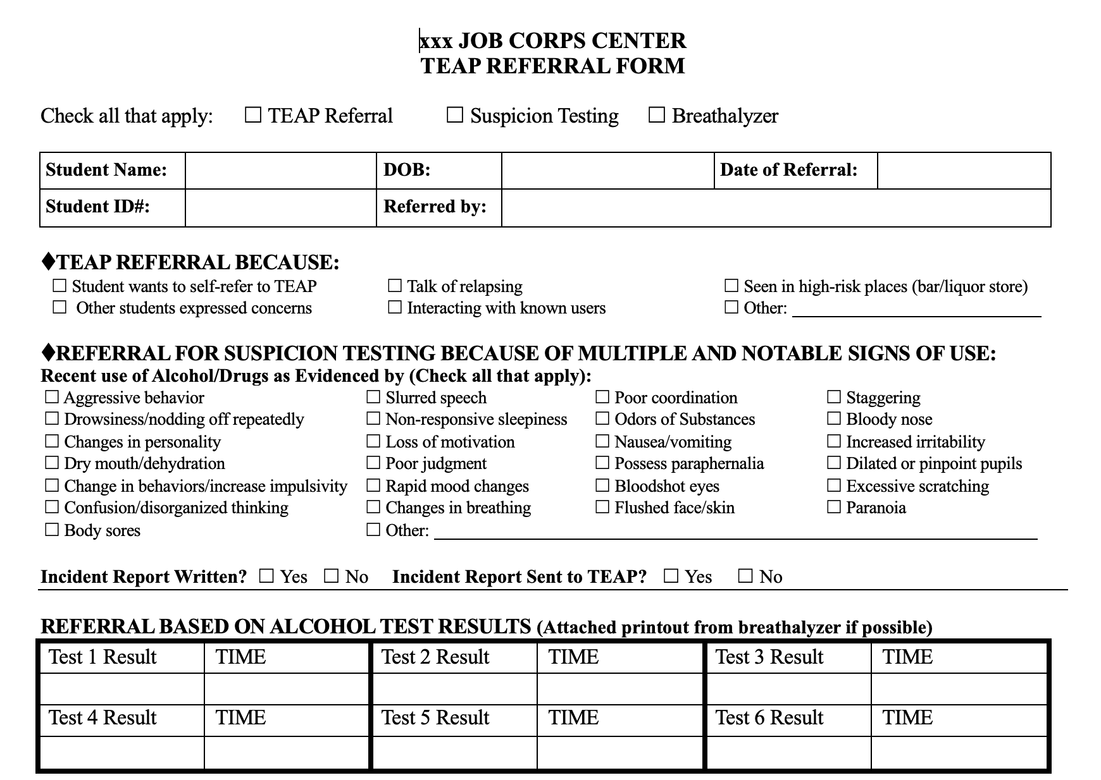

Slide 45
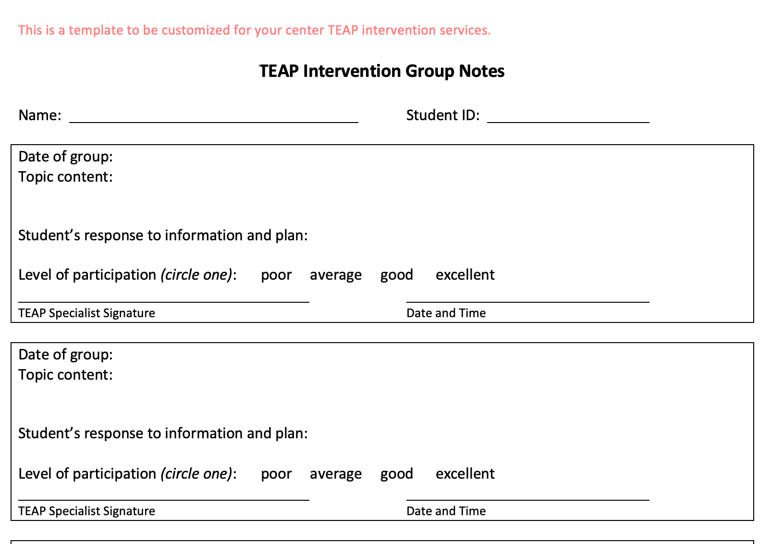

Slide 46
Staff Training
Suspicion screening (drugs and alcohol)
Narcan – online training at: https://www.getnaloxonenow.org/
Health Care Guidelines (HCG) and Symptomatic Management Guidelines (SMG)
Treatment Guidelines for Health Staff for Acute Alcohol Intoxication, Alcohol or Drug Use Behavior, and Intranasal Narcan for Suspected Opioid Overdose
Other AODA-related trainings per your center culture
Use community partners for these trainings

Slide 47
TEAP Best Practices
Peer Mentoring
Full-time employee or at least full-time visibility on center (Exhibit 5-5)
Relapse Prevention Groups
Separate mandatory versus voluntary TUPP groups
Ways to keep TEAP visible
Strong community partners
Strong center alliances
Strong management alliances

Slide 48
Applicant File Review
See the webinar on the Job Corps Community Website called, “All you ever wanted to know about AFR and TEAP”
Use only Form 2-05: Health Care Needs Assessment (HCNA)
If there are TEAP-related issues – then TEAP Specialist is the qualified health professional and MUST be involved and sign HCNA
Focus on current functioning and what interferes with ability to benefit from training at Job Corps
Contact Diane Tennies or Christy Hicks as the process may seem daunting but is easily accomplished so that file is not returned to your center

