Slide 1
TEAP Trends: Retaining Students, Relapse Prevention and Delta-8 THC
Diane Tennies, PhD, LADC
LEAD TEAP Health Specialist
April 2024

Slide 2
Learning Objectives
1.) Define two emerging drug trends impacting students at Job Corps in 2024.
2.) Articulate how the changes to the ZT policy are positively impacting students.
3.) Identify three ways to expand Relapse Prevention Services to support students retained for residential concentrations of THC.
4.) Learn how to integrate information regarding increased use of Delta-8 in young people in TEAP programming.

Slide 3
National Drug Trends: What do we Know about Potential Job Corps Students?

Slide 4
2023 Monitoring the Future Survey
Ongoing study of behaviors and attitudes of Americans (teen through adults). Sample annually is 50,000 students (8th, 10th and 12th grades)
The 2023 data shows stable or declining trends in the use of illicit drugs among young people over many years
BUT dramatic increases in overdose deaths among teens (from 2010 to 2022) primarily due to illicit fentanyl contaminating counterfeit pills
Conclusion: Drug use is not more common among young people but is more dangerous
https://monitoringthefuture.org/
https://nida.nih.gov/news-events/news-releases/2023/12/reported-drug-use-among-adolescents-continued-to-hold-below-pre-pandemic-levels-in-2023

Slide 5
The 2023 data showed (compared to 2022):
Alcohol use stable for 8th and 10th graders (15% and 31% reporting use in the past year respectively). Declined for 12th graders, with 46% reporting use in the past year (compared to 52% in the previous year).
Nicotine vaping remained stable for eighth graders (11% reporting vaping nicotine and declined in the older grades (21% to 18% in 10th grade and from 27% to 23% in 12th grade).
Cannabis use remained stable for all three with 8% of eighth graders, 18% of 10th graders, and 29% of 12th graders reporting cannabis use in the past year.
Emerging trend: 7% of eighth graders, 13% of 10th graders, and 20% of 12th graders reported vaping cannabis within the past year, reflecting a stable trend among all three grades.
Delta-8-THC (a psychoactive substance found in the Cannabis sativa plant, of which marijuana and hemp are two varieties) use was measured for the first time in 2023, with 11% of 12th graders reporting use in the past year.

Slide 6
More 2023 Drug Trends Data
Any illicit drug use (not cannabis) remained stable for all three grades surveyed 8th (5%),10th (5%), and 12th (7%) reporting illicit drug use in the past year. These data build on long-term trends documenting low use of illicit substances (cocaine, heroin, and misuse of prescription drugs).
Use of narcotics other than heroin (Vicodin, OxyContin, Percocet, etc.) decreased among 12th graders (to 1% reporting use) and matching the all-time low reported in 2021 and down from a high of 9.5% in 2004.
Abstaining (from marijuana, alcohol, and nicotine) increased for 12th graders (63% abstaining in past month. This percentage remained stable for 8th (87%) and 10th (77%)

Slide 7
Drug Trends Summary
Drug use is not more common among young people but is more dangerous due to fentanyl contamination
Alcohol use decreasing about <50% reporting use in the prior year
Nicotine use is decreasing
Overall cannabis use stable but vaping cannabis increasing
Use of Delta-8 increasing
Other drug use stable and low among this age group (consistent with JC drug testing trends)
Abstaining from drugs is still around 63% (consistent with JC entry positive rate of 31%)

Slide 8
ZT Trends with Updated Policy Change
Utilization of nanogram data to expand and refine intervention planning
Remember intervention services must be provided to students determined to be at risk for substance use issues
Use expanded formalized assessment measures – get beyond the MAST and DAST to Cannabis Use Disorder Identification Test-Revised (CUDIT-R)
Located at: https://adai.uw.edu/instruments/pdf/Cannabis%20Use%20Disorders%20Identifcation %20Test%20Revised%2059.pdf
Measures problem cannabis use in the past 6 months. A score of 8 or more indicates hazardous use; a score of 12 or more indicates the need to assess for cannabis use disorder

Slide 9
Relapse Prevention Program Expansion
PRH now mentions RP four times!
Integrated into all intervention programming (PRH 2.3 R5 d): “Relapse prevention to include development of coping and resistance skills.”
“Relapse Prevention services to include: Group(s), support services, and activities available to all students at any time during enrollment.”
“Utilization of support services (e.g., AA/NA local meetings, online self-help meetings) available to all students at any time during enrollment.”
Expanded for those retained due to residual use (PRH 2.3 R5 e), “An additional minimum of five mandatory sessions provided by the TEAP Specialist for those students who tested positive for marijuana [THC] on the follow-up drug test, but who were retained…due to residual use.”

Slide 10
Baseline: Relapse Prevention (RP)
Relapse prevention usually the goal for those impacted by addiction
RP is an umbrella term that refers to strategies to reduce the likelihood and severity of relapse when someone is trying to abstain
Most RP strategies focus on Cognitive-Behavioral Therapy (CBT) skills and coping responses.
CBT skills refer to a person’s ability to recognize their thought patterns, which influence their emotions, which determine their behavior
Coping responses are behavioral responses to stressful situations
Why needed? Because addiction to a substance results in brain changes that make it difficult to overcome their disorder
Everyday life at and away from JC contains many triggers so relapse is not uncommon as people recover
Stages of Relapse: emotional, cognitive and physical

Slide 12
What to do with Five Additional RP Sessions?
Develop an RP plan – what does this student need?
Individualized with focus on support
Improve coping and resistance skills through:
Recreation/Leisure time/HEALs planning and check-ins
Continue to attend intervention programming
Meeting with student individually
Using online resources for homework
Referral to off center addiction treatment/programming
Sleep monitoring, encourage volunteering, and journaling
Document plan and response

Slide 13
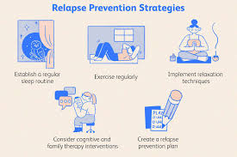

Slide 14
How to Present: Use Listening and Empathic Style (Motivational Interviewing Techniques)
Affirmed | Accept | Approach
Understood | Open | Talk more
Accepted | Non-defensive | Liking
Respected | Interested | Engaged
Heard | Cooperative | Activated
Comfortable/safe | Listening | Come back
Empowered
Hopeful/Able to change

Slide 15
Without A TEAP: What to Do?

Slide 16
Without a TEAP –Updated Document on Website
Task | Resources | Suggested staff
Frequency: New Inputs
Review and sign the Social Intake Form (SIF) within 1 week of arrival | Indicate on the TEAP signature line that the position is vacant and that the form is being reviewed by alternate licensed staff Ensure students referred for TEAP services through the SIF are seen for assessment and provided with follow up support, and document in the student health record (SHR). There is a high co-morbidity between substance use and mental health issues so a large portion of high-risk students may have both issues. Ask the CMHC or intern if they are willing to follow- up with students who score 2 or more on the CRAFT (questions 4-9 only). | H&W staff
Assessment Using Formalized Assessment Measures (FAMs) | Determine if others in HWC are trained in administering FAMs, such as the CMHCs, interns or CP/NP/PA If staff are trained and it is within their scope of practice, administer FAMs (such as CUDIT-R, MAST, DAST or AUDIT which are all in the public domain and can be located online) to students who score 2 or more on the CRAFFT (Questions 4-9). Ensure that the protocols are scored and the results documented in the SHR along with the student response and the plan. Consider using an outside agency to conduct assessments For students who score in the high risk range, refer them to outside substance use agency if treatment is need | Training H&W staff
Applicant File Reviews (AFRs) | Contract with the former TEAP specialist to continue to conduct AFRs Contact your center’s contractor and identify a TEAP specialist from another center run by your contractor to conduct AFRs. Utilize the Center Physician/Nurse Practitioner/Physician Assistant in collaboration with the Health and Wellness Director (HWD) Hire and train an outside substance use professional to complete AFRs with assistance from the HWD and Disability Coordinators (DCs). NOTE: This provider must meet PRH credentialing requirements for the position and be approved by the RO/NO. | Credentialed/Licensed substance use or medical professional

Slide 17
1-hour presentation on TEAP for all new students during CPP | Topics to cover and other information on this presentation is available on the Job Corps Health and Wellness website Suggested Career Preparation Period (CPP) Activity for TEAP and TEAP CPP Welcome Letter. Make sure to include the required topics from Job Corps Program Instruction Notice 22-16. Information must include how TEAP services will be covered during a period without a TEAP specialist. | H&W staff
Entrance and Follow-up UDS | Have nurses collect the entry UDS when collecting other biological samples. Designate a staff member to review the entry UDS results and print them to put into SHR Develop a method of tracking to ensure a follow-up drug test is collected 37-40 days after date of arrival for those students who test positive on entrance. Meet with students within 24 hours of results to congratulate those who are negative and review TEAP Intervention Agreement with those who are positive on entrance. Designate staff to collect the follow-up UDS and for those who test positive – enter both the entry and follow-up results into CIS to determine if a positive follow-up UDS is due to residual use or active/current use. | H&W staff
Intervention Services | Identify other staff outside of HWC who might assist with intervention services and develop a method to ensure these services are documented. Ensure students receive at least 7 intervention sessions (including 2 individual sessions) that are documented in the SHR. Coordinate with recreation to develop activities to help students exercise or learn leisure time activities such as workouts, art activities, a walking club or other activities for at least 15 hours during the intervention period. Have students identify staff members to talk with for support. | H&W staff and other center staff
Suspicion Screen Referrals | Ensure the TEAP referral form has multiple and notable signs of use and follow center’s suspicion screen process. | H&W staff
Relapse Prevention Services | Ensure access to online support services (such as AA or NA) Designate a staff to meet with those students retained due to residual concentrations of THC. | H&W staff

Slide 18
Frequency: Annually
Annual center-wide activities (at least 3 per year) | Enlist community speakers/resources to provide a brief presentation at a center-wide assembly. Have H&W staff provide substance use prevention materials during the student lunch hour. Consider making use of the electronic communications, such as emails, newsletters and electronic bulletin boards to promote TEAP. This increases visibility of program with very little effort. Utilize the TEAP Observances document for online resources. | H&W staff

Slide 19
Frequency: As Needed
Presentations for CDP and CTP | Have H&W staff meet with students in these phases to provide information about impact of drug use on employability (for CDP) and resources available after leave Job Corps (for CTP). Utilized materials on the website for ideas for CDP and CTP presentations
Medical Separation with Reinstatement Rights | Utilize the Center Physician/Nurse Practitioner/Physician Assistant in collaboration with the HWD. The CP/NP/PA must document the current symptoms and behaviors substantiating the MSWR, provide the diagnostic code, make the recommendation for MSWR, and complete the MSWR documentation. Contact the student’s outside treating provider, if applicable, for a recommendation of MSWR and diagnostic information. Wellness staff must complete the MSWR documentation, noting the information from the outside provider. | H&W staff

Slide 20
Delta 8 THC Drug

Slide 21
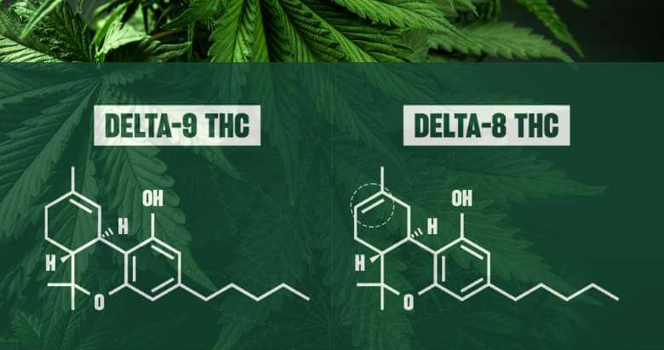

Slide 22
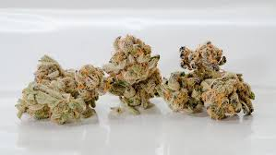
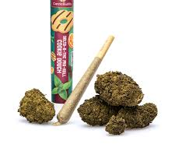
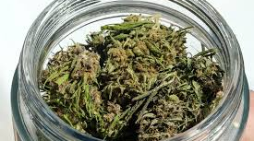

Slide 23
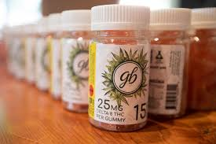
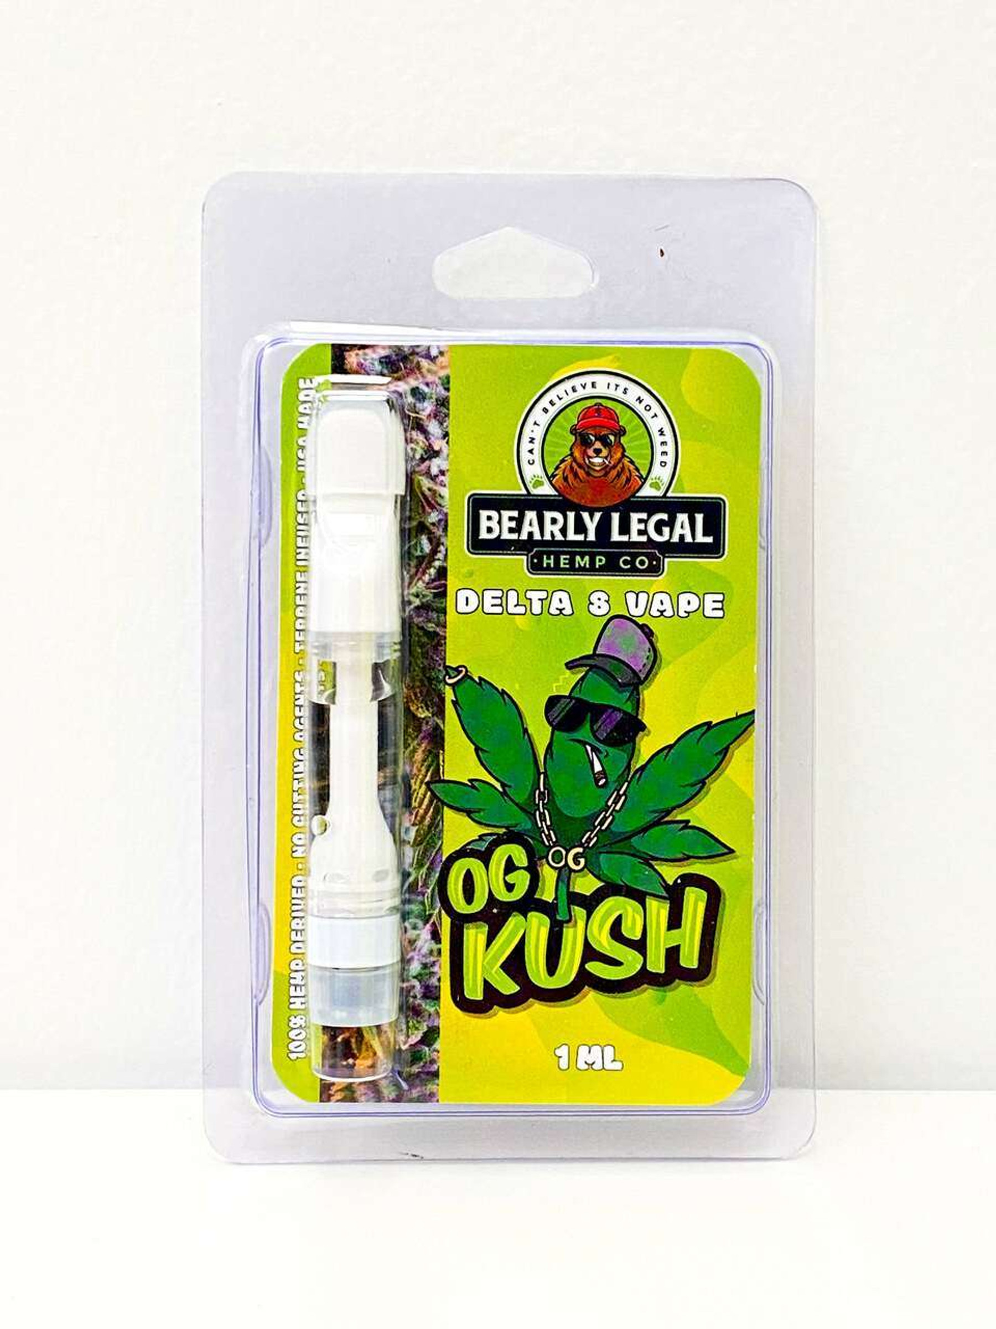
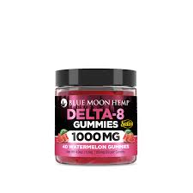
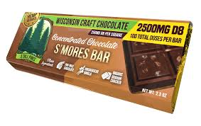

Slide 24
Delta-8-tetrahydrocannabinol versus Delta-9-tetrahydrocannabinol
Delta-8 and delta-9 are both forms of THC
Delta-8 THC іѕ a minor cannabinoid occurring in the plant in very small concentrations
Delta-8-THC called “THC lite” and produces a weaker but still psychoactive effect
Delta-8 (like delta-9), binds to the body’s endocannabinoid system = intoxicating effects
Both cannabinoids have a chain of carbon atoms, but delta-8 has the double bond (what causes intoxication) on the eighth carbon, whereas delta-9 has it on the ninth
THC can cause negative effects (anxiety or paranoia). Delta-8 may offer a smoother and milder high (theoretically)
Very little research on delta-8 as compared to Delta 9 THC

Slide 25
Why Delta 8 now?
The 2018 Farm Bill changed the game for hemp and its cousins. It dictated that hemp-derived cannabinoids were not controlled substances
Defined hemp as: “All derivatives, extracts, cannabinoids, isomers, acids, salts, and salts of isomers, whether growing or not, with a delta-9 tetrahydrocannabinol concentration of not more than 0.3 percent.”
Delta-8 THC is extracted/derived from Hemp so is legal at the federal level because it does not contain any delta-9 THC

Slide 26
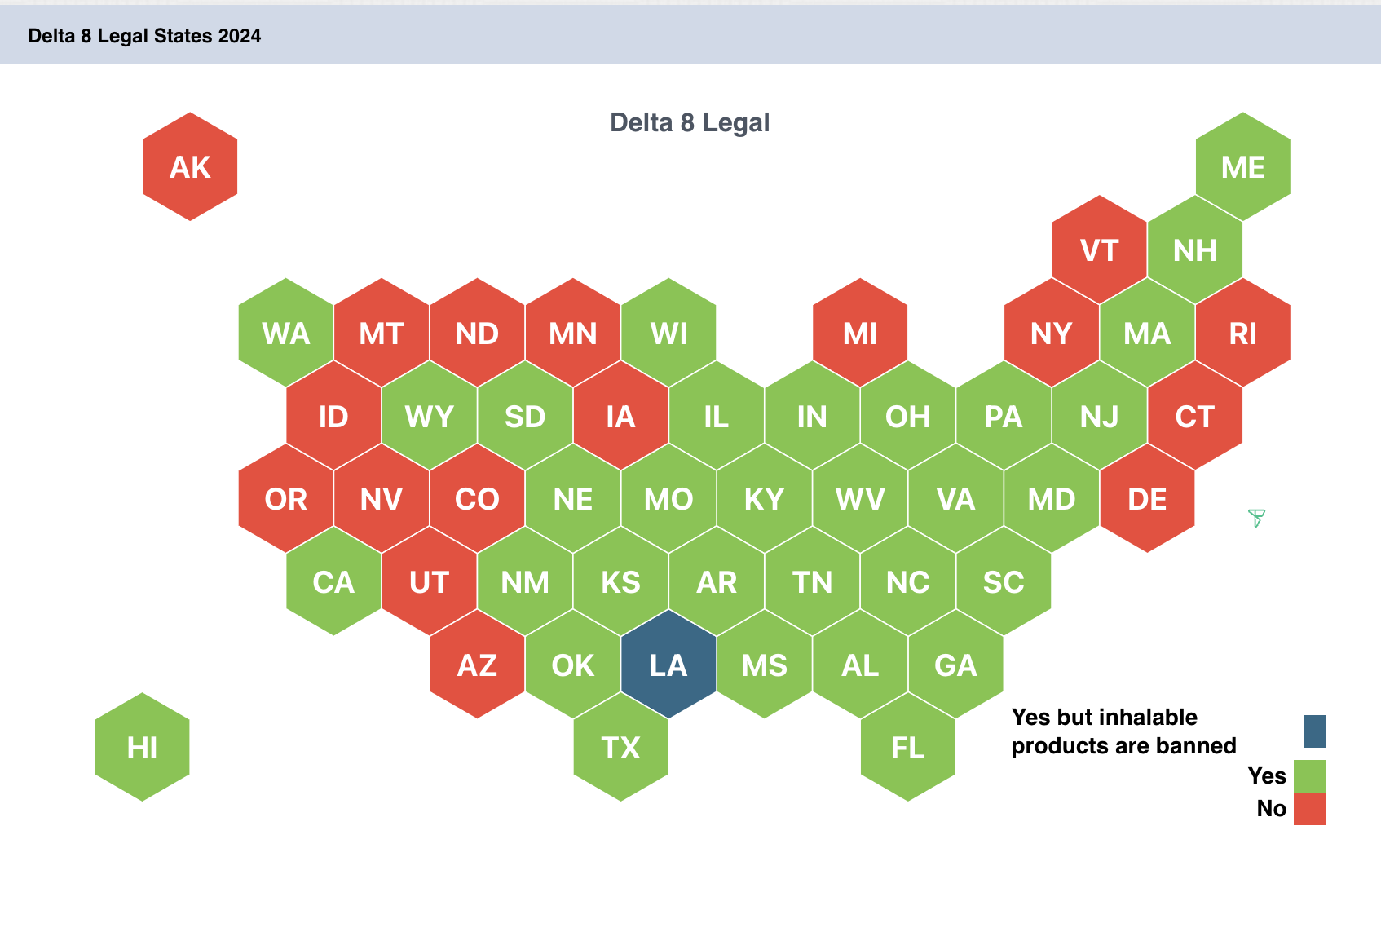

Slide 27
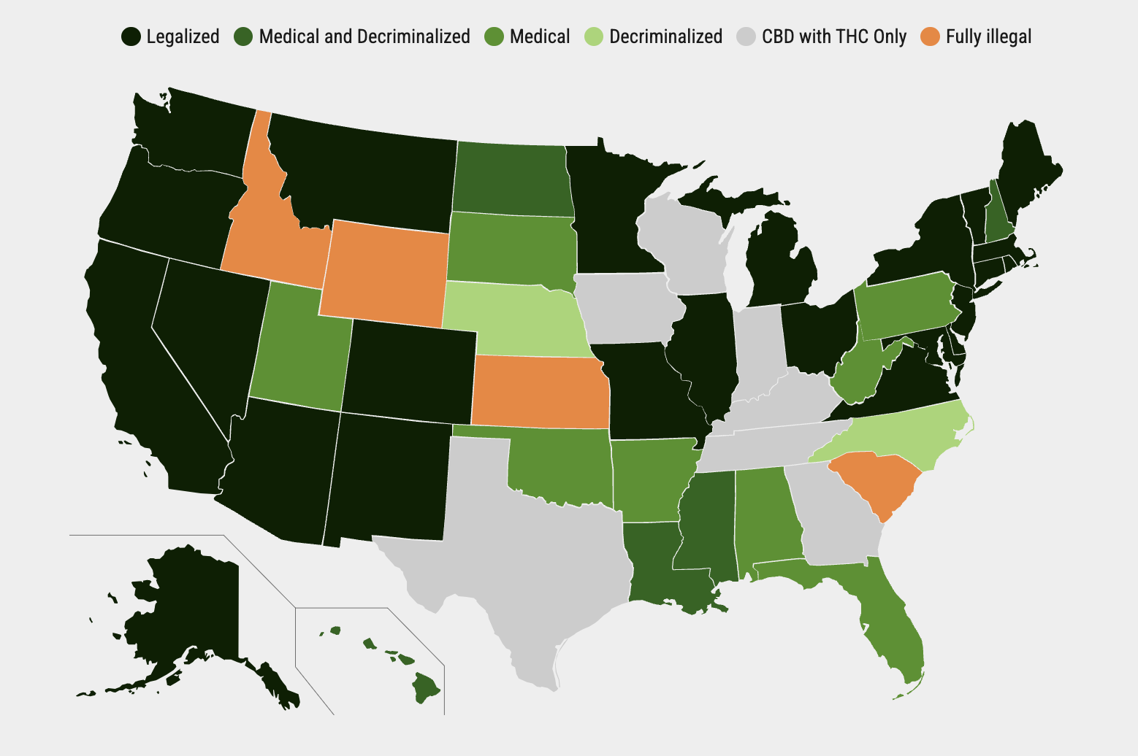
As of 04/02/2024
Notes:
Kansas; South Carolina; Idaho and Wyoming

Slide 28
From Colorado Department of Transportation
Non-intoxicating hemp products like CBD, for example, are legal when derived from hemp
Through a chemical process, CBD is used to make Delta-8 and Delta-10 THC — psychoactive
The intoxicating “cannabinoids” in regulated (legal) products — cannabis flower, edibles, distillates like wax and shatter all contain Delta-9 THC
When when it comes to impairment, the physical and cognitive effects are the same for Delta 8 and Delta 9:
Slowed reaction time
Difficulties in road tracking and lane-position variability
Decreased, divided attention
Impaired cognitive performance
Relaxed inhibitions
Impaired executive functions, including route planning, decision making and risk taking, or a combination of all

Slide 29
If Delta 8 is Legal Federally - Why Not at JC?
Exhibit 2.1 Zero Tolerance Infractions (see page 3)
Drugs: Possession or distribution of drugs on center or under center supervision knowingly possessing, using, or distributing any of the following:
Illegal drugs, as defined by the Controlled Substances Act including seeds and residue, except when the drug is possessed and/or used in accordance with a valid prescription (Note: Under Federal law, no valid prescription can be provided for Schedule I drugs, including marijuana)
Synthetic drugs
Legalized marijuana
Prescription drugs not prescribed for the individual
Substances used for the purpose of intoxication
Over-the-counter medications for the purpose of intoxication
Drug paraphernalia
Drug sale ledger or distribution list

Slide 30
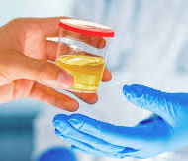
What about Drug Testing?
Will someone using Delta 8 test positive for cannabis?
Short Answer is Yes.
Those using Delta-8 have a high probability of having a positive drug test (unlike CBD where the likelihood is lower of testing positive).

Slide 31
Revisiting Learning Objectives
1.) Define two emerging trends impacting students at Job Corps in 2024.
Overall cannabis use stable but vaping cannabis increasing
Use of Delta-8 increasing
2.) Articulate how the changes to the ZT policy are positively impacting students.
Use nanograms for individualized RP
Expanded assessment using specialized tools
Retaining more students with expanded RP services
3.) Identify three ways to expand Relapse Prevention Services to support students retained for residential concentrations of THC.
Develop RP plan with components such a leisure time planning, online supports, and intervention services
4.) Learn how to integrate information regarding increased use of Delta-8 in young people in TEAP programming.
While federally legal (and legal in some states) it is still prohibited at JC because it is explicitly used for purposes of intoxication
Those using it will test positive on drug test
Make the connection to employability

