Slide 1
by Dr. K. Felder Moore and Mr. K. Wilson
Center Mental Health Consultants
Woodstock Job Corps Center
Zoomers and Alphas:
A Multigenerational View of
Mental Health Matters
Job Corps National Webinar - August 13, 2024

Slide 2
Background & Purpose
Background:
People in the United States are living longer than any generation before them. This means that individuals are also working later in life than ever before. Here at Job Corps you will find yourself interacting with student-trainees that may be anywhere from 1 to 3 generations younger than you.
Purpose:
This training is designed to give you a cursory overview of two generational cohorts: Gen Z – our current cultural community and Gen Alpha – our rising vocational consumers. Ideally, highlighting key determinants of each generation will foster a more collaborative and communicative work environment for everyone.

Slide 3
Learning Objectives
After completing this training you will:
01
Be able to articulate the cultural and life experiences of Zoomers and Gen Alpha
02
Better understand Post-Covid implications for Gen Z, Gen Alpha, and their mental health
03
Better understand the benefits of using practical applications for early identification of mental health concerns
04
Identify the strengths of each generation in order to improve direct care and collaboration between staff and trainees.

Slide 4
What is a Generation?
Generation Cohort Theory:
“A generation is defined as a group of individuals born and living contemporaneously who share common knowledge and experiences that affect their thoughts, attitudes, values, beliefs and behaviors” (Clark, pg. 379 2017)
Photo Credit: Authors unknown, licensed under CC BY-SA-NC

Slide 5
Why is this important to Health and Wellness?
Shifts in culture, technology and societal norms
Differing perspectives
Fostering open communication and understanding
A more mentally healthy future.

Slide 6
Current Generations

Slide 7
The Silent Gen (1925-1945)
Smallest Generation in past 100 years
Lived during the Great Depression and WWII
Be seen, not heard was part of the social and culture environment
Motto: “Use it up, fix it up, make it do, or do without”
Rebuilt the economy after the Great Depression and helped launch the Civil RIghts Movement

Slide 8
The Silent Gen & Mental Health
MH issues are considered taboo
Stiff upper lips and stoic attitudes were the norm
Seeking help for MH was seen as a sign of weakness
Many still carry these beliefs, but some are now educating themselves and advocating for better mental health

Slide 9
Baby Boomers aka Boomers
Influenced by Women’s Rights, Civil Rights, and Disability Rights Movements
Moved out of their parents’ home at age 18 or after college
Started working at age 14
Have a strong work ethic and will work long hours. They tend to be defined by their careers.

Slide 10
Boomers & Mental Health
Adolescents during the counterculture movement of the 60's
Witnessed the deinstitutionalization of mental health care
Influenced by the idea that MH issues can be resolved through personal growth and self-help
While some embrace therapy and self-exploration, others remain skeptical of psych meds

Slide 11
Generation X or Gen X
Influenced by Roe v. Wade, birth control pill, Aids Epidemic, and Dot Com boom
Smallest cohort
Cautious about starting families due to high divorce rates
Saw huge boom in double income households – latchkey kids.

Slide 12
Gen X & Mental Health
Increasing divorce rates and the latchkey kid phenomenon.
Gen X has been known for its independence and self-reliance.
The first generation to experience the rise of the self-help movement and the stigmatization of mental health issues.

Slide 13
Millennials
The most racially & ethnically diverse adult generation:
57% are white 21% are Latino 13% are black 6% are Asian
Influenced by the rise of social media, cell phones/smart phones, massive college debt
First Generation where some members were born into a digitally connected and globalized world.

Slide 14
Millennials & Mental Health
Have grown up in a time of rapid technological change and increasing mental health awareness.
Tend to be more open and accepting of discussing mental health issues.
Social media and the internet have given them access to information and resources.
As a result, they are more likely to seek help and support when needed.
MH advocacy and self-care are central themes for many in this generation.

Slide 15
Generation Z, Gen Z, or Zoomers

Slide 16
Gen Z (born between 1997 and 2009)
Digital Natives” - raised on the internet and social media
Comprise 27% of the US Population
Closely mirror millennials on key social and political issues but without much of the optimism
Eclipse all other generations in embracing diversity and inclusion

Slide 17
Gen Z Facts
Value flexibility, authenticity, and relevance
Are pragmatists
Criticized as lazy because they don’t seek after school or summer jobs; however, they make significant money through online activities
Attention span is 8 seconds compared to Millennials at 12 seconds
Using commercial for marketing is poor marketing
Known to toggle between 5 screens at once
Utilize YouTube for learning rather than conventional methods (i.e. tutor)
Favorite form of communication is IN PERSON

Slide 18
Gen Z - Historical Perspective
9/11
War on Terror (Code Orange)
War in Iraq & Afghanistan
Mars Exploration Rovers
Great Recession
1st African American President
1st Hispanic Supreme Court Justice
H1N1 - Swine Flu
Boston Marathon Bombing
DACA/Dreamers
Don’t Ask/Don’t Tell Repeal
Legalization of Gay Marriage

Slide 19
Gen Z
Historical Perspective
Smartphones & Smart TV’s
YouTube - Broadcast Yourself
Cyberbullying
Introduction of IPhone
Ipod, ITouch, mp3
Netflix, Redbox, streaming
End of Roe v. Wade
Mass School Shootings
Affordable Care Act
Charleston Church Shooting
Government Shutdown/Furlough
COVID-19 Pandemic
1st elected President - Donald Trump

Slide 21
Gen Z in the workplace
Entering the workforce after the COVID-19 pandemic; accounting for 1/3 of the workforce
Value work-life balance and discuss it at the first interview
1 in 8 are losing their jobs within their first week
Well-versed in technologies but less fluent in softer skills
Quitting jobs whose culture does not align with personal values such as mental health and self care

Slide 22
Gen Z & Mental Health
Gen Z has grown up in a world that is even more connected through technology and social media.
They have a wealth of information at their fingertips and are generally very open about their mental health challenges.
Conversations around mental health are common, and many are advocates for breaking the stigma surrounding it.
They have a strong belief in the importance of mental well-being.

Slide 23
Generation Alpha

Slide 24
Gen Alpha Facts
Hyperconnected - Alpha children/tweens are permanently connected
Independent - when it comes to making their own decisions. They expect their individual needs and preferences to be taken into account.
Visual - Video will be their preferred format. Video games will boost their visual skills, improve coordination and the ability to easily switch tasks.
They become experts in the use of new technologies which facilitates digital learning, opening up a wide range of possibilities.
Diversity - not only refers to demographics, such as ethnicity and gender, but also to tastes, lifestyles and points of view.
Reduced attention span and concentration - because they are used to using multiple screens and quickly scanning information, these abilities become impaired.

Slide 25
Gen Alpha Facts
Less time for socializing - Spending much of the day online, both inside and outside the home, reduces the time for learning, playing and socializing in more traditional ways. In fact, much of socialization is transferred to social networks.
55% of 7-12 year-olds use social media; 59% agree that mental health is a big issue; 62% say their school should focus more on mental health education than physical education (Calandra 2023).
“Sharenting” - Having been born in the social media era, many have also had their personal stories, photographs, and videos posted online by their parents since their birth.

Slide 26
Gen Alpha - Historical Perspective
Haiti Earthquake - January 12, 2010
World’s First Ipad
Penn State Scandal - Sandusky
Osama Bin Laden Killed
Gangham Style
Ice Bucket Challenge
Diverse Emojis
Largest Women’s March
Rise of Share Economy - Uber/Lyft
Increase in School Shootings
Student Walkouts/Protests
Active Shooter Drills
Hurricane Season
Black Lives Matter
#MeToo
Cancel Culture
Trump Presidency
January 6th Riot
Kamala Harris as VP
Haiti Crisis - 2024

Slide 27
Gen Alpha - Mental Heath
Why focus on Gen Alpha? This generation will begin to enter Job Corps within the next two to four years
2023 Virginia School Survey of Climate and Working Conditions
70% of eligible schools participated in the student portion of the survey.
183,837 student responses (65.4% among 6th-8th grade students)
“23% of students reported feeling anxiety more than half the days over the last two weeks”
“20% reported experiencing signs of depression more than half the days over the last two weeks”
“99,842 (54.3%) reported problematic depressive thoughts, feelings, or behaviors within the past 12 months
11% of students reported seriously considering suicide within the past 12 months
59.3% reported bullying as a problem (physical appearance, sexual orientation, race, disability)

Slide 28
Implications from the Pandemic
47% of Gen Z American are thriving in their lives
15% of Gen Z ages 18-26 describe their MH or well-being as excellent
This is steep drop compared to when 52% of Millennials at the same age range reported excellent MH.
Research shows that Gen Z was able to recognize the negative emotional impact of overconsumption of COVID related news on their mental health and would disconnect periodically to improve their emotional well-being.
Between 2010 and 2015, anxiety, depression, and suicidal tendencies began to rise. US Teens reporting depressive symptoms rose by 150% during this time period.
In 2020, while an increase in depression was noted in teen girls, it was noted that the majority of the rise was in place before the pandemic

Slide 29
Applications in Practice
Since November 2021, an Intake Assessment has been completed with every new arrival within their first week.
MHWP Orientation completed during CPP to share about services and emphasis on addressing a crisis (suicide or threat of violence)
Students are permitted to choose the session format in which they would like to engage (i.e. F2F, in office or outdoors, walk and talk, etc.)
Complete multiple center-wide MH activities throughout the year promoting mental health matters, including a weekly Calming Room from May 2022-September 2023

Slide 30
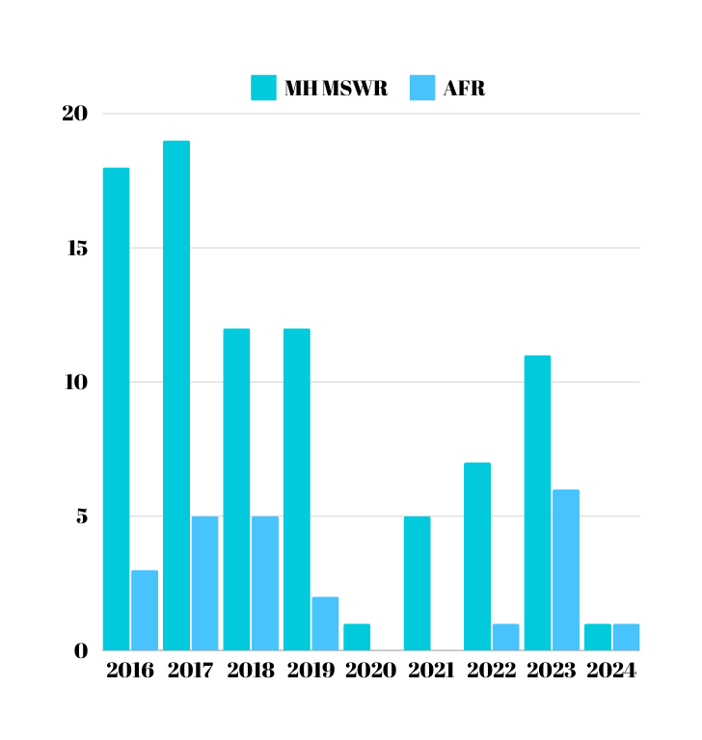
Observations
WJCC specific observations
Top 3 MH Diagnoses on Applicant Review (From 2016-Present)
ADHD
Depression
Anxiety
MSWR
Are increasing as the OBS increases
Majority have been SIB

Slide 31
Gen Alpha - MH Predictions
What MH issues could Job Corps see as Gen Alpha enters Job Corps in 2-4 years?
ADHD
Depression
Anxiety
Rise in Trauma Related Disorders including trauma related to mass shootings)
Psychosis
Screen Addiction
Cyberbullying
Suicidality
Sextortion Victims
Expectation of mentorship and relationship

Slide 32
Recommendations
These suggestions are recommended based on the characteristics of Gen Z, Gen Alpha, and our experience implementing these applications
Screening Tools
Mood Feeling Questionnaire - Measures depressive symptoms over past two weeks.
Given to every student in their cursory packet.
Follow up with PHQ-9 for any student scoring 11 or higher
Intake Assessment
Completed with every new arrival within the first week. C-SSRS, PHQ-9, GAD-7, & PCL-5 completed as needed
Insurance
Recommend helping every student enroll with an insurance provider upon entry
Trauma Informed Approach
Has to be ingrained across the board as a standard of practice

Slide 33
Recommendations
These suggestions are recommended based on the characteristics of Gen Z, Gen Alpha, and our experience implementing these applications
Social Emotional Learning
Improving soft-skills underdeveloped or lost as a result of the pandemic
Groups focused on SEL
Incorporate SEL activities or practices into the CPP curriculum (CASEL)
For more information or training on SEL, you can go to CASEL.org
Mentoring and Modeling
Relationships
Daily Living/Life Skills
Communication
EQ

Slide 34
References
“2023 Virginia School Survey of Climate and Working Conditions: Executive Summary. “ Virginia Department of Criminal Justice Services.
Becton, J.B., Walker, H.J., Jones-Farmer, A. (2014). Generational differences in workplace behavior. Journal of Applied Social Psychology, 44, 175-189.
Calandra, Carla. Gen Alpha’s Mental Wellness. February 22, 2023. https://www.vml.com/insight/gen-alphas-mental-wellness
Clark, K.R. (2017). Managing Multiple Generations in the Workplace. Radiologic Technology, 88, 379-398.
Cohen, M. (2023, May 26). Companies are learning that Gen Z isn’t the easiest generation to work with. CNBC.
Dennis, Hellen (2023, May 21). “Taking a closer look at the achievements of the Silent Generation.” Los Angeles Daily News.
De Witte, M. (2022). What to know about Gen Z. Stanford News. https://news.stanford.edu/2022/01/03/know-gen-z/
“Generation Alpha will lead a 100% digital world” (Iberdrola.com). https://www.iberdrola.com/talent/alpha-generation#:~:text=Generation%20Alpha%20will%20lead%20a%20100%25%20digital%20world&text=The%20year%202010%20saw%20the,they%20interact%20with%20their%20peers. Accessed May 3, 2024.
Gibaldi, C.P. (2013). Changing the trends of retirement: Baby Boomers leading the charge. Review of Business, 34, 50-57.
Haidt, Jonathan. (2024) “Generation Anxiety: smartphones have created a gen Z mental health crisis - but there are a few ways to fix it.” The Guardian.

Slide 35
References
https://www.cnbc.com/2023/05/26/employers-are-learning-gen-z-isnt-the-easiest-generation-to-work-with.html
https://hbr.org/2023/01/helping-gen-z-employees-find-their-place-at-work
https://nypost.com/2023/04/25/employers-reveal-why-gen-z-is-hardest-generation-to-work-with/
https://oaksintcare.org/understanding-generational-views-on-mental-health/ Understanding Generational Views on Mental Health (Nov 20, 2023).
Lawson, M. (2017). Shifting to the next generation workplace. Public Management, 14-18.
Meola, A. (2023). Generation Z: Latest gen Z news, research, facts 2023. Insider Intelligence. https://www.insiderintelligence.com/insights/generation-z-facts/
Patel, D. (2017, November 27). 5 D​differences ​between ​marketing ​to​ M​illennials V​s. Gen Z. Forbes.
https://www.forbes.com/sites/deeppatel/2017/11/27/5-d%E2%80%8Bifferences-%E2%80%8Bbetween-%E2%80%8Bmarketing-%E2%80%8Bto%E2%80%8B-m%
E2%80%8Billennials-v%E2%80%8Bs%E2%80%8B-%E2%80%8Bgen-z/?sh=67cfaec72c9f
Weston (2001). Coaching Generations in the Workplace. Nursing Administration Quarterly, 88, 11-21.

Slide 36
Contact Information
Dr. Karyn Felder Moore, LCPC
moore.karyn@jobcorps.org
410-696-9337
Karon Wilson, LCPC
wilson.karon@jobcorps.org
410-696-9415
Please follow, like and subscribe
YT: @keepthisinmind7136
IG: _KeepThisInMind
FB: Keep This In Mind

