Slide 1
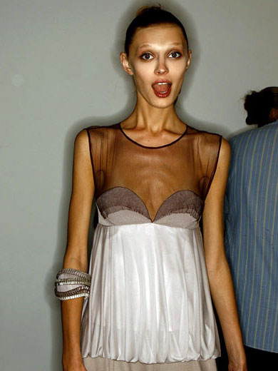
Contradictory Trends
Notes:
Americans are gaining weight rapidly. However, our image of beauty, with a few exceptions, is of very skinny models.

Slide 2
Outline
Trends in body weight in the U.S.
Causes of obesity
Images of beauty in our society

Slide 3
Obesity Trends* Among U.S. Adults BRFSS, 1985
(*BMI ≥30, or ~ 30 lbs. overweight for 5’ 4” person)
No Data <10% 10%–14%
Source: Centers for Disease Control. (2009). Retrieve from: http://www.cdc.gov/obesity/data/trends.html
Notes:
Share these slides with your class. They show how much weight Americans have gained over a 20 year period.
Many states did not report data for the first couple of years. As it gets closer to present day, the obesity rate climbs!

Slide 4
Obesity Trends* Among U.S. Adults BRFSS, 1986
(*BMI ≥30, or ~ 30 lbs. overweight for 5’ 4” person)
No Data <10% 10%–14%

Slide 5
Obesity Trends* Among U.S. Adults BRFSS, 1987
(*BMI ≥30, or ~ 30 lbs. overweight for 5’ 4” person)
No Data <10% 10%–14%

Slide 6
Obesity Trends* Among U.S. Adults BRFSS, 1988
(*BMI ≥30, or ~ 30 lbs. overweight for 5’ 4” person)
No Data <10% 10%–14%

Slide 7
Obesity Trends* Among U.S. Adults BRFSS, 1989
(*BMI ≥30, or ~ 30 lbs. overweight for 5’ 4” person)
No Data <10% 10%–14%

Slide 8
Obesity Trends* Among U.S. Adults BRFSS, 1990
(*BMI ≥30, or ~ 30 lbs. overweight for 5’ 4” person)
No Data <10% 10%–14%

Slide 9
Obesity Trends* Among U.S. Adults BRFSS, 1991
(*BMI ≥30, or ~ 30 lbs. overweight for 5’ 4” person)
No Data <10% 10%–14% 15%–19%
Notes:
This was the first year that the 15%-19% obesity category was added.

Slide 10
Obesity Trends* Among U.S. Adults BRFSS, 1992
(*BMI ≥30, or ~ 30 lbs. overweight for 5’ 4” person)
No Data <10% 10%–14% 15%–19%

Slide 11
Obesity Trends* Among U.S. Adults BRFSS, 1993
(*BMI ≥30, or ~ 30 lbs. overweight for 5’ 4” person)
No Data <10% 10%–14% 15%–19%

Slide 12
Obesity Trends* Among U.S. Adults BRFSS, 1994
(*BMI ≥30, or ~ 30 lbs. overweight for 5’ 4” person)
No Data <10% 10%–14% 15%–19%
Notes:
States in the south, east, and the eastern part of the mid west are more obese than states in the west.

Slide 13
Obesity Trends* Among U.S. Adults BRFSS, 1995
(*BMI ≥30, or ~ 30 lbs. overweight for 5’ 4” person)
No Data <10% 10%–14% 15%–19%

Slide 14
Obesity Trends* Among U.S. Adults BRFSS, 1996
(*BMI ≥30, or ~ 30 lbs. overweight for 5’ 4” person)
No Data <10% 10%–14% 15%–19%

Slide 15
Obesity Trends* Among U.S. Adults BRFSS, 1997
(*BMI ≥30, or ~ 30 lbs. overweight for 5’ 4” person)
No Data <10% 10%–14% 15%–19% ≥20%
Notes:
This is the first year that more than 20% of a state’s population reported that they were obese.

Slide 16
Obesity Trends* Among U.S. Adults BRFSS, 1998
(*BMI ≥30, or ~ 30 lbs. overweight for 5’ 4” person)
No Data <10% 10%–14% 15%–19% ≥20%

Slide 17
Obesity Trends* Among U.S. Adults BRFSS, 1999
(*BMI ≥30, or ~ 30 lbs. overweight for 5’ 4” person)
No Data <10% 10%–14% 15%–19% ≥20%
Notes:
There was a big jump during the two years leading up to this.

Slide 18
Obesity Trends* Among U.S. Adults BRFSS, 2000
(*BMI ≥30, or ~ 30 lbs. overweight for 5’ 4” person)
No Data <10% 10%–14% 15%–19% ≥20%
Notes:
By 2000, Colorado was the only state with less than 15% obesity.

Slide 19
Obesity Trends* Among U.S. Adults BRFSS, 2001
(*BMI ≥30, or ~ 30 lbs. overweight for 5’ 4” person)
No Data <10% 10%–14% 15%–19% 20%–24% ≥25%
Notes:
Mississippi is the first state to become more than 25% obese.

Slide 20
Obesity Trends* Among U.S. Adults BRFSS, 2002
(*BMI ≥30, or ~ 30 lbs. overweight for 5’ 4” person)
No Data <10% 10%–14% 15%–19% 20%–24% ≥25%
Notes:
It didn’t take long for other states to follow. This year, the 10%-14% category disappeared.

Slide 21
Obesity Trends* Among U.S. Adults BRFSS, 2003
(*BMI ≥30, or ~ 30 lbs. overweight for 5’ 4” person)
No Data <10% 10%–14% 15%–19% 20%–24% ≥25%

Slide 22
Obesity Trends* Among U.S. Adults BRFSS, 2004
(*BMI ≥30, or ~ 30 lbs. overweight for 5’ 4” person)
No Data <10% 10%–14% 15%–19% 20%–24% ≥25%

Slide 23
Obesity Trends* Among U.S. Adults BRFSS, 2005
(*BMI ≥30, or ~ 30 lbs. overweight for 5’ 4” person)
No Data <10% 10%–14% 15%–19% 20%–24% 25%–29% ≥30%
Notes:
Colorado and Hawaii are alone in the 15-19% range. The greater than 30% category is added.

Slide 24
Obesity Trends* Among U.S. Adults BRFSS, 2006
(*BMI ≥30, or ~ 30 lbs. overweight for 5’ 4” person)
No Data <10% 10%–14% 15%–19% 20%–24% 25%–29% ≥30%

Slide 25
Obesity Trends* Among U.S. Adults BRFSS, 2007
(*BMI ≥30, or ~ 30 lbs. overweight for 5’ 4” person)
No Data <10% 10%–14% 15%–19% 20%–24% 25%–29% ≥30%
Notes:
Again, Colorado hold the title of the thinnest state.

Slide 26
Obesity Trends* Among U.S. Adults BRFSS, 2008
(*BMI ≥30, or ~ 30 lbs. overweight for 5’ 4” person)
No Data <10% 10%–14% 15%–19% 20%–24% 25%–29% ≥30%

Slide 27
Obesity Trends* Among U.S. Adults BRFSS, 1990, 1999, 2008
(*BMI ≥30, or about 30 lbs. overweight for 5’4” person)
1990
1999
2008
No Data <10% 10%–14% 15%–19% 20%–24% 25%–29% ≥30%

Slide 28
Why do you think Americans have gained so much weight?
Notes:
Class discussion.

Slide 29
Reason #1, 2, and 3
More fast food advertising
More time spent in front of the TV
Less time spent outside engaged in physical activity

Slide 30
Effects of Fast-Food Restaurant Advertising on Children
TV’s Effects
Takes time away from physical activity
Encourages eating unhealthy foods
Advertisements
candy (32 percent of all children’s ads)
cereal (31 percent)
fast-food restaurants (9 percent)
Ban on advertising would reduce the number of overweight adolescents by 14%
Source: Chou ,S.Y., Rashad I. (2006). Fast-food restaurant advertising on television and its Influence on childhood obesity. Retrieved November 4, 2009 from: http://www.aeaweb.org/annual_mtg_papers/2007/0106_1015_2004.pdf
Notes:
Study results indicate that a ban on these advertisements would reduce the number of overweight children ages 3-11 in a fixed population by 18 percent and would reduce the number of overweight adolescents ages 12-18 by 14 percent.

Slide 31
Children and Commercials
Notes:
Children and adolescents see a lot more commercials than they did 30 years ago. Why? Because they watch a lot more TV.

Slide 32
Reason #4
Portion sizes are much, much larger

Slide 33
Coffee
20 Years Ago
Coffee (with whole milk and sugar)
Today
Mocha Coffee (with whole milk and mocha syrup)
A standard cup of coffee 20 years ago was 8 ounces and had 45 calories. Now it’s up to about 350 for an average sized cup.
Source: National Institutes of Health. Portion Distortion Interactive Quiz. http://hp2010.nhlbihin.net/portion/
Notes:
Portion sizes have gotten a lot bigger.

Slide 34
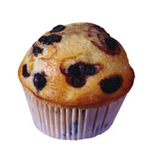
Muffins
20 Years Ago
Blueberry Muffin
Today
Blueberry Muffin
A muffin 20 years ago was 1.5 ounces and had 210 calories. Now it’s up to about 5 ounces and 500 calories.

Slide 35
Food Consumption is Different
More soda and sugary beverages
More eating out (food eaten out usually has more calories)
More processed foods
More sweets and junk food available

Slide 36
Why is skinny attractive?
Or is it?
Notes:
Class discussion. Why do you think that models and actors are so skinny?

Slide 37
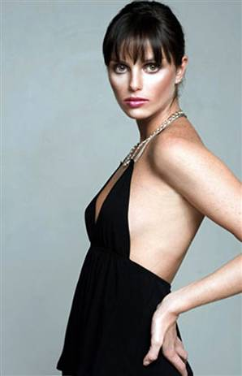
Ana Carolina Reston, 5’8”, 88 pounds
Notes:
Our ideal woman has gotten smaller. In the 1950s and 1960s models looked like regular women. Today, they are often an unhealthy weight.
Ms. Reston was a Brazilian model who died of Anorexia. She was 88 pounds when she died. Since then, many modeling agencies and corporations have enacted laws to ensure that models live healthier lifestyles. For example, models at Nicole Miller Fashion House must maintain a weight that doctors consider healthy or normal. Underweight girls are not allowed to model for that agency.

Slide 38
Where do we go from here?
Notes:
What do you think is the solution to our body weight and body image issues? (class discussion)

Slide 39
http://www.dove.us/#/features/videos/default.aspx[cp-documentid=7049560]/
Notes:
In this video, make up artists prepare a woman for a photo shoot.

