Slide 1
Using Accessible Technology to Remove Barriers: A Closer Look at Tablets, Apps and Accessibility
Carolyn Phillips and Liz Persaud, Tools for Life
With contributions from Martha Rust
www.gatfl.org
National Job Corps
December 3 & 5, 2013

Slide 2
Who we are
Carolyn Phillips,
Director of Tools for Life
Liz Persaud,
Training, Outreach and Development Coordinator

Slide 3
Technology Evolution
With the introduction of Apps, we are experiencing a drastic technology evolution that is revolutionizing the field of Assistive Technology and producing positive life changing results for individuals with disabilities. Apps are assisting those with disabilities by promoting more independence, increasing opportunities for inclusion, promoting depth of learning, providing equal access in educational settings and supporting smoother transitions.
This webinar will provide participants with opportunities to explore specific App solutions that promote success and can ultimately assist with successful transitions into the workplace and community.

Slide 4
Agenda
Accessing Your AT Act Program
Understanding the Difference amongst Android, Apple & Microsoft
Take a Closer Look at Tablet Features
Considering Accessibility
Access the Tools For Life AppFinder
Exploring Some of Tools for Life’s Favorite Apps

Slide 5
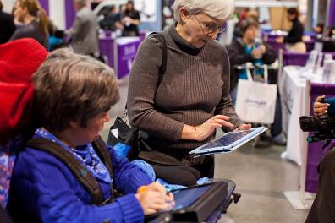
Tools for Life Mission
We’re here to help Georgians with disabilities gain access to and acquisition of assistive technology devices and assistive technology services so they can live, learn, work, and play independently in the communities of their choice.

Slide 6
Tools for Life at Georgia Tech Georgia’s Federal AT Act Program
TFL developed Georgia’s Plan for AT
We serve individuals of all ages & all disabilities in Georgia
Over 50,000+ thru various activities throughout the year
TFL Network
Assistive Technology Resource Centers
Lending Libraries
Training and Demonstrations
AT Reuse
AT Funding Education/Assistance and Resources
Online Resources
www.gatfl.org - 12,000 unique visitors a month

Slide 7
Locate Your AT Act Program
http://www.resnaprojects.org/allcontacts/statewidecontacts.html

Slide 8
Which One???

Slide 9
LET’S TAKE A LOOK AT SOME OPTIONS
Notes:
MR

Slide 10
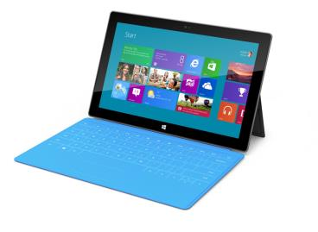
Microsoft Surface
Windows 8
Slim and has a USB port
Moveable Tiles
Built-in Accessibility
Speech-to-text
Narrator
Thin pressure sensitive cover that doubles as a keyboard
Starts at $349
Notes:
MR and CP

Slide 11
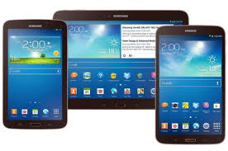
Samsung Galaxy Tab 3
Android System
7, 8, or 10 in screen
Camera
Micro card
Wi-Fi
USB for computer
Some built-in accessibility app
Download others
Starts at $199.99

Slide 12
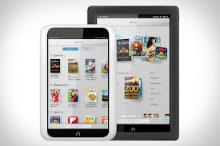
Nook HD
eBook Reader and mobile tablet
No Camera
Access to shop both Google Play Store and Barnes and Noble
Purchase apps
Starts at $129

Slide 13
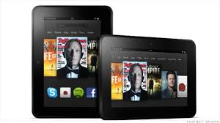
Kindle Fire HD
eBook Reader and mobile tablet
Front facing camera
Access to Amazon apps
Free cloud storage for Amazon purchases
Purchase Apps
7 inch or 8.9 inch screen
Starts at $199.99

Slide 14
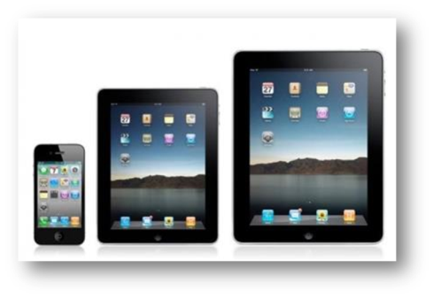
Apple iPad/ mini iPad
Multi- touch screen
New iOS 6
Millions of apps
Surf web
iTunes
Videos
Organization
Accessibility
Books
Photos
Speakers
New iPad had 5.0 megapixel camera
Starts at $499/$399 and mini $329

Slide 15
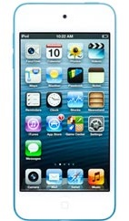
Apple iPod Touch
5 Megapixal Camera
Millions of apps
Videos
Surf Web
Voice Over
Organization
Speakers
Bluetooth
New iOS 6
Starts at $299 / $199 4th gen
Notes:
CP and MR
15

Slide 16
Refurbished Tablets
If you do not need the latest and greatest consider an older models for a discount
Want to make sure that refurbish tablets have been certified
Look for at least 1 year warranty
Many places now sell
Apple
BestBuy
Amazon

Slide 17
CONSIDERING ACCESSIBILITY
Notes:
MR

Slide 18
Comparing Tablets
Property | Android | iOS | MS Windows | Amazon Kindle | Barnes and Noble Nook
Number and variety of Tablets | Over 11,000 | iPad and iPad mini | Several | Kindle Fire and Fire HD | Nook HD
Operating System | Android (Jelly bean) | ios7 (Sept 18, 2013) | Microsoft Windows 8 | Modified version of Android ICS | Modified version of Android- Microsoft bought 2013
Apps | 860,815 (AppBrain.com updated 9/13/13) | 900,000 with 375,00 optimized for iPad/mini (mobileburn.com updated June 2013) | 104,917 (winbeta.org updated July 4, 2013) | 50,000 in Amazon App store also shop in Google Play Store (theverge.com updated August 2013) | 10,000 in Barnes and Noble and have access to Google Play store (barnesandnoble.com updated August 2013)
Software Updates | As it becomes available on Google | Apple releases updates | MS releases updates | Amazon releases updates | Barnes and Noble releases updates
Interface | As designed by manufacturer | Icons and widgets designed by Apple | Metro style designed by Microsoft | Modified version of regular Android | Modified version of regular Android
www.bluebugle.org updated by TFL 2013

Slide 19
Layout of the iPad

Slide 20
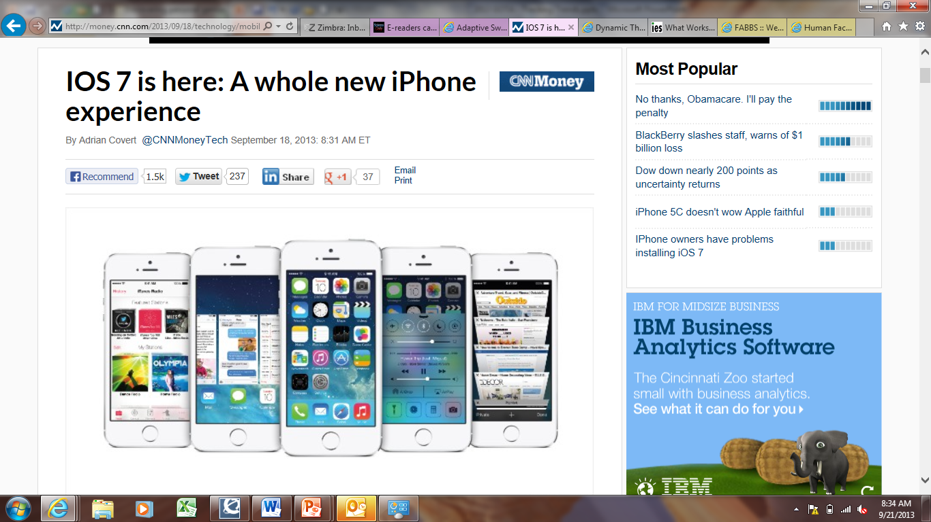
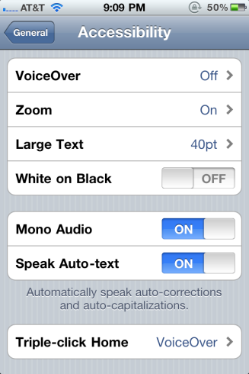
Built-in Accessibility Features
VoiceOver
Zoom
Large Text
Invert Colors
(white on black)
Speak Selection
Speak Auto Text
Mono Audio
Assistive Touch
Guided Access
Home-Click Speed
Incoming Calls
Braille Displays

Slide 21
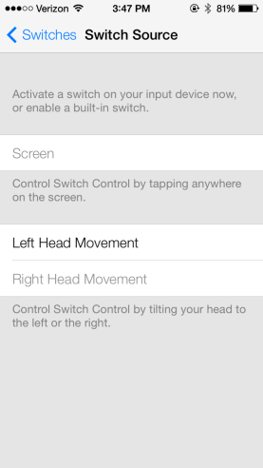
New iOS 7 Features
September 2013
Automatically turn on captioning and subtitles
Switch Source under Accessibility
Allows user to control devices by head movement

Slide 22
VoiceOver
Standard feature on iPhones, iPads, and iTouches
World’s first gesture-based screen reader
DOES NOT WORK WITH ALL APPS
Does not work with many eBooks or textbooks
Works with built-in apps
Built-in voices that speak 36 languages
Adjustable speaking rate
Echoes each character as you touch it when typing or can speak completed word instead.
Speak Auto-text
Has the rotor
Works with all built-in applications

Slide 23
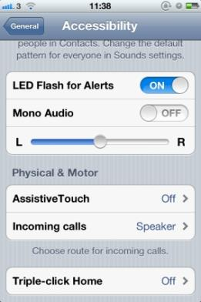
Assistive Touch
Lets you enter Multi-Touch gestures using one finger or stylus
Create custom gestures
Supports the use of adaptive input devices
Headsets and switches
Change Tracking Speed

Slide 24
Creating Keyboard Shortcuts
Go to General => Keyboard and make sure Shortcut is turned on
Go to Add New Shortcut
Put in your Phrase
Create Short Cut
Example:
Phrase : Martha E. Rust, MS CRC ATP
Shortcut is: MER
So when MER is typed it will put in the above Phrase
OMW => On My Way!

Slide 25
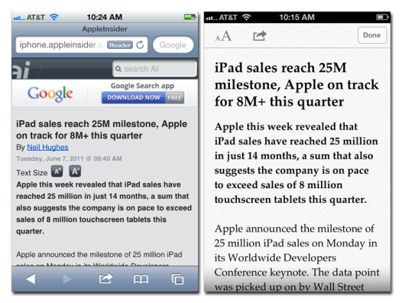
Reader for Websites
Read articles and web pages without distractions
Clutter disappears
Add link into Reading List and finish later

Slide 26
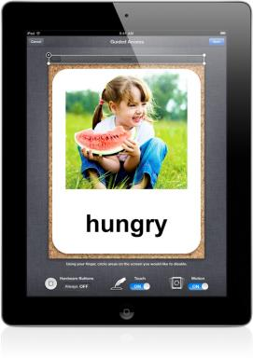
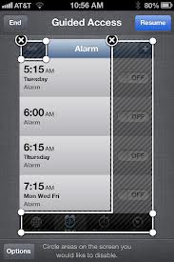
iOS 6 NEW: Guided Access
Helps remain on task and focus
Limit to one app / turn off home button
Restrict touch input on certain areas of the screen

Slide 27
Surface
2 types
RT
PRO
RT
Cannot download software
Does not support digital pen
Built in MS Office
Word, PowerPoint, Excel
Pro
30 day trial of MS Office
Ability to download software
Open 3 Windows
Tiles
Start screen
Charms
Right hand side

Slide 28
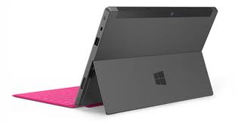
Layout of Surface
Power Button
Camera
Speaker
Micro USB
USB
Charger
On Left Side
Speaker
Headphone Jack
Volume control

Slide 29
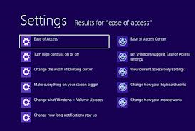
Accessibility of Surface
Uses Windows 8
Ease of Access
Narrator
Magnifier
On-Screen Keyboard
Windows Speech Recognition

Slide 30
Some Surface Apps
Maluuba
Personal assistant app
Apollo
Can be a calendar
See when the sun sets and rises
Barcode Generator
Free way to create your own barcodes

Slide 31
Layout of the Nook HD
Volume
Head phones
Power
Home Key
Charger

Slide 32
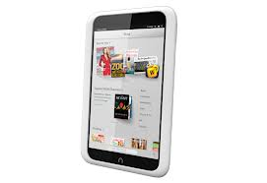
Nook HD
Download Books and Movies
Access to Barnes and Noble Store
Access to Google Play Store
No Camera
Does not read books out loud
Note taking features
Can Change:
Font
Line Spacing
Text Size
Background color

Slide 33
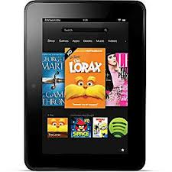
Kindle Fire HD
Download Books and Movies
Access to Amazon
Front Facing Camera
Skype
Read Books Out Loud
If book has this feature enabled
Check on product details page
Whispersync for Voice
Immersion Reading
Can Change:
Font
Line Spacing
Text Size
Background color
Notes:
Whispersync- ability to download wireless
Whispersync for voice- downloading the kindle autobook
Immersion Reading with whispersynce- highlighting and following the text

Slide 34
Layout of the Kindle Fire HD
External Speakers
Power Button
Charger
Headphone Jack

Slide 35
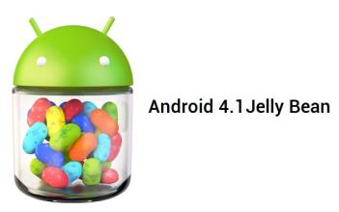
Android Tablets
Accessibility features are not built in
Talkback, Kickback, and Soundback
Gesture Feature in Jellybean
No zoom or contrast right now
What operation system is tablet running
Jellybean, Ice cream sandwich, Honeycomb, Gingerbread
Google Play Store to buy apps
Must have Gmail address
Can use Amazon gift cards
Not the best to use with someone who has low vision and/or blind or cognitive disabilities
Notes:
CP and MR

Slide 36
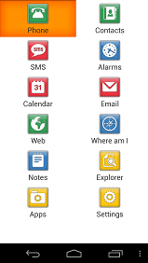
Accessible Android Apps
Big Launcher- icons look darker and text is larger
Vlingo Virtual Assistant and iris. (alpha)- voice command apps
Text to Speech Toy- Text-to- Speech
Eyes-free keyboard
IDEAL web reader
Code Factory - Mobile Accessibility Suite for AT&T users
12 different apps / 30 day free trial -$99
www.androidaccess.net
Notes:
MR

Slide 37
TFL AppFinder
Search by:
App Name
Categories
Book
Education
Environmental Adaptations
Hearing
Cognition, Learning, Developmental
Navigation
Personal Care and Safety
Productivity
Communication
Therapeutic Aids
Vision
Notes:
MR

Slide 38
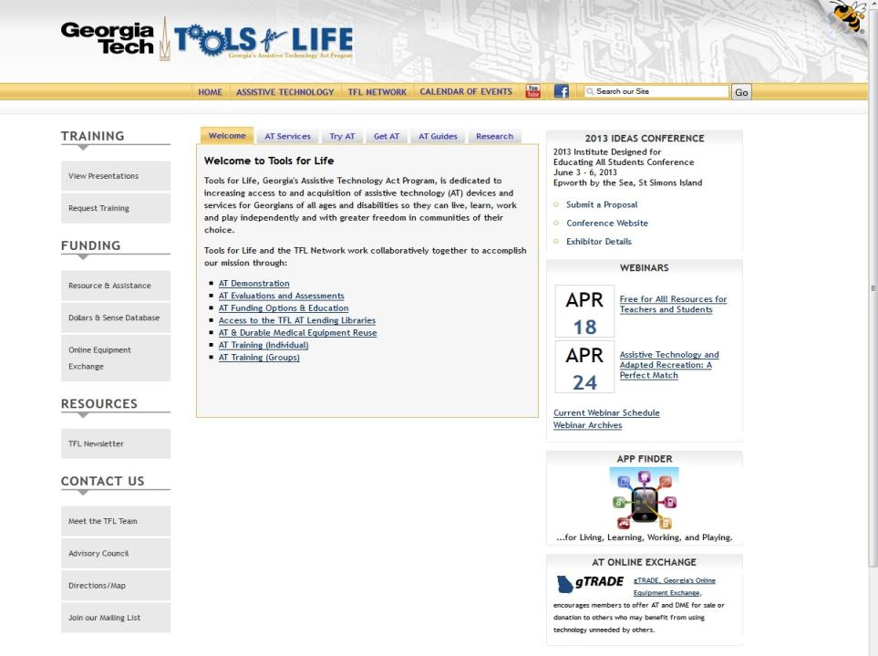

Slide 39
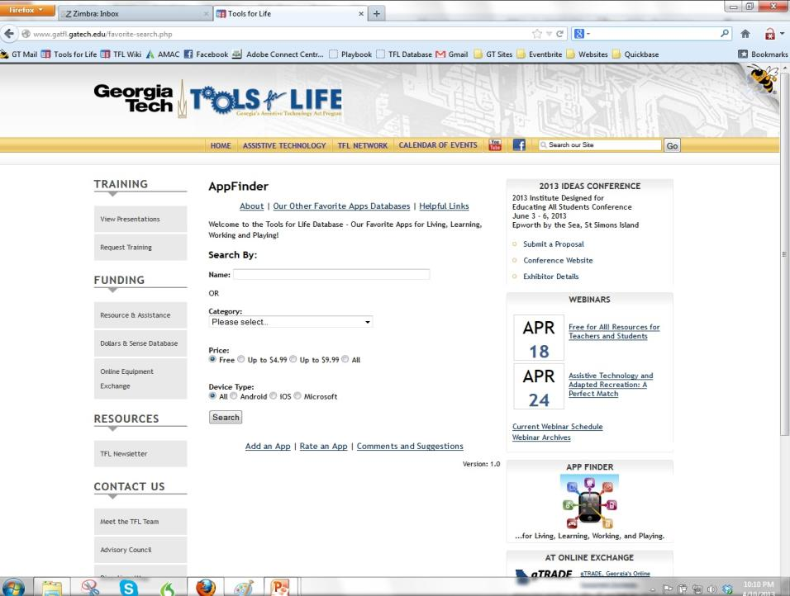

Slide 40
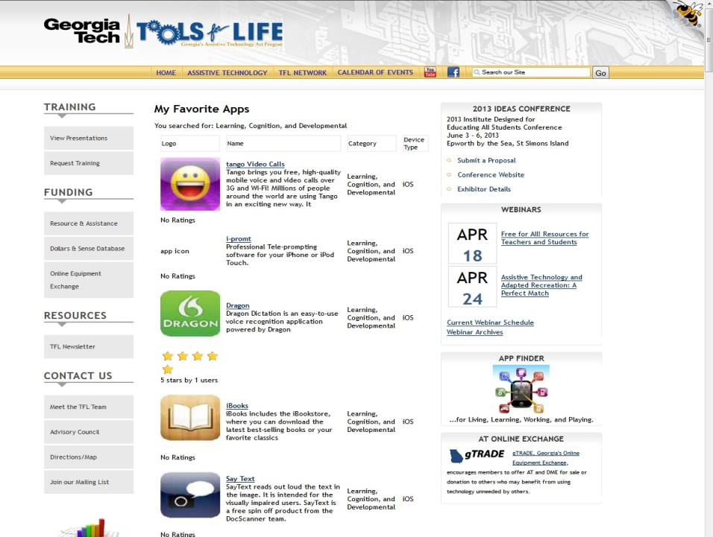

Slide 41
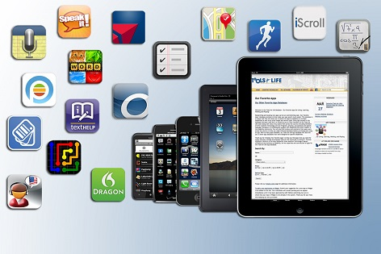
SOME OF OUR FAVORITE APPS!
What are Your Favorite Apps?

Slide 42
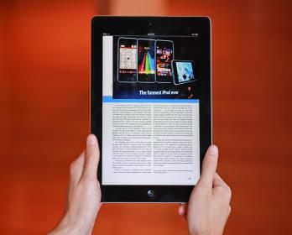
Apps for Writing and Reading

Slide 43
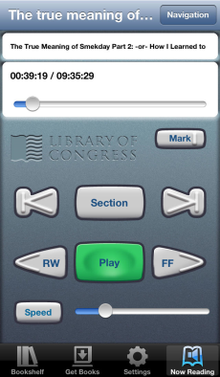
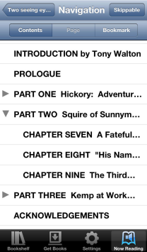
BARD Mobile
Access directly to the National Library Service for the Blind and Physically Handicapped (NLS)
Must be registered
Settings
Can use with braille display
http://www.loc.gov/nls/find.html
Free

Slide 44
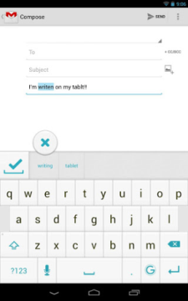
Ginger App
Free
Grammar and Spell checker
Personal Assistant
Use it to correct text messages, Whatsapp messages, Gmail and Outlook emails, and even social media apps such as Facebook

Slide 45
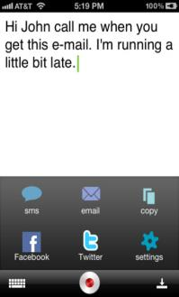
Dragon Dictation
Voice Recognition
Free
Dictate notes, emails, Twitter, and Facebook
Supports many languages
Cut, Copy, Paste
Android
Dragon Go!
Dragon Hands Free Assistant
Notes:
CL

Slide 46
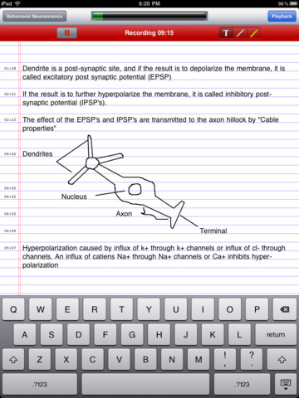
AudioNote
Records your notes, meetings or lectures
Can take notes by typing, stylus, or drawing
Time stamps so you can go directly to where you want to hear
Highlights notes when read back
$4.99
Notes:
CP

Slide 47
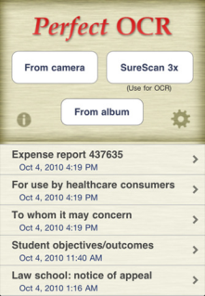
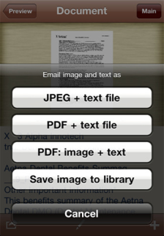
Perfect OCR
$3.99
Uses the built in camera to scan documents
Edit, copy, store, email documents
Upload to online storage is as Evernote
Does take practice for picture
Notes:
CP

Slide 48
Brevity
Word Completion App
Automatically add words if not in list
Remembers how often you use words and offers the most frequently chosen options to you first
E-mail Support - Send e-mails from directly within the application
Text Message Support
Remove misspelled or unwanted words
Set prediction font size and window transparency

Slide 49
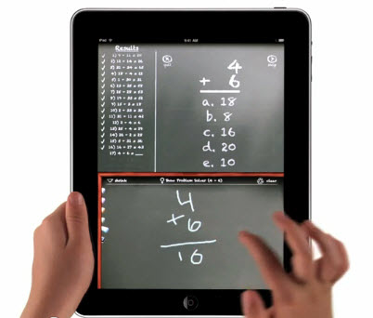
Apps for Math

Slide 50
Talking Calculators
Simple Talking Calculator
Percentages
Square-root
Square and Cube
Big buttons
Talking Calculator HD
Hear numbers on the screen
Works for someone who may have a vision loss

Slide 51
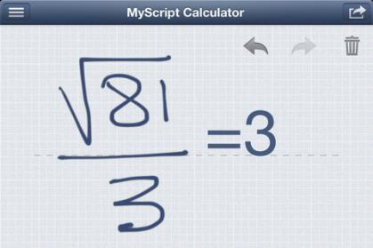
MyScript Calculator
Use your handwriting to write any arithmetic formula
Write and calculate mathematical expressions in with no keyboard
Scratch-out gestures to easily delete symbols and numbers
Portrait and landscape operation
Redo and undo functions

Slide 52
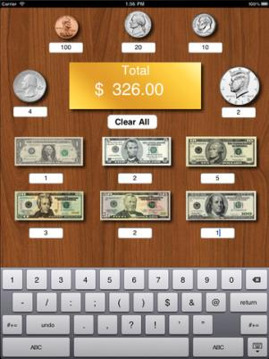
Money Counter Calculator
iPad only
Enter amount of coins and dollars and total is provided
Free

Slide 53
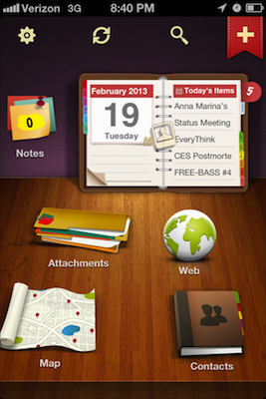
Apps for Organization

Slide 54
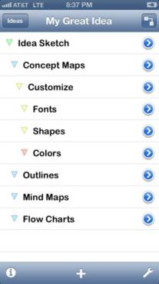
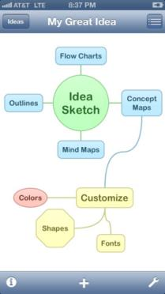
Idea Sketch
Mind and concept mapping
Create flow charts
Brainstorm ideas
Convert flowchart to text outline and vice versa
Free

Slide 55
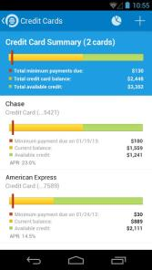
Pageonce
Free
Keep track of your cash and credit cards
Pay your bills
Real-time alerts and reminders about upcoming bills, overage charges, and suspicious transactions
Understand your debt
Notes:
MR

Slide 56
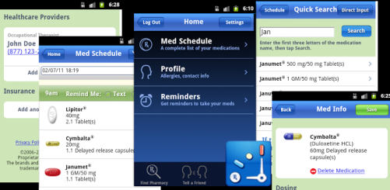
MyMedSchedule
Keep track of medication
Reminders
Refill Reminders
Healthcare Provider Profiles
Insurance Information
Allergies
Works across Platforms
Free
www.mymedschedule.com

Slide 57
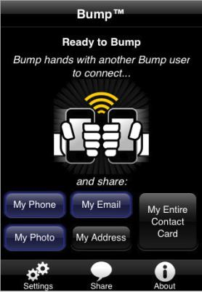
Bump
Use Bump™ to share contact information and photos by simply bumping two phones together.
Just open Bump, hold your phones, and gently bump your hands together
Free!
Demo
Notes:
CL

Slide 58
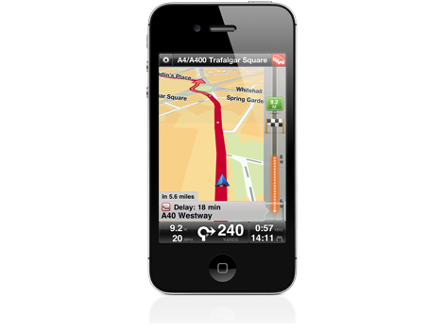
Apps for Navigation

Slide 59
HopStop
Get detailed subway, bus, taxi, walking & biking directions along with official transit maps, a nearby station finder, and schedules in 100's of cities throughout the US, Canada & Europe
Biking routes available
See how many calories you have burned
Wheelchair and stroller accessible routes
Works with Voiceover
Notes:
MR

Slide 60
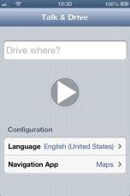
Favorite Navigation Apps
Around Me
Identifies where you are
Lists what is around you
View route to place from where you are
Add information to contact list
Talk and Drive Waze
Operate your map applications simply by talking
Launch the application, say your destination
Notes:
CP

Slide 61
Navigon North America
Voice guided directions for driving and walking
GPS runs in background to save battery life
Day and night modes
Text-to-Speech
Route Planning function
$39.00 Apple
$59.99 Android

Slide 62
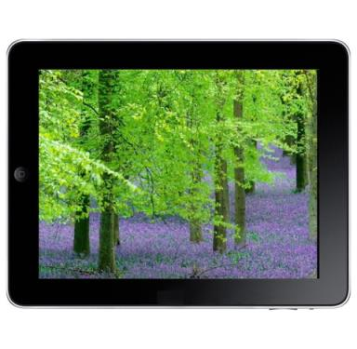
Apps for Relaxation

Slide 63
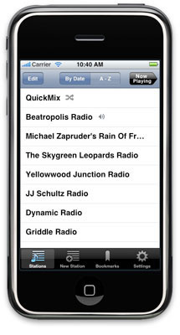
Pandora
Free internet radio
Create custom stations based on genre, song, artist

Slide 64
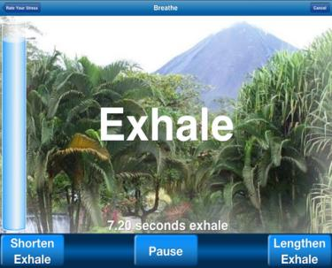
Breathe2Relax
Portable stress management tool
Detailed information on the effects of stress on the body
Instructions and practice exercises to learn the stress management skill called diaphragmatic breathing

Slide 65
iZen Garden
Choose from 100s of objects, plants and creatures to place in your garden
Rake the sand and share your creations
Helps you to center your mind, relax your psyche and relieve your stress

Slide 66
Our Question to You: What have You Learned today?
Notes:
66

Slide 67
Contact
Carolyn Phillips
Director of Tools for Life
Carolyn.Phillips@gatfl.gatech.edu
Liz Persaud
Training, Development and Outreach Coordinator
Liz.Persaud@gatfl.gatech.edu
Martha Rust
AT Specialist
Martha.Rust@gatfl.gatech.edu
Disclaimer
This presentation is produced by Tools for Life which is a result of the Assistive Technology Act of 1998, as amended in 2004. It is a program of the Georgia Institute of Technology, AMAC Accessibility Solutions and is funded by grant #H224C030009 of the Rehabilitation Services Administration (RSA), Department of Education. The contents of this presentation were developed under a grant from the Department of Education. However, those contents do not necessarily represent the policy of the Department of Education, Georgia Tech or AMAC and you should not assume endorsement by the Federal government.

