Slide 1
Piecing the Puzzle Together:
Developing Appropriate Supports and Services for Students with Autism Spectrum Disorder (ASD)
Part 2: Accommodating Students with Autism Spectrum Disorder

Slide 2
Objective #1
Objective #2
Objective #3
Objective #4
List some common sources of documentation of disability for a diagnosis of ASD.
List 2-3 of the common characteristics (e.g. functional limitations) of someone on the autism spectrum.
Identify 1-2 accommodations to support each functional limitation identified.
Determine if the accommodations are effectively supporting the identified functional limitation by reviewing participation and performance outcomes.
Part 1
Part 1
Part 2
Part 2

Slide 3
Review
of Part One

Slide 4
Autism Spectrum Disorder (ASD)
Symptom Variation
Overview
Autism spectrum disorder (ASD) is a developmental disorder that affects communication and behavior.
ASD is a “spectrum” disorder because there is wide variation in the type and severity of symptoms people experience.
https://www.nimh.nih.gov/health/topics/autism-spectrum-disorders-asd/index.shtml

Slide 5
Daniel Wendler, Ph.D. ImproveYourSocialSkills.com; https://www.danielwendler.com/
Spring 2018 – Webinar: Helping Autistic People Flourish
Growth Mindset
From seeing deficits as weakness TO seeing deficits as opportunities to grow
Building Motivation
From forcing social interaction TO inspiring social motivation
Teaching Skills
From rote memorization TO seeing the world from the students’ perspective
Notes:
Although there are common characteristics in individuals with ASD, each person is unique and their presentation of ASD is unique so we have to be sure to get to know the individual and tailor supports to his or her unique needs and build upon his or her strengths.

Slide 6
Where to Begin

Slide 7
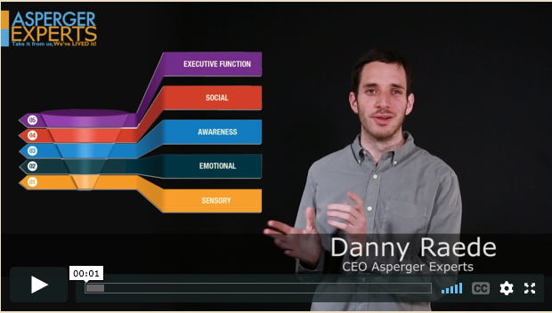
Sensory Funnel
Notes:
https://www.aspergerexperts.com/
0-3:54

Slide 8
Functional Limitations

Slide 9
Review of General Functional Limitations
Social Communication
Restrictive/Repetitive Behaviors
Sensory-related Responses
Anxiety
Learning-related (varies greatly dependent upon where the person is on the spectrum, presence of co-morbid disorders, etc.)
The Center on Secondary Education for Students with Autism Spectrum Disorders (CSESA)
Notes:
https://csesa.fpg.unc.edu/sites/csesa.fpg.unc.edu/files/Supporting%20Communication%20in%20High%20School.pdf

Slide 10
How do these limitations affect the [student] and the [student’s] performance on center (in academics, career technical, residential, other areas)?
What limitations is the [student] experiencing?
What accommodations are available to reduce or eliminate these problems?
Are all possible resources being used to determine possible accommodations?
What specific tasks are problematic as a result of the limitations?
Determining Accommodation Needs (askjan.org)

Slide 11
Once accommodations are in place, have you met with the [student] to evaluate the effectiveness of the accommodations and to determine whether additional accommodations are needed?
Do staff and other students need training?
What specific tasks are problematic as a result of the limitations?
Determining Accommodation Needs (cont.)

Slide 12
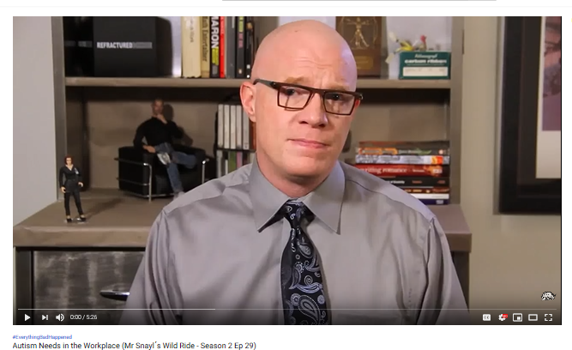
Video – Mr. Snayl’s Wild Ride
Notes:
https://www.youtube.com/watch?v=3U9u2gVMkY4
0 – 1:54
3:19 – 4:30

Slide 13
Autism @Work Roundtable
Playbook being released to HR Professionals to create employment opportunities for individuals on the autism spectrum

Slide 14
EY
JP Morgan
Chase
Microsoft
SAP
Ford
IBM
Willis Towers Watson
Traveler’s Insurance
Fidelity Investments
Freddie Mac
Cintas
Spectrum Designs
Ultra Testing
Rising Tide Car Wash
DXC Technology

Slide 15
Case Studies

Slide 16
DeAndre’

Slide 17
Let’s learn about DeAndre’…
DeAndre’ is 21 years old.
He is interested in some type of computer-related training.
He has a diagnosis of ASD.
He has some difficulty comprehending what he reads but performs better when given information in multisensory formats and if orally presented, at a slower rate of speed.
He has excellent math calculation skills and has very strong visual skills.
Notes:
Let’s start with a more classic type set of functional limitations and then on the next case, we will deal with a bit more challenging scenario.

Slide 18
Let’s learn about DeAndre’…
He is hypersensitive to touch and loud noises.
He is somewhat uncoordinated and has difficulty making his bed.
He tends to stim when he gets overwhelmed to calm himself back down.
His stimming is a small gallop/pacing type gait back and forth
He struggles with reciprocal conversation but states that he is interested in making friends.

Slide 19
Let’s Walk Through the Interactive RA Process:
What limitations is DeAndre’ experiencing?
Reading comprehension
Heightened sensory responses to loud noises and light touch
Has difficulty with motor coordination and making his bed
Has difficulty either understanding or knowing how to respond appropriately in conversations (e.g., reciprocal conversation)
Anything else?
Notes:
What do you think about DeAndre’s stimming behavior? Let’s talk about this for a minute.
What about his strengths? Let’s not forget that we can put supports and strategies in place that use his strengths!

Slide 20
Accommodating Specific Functional Limitations
What accommodations are available to reduce or eliminate these problems? Are all possible resources being used to determine possible accommodations?
Difficulty understanding what he reads
Oral presentations of content
Text to speech
Promotes independence
Can adjust the rate of speed
Can repeat as many times as needed
Multi-sensory (usually can turn on highlight features, choose voices, etc.)
Picture Supports
Staff or peer buddy reading out loud (or proctor-read on TABE)

Slide 21
Accommodating Specific Functional Limitations
What accommodations are available to reduce or eliminate these problems? Are all possible resources being used to determine possible accommodations?
Averse to being lightly touched or tapped on the arm or shoulder, etc.
May have difficulty being in crowded spaces
What are your ideas for accommodating DeAndre’ with this functional limitation?
NOTE: If you have attended multiple webinars on accommodating students, you are beginning to see that some accommodations apply to supporting many types of conditions!

Slide 22
Difficulty managing loud noises
Struggles with motor coordination
Difficulty with reciprocal conversation
Headsets
Schedule adjustments
Picture supports
Dorm Room Selection
Voice dictation software
Peer Buddy/Mentor
Schedule adjustments
Alternate uniforms/fasteners
Social Stories
Breaks/Passes
Lower bunk
Role Playing
Fidget items
Harness on scaffolding
Videotaping
Notes:
What type of headsets might be best? What about ear buds and their effectiveness with filtering loud noises
Motor coordination
- schedule adjustments to minimize traveling up and down stairs

Slide 23
Effectiveness of Accommodations
Once accommodations are in place (within 60 days and every 60 days thereafter), have you met with the DeAndre’ to evaluate the effectiveness of the accommodations and to determine whether additional accommodations are needed?
Use required Disability Program required effectiveness reviews (via ESPs) to monitor for accommodation implementation and effectiveness.

Slide 24
Implementation/Management of Accommodations
Do staff and other students need training?
Do staff need information and practice on using various apps or accommodations?

Slide 25
Rebecca

Slide 26
Let’s learn about Rebecca…
Rebecca is 16 years old.
She is interested in carpentry.
She has a diagnosis of ASD, Depression, Generalized Anxiety Disorder and a Learning Disability, specifically Dysgraphia (along with other written expression challenges).
She struggles with hand-to-eye coordination.
She is averse to certain food textures.
She has excellent recall for facts when presented with information orally.
Notes:
Rather than identify accommodations for every functional limitation, this time, we are going to talk more about the considerations you need to make throughout the process.

Slide 27
Functional Limitations
What limitations is Rebecca experiencing?
Anxiety (when?)
Anxious about completing tasks that are difficult for her
Results in attention, memory, and organizational challenges
Takes longer to complete tasks
Feels overwhelmed at times
Hand fatigues with handwriting and generally is illegible; Struggles to initiate tasks when writing on paper
Cannot replicate shapes or attend well to information on white backgrounds
Becomes nauseous and/or gags when attempting to eat certain food textures
Notes:
Functional limitations are not always clearly spelled out for you. You may have to ask the applicant/student how something affects them or use the documentation to ask relevant questions about potential supports needed. For example, how does her depression impact her? The CMHC should be involved and perhaps can offer some suggestions for relevant reasonable accommodations/supports.

Slide 28
Functional Limitations
Question: Is Carpentry out as a career technical option because of her motor coordination challenges?
Notes:
Functional limitations are not always clearly spelled out for you. You may have to ask the applicant/student how something affects them or use the documentation to ask relevant questions about potential supports needed. For example, how does her depression impact her? The CMHC should be involved and perhaps can offer some suggestions for relevant reasonable accommodations/supports.

Slide 29
Accommodating Specific Functional Limitations
Is Rebecca entitled to testing accommodations (i.e., TABE)?
What are some accommodations you can provide related to her visual-spatial/figure-ground challenges?
Templates
Rulers
Manipulatives
Computer, tablet, or phone apps
Color-coding
What do you do about the food aversion functional limitation?

Slide 30
Considering Applicant/Student Strengths
How can we use her strengths to support the development of a strong Accommodation Plan (AP)? Remember, she has excellent recall for facts/details when given information orally?

Slide 31
Closing Out – A Tip for Your Consideration!
When working with students who have ASD, it is often important that staff approach various tasks the same way. For example, if a math teacher teaches a math concept one way and the career technical instructor teaches it a different way, it may be confusing for the student who has ASD.
This is a situation in which the use of applied academics, co-teaching, or collaboration between those two instructional staff is strongly encouraged!
Task Analysis
What is the task?
Identify the steps in the task and list them in order.
Share the task sequence with other staff!

Slide 32
Using Task Analysis
When I prepare for a lesson that will use Task Analysis, I first complete the task myself and write down the steps needed to complete the task. For example, when I will be teaching a hand washing routine to students, I walk through my personal hand washing routine. As I do this, I have written down the steps I use. It looks something like this:
Put soap on hands
Rub soap on both hands
Turn on water
Rinse hands
Turn off water
Retrieve paper towel
Dry hands
Throw away paper towel
Exit restroom
Now that I know the steps needed to complete a hand washing routine, I can create a lesson plan and data sheet for use with my students.
http://www.youaut-aknow.com/2016/10/what-is-task-analysis.html

Slide 33
Video – Virginia Commonwealth University Research and Rehabilitation Training Center
Notes:
https://www.youtube.com/watch?v=LXDgFdusXGM
Video clip options:
Staff and clip intro: 0-43
Behavior – 24:50 – 27:52
Sensory – 27:53 – 30:46
Workplace Challenges – 33:49 – 37:51

Slide 34
Resources

Slide 35
Virginia Commonwealth University Research and Rehabilitation Research and Training Center https://vcurrtc.org/
35

Slide 36
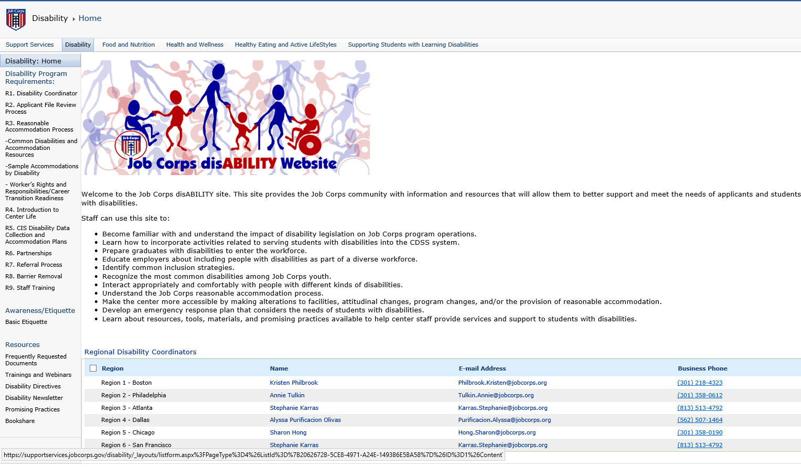
Job Corps Disability Website https://supportservices.jobcorps.gov/disability/Pages/default.aspx
36

Slide 37
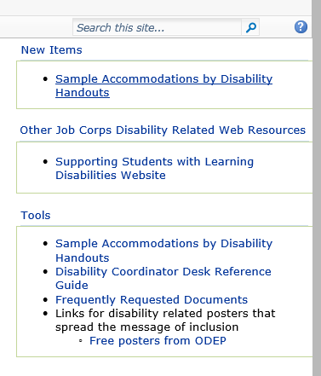
Job Corps Disability Website https://supportservices.jobcorps.gov/disability/Pages/default.aspx
37

