Slide 1
Piecing the Puzzle Together:
Developing Appropriate Supports and Services for Students with Autism Spectrum Disorder (ASD)
Part 1: Understanding Autism Spectrum Disorder

Slide 2
Objective #1
Objective #2
Objective #3
Objective #4
List some common sources of documentation of disability for a diagnosis of ASD.
List 2-3 of the common characteristics (e.g. functional limitations) of someone on the autism spectrum.
Identify 1-2 accommodations to support each functional limitation identified.
Determine if the accommodations are effectively supporting the identified functional limitation by reviewing participation and performance outcomes.
Part 1
Part 1
Part 2
Part 2

Slide 3
Background
Almost half (44%) of children identified with ASD has average to above average intellectual ability.
ASD commonly co-occurs with other developmental, psychiatric, neurologic, chromosomal, and genetic diagnoses.
The co-occurrence of one or more non-ASD developmental diagnoses is 83%.
The co-occurrence of one or more psychiatric diagnoses is 10%.
https://www.cdc.gov/ncbddd/autism/data.html

Slide 4
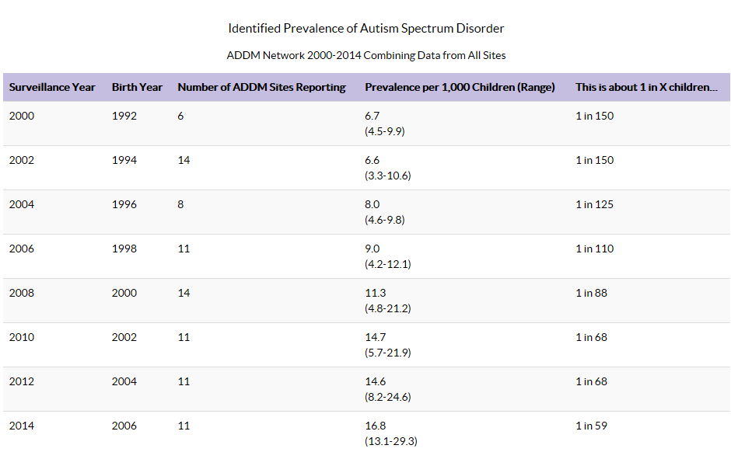
https://www.cdc.gov/ncbddd/autism/data.html

Slide 5
Daniel Wendler M.A. ImproveYourSocialSkills.com
Spring 2018 – Webinar: Helping Autistic People Flourish
Growth Mindset
From seeing deficits as weakness TO seeing deficits as opportunities to grow
Building Motivation
From forcing social interaction TO inspiring social motivation
Teaching Skills
From rote memorization TO seeing the world from the students’ perspective
Notes:
Although there are common characteristics in individuals with ASD, each person is unique and their presentation of ASD is unique so we have to be sure to get to know the individual and tailor supports to his or her unique needs and build upon his or her strengths.

Slide 6
Documenting ASD
6

Slide 7
Documenting ASD
What are some sources of documentation that Job Corps might accept/use to support the disability status and accommodation needs for a person on the autism spectrum?
IEPs (Autism Spectrum Classification)
504 Plans
Chronic Care Management Plans (CCMP)
Medical Records
Division of Vocational Rehabilitation (DVR)
Psychological or Neuropsychological Assessment (School, private, DVR, etc.)

Slide 8
ASD Defined
8

Slide 9
Autism Spectrum Disorder (ASD)
Overview
Symptom Variation
Communication
Behavior
Autism spectrum disorder (ASD) is a developmental disorder that affects communication and behavior.
ASD is a “spectrum” disorder because there is wide variation in the type and severity of symptoms people experience.
Difficulty with communication and interaction with other people
Restricted interests and repetitive behaviors
https://www.nimh.nih.gov/health/topics/autism-spectrum-disorders-asd/index.shtml

Slide 10
Functional Limitations
Social Communication
Restrictive/Repetitive Behaviors
Sensory
Other – Learning, Attention, etc.

Slide 11
Social Communication
1
MAY:
Avoid eye or consistent eye contact
Have difficulties with reciprocal conversation
Talk at length about a favorite subject without noticing that others are not interested or without giving others a chance to respond
Have facial expressions, movements, and gestures that do not match what is being said
Have an unusual tone of voice that may sound sing-song or flat and robot-like
Have trouble understanding another person’s point of view or being unable to predict or understand other people’s actions or struggle to read other’s feelings and emotions
Respond unusually when others show anger, distress, or affection
2
3
4

Slide 12
Restrictive/Repetitive Behaviors
1
MAY:
Get upset or struggle with slight changes in routine
Need set schedules or routines, including menus of food items
Feel need to complete a task or reach some particular point in the task before they want to stop or change tasks
Need transition time or advance cues to adjust to changes in routine
Repeat certain behaviors or have unusual behaviors which might include overly focused interests in such things as moving objects or parts of objects
Example – must watch all the credits roll at the conclusion of a movie
2
3
4

Slide 13
Sensory
1
MAY:
Have a tendency to seek out or avoid sensory input
Have sensitivities to tags in clothing, certain textures of clothing or bed linens
Have sensitivities to loud noises (e.g., fire alarms, classroom bells, cafeteria, assemblies)
Have sensitivities to certain smells
Have sensitivities to various temperatures
Be under-responsive to certain input or stimuli
Feeing the weight of a specific object
Feeling where their body is in space
Strong sensory responses can cause the individual to become physically ill and/or experience discomfort and pain
2
3
4

Slide 14
Other – Learning, Attention, etc.
1
May:
Have a tendency to be clumsy and uncoordinated which can translate into difficulty with handwriting, riding a bike, catching a ball or running
NOTE: Can also be symptoms of dyspraxia, dysgraphia and sensory processing issues
Have difficulty with executive function and find it hard to get organized and solve problems
May struggle to keep their emotions in check and change the way they do things without getting upset
2
3
4

Slide 15
Strengths!!!!
Although people with ASD experience challenges, they may (and do) also have many strengths, including (but not limited to):
Being able to remember details and retain that information for long periods of time
Being strong visual and auditory learners
Excelling in math, science, music, or art
Of course, this varies by individual and the presence of other co-morbid conditions, etc.

Slide 16
Communication
16
Notes:
We are going to spend some time talking about communication, both as it applies in applicant file review for individuals on the spectrum as well as for participation in the program. Why? Because not only is communication critical to understanding wants, needs, expectations, to learning but it also can have a significant impact on an individual’s behavior. Further, one’s behavior in and of itself also is communication.
Bryce example – when young and before adequate communication skills

Slide 17
Communication – Generally
Your obligation to communicate effectively with people with disabilities – whether those people are students, staff, applicants for admission or employment, parents, guardians, or members of the public – is separate from your obligation to provide reasonable accommodations for qualified people with disabilities.
Notes:
We are going to spend some time talking about communication with regard to individuals with ASD for a couple of reasons. One, I want to be sure that everyone is clear on the legal requirements related to communication but maybe as equally important is to acknowledge and remember that “behavior” manifestations themselves are a form of communication so we want to talk about how effective communication and recognition of the connection between behavior and communication may assist the student with ASD in being more successful in the Job Corps environment.

Slide 18
Legal Obligations
The Workforce Innovation and Opportunity Act (WIOA) nondiscrimination regulations, distinguish between these two obligations, for a very simple reason:
Without clear, accurate, effective communication, any encounter between a person with a disability and a program from which he or she is seeking services, such as Job Corps, will be literally meaningless.

Slide 19
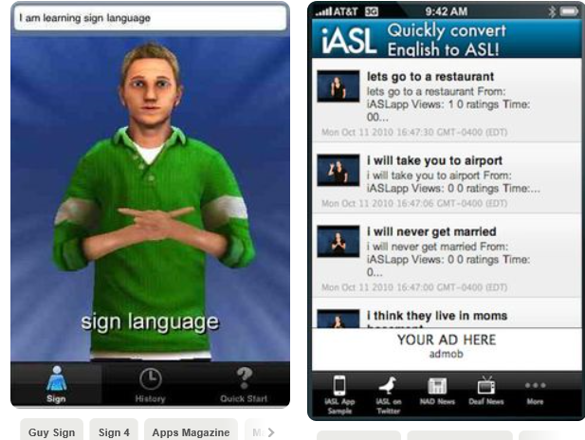
Who is Responsible?
Under the law, the burden is on Job Corps to provide the auxiliary aids and services (communication aids) that are needed for equally effective communication with a particular person with a disability.

Slide 20
Achieving Effective Communication
The method of communication used by the person.
The nature, length and complexity of the communication.
The context in which the communication is taking place.
Specific factors that determine the type of auxiliary aid or service necessary to ensure effective communication

Slide 21
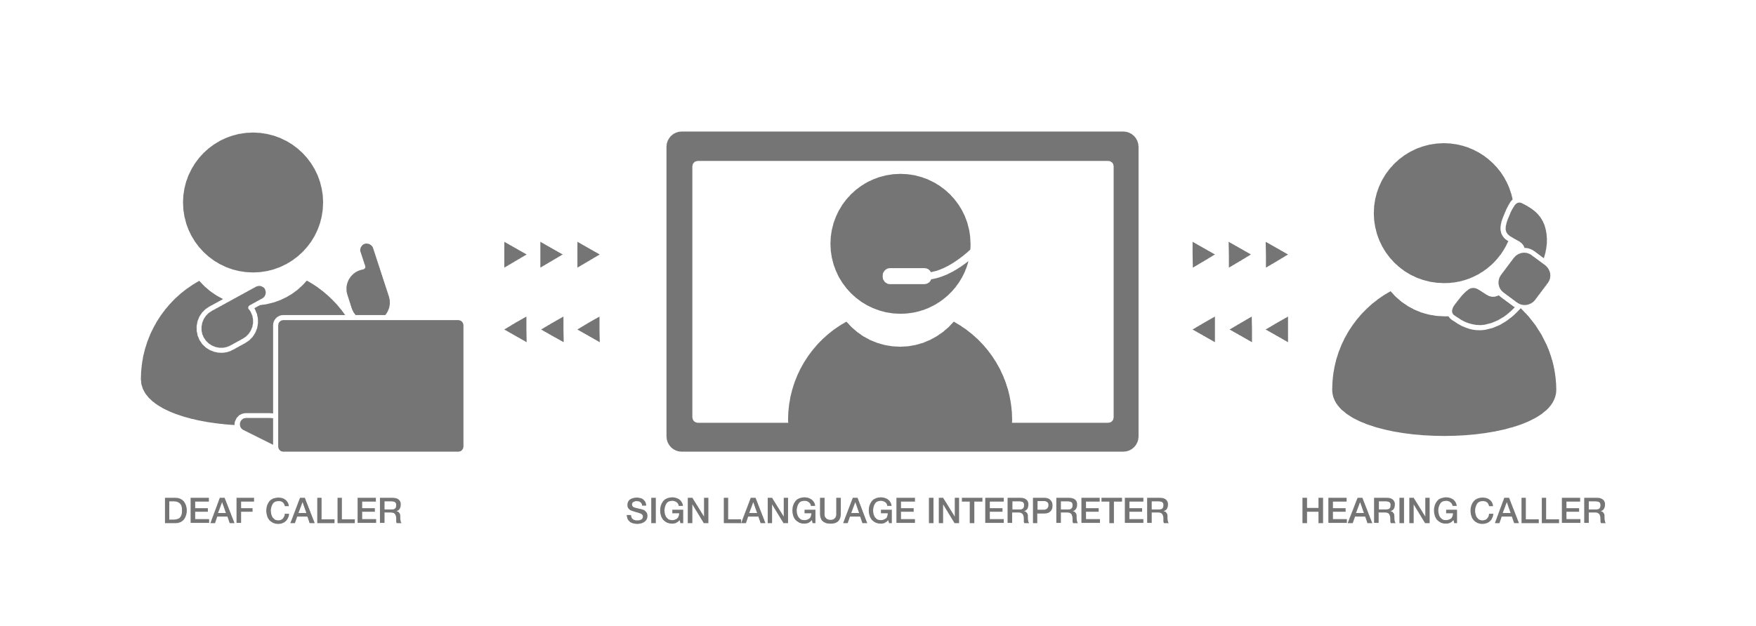
So, what’s first?
The first thing you should do is find out how to communicate effectively with that person.

Slide 22
Why is “primary” consideration given to the individual?
Because the individual with a disability is the best source of information about his or her own needs. Not everyone who appears to have “the same” disability, or type of disability, is able to use and understand the same communication method.
If you speak English only and I insist on speaking to you in Spanish only, then we are not going to be able to effectively communicate.*
If you cannot read well and I insist on communicating via print, then we are not going to be able to effectively communicate.
*Only referring to students with disabilities

Slide 23
Communication – Applicant File Review
MUST provide communication-related accommodations during the clinical and or interactive reasonable accommodation process interviews for a person with ASD
The applicant File Review Team (FRT) and the Reasonable Accommodation Committee (RAC):

Slide 24
ASD and Communication Dr. Valerie Cherry, Lead Regional Mental Health Specialist
The ASD diagnosis “per DSM 5 does assume some level of social communication challenges, but it can vary in severity and for some young people in our JC age group if the severity level is low, they may have developed adaptive strategies related to social communication.”
“As a clinician, if I was interviewing an applicant with ASD , I would definitely be cognizant of and assess the need for social communication accommodations, but not assume that each applicant required accommodations or the same type/level of accommodation during the interview.”

Slide 25
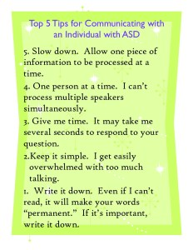
What IS a Communication-related Accommodation?
Any adjustment or modification, support, and so forth that enables the individual to be able to both receive and express information in a way that is meaningful to them.

Slide 26
Individualize!
Communication
Simplification of language to include rephrasing statements of questions.
Repeated phrases and giving extra time for processing.
Slow rate of speech
Interviewing face-to-face in lieu of phone.
Using pictures or other symbols to convey meaning.
Interpreters, hearing assisted devices, text to speech technology.
Provide handouts of questions and/or necessary information and ensure written in simplified language and/or using picture-related supports
Allow written communication such as e-mails, texts, or written responses if in person, etc.
Ask the applicant to repeat back information received to confirm understanding
Provide more specialized accommodations, as needed, such as a sign-language interpreter or a language translator (e.g., Spanish speaking, Vietnamese, etc.) for a person with a disability who is ELL
Communication Accommodation Examples
Animated Page

Slide 27
How to Document Communication-related Accommodations within AFR
Document your observations and assessment of the applicant's ability to understand the questions being asked, the information provided, and his or her ability to respond to the questions asked. For example:
“To minimize the effect of any communication barriers, the CMHC used a slow rate of a speech when speaking with the applicant. Questions or statements were repeated or simplified as needed…”
“Applicant appeared to understand all questions and provided appropriate responses. With the accommodations provided, she /he was able to participate fully in the interview with no apparent difficulties.”
Notes:
In these cases, the center clinician such as the CMHC explains the accommodations used and then also documents the outcome of using those accommodations.
Refer to RHS’s if further information is needed.

Slide 28
Documenting Other Communication-related Scenarios
No apparent difficulties communicating (understanding):
“While applicant initially appeared to have difficulty responding to questions and asked for questions to be repeated, this appeared to be due to being nervous and not due to a communication barrier. After the first few minutes, she/he was able to understand and respond to all questions without difficulty. She/he did not require any communication accommodations.“
“Applicant did not exhibit any noticeable difficulties in comprehension or social communication during the interview. He/she was able to engage in a reciprocal conversation and answer questions."
Notes:
So, suppose we had an applicant who we know is on the spectrum or even perhaps has an intellectual disability, etc. – some indication that communication may be a concern, then you also want to document what occurs if the individual actually does not demonstrate any difficulties or challenges in participating in and understanding the content of the interview.

Slide 29
Documenting Other Communication-related Scenarios
Not able to engage in the interview:
“Applicant was not able to engage in the interview due to an impairment in his/her mental status. Communication barriers are secondary to psychosis (thought blocking, disorganized thinking) or drug use (high during interview) or…”

Slide 30
Communication and Behavior
Sensory responses
Anxiety
Stimming
Eye avoidance
Crumpling up work
Smiling
Crying
Silence
What behaviors might convey communication?
Notes:
Behavior is a form of communication and some forms of behavior are overtly obvious and others not obvious at all so all the more important to recognize the variations it may actually take.

Slide 31
Communication as Behavior From the perspective of a person with ASD
It’s not enough to simply assume “this person is stimming so they must be stressed or anxious. Sometimes stimming is about sensory overload… My stims are a language unto themselves. I have a stim for every mood, and while the physical movements may sometimes be similar, the feelings that go with them are distinctly different. My happy flapping is different from my grossed out flapping... The autistic body is constantly communicating and it’s saying so much more than, ‘I’m in distress’.”
Behavior is Communication: Are you Listening? April 30, 2014; Retrieved 11/12/18: https://musingsofanaspie.com/2014/04/30/why-behavior-is-communication-is-no-longer-good-enough

Slide 32
Understanding the Context of the Communication
Lack of
communication
IS
communication!
Lack of eye contact IS communication!
Quickly withdrawing from touch IS communication!
Covering one’s ears IS a form of communication!
A person with ASD may express interest in something by studying it for a long time rather than directly engaging at first.
Sometimes the individual with ASD prefers to understand how all the parts of an object work or how a person responds in different situations before they feel comfortable interacting.*
“If I’m staring off to the side while you’re talking to me, that’s a sign I’m intensely concentrating on what you’re saying. And if I’m making intentional intermittent eye contact? I’m more focused on ‘passing’ to avoid looking odd than I am on listening to what you’re saying.”*
*Behavior is Communication: Are you Listening? April 30, 2014; Retrieved 11/12/18: https://musingsofanaspie.com/2014/04/30/why-behavior-is-communication-is-no-longer-good-enough
Notes:
One has to ask themselves what message the student with ASD is attempting to communicate. The message conveyed by the behavior, the non-verbal actions, etc. could be that the individual is trying to manage their internal sensory and nervous system responses to the external environment. In those circumstances, being patient and developing some basic understanding of the manifestations that may be exhibited by a person with ASD is really critical to helping them navigate and learn to successfully manage the work environment. However, it could simply be characteristic of how the individual communicates generally speaking. Then we have to be cognizant of their “language” in order to best understand what they are communicating to us.

Slide 33
Food for thought…
“…need to be allowed to communicate a broad range of messages in the ways that are natural for them.”
“…Forcing to make eye contact or to stop flapping is the equivalent of forcing [someone] to speak a foreign language. “
“It’s telling them that if they want to use behavior to communicate more than distress, they’ll have to speak another language because theirs is substandard and the people around them can’t be bothered to learn it.”
*Behavior is Communication: Are you Listening? April 30, 2014; Retrieved 11/12/18: https://musingsofanaspie.com/2014/04/30/why-behavior-is-communication-is-no-longer-good-enough

Slide 34
Remember!
A person with Autism Spectrum Disorder (ASD) is a unique individual. “Communicating” with them, learning about their specific functional limitations, and then developing accommodations that fit their specific needs is essential.
However, developing an accommodation plan in CIS is not enough – the center has to go the next step and ensure that the accommodations are implemented center-wide, and that staff understand the importance of these accommodations to the individual’s ability to access and participate in the Job Corps program.

Slide 35
ASD in the Workplace
35
Notes:
We are going to spend some time talking about communication, both as it applies in applicant file review for individuals on the spectrum as well as for participation in the program. Why? Because not only is communication critical to understanding wants, needs, expectations, to learning but it also can have a significant impact on an individual’s behavior.

Slide 36
Temple Grandin, PhD.
Temple also happens to have ASD. She travels the country talking about ASD and shares specific information that is very helpful to individuals with ASD preparing for the workplace.
Jobs need to be chosen that make use of the strengths of people with autism.
I have great difficulty with tasks that put high demands on short-term working memory. I cannot handle multiple tasks at the same time.
https://www.autism.com/advocacy_grandin_job
Notes:
Again, it is critical that we individualize and look at each individual’s strengths and functional limitations.

Slide 37
ASD in the Workplace – CBS Sunday Morning: Autism in the Workplace
Notes:
https://www.youtube.com/watch?v=3b5OGx-v6Ao
0-4:20 – Intro and story about Christopher
4:21 – 6:09 – Discussion about addition of over 50 companies to the initiative
6:10 – 7:30 – Gloria as a child/parents (SKIP)
7:30 – 8:56 – Story about Gloria at SAP
8:57 – 9:27 – retention rate/intro concept of workplace mentors
9:28 – 10:21 – Mentors
10:22 – end – Wrap up of Christopher’s story

Slide 38
Piecing the Puzzle Together:
Developing Appropriate Supports and Services for Students with Autism Spectrum Disorder (ASD)
Part 2: Accommodating Students with Autism Spectrum Disorder

Slide 39
Resources
Notes:
We are going to spend some time talking about communication, both as it applies in applicant file review for individuals on the spectrum as well as for participation in the program. Why? Because not only is communication critical to understanding wants, needs, expectations, to learning but it also can have a significant impact on an individual’s behavior.

Slide 40
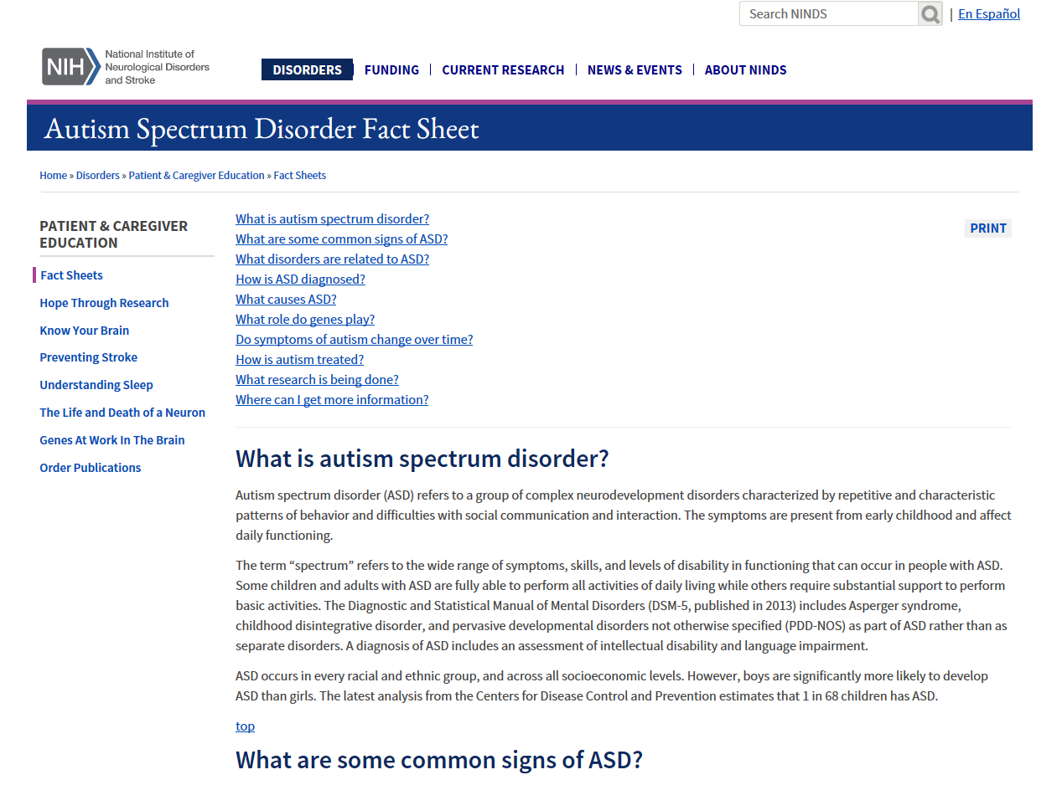
National Institute of Neurological Disorders and Stroke https://www.ninds.nih.gov/Disorders/Patient-Caregiver-Education/Fact-Sheets/Autism-Spectrum-Disorder-Fact-Sheet

Slide 41
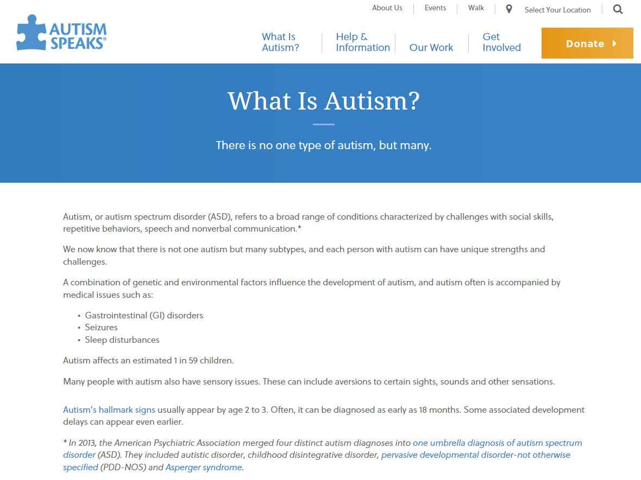
Autism Speaks https://www.autismspeaks.org/our-work

Slide 42
Job Corps Disability Website https://supportservices.jobcorps.gov/disability/Pages/default.aspx
42

Slide 43
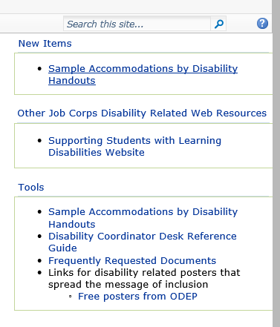
Job Corps Disability Website https://supportservices.jobcorps.gov/disability/Pages/default.aspx
43

