Slide 1
Accommodating and Supporting Reading Disabilities
Notes:
The purpose of this webinar is to understand the limitations that impact our students’ reading abilities in the Job Corps program, and to discuss what can be done to support and serve these students through accommodations and strategies. An emphasis is placed on promoting independence and employability. We will also discuss strategies and accommodations for distance and blended learning settings.

Slide 2
Learning Objectives
Identify and describe cognitive and processing limitations that impede students’ reading abilities and identify related functional limitations.
Identify at least two specific accommodations to support each type of reading limitation.
Describe several learning/instructional strategies and best practices that may help a student develop literacy skills and improve independence and employability.
List at least 2 reading-type assistive technologies that could be applied for implementing accommodations for students with disabilities.

Slide 3
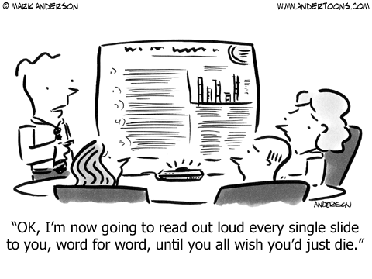
Reading Disorders
Defined

Slide 4
Reading Disorders
Reading disorders occur when a person has trouble with any part of the reading process.
These disorders are present from a young age and usually result from specific differences in the way the brain processes language.
There are many different symptoms and types of reading disorders, and not everyone with a reading disorder has every symptom.
Reading disorders are not a type of intellectual and development disorder, and they are not a sign of lower intelligence or unwillingness to learn.
However, many of the accommodations and strategies we are going to discuss today also can assist individuals with reading challenges due to an intellectual disability.
Notes:
We are not going to talk about specific reading disorders today. Instead we are going to focus on the manifestations and functional limitations related to having a reading disorder and strategies and accommodations to support them and ensure access to the program.
https://www.nichd.nih.gov/health/topics/reading/conditioninfo/disorders; Retrieved 1/20/20.

Slide 5
Other Conditions where Students may have Corresponding Reading Difficulties
Can go beyond Learning Disabilities…
Attention Deficit Hyperactivity Disorder (ADHD)
Anxiety
Spectrum-related or Developmental Disorders
Visual Impairments
Intellectual Disabilities or Traumatic Brain Injuries
How might other non-reading related conditions contribute to reading difficulties?

Slide 6
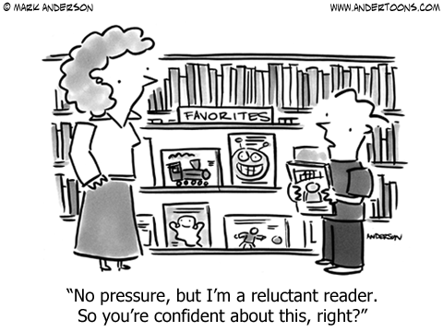
Functional Limitations Related to Reading Disabilities/ Disorders

Slide 7
Overarching Functional Limitations of Reading Disorders
Word decoding challenges: difficulty applying knowledge of letter-sound relationships, including knowledge of letter patterns, to correctly pronounce written words.
Lack of fluency: difficulty reading quickly, accurately, and with proper expression (if reading aloud).
Poor reading comprehension: difficulty understanding what was read.
7

Slide 8
Common Difficulties While Reading
Losing your place
Have you ever lost your place while reading within a sentence or within a passage or paragraph?
Losing your focus
Have you ever been reading a passage and realized halfway through that you have no idea what you have just read?
Forgetting what you have read
Have you ever come to the end of the passage and cannot recall what it was about?
8

Slide 9
Examples of Possible Reading-related Functional Limitations
Problems sounding out words
Difficulty recognizing known words
Poor spelling
Slow reading
Problems reading out loud with correct expression
Problems understanding what was just read
Limited vocabulary development
Processing challenges both auditory and visual

Slide 10
Supporting Functional Limitations of Reading Disorders

Slide 11
Goals when Considering Reading Accommodations/Strategies
Building independence
What accommodations can promote independence and make the student less dependent upon others?
Accessibility
How can we best provide access to all areas of the program?
Employability
What accommodations translate well into the workplace if still needed?

Slide 12
What Can You Do to Support Reading Functional Limitations?
Accommodate the functional limitations and remove barriers to the program.
Teach students strategies they can use to support their functional limitations.
Assist students in developing compensatory skills.
Remediate skills deficits.
This webinar focuses on items #1 and #2.
12

Slide 13
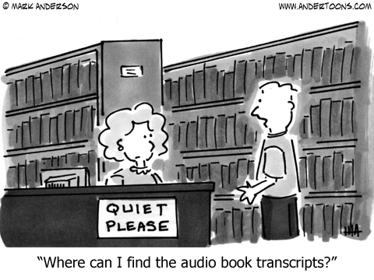
Accommodating Functional Limitations and Reading Strategies

Slide 14
Poll Assistive Technology for Reading Support
Our center is currently using some form of assistive technology (BookShare, screen readers, reading apps, etc.) to support students with reading difficulties.
Yes or No.
Notes:
Our center is currently using some form of Assistive Technology (Bookshare, Screen Readers, reading apps, etc) to support students with reading difficulties.
Yes or No.

Slide 15
Importance of Access to Print Content
Lack of or Limited Access to Print Materials
Creates dependence…
Wastes instructional and other valuable learning time and opportunities…
Slows progress…
Deflates self-esteem…
Places a cap on performance and achievement possibilities…

Slide 16
Accommodations for Major Reading-related Functional Limitations
Word decoding
Lack of fluency
Poor reading comprehension
Losing your place
Losing your focus
Forgetting what you have read
Poor vocabulary development
16

Slide 17
Word Decoding Challenges
Accommodations
Strategies
Audio and video tapes, CDs, DVDs, digital files
Text-to-speech programs
Reading pens
Electronic dictionaries
Decoding apps and games
Extra time
Simple charts with basic decoding rules
Colored disks for segmenting syllables
17
Notes:
Word decoding challenges: difficulty applying knowledge of letter-sound relationships, including knowledge of letter patterns, to correctly pronounce written words.

Slide 18
Lack of Fluency
Accommodations
Strategies
Reduce content
Audio and video tapes, CDs, DVDs, digital files
Text-to-speech programs
Reading pens
Electronic dictionaries
Extra time
Read shorter passages and discuss or take notes (into a tape recorder, recording app, or in margins, etc.).
Take pictures of notes on the board or print copy of notes from Smart Board.
Highlight unknown vocabulary words and use reading pen to scan and hear definition as a pre-reading strategy.
18
Notes:
Lack of fluency: difficulty reading quickly, accurately, and with proper expression (if reading aloud).
Some individuals may have developed accurate word decoding and pronunciation skills but read slowly. Their limited fluency may affect performance in the following ways:
they read less text than peers and have less time to remember, review, or comprehend the text;
they expend more cognitive energy than peers trying to identify individual words; and
they may be less able to retain text in their memories and less likely to integrate those segments with other parts of the text
(Mastropieri, Leinart, & Scruggs, 1999).

Slide 19
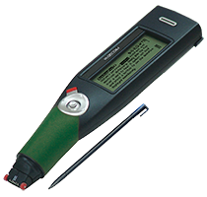
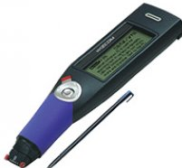
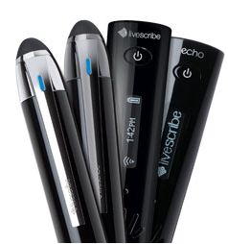
Fluency Technology Supports
Reading Pen
Info-scan
Digital pen for recording audio and syncing with written notes

Slide 20
Poor Reading Comprehension
Accommodations
Strategies
Reduce content
Audio and video tapes, CDs, DVDs, digital files
Text-to-speech programs
Reading pens
Electronic dictionaries
Extra time
Quiet/private space or minimize distractions
Graphic organizers, highlighters, colored overlays, other AT as needed
Establish structure where students ask questions or retell as they go
Frequently check for understanding (Who, What, Where, When, Why, How…)
Have student(s) look at the pictures, table of contents, chapter headings, maps, diagrams, and bold print words to make predictions
Connect the text to life experiences or prior knowledge
20

Slide 21
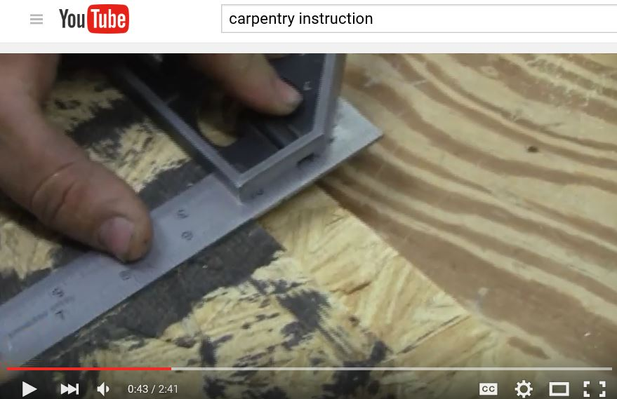
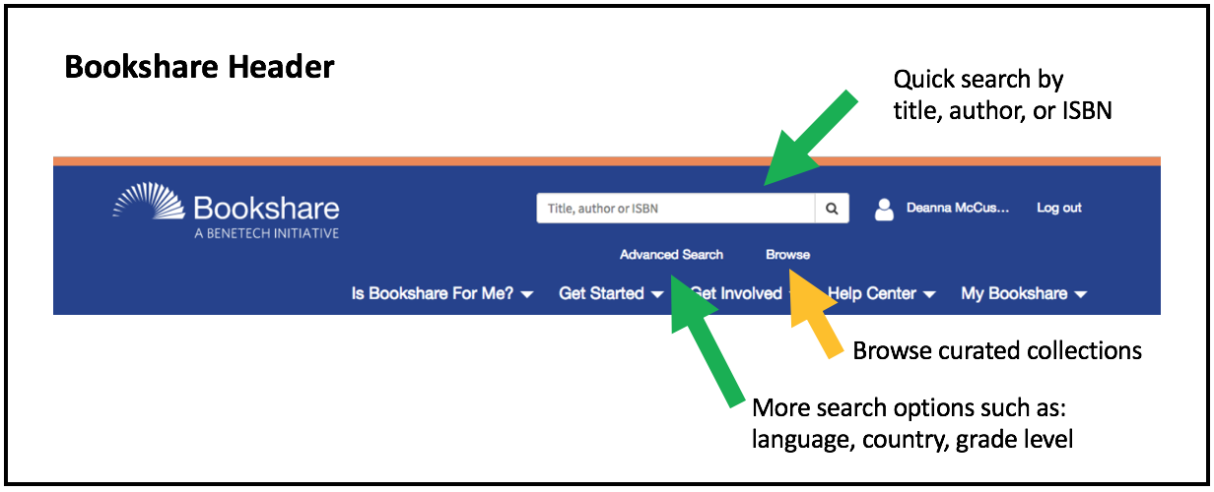
Comprehension Technology Supports
Notes:
Check with publisher’s about the availability of digital text books!

Slide 22
Benefits of Using Digital Textbooks
Enables students to reread text (reinforces and deepens learning)
Enhances motivation
Digital features such as animation and audio facilitate comprehension
Built-in tutors/virtual assistants can help focus attention and provide “on-the-spot” teaching of skills
Supports individualized learning strengths and preferences
22

Slide 23
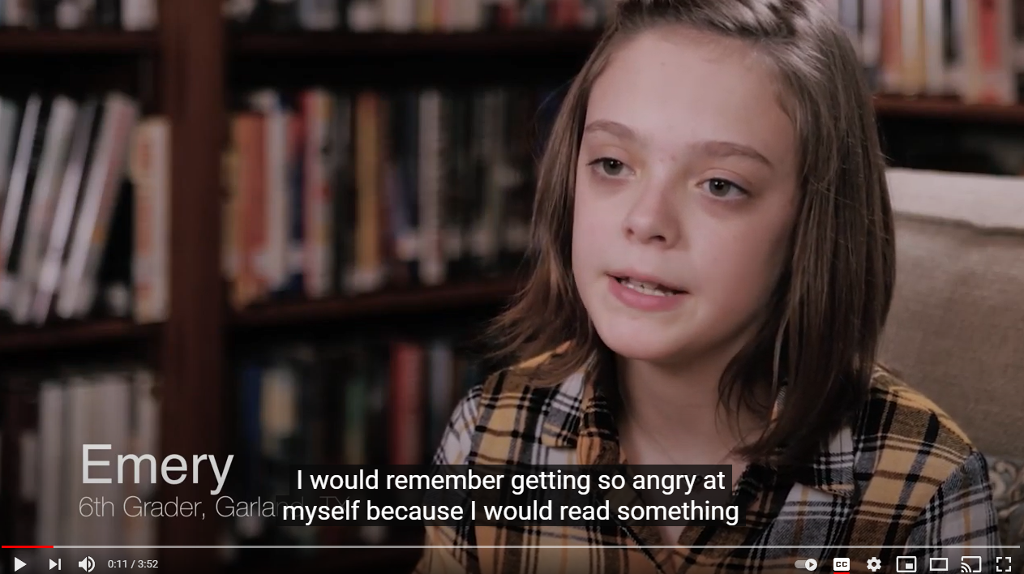
https://www.youtube.com/watch?v=0AYxGFuS5eI https://supportservices.jobcorps.gov/disability/Pages/Bookshare.aspx
Notes:
00:08 – 03:37

Slide 24
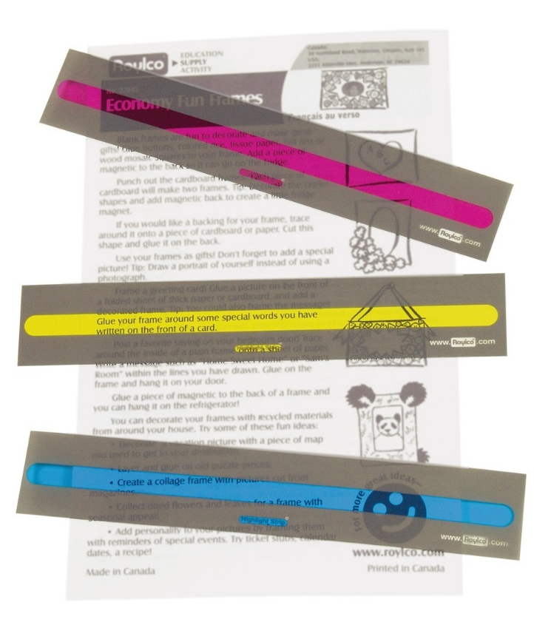
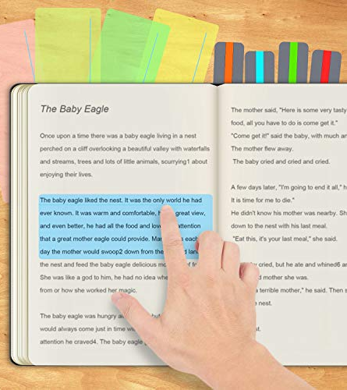
Losing Your Place
Accommodations
Tracing your place using…
Rulers
Mask cut outs
Colored overlay line guides
Finger
24
Notes:
Ruler, cutting a rectangle shape out of a piece or paper or notecard

Slide 25
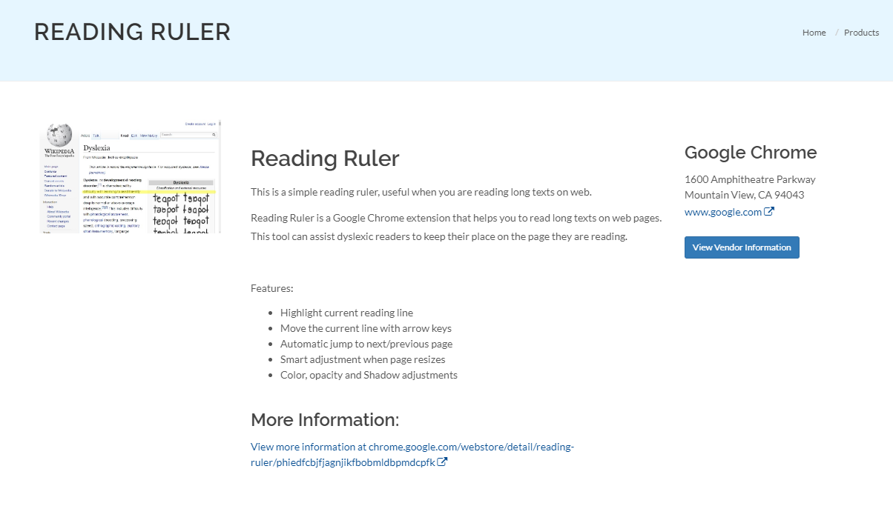

Slide 26
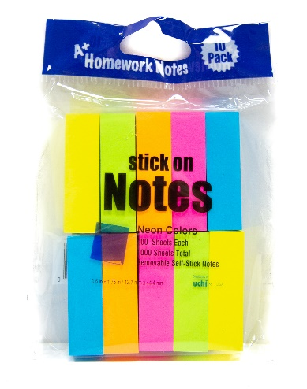
Losing Your Focus
Accommodations
Paying attention, memorizing, etc.
Take MOVEMENT breaks
Use fidget items
Chunk information by only assigning small reading selections at a time, having the student summarize (in writing or orally) before reading further, and highlighting important information or key words.
26

Slide 27
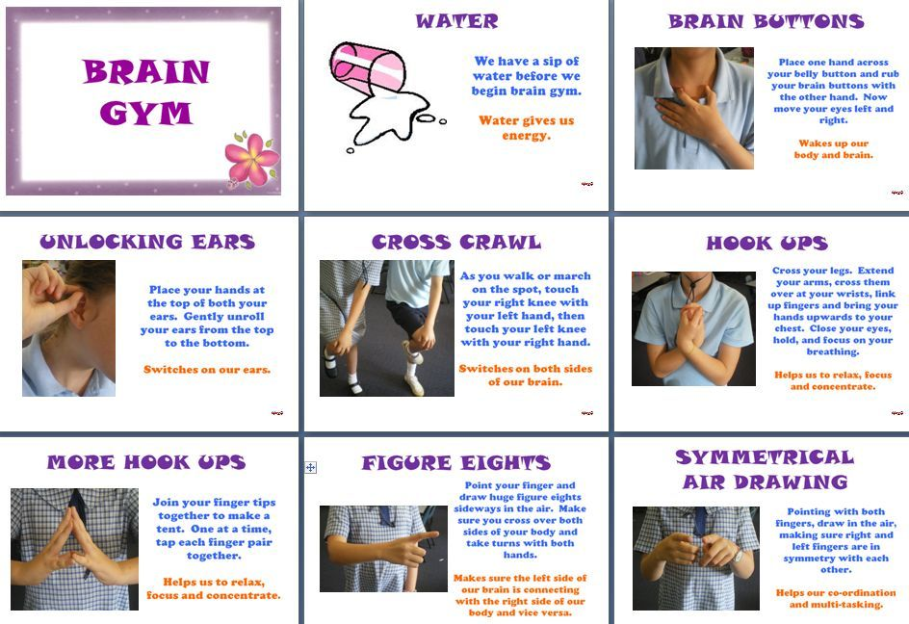
Losing Your Focus
27

Slide 28
Losing Your Focus
Strategies
Paying attention, memorizing, etc.
Whisper read/pair reading
Read a paragraph or two and draw a visual scene
28

Slide 29
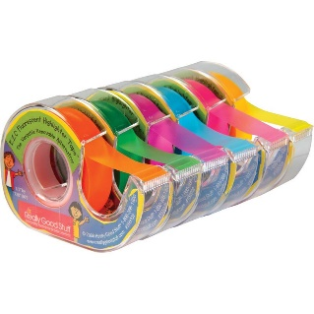
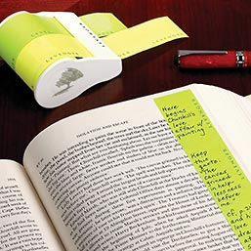
Forgetting What You Have Read
Accommodations
Fluency, Working Memory, Distractions
Use highlighter tape to record notes in the margins
Colored flags and tape to highlight important information or key terms
Chunk information by only assigning small reading selections at a time and having the student summarize (in writing or into digital tape recorder) before reading further
Use graphic organizers to break information down and/or to document key elements of the reading passage
29

Slide 30
Why is vocabulary learning so important? To understand a text, one must understand the words that represent the ideas or concepts. Studies confirm the high correlation between vocabulary knowledge and reading comprehension.

Slide 31
https://www.youtube.com/watch?v=5Y00Oe-cODw
Notes:
00:14 – xxx

Slide 32
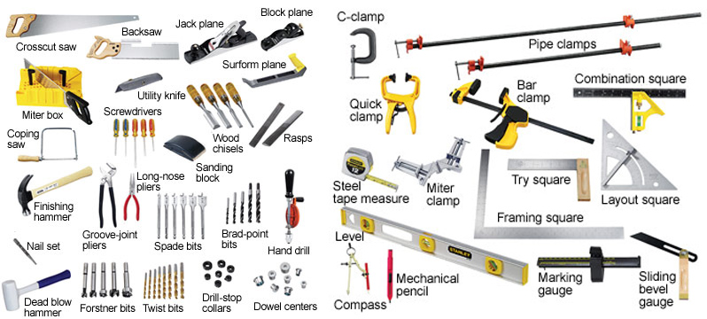
“Word Wall” Example in Career Technical Training
Construction terminology
Notes:
A good example of a UDL CTT strategy is the use of word walls…in this case a tool wall with the words printed next to each tool.
Students get more exposure from things they see often, so this is a great way to reinforce new learning.

Slide 33
Instructional Strategies in CTT – “Word Walls”
Provides a meaningful approach to teaching vocabulary
Improves reading and writing skills
Provides visual cues for students
Reinforces understanding of subject-specific terminology
Helps students improve spelling and awareness of spelling patterns
Encourages increased student independence when reading and writing
Medical prefixes/suffixes
Culinary terminology

Slide 34
https://www.vocabulary.com/

Slide 35
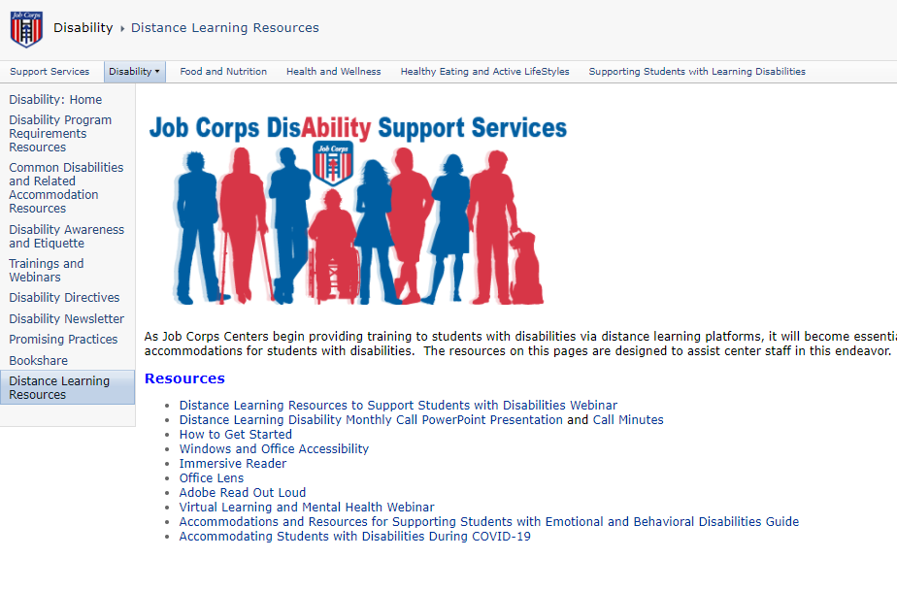
Other Assistive Technology to Support
Reading-related Functional Limitations

Slide 36
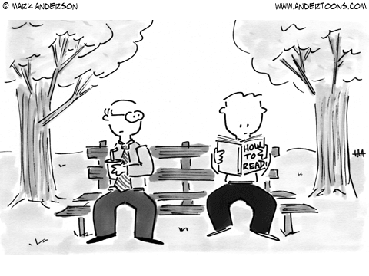
Resources

Slide 37
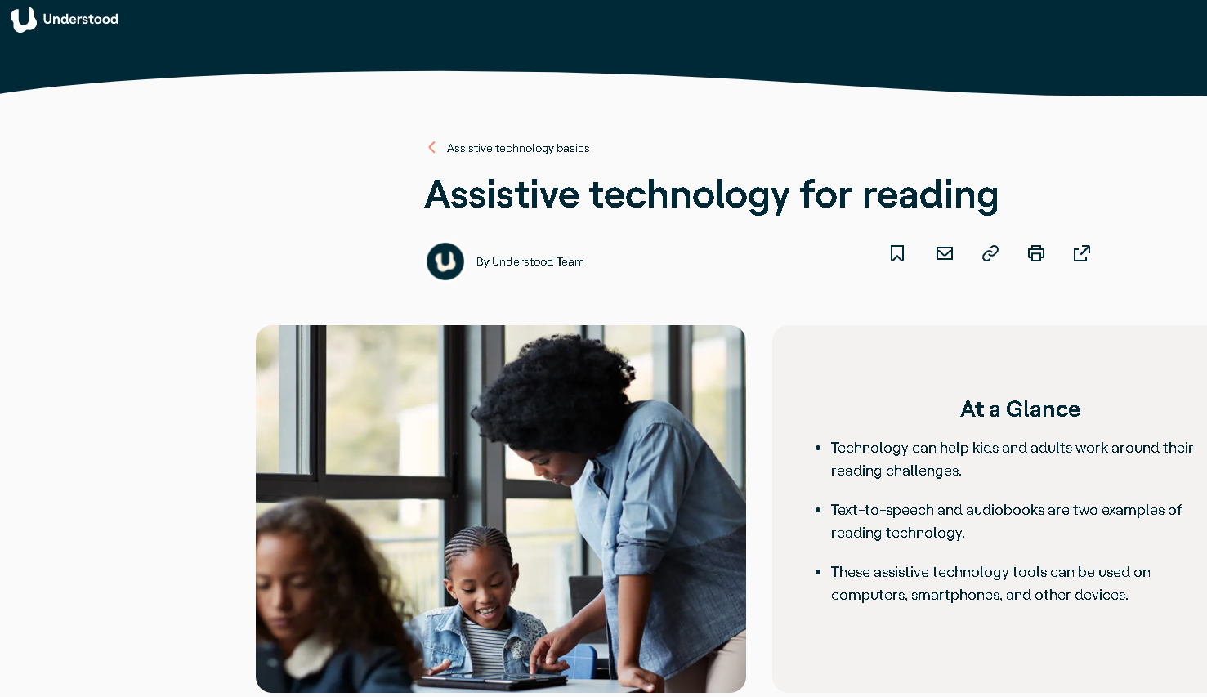
Understood www.understood.org
Notes:
https://www.understood.org/en/school-learning/assistive-technology/assistive-technologies-basics/assistive-technology-for-reading

Slide 38
https://www.texthelp.com/en-us/company/education-blog/september-2016/10-free-reading-resources-teachers/

Slide 39
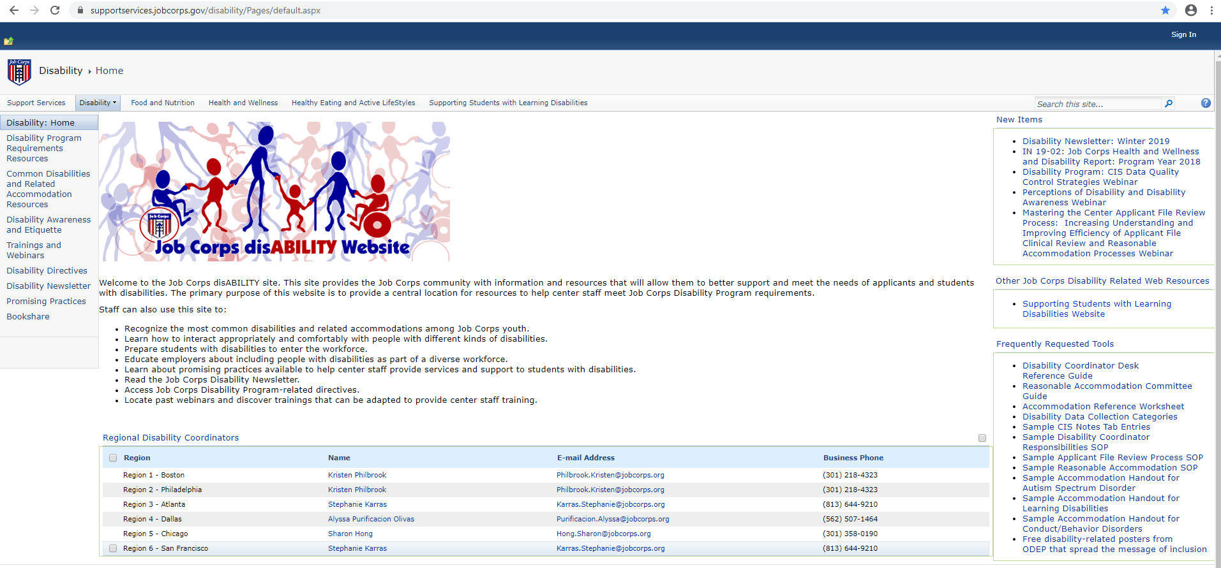
Job Corps Disability Website https://supportservices.jobcorps.gov/disability/Pages/default.aspx

Slide 40
Thank you for attending!

