Slide 1
Supporting Students
With Emotional Disabilities
April 2023
Notes:
Welcome to our webinar on Supporting Students with Emotional Disabilities. With the increase in individuals with mental health support needs post Covid, this is a critical time to ensure that we understand our obligations and responsibilities in supporting our students who have emotional disabilities.

Slide 2
Objectives
Identify several common functional limitations experienced by individuals with emotional disabilities.
Develop 3-4 accommodation ideas specific to identified behavioral and/or emotional functional limitations.
Identify 3-4 strategies specific to identified behavioral and/or emotional functional limitations.
Describe 1-2 examples of how assistive technology might be used to support behavioral and/or emotional functional limitations.
Identify 1-2 web resources with behavioral support recommendations.
Notes:
Today we are going to be discussing and reviewing the general characteristics and functional limitations of individuals who have Emotional Disabilities. Focus is not only on the identification and development of disability accommodations and strategies for both center participation and for the workplace, but also on the importance of building relationships with these students. Many of the supports and strategies we will discuss today can have application for use with ALL students.
Specifically, we want you to be able to identify some of the common functional limitations experienced by individuals with emotional disabilities and then to be able to identify relevant accommodations and strategies specific to those functional limitations. We will review some assistive technology suggestions that might be helpful and include some great web resources loaded with practical and useful information for supporting students with emotional disabilities or behavioral manifestations.

Slide 3
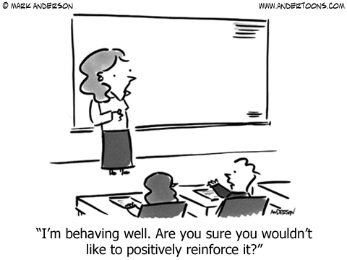
Background
Definition and Characteristics/ Functional Limitations
Notes:
Background – Definition and Characteristics/Functional Limitations

Slide 4
Emotional Disabilities
Generally, the characteristics exhibited occur over a long period of time to a marked degree and adversely impact/affect one’s educational performance. (IDEIA)
May be referenced on an IEP, for example, as an Emotional Disorder (ED) or an Emotional Behavioral Disorder (EBD).
May include functional limitations as a result of multiple disorders to include (but not limited to) mental health disorders, ADHD, autism spectrum disorder, brain traumas or intellectual disabilities.
Notes:
When we talk about “Emotional Disabilities,” what do we mean? Although Job Corps does not generally fall under the regulations of the Individuals with Disabilities Education Act, the program does receive many IEP documents as documentation of an individual’s disability so today we are using IDEA’s basic definition for emotional disabilities.
Generally, the characteristics exhibited occur over a long period of time to a marked degree and adversely impact/affect one’s educational performance. (IDEIA)
May be referenced on an IEP, for example, as an Emotional Disorder (ED) or an Emotional Behavioral Disorder (EBD).
May include functional limitations as a result of multiple disorders to include (but not limited to) mental health disorders, ADHD, autism spectrum disorder, brain traumas or intellectual disabilities.

Slide 5
Common Functional Limitations
Physical, Emotional, Behavioral, Learning-related
Self-regulation
Difficulty with change/transitions
Impulsivity
Avoidance
Physical symptoms
Difficulty with focus/concentration
Memory issues
Difficulty completing tasks, assignments, etc.
Anxiety/Stress tolerance
Notes:
Common Functional Limitations
This list is not all inclusive but certainly includes many of the most commonly experienced functional limitations. Functional limitations manifestations for individuals with emotional disabilities may not only have emotional, behavioral, and learning-related functional limitations but physical ones as well.
Some examples of functional limitations include:
Self-regulation
Difficulty with change/transitions
Avoidance
Difficulty with focus/concentration
Memory issues
Difficulty completing tasks, assignments, etc.
Anxiety/Stress tolerance
Remember how a disability manifests and their functional limitations may look different for each individual with the same disability diagnosis.

Slide 6
Behavior is Communication!
Behavior serves a purpose for the individual and/or is telling a story of how they are managing. So, our first thought should be what is the function of that behavior?
Sensory overload?
Cognitive overload?
Anxiety or fear?
Insecurity or lack of confidence or self-esteem?
Attention seeking?
Trauma or stress triggers?
Notes:
I think we all know this but sometimes in the moment of dealing with challenging behaviors, we may forget that all behavior is communication.
Behavior serves a purpose for the individual and/or is telling a story of how they are managing. So, our first thought should be what is the function of that behavior? Is it related to
Sensory overload which might include some environmental factors like lighting, smells, noise levels, etc.
Cognitive overload? Does the individual need a break, need information chunked down to smaller components, need the information presented in different format, etc.?
Anxiety or fear? We all know when we are in flight or fright mode, that the body is only concerned about protecting itself. Learning really cannot occur when in this mode.
Insecurity or lack of confidence or self-esteem? The student may misbehave to avoid tasks that are difficult for them or because there are social demands beyond their comfort levels.
Attention seeking? Sometimes students act like the class clown because they want attention and do not know how to successfully engage in class or with their peers;
Trauma or stress triggers? Sometimes proximity to others, certain sounds, smells, etc. may trigger an individual’s anxiety or increase their stress levels if it is related to a previous trauma or they lack confidence in how to engage or proceed.

Slide 7
General Behavioral Considerations
Do not force student to look directly at your face when addressing behavioral concern.
Ask student to re-state their own understanding of a behavioral expectation.
If concerns, speak with student privately (away from peers).
Give “cool down” time if needed.
Notes:
General Behavior Considerations
Most of these seem obvious and yet in our hurry or in our own stress response to a situation, we may not always think about these considerations so let’s review them.
Do not force student to look directly at your face when addressing behavioral concern.
Ask student to re-state their own understanding of a behavioral expectation.
If concerns, speak with student privately (away from peers). In this scenario, building a relationship with your students especially matters and we are going to talk about that next.
Give “cool down” time if needed. None of us are productive or think as clearly as we should when we are in the midst of feeling stress, being angry or distraught or experiencing sensory overload. Give the student some time to self-regulate before engaging.

Slide 8
Strategy Foundations
Building Relationships, Communication, De-escalation
Notes:
Strategy Foundations – Building Relationships, Communication, and De-escalation
In just a little bit, we are going to talk more about the nuts and bolts of this presentation and how to accommodate specific functional limitations or behaviors but first, we want to lay a “foundation” about how we interact and engage students who have emotional disabilities as this is critical to the effective implementation of other supports and to aiding that student participate successfully in the Job Corps program and equally importantly, prepare them for engaging successfully in the work world.

Slide 9
Building Relationships!
https://www.ted.com/talks/rita_pierson_every_kid_needs_a_champion?language=en#t-1162
Every kid needs a champion!
Notes:
I don’t think that we can say enough about how critically important it is to build relationships with your students. When there are challenging moments, especially related to behavior management, those relationships will matter more than ever.
We are going to show you a 7-minute clip of a TED talk by Rita Pierson and her theme is “Every kid needs a champion!” Rita spent her entire career teaching, and she knows the value of relationship. Even though she is talking to a group of educators in this clip, the information has application for all staff and is beneficial to achieving positive engagement with all students.
Show clip.

Slide 10
The Benefits of Building
Relationships
Wow!!!
Developing Mutual Respect
Building Trust
Supporting Development of Resiliency
Learning Persistence
Building Self Confidence
Notes:
Wow!!! Those relationships do matter! What are some of the benefits of building relationships with our students who have emotional disabilities?
It builds trust
There is a mutual respect that develops
From there we can use those relationships to help build self confidence, teach persistence, and hopefully facilitate the development of resiliency.
Examples:
Student is struggling with being compliant in the classroom and is being disruptive and you want them to come outside the classroom to talk. A student in this frame of mind may not be compliant with your request; however, if you have a strong relationship with them, it is MORE likely that they will comply with your request.
Student who is being defiant, behaviorally rigid, etc. Slip them a note that says, “I am here to help you.” Sometimes just a simple statement or a calmly and softly spoken statement like that is enough to take the defiant wind out of their sails, if you will.
We love developing knowledge, strategies, and supports that have application center-wide and the benefits of building relationships is one of those. Not only should ever kid have a champion, as Rita Pierson states, but we also believe that every kid (e.g., our students with emotional disabilities) cannot have too many champions who are invested in helping them!

Slide 11
How do you orient new students?
Do you take time to talk to them 1:1 and get to know some personal interests and facts about them?
Do you explain your expectations for your area and what they can expect from you?
Do you routinely demonstrate your awareness of them by incorporating their interests and general personal facts into the conversation, assignment, activity?
Notes:
An important aspect of building a good relationship starts with good first impressions, showing interest in who the individual is as a person to include learning about their hobbies or interests, etc. Truly coming from a place of authenticity in your conversations is critical. Students generally are perceptive and will be noting your level of interest in them.
Do you only do group orientations or are you able to take time to talk to each student on a 1:1 basis?
Do you explain your expectations for your area and what they can expect from you?
Do you routinely demonstrate your awareness of them by incorporating their interests and general personal facts into the conversation, assignment, activity?
Students drink in the fact that you remember something specific about them or their interests and they often really like when you can incorporate that information into a task that they are assigned to complete. For example, let’s say the student needs to work on writing skills and you have them write facts about their favorite area of interest. They can add pictures, put it into a PowerPoint, etc. The point here is that you noticed what was important to them and you are demonstrating that you noticed AND equally important, they worked on their writing skill development!
Talk about personal example (i.e., you are going to change the world).

Slide 12
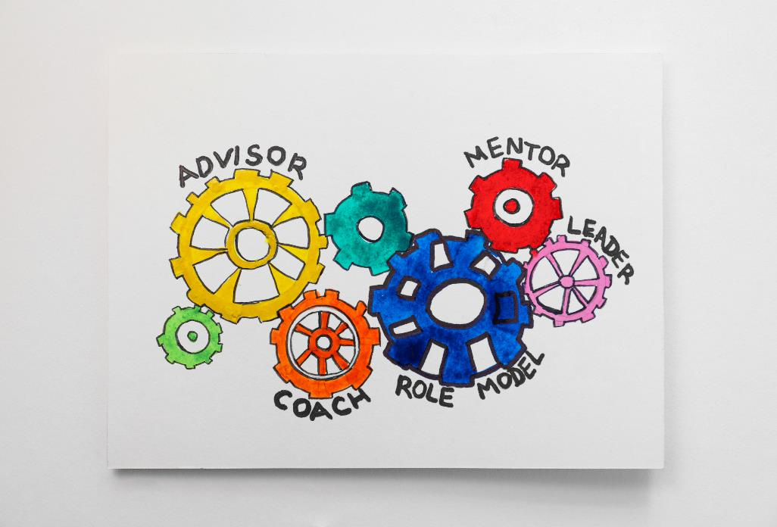
Managing and Modeling Desired Behaviors, Self-Regulation, Conflict Resolution, and more!
Why might this be helpful and/or of what benefit is it to students who have emotional disabilities?
Notes:
Managing and Modeling Desired Behaviors, Self-Regulation, Conflict Resolution, and more!
Why might this be helpful and/or of what benefit is it to students who have emotional disabilities?
If we can model our humanness, in appropriate ways, of course, then it creates an accepting environment that encourages students with emotional disabilities to do the same. For example, perhaps we are feeling frustrated and we simply state that sometimes when I get frustrated, I stop and I take a deep breath, I count to 10 silently and then I exhale slowly and that helps me release some of that frustration so that I can better manage the situation, resume working, etc.

Slide 13
Calming and De-Escalation Strategies
https://www.youtube.com/watch?v=R2PSExM-NhU
Notes:
Calming and De-Escalation Strategies
We are going to watch another video clip and this one is on calming and de-escalation strategies. Of course, the immediate goal is to de-escalate situations that are escalating and to calm things down but as we can, we also want to model how to handle stressful situations and difficult moments.
00:00 - 4:21

Slide 14
Calming and De-Escalation Strategies Recap
Low and Slow
Name it to Tame it
Regulate over Educate
Keep your voice low and talk slowly
Walk slowly
Keep hands forward and open
Get on their physical level (if necessary)
Affirm the person’s feelings (i.e., it’s okay to feel angry as long as you stay safe)
Do not attempt to “teach” a lesson on behavior or anything else during difficult behavioral management moments/events
Provide adequate time for de-escalation (20 to 30 minutes)
Notes:
That short clip contained a lot of valuable information. Let’s recap the core elements of what was stated.
First, remember to stay low and be slow.
Keep your voice low and talk slowly
Walk slowly
Keep hands forward and open
Get on their physical level (if necessary)
Then name it to tame it or name the emotion and acknowledge that the feeling is acceptable to feel and what is critical is that we manage those feelings appropriately (i.e., it’s okay to feel angry as long as you stay safe).
Finally, regulate over educate meaning
Do not attempt to “teach” a lesson on behavior or anything else during difficult behavioral management moments/events
Provide adequate time for de-escalation (20 to 30 minutes)

Slide 15
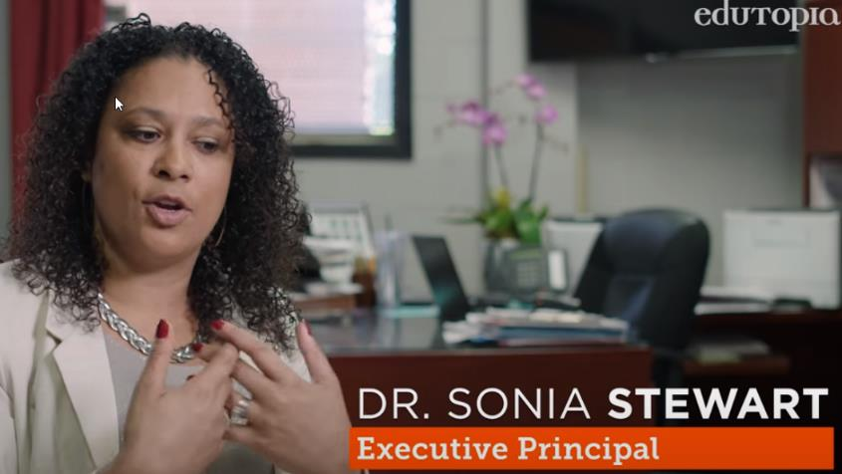
De-escalation Spaces/ Real Time Conflict Resolution
(Space is still monitored)
https://www.youtube.com/watch?v=YxC_Q8zE0SU
Notes:
Let’s watch one final video clip on de-escalations spaces and real time conflict resolution. This is a 3.5 minute clip on how one high school is helping students de-escalate and manage conflicts.
00:00 - 03:39

Slide 16
Have teen/adult coloring sheets, mazes, colored pencils available to use as calming activities.
Tools, Resources, and Routines
Do some mental and/or physical warm up exercises.
Have weighted lap items or small fidget items to aid with calming and other anxiety and/or sensory related symptoms.
Being Prepared!
Notes:
Tools, Resources, and Routines – It is all about being prepared!
Sensory breaks, calming breaks, etc. also can be accommodations as well as allowing the use of fidget items, weighted blankets, using mindfulness, meditation or yoga, etc. It is also possible to set up your classroom, communal spaces, etc. using universal designs for learning concepts meaning we set up the environment for everyone’s use but it improves overall accessibility for people with disabilities. Just ensure that students who need or require certain accommodations have them included in the accommodation plan even if your space is “universally designed” so it is known that they need and can use these supports in other areas of the center.
Other ideas include having teen/adult coloring sheets, mazes, complex dot to dot sheets, and colored pencils available to use as calming activities. Do some mental and/or physical warm up exercises like brain gym routines.

Slide 17
Use Center Resources/Expertise
Career Counselors
Center Mental Health Consultants
Staff Mentors
Peer Mentors
What are some ways the student who is struggling behaviorally can be engaged in positive activity?
Notes:
Very Important! Use the center resources and staff expertise available to you! Perhaps the student would benefit by a trusted staff mentor, may need an additional session with the CMHC to discuss some particular area of struggle and ideas for managing it, working with the career counselor on organizational and planning skills or social interactions, etc. Peer mentors can be very helpful but do provide them with some basic training and information so they know when to reach out to staff and to understand that the peer student is NOT their personal responsibility – that they are there to assist in certain ways, maybe to invite that student to sit at their table for lunch, serve as a role model or providing some in class tutoring, etc.

Slide 18
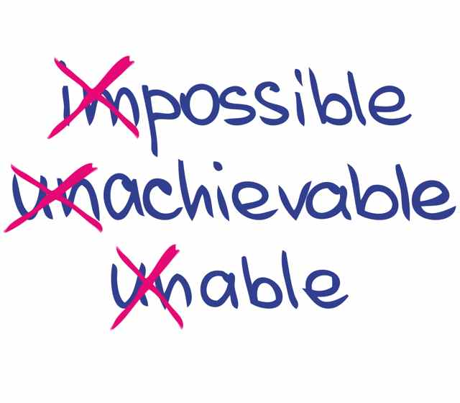
Set the Tone Early!
Provide some opportunity for success each day. If academics or career technical, preferably early into a class period.
Reinforce Positive Behavior OFTEN!
Look for opportunities to provide feedback on positive/appropriate behavior, management of emotions, etc.
Notes:
Establishing daily routines can be helpful, especially if it is an interesting, fun, and/or known to be achievable type of activity. This can set the tone for the rest of the class session, dorm meeting, etc.
For example, make the very first activity in class each day an easy review item or some activity that you know the student with an emotional disability can readily accomplish. Do some brain gym or “fun” cognitive activity or warm up game.
Then reinforce positive behavior OFTEN!!! Look for opportunities to provide feedback on positive/appropriate behavior, management of emotions, etc.

Slide 19
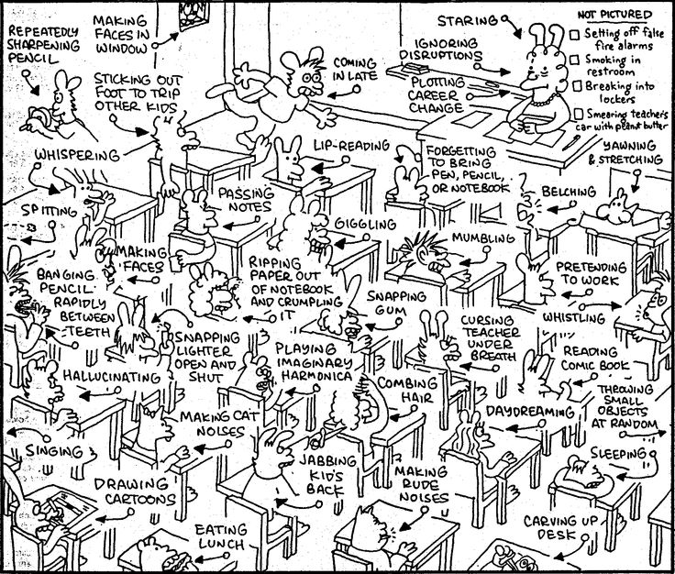
Completing the Practical Stuff!
Behavior Supports in Student Accommodation Plans, Monitoring, and Adjusting Supports
Notes:
Completing the Practical Stuff! - Behavior Supports in Student Accommodation Plans, Monitoring, and Adjusting Supports
So far we discussed "universal" ways of building relationships, setting students up for success, creating inclusive settings, and utilizing strategies and techniques; now we will focus on specific ways to create effective individualized accommodation plans to support students with emotional disabilities.

Slide 20
Behavior Supports
Ensure that all functional limitations from ALL disclosed conditions are discussed for support needs.
Review the Student’s History of Behavioral Concerns and Supports!
“Behavior supports” is a broad term that refers to proactive accommodations, and prevention-focused supports that enable students with behavior manifestations of their disability to participate in Job Corps.
Notes:
The term “behavior supports” within Job Corps refers to the positive approach to accommodating students with behaviorally-related manifestations of their disability. Behavior supports are designed to enable the individual with a disability who has behavioral manifestations to participate in/access the Job Corps learning/working/living environment.
When students disclose conditions/disabilities, be sure to review the student's HISTORY of Behavioral Concerns and any previously provided behavioral supports and discuss possible needs with the student. Additionally, ensure that all functional limitations from ALL disclosed conditions are discussed for support needs which might include student's on the autism spectrum, those with ADHD, those who have intellectual disabilities as well as individuals with certain behavioral manifestations from specific psychiatric conditions.

Slide 21
Students with behaviorally related functional limitations are entitled to behaviorally related disability accommodations.
1
Why We Use Behavior Supports in Job Corps!
Reinforcing positive and effective behaviors can benefit ALL students.
2
Successfully increasing center-wide positive behaviors for all students can lead to the development of a positive normative culture.
3
Notes:
Why We Use Behavior Supports in Job Corps
First, students with behaviorally related functional limitations are entitled to behaviorally related disability accommodations.
Secondly, reinforcing positive and effective behaviors can benefit ALL students. Staff are required to provide the accommodations from Accommodation Plans for students with disabilities but can additionally implement positive behavior reinforcement strategies for an entire class.
Everyone can benefit from a system which reinforces positive or prosocial behaviors. Within the context of the accommodation plans, and as we stated earlier, staff are required to provide the accommodations from accommodation plans for students with disabilities but may additionally choose to implement positive behavior reinforcement strategies for an entire class or group. One example of extending an individual accommodation into a group dynamic may look like providing personalized, positive feedback for each member of an entire group. This type of positive acknowledgement may help students see what strategies work well for their peers without focusing on negativity or criticism. Success in increasing center-wide positive behaviors can slowly create a culture in which positive behaviors from all students is the norm.
We also hope that the use of this positive approach will help the student improve in their persistence of tasks that are difficult and that when they have missteps or failures, that they will double down and try again.

Slide 22
Creating an environment that emphasizes self-regulated positive behaviors can reflect aspects of some post-Job Corps employment positions.
Example: Consistent growth of an employee’s skills and gains in the workplace can lead to success in the form of promotions, raises, performance-based awards, etc.
Emphasis on independence-related behaviors can assist students in learning to self-regulate and building their intrinsic (internal) motivation.
4
Why We Use Behavior Supports in Job Corps! (cont.)
Notes:
Effective behavior supports assist in creating an appropriate environment for a student to effectively learn new skills or a trade. When considering behavior-related accommodations, consider what supports will best accommodate the student’s specific needs as he or she initially learns and builds fluency with unfamiliar tasks.
Furthermore, environments that focus on teaching self-regulation of productive behaviors can help expose students to some elements of post-Job Corps employment. Independence and self-monitoring are crucial skills in many employment positions. Ultimately, students who understand the importance of continuously growing their skills may be more prepared for some professional practices including performance-based awards, merit-based promotions, etc. An emphasis on independence-growing behaviors can assist students in learning to self-regulate and foster their intrinsic (internal) motivation.

Slide 23
First Things First
When identifying new accommodations for students who previously had behavior supports in a school setting, remember:
01
02
03
Past behaviors may not be relevant in Job Corps.
Behavioral accommodations may or may not be needed in a new environment.
Applicant/Student is best source of information.
Notes:
First Things First
Keep in mind that behavior-related accommodations are intended to assist in creating the appropriate environment for a student with a disability to learn new processes and information. Each learning environment comes with unique challenges, and behavioral accommodations should be considered accordingly.
When identifying new accommodations for students who previously had behavior supports in a school setting, remember:
Job Corps likely involves different demands than a student’s previous environment, and thus their past behaviors may not be relevant within the unique environment of Job Corps, students may need different or less accommodations than they needed in the past.
To identify relevant supports, the student should be involved in an interactive process to identify their limitations and consider corresponding accommodations. As with all accommodations, behavior-related accommodations should not be added to an accommodation plan without first having a discussion with the student. For example, instead of assuming that a student who struggles with attention needs to be seating at the front of the class (e.g., preferential seating), ask the student where they function best in the classroom or in a group meeting, etc.

Slide 24
If we expect students to meet specific behavior requirements, we need to explain what those expectations are and model the appropriate behaviors for students.
Behavior expectations should be posted, modeled, and reviewed regularly.
Notes:
Behavior expectations should be posted, modeled, and reviewed regularly.
If we expect students to meet specific behavior requirements, we need to explain what those expectations are and model the appropriate behaviors for students. It may be helpful to talk about why some of the requirements exist or pick one a week and talk more in-depth about that requirement. Students often respond better to requirements and rules when they understand why they exist and that they are not just because a staff person says so. If possible, involve the students in the creation of some of the requirements of the behavior expectations. This could allow for more buy-in to uphold the desired behaviors.

Slide 25
Using the Comments Field on Accommodation Plans
Using the comments field can help clarify details about the specific behavior support accommodation that should be provided
Accommodation | Specific Accommodation | Comments
Behavioral | 02-Verification of understanding of expectations | Instructors/center staff should prompt student to verbally paraphrase their understanding of the instructions.
Notes:
If the specific accommodation is vague or open to interpretation, the comments section should be used to clarify the specific accommodation staff should provide. In the example above, the accommodation is “Verification of understanding of expectations.” Maybe the documentation disclosed some information about what has been helpful for this student in the past. In this example, the comments explain that the verification should occur by having the student verbally paraphrase or explain what the instructions mean to them. Another example might be having the student complete a few of the problems or questions while the teacher or instructor or other center staff is observing them do so. Once it is clear that the student understands what they are supposed to be doing, then the staff person can move on to assist another student.
Reminder: the comments field should not include any specifics about diagnosis or confidential information when explaining or clarifying the specific accommodations

Slide 26
Disability Accommodation Examples
Behavioral Supports
Proximity Control
Positive Phrasing
Clearly Defined Routines
Pre-arranged Signs
Notes:
Next we are going to discuss some behavioral support disability accommodation examples. There are a wide variety of options available to us all but today we are going to focus on 4 specific ones:
Clearly defined routines
Proximity control
Pre-arranged signs
Positive phrasing

Slide 27
The student will use his watch or cell phone alarm to signal 5 minutes before transitioning to the next part of his day
Clearly Defined Routines
The instructor rings a bell 5 minutes before a transition to the end of the class or an assignment
Notify or alert when changes are pending
Use video modeling for the student
Staff should provide student with ample warning if changes to their typical routine will occur.
Students who struggle to maintain routines may benefit from creating a video of the student performing required step by step routines.
The DC and/or the instructor outline schedules in a written and picture format
Notes:
Let’s start with students who have functional limitations where clearly defined routines are needed.
First, if possible, notify or alert the student when changes to the schedule or routine are pending so that they have time to process the change and prepare for the change.
Use video modeling for the student who struggles to maintain routines. This student may benefit from creating a video of a student performing required step by step routines or from a prompting video where each step of the routine is prompted, the student completes it, and then advances the video to the next step.
Some other accommodation ideas that will help establish/maintain routines:
The student will use his watch or cell phone alarm to signal 5 minutes before transitioning to the next part of his day
The instructor rings a bell 5 minutes before a transition to the end of the class or an assignment
The DC and or the instructor outline schedules in a written and picture format
Other:
Student will be provided a calendar or planner to keep track of daily, weekly, and monthly schedules; counselor will check in with student weekly to see if they are using the calendar or other organizational tools, to encourage use of the tools if they are not, and/or to assist them with using the tools if they are struggling to use them. Perhaps, the student needs different tools so the career counselor can discuss this with the center Disability Coordinator(s).

Slide 28
Seating locations may vary dependent upon the need – away from flow of traffic, closer to staff person for better communication, etc.
Proximity Control
Be mindful of the personal space of the student
Talk to the student about supports that work best for them
Allow student to attend large group activities via video stream if available.
If a student is agitated, anxious, or struggling behaviorally, it is generally good to stay at least 2 arm lengths away.
What works for one student may not work for another one in the same way. Be clear about the functional limitation/need.
Use Video Modeling for the Student
Allow student to leave class 5 minutes early to avoid crowded hallways.
Notes:
Another area of functional limitation that you may see more often than some others is the need for proximity control.
Be mindful of the personal space of the student. If a student is agitated, anxious, or struggling behaviorally, it is generally good to stay at least 2 arm lengths away. Earlier we mentioned keeping our bodies open, hands somewhat forward – in other words, maintaining a non-threatening posture.
Talk to the student about supports that work best for them. We cannot emphasize enough how important the interactive part of the disability accommodation process is. What works for one student may not work for another one in the same way. Be clear about the functional limitation/need so you can assist the student in identifying appropriate supports.
Some other accommodation ideas that will help with proximity related functional limitations:
Seating location may vary dependent upon the need – away from flow of traffic, closer to staff person for better communication, etc. Again, ask the student what works best for them and equally important, what is the worst seating scenario for them.
Allow student to attend large group activities via video stream if available.
Allow student to leave class 5 minutes early to avoid crowded hallways.

Slide 29
Allow student to sign “time out” when a break is needed.
Pre-Arranged Signals
Non-verbal communication may be used to aid attention or other behaviors
Discretely provide the student with a fidget item if struggling to focus.
Pre-arrange a gesture, sign, or card to use when a support is needed
The key is to find discrete ways to communicate behavior support needs – to the student and the student to center staff.
Behavior supports can be used to reinforce proactive and positive behavior as well if that better enables the student to participate.
Use Video Modeling for the Student
Allow the student to present a card when they need to see a pre-designated staff mentor.
Notes:
Our third area of disability accommodation examples is to discuss and develop pre-arranged signals. Allowing the student who needs additional support to be able to access it discretely can mean the difference between them using the support and not using it.
If there are areas of support that a student needs to alert you regarding and/or you to alert them regarding, pre-arrange a gesture, sign, or card that can be used. The key is to find discrete ways to communicate behavior support needs – to the student and the student to center staff.
Also, non-verbal communication may be used to aid attention or other behaviors. A light tap on the shoulder (if agreed upon) or the use of a card that only the student knows the meaning related to it, could be used. Keep in mind that behavior supports can be used to reinforce proactive and positive behavior as well if that better enables the student to participate. These could be methods to routinely provide positive feedback.
Some other pre-arranged signal examples:
Allow student to sign "time out" when a break is needed.
Discretely provide the student with a fidget item if struggling to focus.
Allow the student to present a card when they need to see a pre-designated staff mentor.
Overuse
We are sometimes asked what do we do if a student is “abusing” the use of an accommodation. First, be sure that they are not experiencing an increased need for support which might appear as overuse of the support. Have a conversation with the student. Contact the Disability Coordinator and the CMHC and ask for assistance if the student is experiencing heightened symptoms, behaviors, functional limitations. Then IF the student is truly using a support to leave the classroom, training area or meeting more than they really should be and you know it is not due to a heightened need for support, also connect with the center DC and talk to the student about the appropriate use of the disability accommodation.

Slide 30
Positive Phrasing
Telling a student what the expected behavior is and how to meet that expectation is more effective than waiting until a negative behavior occurs and telling the student what “not” to do.
Positive
Negative
Thank you for getting started right away on your assignment.
I see how hard you are trying. Good job!
I am impressed that you did not quit even when the work was difficult.
Stop talking!
Why? Because I said so!
Pay attention.
Do it over.
Notes:
Positive Phrasing
Who doesn’t like to hear praise or be told they are doing a good job or have someone recognize their effort! Without question, telling a student what the expected behavior is and how to meet that expectation is more effective than waiting until a negative behavior occurs and telling the student what "not" to do.
Positive language uses might include:
Thank you for getting started right away on your assignment.
I see how hard you are trying. Good job!
I am impressed that you did not quit even when the work was difficult.
Negative language uses might include:
Stop talking!
Why? Because I said so!
Pay attention.
Do it over.
Some other considerations:
Take every opportunity to provide timely positive feedback when the student displays a desired behavior(s) or effort. The more specific you can be with your feedback the better.
Ensure that staff in all areas of the center are mindful of making rules/expectations clear to all students before an activity or event and that they, too, should provide positive feedback any time they note appropriate behaviors occurring. For example, the Recreation Supervisor should explain the expected behavior of “good sportsmanship” prior to games and activities with the student and then acknowledge the student when they are demonstrating good sportsmanship.

Slide 31
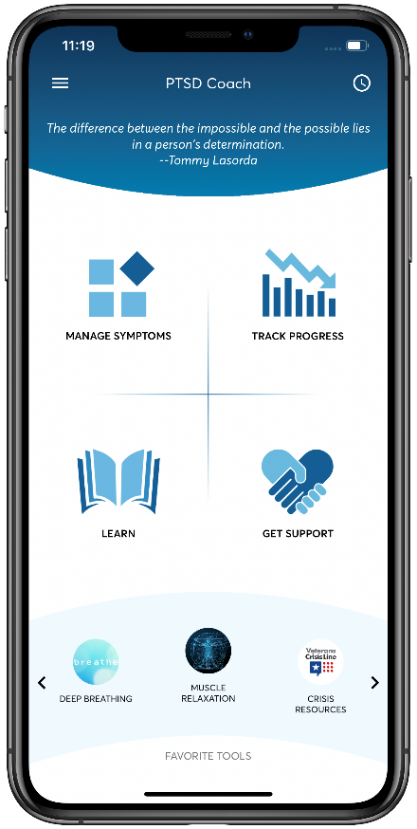
PTSD Coach
Helps students manage stress related to PTSD
Offers a self-assessment
Provides resources, exercises and tools.
MOVEIT
A Google extension from PE Geek that prompts movement breaks and provides reminders at set intervals.
Happify
Helps students overcome stress and negative thoughts, build resilience, and provides exercises, activities, and games to practice generating positive feelings.
Notes:
There are multitudes of assistive technology resources for assisting individuals with managing behavior, feelings, organizational and time related challenges. We are highlighting a few for you today. The benefit of encouraging or teaching students to use apps as one tool in their toolbox is to promote and build their abilities to independently manage their behavioral challenges.
We have been longstanding supporters of the use of PTSD Coach. It is free and allows the individual to gauge their current feelings and guide them as to what strategies they might wish to use or if they need to seek help.
The MOVEIT app is a Google extension from PE Geek that is loaded to a computer and can prompt movement breaks and provide reminders at set intervals. We know that exercise increased endorphins, so movement breaks are generally good ways to help us refresh, get refocused, get some restless energy out, and get ready to get back to work. As an aside, opening the gym during lunch breaks “may” be a good way to help students get ready for that second half of the training day!
Finally, the app Happify helps students overcome stress and negative thoughts, build resilience, and provides exercises, activities, and games to practice generating positive feelings.

Slide 32
Resources
Websites and Tools
Notes:
As with the apps, there are a multitude of website resources and tools that can be accessed and used to assist you in working with student who have emotional disabilities.

Slide 33
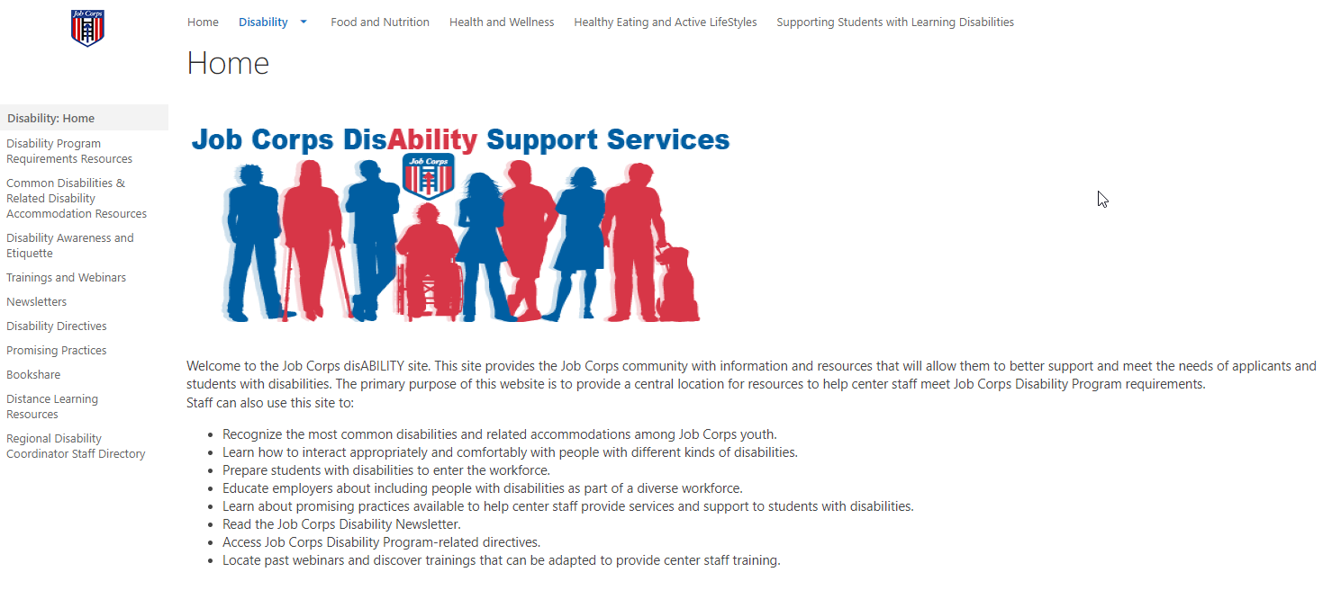
Job Corps Disability Website
https://supportservices.jobcorps.gov/disability/Pages/default.aspx
Notes:
The first one is the Job Corps Disability website. New information is being added to the site on a regular basis. We encourage you to spend 15-20 minutes a week reviewing these resources and using them to assist in supporting students with disabilities.

Slide 34
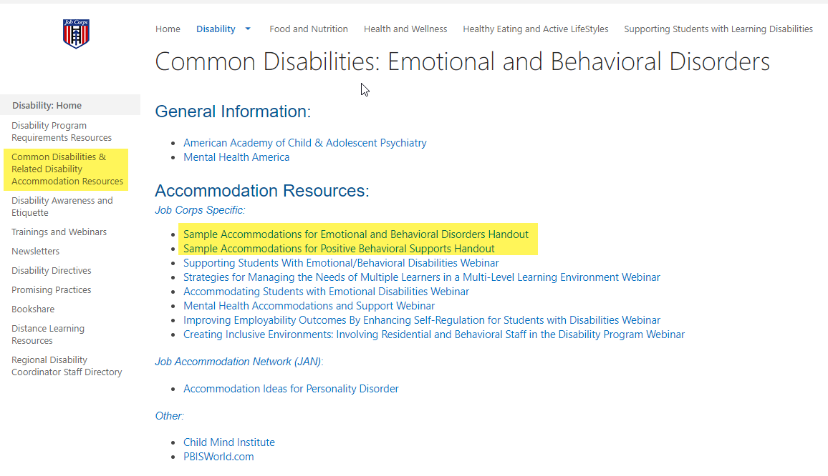
Job Corps Disability:
Emotional and Behavioral Disorders Related Resources
Notes:
If you select the “Common Disabilities and Related Disability Accommodation Resources” selection from the menu on the left of the Job Corps Disability website, you find a list of documents that contain accommodation suggestions including one for individuals who have emotional disabilities.

Slide 35
Understood.org
https://www.understood.org/en/articles/what-are-positive-behavior-strategies
Notes:
Understood.org has a wealth of resources for working with students with disabilities. They also have a section on positive behavior strategies and even though it says it is for teachers, please remember that these strategies can be used center-wide and by all staff.

Slide 36
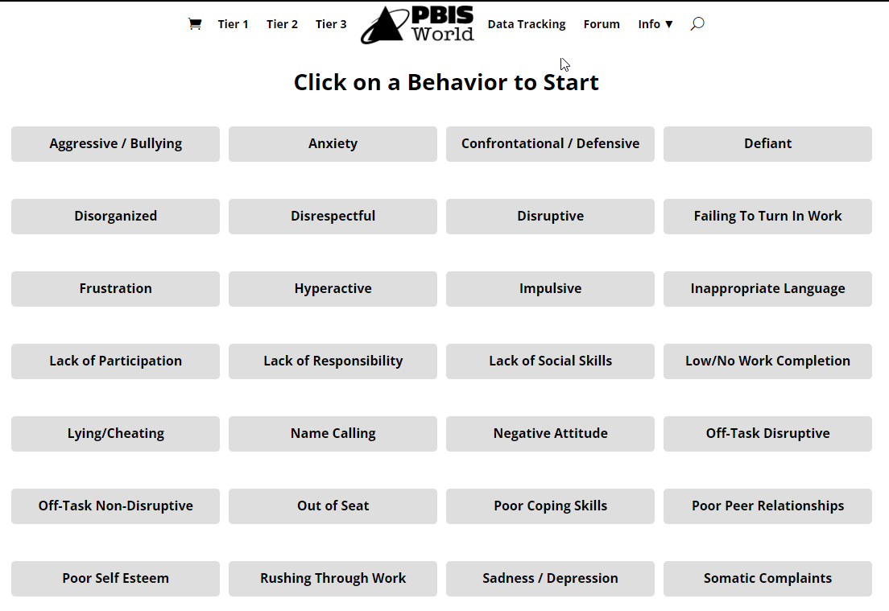
PBIS World – Behavior Support Recommendations/Resources
www.pbisworld.com
Notes:
We have been using and referencing this site for a number of years but it has recently undergone an overhaul really to match the multi-tier response to intervention models traditionally used in the public school system. Nonetheless, there is a ton of great information available. You can select an overarching functional manifestation/behavior and find lots of suggestions and resources to support that particular manifestation. If you click on Tier 1, that is the least invasive and simpler (if you will) types of accommodations, Tier 2 will be more involved and then Tier 3 are those suggesting the most complex types of supports. Not every suggestion can be applied to our program but there is a wealth of good information that can be used and that might spark other ideas of supports to use.

Slide 37
Questions?

