Slide 1
ANXIETY
Recognizing the Symptoms and Manifestations
of Anxiety that Exist Within a Myriad of Disabilities:
Supporting and Accommodating Students With Anxiety-Related Functional Limitations
Notes:
Welcome to the Anxiety, Supporting and Accommodating Students with Anxiety-Related Functional Limitations webinar!

Slide 2
Objectives
Identify several common functional limitations experienced by individuals with specific anxiety-related disabilities.
Develop 3-4 possible accommodations for students with emotional, behavioral, and learning challenges specific to their functional limitation manifestations
Identify 2-3 strategies that may assist students with anxiety-related challenges on the Job Corps center and in the workplace, focusing on independence and employability
Describe 1-2 examples of how assistive technology might be utilized to support students with anxiety disabilities in various Job Corps settings
Notes:
Let’s review our objectives for today’s webinar. By the end of this presentation, we hope you can identify several common functional limitations…, etc.

Slide 3
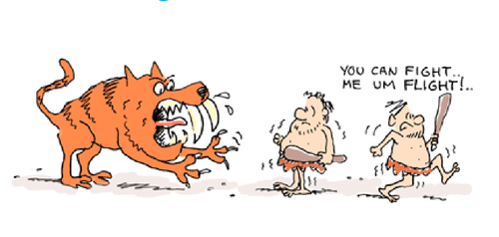
PURPOSE
BACKGROUND
Notes:
We have presented this webinar once previously, but we have adjusted it since that time and believe it to be a very important area that is sometimes, if not often, overlooked when developing accommodation plans for students with disabilities. Let’s talk about the significance of how anxiety functional limitations can impact individuals who experience them.

Slide 4
Purpose
To talk about how unsupported anxiety functional limitations sometimes can impede the effectiveness of other accommodations, strategies, and supports.
The importance of considering and including accommodations specific to anxiety-related functional limitations.
In Defense Mode, everything is harder because you are constantly trying to protect against an imminent, perceived, but extremely vague threat. The perceived threat creates the same anxiety as a true life-threatening situation.
When you are in Defense Mode, since you spend the majority of your resources fighting your feelings, the outside world and anything you perceive as threatening, you have very little leftover resources for day-to-day functioning.
https://www.aspergerexperts.com/
Notes:
Our purpose today is to talk about how UNSUPPORTED (e.g., unaccommodated) anxiety-related functional limitations can potentially impact or impede the effectiveness of other accommodations, strategies and supports. Why? Because when a person’s is in defense mode (has feelings of fight or flight, etc.), everything feels harder to accomplish or takes longer to complete. The person can become distracted and have difficulty concentrating or focusing on the instructions being given or completing the task at hand.
Individuals on the autism spectrum, for example, may experience anxiety, and they explain on the aspergerexperts.com forum that when you are in DEFENSE MODE, you spend so many of your resources fighting your feelings, physical responses to those feelings, etc., that you may have very little leftover resources for day-to-day functioning.

Slide 5
What is the Implication?
So, until [one] gets out of Defense Mode, it is very hard to learn social skills, make friends, be productive in school or a job, and take care of oneself and manage the [feelings of being] overwhelmed and stressed that can come with everyday life.
https://www.aspergerexperts.com/
Notes:
So, what does this all mean? While a person is in defense mode, it is VERY DIFFICULT or HARD to interact with others successfully, to manage one’s emotions, to be productive in school or work. Small tasks and daily life responsibilities can feel overwhelming. Increased stress over an extended amount of time certainly impacts overall performance.

Slide 6
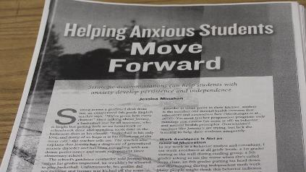
What is the application to Job Corps?
The impact or benefit of other non-anxiety-related accommodations that are being provided may be limited or minimized, etc. because the functional limitation (e.g., anxiety) that is really presenting the greatest barrier to functioning and performance has not been supported or addressed yet.
Notes:
So how does being in defense mode or anxious impact the student with a disability in the Job Corps program?
It may limit or diminish the effectiveness of other non anxiety-related accommodations because the functional limitation (which in this case is the anxiety) likely is presenting the greatest barrier to functioning and performance. It may result in the exhibition of undesirable behaviors while the student is trying to navigate through their feelings of “fight” or “flight” and result in unnecessary negative consequences. Students may avoid engaging in class, may avoid initiating tasks, have difficulty attending to instruction, or navigating social interactions appropriately or at all!

Slide 7
How to Resolve/Improve Effectiveness?
These students should already be on the Center Mental Health Consultant’s (CMHC’s) radar screen but refer the student to the CMHC for support and anxiety-related accommodation recommendations.
Other potential actions:
Mindfulness/Self-Regulation “Training” with CMHC or other trained staff
Meditation, deep breathing, yoga, support groups
Physical exercise
Accommodations that address anxiety
Notes:
So how do we support the student with a disability who has a functional limitation related to anxiety? Let’s talk about a few possible supports starting with having the student referred to the CMHC for review and discussion of possible anxiety reduction strategies, referral for medication review or other community-supported therapeutic interventions, etc.
Other potential actions might include using Mindfulness training, Self-regulation strategies such as meditation, deep breathing, yoga, participation in support groups, and more. Physical exercise can be a very useful tool in helping to manage a variety of mental health manifestations including anxiety. We are going to talk more about mindfulness and exercise later in this presentation.

Slide 8
BACKGROUND
BACKGROUND

Slide 9
Types of Anxiety Disorders
There are a variety of types of anxiety disorders.
Our focus today is not on the various types but on how anxiety can impede:
access to the program
participation in the program
progress forward in the program
Notes:
There are a variety of types of anxiety disorders including generalized anxiety disorder, PTSD, OCD, etc. Our focus today, however, is not on the various types but on how anxiety can impede:
access to the program
participation in the program
progress forward in the program

Slide 10
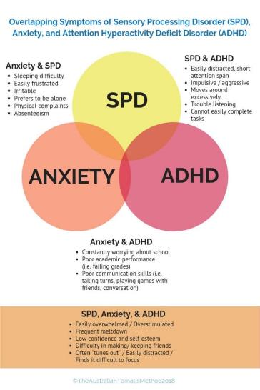
Other Conditions Where Anxiety May be Associated
Autism Spectrum Disorder (ASD)
Attention Deficit/Hyperactive Disorder (ADHD)
Sensory Processing Disorder (SPD)
Other mental health-related conditions
https://tomatis.com.au/2018/09/06/prevent-sensory-meltdown/
Notes:
It is, however, important to note that anxiety may be a manifestation experienced in many other conditions. For example, individuals who are on the autism spectrum and/or who have Sensory Processing Disorder likely have some degree of anxiety-related functional limitations. Look at the chart to the right – you can see a graphic depicting some of the overlapping symptoms in these conditions.

Slide 11
Anxiety Disorders: General Features
All share features of excessive fear/anxiety that impact emotions, behaviors, and learning – can be in response to real or perceived threats or in anticipation of some future threat
Fear of being judged by others (embarrassment, rejection, etc.)
Anxious or avoidant of a specific object or situation (spiders, heights, needles, math, etc. – phobias)
Panic attacks triggered by fears/anxiety related to avoiding a situation or sometimes exhibiting maladaptive ways to avoid the panic attack
Persistent/excessive worry and anxiety in different areas that is difficulty to control and may manifest even physically
Notes:
Let’s review some of the “general” or common features that may occur when a student is experiencing anxiety.

Slide 12
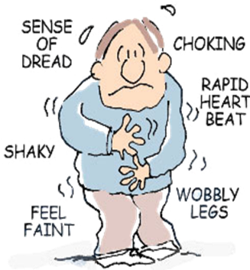
Associated Symptoms
Pounding heart
Excessive sweating
Trembling
Shortness of breath
Choking sensation
Nausea
Headache
Dizziness/lightheaded
Fear of losing control/going crazy/dying
Notes:
The features that we just reviewed (i.e., fear of being judged, being anxious or avoidant of objects, places, people, experiences, etc.) may result in multiple manifestations or symptoms such as:
Pounding heart
Excessive sweating
Trembling
Shortness of breath
Choking sensation
Nausea
Headache
Dizziness/lightheaded
Fear of losing control/going crazy/dying

Slide 13
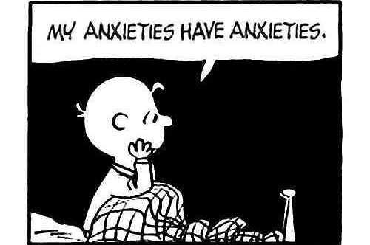
FUNCTIONAL LIMITATIONS & ACCOMMODATIONS
BACKGROUND
Notes:
In this section, we will discuss some other functional limitations related to anxiety and their corresponding accommodations that may enable the student to be able to participate in the Job Corps program.

Slide 14
Neurobiological Skills Impacted When Anxious
When anxiety goes up, 5 neurobiological skills go down!
Self-regulation
Executive functioning
Flexible thinking
Accurate thinking
Social skills (perspective taking)
Notes:
Jessica Minahan is a Behavior Analyst and she states that there 5 neurobiological skills that are impacted when an individual experiences a significant amount of anxiety. They are:
Self-regulation
May have difficulty hitting the pause button when distressed, may be impulsive, unable to think about consequences before doing, etc.
Executive functioning
Can impact the student’s ability to initiate or engage or to remain engaged or the student may struggle to persist with a task so they may disengage.
Flexible thinking
Can easily lead to a power struggle.
Accurate thinking
When anxious, we tend to think negatively and have difficulty to think positively or accurately.
Social skills (perspective taking) – understanding someone’s else thoughts and feelings; often there is a distortion. For example, a student experiencing anxiety might walk into a classroom and 2 students talking glance up and the student immediately thinks that the students talking are talking about them.
Resource:
Jessica Minahan - https://www.youtube.com/watch?v=oQqFN110gMM

Slide 15
Anxiety-related Functional Limitations
Examples:
Self-management; self-control
Difficulty with change/transitions
Impulsivity
Avoidance
Physical symptoms
Difficulty with focus/concentration
Memory issues
Difficulty completing tasks, assignments, etc.
Physical
Emotional
Behavioral
Learning-related
Notes:
If we translate those associated symptoms we discussed a few slides ago into functional limitations, they likely would look like the ones listed here.

Slide 16
Let’s Look at Some General Accommodations
Provide
…breaks for the student to use self-calming or anxiety-reducing techniques taught by the CMHC.
Allow
…the student to have a self-calming object or picture on hand.
Allow
…the student to see assigned staff mentor or go to Wellness.

Slide 17
Specific Functional Limitations – Crowds/Groups
Allow
…student to sit in classroom where they are the most comfortable.
Allow
…student to sit near an exit or back or the room during large meetings such as assemblies.
Allow student to leave the assembly to go to a designated area for a break.
Pair
…with student buddy during group activities.
Allow
…student to leave each class a few minutes early to arrive at next location before the bell rings.
Notes:
Some ways we can accommodate for anxiety in crowds/groups…

Slide 18
Specific Functional Limitations – Crowds/Groups
Allow
Give
…student to present information just to teacher, instructor, residential advisor instead of in front of the group.
…the student an agreed upon signal before calling on them to answer or demonstrate something and/or give them option to use and “opt out” signal.
Notes:
A couple more ways to accommodate for anxiety when in crowds or groups…

Slide 19
Specific Functional Limitations – Learning-related
Break
Check-in
Allow
…assignments into smaller chunks.
…frequently for understanding and to check emotional temperature.
…extra time on assignments and tests (if documentation supports disability status and the specific functional limitations).
Notes:
Here we have some ways to accommodate for learning-related functional limitations related to anxiety…

Slide 20
Two Effective Supports!
Exercise and Mindfulness!!!
Exercise as an accommodation:
Provide schedule adjustments to allow for exercising.
Open the gym during lunch or set up mid-morning or mid-afternoon breaks for walking or other forms of exercise.
Establish support groups for exercise purposes (can even be lead by student leaders and serve many purposes).
Use contests rewarding students who complete so many times a week participating in exercise activities and who reach various milestones!
Provide movement breaks (and encourage exercise during breaks).
Notes:
We briefly touched upon the use of exercise and mindfulness as effective supports earlier in the presentation. Let’s talk about these two areas a little more because they are cost effective (e.g., FREE), they are portable meaning the student can take these strategies/accommodations into work and life situations after Job Corps, and they can be effective in reducing manifestations/symptoms such that the individual may be able to access and participate successfully in the program. Just more tools in the toolbox…
Review the slide content.
Think about how these accommodations may produce a side benefit in relation to other conditions, other programs on center such as HEALS.

Slide 21
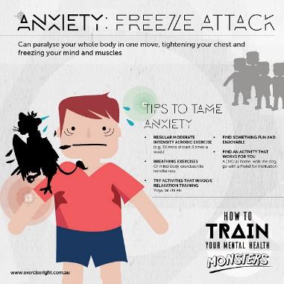
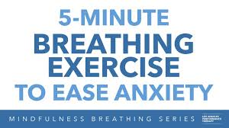
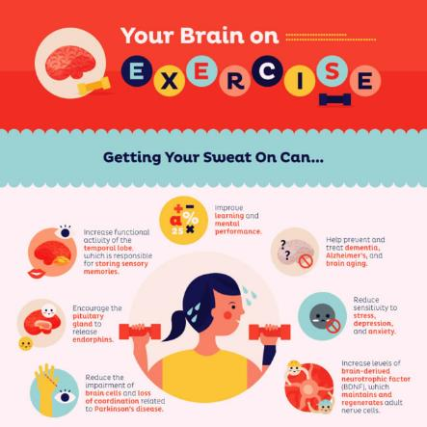
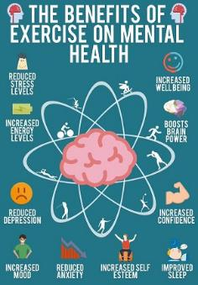
Notes:
Start exercise groups, Yoga programs, etc. There are so many apps, videos, and other free resources out there that can be used to support these groups and individuals if a group scenario is not effective for them. These can benefit ALL students!
Positive outcomes of routine use of these supports might include:
Weight loss or weight maintenance
Assisting in reorganizing/waking up brain/aiding processing
Aiding in sleep hygiene
Improving mood and overall health
Social Benefits/Feeling of community
We are not yet done with Mindfulness because it is a research-based strategy/tool that we believe is worthy of spending some extra time discussing.

Slide 22
What is Mindfulness?
Notes:
https://www.youtube.com/watch?v=NvjRSpIwgLM
00-4:16

Slide 23
Mindfulness (Mind Full, or Mindful?)
Mindfulness as an accommodation:
Provide schedule adjustments to allow for visits to CMHC to practice or learn mindfulness/other self-regulation techniques.
Start meditation and yoga groups on center that the student can spend a short time in during the day or after the training day.
Provide breaks (and encourage use of mindfulness strategies/activities).
Pair with peer buddy to encourage use and practice of mindfulness activities.
Notes:
What is meant by “Mindfulness”? Research that supports mindfulness as a strategy for self-regulation:
Mindfulness helps a person become more aware of their feelings (not having less emotions) and this in turn, improves executive functioning and impulse control.
Mindfulness can be taught in classes, by CPP teachers, individually by counselors, in groups.
Forms of mindfulness:
Awareness of body exercises
Progressive Muscle Relaxation
Mindful eating/Mindful walking/Finding body safe spots
Awareness of breath scripts
Awareness of thoughts scripts
Awareness of perceptions in the here and now

Slide 24
https://philboissiere.com/
Notes:
Practicing the 3x3 method.
I see a table.
Inhale and exhale slowly.
I see a lamp.
Inhale and exhale slowly.
I see a dog.
Inhale and exhale slowly.

Slide 25
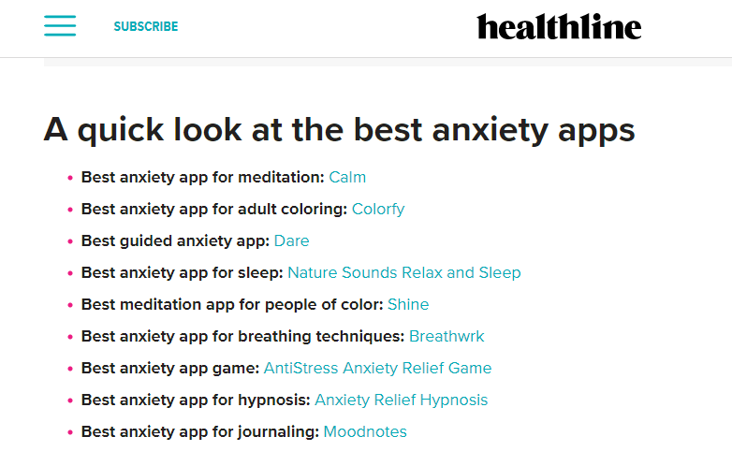
Free options are included
https://www.healthline.com/health/anxiety/top-iphone-android-apps#how-we-chose
Notes:
Teaching students to use apps, providing them with accommodations that afford them a break or the ability to use an app to assist with managing their anxiety again, can have lifelong benefits. Developing small meaningful habits that will travel with them into the workplace, into relationships and throughout life only improves their independence.

Slide 26
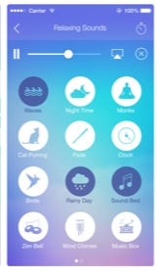
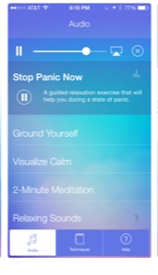
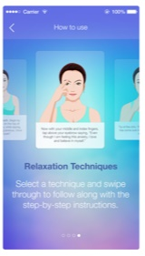
Calm Down Now App
Notes:
So many low-to-no cost apps are available for anxiety, mindfulness, self-regulating. One such app is called “Calm Down Now” or “Calm” for short. Calm is a guided meditation app to help reduce stress and enhance wellbeing. The 7-step program teaches you how to meditate, with adjustable nature scenes and relaxing music tracks. Sessions range from 2 to 30 minutes on the topics of focus, creativity, energy, confidence, sleep and more.

Slide 27
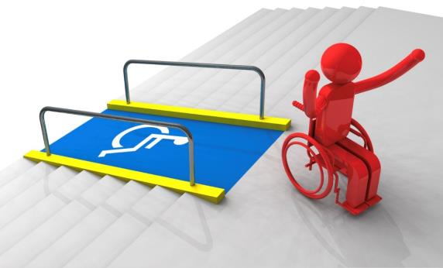
CASE STUDY: Reasonable Accommodation Process
BACKGROUND
Notes:
Let’s look at a case study involving a student with an anxiety disorder.

Slide 28
Questions to Consider (askjan.org)
What limitations is the [student] experiencing?
How do these limitations affect the [student] and the [student’s] performance on center (in academics, career technical, residential, other areas)?
What specific tasks are problematic as a result of the limitations?
Notes:
First, what types of considerations or questions can we ask when beginning the RA process? We used Job Accommodation Network or askjan.org for guidance. (Read slide)

Slide 29
Questions to Consider (askjan.org)
What accommodations are available to reduce or eliminate these problems?
Are all possible resources being used to determine possible accommodations?
Once accommodations are in place, have you met with the [student] to evaluate the effectiveness of the accommodations and to determine whether additional accommodations are needed?
Do staff and other students need training?

Slide 30
Marissa

Slide 31
Let’s learn about Marissa…
She is interested in certified nursing assistant (CNA) training.
She has a diagnosis of Generalized Anxiety Disorder (GAD), Depression, and Post Traumatic Stress Disorder (PTSD).
She has a service dog as PTSD support.
Triggers:
People getting into her personal space. (Note: Service animal steps in-between her and person too close to her.)
Loud noises (i.e., fire alarms, class bells, etc.)
She has difficulty getting to sleep initially at night.
She is easily overwhelmed.
She struggles to get started on assignments and required activities.

Slide 32
Let’s Walk Through the Interactive RA Process:
What limitations is the [student] experiencing?
People getting into her personal space.
Loud noises (i.e., fire alarms, class bells, etc.)
She has difficulty getting to sleep initially at night.
She is easily overwhelmed.
She struggles to get started on assignments and required activities.

Slide 33
Impact of Functional Limitations
How do these limitations affect the [student] and the [student’s] performance on center (in all areas)?
Getting started on tasks
Being in crowded spaces
Managing loud noises
Getting to sleep at night; being alert during training day
Feeling overwhelmed which impedes her ability to concentrate, complete tasks, rest well, remember newly learned information, etc.

Slide 34
Accommodating Specific Functional Limitations
What accommodations are available to reduce or eliminate these problems?
Getting started on tasks
Verify understanding by having her give back what she is supposed to do or demonstrate completion of a sampling of the assignment or work requirement
Break information down into smaller segments or chunks
Use graphic organizers (electronic or hard copy)

Slide 35
Accommodating Specific Functional Limitations
What accommodations are available to reduce or eliminate these problems?
Being in crowded spaces
Allow to leave class early, start lunch early or eat near end of lunch break
Allow for preferred seating so that student can choose where she is most comfortable (i.e., near exits, at front, in the back, etc.)
Provide a single bed and not a bunk bed; allow use of a privacy screen, if needed
White noise or meditation-related devices/apps with headsets for nighttime
Allow service animal in all same areas of the center as the student

Slide 36
Accommodating Specific Functional Limitations
What accommodations are available to reduce or eliminate these problems?
Managing loud noises
Use of “NOISE-cancelling” headsets with relaxing sounds, soothing music, etc.
Getting to sleep at night; being alert during training day
Headsets as noted above
Allow for cup of hot tea or warm milk at bedtime
Pairing with peer buddy to exercise early in the evening
Use meditation apps

Slide 37
Accommodating Specific Functional Limitations
What accommodations are available to reduce or eliminate these problems?
Feeling overwhelmed impedes her ability to concentrate, complete tasks, rest well, remember newly learned information, etc.
Verify understanding; re-review content/expectations prior to starting task or requirement
Provide organization support such as watches with reminders/alerts, scheduling apps, electronic notebooks
Provide schedule adjustments to build in time for exercise and/or mindfulness-related activities
Break tasks and assignments down into smaller segments
Check in on performance frequently; offer feedback frequently

Slide 38
Effectiveness of Accommodations
Once accommodations are in place, have you met with the [student] to evaluate the effectiveness of the accommodations and to determine whether additional accommodations are needed?
Use required Disability Program required effectiveness reviews (via ESPs) to monitor for accommodation implementation and effectiveness.

Slide 39
Implementation/Management of Accommodations
Do staff and other students need training?
For example, do staff need information about how a service animal functions in the Job Corps program and regarding appropriate etiquette for interacting with the student and her service animal?

Slide 40
RESOURCES
BACKGROUND

Slide 41
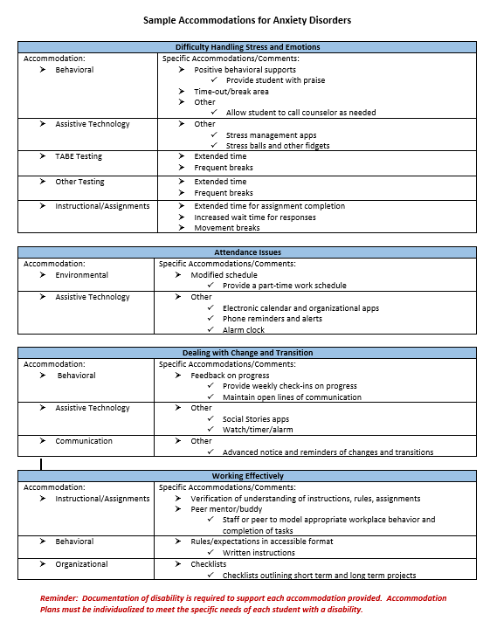
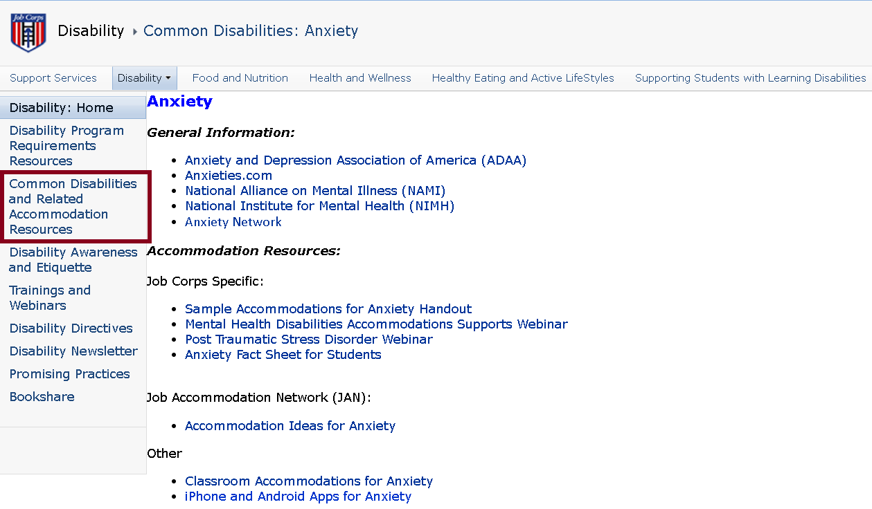
Accommodations by Disability Handouts
Job Corps Disability Website https://supportservices.jobcorps.gov/disability/Documents/Accommodation Handouts/Sample Accommodations for Anxiety Disorders.docx

Slide 42
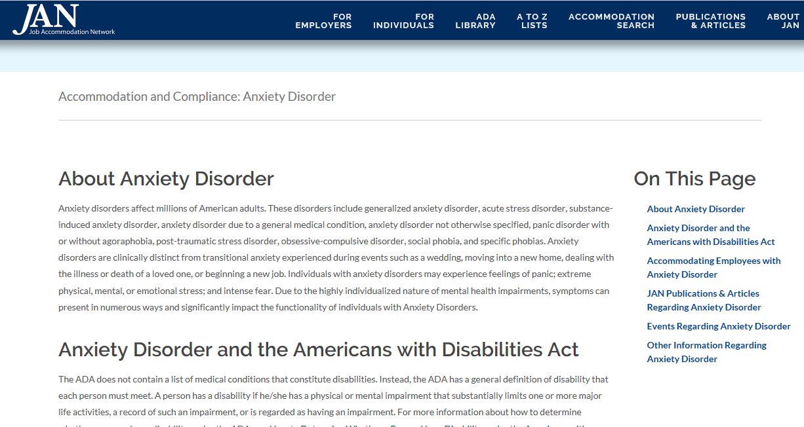
Job Accommodation Network http://askjan.org

Slide 43
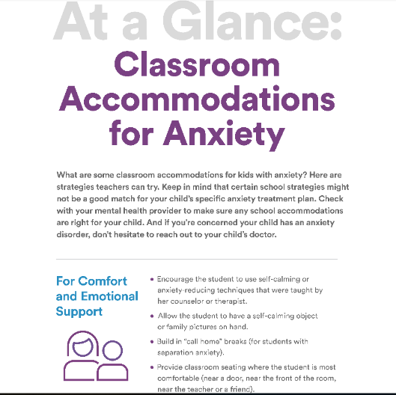
Understood.org https://www.understood.org/en/school-learning/partnering-with-childs-school/instructional-strategies/at-a-glance-classroom-accommodations-for-anxiety

Slide 44
Anxiety and Depression Association of America https://adaa.org
Information on education, training, and research for anxiety, depression and related disorders.
Features include a therapist directory, blog posts, tips to manage anxiety and stress, monthly webinars, and an online peer-to-peer support group.

Slide 45
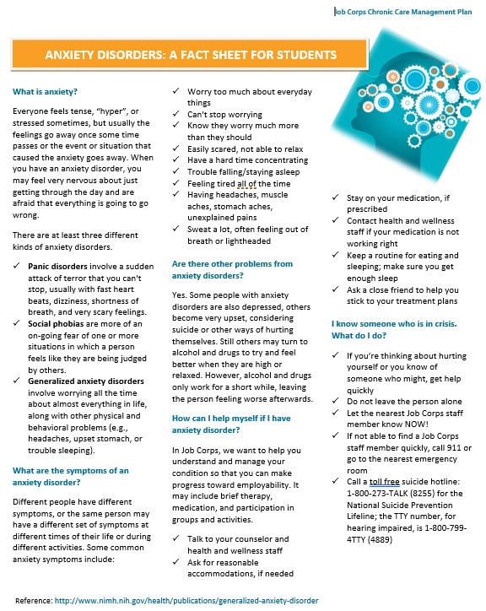
Anxiety Fact Sheet for Students
Notes:
https://supportservices.jobcorps.gov/sites/search/Pages/Results.aspx?k=Anxiety%20Fact%20Sheet%20for%20Students

Slide 46
Thank you!

