Slide 1
All About Bookshare for Job Corps Students, Part 2
December 2020

Slide 2
Learning Outcomes
Participants will be able to:
Describe how to find and assign available books
List examples of Job Corps related texts that are available and describe how to subscribe to the Job Corps Reading List
Identify various reading tools and apps that work in conjunction with Bookshare books
Describe how to give Individual Memberships to Students

Slide 3
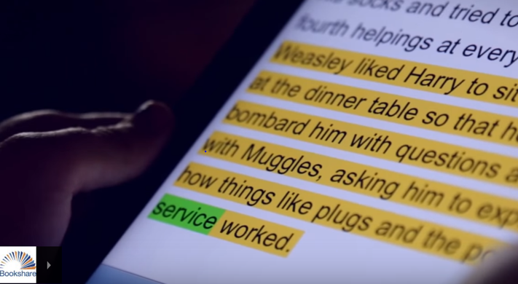
Bookshare is…
…an ebook library of over 938,000 books that makes reading easier. People with reading barriers such as dyslexia, blindness, and physical disabilities can read in ways that work for them:
Listen to books read aloud
Follow along with audio and highlighted text
Read in large type
Read in Braille

Slide 4
Find and Assign Available Books
Three ways to find books:
Standard search
Advanced search
Browse page
Two ways to Assign books:
Assign & Read Button
Reading Lists

Slide 5
DEMO: Find and Assign Books

Slide 6
Job Corps Reading List
Job Corps Reading List
TABE
GED
HiSet
Career resources (automotive, construction, welding, culinary, health care, food and hospitality, finance and more!)
Can Subscribe to the list and assign to students. List will automatically update when new titles added
Can copy the list which takes a "snapshot", which you can then customize by adding or removing books

Slide 7
Subscribe to/copy the Job Corps Reading List
Navigate to the Job Corps Reading List
Select the wavy lines to subscribe or the copy icon to copy
Add students
Review the How to Guide: Subscribe to/Copy Reading Lists

Slide 8
DEMO: Reading Lists

Slide 9
Many Reading Options!
Reading Tools Wizard
Chromebooks/Computers
Bookshare Web Reader – FREE
Enhance with TextHelp’s Read&Write for Google or Don Johnston’s Snap&Read Chrome extensions
Capti Voice – FREE/premium paid
Microsoft Word – download books in Word format
iPad and iPhone
Dolphin Easy Reader – FREE (also available for Android)
Capti Voice – FREE/premium paid
Voice Dream Reader – $14.99 (also available for Android)

Slide 10
DEMO: Reading Tools

Slide 11
Individual Memberships
Advantages of Individual Memberships:
Allows students to access books from full Bookshare collection
Free as long as they are a student
Enables them to maintain Bookshare account after separation from the Job Corps Center
It’s easy to initiate the Individual Membership for students from “My Members” Page!

Slide 12
DEMO: Add Individual Membership

Slide 13
Next Steps for Job Corps Centers
Sign up for an Account if needed
Submit Organizational Agreement if needed
Add your qualified students
Add other instructors
Assign books to students
One book at a time (using “Assign” feature)
Create Reading List
Subscribe to Reading Lists
Review Available Reading Tools
Show students how to log in and read!
Add Individual Memberships

Slide 14
Get Help and Support
Take advantage of online training and resources:
Help Center: get answers to common questions
Learning Center: videos and how-to guides
Ask the Bookshare user community
Get live help via phone (1-650-352-0198) or email, M-F, 9 a.m.- 5 p.m. PT
Connect with Bookshare on Facebook, Twitter, Pinterest, YouTube

Slide 15
Questions?
Lara Rondberg
Associate Relationship Manager
Bookshare – a Benetech Initiative
larar@benetech.org
650-352-1081

