Slide 1
All About Bookshare for Job Corps Students
November 2020

Slide 2
Learning Outcomes
Participants will be able to:
Describe what Bookshare is and who is eligible.
Explain how Bookshare can support Job Corps students in center and distance learning settings.
Name at least two technologies that students can use to read Bookshare books.

Slide 3
Problem: Printed Text Doesn’t Work Well for All Learners
Reading is fundamental to learning and work
Many students need reading materials in formats other than standard print.
At least 5% of students experience a barrier to reading printed books
Some ebooks have the same limitations that hard-copy printed materials do
Just making it digital doesn’t fix the problem!
They need access to the same materials, at the same time, as their peers

Slide 4
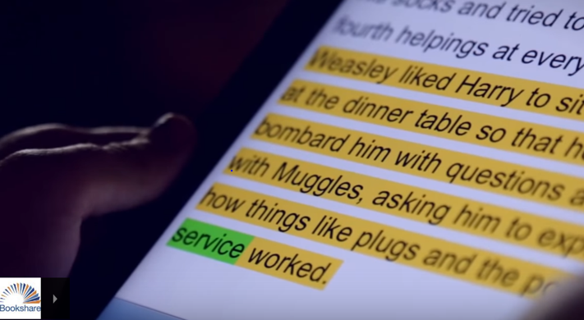
Bookshare is…
…an ebook library that makes reading easier. People with reading barriers such as dyslexia, blindness, and physical disabilities can read in ways that work for them:
Listen to books read aloud
Follow along with audio and highlighted text
Read in large type
Read in Braille

Slide 5
Bookshare Offers…
932,000+ titles! (~5K titles added each month)
Textbooks
Educational study guides
Career advancement materials
Books for leisure reading
Newspapers and periodicals
FREE memberships for all qualified U.S. students of any age (funded by U.S. Dept of Education)
Many FREE, low-cost, and commonly available reading options

Slide 6
Many Reading Options!
Chromebooks/Computers
Bookshare Web Reader – FREE
Enhance with TextHelp’s Read&Write for Google or Don Johnston’s Snap&Read Chrome extensions
Capti Voice – FREE/premium paid
Microsoft Word – download books in Word format
iPad and iPhone
Dolphin Easy Reader – FREE (also available for Android)
Capti Voice – FREE/premium paid
Voice Dream Reader – $14.99 (also available for Android)

Slide 7
Who Qualifies?
Under recently revised copyright law, an “eligible person” is one who:
“is blind,” OR
“has a visual impairment or perceptual or reading disability” rendering them unable to read printed works “to substantially the same degree as a person without an impairment or disability,” OR
“is otherwise unable, through physical disability, to hold or manipulate a book or to focus or move the eyes to the extent that would be normally acceptable for reading,”
“As determined by a competent authority possessing experience in making such determinations.”

Slide 8
Account Types
Organizational
Teachers (“Sponsors”) add students (“members”) and assign books
Students log in, find books, read (can only open books shared with them by their teachers)
Individual
Student + parent (if student is under 18) sign up, submit signed Proof of Disability (POD) form
If student already on Organizational acct, no POD needed
Student logs in, searches for books, reads

Slide 9
Bookshare for Job Corps Centers
Organizational accounts are set up for most centers
Disability Coordinators or other designees serve as the primary contact and “competent authority” for account and certifies student eligibility.
Can add other instructors as needed
Dedicated Job Corps Reading List of commonly used textbooks, study guides and career resources
Also a HiSet List and GED List

Slide 10
Getting Started is Easy
Log in
Add a qualified student
Assign book(s) to your student
Assign a single book
Subscribe to and share a public Reading List
Create/share custom Reading List
Students will:
Log in
Look at assigned books
Select book
Read!

Slide 11
Next Steps for Job Corps Centers
Sign up for an Account if needed
Submit Organizational Agreement if needed
Add your qualified students
Add other instructors
Assign books to students
One book at a time (using “Assign” feature)
Create Reading List
Subscribe to Reading Lists
Show students how to log in and read!

Slide 12
Get Help and Support
Take advantage of online training and resources:
Help Center: get answers to common questions
Learning Center: videos and how-to guides
Ask the Bookshare user community
Get live help via phone (1-650-352-0198) or email, M-F, 9 a.m.- 5 p.m. PT
Connect with Bookshare on Facebook, Twitter, Pinterest, YouTube

Slide 13
Questions?
Lara Rondberg
Associate Relationship Manager
Bookshare – a Benetech Initiative
larar@benetech.org
650-352-1081

