Slide 1
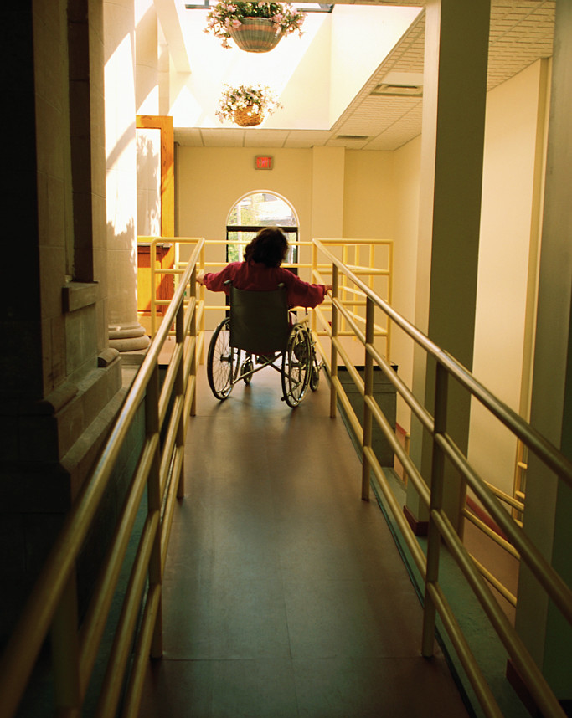


Melissa Cusey
Debbie Jones
Humanitas
September 2011
Case Management & Reasonable Accommodation
What is the Difference?

Slide 2
PURPOSE
To clarify the difference between health case management and reasonable accommodation for applicants/students with disabilities.

Slide 3
Reasonable Accommodation
Defining accommodation and reviewing examples

Slide 4
Reasonable Accommodation
It is a PRH and legal requirement that all applicants and students with disabilities be provided the opportunity to request and receive reasonable accommodations
4

Slide 5
Defined
Accommodations are any
  changes to the environment or
  in the way things are customarily done that give a person with a disability an opportunity to participate in the application process, job, program, or activity in a way that is equal to the opportunity given to similarly situated people without disabilities.
5

Slide 6

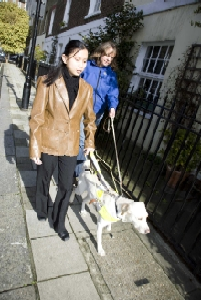

Defined
Reasonable accommodation may involve
  providing an appropriate service or product;
  modifying or adjusting a job, work/academic environment, policy, program, or procedure; or any other action that removes those barriers for the person with a disability.
6

Slide 7

Let’s Practice
First, let’s identify the type of accommodation. Is it
  A change to a policy or procedure
  Providing an appropriate service
  Modifying or adjusting a job, work, or academic environment?
7

Slide 8

Example #1:
A change to a policy or procedure
Providing an appropriate service
Modifying or adjusting a job, work, or academic environment?
A student who is diabetic may need to have a schedule adjustment that allows him or her to come to wellness each day 30 minutes before lunch.
8

Slide 9
Change to a policy/procedure

Slide 10

Example #2
A change to a policy or procedure
Providing an appropriate service
Modifying or adjusting a job, work, or academic environment?
A student with a vision or motor impairment may use voice dictation software to type instead of a keyboard.
10

Slide 11
Modifying or adjusting a job, work/academic environment

Slide 12
Example #3:
A change to a policy or procedure
Providing an appropriate service
Modifying or adjusting a job, work, or academic environment?
A student with an anxiety disorder may have a pass to leave class 5 minutes before it ends, may be able to have a certain seat in the classroom, and may be able to shower before or after other students in the dormitory.
12

Slide 13
Change to a policy/procedure

Slide 14

Example #4:
A change to a policy or procedure
Providing an appropriate service
Modifying or adjusting a job, work, or academic environment?
A student with a learning disability may be provided double time during testing.
14

Slide 15
Change to a policy/procedure

Slide 16
Example #5:
A change to a policy or procedure
Providing an appropriate service
Modifying or adjusting a job, work, or academic environment?
A student who is deaf may be provided a sign language interpreter.
16

Slide 17
Providing an
appropriate service

Slide 18
Example #6:
A change to a policy or procedure
Providing an appropriate service
Modifying or adjusting a job, work, or academic environment?
A student with Attention Deficit/ Hyperactivity Disorder (ADHD) may have testing accommodations that allow him or her to test in a private setting.
18

Slide 19
Change to a policy/procedure
OR
Modifying or adjusting a job, work, or academic environment

Slide 20
Example #7:
A change to a policy or procedure
Providing an appropriate service
Modifying or adjusting a job, work, or academic environment?
A student with a physical condition limiting mobility may be provided an elevator pass.
20

Slide 21
Change to a policy/procedure

Slide 22
Example #8:
A change to a policy or procedure
Providing an appropriate service
Modifying or adjusting a job, work, or academic environment?
A student with a seizure disorder may be provided a bottom bunk.
22

Slide 23
Change to a policy/procedure
OR
Modifying or adjusting a job, work, or academic environment

Slide 24

Example #9:
A change to a policy or procedure
Providing an appropriate service
Modifying or adjusting a job, work, or academic environment?
A student on the autism spectrum may be exempted from attending large assemblies (due to sensory difficulties) and instead allowed to watch the assembly later via videotape.
24

Slide 25
Change to a policy/procedure

Slide 26
Example #10:
A change to a policy or procedure
Providing an appropriate service
Modifying or adjusting a job, work, or academic environment?
A student who is blind may be provided a mobility coach to assist in learning to navigate the center.
26

Slide 27
Providing an
appropriate service

Slide 28
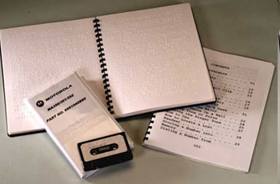
Example #11:
A change to a policy or procedure
Providing an appropriate service
Modifying or adjusting a job, work, or academic environment?
A student with a print disability (i.e., a form of a learning disability such as dyslexia) may need center informational and instructional materials in an alternate format such as audio tape.
28

Slide 29
Modifying or adjusting a job, work/academic environment

Slide 30
Health Case Management
Defining health case management and reviewing examples

Slide 31
Health Case Management
Definition of case management:
“a collaborative process of assessment, planning, facilitation and advocacy for options and services to meet an individual’s health needs through communication and available resources to promote quality cost-effective outcomes.”
Case Management Society of America
31

Slide 32
CASE MANAGEMENT
The PRH requires case management of health needs in Chapter 6, Section 6.10, R1.b.4
Several CCMPs (Chronic Care Management Plans) and MHCCMPs (Mental Health Chronic Care Management Plans) have been developed and are available in Information Notices 06-17 and 08-02.
32

Slide 33
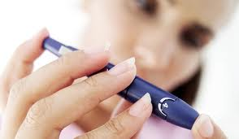

CASE MANAGEMENT EXAMPLES
A student who is diabetic is monitored for medication compliance, glucose levels, and knowledge of condition in the wellness center
A student with a depressive disorder is monitored for changes in behavior. If a concern, an appointment with the CMHC may occur.
33

Slide 34
RELATIONSHIP BETWEEN
Reasonable Accommodation Plan
Case Management
Plan
Student must have a disability
May not be a substitute for a case management plan
Should be individualized and should not contain confidential information
Used to inform staff of the specific accommodations the student must be provided
May or may not include reasonable accommodations
Focus on teaching self management of diagnosis
Individualized and focused on solving or minimizing the existing problem
Focused on the future

Slide 35
Example: Asthma
Health Case Management
Reasonable Accommodation
Offer medical identification bracelet
Provide self-management education
Discuss trade selection
Discuss life style changes, smoking cessation
Educate student and staff about condition
There would most likely be no accommodation. If condition worsened, accommodation plan may be created

Slide 36
Example: Diabetes
Health Case Management
Reasonable Accommodation
Monitor glucose testing
Annual vision exam
Dental exam
Offer medical identification bracelet
Regular follow up
Leave class 15 minutes before lunch to go to wellness
Refrigerator in dorm room for medications
Healthy snack at bedtime

Slide 37
Example: Schizophrenia
Health Case Management
Reasonable Accommodation
Offer medical identification bracelet
Provide self-management education
Discuss trade selection
Discuss life style changes, smoking cessation
Educate student and staff about condition
Allow flexible training schedule–breaks when needed
Provide a quiet place to complete assignments/tests
Locate a quite place in the dorm when student is stressed
Single room or fewer roommates when available

Slide 38
Logistics
Documentation Storage

Slide 39
Documentation Requirements
Students with disabilities who are being case managed and have no accommodations will not have a separate accommodation file.
Students with disabilities who are being case managed and have an accommodation plan will have a separate accommodation folder.
All case management notes will be found in the student medical record.

Slide 40
Documentation Requirements
Accommodation plans are only created for students who actually receive accommodations.
For students being case managed, information should be shared with staff that have a need to know.

Slide 41
Review
Identifying Case Management versus Reasonable Accommodation

Slide 42
Reasonable Accommodation or Case Management?
Medication Management
Schedule Adjustments
Medication Compliance
Therapy or Counseling Sessions
Distraction free space
Large Print
Mental Health Stability

Slide 43
Resources
Websites, Regional Disability Coordinators and Regional Nurse Specialists

Slide 44
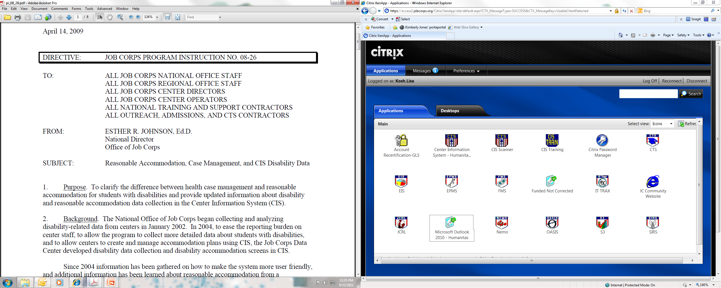
Program Instruction 08-26

Slide 45
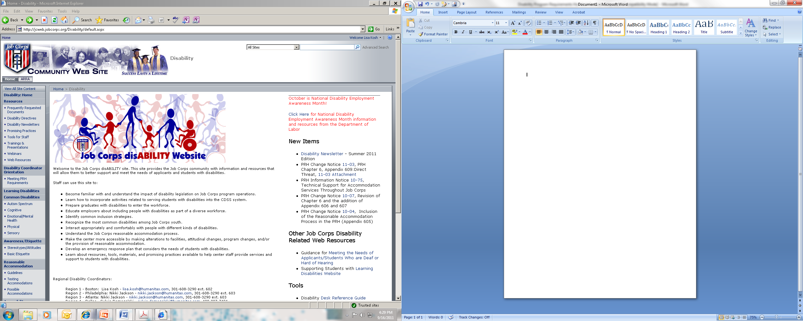
JC Disability Website

Slide 46
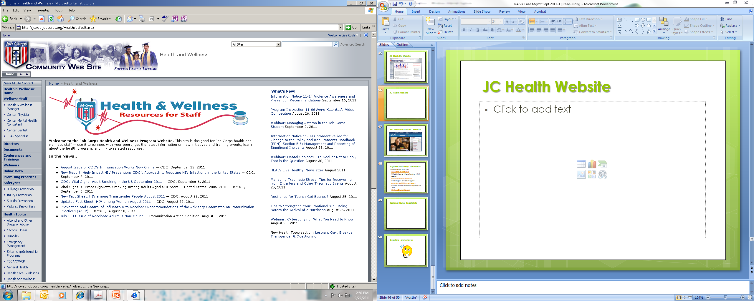
JC Health Website

Slide 47
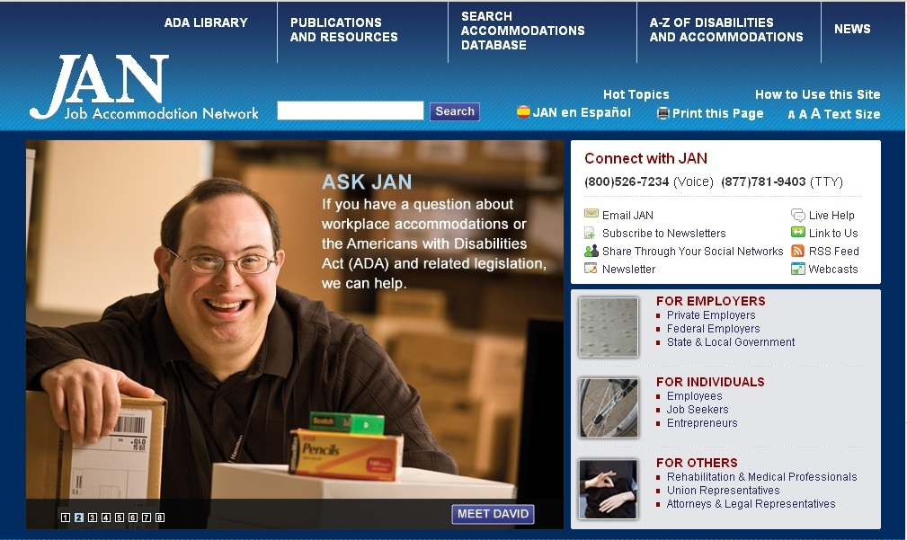
Job Accommodation Network

Slide 48
Regional Disability Coordinators
Boston Region – Lisa Kosh
lisa.kosh@humanitas.com
Atlanta and Philadelphia Regions– Nikki Jackson
nikki.jackson@humantias.com
Dallas Region– Sylvia Domagalski
sylvia.domagalski@humanitas.com
  Chicago and San Francisco Regions – Kim Jones
  kim.jones@humanitas.com

Slide 49
Regional Nurse Specialists
Atlanta, Chicago, and San Francisco Regions - Melissa Cusey, RN
macuse1029@sbcglobal.net or
cusey.melissa@jobcorps.org
Boston, Dallas, and Philadelphia Regions – Shannon Bentley, RN
shannonbentley_rn@yahoo.com

Slide 50
Questions and Answers

