Slide 2
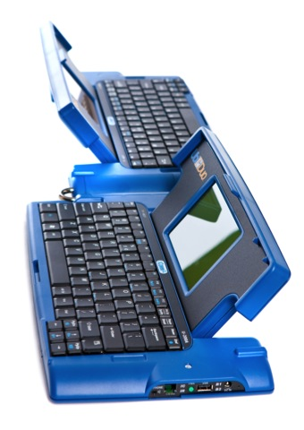
Agenda

Slide 3
Who Are We?
is engineer and manufacturer of the UbiDuo. The mission is to shatter face-to-face communication barriers and empower deaf, hard of hearing, hearing people, and others with communication barriers the freedom to interact face-to-face with anyone, anywhere and at any time.

Slide 4
What is Face-to-Face Communication?
Face-to-face communication occurs when two people simply strike up a conversation across each other at a desk, over coffee, in a lobby, in an office without a conscious effort.
Face-to-face conversation can be as quick as a chat in the hallway, at the employee’s desk, in the conference room, in the break room or a 60 minute meeting discussing the work.

Slide 5
Power of Face-to-Face Communication
Personal conversation within face-to-face interaction is the foundation of communication. It is the way two people are able to establish a relationship.
Having a personal connection builds trust and maximize interpretation and understanding.
Having the power of face-to-face communication is the ability to have a personal conversation and to establish a relationship without communication barriers.

Slide 7
The Problem
Deaf/Hard of Hearing, and Hearing individuals are struggling to communicate with each other face-to-face in the work environment on the spot without communication barriers.

Slide 8
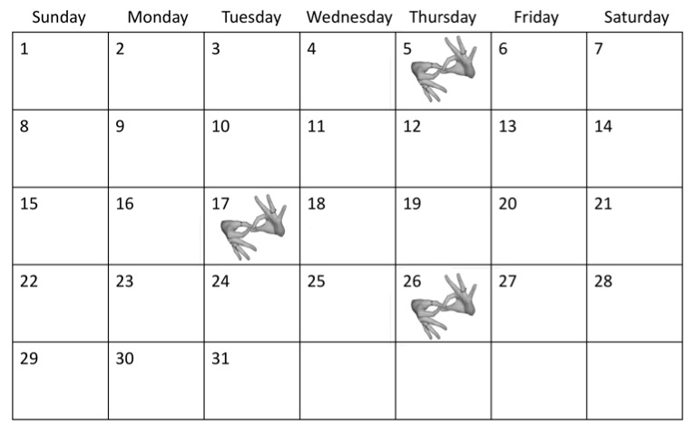
Current Calendar

Slide 9
Why Settle for No Face-to-Face Communication
When communication equality is not available right on the spot, deaf, hard of hearing, and hearing individuals are frustrated and powerless.
Individuals wish for on the spot face-to-face communication to get the work done in a timely and efficient way with communication equality.
What is the solution for face-to-face communication between deaf, hard of hearing, and hearing in the work environment?

Slide 10
The is the solution.
The is a communication device that empowers deaf, hard of hearing, and hearing to communicate instantly with each other face to face and empower Communication Equality.

Slide 11
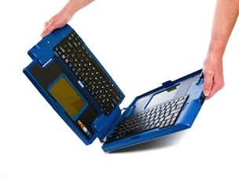
Key Features
Patented Real Time/Simultaneous Split Screen
12 to 24 font point
Reverse video capability
Rugged for optimal longevity
Fully Portable
500 feet secured and encrypted wireless frequency
Does not required internet, cellular towers, or wireless hubs.
Two to four people
6 to 8 Hour Battery Life
Patented Hinge Technology

Slide 12
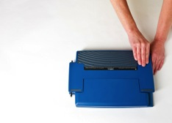
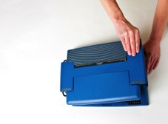
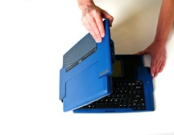
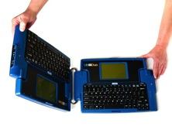
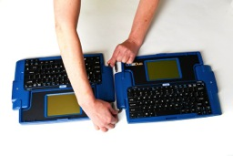
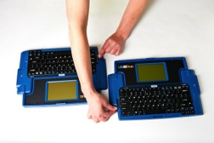
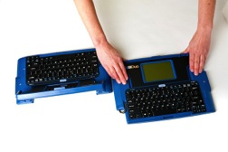
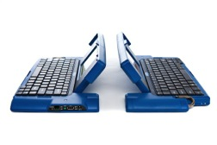
Patented Hinge Mechanism

Slide 13
Split Screen
Main Benefit:
This split screen allows for simultaneous streaming text to flow on both the top and bottom of the screen on both sides of the UbiDuo. Both users can type and read each other’s text at the same time without any delay time. It allows both users to interact with each other in leave real-time, express thoughts and emotions freely.
Hello, my name is Susan. How are you
doing?
I am great! Thank you for asking me.

Slide 14
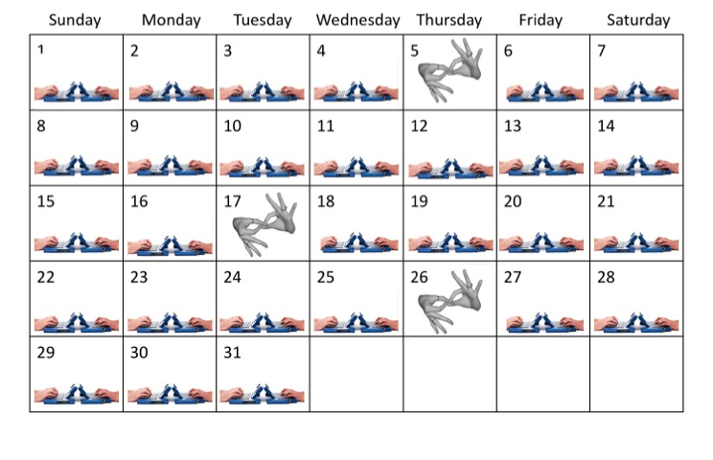
Calendar

Slide 15
User Experience

Slide 16
Other Communication Tools
7 different communication tools that provide other types of communication:
Paper/Pen
IM/Instant Messaging
Lip reading
Learning Sign Language
VRS/Video Relay Service
VRI/Video Remote Interpreting
Interpreter

Slide 17
Paper/Pen
You and the other person can’t talk at the same time. What do you think the other person is doing while you’re writing? He or she might be studying your hairstyle or your clothing, or maybe he’s just zoning out while waiting for you to finish so he can read what you have to say and then write his response. While he’s writing, you might be studying his sunglasses, wishing you had his tan, or planning what you’re going to have for dinner that evening.
This is not 100% face-to-face communication.

Slide 18
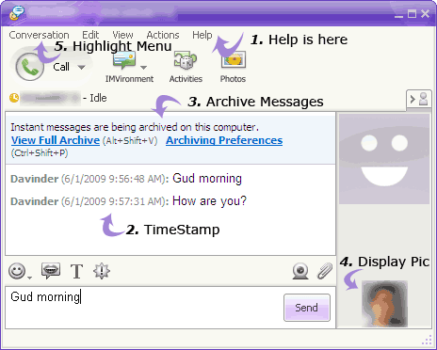
IM/Instant Messenger
IM is designed for office to office communications through the internet. You have to talk back and forth and you are not getting the face to face interaction.
This is not 100% face-to-face communication.

Slide 19
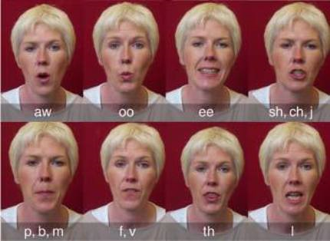
Lip Reading
You cannot understand 100% of what the other person is saying. You can only catch an average of 50% of what the person says.
This is not 100% face-to-face communication.

Slide 20
Sign Language
You cannot learn sign language overnight. It will be a long time before you will be fluent in sign language and participate in a 100% face-to-face conversation.
This is not 100% face-to-face communication.

Slide 21
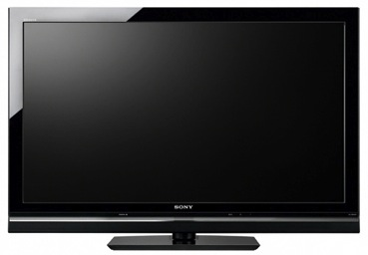
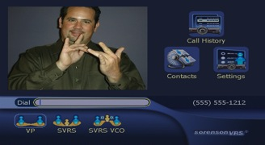
VRS/Video Relay Service
VRS/Video Relay Service is a video phone service that allows deaf, hard of hearing and speech impaired individuals to communicate with hearing people via a relay sign language interpreter. This service is only for relay phone calls, not for face-to-face communication. You cannot use the VRS interpreter as an interpreter with a person in the same room which is illegal stated by the Federal Communication Commission (FCC). The FCC pays for this service.
This is not 100% face-to-face communication.

Slide 22
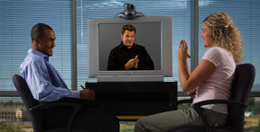
VRI/Video Remote Interpreting
VRI/Video Remote Interpreting uses video devices or web cameras to provide sign language or spoken language interpreting services, through a remote or offsite interpreter. You have to pay for this interpreting services.
This is not 100% face-to-face communication.

Slide 23
Interpreter
The interpreter cannot be available 24/7 for the deaf, hard of hearing, or hearing person. No employer can afford to sit or stand an interpreter in the workplace 24/7/365. You have to pay for this interpreting service.
This is not 100% face-to-face communication.

Slide 24
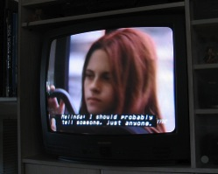
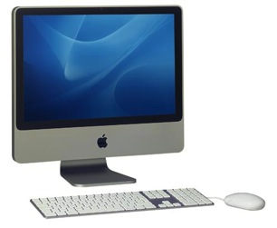
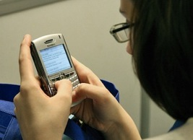
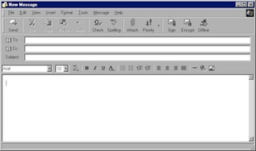
English Problems
READING
CLOSED CAPTIONING
WRITING
NETWORKING
FINGERSPELLING
TEXTING
EMAILING

Slide 25
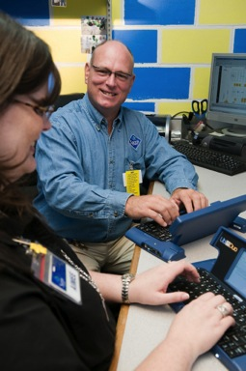
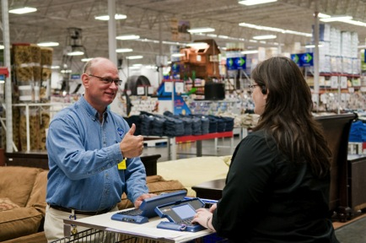
Face-to-Face Communication
Sam’s Club deaf employee communicating with hearing club member.

Slide 26
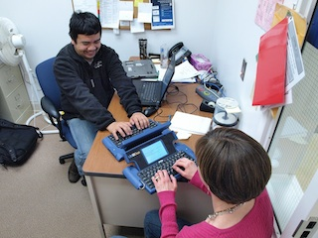
Face-to-Face Communication
School deaf employee communicating with hearing co-worker.

Slide 27
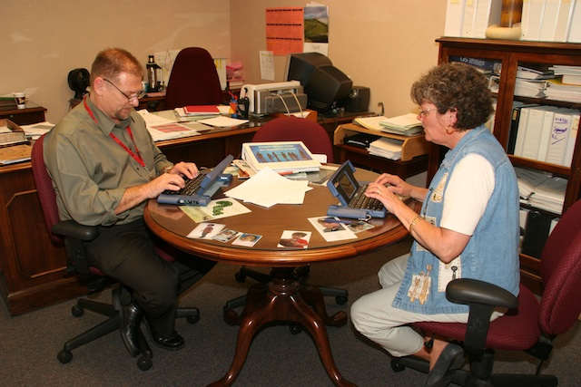
Face-to-Face Communication
Deaf government employee communicating with her manager at the USDA.

Slide 28
NAME UbiDuo User
PICTURE OF
UBIDUO USER

Slide 29
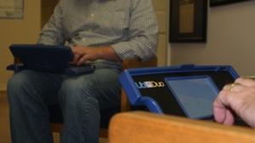
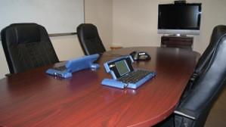
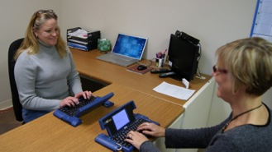
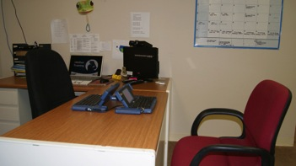
Different Settings
Coffee break
Office
Desk
Conference room
Appointment
Meeting
Person’s lap
Customer Service
On a person’s lap
In the conference room
On the desk
In the office
Unlimited one on one interactions between deaf/hard of hearing, and hearing individuals on spot without an interpreter.

Slide 30
Communication Equality
Deaf/hard of hearing, and hearing individuals want to have Communication Equality: the ability to strike up a face-to-face conversation with equality.
Deaf/hard of hearing, and hearing individuals value communication equality when they come face-to-face with each other.
The UbiDuo will empower deaf/hard of hearing, and hearing individuals to interact with each other with Communication Equality.

Slide 31
References
is the direct Sole Source provider and seller of the UbiDuo Communication device.
The UbiDuo is endorsed by National Institutes of Health (NIH) Deafness and other communication disorders.
The UbiDuo is approved by the
GSA Schedule - #GS-35F-0033V

Slide 32
Clients

Slide 33
UbiDuo Deployment – 1274 Offices
SSA Nationwide Deployment

Slide 34
ADAAA and Section 504 Compliant
The UbiDuo meets ADAAA and Section 504 compliance requirements by providing face-to-face Communication Equality for deaf, hard of hearing, and hearing employees and customers.
The UbiDuo can be utilized in several areas to aid in face-to-face communication between deaf/hard of hearing and hearing employees and customers including individuals who are speech impaired, late deafened, laryngeal injury, or other who have communication problems.
The UbiDuo empowers employees and customers to communicate with each other face-to-face on the spot instantly anytime and anywhere even in remote or disaster places that don’t have Ethernet or WIFI.
The UbiDuo is the solution.

Slide 35
The Preferred Choice
The is the preferred choice for the deaf/hard of hearing and hearing individuals:
Engineered from ground up only for face-to-face communication
High-tech simplicity and purity
Ease and convenience
Worry-free
Anywhere and anytime in the work, academic, and social environment.

Slide 36
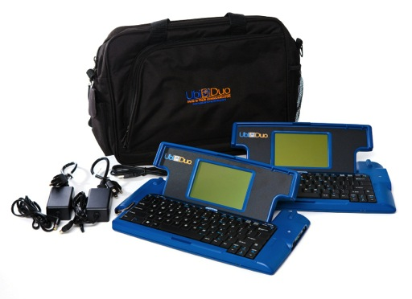
Combo Package
$2095
(pair)
Carrying Case
USB Interface Cable
2 Power Supplies
User Manual
One Year Warranty
FREE Shipping
Unlimited Customer Service/Technical Support

Slide 37
DEMO

Slide 38
Solutions for Job Corps
Customer Service to the General Public (Outreach and Admissions)
One on One Training (Career Preparation and Development Period)
Job Interviews (Career Development Period)
Internships (Career Development Period)
Job (Career Transition Period)
Deaf Employee to Hearing Employee within Job Corps
One Stop Centers – 125 Locations

Slide 39
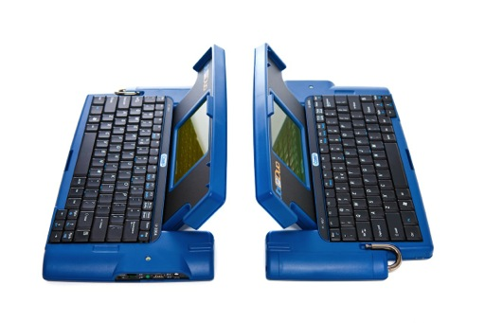
Questions & Answers

Slide 40
Contact
sComm
manny@scomm.com
512-298-0908
www.sComm.com

