Slide 1
Deconstructing the Mysteries and Fallacies of ADHD:
Promoting independence and employability through the use of accommodation and positive behavior supports

Slide 2
Presenters
DR. HILDY DINKINS, Psy.D.
CMHC
Gary Job Corps Center
DR. DREW ALEXANDER, M.D.
REGIONAL MEDICAL SPECIALIST - DALLAS
Humanitas, Inc
DIANE FAIRCHILD
EDUCATIONAL CONSULTANT
Humanitas, Inc

Slide 3
Objectives
Articulate the recent changes in ADHD terminology and criteria with the new DSM 5.
Identify 3-5 behaviors and/or symptoms of ADHD along with specific evidenced based interventions.
Describe basic types of pharmacological interventions for ADHD.
Identify at least 1 accommodation to support each functional limitation (i.e., specific behaviors/symptoms) listed.
ID how 1 specific functional limitation, such as “feeling overwhelmed & shutting down“ could be supported in a variety of settings throughout the center (i.e. residential, academic, CT, recreation, etc.).

Slide 4
DSM V UPDATES/TERMINOLOGY REVIEW
DIAGNOSTIC CHANGES & TERMS

Slide 5
The New DSM Nomenclature
Attention-Deficit/Hyperactivity Disorder
ADHD Subtypes:
Predominantly Inattentive Presentation
Predominantly Hyperactive/Impulsive Presentation
Combined Presentation
Individuals are diagnosed ONLY with 1 of the 3 subtypes!
Notes:
Many times terminology changes; for example, Bipolar Disorder used to be Manic-Depressive Disorder.
ADHD is the diagnosis for everyone, even if the person does not have hyperactivity.
Remember, it is the specifiers that differentiate the type (e.g. inattentive or hyperactive/impulsive).

Slide 6
WHEN TERMINOLOGY CHANGED?
Terminology actually changed 2 editions ago (e.g., more than 10 years ago!)
PREVIOUS TERMINOLOGY
Previous term was ADD for “Attention Deficit Disorder”
Notes:
If you are reading records from some years ago, or the applicant or student saw a clinician who was trained when the ‘old’ name was used, then the individual’s records may say ADD.
Applicants/students and families often use the term ADD.

Slide 7
DSM-V Changes
ADHD is no longer paired with Disruptive Behavior Disorders and is now included with Neurodevelopmental Disorders.
This better conceptualizes how we now see the disorder.
We now have examples of how the condition appears in older adolescents and adults.

Slide 8
DSM-V Changes
Onset of symptoms now before 12 years of age, instead of before 7, and
Looking for interference in 2 settings now, as opposed to ‘impairment,’ (i.e., home, school, community)
Use of severity specifiers

Slide 9
Documentation Issues
Outdated/missing psychological testing results
Some students may possess outdated psychological testing results or may be in need of supporting documentation.
In these instances, the center could explore local resources to see if it can assist the student in obtaining an updated assessment.
See Job Corps Educational and Assessment Guidelines for recommendations on how to proceed. This may be found in the the CMHC Desk Reference Guide.
Notes:
For less formal assessment or as a starter, CMHC’s might use the World Health Organization ‘Adult ADHD Self-Report Scale.’

Slide 10
GENETICS/DEMOGRAPHICS

Slide 11
The Inheritance of ADHD
What are the odds?
25-35% if sibling has ADHD
20-54% if parent has ADHD
78-82% if identical twin has ADHD
Ongoing research attempts to isolate alleles

Slide 12
Demographics
Initially restricted to males
BOTH GENDERS
Initially restricted to youth
2006 Dx ADULTS
Initially restricted to over activity
NOT NOW
Inclusive of all races and ethnicities

Slide 13
Causes of ADHD
Inheritance
Fetal exposure to smoking, alcohol, drugs
Premature delivery
Low birth weight
Traumatic Brain Injury
Environmental exposures (e.g., lead)
Attention-Deficit/Hyperactivity Disorder (ADHD): www.cdc.gov; Retrieved 4/7/15.

Slide 14
Heterogeneity - Concept of a Continuum
Like many disorders, ADHD exists on a continuum.
Two students who both have the disorder may behave and demonstrate very different symptomology or severity.
Don’t expect everyone who has ADHD to look the same.
Notes:
Drew

Slide 15
Co-occurrence
Many times, more than one disorder or condition exists at once, which can make things more complicated.
Individuals may have ADHD and sensory processing disorders, autism spectrum disorder, depression, oppositional-defiant disorder, etc.
Behavior intervention should target the specific problematic behaviors, not focus on just ADHD symptoms.
Notes:
Drew

Slide 16
Special note regarding sensory processing
Specific sensory symptoms are correlated with particular behavioral problems such as aggression and delinquency in ADHD.
The higher level of sensory problems in ADHD predicts the higher levels of aggression and delinquency.
In addition, sensory functioning has a strong correlation with academic achievement and cognitive processing in ADHD.
Notes:
Drew
The impairment of receiving and processing of sensory information in children with ADHD may cause inappropriate responses at different settings such as school, home and in the community.
Earlier detection and management of sensory processing problems can play an important role for the performance improvement in children with ADHD.

Slide 17
DIAGNOSIS AND SYMPTOMS
CHRONIC CARE & BEHAVIOR MANAGEMENT

Slide 18
Is ADHD “Real”?
Yes!
It is a chemical /physiolgic disorder!

Slide 19
Identification and Diagnosis of ADHD
Interference/manifestations in more than 1 setting (e.g., at least 2 settings), plus symptoms
Core symptoms include
Inattention – not paying attention to what is going on
Easily distractible – attention or focus is easily diverted away from task
Lack of focus – easily distracted, finding it hard to listen to others in a conversation, overlooking details, and not completing tasks or projects
Notes:
Drew

Slide 20
Identification and Diagnosis of ADHD
Ancillary symptoms include
Hyperactivity – constant motion (touching, moving, climbing, fidgeting, shaking leg)
Impulsivity – acting without thinking of consequences – interrupting, not waiting turn to speak, being impulsive with their body like in risk-taking behavior – cliff diving or similar activities
Disruptive behavior – interrupting others, lowered tolerance levels so may show irritation sooner with challenging tasks, may show impatience in waiting for appropriate times to engage others or take turn, etc.
*See current DSM for exhaustive list or ask your CMHC if you are a non-medical staff member
Notes:
Drew

Slide 21
What to do?
The American Academy of Pediatrics indicates that psychosocial treatments should accompany medical (medication) treatments for ADHD
Medication alone may not be sufficient and in some cases, neither treatment is sufficient alone
Use of both often affords the best outcome
Notes:
Drew

Slide 22
Treatment Options
Three drug treatment options are available
Dopamine enhanced neuro-transmission
Norepinephrine enhanced neuro-transmission
Serotonin enhanced neuro-transmission
Mono or combined therapy may be effective
Treatment must include behavior intervention

Slide 23
DOPAMINE
Once a day dosing preferred
TYPES
Methylphenidate
Amphetamine salts
Short acting doses are most abused

Slide 24
NOREPINEPHRINE
Once a day dosing preferred
TYPES
Strattera
Intuniv (Guanfacine ER)
Kapvay (Clonidine ER)
Rare abuse

Slide 25
SEROTONIN
SSRI is the class of medication (many choices)
FDA approves SSRI’s for depression
SSRI’s help focus and attention
1986 - Prozac is marketed as the first SSRI
INFO

Slide 26
What kinds of “ADHD type” behaviors do we see in Job Corps?
Notes:
Please type your answers in the chat box to the left.

Slide 27
Evidence-based Interventions - Psychosocial Treatments
Instructor and RA Skills Training (replaces parent training)
Social Skills Training
Relaxation Training
Psychotherapy
Cognitive Rehabilitation Exercises

Slide 28
ABC Model
A
B
C
Antecedent
Behavior
Consequence

Slide 29
ABC Model
Job Corps Example
A or Antecedent – the bell rings for an academic or TABE class to begin
B or Behavior – the student ignores the bell while the rest of the class is getting out books and papers and are ready to begin
C or Consequence – the teacher or instructor reprimands, tells the student he or she is off task, or something similar occurs
The goal is to interrupt the cycle, for instance, by having the teacher provide a prompt or cue to the student in-between the A and B

Slide 30
Instructor and RA Skills Training (Replaces Parent Training)
Skills to manage student’s behavior in classrooms and dorms
Token or point systems
Time out
Not a punishment but a removal from problematic area
Rewarding appropriate behavior
Catching students using appropriate behaviors and complimenting them
Instructors and RAs model the desired behavior (including how to come down from escalated behaviors)

Slide 31
Social Skills Training
Provide instruction, modeling, role-playing, and feedback re social relationships and desired social skills (e.g., waiting turn, sharing, asking for help)
Explain how impulsivity negatively affects social relationships
Failure to stop and think first often has devastating social consequences
When coaching, do not single out student; address 1:1 or provide as a group lesson or experience
Notes:
Individuals with ADHD often experience social difficulties, social rejection, and interpersonal relationship problems as a result of their inattention, impulsivity, and hyperactivity. Such negative interpersonal outcomes cause emotional pain and suffering. They also appear to contribute to the development of co-morbid mood and anxiety disorders. More recently, ADHD has been re-conceptualized as an impairment of the executive or controlling functions of the brain. It follows from this conceptualization that the social deficits of the individual with ADHD may not be primarily the result of a lack of social skills, but rather a lack of efficiency in reliably using social skills that have already been acquired. Modeling, Roleplaying, and Feedback ---CSS standards and SST curriculums on center
Explain how impulsivity negatively affects social relationships because others may attribute impulsive words or actions to lack of caring or regard for others

Slide 32
Accommodations
SUPPORTS RELATED TO FUNCTIONAL LIMITATIONS & SELF-MONITORING STRATEGIES FOCUSED ON PROMOTING INDEPENDENCE & DEVELOPING EMPLOYABILITY SKILLS
Notes:
So in the interest of time, we took a look at three specific functional limitations, and explored accommodations that could be applied in more than one setting. We also kept in mind that lasting behavior change is often coupled with self-monitoring.

Slide 33
Quick Review!
What is the definition of an accommodation?
What does functional limitation mean?
How do we identify accommodations?
An applicant/student requests accommodations.
There is a review of documentation along with an interview of the individual to determine current functional limitations; then the RAC (which includes the applicant/student) suggests and discusses reasonable accommodations that might support the identified functional limitations.
Notes:
Accommodation - Reasonable accommodations are any changes to the environment or in the way things are customarily done, that give a person with a disability an opportunity to participate in the application process, job, program, or activity that is equal to the opportunity given to similarly situated people without disabilities.
Functional Limitation - Definition: The inability to perform an action or a set of actions, either physical or mental, because of physical, mental or emotional restriction²

Slide 34
Building Independence & Employability
Educate the student about strategies and supports s/he can use to assist in managing the functional limitations (e.g., symptoms/behaviors) of their condition.
Include appropriate related supports on the accommodation plan.
Provide opportunities and reminders to use the strategies and supports; offer frequent and positive feedback to reinforce their use. Model whenever possible.
Notes:
How do we go about doing this?
Comments or talking points: Point out examples of adults who are using supports, strategies, accommodations on the job successfully (possibly examples from on center) making it all part of the norm…
Teach replacement behaviors (e.g. Student is acting out / disrupting class. 1-1 teach student to request a time out or break).

Slide 35
Supporting Functional Limitations with Accommodations
Focus – Employability/Independence!
WORKPLACE
RESIDENTIAL
CAREER TECHNICAL
ACADEMICS
Notes:
When we are looking at supporting Functional Limitations, Consideration might need to be given to other areas such as recreation, the cafeteria, social activities or formal assemblies, etc.
Are the accommodations on the student’s plan enabling them to have equitable access to the program AND to the extent possible and practical, are they assisting the individual in becoming as independent as possible and building their employability skills?

Slide 36
Distractibility
Possible Accommodations
Which Area (i.e. academic, CT, residential, workplace)?
Consider placement of work area (i.e. away from window, high traffic area)
Adjust assignments or work tasks (chunk them)
Pair written instructions with oral instructions
Work together (staff with student) to develop private signals to return to task
ALL
ALL
ALL
Academic, CT, and residential
Notes:
So we took a look at three functional limitations as related to ADHD, and asked: What are some possible accommodations? Which areas does each of the accommodations apply to?

Slide 37
Accommodations for distractibility that promote independence
Student learns to naturally build in brain breaks or upshifts by
Adjusting workstation height to allow standing
Using pass that allows him/her to take a brief movement break
Requests access during lunch to gym equipment such as a treadmill or elliptical machine
Notes:
Now what are some accommodations that specifically might assist the student in learning to better monitor his own distractibility?

Slide 38
Disorganization
Possible Accommodations
Which Area (i.e. academic, CT, residential, workplace)?
Provide organizer (e.g., paper or electronic) and teach options for use
Color coding/Limiting priority items
Provide access to online storage (e.g., Dropbox, other iCloud options, etc.)
Give assignments or tasks one at a time
Provide watch with memo option
ALL
ALL
ALL
ALL
Notes:
What are some possible accommodations? Which areas does each of the accommodations apply to?
Consider individual preferences, strengths, etc. If the individual is likely to lose the paper version routinely, electronic may be more useful.

Slide 39
Accommodations for disorganization that promote independence
Student uses daily checklists to self-manage tasks in each area needed (e.g., academic, residential, etc.)
Initially has staff review and check for completion
Might benefit from curriculum on video, via BookShare, or supplemented by materials in alternate format
Allows for repetitive review and gives user ability to control rate and speed content is heard which might aid processing/attentiveness
Notes:
Now what are some accommodations that specifically might assist the student in learning to better monitor his own disorganization?
Again the checklists can be tailored to student preference (paper, electronic…)
BookShare =

Slide 40
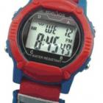
How might these Assistive Technology (AT) options be helpful?
Vibrating watch x 6 reminders
or vibrating watch w/memo options
Notes:
Something to think about…may get you thinking of other cost effective assistive technology devices or applications that can be of support to students with ADHD

Slide 41
Impulsivity
Possible Accommodations
Which Area (i.e., academic, CT, residential, workplace)?
Seat in close proximity to instructor or assign room close to RA office
Provide a pass that individual can go to designated “safe zone” or place to let off steam
Behavior contract with student learning how to self-monitor (positive based – not punitive)
Academic, CT, and residential
ALL (With employer, would probably request option to take a break for emotional health purposes.)
Academic, CT, and residential
Notes:
What are some possible accommodations? Which areas does each of the accommodations apply to?
Free electronic apps such as “Optimism” that prompt and teach triggers, symptoms, and stay well strategies.

Slide 42
Accommodations/Strategies for impulsivity that promote independence
Allow individual to review work or living environment to identify distractors, etc. and remove them or ask for changes to be considered (i.e. visual clutter on walls removed, type of lighting, etc.
Use self-talk in working through assignments or repeat understanding of assignment
Before responding to questions, pause and count silently to 5
Notes:
Now what are some accommodations that specifically might assist the student in learning to better monitor his own impulsivity?

Slide 43
Potential Sensory Processing Challenges
Tactile
May have hypo or hypersensitivity to touch
Auditory
May have difficulty integrating sounds or filtering out certain noise; may find certain loud noises physically painful
Balance
May fall more frequently than typical or appear somewhat clumsy
Notes:
Dr. Alexander spoke earlier about potential sensory processing challenges…

Slide 44
Potential Sensory Processing Challenges
Visual
May have sensitivity to light or to certain patterns, etc.
Olfactory (smell)
May have sensitivity to certain smells and can experience a negative physical reaction to them

Slide 45
Sensory Processing Disorder-related Accommodations
Use of:
Headsets; earplugs
White noise tapes; fan in room
Weighted items
Tagless clothing or cotton fabrics
Decluttered worksheets
Copy of the day’s schedule/visual schedule
Fidget items
Stretching exercises
Colored or muted overlays for computer monitors
Notes:
Get to know them, read school and other records if are permitted. Ask about how they do in other arenas. Then, you will know what works well and what does not. For instance some individuals do well with a light touch on the shoulder or back, and other are over-reactive to touch. The same is true for sounds. Some are very sensitive to ‘noise’ even white noise, while some embrace and work better with it. We have to know our students. They will do best if we structure their settings to best meet their needs. Adapt the setting as much as possible to suit their challenges.

Slide 46
Self-Monitoring Applications
The Mindfulness App
By MindApps
CALM DOWN
NOW
Optimism
Notes:
Here are a few examples of self-monitoring apps; you may have ideas of your own.

Slide 47
RESOURCES
WEB, ORGANIZATIONS, & REGIONAL SPECIALISTS AND DISABILITY COORDINATORS
Notes:
We want to remind you that there are many resources that have been specifically researched or designed to support you in this process…

Slide 48
E-zines
http://www.additudemag.com
Notes:
This is a FREE electronic magazine that is contains current research-based strategies and support for ADHD and LD –very user-friendly

Slide 49
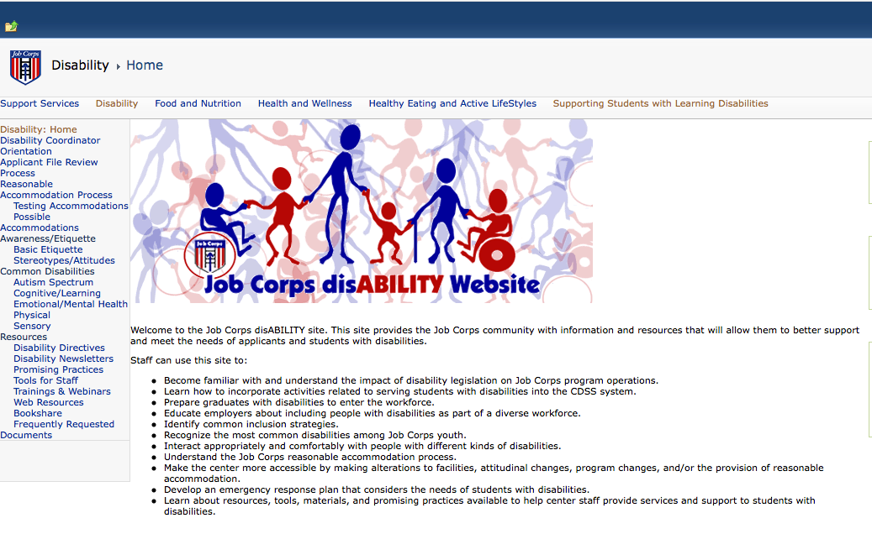
Job Corps Disability Website
https://supportservices.jobcorps.gov/disability/Pages/default.aspx
Notes:
Of course we have the JC Disability Website

Slide 50
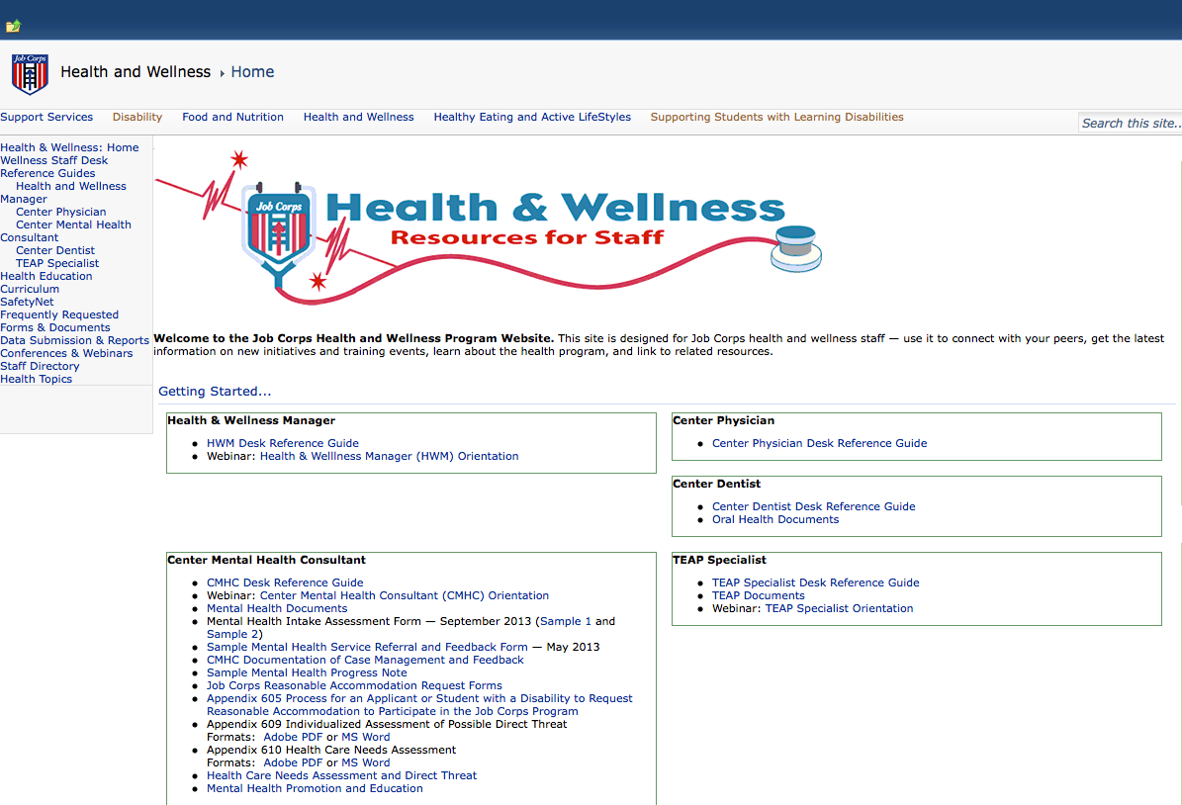
Job Corps Health & Wellness Website
https://supportservices.jobcorps.gov/Health/Pages/default.aspx
Notes:
Along with the JC Health & Wellness Website

Slide 51
Job Accommodation Network http://askjan.org
Notes:
Job Accommodation Network – if ever in doubt of realistic workplace and independence-based accommodations…call or email JAN

Slide 52
Regional Mental Health Specialists
Region 1
David Kraft, MD, MPH
dkraft@external.umass.edu
Maria Acevedo, PhD (Puerto Rico)
mmacevedo@onelinkpr.net
Region 2
Valerie Cherry, PhD
vcherryphd@gmail.com
Region 3
Suzanne Martin, PsyD, MPH
suzannempsyd@gmail.com
Region 4
Lydia Santiago, PhD
lydia.v.santiago@att.net
Region 5
Helena MacKenzie, PhD
helena.mackenzie530@gmail.com
Region 6
Vicki Boyd, PhD
vdelboyd@aol.com
Notes:
On this slide, you will find current contact information by region for your regional mental health consultants.

Slide 53
Regional Medical Specialists
Region 1
John Kulig, MD, MPH
jwkulig@gmail.com
Region 2 and 3
Teresa Lowery, MD, MPH
tlowerymd@aol.com
Region 4
Drew Alexander, MD
cyvoc@yahoo.com
Region 5
Gary Strokosch, MD
gstrokosch@aol.com
Region 6
Sara Mackenzie, MD, MPH
saramack17@msn.com

Slide 54
Regional Disability Coordinators
Boston, and Philadelphia Regions – Kristen Philbrook
kristen.philbrook@humanitas.com
Atlanta Region – Jasmin Merritt
jasmin.merritt@humanitas.com
Dallas Region – Laura Kuhn
laura.kuhn@humanitas.com
Chicago and San Francisco Regions – Kim Knodel
kimberly.knodel@humanitas.com

Slide 55
Questions? Comments?
Notes:
Check back in with our facilitator, Julie, on how we are doing with time…

