Slide 1
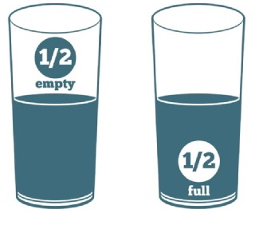
IS THE GLASS
Half Empty or Half Full
Perceptions of Disability and Disability Awareness/Sensitivity
Notes:
So today, we are going to start with talking about our perceptions and beliefs surrounding disability. We all have them and sometimes our perceptions can color how we “see” or “perceive” an individual. Then we are going to talk briefly regarding disability sensitivity and awareness and how to appropriately interact and communicate with our students with disabilities.

Slide 2
Objectives
Describe 1-2 ways their own perceptions may impact their belief about the abilities of people with disabilities
Identify 1-2 examples of person-first language.
List at least 2 tips for communicating with people with disabilities.
Identify at least 2 disability sensitivity and/or awareness-related resources.
2

Slide 3
Perceptions
We can see the same thing differently!
3

Slide 4
What Do You See?
What do you know about each of these individuals from looking at their pictures?
What are your impressions about each individual based upon what you see?
4
Notes:
Look at each of the individuals and tell me some of the “things” (characteristics) that you see! Sometimes we can all look at the same situation, scenario, picture, etc. and yet each of us focuses on some different aspect of the situation or item. Why?
Because our life experiences, our previous perceptions, etc. all influence our current belief systems and perceptions and often, those life experiences and previous perceptions will influence HOW and WHAT we see. This is the same concept as is the glass half empty or is it half full?
The goal today is for each of us to become more aware of what our individual perceptions are regarding disability, to do a self-check on your disability awareness to ensure that we always are doing are very best to make informed decisions so that we are not INADVERTENTLY limiting opportunities for students with disabilities within the Job Corps program.

Slide 5
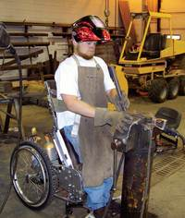
Chef who is blind
Pilot who does not have
arms
Welder who is in a
wheelchair
Carpenter who is deaf
Winner of the show Master Chef!
Raymond has the ability to do anything he is asked to do in the carpentry industry,” says his manager, David Stone.
https://prideindustries.wordpress.com/tag/national-disability-employment-awareness-month/
An individual who completed a welder certification program and has a mobility impairment!
A licensed pilot of small aircraft!
5
Notes:
Think about the perceptions you had about each individual on the previous slide. Now compare them with the perception that you have once you have learned more details about each specific individual.
Do not answer this in the chat box – just sharing this as food for thought. Would you have believed that each of these individuals could have readily completed a career technical program in Job Corps if you had not known of their outcomes? If not, why not?
Is the glass half empty or half full? Do you think these are individuals who can complete a career technical program in Job Corps? If not, what are your concerns?

Slide 6
Individual Who is Blind Video
6
Notes:
Let’s take a look at some individuals with disabilities in their respective workplaces!
https://www.youtube.com/watch?v=eOipaGDSBTQ
2:29

Slide 7
Individual Who has Physical Impairment Videos
7
Notes:
0 – 3:53 (tells about herself and her accommodations at work)
5:56 – 6:52 (demonstrates how the individual drives her car adapting for her disability).
https://www.youtube.com/watch?v=exmiTRdwJm4

Slide 8
Managing Questions by Others
Responding to questions by other students about an individual’s accommodations
8

Slide 9
Job Corps is an Employer Under the Law
So, what do you do when other students question why another individual is being allowed to do something either in a different way or that generally is against center policies?
9

Slide 10
What Does the American’s with Disabilities Act (ADA) Say?
Under the Americans with Disabilities Act (ADA), an employer cannot breach the confidentiality of the employee with the disability.
The employer cannot share with co-workers any information about the employee regarding disability, medical condition, or accommodations.
However, the employee with the disability is free to provide information to co-workers that can explain those matters.
https://askjan.org/publications/consultants-corner/Disability-Awareness-Training.cfm
10
Notes:
Many times an employee with a disability would like for his co-workers to have more information about him so they will better understand social issues, information processing, and / or learning differences that may be affecting the employee, or why accommodations may be needed.

Slide 11
Equal Employment Opportunity Commission (EEOC)
It states that an employer may not disclose that an employee is receiving a reasonable accommodation because this usually amounts to a disclosure that the individual has a disability.
The ADA specifically prohibits the disclosure of medical information except in certain limited situations, which do not include disclosure to co-workers.
What is an employer to say when specifically asked about an employee’s treatment that may be perceived as more favorable by co-workers?
The Equal Employment Opportunity Commission (EEOC) answers this question in its publication Enforcement Guidance: Reasonable Accommodation and Undue Hardship Under the Americans with Disabilities Act.
11
Notes:
Many times an employee with a disability would like for his co-workers to have more information about him so they will better understand social issues, information processing, and / or learning differences that may be affecting the employee, or why accommodations may be needed.
https://askjan.org/publications/consultants-corner/Disability-Awareness-Training.cfm

Slide 12
If employer wishes to do disability awareness training that may help an employee with a disability in the workplace, then the employer must be certain the individual understands his/her role and is fully in agreement with the training.
An employee with a disability often feels that providing information about the disability, how it affects him/her, and what s/he needs in order to perform at his best is going to allow co-workers the understanding needed to accept him/her for who s/he is.
ABOUT OUR COMPANY
It’s now that much easier and more effective to start your business, thanks to company!
It’s now that much easier and more effective to start your business, thanks to company! Our tool will guide you step by step to get your project done. Evaluate how successful
12
Notes:
If the employer feels that disability awareness training may help the individual in the workplace by allowing co-workers to have a better understanding of their needs, the employer must be certain that the employee is fully on board and thoroughly understands their role before moving forward with any type of training or information session.
Remember ADA confidentiality rules.
If the employer feels that disability awareness training may help the individual in the workplace by allowing co-workers a better understanding of the employee’s needs, the employer must be certain that the employee is fully on board and thoroughly understands their role before moving forward with any type of training or information session.
https://askjan.org/publications/consultants-corner/Disability-Awareness-Training.cfm

Slide 13
How Is This Accomplished?
EMPLOYER allows time for training.
EMPLOYER allows opportunity for training.
FINISH
The actual verbalization of the information should come from the employee or from a qualified person designated by the employee.
An employer may provide a general form of disability awareness training and would not need to have the permission and participation of employees with disabilities that are part of the group.
CAUTION:
Timing and topic of the training is important!
WHY?
13
Notes:
Most often the employee is the one who fully knows how the disability affects him, what he finds to be difficult, what he needs in order to succeed, and how others can assist him in that process. In some cases, a service provider, an educator, or even a family member may be the most qualified individual to present the needed information to the group. The proper person could be whoever the employee feels most comfortable with, and who would be most effective in conveying the essential information.
If an employer wants to provide a general form of disability awareness training that might include ADA and accommodation information, they can do so at any time, and would not need to have the permission and participation of employees with disabilities that are part of the group.
However, the employer would want to be sure the timing of the training is appropriate. If a newly hired engineer, for example, in a tight-knit department has been having some difficulties with the social aspects of the position due to an autism spectrum disorder, the employer would not want to suddenly provide a training with information on autism and social difficulties to that department. A more general training on disabilities, the ADA and its confidentiality protections, accommodations, and how to participate in the interactive process would be more appropriate at that time.

Slide 14
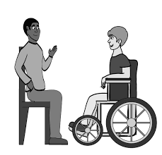
Disability Awareness
Some basic disability etiquette for the workplace!
14

Slide 15
Disability Awareness/Sensitivity
Notes:
https://www.rockymountainada.org/resources/disability-etiquette-video
1:58
Rocky Mountain ADA Center
“Learning respectful ways to interact with people with disabilities is a great way to ensure people can fully be a part of our communities.”

Slide 16
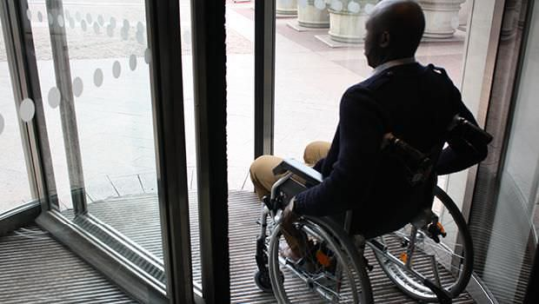
What Do You Think? You see a person with a mobility impairment struggling to open a door.
What do you do?
Do not get involved.
Open the door for them!
Ask them if they need assistance with the door?
16
Notes:
What could happen if the person uses crutches and you open the door for that person while s/he are trying to open the door her/himself?
c

Slide 17
What Do You Think? You see a blind person who may need assistance with navigating their environment?
What do you do?
Don’t get involved as it would embarrass them.
Take them by the arm and guide them.
Ask if they need assistance.
17
Notes:
c

Slide 18
What Do You Think? You see a person on the autism spectrum or someone who appears to be having a “meltdown” but is not hurting themselves or others?
What do you do?
Go over and attempt to physically guide them to a private location.
Calmly reassure them and offer to take them to a private location.
Clear others from the area if they are unable to change locations.
B and C
18
Notes:
D

Slide 19
Communication and Disability Etiquette
Person-first Language and Other Communication Tips!
19

Slide 20
Person First Language Examples
NEGATIVE PHRASES
Retarded
Mentally Defective
AFFIRMATIVE PHRASE
Person with an intellectual, cognitive, developmental disability
NEGATIVE PHRASES
The Disabled
Handicapped
AFFIRMATIVE PHRASE
Person with a disability
,
Notes:
Positive language empowers. When writing or speaking about people with disabilities, it is important to put the person first. Group designations such as "the blind," "the retarded" or "the disabled" are inappropriate because they do not reflect the individuality, equality or dignity of people with disabilities. Further, words like "normal person" imply that the person with a disability isn't normal, whereas "person without a disability" is descriptive but not negative.
Other examples below:
AFFIRMATIVE PHRASE followed by the NEGATIVE PHRASE
person who is blind, person who is visually impaired
the blind
person who is deaf
the deaf; deaf and dumb
person who is hard of hearing
suffers a hearing loss
person who has multiple sclerosis
afflicted by MS
person with cerebral palsy
CP victim
person with epilepsy, person with seizure disorder
epileptic
person who uses a wheelchair
confined or restricted to a wheelchair
person who has muscular dystrophy
stricken by MD
person with a physical disability, physically disabled
crippled; lame; deformed
unable to speak, uses synthetic speech
dumb; mute
person with psychiatric disability
crazy; nuts
person who is successful, productive
has overcome his/her disability; is courageous (when it implies the person has courage because of having a disability)

Slide 21
General Tips for Communicating with People with Disabilities
Introductions
When introduced to a person with a disability, it is appropriate to offer to shake hands.
Be Yourself
Relax! Don't be embarrassed if you happen to use common expressions such as "See you later," or "Did you hear about that?" that seem to relate to a person's disability.
Offer Assistance
If you offer assistance, wait until the offer is accepted. Then listen to or ask for instructions.
Ask Questions
Don't be afraid to ask questions when you're unsure of what to do.
Respect the Individual as an Adult
Treat adults as adults. Address people who have disabilities by their first names only when extending the same familiarity to all others.
Notes:
When introduced to a person with a disability, it is appropriate to offer to shake hands. People with limited hand use or who wear an artificial limb can usually shake hands.
(Shaking hands with the left hand is an acceptable greeting.)
https://www.dol.gov/odep/pubs/fact/communicating.htm

Slide 22
Tips for Communicating with Individuals who are Deaf or Hard of Hearing
Gain their Attention
Gain the person's attention before starting a conversation (i.e., tap the person gently on the shoulder or arm).
Speak to the Individual
If the individual uses a sign language interpreter, speak directly to the person, not the interpreter.
Consider Speaking Position & Tone
Look directly at the individual, face the light, speak clearly, in a normal tone of voice, and keep your hands away from your face. Use short, simple sentences. Avoid smoking or chewing gum.
Use TTY or Relay Service
If you do not have a Text Telephone (TTY), dial 711 to reach the national telecommunications relay service, which facilitates the call between you and an individual who uses a TTY.
Notes:
https://www.dol.gov/odep/pubs/fact/communicating.htm

Slide 23
Tips for Communicating with Individuals who have Mobility Impairments
Speak at Eye Level
If possible, put yourself at the wheelchair user's eye level.
Ask if Help is Needed
Do not assume the individual wants to be pushed —ask first.
Do Not Touch/Use Wheelchair
Do not lean on a wheelchair or any other assistive device.
Offer Assistance
Offer assistance if the individual appears to be having difficulty opening a door.
Do Not Patronize
Never patronize people who use wheelchairs by patting them on the head or shoulder.
Allow Extra Time
If you telephone the individual, allow the phone to ring longer than usual to allow extra time for the person to reach the telephone.
Notes:
https://www.dol.gov/odep/pubs/fact/communicating.htm

Slide 24
Tips for Communicating with Individuals who have Cognitive Disabilities
Remove Distractions
If you are in a public area with many distractions, consider moving to a quiet or private location.
Offering Assistance
Offer assistance completing forms or understanding written instructions and provide extra time for decision-making. Wait for the individual to accept the offer of assistance; do not "over-assist" or be patronizing.
Repeat Information
Be prepared to repeat what you say, orally or in writing.
Afford Extra Time and Confirm Understanding
Be patient, flexible and supportive. Take time to understand the individual and make sure the individual understands you.
Use Visual Supports
Be prepared to use visual supports/pictures to aid in communicating.
Notes:
https://www.dol.gov/odep/pubs/fact/communicating.htm

Slide 25
Job Corps Center Accommodations
Examples of Unique Accommodations Provided at JC Centers
25

Slide 26
Functional Limitations & Solutions
How Job Corps Centers are Accommodating Students with Disabilities
A student with a double leg amputation and a wheelchair user was having difficulty completing dorm tasks because of inability to reach certain spaces.
A student who was visually impaired had difficulty seeing information on the computer screen.
The Simple Solution?
A disability partner provided the student a magnifying screen for their computer and came to the center to show the student how to use the screen.
Students needed driving adaptations to complete Driver’s Education and take the state driving test.
The Simple Solution?
The center worked with Shriner’s hospital to complete evaluations of students with physical disabilities.
The Simple Solution?
The center purchased a long-arm duster.
Notes:
The student also was able to keep the assistive technology.

Slide 27
Functional Limitations & Solutions
How Job Corps Centers are Accommodating Students with Disabilities
Student is unable to read print content due to severe dyslexia.
Student has diabetes and needs access to snacks throughout the day
The Simple Solution?
Student was given a special pass to go to cafeteria and select a healthy snack and a refrigerator with healthy snacks was placed in the residential advisor’s office.
Student has serious sensory issues related to sound and bright lights
The Simple Solution?
Student allowed to use noise cancelling headsets when instructor is not teaching and/or does not pose a safety hazard.
The Simple Solution?
The center set up a Bookshare account, provided center information verbally and via audio tape, video tape and text-to-speech software.
Notes:
The student also was able to keep the assistive technology.

Slide 28
Long Beach Job Corps Immersive Reader Tutorial

Slide 29
Let’s Review
Examples of Disability Sensitivity and Awareness
29

Slide 30
True or False
If you have difficulty understanding someone with a speech or hearing impairment, pretend that you understand what s/he is saying so that you do not offend her/him.
30
Notes:
You can even ask the person if they can write down what they are trying to say if that is feasible for them to do so.

Slide 31
True or False
It is acceptable to go up and pet a service dog as long as you allow the dog to sniff your hands first.
31
Notes:
The general rule of thumb is do not touch or distract a service dog. Interacting with a dog that is working could put the person with a disability in harm's way and/or interfere with the dog's focus or inhibit his ability to pick up commands.

Slide 32
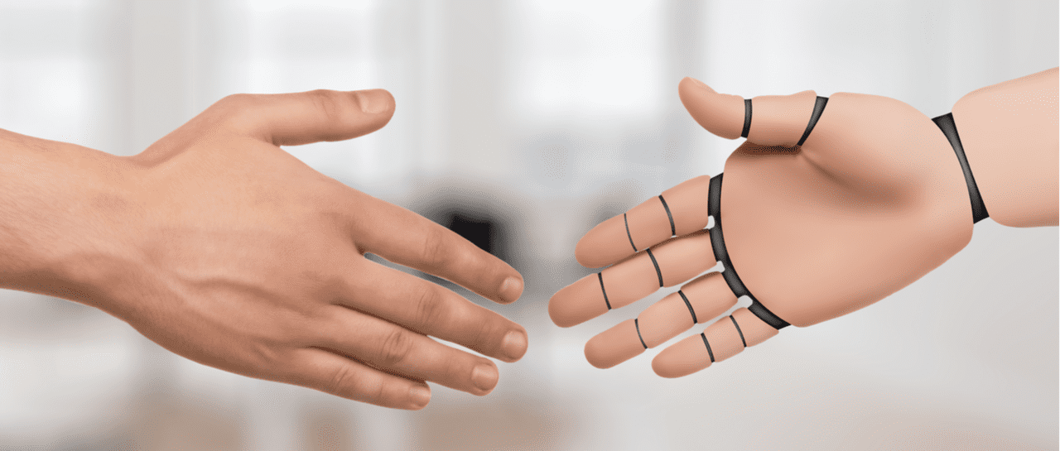
True or False
Never attempt to shake hands with someone who has a prosthetic hand or arm or who has a condition in which their arm is shortened or different from a typical arm/hand.
32

Slide 33
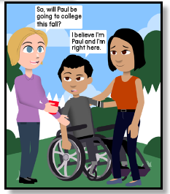
True or False
You should treat people based on their intellectual age and not their chronological age.
https://www.unitedspinal.org/pdf/DisabilityEtiquette.pdf
33

Slide 34
True or False
Always speak directly to a sign language interpreter rather than the person who is deaf so that s/he can follow the conversation accurately.
34

Slide 35
Pepsico
Notes:
https://www.youtube.com/watch?v=yBHtdEvrVyM
Stop at 4:22

Slide 36
Resources
36

Slide 37
Notes:
2019 - NDEAM Posters can be downloaded and printed or ordered via the ODEP website.

Slide 38
38
38
Notes:
2020 – Over the course of this next year, we are going to be focusing quite a bit on increasing access!

Slide 39
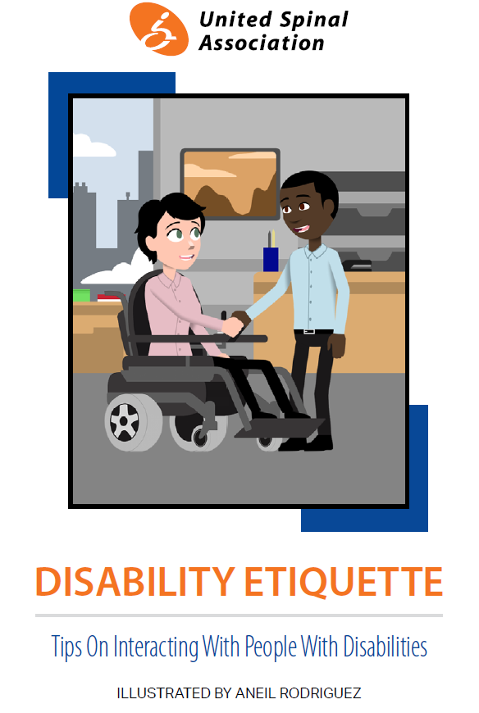
United Spinal Association
https://www.unitedspinal.org/pdf/DisabilityEtiquette.pdf
Notes:
https://supportservices.jobcorps.gov/disability/Pages/Disability%20Awareness%20and%20Etiquette.aspx

Slide 40
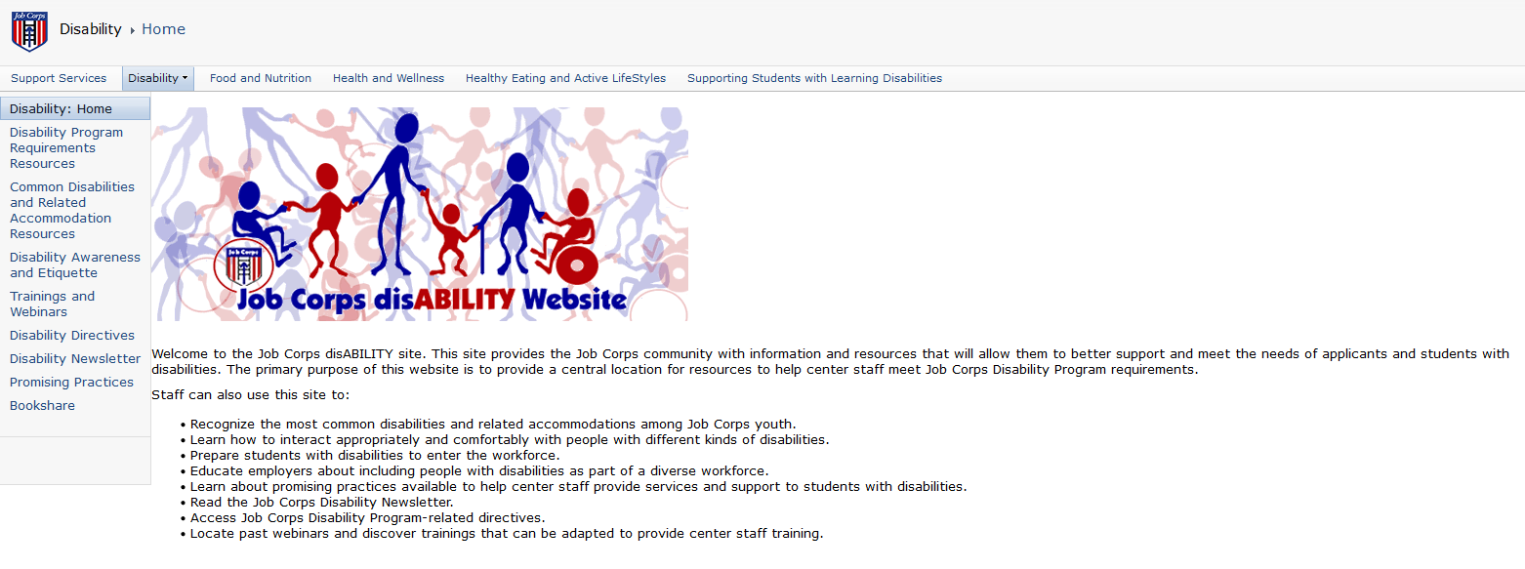
Job Corps Disability Website
https://supportservices.jobcorps.gov/disability/Pages/Disability%20Awareness%20and%20Etiquette.aspx
40
Notes:
https://supportservices.jobcorps.gov/disability/Pages/Disability%20Awareness%20and%20Etiquette.aspx

Slide 41
Thank You!
Comments
Suggestions
Questions
Discussion
41

