Slide 1
Accommodating Students with Drug & Alcohol Disabilities
Laura Kuhn, Regional Disability Coordinator Humanitas, Inc.

Slide 2
Overview
Background
Accommodating a Student with a Drug/Alcohol Disability
Accommodations to Support a Drug/Alcohol Disability
Resources

Slide 3

BACKGROUND
Objectives, Legal & Policy Requirements

Slide 4
Objectives
After this presentation, participants will be able to:
  Describe how people with drug addiction and alcoholism diagnoses can be protected by federal disability nondiscrimination laws.
  Describe at least 3 functional limitations that people with drug/alcohol disabilities may experience.
  Describe at least 3 possible accommodations for students with drug/alcohol disabilities.

Slide 5
Legal & Policy
Key Legal and Policy References
  Section 504
  Americans with Disabilities Act Amendments Act (ADAAA)
  EEOC Regulations
  Appendix 605 of the PRH

Slide 6
Who is a Person with a Disability?
A person has a disability if he/she has a physical or mental impairment that substantially limits one or more major life activities, a record of such an impairment, or is regarded as having an impairment.¹
  Remember – being regarded as having an impairment does not entitle one to positive actions (i.e., accommodations) but it does protect the individual from being discriminated against for having a disability.
¹EEOC Regulations To Implement the Equal Employment Provisions of the Americans With Disabilities Act, as Amended, 29 C.F.R. § 1630 (2011).

Slide 7
Drug Addiction Under the ADAAA
Persons who are current illegal users of drugs are not protected under ADAAA as individuals with disabilities.
Persons who casually used drugs illegally in the past, but did not become addicted are not protected under ADAAA as individuals with disabilities.
Persons addicted to drugs, but who are no longer using drugs illegally and are receiving treatment for drug addiction or who have been rehabilitated successfully may be protected under the ADAAA as individuals with disabilities.
Notes:
The following categories of persons are considered individuals with disabilities and are therefore protected from discrimination on the basis of the drug addiction itself:
Persons with a drug dependence diagnosis
who have successfully completed a supervised drug rehabilitation program (an in-patient, out-patient, or employee assistance program), and who are no longer using drugs illegally.
who have been rehabilitated successfully in some other way (e.g., recognized self-help programs such as Narcotics Anonymous) and who are no longer using drugs illegally.
who are currently participating in a supervised rehabilitation program, and who are no longer using drugs illegally.

Slide 8
Alcoholism Under the ADAAA
Persons who are alcoholics may be protected under the ADAAA as individuals with disabilities.
Even those who are currently using alcohol are protected.

Slide 9
Drug Addiction, Alcoholism and
Job Corps Policies
Students with drug addiction or alcoholism disabilities are subject to the center’s disciplinary policies and measures regarding the use and abuse of alcohol, as well as to Job Corps’ Zero Tolerance policy regarding the use of drugs.

Slide 10
Behavior/Discipline Example
What are the center’s options if a student who is an alcoholic and has met the criteria to be considered a person with a drug/alcohol disability is caught drinking alcohol on center or coming on center intoxicated?
Is it discriminatory to take disciplinary action in this scenario?
  No, it is not discriminatory to take disciplinary action. Why?
    Because the center is taking the action because the student has violated the center’s standards of conduct and not because the center knows the student is an alcoholic.

Slide 11

Test Your Knowledge
What are the criteria to being recognized as a person with a substance-related disability?
  For drugs
  For alcohol
True or False - Job Corps may not separate a student who is abusing alcohol and comes on center intoxicated if s/he is a person with a drug/alcohol disability.

Slide 12

Accommodating the Student with a Drug/Alcohol Disability
Considerations in Determining Accommodation Needs

Slide 13
Functional Limitations
Definition: The inability to perform an action or a set of actions, either physical or mental, because of physical or emotional restriction²
Time Management
Organization and Prioritization
Social Skills
Concentration
Memory
Communication
Stamina
Responding to Change
Screening Out Environmental Stimuli
Managing Stress
²Brodwin, M., Tellez, F., Brodwin, S. (1993). Medical, Psychosocial and Vocational Aspects of Disability. Athens, GA: Elliott and Fitzpatrick, Inc.

Slide 14
Determining Functional Limitations for Students with Alcohol/Drug Disabilities
Individuals with any type of disability will experience varying degrees of impact from that disability. Even individuals experiencing similar types of functional limitations may experience the impact in varying degrees. Given this, each person’s limitations and needs should be considered on an individual basis and not in relation to a specific diagnosis.
  Determine the symptoms and behaviors related to the substance issue that are impacting the individual’s life (i.e., major life activities).

Slide 15
Determining Reasonable Accommodation
How do you know what accommodations an individual with an drug/alcohol disability might need?
  Did the individual request any accommodations or provide documentation of a drug/alcohol disability?
  Does the individual request accommodations on the 6-53?
  Has the individual requested accommodations via an Accommodation Request Form or any other medium?
  Is there documentation of a drug/alcohol disability that shows previous need/history of use of certain supports and accommodations?
  Does the individual verbalize possible support needs during the interactive accommodation process?

Slide 16

Accommodations to Support a Drug/Alcohol Disability
Functional Limitations and Accommodation Examples

Slide 17
Areas/Examples of Potential Impact
Attendance
Concentration
Organization/Time Management
Stress Management
Memory
Stamina

Slide 18

Attendance
Modified schedule to permit:
  Attending counseling appointments in the community.
  Attending group meeting(s) on center or in community.
Provide special pass to see TEAP Specialist or other designated staff person when feeling overwhelmed.

Slide 19

Concentration
Reduce visual/auditory distractions by:
  Providing preferential seating such as designating seating location away from high traffic areas.
  Reducing visual clutter.
  Allowing use of headsets.
Provide space enclosures.
Allow for frequent breaks or one longer break.
Divide large assignments into smaller tasks and steps.
Provide vibrating watches or use visual timers.

Slide 20
Concentration
Afford extended time for assignments, tasks, or in testing.
Increase wait time for responses.
Provide cues to return to task.

Slide 21
Organization/Time Management
Use check lists and/or daily to-do lists.
Use electronic organizers.
Maintain a current calendar.
Use color coding to identify key activities.
Schedule weekly meeting with DC or other center mentor to review organizational efforts and receive ongoing suggestions.
Establish written long term and short term goals.

Slide 22

Stress Management
Provide praise and positive reinforcement.
Provide frequent feedback.
Set short term goals.
Use checklists with no more than 1-3 items initially.
Allow for the ability to modify daily schedule.
Allow for frequent breaks.
Provide a special pass that allows individual to visit identified mentor or safe place when feeling overwhelmed.

Slide 23
Memory
Provide clear but brief expectations for rules, assignments, etc. in writing.
Create daily task lists.
Provide verbal prompts and reminders.
Provide electronic organizer.
Provide copies of notes.
Allow student to tape record instruction content, directions, etc.

Slide 24
Maintaining Stamina
Allow for longer or more frequent breaks.
Allow flexible scheduling.
Reduce physical exertion, ensuring individual is still meeting essential functions of the job.

Slide 25
Test Your Knowledge
Review exercise

Slide 26
Test Your Knowledge
What are some functional limitations a person with a drug/alcohol disability might experience?
What are some possible accommodations for the examples you identified in the previous question?

Slide 27
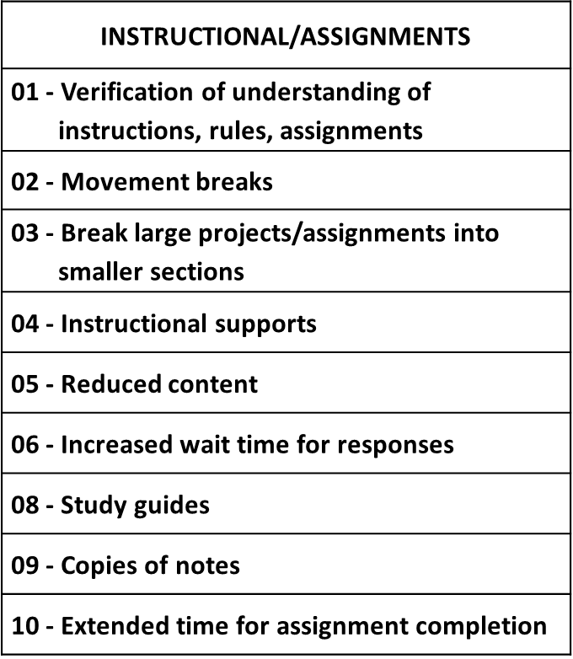
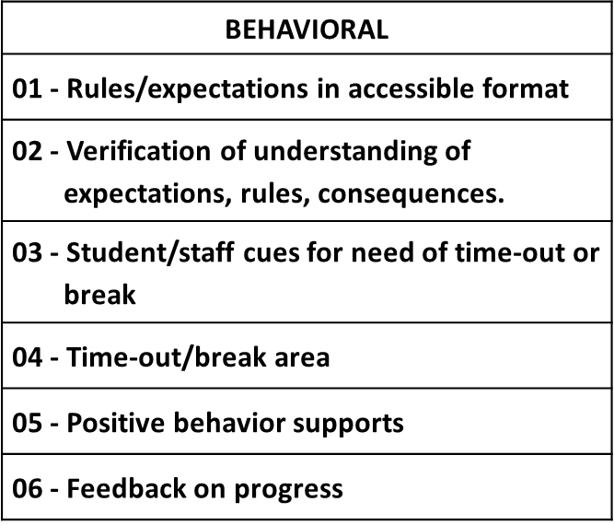
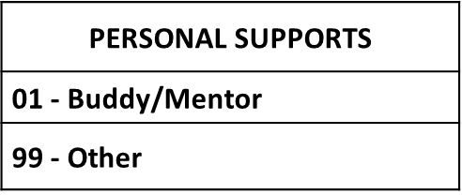
Possible Accommodations

Slide 28
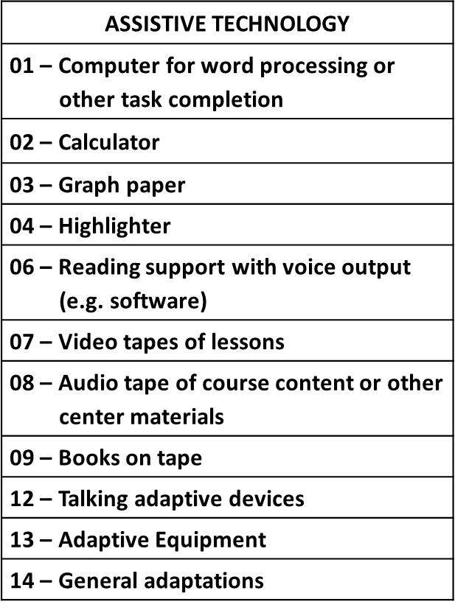
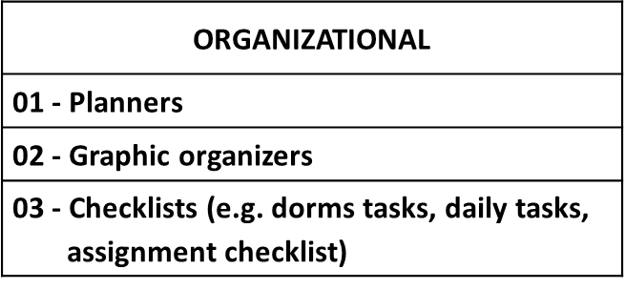
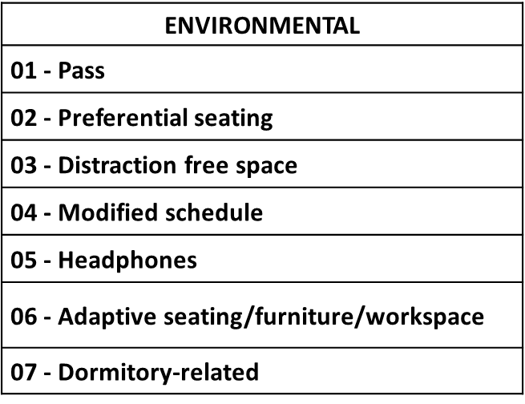
Possible Accommodations

Slide 29

Resources
Job Corps & Outside Organizations

Slide 30
Drug/Alcohol-related Resources
National Council on Alcoholism and Drug Dependence (NCADD)
  Provides education, information, help, and hope in the fight against the chronic, often fatal, disease of alcoholism and other addictions.
http://www.ncadd.org
The Substance Abuse and Mental Health Services Administration (SAMHSA)
  Improves the quality and availability of prevention, treatment, and rehabilitation services in order to reduce illness, death, disability, and cost to society resulting from substance abuse and mental illnesses.
http://www.samhsa.gov

Slide 31
Drug/Alcohol-related Resources
American Society of Addiction Medicine (ASAM) Dedicated to educating physicians and improving the treatment of individuals suffering from alcoholism or other addictions.
http://www.asam.org
National Association on Alcohol, Drugs & Disability (NAADD)
Promotes awareness and education about substance abuse among people with coexisting disabilities.
http://www.naadd.org

Slide 32
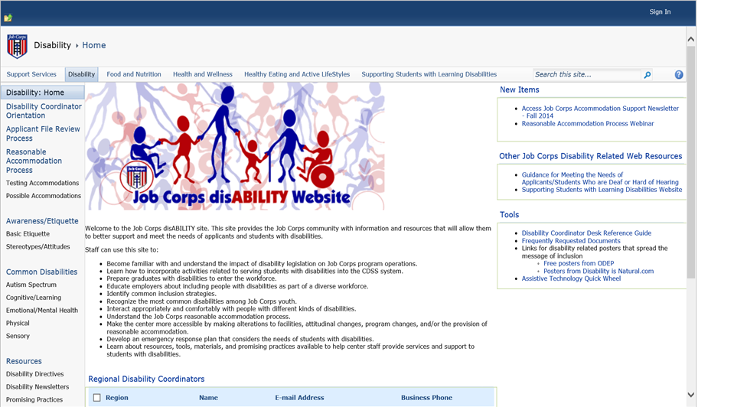
Job Corps Disability Website https://supportservices.jobcorps.gov/disability/Pages/default.aspx
Notes:
The Job Corps Disability Website is located at: https://supportservices.jobcorps.gov.

Slide 33
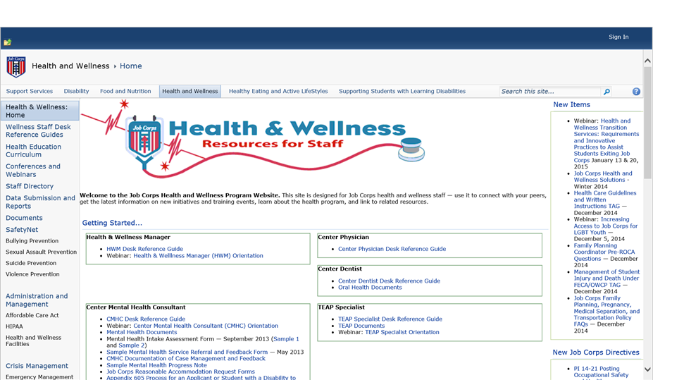
Job Corps Health & Wellness Website https://supportservices.jobcorps.gov/health/Pages/default.aspx
Notes:
The Health & Wellness Website is located at: https://supportservices.jobcorps.gov.

Slide 34
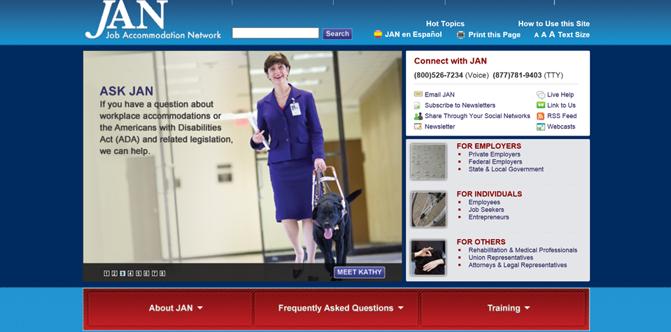
Job Accommodation Network (JAN) http://askjan.org
Notes:
The JAN website is located at http://www.askjan.org.

Slide 35
Regional Disability Coordinators
Boston and Philadelphia Regions – Kristen Philbrook
  Kristen.Philbrook@Humanitas.com
Atlanta Region – Jasmin Merritt
  Jasmin.Merritt@Humanitas.com
Dallas Region – Laura Kuhn
  Laura.Kuhn@Humanitas.com
Chicago and San Francisco Regions – Kimberly Knodel
  Kimberly.Knodel@Humanitas.com

Slide 36
Regional TEAP Specialists
Diane Tennies, PhD – Boston, Philadelphia & San Francisco Regions
  (207) 478-9278 (cell)
  datphd@aol.com
Christy Hicks, MSW – Atlanta, Chicago and Dallas Regions
  (606) 791-0448 (cell)
  christyhicks.msw@gmail.com

Slide 37

Questions

