Slide 1

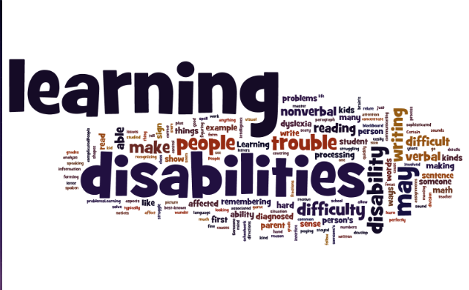
Part 2 of a 3 Part Webinar Series on Learning Disabilities
200
Notes:
Welcome to Learning Disabilities 200 webinar. This is part two of a three part series designed to define, discuss, and provide solutions for Job Corps staff working with students with a range of learning disabilities.

Slide 2

2

Slide 3

Objectives
Review the various types of learning disabilities and identify 1-2 functional limitations related to each.
Identify at least two specific accommodations to support corresponding functional limitations of each type of LD.
Identify accommodations for each specific area on center related to 1-2 specific functional limitations.
3
Notes:
The purpose of this webinar is to build on the basic knowledge of learning disabilities unfolded during the LD 100 webinar. In LD 100, we focused on defining the different types of specific learning disabilities, identified a few basic functional limitations and corresponding accommodations for those functional limitations.
Today, we will be reviewing those specific learning disabilities that we discussed in LD 100 but this time, we will identify a few more commonly occurring functional limitations that students experience when they have a specific type of LD and then we will discuss how the accommodations may be needed throughout the various areas on the center. Finally, we will spend a little time talking about the specific roles and responsibilities of various staff throughout the center within the reasonable accommodation process.

Slide 4
Let’s Review!
4
Notes:
.

Slide 5


Poll #1
Poll
  True or False?
    An individual with a learning disability has to be below average intelligence.
5

Slide 6

What is a Learning Disability?
A LD is a neurobiological condition that affects the way individuals of average to above average intelligence
Receive information
Process information
Express information
www.ncld.org
LD can impact the ability to acquire basic skills of listening, speaking, thinking, reading, spelling, writing, and/or mathematics
6
Notes:
What does the term learning disabilities really mean? Learning Disabilities refer to a number of disorders that may affect the acquisition, organization, retention, understanding or use of verbal or nonverbal information. These disorders affect learning in individuals who otherwise demonstrate at least average abilities essential for thinking and/or reasoning.
LD is a high incident type of disability which means it occurs often so we are very likely to serve students with LD in our JC program. To appropriately serve our students, we need to identify and implement strategies, identify and implement appropriate accommodations, and evaluate effectiveness of supports and accommodations.
An individualized approach is important in the development of each and every accommodation plan. Avoid getting caught up in the development of “cookie cutter” plans, particularly those that only serve to support students on the TABE test.

Slide 7
Types of Learning Disabilities
Dyslexia
Dysgraphia
Dyscalculia
Dyspraxia
Auditory Processing Disorders
Visual Processing Disorders
7
Notes:
As I mentioned earlier, we will be discussing these 6 types of LDs.
In order to discover a bit about how it feels from the perspective of a person with LD, we chose to start with a short video called “A Boy with LD Becomes a Scientist”
While I am cuing up this Youtube, write “yes” or “no” in the chat box if you have a personal connection to someone with a LD of any type….
Show video now…

Slide 8
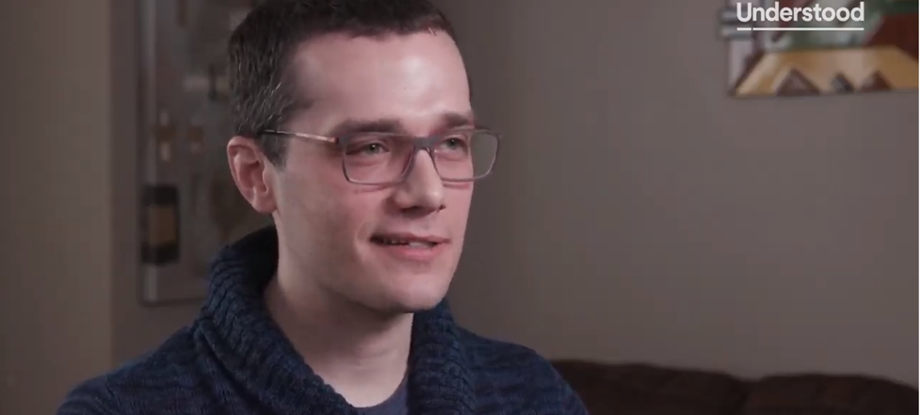
Video Clip: A Boy with LD Becomes a Scientist
https://www.youtube.com/watch?v=dFo9WcRewKo
8
Notes:
https://www.youtube.com/watch?v=dFo9WcRewKo
(approximately 6 minutes)
“A Boy with LD Becomes a Scientist” – overall good video for what it is like to have LD from student’s perspective
Understood
Published on Mar 16, 2018
When Collin Diedrich was in elementary school, he had a self-described panic attack preparing for a timed math test. He struggled with reading and had trouble processing information in school. Today, he has a Ph.D. in molecular virology and microbiology, doing valuable research on HIV at the University of Pittsburgh. So how did he get here? Watch Collin’s inspiring journey, from being diagnosed with a learning disorder not otherwise specified (LD-NOS) through tutors, accommodations and more. Plus, hear his explanation about suffering through “imposter syndrome” in graduate school and how he ultimately found his confidence and success. Then see more inspiring stories about young adults with learning and attention issues at Understood.org.

Slide 9
Center-wide Accommodations
9
Notes:
Let’s transition to a few thoughts about Center-wide Accommodations…
Knowing why it’s important to understand learning disabilities allows us to further discuss why accommodations must be considered on a center-wide basis, if necessary.
For example, an IEP often only addresses a student’s needs primarily focused on an academic learning environment. It often does not address recreational facilities and activities, residential settings, workplace learning, and so forth.

Slide 10
Considering Accommodations Center-wide
What do we mean when we ask for accommodations to be considered center wide? (Note: This list is not all inclusive.)
Academics
Testing
Career Technical
Residential
Cafeteria
Work-based learning
Navigating around center
Recreational facilities
Health services
10
Notes:
We see a lot of accommodation plans that only target academic and testing environments, and the question that we must first ask ourselves is did we individualize the reasonable accommodation process for that person?
Have we thought about the fact that Job Corps is a residential program and what accommodations needs may carry over to that area or to health services, recreation, and all of the other departments on center?
So we want to think about the impact of the functional limitation(s) in every environment the student touches to determine if an accommodation is necessary to provide access to the program in that particular environment and would it be appropriate.
The accommodations listed in the students plan should reflect the support needed in each environment related to the individual’s specific functional limitation manifestations.

Slide 11
Considerations for Accommodations
Generally
Student-Specific
Does the accommodation:
  remove barriers caused by the disability?
  afford access to the program?
  build independence?
  improve employability?
Does the student have documentation of the disability?
What limitations is the student with the learning disability experiencing?
How do these limitations affect the student’s performance?
What specific tasks are problematic as a result of these limitations?
Does staff need training regarding learning disabilities?
11
Notes:
When considering accommodations, the team will want to ask some general questions, and some student-specific questions such as these…

Slide 12

What are your Responsibilities?
Ensure that accommodations under your responsibility are implemented and effective.
  How do I know which accommodations I am responsible for implementing?
  Where do I go to get help when I am unclear about an accommodation?
  How do I know that accommodations are working or not?
12
Notes:
Also, regarding APs, we want al staff that will be in contact with the student to understand their role and responsibilities. As DCs, we can better ensure that staff understand their responsibilities in relation to each student with an AP by considering a few questions such as these:
(Feel free to answer these questions in the chat box or at least think about how to answer them…)
How do I know which accommodations I am responsible for implementing?
Where do I go to get help when I am unclear about an accommodation?
How do I know that the accommodations are working or not?

Slide 13
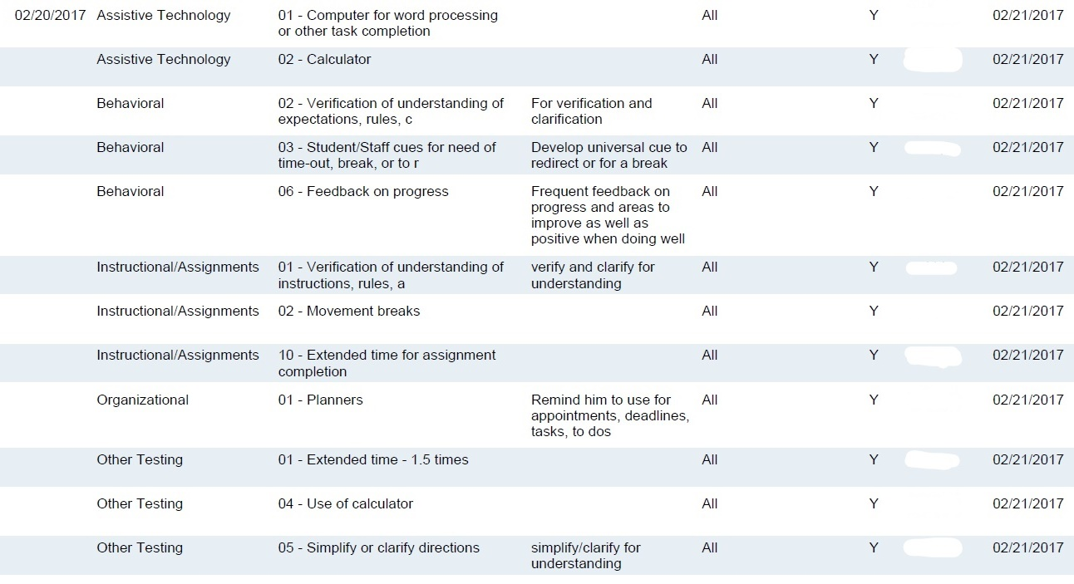
Accommodation Plan Sample
13
Notes:
Here we have an example of an AP. The “Staff Responsible” column tells you if you are responsible. Obviously, if it reads “all,” you are included.
Your center should have a process for informing each staff member responsible for student accommodations. This process should be outlined in an SOP.

Slide 14
Let’s See What You Think!
If a student requires the use of lists and/or visual supports like the use of pictures or graphics, how might that be applied in the various areas throughout the center?
  What about in career technical and academics?
    Supports learning a new skill or concept
    Allows for independent repetition/practice of completing a skill or concept
    Provides guidance/memory cues to be referenced later
  What about in residential?
    Same as above except substitute learning dorm duties for the task
Notes:
Let’s generate a few ideas/solutions for a student that requires the use of lists and/or visual supports like pictures, graphics, written instructions etc…How might that be implemented in the various areas of the center?
What about in career technical and academic classes?
What about in residential?
(next slide)…What about regarding discipline on center?

Slide 15
Let’s See What You Think!
If a student requires the use of lists and/or visual supports like the use of pictures or graphics, how might that be applied in the various areas throughout the center?
  What about regarding discipline?
    Aids understanding of the sequence of the discipline system or differences in rules from one area of the center to another
    Provides simplified language of rules and expectations/provides visual representations that aid understanding
Notes:
So the use of lists and/or visual supports (e.g., pictures, graphics, bulleted lists with pictures, even video clips) could aid in the understanding of:
The sequence of the discipline system or differences in rules from one area of the center to another.
Could provide simplified language of rules and expectations for any student with a LD or even language barriers in general.

Slide 16

Audio Content
Why?
Breaks due to Crowded Space(s) Triggers
Why?
What are some other types of accommodations that readily can have application center-wide and/or likely have a need to be implemented center-wide?
Organizers
Why?
Text to Speech
Why?
Notes:
Think about other types of accommodations that can easily/readily have center-wide applications.
Click through…and if time permits have participants…
Answer the “why” to each type of accommodation either to yourself or share your ideas in the chat box…

Slide 17
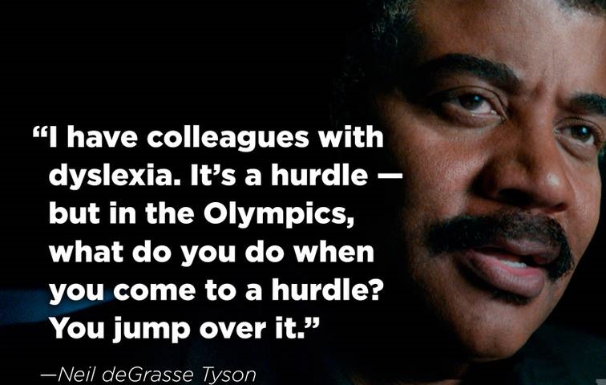
17
Notes:
A little metaphor for accommodations – barrier removal…
It never hurts to remind ourselves and our students that there are so many successful individuals out there with invisible disabilities achieving amazing things!

Slide 18
Practical Accommodation Plan (AP) Examples
18
Notes:
Now let’s take a look at some practical examples of accommodating learning disabilities on center.

Slide 19
Written List for RESIDENTIAL
Cleaning the toilet
  Go to the storage supply cabinet and get cleaning supplies
  Spray cleaner under rim of toilet bowl and let sit for 5 minutes
  Use scrub brush and scrub inside of toilet bowl
  Flush toilet and make sure bowl is clean
  Use disinfecting wipe and wipe down outside of toilet
19
Notes:
This is an example of a written list in residential that addresses challenges such as auditory processing issues, memory impairment, and organizational skills and more…
So, here we have a possible sequential list for “cleaning the toilet.”

Slide 20
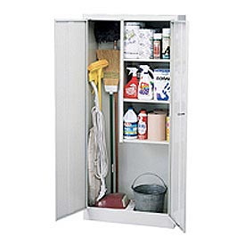

Visual List for RESIDENTIAL
Cleaning the toilet
Step 1 | Go to the storage supply cabinet.
Step 2 | Get cleaning supplies*
Note: *Use pictures of the actual supplies the student would need to retrieve.
20
Notes:
Here we have a possible visually supported list to begin the same task of “cleaning the toilet.”
By providing pictures or graphics, a student can pair the written instructions with the actual items to make meaning.

Slide 21

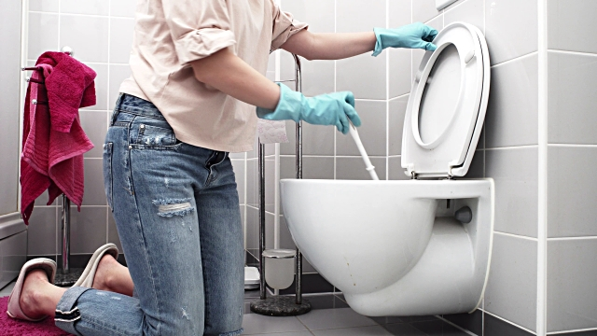
How else could you present this same information besides in a written or visual list?
Videotape a staff or student completing each step of the task stating each step as they go.
Using an accommodation also a learning support/strategy: Videotape the student who needs the accommodation and allow them to watch back their video and compare the actions to a visual list to determine if they completed all the required steps.
21
Notes:
Taking this concept one step further…what if we provide short video clips of the task at hand?
(Read bullets on slide)
(If time, share about the 30 second video clips about safety in the trades)

Slide 22
Written List for CULINARY ARTS (CAREER TECHNICAL)
Baking Muffins
  Pre-heat oven
  Get ingredients from the cabinet and refrigerator
  Get cooking pan(s) and utensil(s) needed (e.g., measuring tools, muffin pan)
  Look at the measurements listed to the left of each ingredient and use your measuring tools to measure each ingredient
  Combine dry ingredients in mixing bowl
    You get the idea!!!
22
Notes:
Quickly: Another example in culinary.
There are a lot of skills involved in baking like math, measuring, following a set of directions in sequence.
Simplify language/vocabulary, if necessary. For example, instead of “get ingredients,” you could say “get supplies” and then list the supplies for this task. Other students could assist in making “lists” both written and visual and it could serve as additional practice and repetition for them!
This type of accommodation can also be referred to as “task analysis” where we analyze what possible steps are required to complete a task successfully.

Slide 23
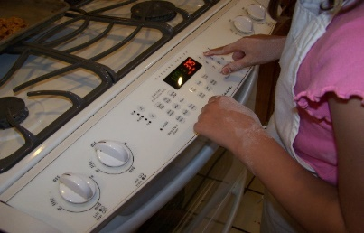


Visual List for CULINARY ARTS
Baking Muffins
Step 1 | Preheat oven
Step 2 | Get ingredients*
Step 3 | Get cooking pans and utensils*
Note: *Use pictures of the actual supplies the student would need to retrieve.
23
Notes:
…again, a possible visually supported list (now simplifying language and including pictures)
Some other ways that we could support students with visual processing issues in this same setting (Culinary):
Instructions on audio (tape) that go along with written instructions
Peer mentor prompting
YouTube or video of the task and/or actual terminology that can be viewed ahead of time to pre-teach the skills
Other ways to support LD: Pre-teach culinary vocabulary by using the actual objects. You can make a game for entire class out of terminology (like Jeopardy).

Slide 24
Supporting Functional Limitations of Learning Disabilities
24
Notes:
In LD 100, we reviewed the different subtypes of LD and discussed most of them in some degree of detail. During this webinar, we want to really bring home a few more key points:
LD is a broad category of disability that covers a number of disorders that may affect how students learn.
Individuals can and do achieve with the appropriate supports in place so we want to take a closer look at some of the technologies that improve access to the program, especially to the learning and training environments but that also have application center-wide.
Helping you to build a resource library that the center RAC can use to assist with identifying possible accommodations/supports and understanding how to use/navigate those resources.
To get detailed definitions, impacts of the conditions/functional limitations, and specific accommodations, you can review LD 100 PPT available in the “file share box, on the JC Disability website, and on the Job Accommodation Network website. Speaking of JAN…

Slide 25
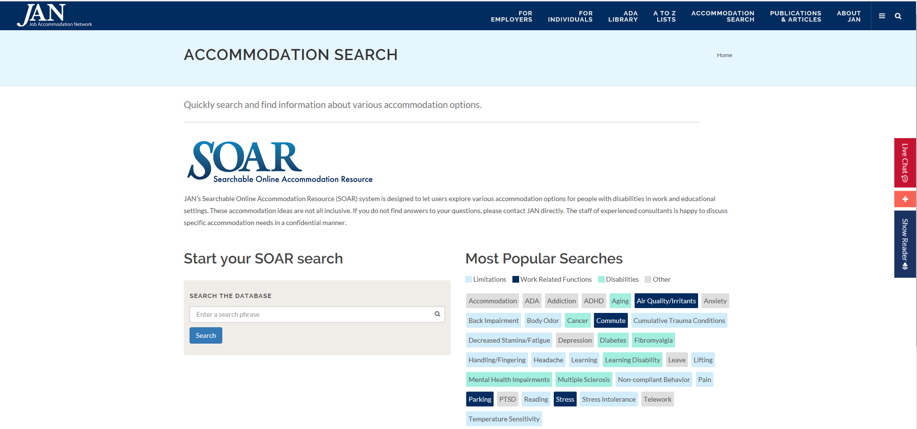
DEMO: Searchable Online Accommodation Resource (SOAR)
https://askjan.org/soar.cfm
25
Notes:
Let’s take a little website tour of JAN to discover LD-related resources and ideas…
While I am loading the website, type “yes” in the chat box if you have ever used JAN as a resource on your center. If you are willing, tell us how it helped.

Slide 26
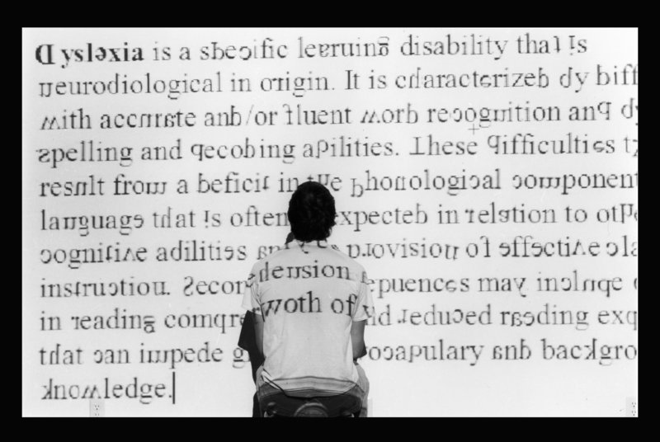
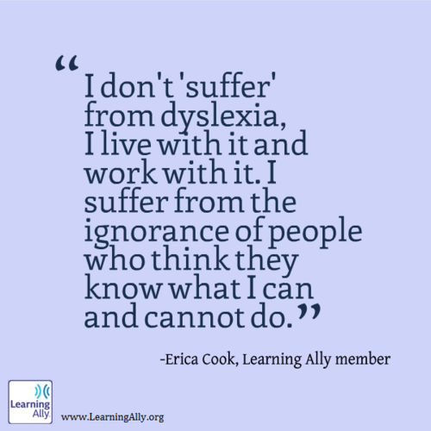
Dyslexia – Examples of Functional Limitations
Deficits in visual, auditory, or motor processing, which interfere with reading and reading comprehension
Difficulty with visually discerning letters and numbers; characters may appear jumbled or reversed; entire words or strings of letters may be unrecognizable
  Reads slowly and painfully
  Can have trouble with spelling
  Experiences decoding errors, especially with the order of letters
  May have difficulty with remembering what is read (memory in general)
26
Notes:
Let’s now transition to discuss the various types of learning disabilities starting with Dyslexia. Some of the functional limitations of Dyslexia include (read slide)…
Young adult non or low-readers are keenly aware of how they do not fit in. Many have adopted poor behaviors and choices to mask or avoid reading. Ever see a student really act out if the class is reading out loud?
Chat box: What are some areas or activities on center that may be impacted by this disorder? Chat box….
Might these students have other strengths we can tap into?
Specifically, what are some accommodations you are currently using on your center to address students that are struggling readers or have difficulty with printed word? Have Alyssa read answers while I am cueing up video
We often have to overcome the stigma and fear that our students face before we can teach. Sometimes we have to overcome our own fears—that we might not be able to reach each one. Sometimes it takes creativity and tenacity to find the key that opens the door to learning for each of our students. That is why we like this job. Right?

Slide 27
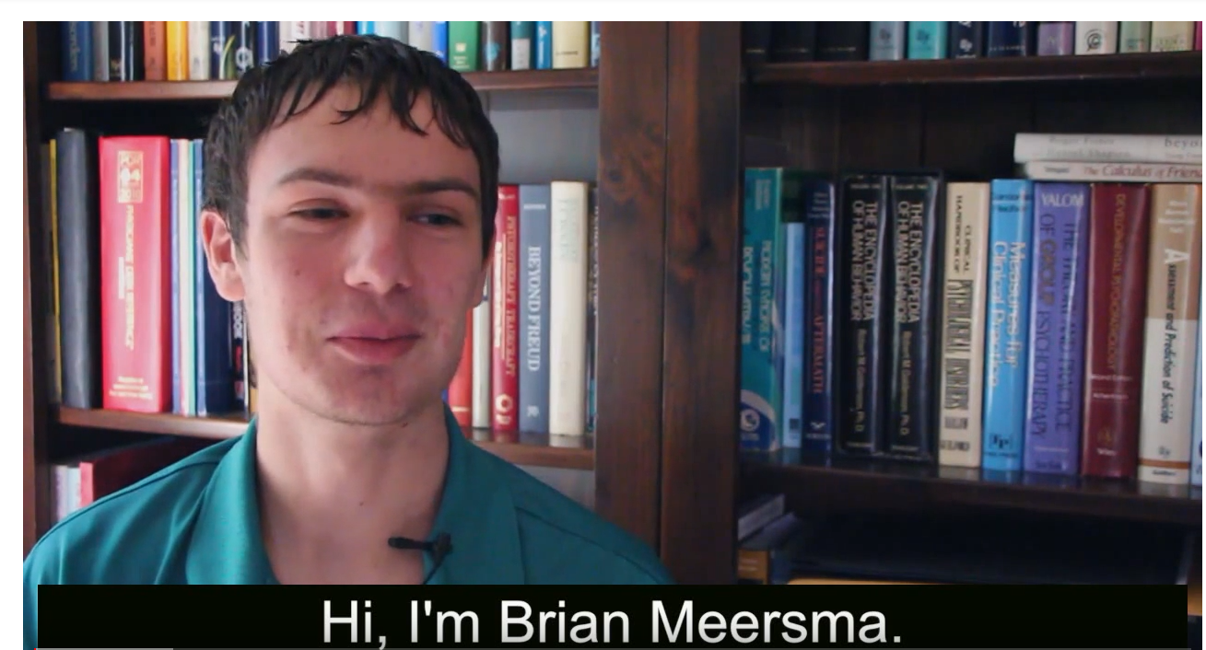
Using Assistive Technology to Participate in a Program
https://www.youtube.com/watch?v=ZbiO2AkGZq4
27
Notes:
Let’s hear from Brian who has had difficulty with reading due to dyslexia.
Stop at .56
Start at 1.15
Stop at 1.28
Start at 1.46
Stop at 3.12
Brian learned how technology can help him read what he likes, independently.
A little about this video clip…

Slide 28
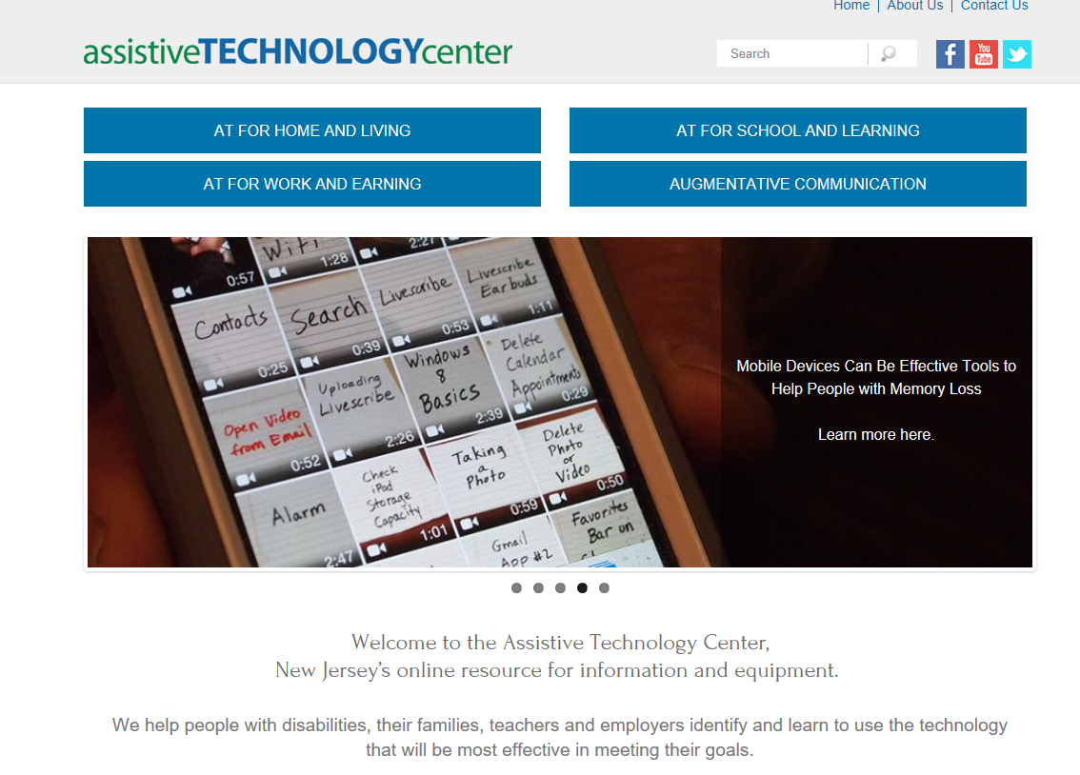

https://www.assistivetechnologycenter.org/
28
Notes:
Advancing Opportunities has created this video as part of our series, AT Stories. AT Stories is a video series of people with disabilities living better lives with a little help from assistive technology. It was made possible by a grant from the Richard West Assistive Technology Advocacy Center at Disability Rights New Jersey.
Although this is not a “new” resource itself, it is one that we have not previously featured or discussed so we wanted to share a few thoughts about it within the presentation rather than the resource section.
For more information, visit their website, www.assistivetechnologycenter.org

Slide 29

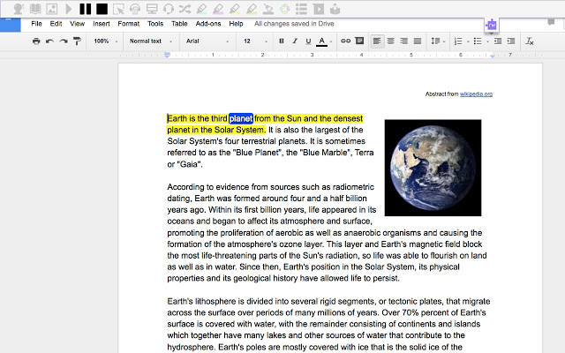


Assistive Technology/Resources - Dyslexia
LiveScribe pen
Text-to-Speech Software
29
Notes:
Brian mentioned Bookshare as a form of text-to-speech AT that he uses. Other forms of technology that we have available today that support the functional limitations of a person with dyslexia might be the use of the Live Scribe pen (I’ll show one more brief video clip of a person who uses it)…
There are thousands of free and low-cost apps out now that support:
Vocabulary
Story structures
Spelling
Pronunciation
Idioms
Note taking
Brainstorming
Decoding
Comprehension

Slide 30
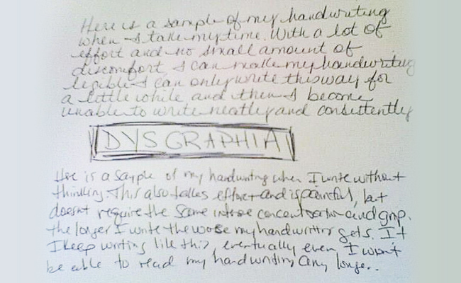

Dysgraphia – Examples of Functional Limitations
Affects a person’s handwriting ability and fine motor skills
May have illegible handwriting, poor spatial planning on paper, poor spelling, and difficulty composing writing as well as thinking and writing at the same time
  Copying or writing is labored
  Handwriting might be illegible
  Inconsistent spacing between words and letters
  Has cramped or unusual grip/may complain of sore hand
30
Notes:
Moving on to another common type of LD—Dysgraphia. It is important to note that Dysgraphia is not just about poor handwriting as the little graphic suggests.
There are other components of writing that are impacted (spelling, spatial planning on paper or on a screen, and often times thinking and writing at the same time).
Some of the functional limitations that a student with dysgraphia may have are on this slide…
What types of center activities do you think a student with Dysgraphia will have difficulty with? For example, copying math problems from the board to paper…what else? What about posted dorm rules? What about signs on center? Alyssa read some of the responses while I cue up another brief video clip…

Slide 31
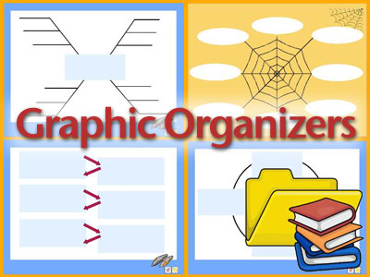

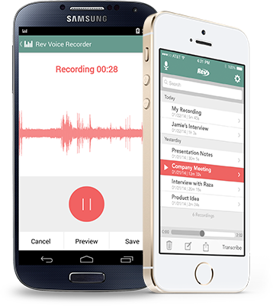
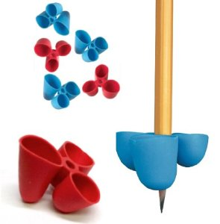

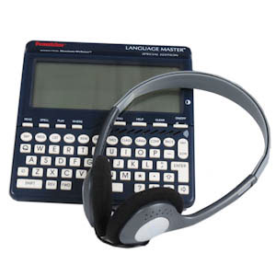
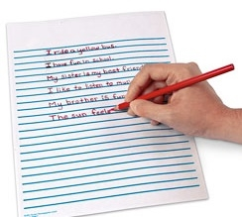
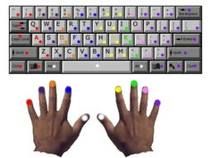
Assistive Technology/Resources - Dysgraphia
31
Notes:
Here we have a few more ideas to accommodate Dysgraphia..
Graphic Organizers
Digital Voice Recorders
Dragon Naturally Speaking software (speech to text)
Phone Voice recording apps
Raised lined paper
Talking dictionaries
Pencil/Pen grips
Color coded keyboards
Again, there is a wide range of low and high tech support out there.
The point: To remove barriers that allow our students to access the program; provide them with the tools that allow them to both acquire and demonstrate their knowledge, skills and abilities.

Slide 32

Dyscalculia – Examples of Functional Limitations
Affects a person’s ability to understand numbers and learn math facts
May also have poor comprehension of math symbols
May struggle with memorizing and organizing numbers, have difficulty telling time, or have trouble with counting
  Difficulty with word problems
  Difficulty organizing problems on the page
  Difficulty remembering facts over a long period of time
  Difficulty sequencing information or events
  Difficulty keeping numbers lined up
32
Notes:
Dyscalculia is the 3rd type of LD we will be discussing today. (Slide)
What types of center activities do you think a student with Dysgraphia will have difficulty with? Chat box…
copying math problems from the board to paper…
What about posted dorm rules?
What about signs on center?
TABE Math,
Certain skills or activities in CT Classes…
Money skills
Schedules
What else?

Slide 33
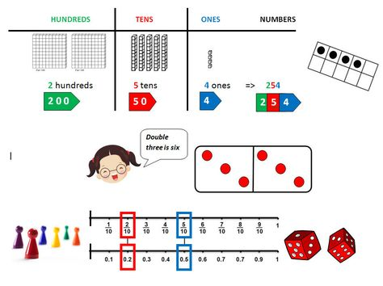
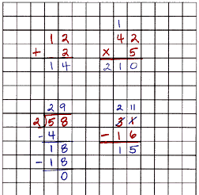
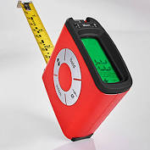
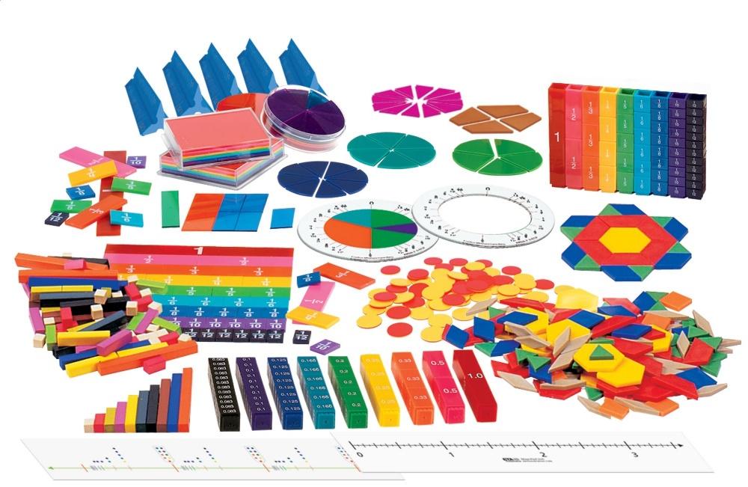
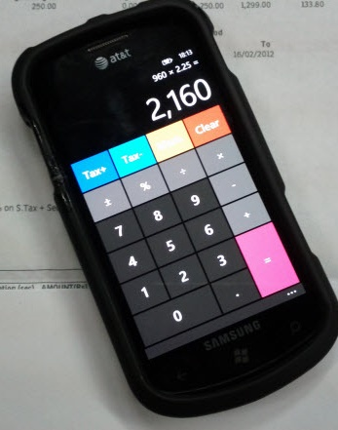
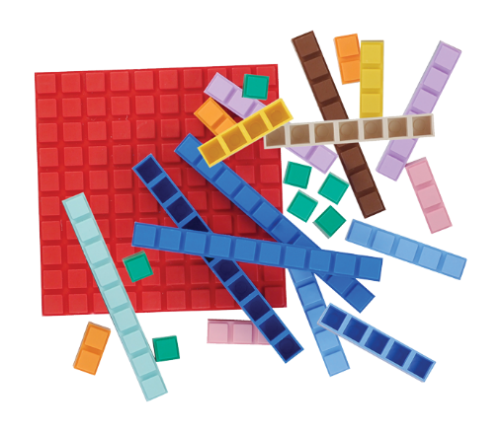
Assistive Technology/Resources - Dyscalculia
33
Notes:
Some examples of low tech and high tech resources for Dyscalculia include:
Using scratch paper to work out math problems
Permitting the use of fractional, decimal, statistical, or scientific calculators
Providing talking calculators
Using calculators or adding machines with large display screens
Using construction calculators, such as Jobber 6
Providing talking tape measures
Using talking scales
Using pre-measurement guides or jigs
Posting mathematical tables at desk or in work area or on walls

Slide 34
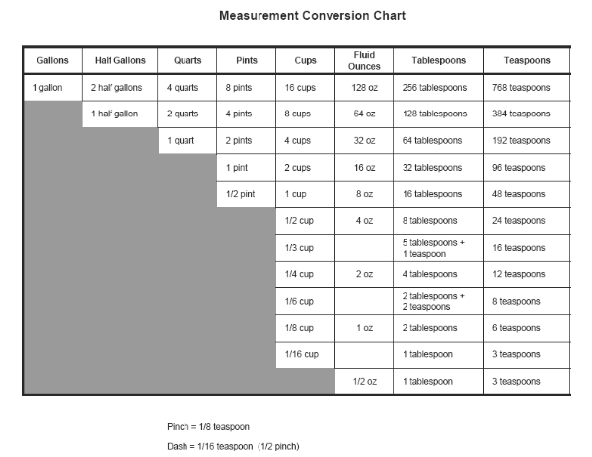
Assistive Technology/Resources - Dyscalculia
34
Notes:
This pre-measuring guide is a specific example of an accommodation tool that could be used in culinary as well as math class.
Can you think of any guides or tools such as this that are used at your center?

Slide 35

Dyspraxia – Examples of Functional Limitations
Affects a person’s conception of how his/her body moves is space.
May impact fine and/or motor skills.
May struggle with planning and coordinating physical movement; balance and posture.
  Difficulty with organization
  Difficulty with concentration (may seem easily distractible)
  Difficulty with sense of balance
  Difficulty sequencing information or events/ following a set of directions
  Difficulty with social skills
35
Notes:
A fourth type of Learning Disabilities is called Dyspraxia. It is in issue that can impact fine and gross motor skills.
Read slide…
What types of center activities do you think a student with Dyspraxia will have difficulty with? Chat box…

Slide 36
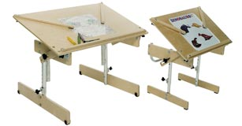
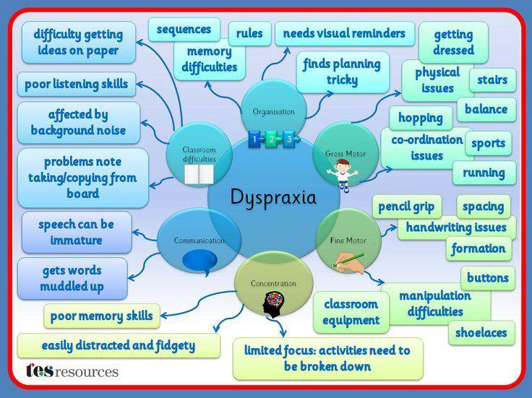
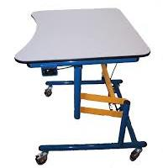

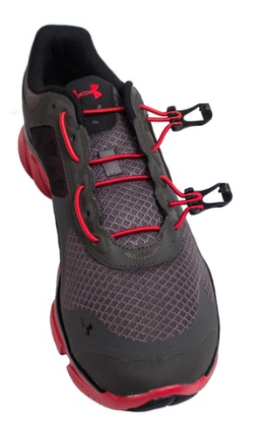
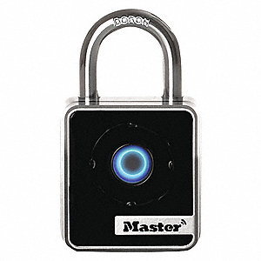
Assistive Technology/Resources - Dyspraxia
36
Notes:
If a student has balance or motor control difficulties, then it may be necessary to consider their ability to navigate their environment. A student with balance and motor difficulties when asked to sit in a chair with a desk attached may get caught in the chair and tip it over. They may need to sit at a table and be able to freely move the chair away from the desk to get in and out--Or use a desk on wheels that they can push away.
For fine motor control, highlighters and post-its are a low-tech way to stay organized without having to take word-for-word notes.
Bottom left-hand corner is a picture of a “digital lock” that works with a phone app—supports motor skills
Bottom right-hand corner is a picture of a shoe with “snap laces” instead of ties—again to support fine motor skills

Slide 37
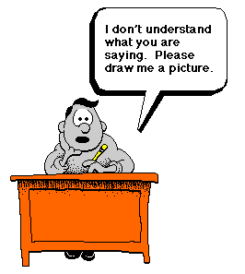

Auditory Processing Disorders
Examples of Functional Limitations
Not a hard of hearing issue; adversely affects how sound that travels unimpeded through the ear is processed and interpreted by the brain
Difficulty understanding speech in noisy environments, following directions and difficulty discriminating (or telling the difference between) similar-sounding speech sounds
37
Notes:
There are many disorders that can affect a person's ability to understand auditory information. For example, individuals with Attention Deficit/Hyperactivity Disorder (ADHD) may well be poor listeners and have difficulty understanding or remembering verbal information; however, their actual neural processing of auditory input in the central nervous system is intact. Instead, it is the attention deficit that is impeding their ability to access or use the auditory information that is coming in.
Similarly, students with autism may have great difficulty with spoken language comprehension. However, it is the higher-order, global deficit known as autism that is the cause of their difficulties, not a specific auditory dysfunction. (www.asha.org)
Sometimes these students may behave as if a hearing loss is present, often asking for repetition or clarification. Often their performance in classes that don't rely heavily on listening is much better, and they typically are able to complete a task independently once they know what is expected of them.

Slide 38
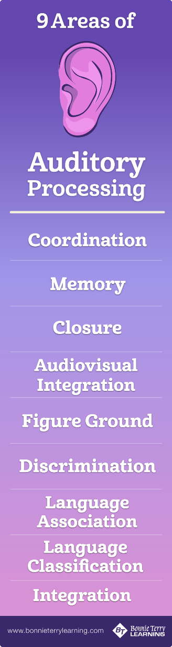
Auditory Processing Disorders
Examples of Functional Limitations
  May process thoughts and ideas slowly and have difficulty explaining them
  Misspells and mispronounces similar-sounding words or omits syllables; confuses similar sounding words
  May be confused by figurative language (metaphor, similes) or misunderstand puns and jokes; interprets words too literally
  May have difficulty understanding/remembering information given orally
  Often is distracted by backgrounds sounds noises
  Finds it difficult to stay focused on or remember a verbal presentation or lecture
  Has difficulty comprehending rapid speech
38
Notes:
Let’s look at some of the functional limitations of Auditory Processing Disorders that are listed on this slide.
This disorder greatly impacts our students when most of instruction or communication is delivered orally.
Let’s think about some ways to support these students. What are your ideas? Chat box…

Slide 39
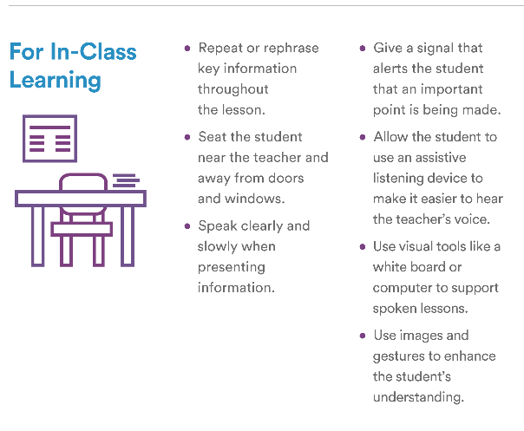
Let’s See What You Think!
What accommodations might be helpful for someone with these types of functional limitations?
  Repeat directions
  SmartPen
  Distraction free space
  Copies of notes
  Videotape demonstration so student can watch as many times as necessary for understanding
  Visually supported step by step instructions
  Variable speed audio recorder so student can review content
www.understood.org
Notes:
We definitely want to provide instructions, lessons, and information in ways that do not completely rely on auditory processing.
Here are a few ideas…

Slide 40
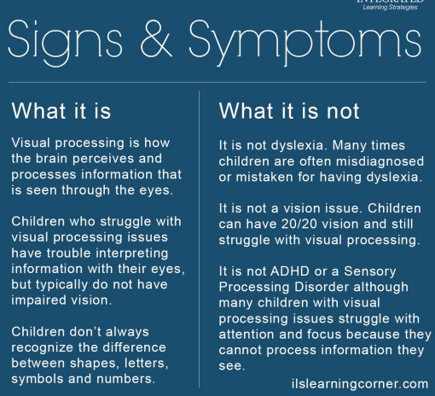
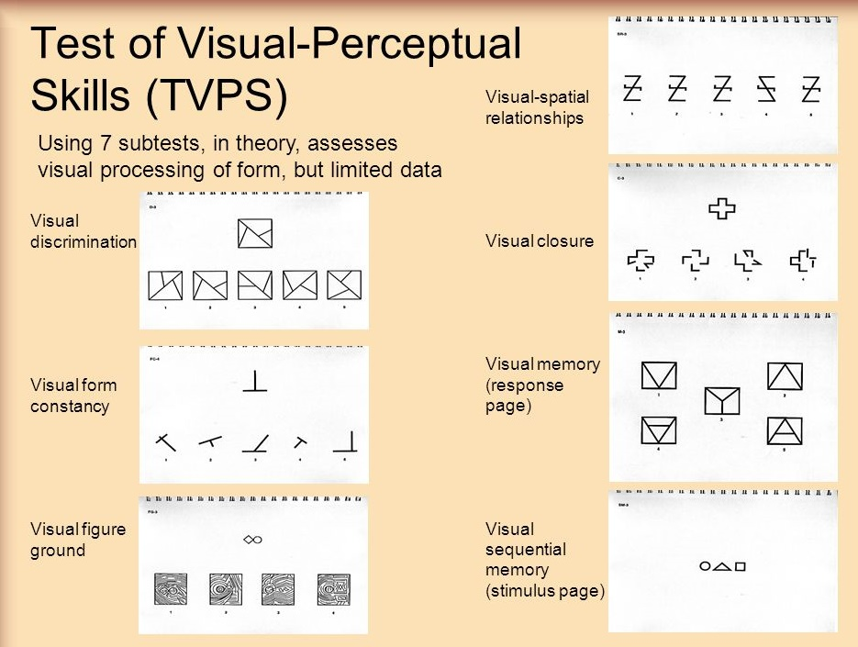
Visual Processing Disorders
Examples of Functional Limitations
40
Notes:
The last type of LD we will review in this webinar is Visual Processing Disorders.
Visual processing is the way the brain, not the eyes, processes the world around us, including things like symbols, pictures, and distances. Individuals with visual processing issues often struggle with visual memory, visual-motor skills and processing what they see, which can affect their reading, tracking, writing and math abilities. The person may see the information clearly, but their brain cannot process the information they see. This may be the reason they write their letters backward, forget letters and numbers, aren’t able to sequence math facts, and can’t use their eyes to track their hand as they write on a piece of paper or copy notes from another source.
Just think about how much information is provided visually on centers (from directions, instruction, rules, procedures, etc.)
What are some practical ways we can support these students?

Slide 41
Visual Processing Disorders
Examples of Functional Limitations
  Difficulty copying accurately
  Frequently loses place when reading text
  May have difficulty navigating around center
  May produce “messy” looking papers (e.g., letters colliding or not on the line and/or irregular spacing)
  May have difficulty “sequencing” or processing images in a specific order
  May have difficulty with “visual memory”—the object is not stored (can result in poor comprehension)
  May have difficulty seeing details in an image (visual discrimination)
  May have difficulty visualizing an entire object—may only see part of an image, such as a letter or number
41
Notes:
Let’s look at some of the possible functional limitations of Visual Processing Disorders that are listed on this slide.
This disorder greatly impacts our students when most of instruction or communication is delivered orally.
Let’s think about some ways to support these students. What are your ideas? Chat box…

Slide 42
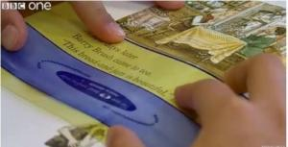
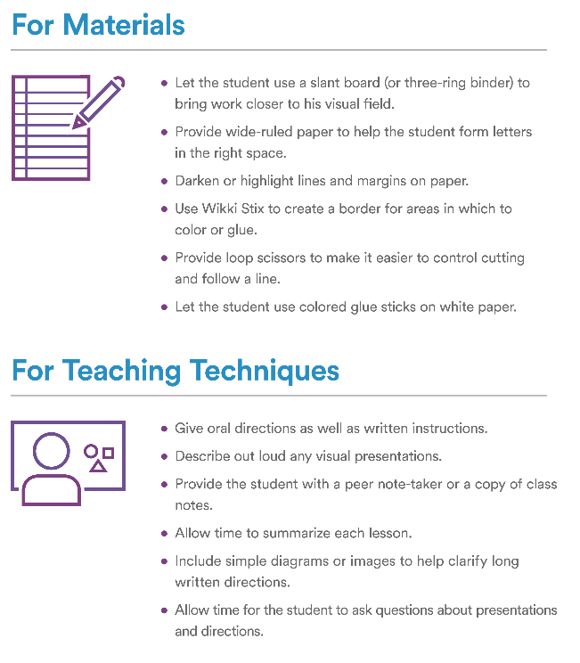
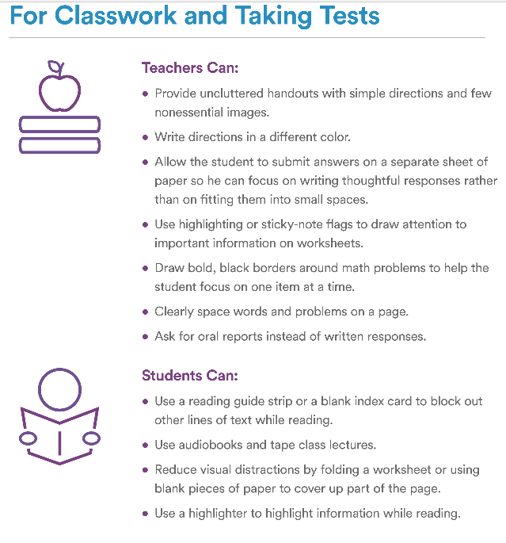
Assistive Technology/Resources – Visual Processing
42
Notes:
Here are a couple of examples of tracking tools for readers who lose their place while reading.

Slide 43
Resources
Notes:
In conclusion, we hope we have provided some realistic solutions to help our students with various types of LD compensate and succeed at JC.
Don’t dwell on definitions, all possible symptoms and/or limitations. Instead, interact with your students and ask specific questions that will help them help you better meet their needs.
Maybe just try one solution from this webinar that seems realistic and helpful. You can build your library of resources from what actually works!
Let’s look at a few of those possible resources…

Slide 44
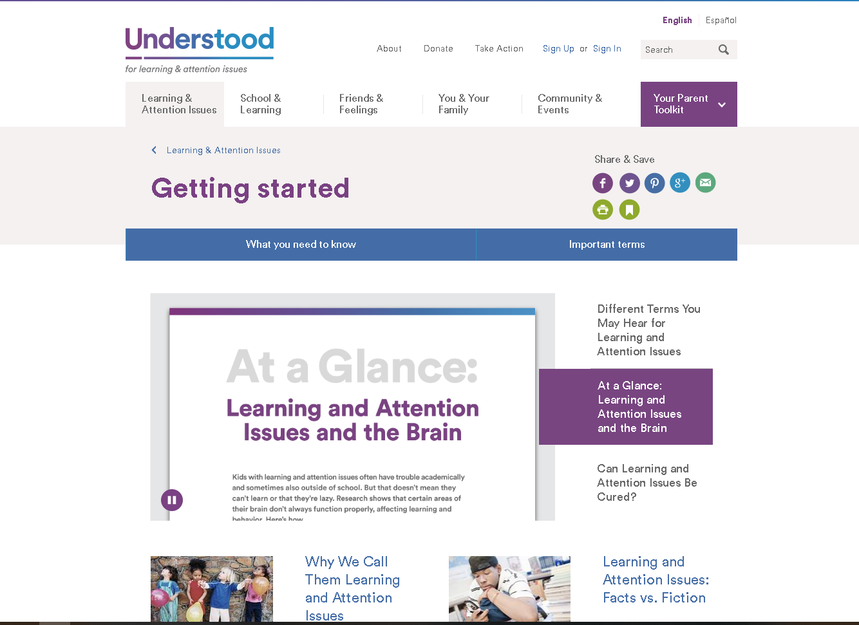
Understood www.understood.org
Notes:
We referenced Understood.org in our 1st video with Colin, the “Boy w/ LD who became a scientist”
Understood.org has so much more to offer. Check it out.

Slide 45
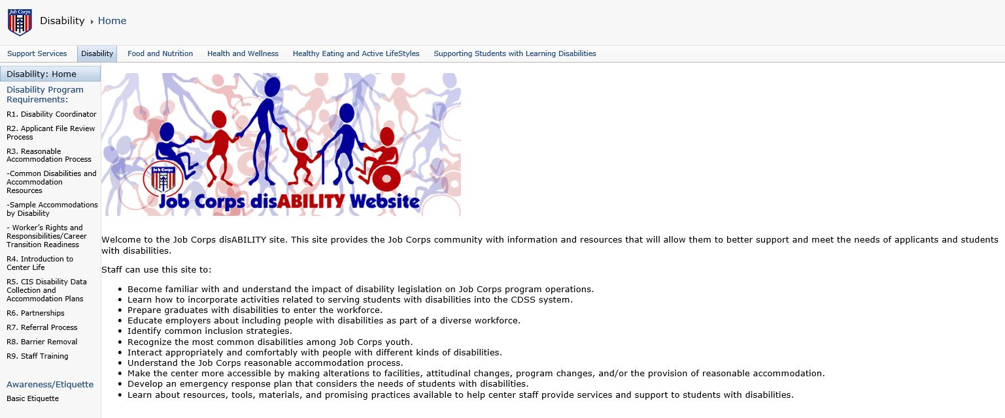
Job Corps Disability Website https://supportservices.jobcorps.gov/disability/Pages/default.aspx
45
Notes:
The Job Corps Disability website provides information on all aspects of the disability process and how each department of Job Corps can best serve individuals with disabilities.
Some specifics sections include LD specific definitions, functional limitations, accommodations and strategies.

Slide 46
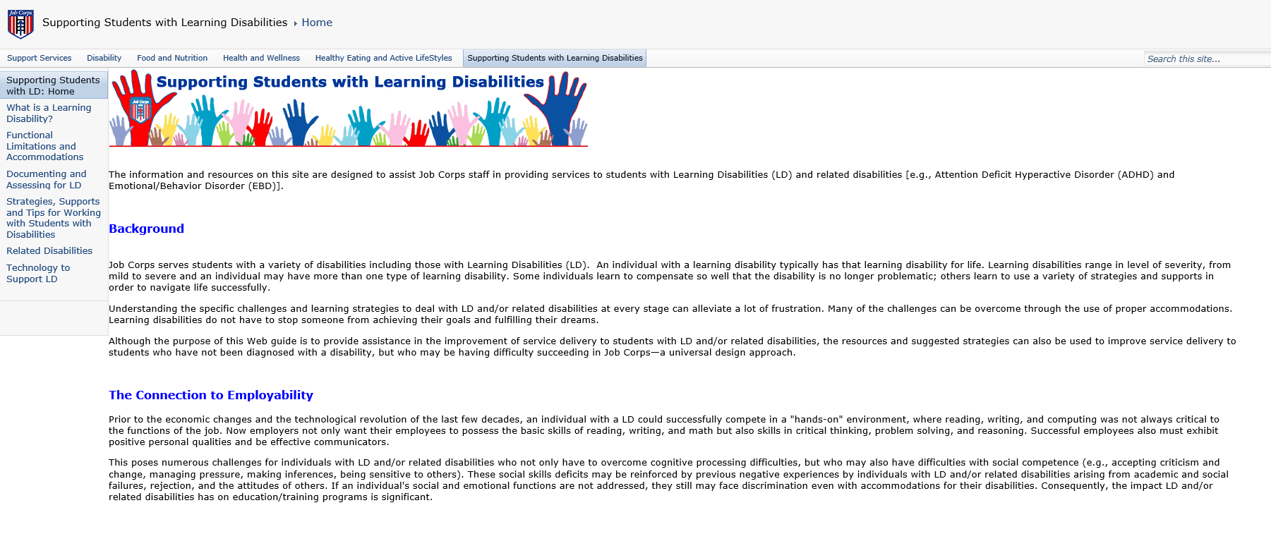
Job Corps Supporting Students with Learning Disabilities https://supportservices.jobcorps.gov/SupportingStudentsLD/Pages/default.aspx
46
Notes:
The LD website also within the JC community provides detailed information about all of those specific LDs we discussed and more. It also includes possible strategies and supports.

Slide 47
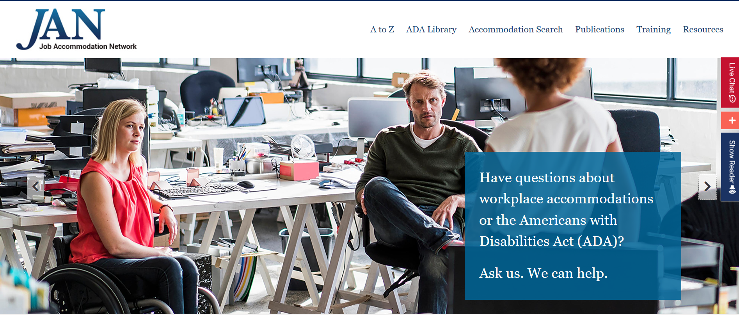
https://askjan.org/

Slide 48
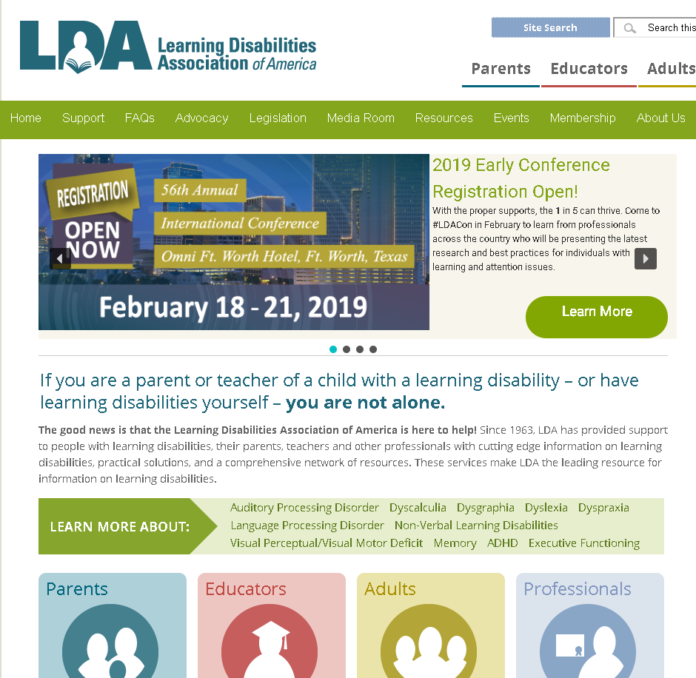
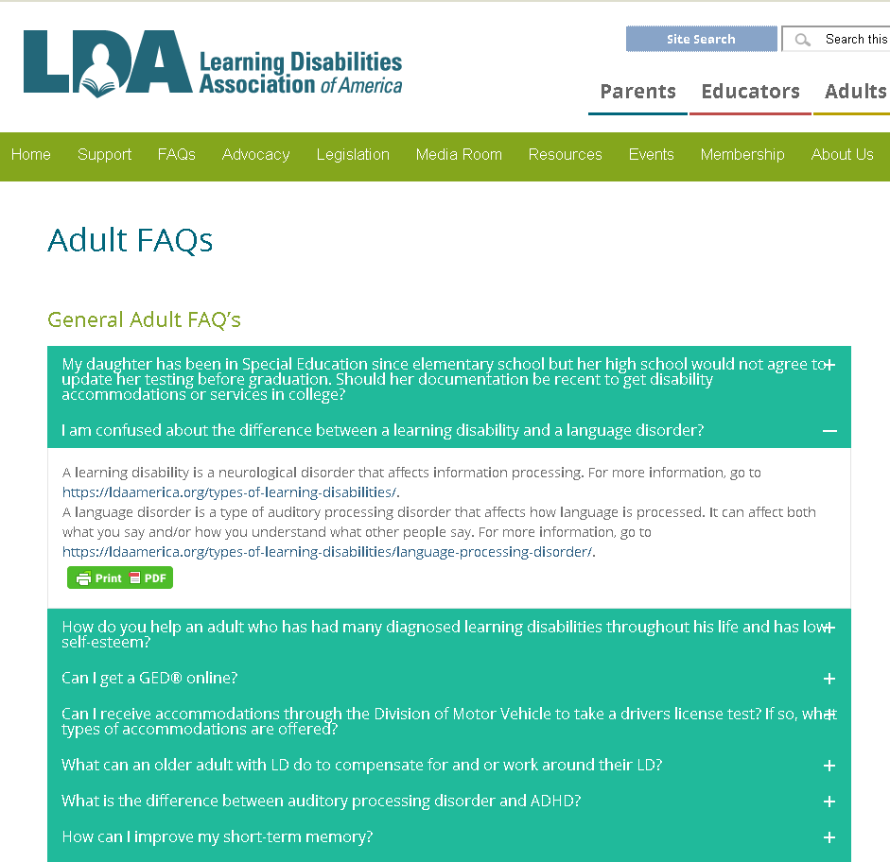
Learning Disabilities Association (LDA) of America https://ldaamerica.org
48

Slide 49
THANK YOU

